Slide 1
Quantifying seasonal patterns in disparate environmental variables using the PolarMetrics R package
DMESS,
Nov 18, 2017, New Orleans
Bjorn J. Brooks
USDA Forest Service,
Eastern Forest Environmental Threat Assessment Center
Notes:
Authority

Slide 2
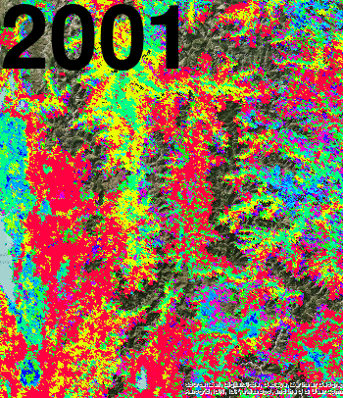
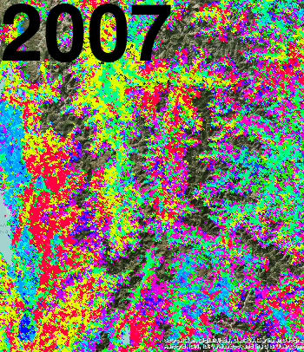
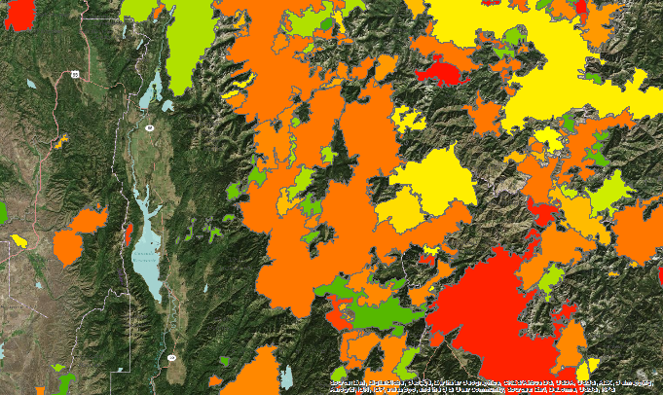
Broader research that I won’t talk about: Clustered phenologies & landscape dynamics
Cascade Complex fire (2007), Idaho
Unburned
Unburned
Burned
Brooks and Lee, AFE 2015

Slide 3
Polar Metrics Maps
landat.org/maps
R package
github/bjornbrooks/PolarMetrics
Notes:
Reciprocity
install.packages(“devtools”)
install.packages(“rasters”)
devtools::install_github(“seantuck12/MODISTools”)
devtools::install_github(“bjornbrooks/PolarMetrics”)
Source(“toy.R”)

Slide 4
Where these Polar Measures Are in Use
Landscape analysis
Appalachian Landscape Conservation Cooperative
Policy directives
National Cohesive Wildland Fire Management Strategy
Forest revision planning
Texas NF
Land conservation prioritization
TNC Maryland
Notes:
Consensus

Slide 5
How Seasonal Patterns are Represented
Time series values
Polar (phenology) values
Year | Jan 3 | Jan 11 | Jan 19 | …
1995 | 0.57 | 0.58 | 0.57
1996 | 0.61 | 0.60 | 0.61
1997 | 0.58 | 0.54 | 0.55
…
Year | Mid Ssn DOY | Length of Ssn | Seasonality (vec. mag.) | …
1995 | 112 | 210 | 0.76
1996 | 111 | 209 | 0.76
1997 | 109 | 221 | 0.76
1998 | 101 | 213 | 0.79
…

Slide 6
A History of Extracting Circular Statistics from Environmental Data

Slide 7
Data Mining Benefits
What benefits can polar transformation offer?
Smaller data set size
Extraction of intuitive measures of change
Visual enhancement of changes in timing
Comparability of different sensor data
Choice of calendar year or a year centered on point of least activity
Notes:
Advantages: 1. Data reduction, 2. Interpretability, 3. phenological parameters can make it easier to probe the data through other statistical means (EFA, DscrFxn), 4. Measurements from disparate latitute/altitudes/locations can be compared with or without bias from their physiographic setting

Slide 8
Data Mining Benefits
Smaller data set size
Faster computing for subsequent analysis

Slide 9
Extracting Polar Measures
PolarMetrics R package calculates circular statistics for any uniformly sampled time series

Slide 10
Extracting Polar Measures
Procedure 4
# Transform first variable into
# its component vectors
vecs =
calc_metrics(lef.7dy$TA,
yr_type="cal_yr", spc=52,
lcut=0.15, hcut=0.85,
return.vecs=TRUE)$vectors
# Repeat calculation and return
# overall avg vecs (RV and AV)
avg_vecs =
calc_metrics(lef.7dy$TA,
yr_type="cal_yr", spc=52,
lcut=0.15, hcut=0.85,
return.vecs=TRUE)$avg.vectors

Slide 11
Dividing the Series & Extracting Metrics
Dividing the time series into regular cycles that begin & end at the point of least activity (anti-vector).
This makes it possible to examine differences in seasonality corresponding to empirically defined years.

Slide 12
Dividing the Series & Extracting Metrics
Timing measures
Calendar yr or empirical yr
Magnitude measures

Slide 13
Capacity for Comparison of Disparate Environmental Variables
Comparability across sensors
Comparable on calendar year or empirically defined year
Empirical year suitable for comparison across elevational, latitudinal gradients

Slide 14
Example Applications: Nonstationarity in Facets of Seasonality
Departures from horizontal reflect shifts, trends, oscillations

Slide 15
Further Applications: Discriminant Functions of LC Types
Polar measures lend themselves to novel analyses that better describe the controls on land cover type

Slide 16
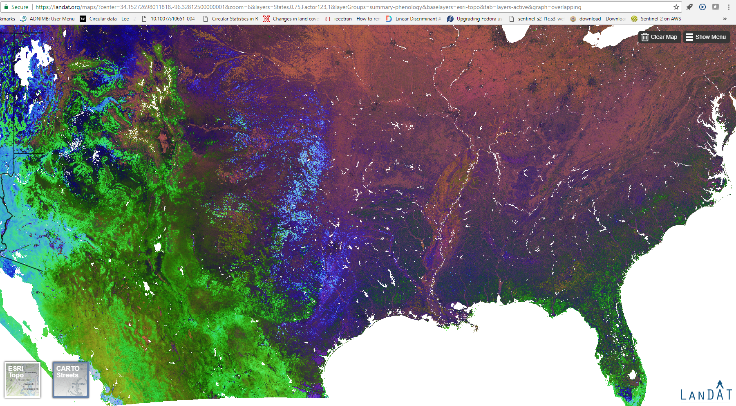
Further Applications: Exploratory Factor Analysis

Slide 17
Wrap-up
The PolarMetrics R package was developed as a set of open source generalizable tools that replicate our initial data processing steps of environmental time series.
PolarMetrics is generalizable and simple, but offers significant analytical benefits:
Functions are flexible, simple yet describe facets of seasonality through intuitive measures
No matter the input the output consist of standardized measures of seasonal profile
Filtering/Focusing on certain parts of the year

Slide 18
Thank You
DMESS,
Nov 18, 2017, New Orleans
Bjorn J. Brooks, Ankur Desai, Danny Lee, Lars Pomara
and William W. Hargrove
Quantifying seasonal patterns in disparate environmental variables using the PolarMetrics R package
Notes:
Authority

