Slide 1
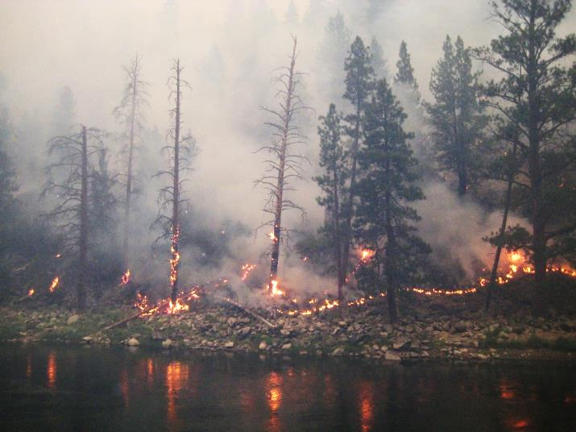
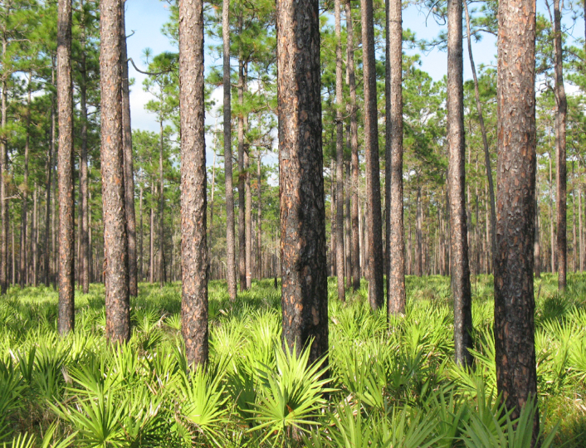
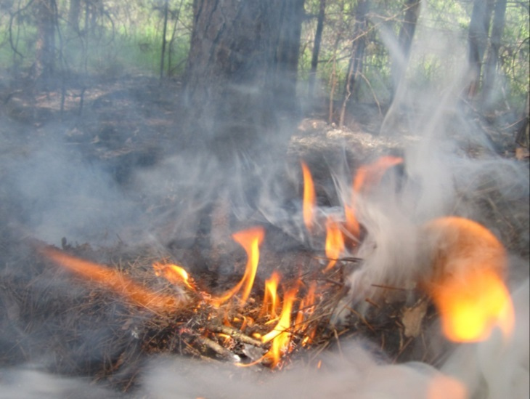
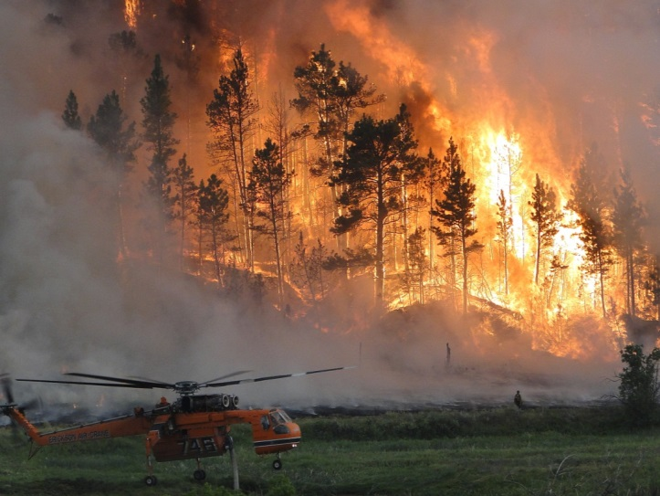
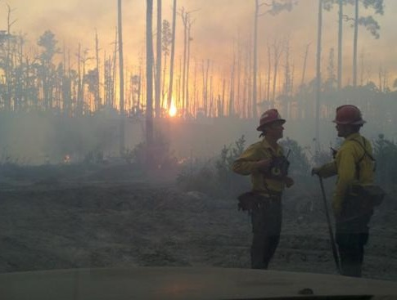
A diagnostic and predictive tool for landscape fire regimes
Steve Norman, Jitendra Kumar, William Hargrove, Forrest Hoffman, Joseph Spruce
International Association for Landscape Ecology, Anchorage AK
May 21, 2014

Slide 2
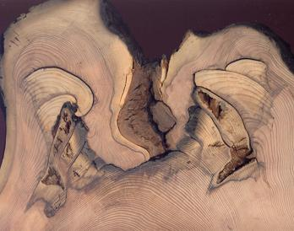
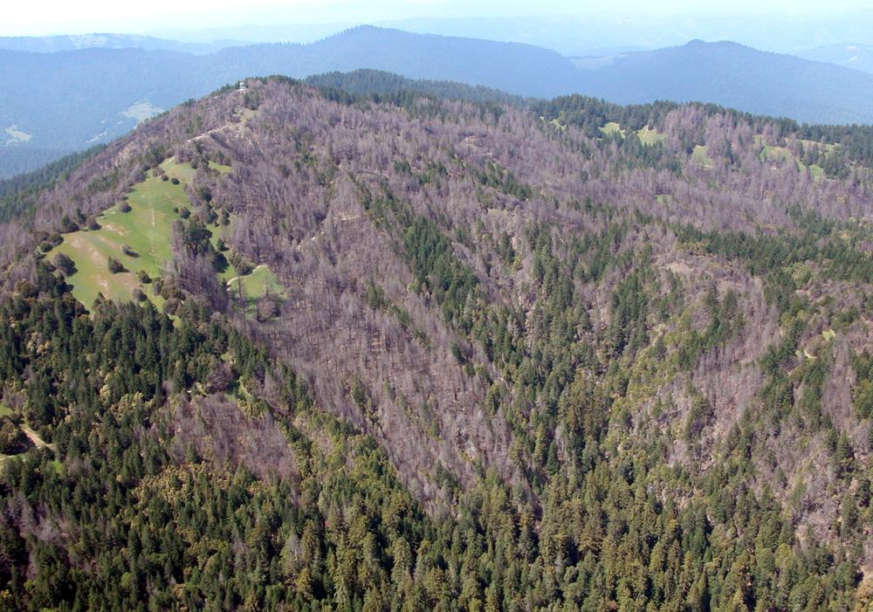
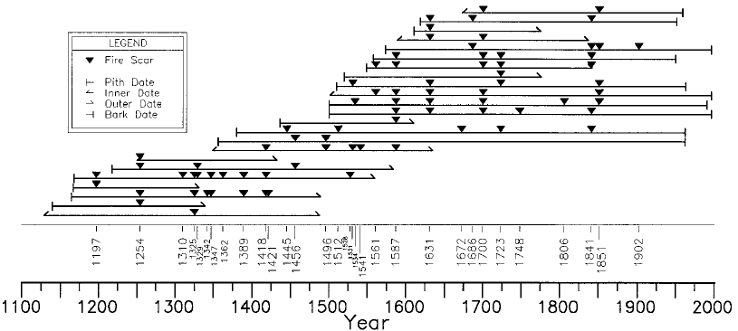
Landscape fire regimes
Existing approaches to characterizing fire regimes
Coast Redwood of California
Brown et al., 1999, Landscape Ecology, 14: 513-532
Central Colorado
Hayman Fire
2002

Slide 3
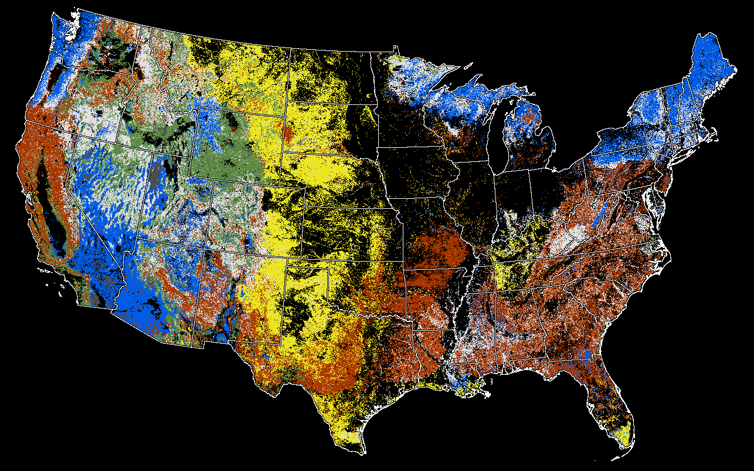
Landscape fire regimes
Historical Fire Regime Groups of existing natural vegetation
FRG I: Frequent, generally low severity
FRG II: Frequent, high severity
FRG III: Moderately frequent, low and mixed severity
FRG IV: Moderately frequent, high severity
FRG V: Infrequent, any severity

Slide 4
Landscape fire regimes
Challenges related to the fire regime concept
Historical regimes varied with climate, fuels and ignitions, so historical data provide perspective and context.
We need characterizations of and monitoring systems for modern fire regimes that reflect changing stressors, values and tradeoffs, not just conditions relative to historical wildland baselines.
Fire and its tradeoffs involve more than
wildland fire, so we need a modern
fire regime concept that is inclusive,
especially at regional to global scales.
Wild
Wildland
Fire
Controlled
Burns
for Grazing
Wildland
Rx Fire
Crop
Residue
Fires
Urban
Fires

Slide 5
Landscape fire regimes
Important attributes of fire regimes
Fire regimes are defined by distributions, not an event.
Fire regimes are both era-specific and area-specific.
Extent,
Patchiness
Seasonal
Phenology
Frequency
Intensity
Duration

Slide 6
Landscape fire regimes
Important attributes of fire regimes and causality
Ignition, Response,
Phenology,
Fuels, Weather,
Rate of spread
Extent,
Patchiness
Seasonal
Phenology
Frequency
Intensity
Duration
Effects

Slide 7
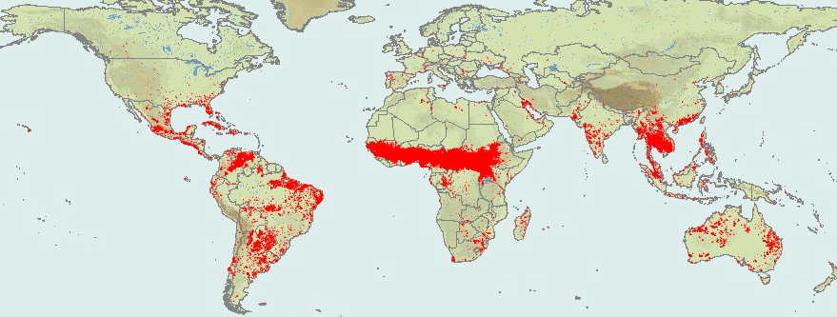
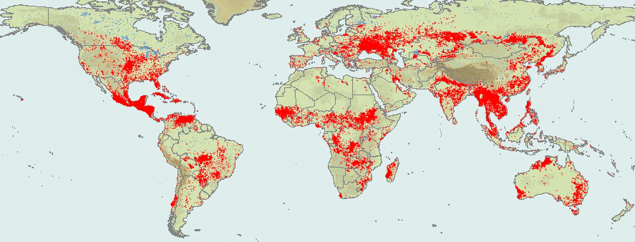
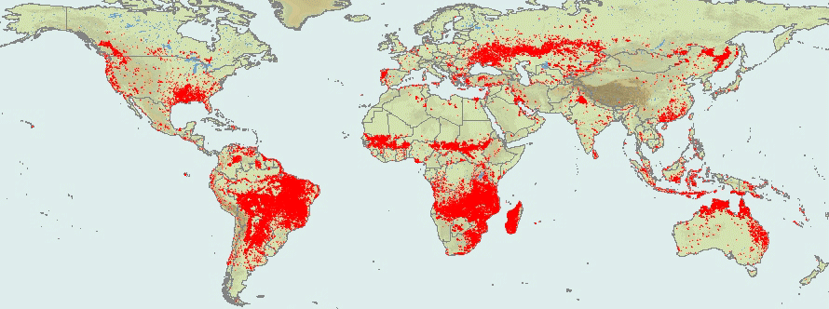
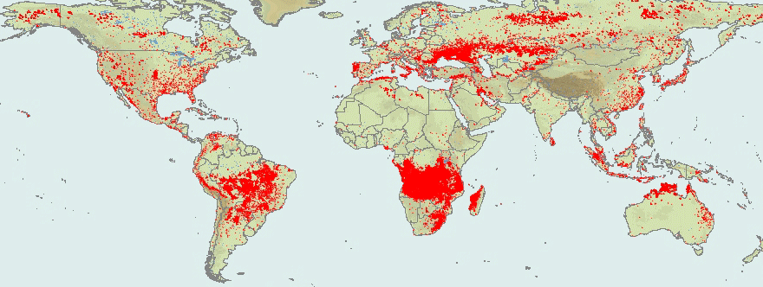
Landscape fire regimes
Fire season indicated by MODIS hotspots for 2005
Jan.
Apr.
Oct.
Jul.
SOURCE: https://firms.modaps.eosdis.nasa.gov

Slide 8
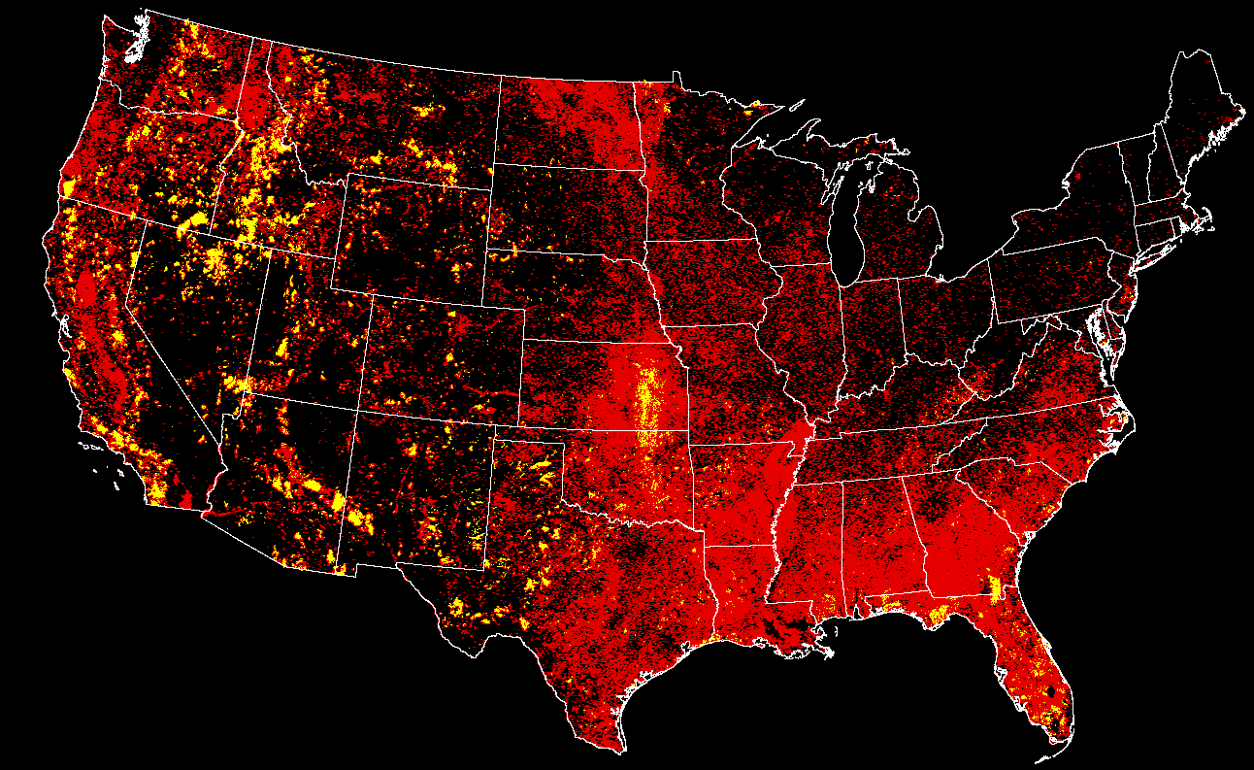
Landscape fire regimes
Comparison of two fire datasets: 2001-2013
Large wildland fires (RSAC, GeoMAC)
MODIS hotspots

Slide 9
Landscape fire regimes
Using hotspots for characterizing fire regimes
PROS
Includes wildland fires that are otherwise unrepresented by databases
(i.e., includes wildfire, prescribed fire, agricultural fires)
Inclusive across jurisdictions (i.e., federal, state, local)
Global coverage; MODIS >2002, VIIRS since 2012, AVHRR and GOES for longer
Indicates fire occurrence, date (not just ignition date) and temperature
Captures all cover types for fire-associated questions that seek those insights
CONS
All cover types are included making it hard to just characterize wildland fire regimes
MODIS is roughly 1 km resolution, scaling the questions askable
Over-representation toward the poles due to satellite orbits
Fires are often obscured by clouds or dense smoke
Under-representation of smaller fires
Under-representation of fire under dense forest canopies
Under-representation of short-lived fires or those with a rapid rate of spread

Slide 10
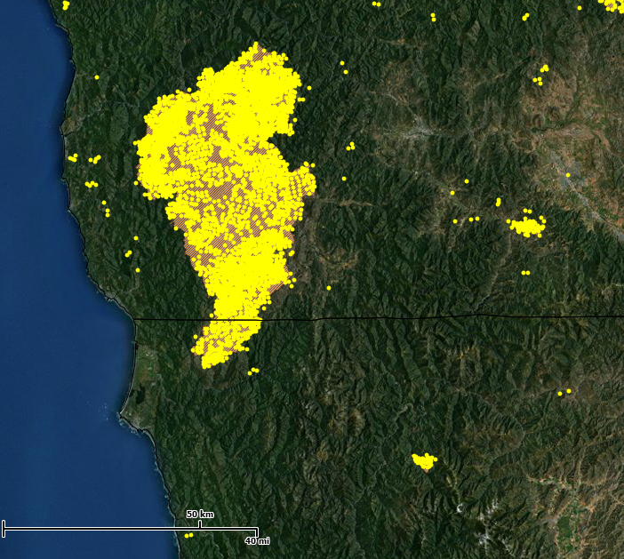
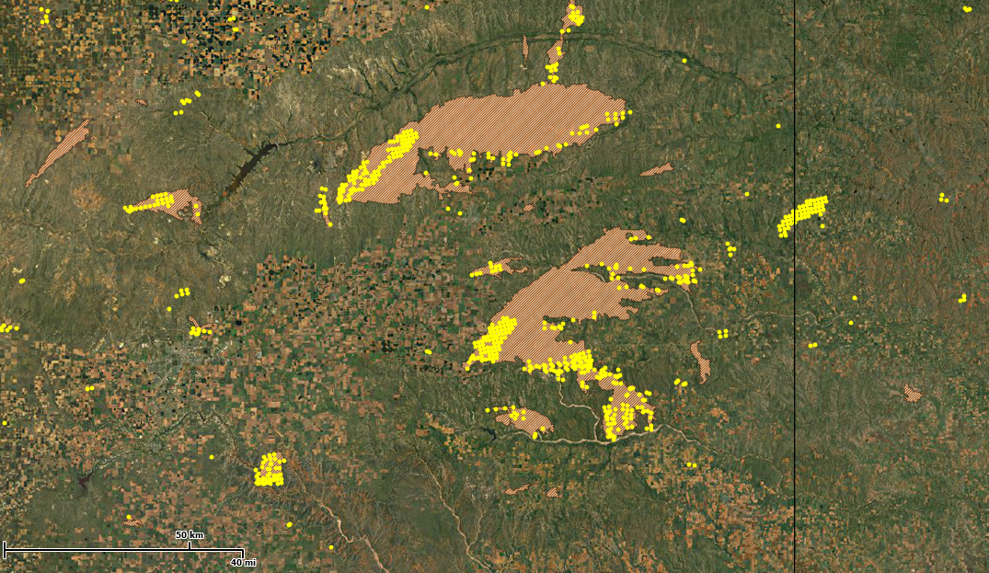
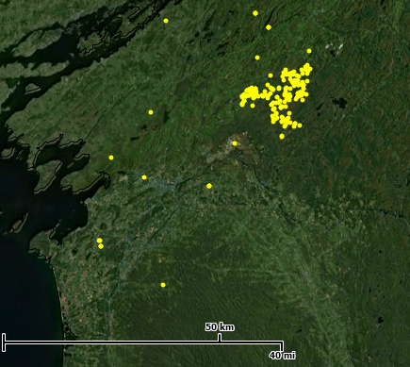
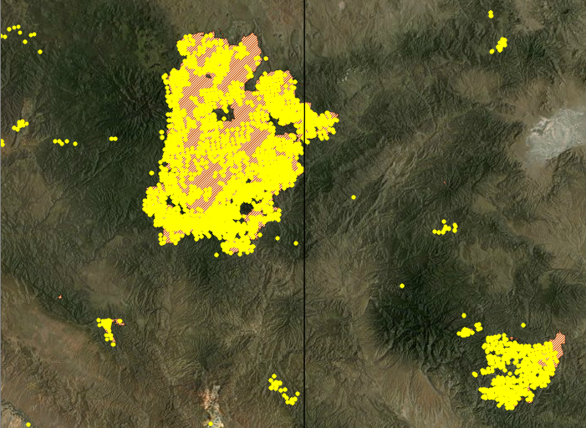
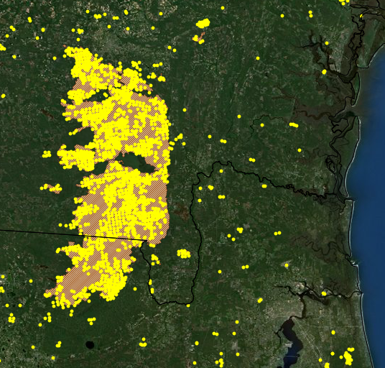
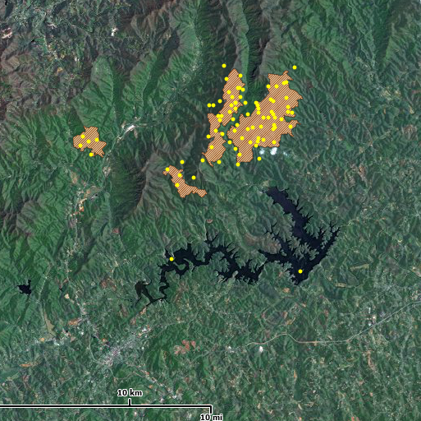
Landscape fire regimes
Wildfire perimeter and hotspot correspondence
No
hotspots
No
perimeter
2002
Biscuit, OR-CA
2006
Amarillo, TX
No
perimeters
All years’ Rx Fire
Fort Drum, NY
2011
Wallow, AZ-NM
2007
Big Turnaround, FL-GA
2007
Linville, NC

Slide 11
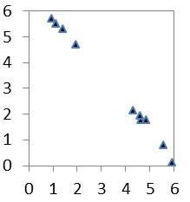
Landscape fire regimes
North American hotspot clustering: 2002-2013
Methodology
North America (prototype test case)
20 km grid cells (Lambert Cylindrical Equal Area projection)
Number of clusters generated: (K) = 5, 10, 15, 20
19 variables: 12 seasonal, 3 frequency, 3 intensity, 1 extent
K-means non-hierarchical clustering to minimize within-cluster variability
When does fire occur? (weight = 63%): “season”
Hotspots grouped by biweek of year; top 6 selected
Adjusted for better cross year seasonal continuity
How often does fire occur? (weight = 16%): “frequency”
Number of years with at least 2 hotspots
Number of consecutive years with continuous fire (max 6)
Number of consecutive years without continuous fire (max 6)
How intense is fire when it occurs? (weight = 16%): “intensity”
Mean hotspot temperature
Maximum hotspot temperature
Minimum hotspot temperature
How much fire occurs? (weight = 5%): “extent”
Total number of hotspots in a grid cell (unadjusted for latitude or land area)
Dec
cos=1
Sep
Mar
sin=-1
sin=1
Jun
cos=-1
Fireless runs
Fire runs

Slide 12
Landscape fire regimes
Cluster 20 results: rotated factor pattern
Fall-
Winter-ness
Winter-
Spring-ness
Burni-ness
 |  | Factor 1 | Factor 2 | Factor 3
1 | biweek 1 sin | 0.90 | 0.01 | 0.15
2 | biweek 1 cos | -0.09 | 0.79 | 0.33
3 | biweek 2 sin | 0.87 | 0.01 | 0.16
4 | biweek 2 cos | -0.09 | 0.87 | 0.10
5 | biweek 3 sin | 0.94 | 0.02 | 0.11
6 | biweek 3 cos | -0.08 | 0.88 | 0.05
7 | biweek 4 sin | 0.88 | 0.05 | 0.07
8 | biweek 4 cos | -0.01 | 0.88 | -0.06
9 | biweek 5 sin | 0.64 | -0.02 | 0.09
10 | biweek 5 cos | 0.06 | 0.74 | -0.17
11 | biweek 6 sin | 0.52 | -0.04 | 0.21
12 | biweek 6 cos | 0.15 | 0.60 | -0.19
13 | # years with fire | 0.23 | -0.03 | 0.95
14 | run of burns | 0.20 | -0.01 | 0.95
15 | run of no burns | -0.24 | 0.02 | -0.95
16 | Mean temperature | 0.54 | -0.46 | -0.15
17 | Max temperature | 0.05 | -0.54 | -0.01
18 | Min temperature | 0.30 | -0.19 | -0.40
19 | # hotspots | 0.40 | -0.40 | 0.48

Slide 13
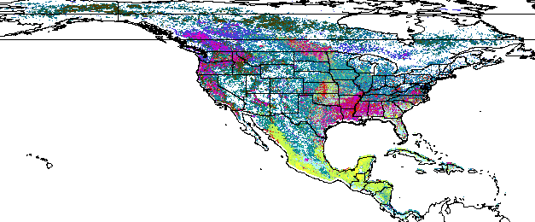
Landscape fire regimes
Similarity colors (20 cluster fire regimes)
Fall-Winter-ness
Winter-Spring-ness
Burni-ness
Darker colors are low in all three factors
Lighter colors are high in all three factors

Slide 14
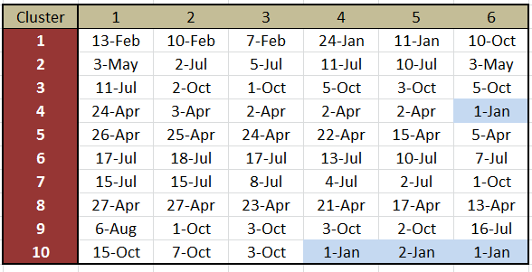
Landscape fire regimes
North American hotspot clustering: 2002-2013
Date of the six most active fire dates among the 10 cluster groups

Slide 15
Landscape fire regimes
North American hotspot clustering: 10 clusters

Slide 16
Landscape fire regimes
North American hotspot clustering: 5 clusters

Slide 17
Landscape fire regimes
North American hotspot clustering: 15 clusters

Slide 18
Landscape fire regimes
North American hotspot clustering: 20 clusters

Slide 19
Landscape fire regimes
North American hotspot clusters
20
15
10
5

Slide 20
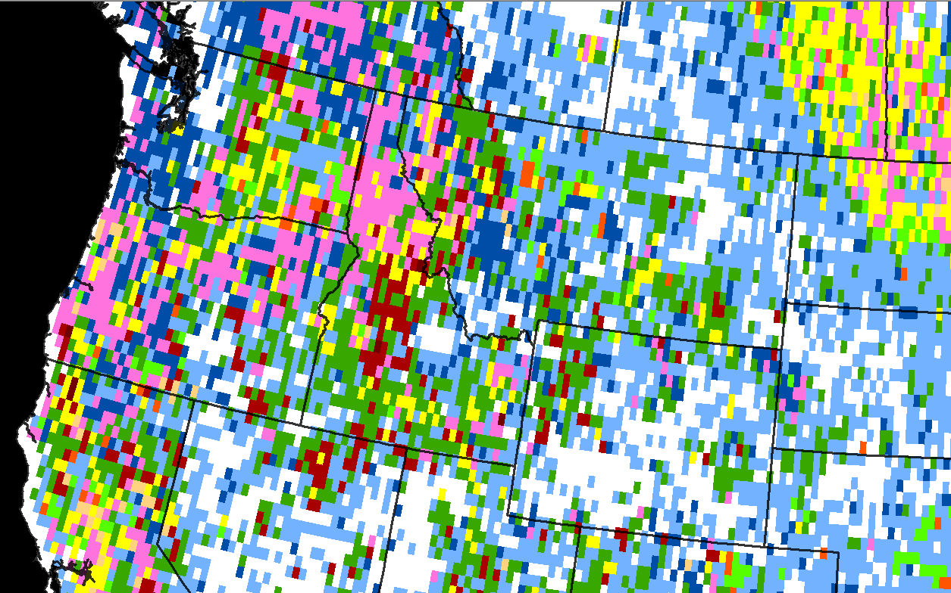
Landscape fire regimes
10 clusters

Slide 21
Landscape fire regimes
10 clusters compared to large fire perimeters

Slide 22
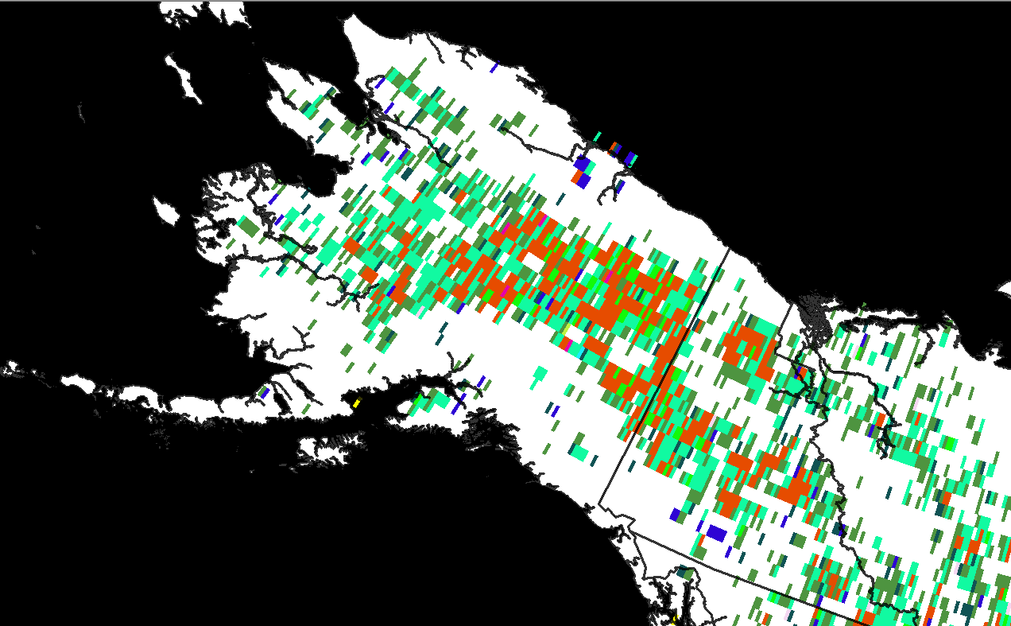
Landscape fire regimes
20 clusters

Slide 23
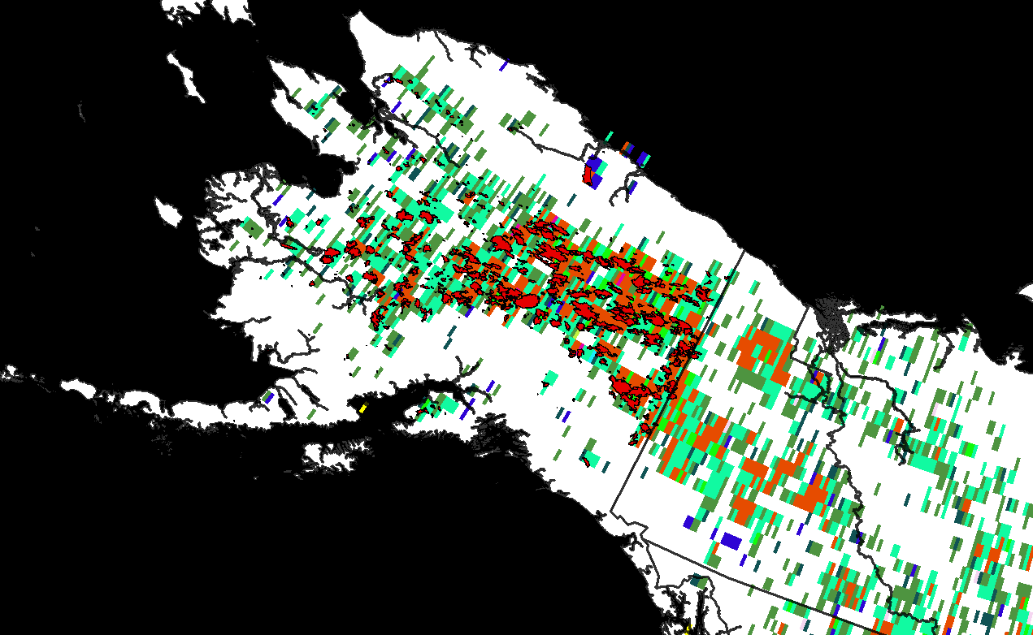
Landscape fire regimes
20 clusters compared to large fire perimeters

Slide 24
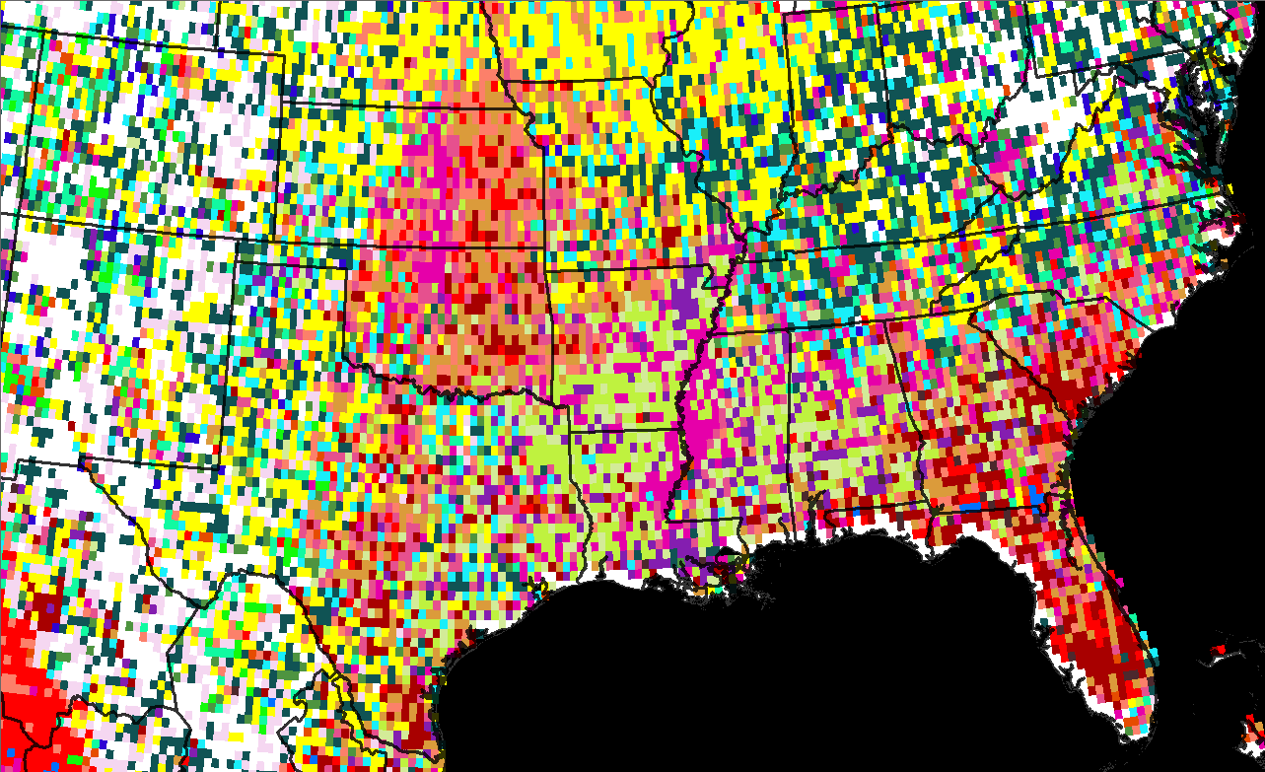
Landscape fire regimes
20 clusters

Slide 25
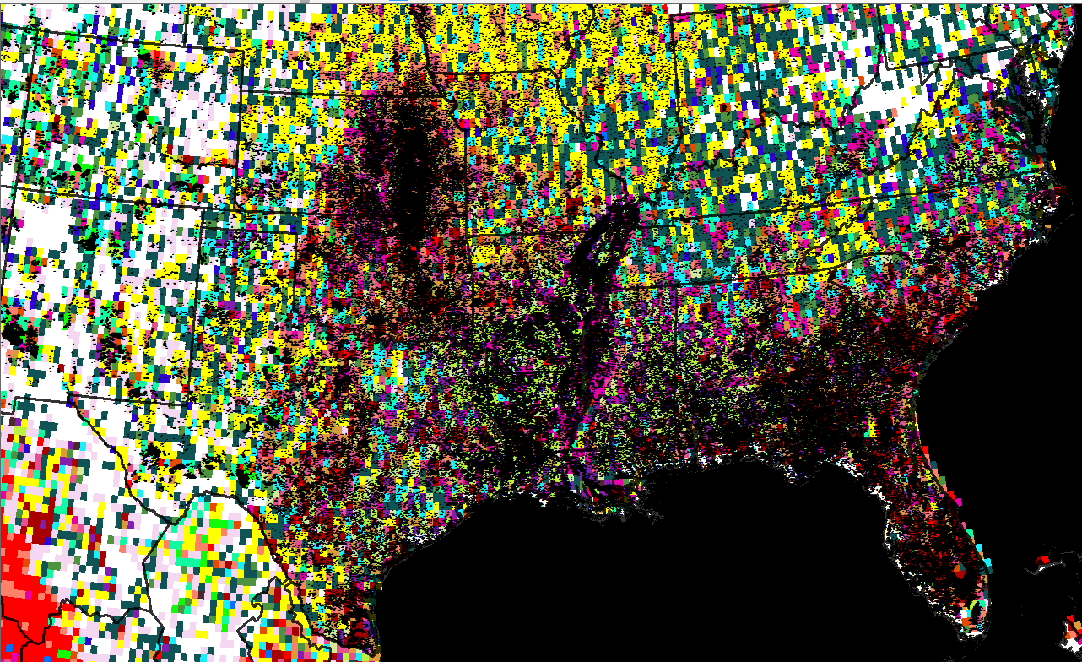
Landscape fire regimes
20 clusters and hotspots

Slide 26
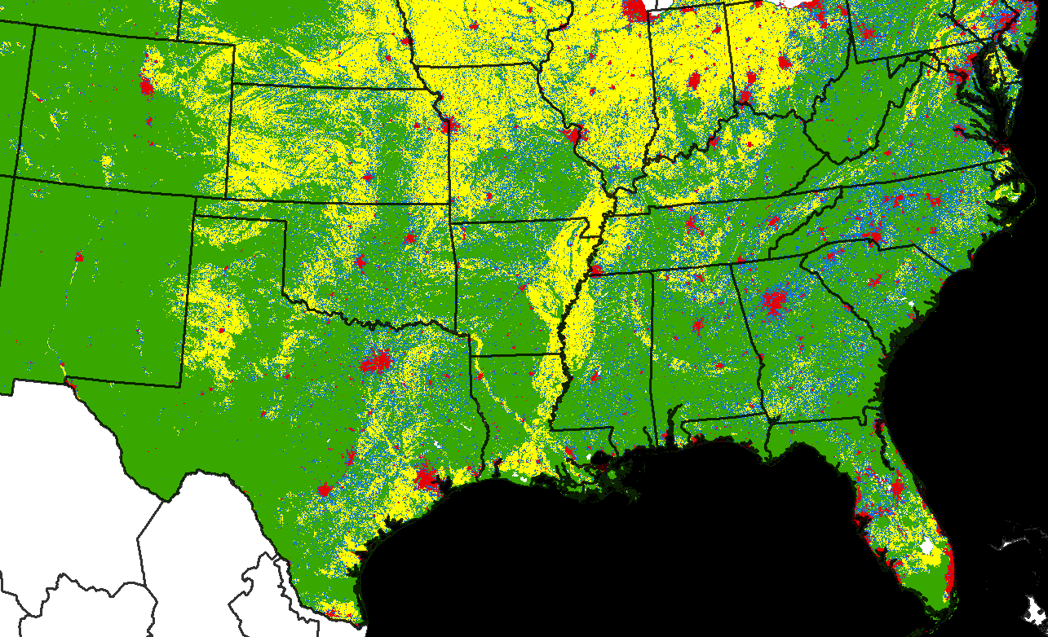
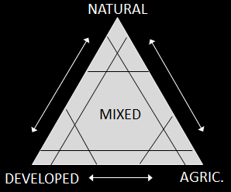
Landscape fire regimes
Riitters 2006 NLCD-derived 810m Land Cover Types
Natural (NN, N, Na, Nd, Nad)
Agriculture (AA, A, Ad, An, Adn)
Developed (DD, D, Da, Dn, Dan)
Mixed (_ad, _an, _dn, _adn)

Slide 27
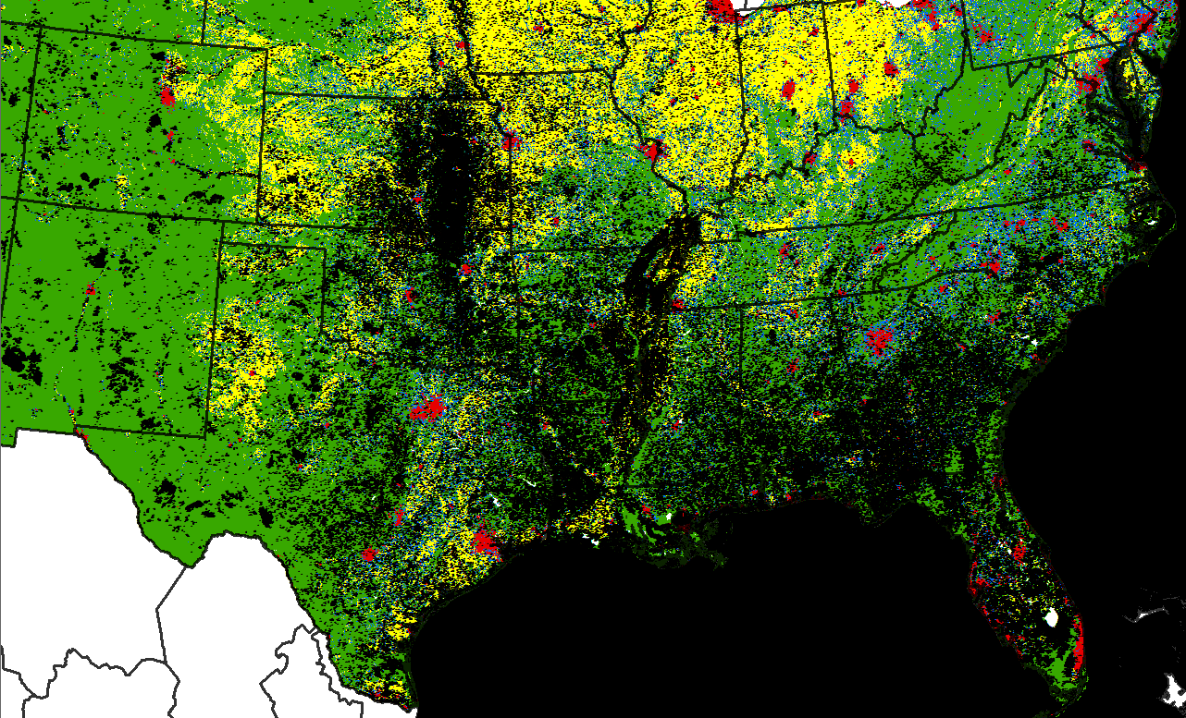
Landscape fire regimes
Riitters Land Cover Types and hotspots
Natural (NN, N, Na, Nd, Nad)
Agriculture (AA, A, Ad, An, Adn)
Developed (DD, D, Da, Dn, Dan)
Mixed (_ad, _an, _dn, _adn)

Slide 28
Landscape fire regimes
Summary
Hotspots have limitations that constrain their use at local scales, but they can provide a unique perspective of fire regimes at landscape to regional scales.
Hotspots help overcome shortcomings of fire datasets that relate to inconsistent jurisdictional reporting and fire-type or cause.
Our approach allows fire regimes to emerge freely from the data with fewer preconceptions.
Next steps: Refinement of inputs, weighting, and expansion to the Earth.

Slide 30
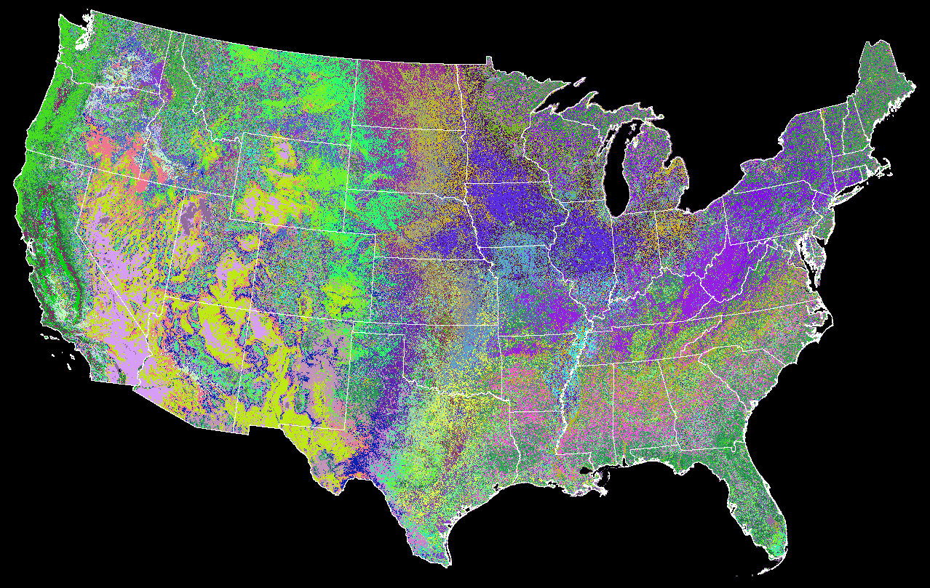
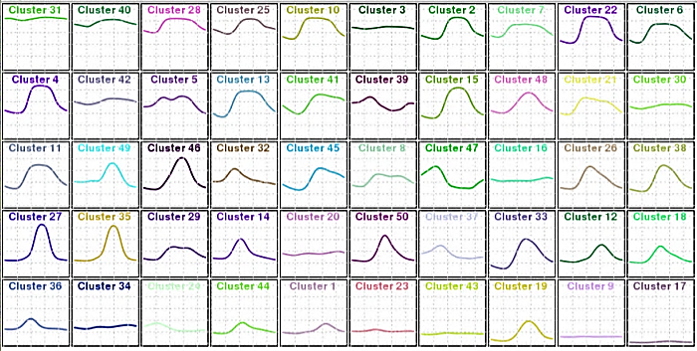
Landscape fire regimes
Hargrove et al.’s 50 MaxMode Phenoregions

