Slide 1
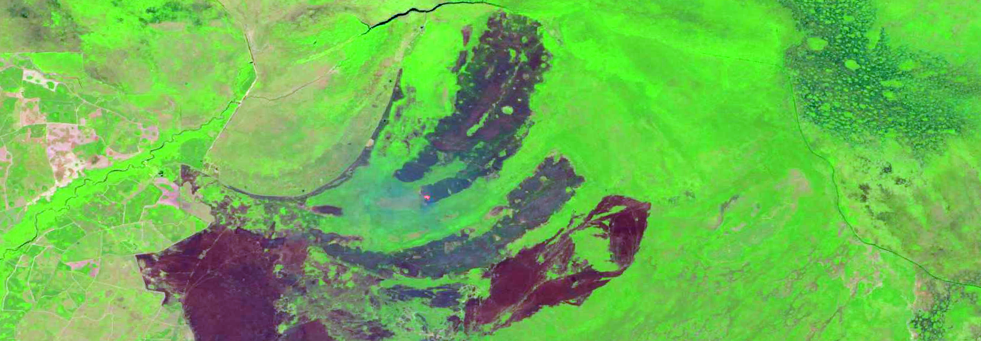
Monitoring the cumulative
effects of fire across woody wetlands
of the southeastern U.S. Coastal Plain
Society of Wetland Scientists Annual Meeting
San Juan, Puerto Rico
June 7, 2017
Steve Norman
William Hargrove
Bjørn-Gustaf Brooks Danny C Lee
William Christie
stevenorman@fs.fed.us

Slide 2
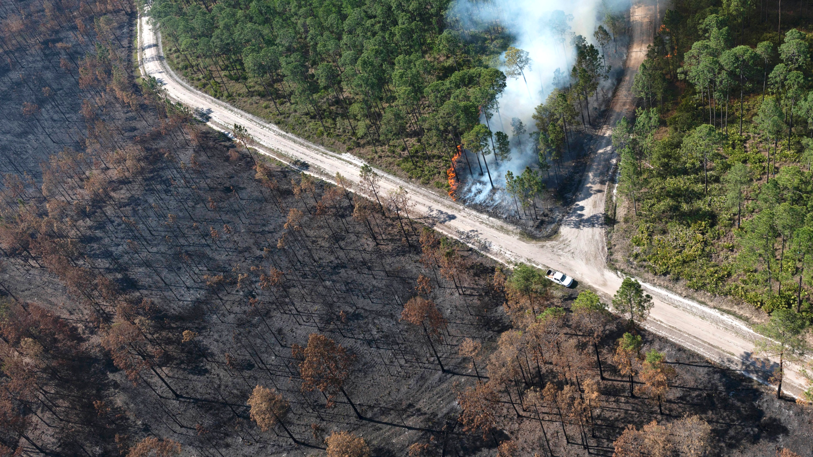
https://earthobservatory.nasa.gov/IOTD/view.php?id=90214

Slide 3
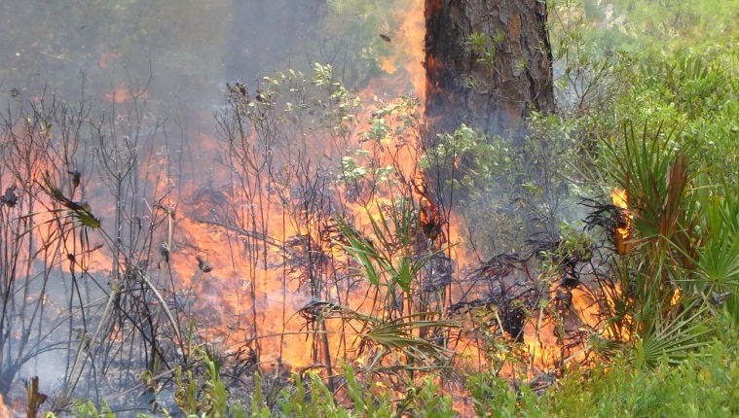

Slide 4
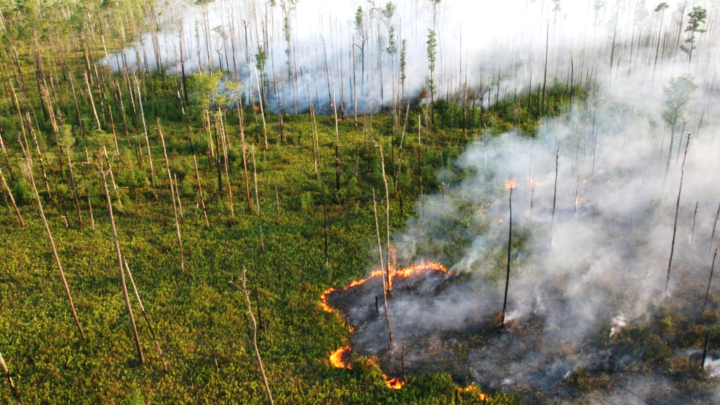

Slide 5
Purpose
To illustrate how remotely sensed phenology provides a powerful tool for monitoring large wetlands.
To characterize the impacts of individual and repeated fires on productivity.
To better understand the vulnerability of this system to drought and disturbance regime change.

Slide 6
Monthly Palmer Drought Severity Index (PDSI) for
Southeastern Georgia (NOAA NCEI Climate Division Georgia #9)
Enlarged below
1900 1910 1920 1930 1940 1950 1960 1970 1980 1990 2000 2010
PDSI
Dryer Wetter

Slide 7
Monthly Palmer Drought Severity Index (PDSI) for
Southeastern Georgia (NOAA NCEI Climate Division Georgia #9)
1932
1954-5
1937: Refuge
1960-2: Sill
1900 1910 1920 1930 1940 1950 1960 1970 1980 1990 2000 2010
1989
1998
2002
2007
2011
2017
1986
1990
2014
1999
2001
PDSI
Dryer Wetter
Landsat fire mapping (MTBS)

Slide 8
Monthly Palmer Drought Severity Index (PDSI) for
Southeastern Georgia (NOAA NCEI Climate Division Georgia #9)
1932
1954-5
1937: Refuge
1960-2: Sill
1900 1910 1920 1930 1940 1950 1960 1970 1980 1990 2000 2010
1989
1998
2002
2007
2011
2017
1986
1990
2014
1999
2001
PDSI
Dryer Wetter
Landsat fire mapping (MTBS)
MODIS analysis

Slide 9
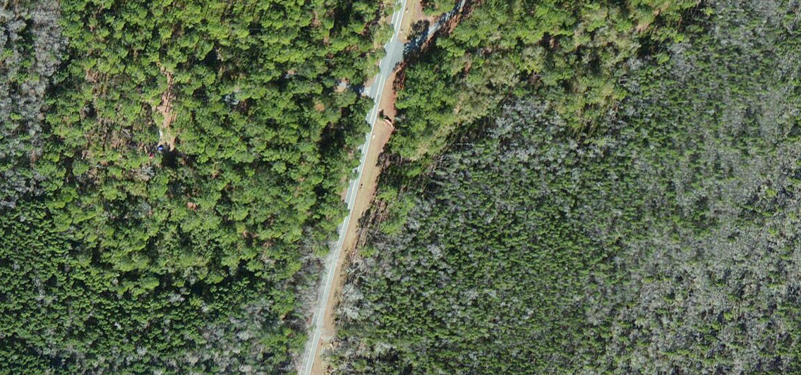
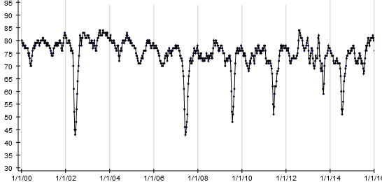
Jones Island (Stephen Foster State Park)
showing MODIS grid resolution and mixed vegetation
The ForWarn Dataset
http://forwarn.forestthreats.org
232 m
232 m
Based on daily MODIS observations from the Terra and Aqua satellites (CONUS coverage).
Uses the Normalized Difference Vegetation Index (NDVI).
Grid cells are 232m resolution (13.3 ac.; 5.4 ha.).
Highly processed to remove clouds and other image quality issues.
Calculated at 8-day time steps (46 periods per year) from 2000 through a year ago.
Provides a consistent record of disturbance magnitude and duration, cumulative impacts, vegetation recovery, and seasonal phenology.
One grid cell from Honey Island showing
rapid NDVI recovery after fires
NDVI
FIRE
FIRE
FIRE
FIRE
FIRE
2000 2002 2004 2006 2008 2010 2012 2014 2016

Slide 10
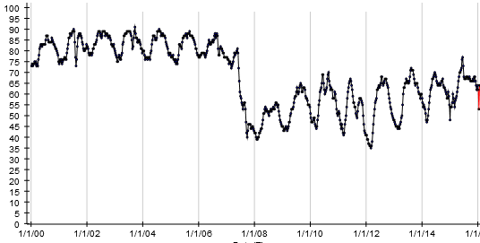
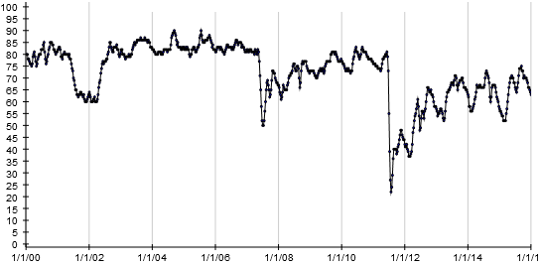
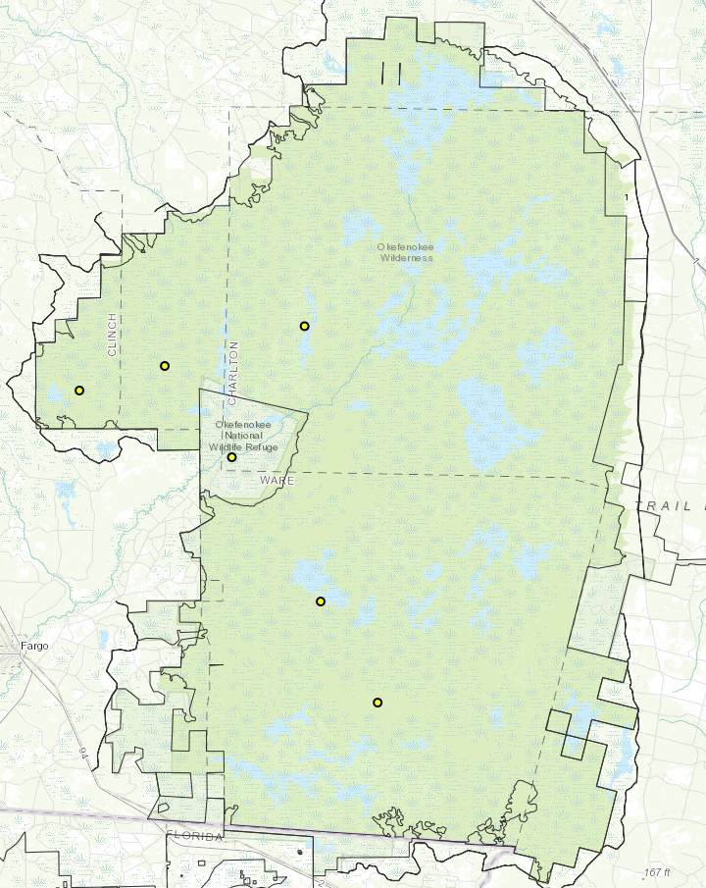
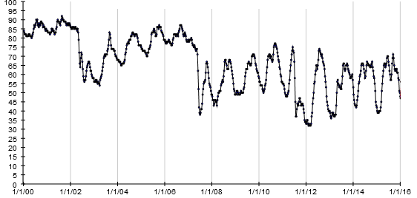
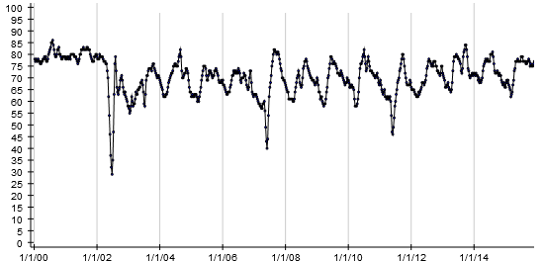
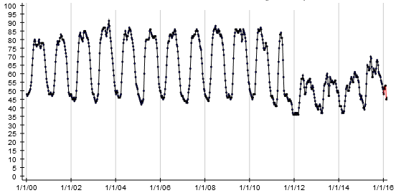
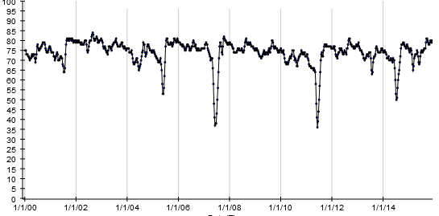
FIRE
FIRE
FIRE
FIRE
FIRE
NDVI
Tour de Okefenokee
NDVI
A. East of Rowell’s Island
D. West of Minnie’s Island
2000 2002 2004 2006 2008 2010 2012 2014 2016
2000 2002 2004 2006 2008 2010 2012 2014 2016
FIRE
FIRE
FIRE
FIRE
FIRE
FIRE
D
NDVI
A
B
NDVI
B. Northwest of the Sill
C
E. South of Honey Island
2000 2002 2004 2006 2008 2010 2012 2014 2016
2000 2002 2004 2006 2008 2010 2012 2014 2016
E
FIRE
FIRE
FIRE
FIRE
FIRE
FIRE
FIRE
F
NDVI
NDVI
C. Just above the Sill
F. Blackjack Island
2000 2002 2004 2006 2008 2010 2012 2014 2016
2000 2002 2004 2006 2008 2010 2012 2014 2016

Slide 11
Weekly change in Average, 10th and 90th Percentile NDVI
for the Okefenokee National Wildlife Refuge
NDVI
FIRE
FIRE
FIRE

Slide 12
Change in productivity (mean NDVI) for the Okefenokee
showing the influence of drought and wildfire
Year-to
-year
change
Percent of Refuge
Cumulative change since
2000
Percent of Refuge

Slide 13
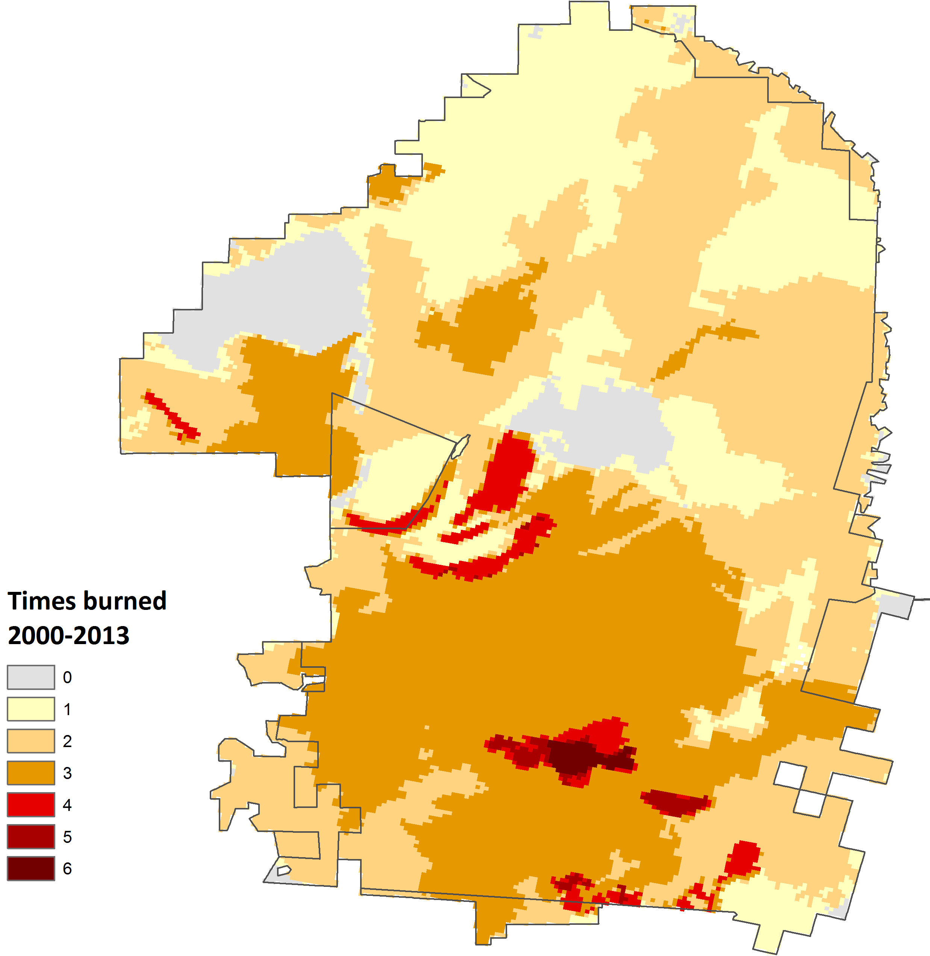
Does fire frequency explain change in productivity?
Most areas in yellow (that burned once) did so in 2011 or 2007.
Most areas in dark orange burned in 2001/2, 2007 and 2011.
Areas in red reflect both wildfire and prescribed fire.

Slide 14
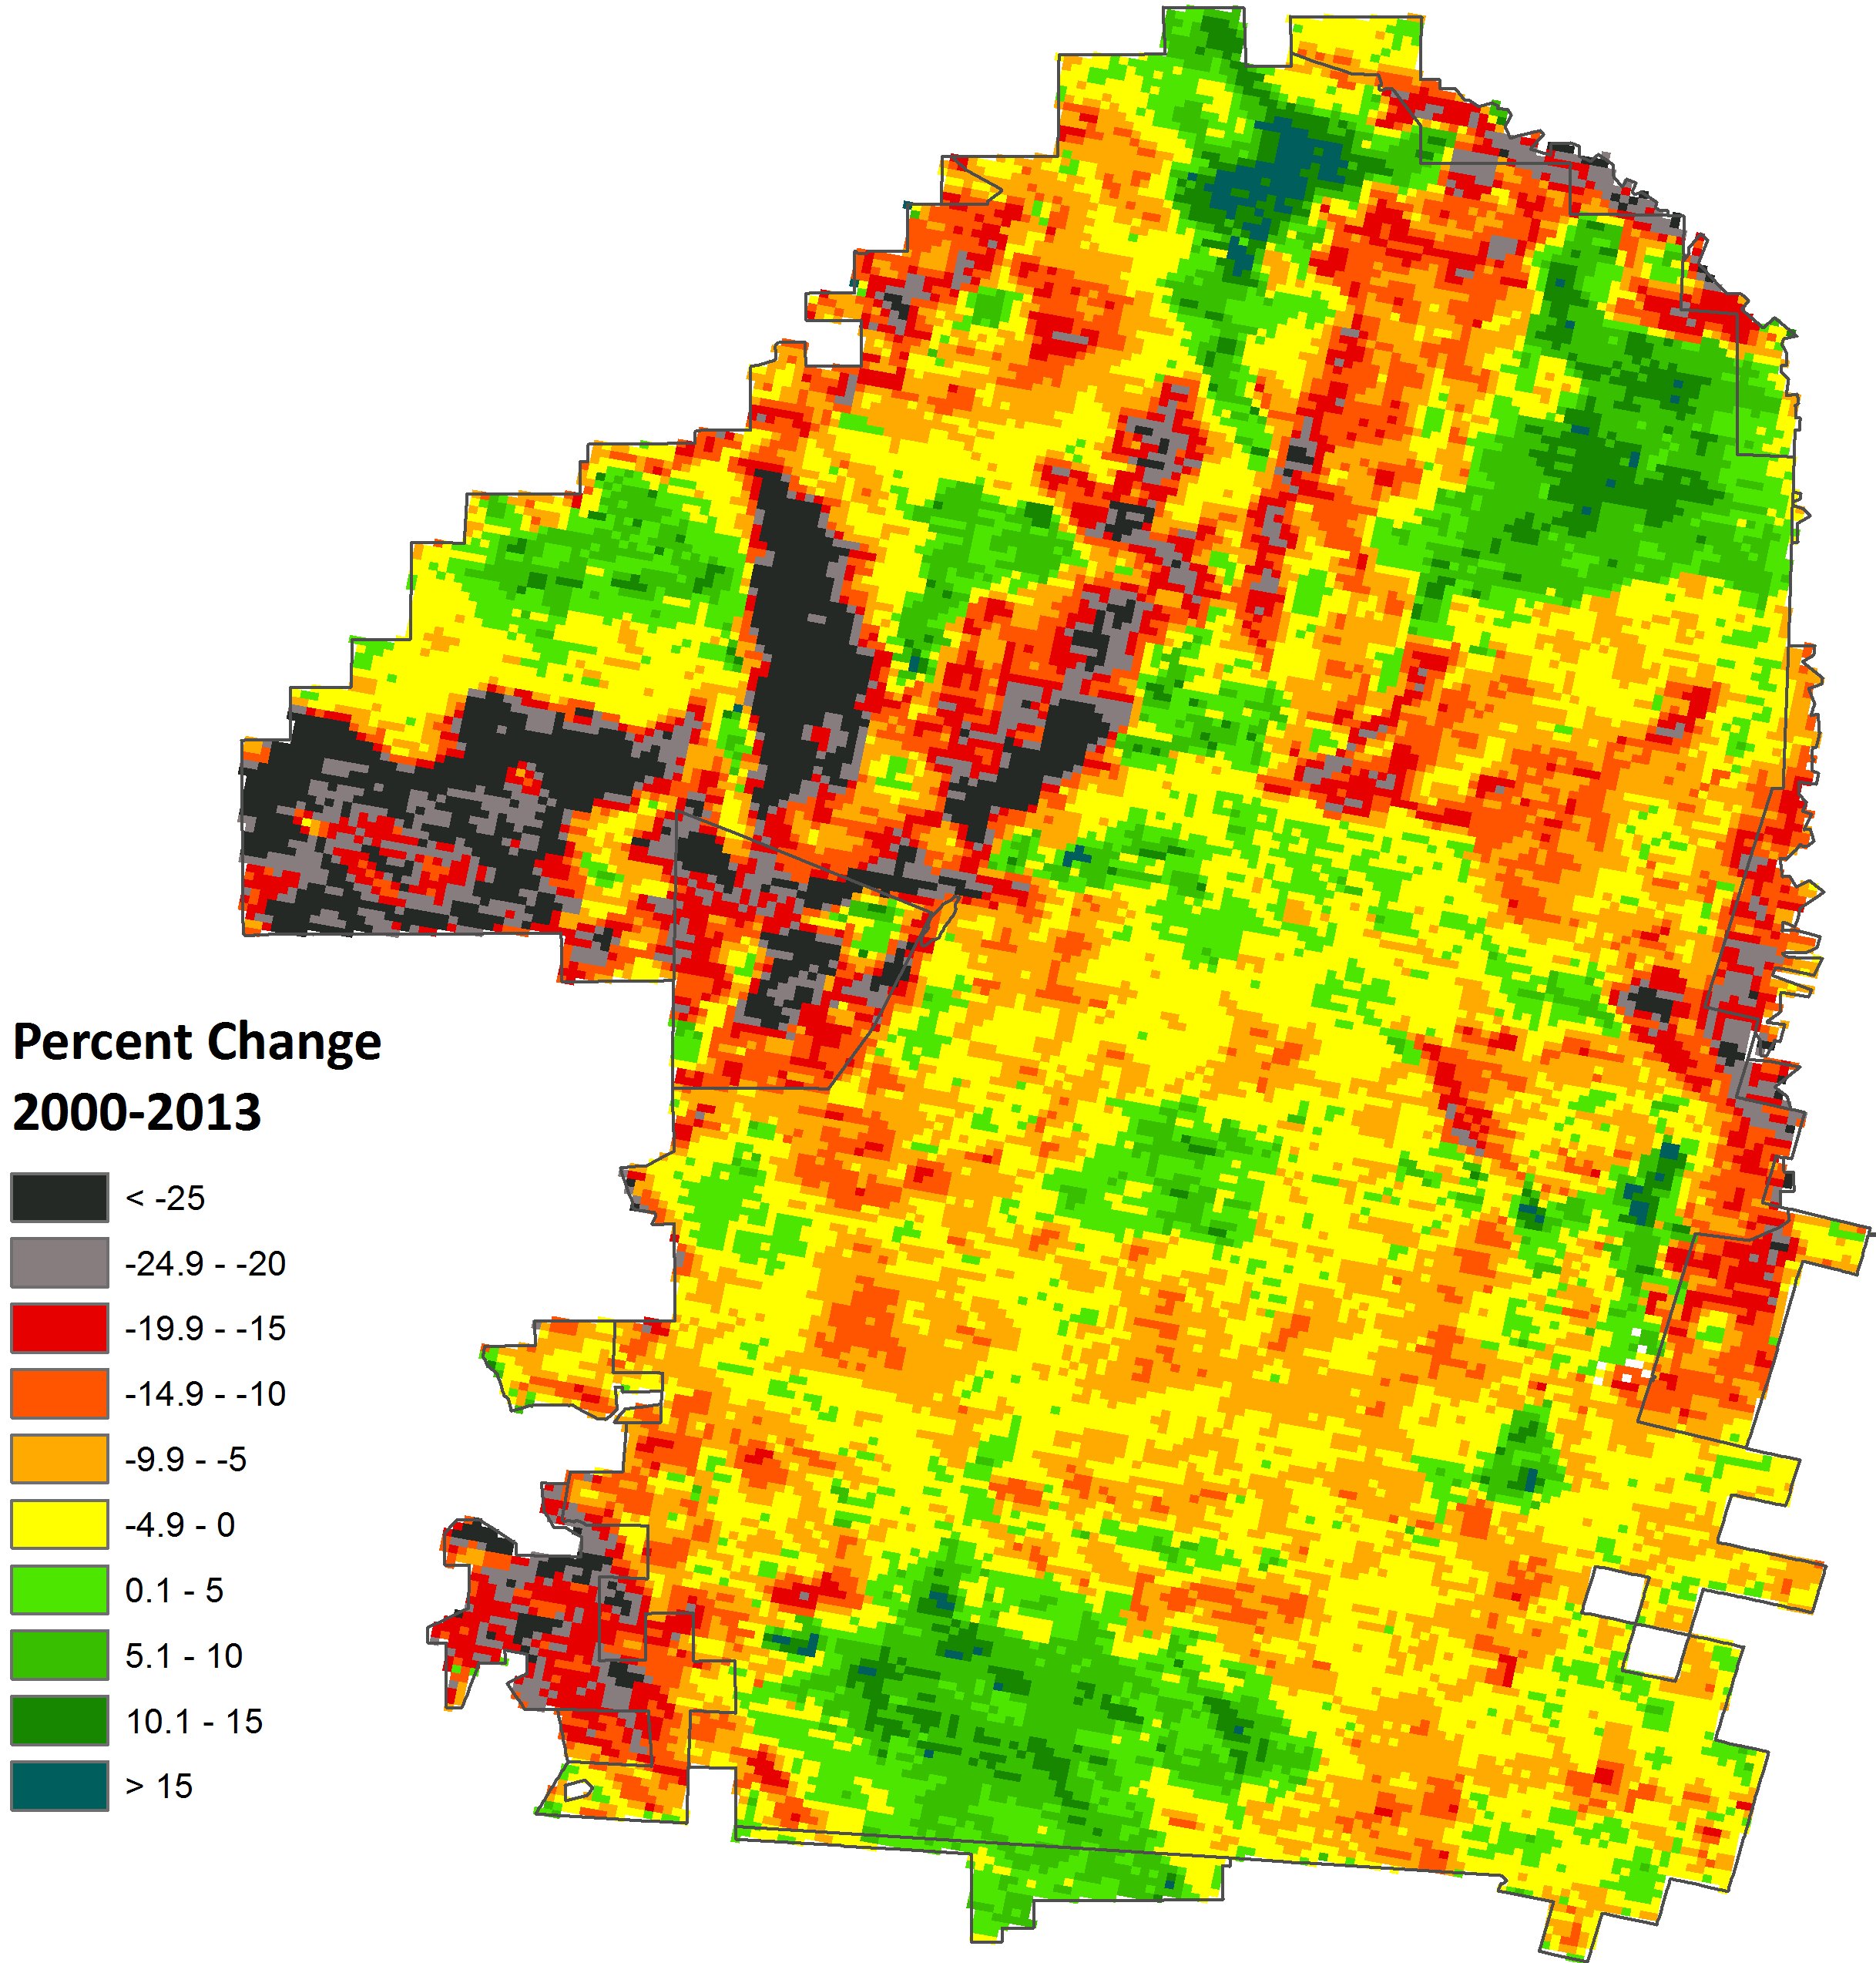
Unburned and once burned areas are increasing.
Severe declines occurred
here after 1-3 fires.
Does fire frequency explain change in productivity?
This area of higher decline burned twice, while areas to the east and west burned just once and are increasing.
Responses are of finer scale than fire frequency from site factors (hydrology, vegetation or nuances of fire behavior).
Frequently burned pine islands are often stable.
3x burned, but NDVI is increasing where trees are less common (this area had burned in 1999).

Slide 16
Distribution of grid cell productivities for starting vegetation in 2000
NDVI group
2000 NDVI | 0.56 | 0.60 | 0.64 | 0.68 | 0.72 | 0.76 | 0.80 | 0.84 | 0.88 | 0.92 | Grand Total
Bare Ground/Urban | 0.0% | 0.0% | 8.0% | 20.0% | 24.0% | 28.0% | 20.0% | 0.0% | 0.0% | 0.0% | 100.0%
Water Lily | 0.0% | 0.4% | 3.2% | 28.2% | 36.1% | 21.5% | 9.4% | 1.2% | 0.0% | 0.0% | 100.0%
Sedges, Ferns, Water Lily | 0.0% | 1.8% | 4.9% | 17.4% | 27.5% | 27.8% | 17.1% | 3.3% | 0.2% | 0.0% | 100.0%
Open Water | 0.0% | 0.0% | 0.0% | 19.0% | 14.3% | 28.6% | 23.8% | 14.3% | 0.0% | 0.0% | 100.0%
Shrub | 0.0% | 0.0% | 0.2% | 2.9% | 14.9% | 26.7% | 35.3% | 18.6% | 1.4% | 0.0% | 100.0%
Mixed Upland/Wetland Shrub | 0.0% | 0.0% | 0.0% | 0.0% | 1.1% | 23.4% | 64.9% | 10.6% | 0.0% | 0.0% | 100.0%
Clearcut, Sparse Pine | 0.0% | 1.7% | 0.0% | 6.7% | 23.3% | 33.3% | 31.7% | 3.3% | 0.0% | 0.0% | 100.0%
Sparse Pine | 0.0% | 0.0% | 0.1% | 1.0% | 6.9% | 27.1% | 53.2% | 11.2% | 0.6% | 0.0% | 100.0%
Upland Pine | 0.0% | 0.0% | 0.3% | 1.1% | 9.7% | 24.4% | 51.0% | 13.2% | 0.3% | 0.0% | 100.0%
Dense Pine | 0.0% | 0.0% | 0.0% | 0.3% | 6.5% | 25.8% | 50.1% | 16.7% | 0.7% | 0.0% | 100.0%
Mixed Wet Pine | 0.0% | 0.0% | 0.0% | 0.0% | 0.3% | 3.4% | 19.1% | 53.4% | 23.0% | 0.7% | 100.0%
Pine, Cypress, Hardwood | 0.0% | 0.0% | 0.0% | 0.0% | 3.8% | 19.1% | 40.7% | 28.0% | 8.1% | 0.4% | 100.0%
Cypress, Gum, Shrub | 0.0% | 0.0% | 0.2% | 2.7% | 10.0% | 19.1% | 35.6% | 27.7% | 4.6% | 0.0% | 100.0%
Gum, Bay, Cypress, Shrub | 0.0% | 0.0% | 0.0% | 0.2% | 2.1% | 9.9% | 32.8% | 37.2% | 17.5% | 0.3% | 100.0%
Gum, Maple, Bay | 0.0% | 0.0% | 0.0% | 0.2% | 4.0% | 11.7% | 24.8% | 44.6% | 14.7% | 0.0% | 100.0%
Loblolly Bay | 0.0% | 0.0% | 0.0% | 0.0% | 0.0% | 1.0% | 6.2% | 27.2% | 50.0% | 15.5% | 100.0%
Majority 2001 Vegetation Type

Slide 17
Distribution of grid cell productivities for starting vegetation by 2015
NDVI group
2015 NDVI | 0.56 | 0.60 | 0.64 | 0.68 | 0.72 | 0.76 | 0.80 | 0.84 | 0.88 | 0.92 | Grand Total
Bare Ground/Urban | 0.0% | 20.0% | 8.0% | 32.0% | 24.0% | 16.0% | 0.0% | 0.0% | 0.0% | 0.0% | 100.0%
Water Lily | 0.0% | 1.9% | 9.7% | 27.4% | 36.9% | 22.1% | 2.0% | 0.0% | 0.0% | 0.0% | 100.0%
Sedges, Ferns, Water Lily | 0.0% | 1.1% | 7.8% | 16.9% | 37.9% | 32.6% | 3.5% | 0.2% | 0.0% | 0.0% | 100.0%
Open Water | 0.0% | 0.0% | 4.8% | 14.3% | 28.6% | 33.3% | 19.0% | 0.0% | 0.0% | 0.0% | 100.0%
Shrub | 0.0% | 2.5% | 6.4% | 9.3% | 24.3% | 38.8% | 16.1% | 2.4% | 0.1% | 0.0% | 100.0%
Mixed Upland/Wetland Shrub | 0.0% | 0.0% | 4.3% | 16.0% | 29.8% | 46.8% | 3.2% | 0.0% | 0.0% | 0.0% | 100.0%
Clearcut, Sparse Pine | 0.0% | 0.0% | 3.3% | 20.0% | 46.7% | 18.3% | 11.7% | 0.0% | 0.0% | 0.0% | 100.0%
Sparse Pine | 0.0% | 1.8% | 3.8% | 8.8% | 25.7% | 53.4% | 6.5% | 0.0% | 0.0% | 0.0% | 100.0%
Upland Pine | 0.0% | 0.6% | 1.7% | 24.4% | 35.0% | 27.5% | 10.9% | 0.0% | 0.0% | 0.0% | 100.0%
Dense Pine | 0.0% | 1.7% | 2.7% | 6.5% | 34.1% | 47.0% | 8.0% | 0.0% | 0.0% | 0.0% | 100.0%
Mixed Wet Pine | 0.0% | 2.2% | 7.2% | 17.9% | 23.5% | 34.6% | 12.1% | 2.4% | 0.0% | 0.0% | 100.0%
Pine, Cypress, Hardwood | 0.0% | 3.4% | 6.8% | 16.1% | 35.6% | 27.5% | 9.3% | 0.4% | 0.8% | 0.0% | 100.0%
Cypress, Gum, Shrub | 0.0% | 3.4% | 8.1% | 12.9% | 26.2% | 30.4% | 14.1% | 4.8% | 0.0% | 0.0% | 100.0%
Gum, Bay, Cypress, Shrub | 0.0% | 9.0% | 7.8% | 12.0% | 14.2% | 25.6% | 20.1% | 11.0% | 0.4% | 0.0% | 100.0%
Gum, Maple, Bay | 0.0% | 9.2% | 6.5% | 6.2% | 5.8% | 10.7% | 33.5% | 28.0% | 0.0% | 0.0% | 100.0%
Loblolly Bay | 0.1% | 14.0% | 13.8% | 11.8% | 11.9% | 13.5% | 16.6% | 12.8% | 5.3% | 0.0% | 100.0%
Majority 2001 Vegetation Type*
*Actual vegetation types have often changed by 2015

Slide 18
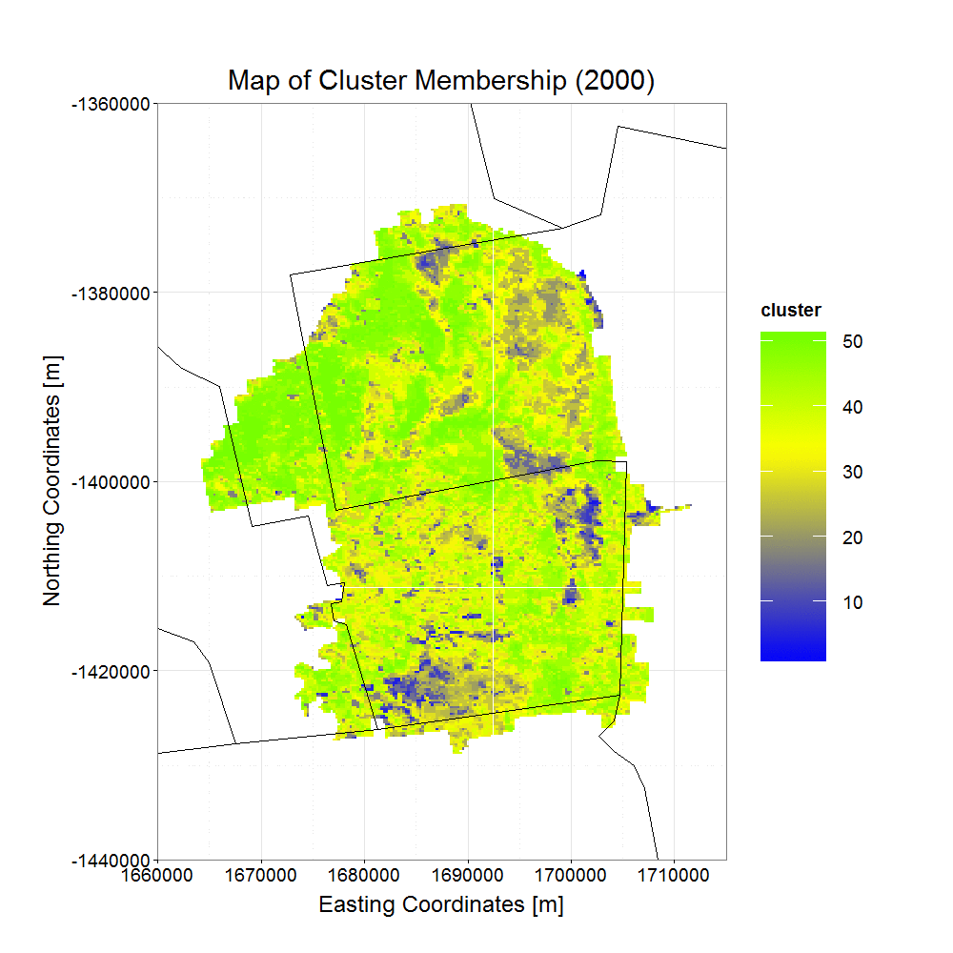
Flux in Annual Productivity
for the Okefenokee
Using Non-Hierarchical K-Means Clustering
of 5 Phenological Shape Indicators
Overall Average NDVI of the Refuge

Slide 19
Summary
High-frequency MODIS based monitoring helps quantify immediate fire effects in large, highly productive wetlands where NDVI recovery can be rapid.
Where fires are frequent, having a consistent multi-year context reveals cumulative disturbance effects.
Such systematic monitoring can be useful for tracking landscape productivity and progress toward management goals.

