Slide 1
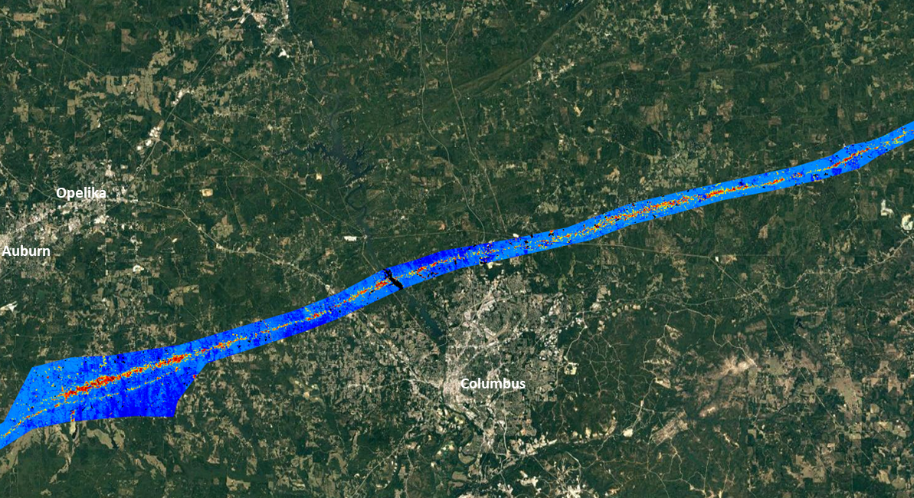
High-Resolution Forest Disturbance Mapping
Bill Christie, Steve Norman and Bill Hargrove Eastern Forest Environmental Threat Assessment Center USDA Forest Service, Southern Research Station, Asheville, NC
2019 SGSF GIS Committee Summer Meeting
June 17 – 20, 2019 Franklin, TN

Slide 2
High-Resolution Forest Disturbance Mapping
Bill Christie, Steve Norman and Bill Hargrove Eastern Forest Environmental Threat Assessment Center USDA Forest Service, Southern Research Station, Asheville, NC
ForWarn II adds Sentinel 10-meter ‘true-color’ to the Viewer
High-Resolution Disturbance Mapping Projects
From HiForM.org
Tornadoes - Beauregard-Smith Station, AL-GA
Hurricanes - Maria, Irma, Florence, Michael
Wildfire - s. Apps 2016, including the Gatlinburg fire
‘Cookbook’ PDF (a hi-res disturbance mapping workflow document)
Tornado forest disturbance mapping by the MS Forestry Commission
Questions
2019 SGSF GIS Committee Summer Meeting
June 17 – 20, 2019 Franklin, TN

Slide 3
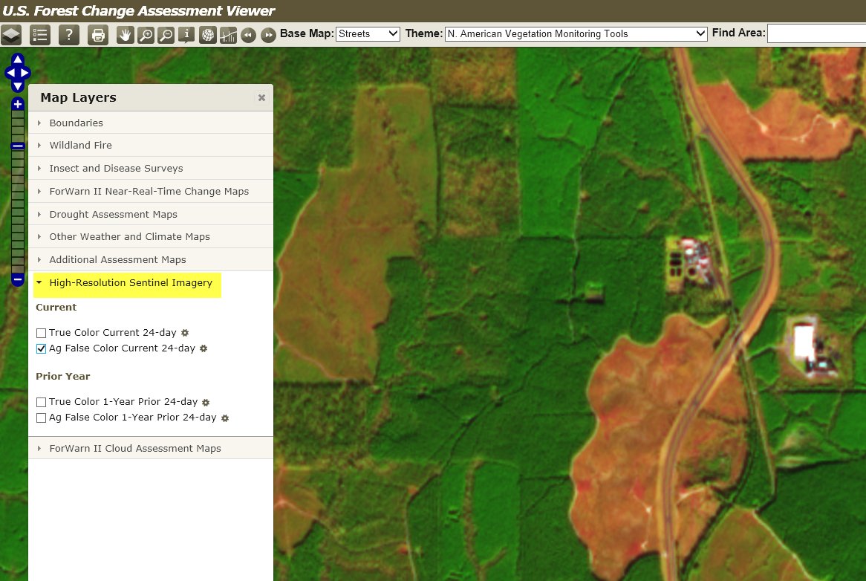
Cloud cover may vary
Sentinel-2 10-meter ‘True Color’ and ‘Ag-Enhanced’ now in Viewer
Quickly vet NDVI departures with current 24-day and previous year’s 24-day satellite imagery
Within the same period, the ‘True-Color’ and ‘Ag-Enhanced’ version may appear different from each other b/c of different cloud cover thresholds being used to request the two images for the same 24-day period.
This was implemented to ensure at least one of the two versions would be cloud free for your areas of interest.
Notes:
We’ve added the current periods (and previous years, same period) 10m Sentinel 2 imagery to the ‘Viewer’! Look in the Map Layers window for a tab named “High Resolution Sentinel Imagery”. The mosaic of the Sentinel imagery displayed is composed from the same dates of the current 24-day window of the current forest change product. When the next 8-day product is created, the dates of the Sentinel imagery sourced moves 8-days to match the new date range of the next 24-day window, it will always stay current with respect the current 24-day compositing window. There is also a companion Sentinel 2 composite for the matching ‘”Prior Year”. There are two flavors of band combinations: (1) Agricultural enhancement (Ag False Color), and (2) a “True Color”, I find the ag-enhanced version most helpful for forestry-related disturbance interpretations.

Slide 4
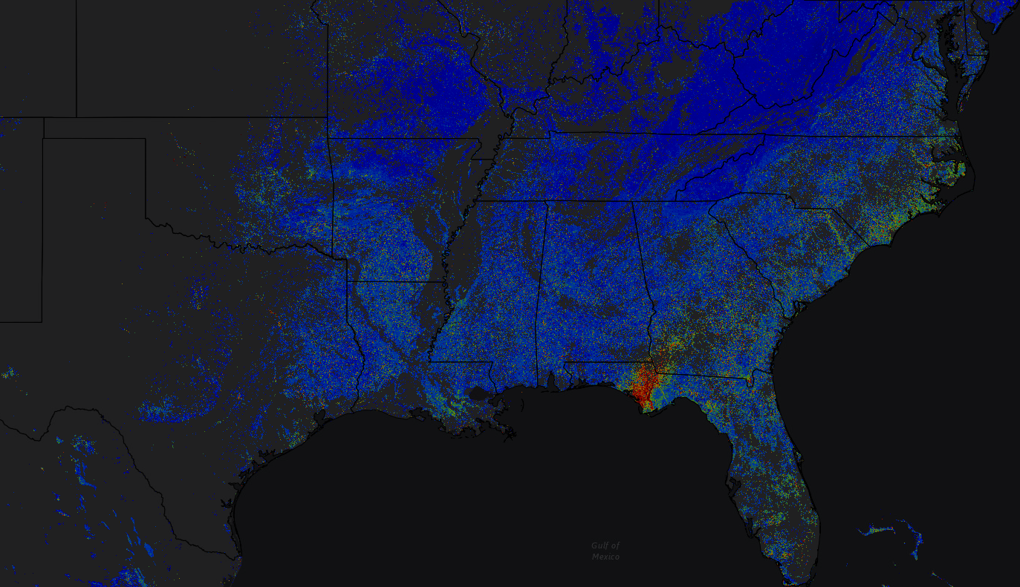
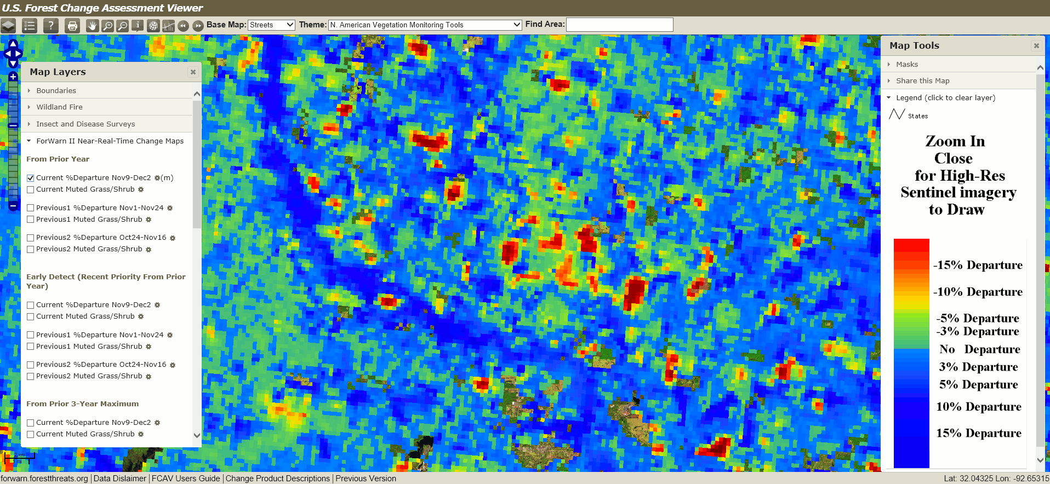
Sentinel-2 10-meter ‘True Color’ and ‘Ag-Enhanced’ now in Viewer
Quickly vet NDVI departures with current 24-day and previous year’s 24-day satellite imagery
Notes:
ANIMATED SLIDE, View in ‘Presentation’ Mode - Here’s an animated blink-map showing a ForWarn II 1yr forest change image (in s. MS) and the corresponding 10m Sentinel 2 ag-enhanced satellite image. Notice how high departures areas present in the forest change image corresponds nicely to silvo-treatments in the Sentinel 2 imagery. This is an awesome way to vet potential disturbances presented in the ForWarn II’s ‘percent NDVI change’ imagery.
Notice the yellow arrow above on the left side of the slide. It is pointing to the mid-point of the zoom scale. In order for the Sentinel 2 imagery to display in the ‘Viewer’, one must be zoomed-in anywhere past the mid-point in the zoom-scale. This scale-dependency is imposed to keep from using bandwidth when trying to display Sentinel 2 imagery at continental, or world-wide extent(s).
The “LINK TO VIEWER” text (upper-right) is a hyperlink that will open the ‘Forest Change Assessment Viewer’ centered on the southeast, with the current periods Sentinel 2 ‘ag-enhanced’ satellite imagery already turned on, just zoom in past half-way (on the zoom scale on the left) to get the current ForWarn II periods’ 10m satellite imagery to appear for your area of interest). You must be in ‘Presentation’ mode for the hyperlink to be enabled.

Slide 5
High-Resolution Forest Disturbance Mapping
Bill Christie, Steve Norman and Bill Hargrove Eastern Forest Environmental Threat Assessment Center USDA Forest Service, Southern Research Station, Asheville, NC
ForWarn II adds Sentinel 10-meter ‘true-color’ to the Viewer
High-Resolution Disturbance Mapping Projects
From HiForM.org
Tornadoes - Beauregard-Smith Station, AL-GA
Hurricanes - Maria, Irma, Florence, Michael
Wildfire - s. Apps 2016, including the Gatlinburg fire
‘Cookbook’ PDF (a hi-res disturbance mapping workflow document)
Tornado forest disturbance mapping by the MS Forestry Commission
Questions
2019 SGSF GIS Committee Summer Meeting
June 17 – 20, 2019 Franklin, TN

Slide 6
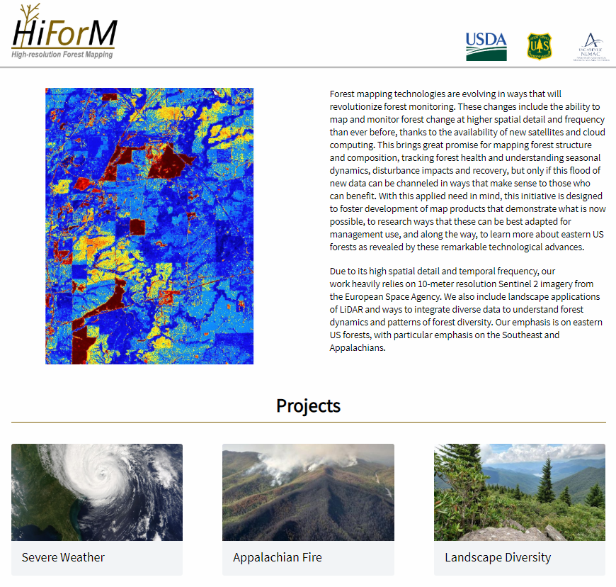
The ‘High Resolution Forest Mapping Project’ was just awarded the USFS Southern Research Station 2019 Director’s Award for Science Delivery.

Slide 7
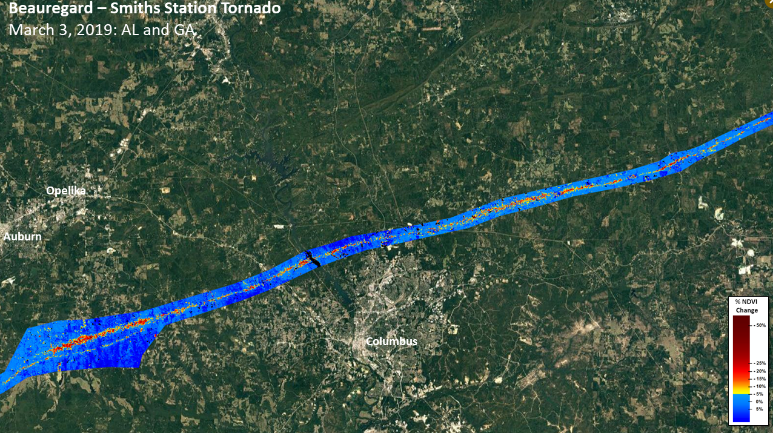

Slide 8
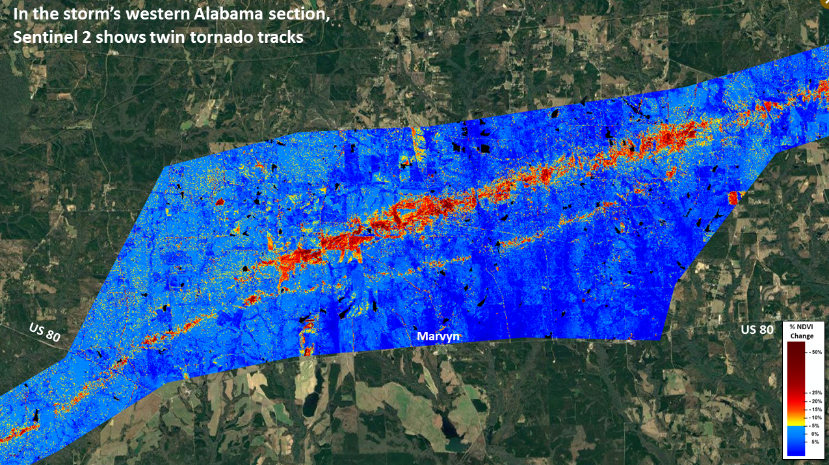

Slide 9
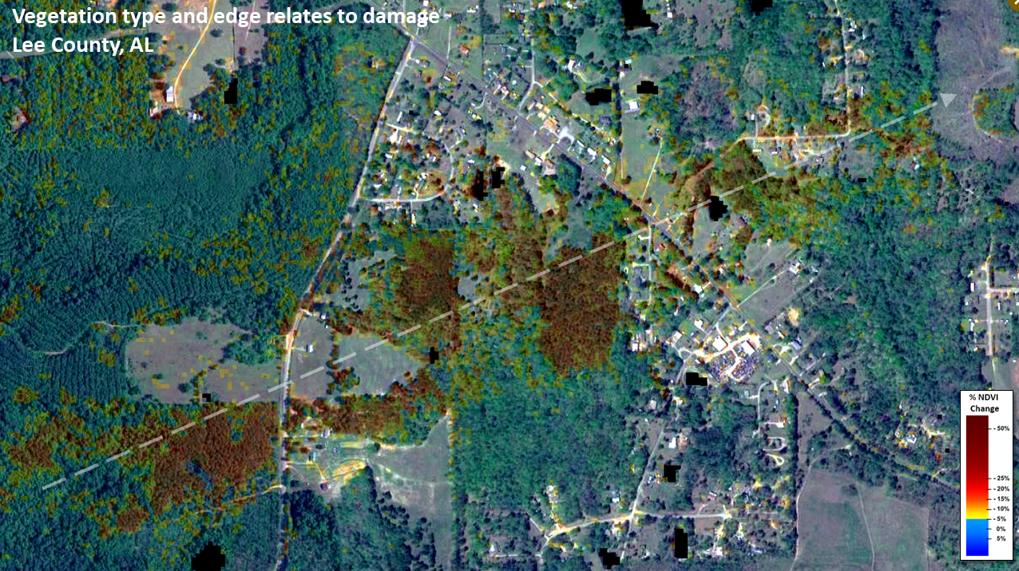

Slide 10
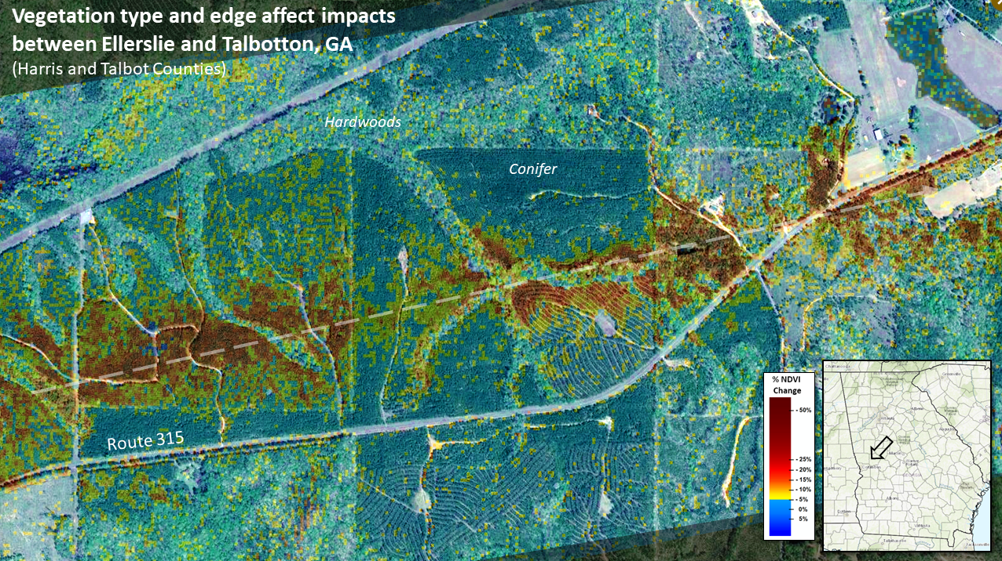

Slide 11
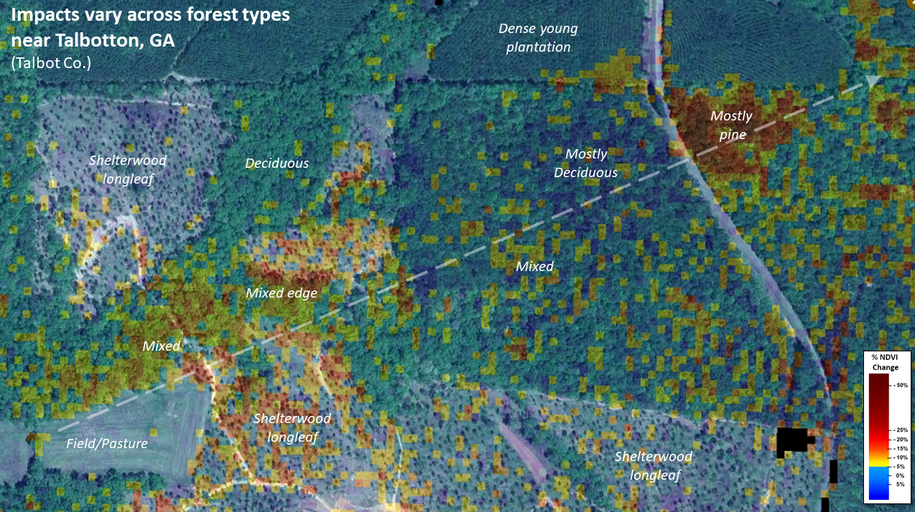

Slide 12
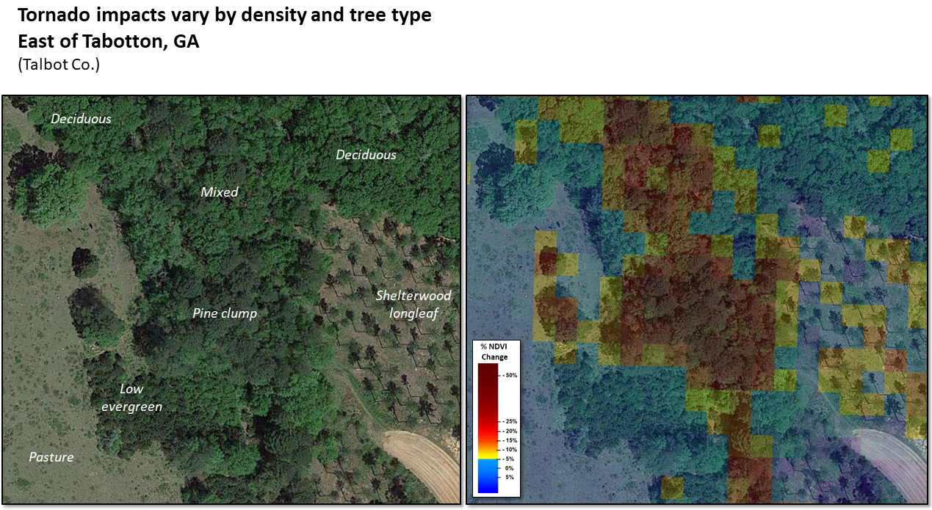

Slide 13
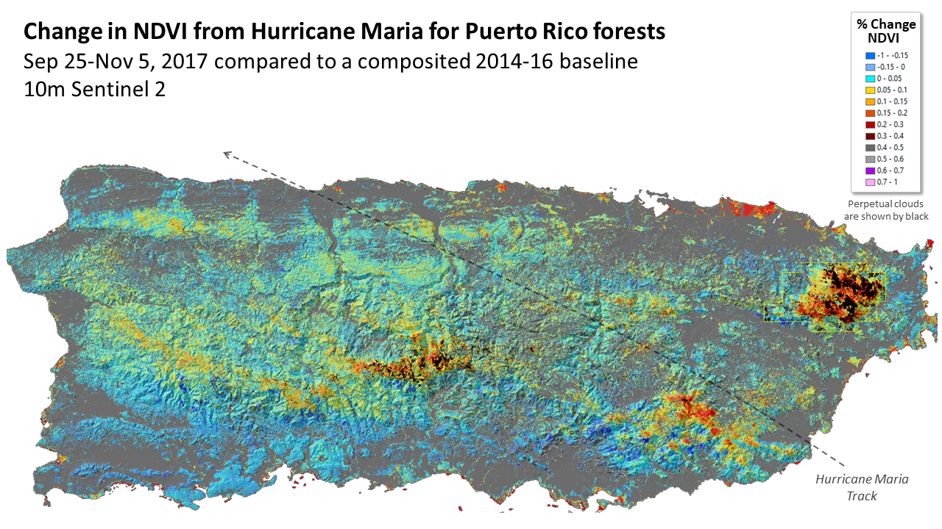

Slide 14
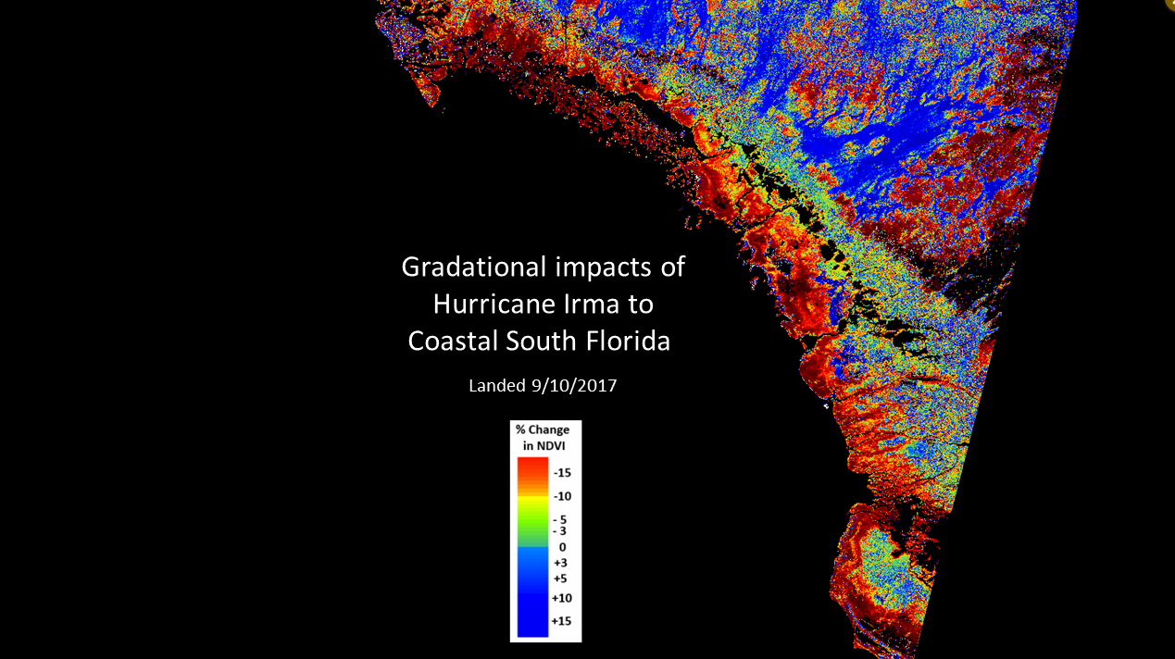

Slide 15
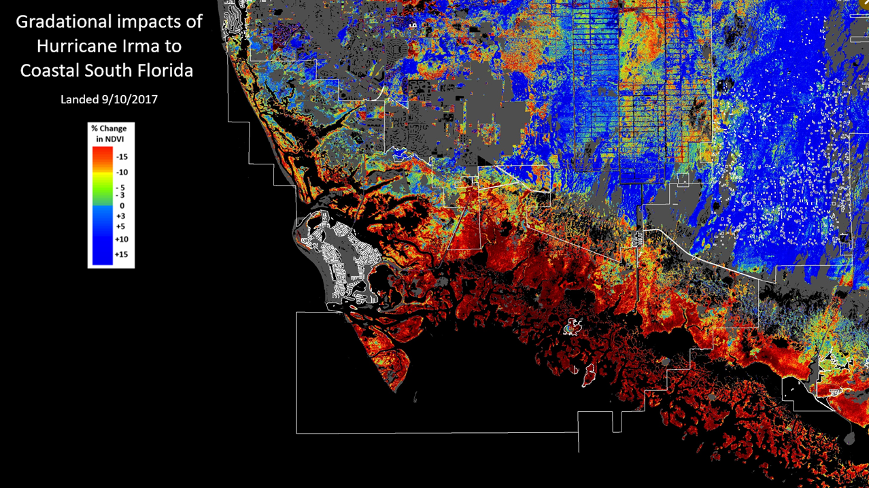

Slide 16
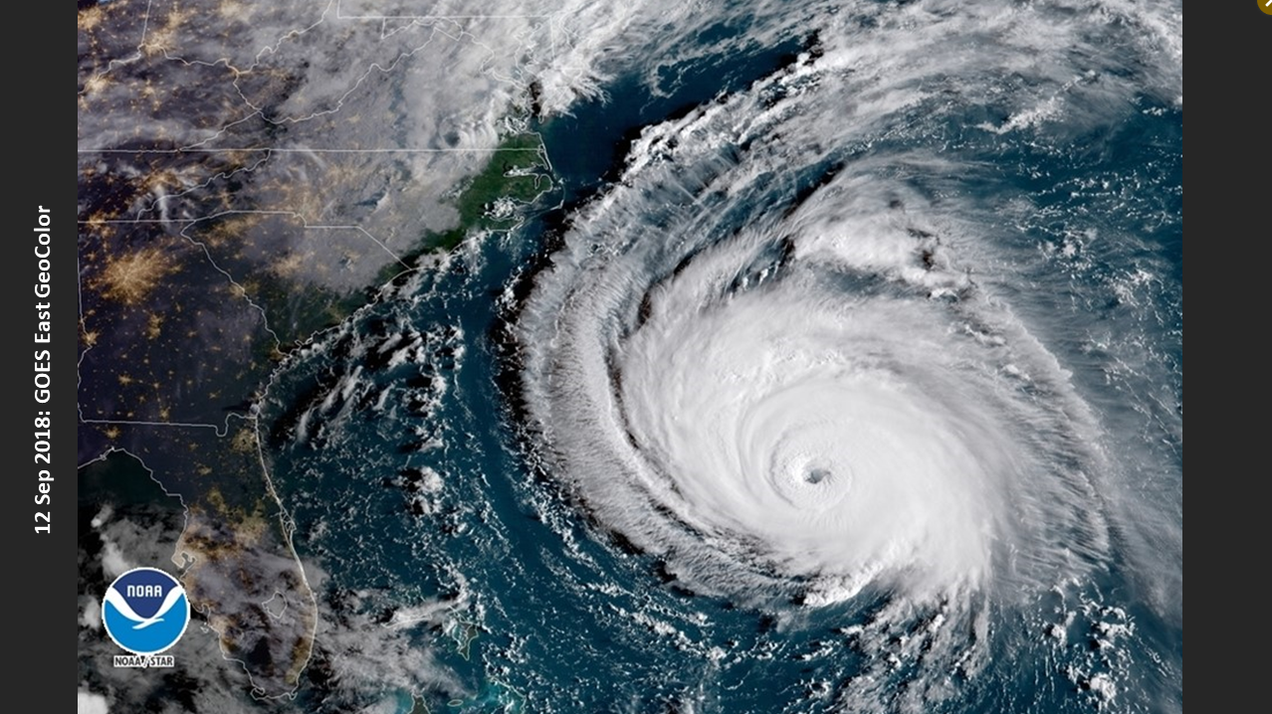

Slide 17
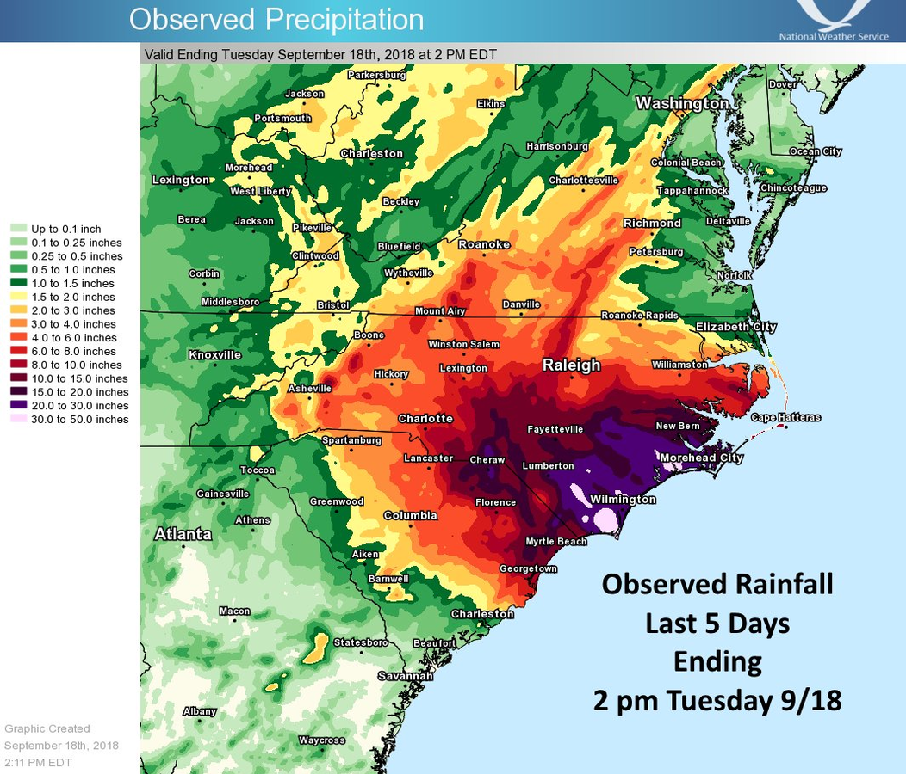

Slide 18
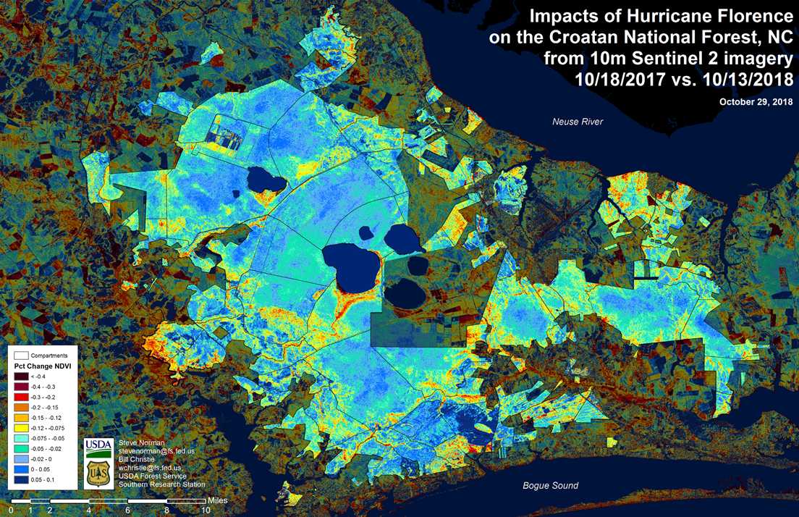

Slide 19
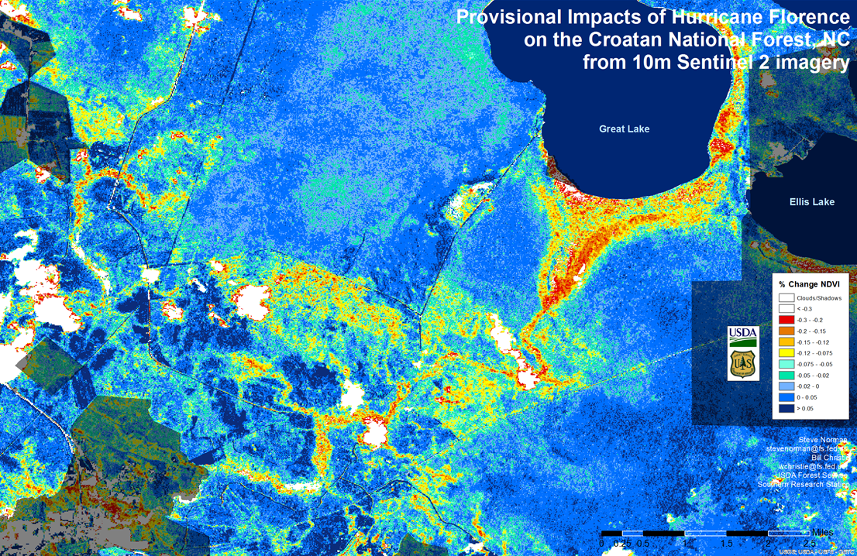

Slide 20
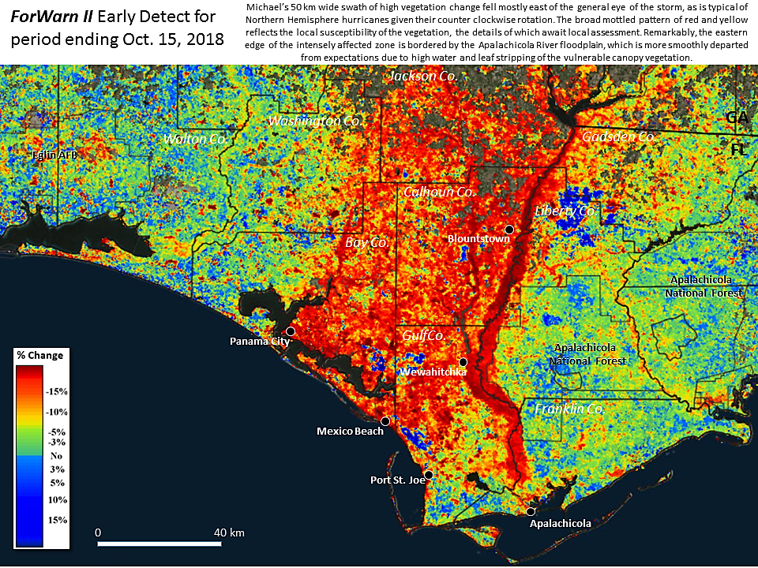

Slide 21
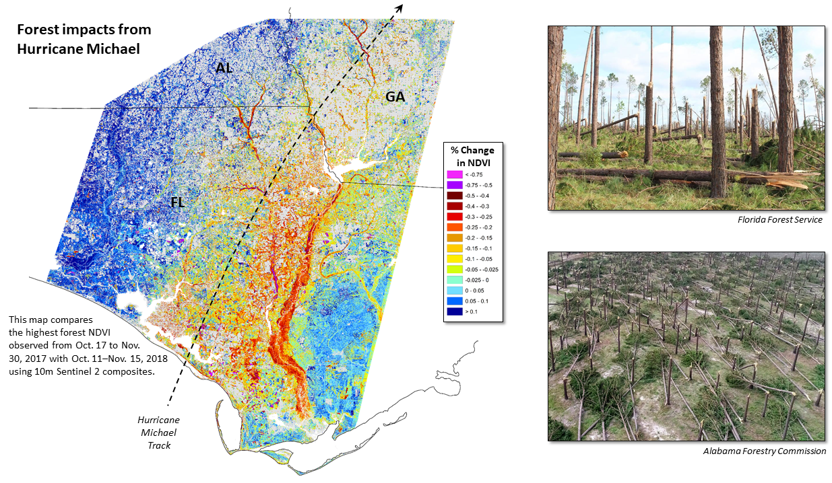

Slide 22
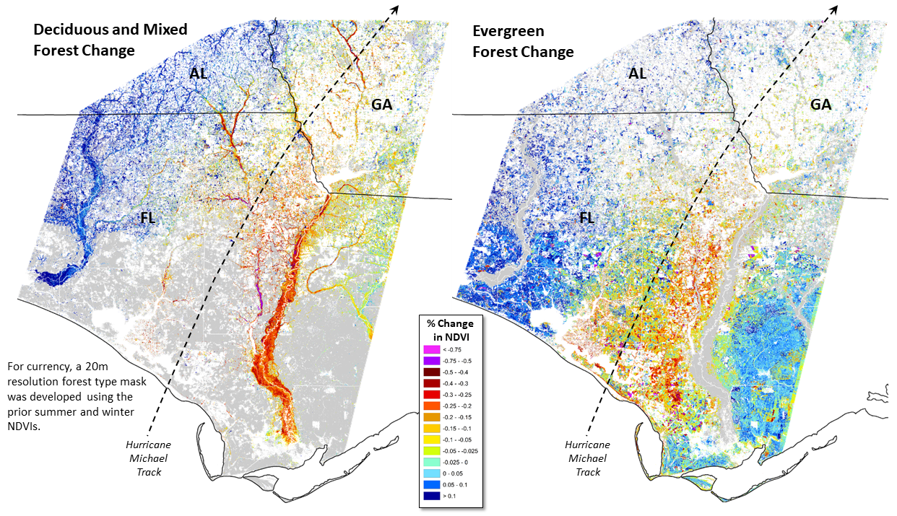

Slide 23
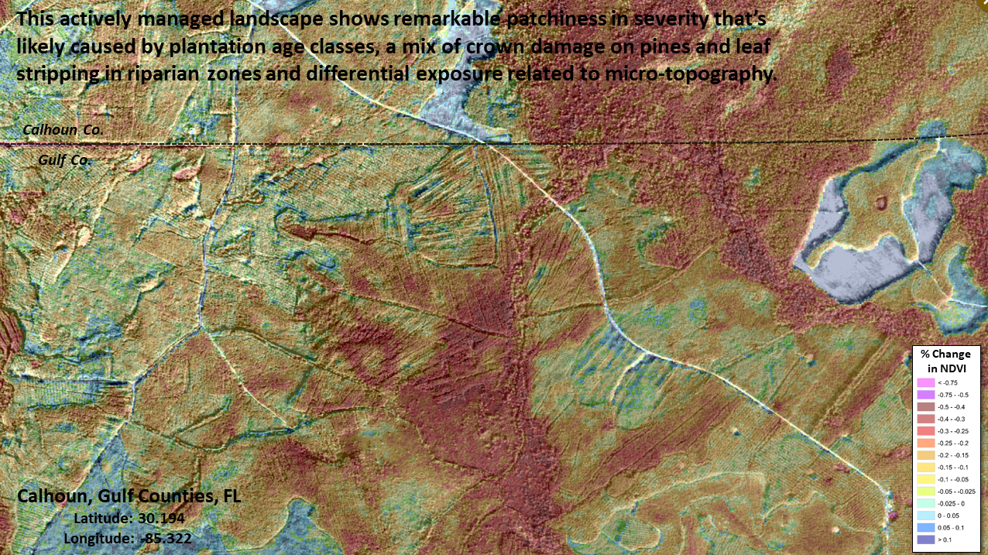

Slide 24
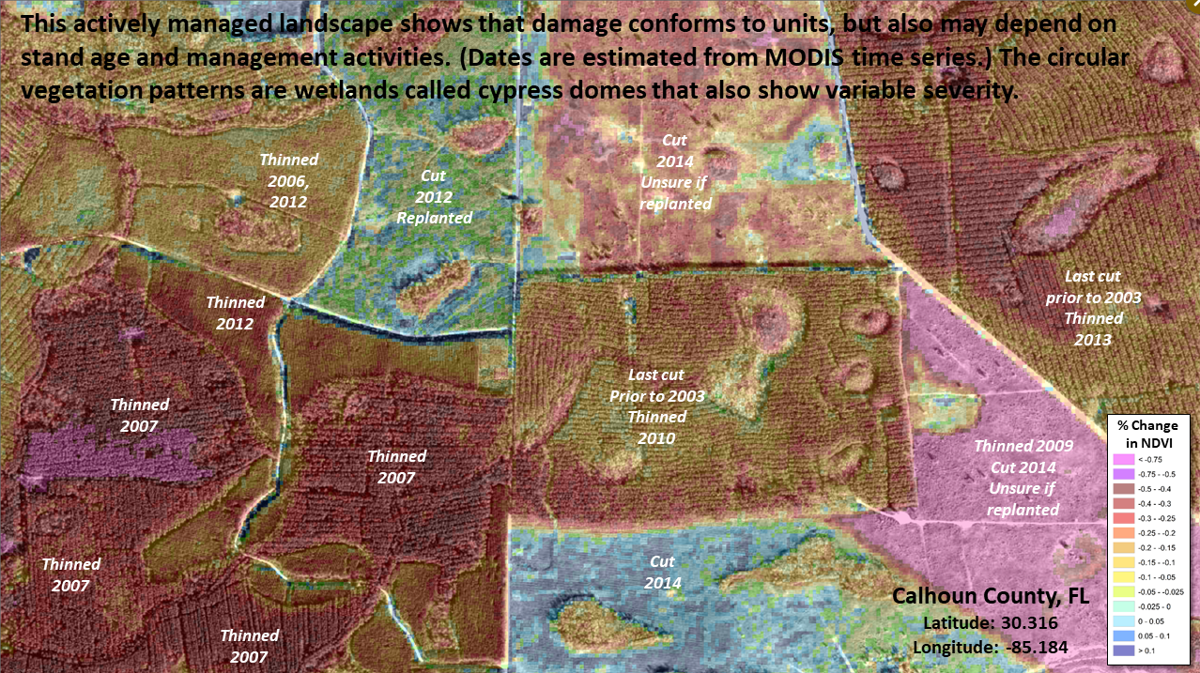

Slide 25
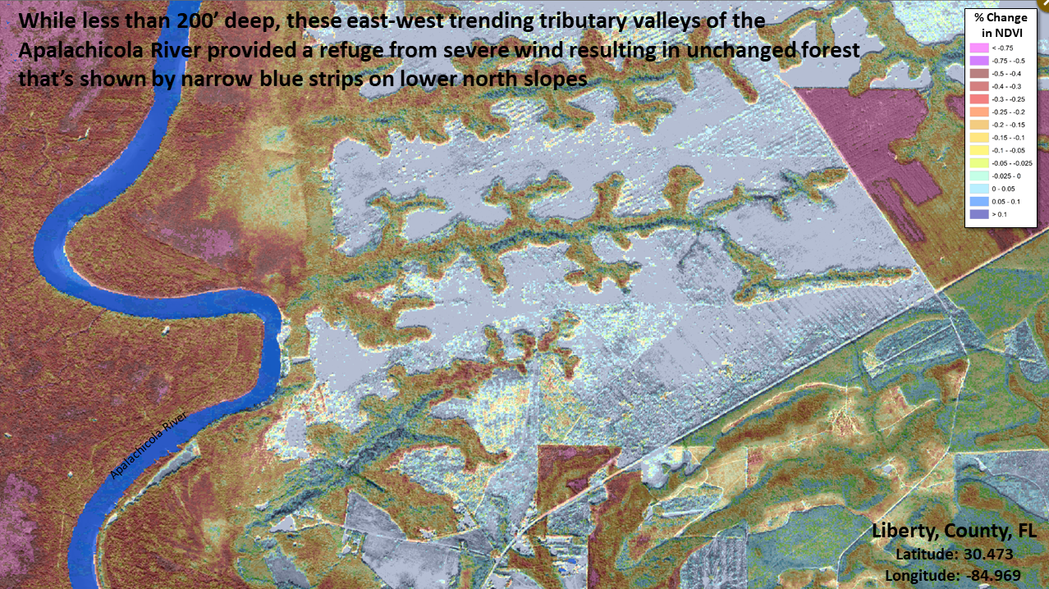

Slide 26
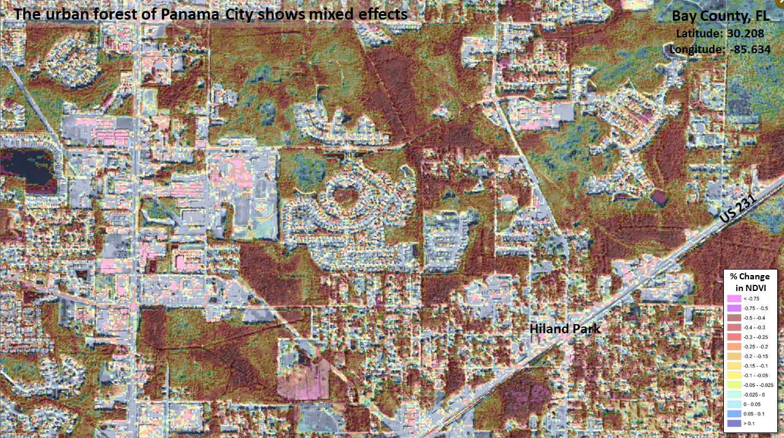

Slide 27
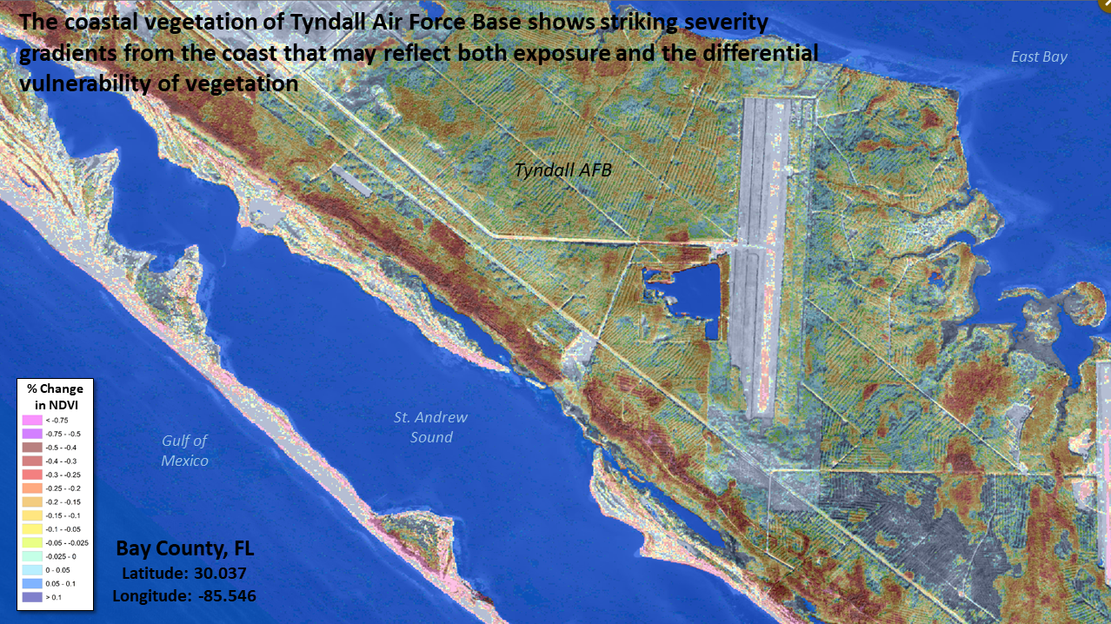

Slide 28
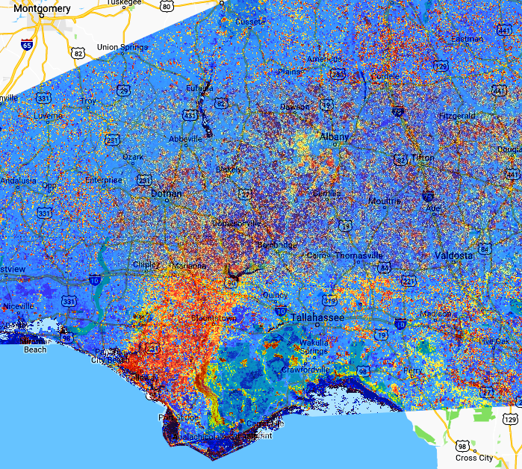
Hurricane Michael
High Resolution Forest Mapping
Pre May 1 – June 17, 2018
Post May 1 – June 17, 2019
Percent NDVI Change
post – pre / pre

Slide 29
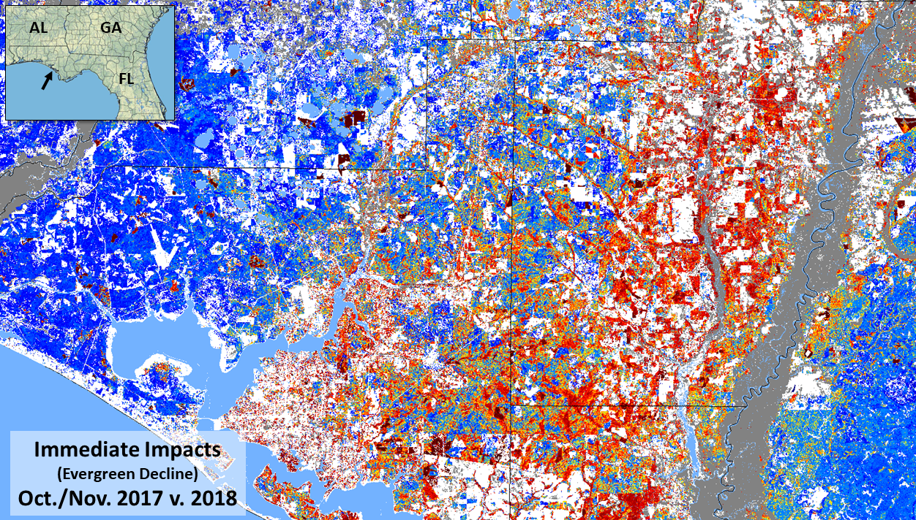

Slide 30
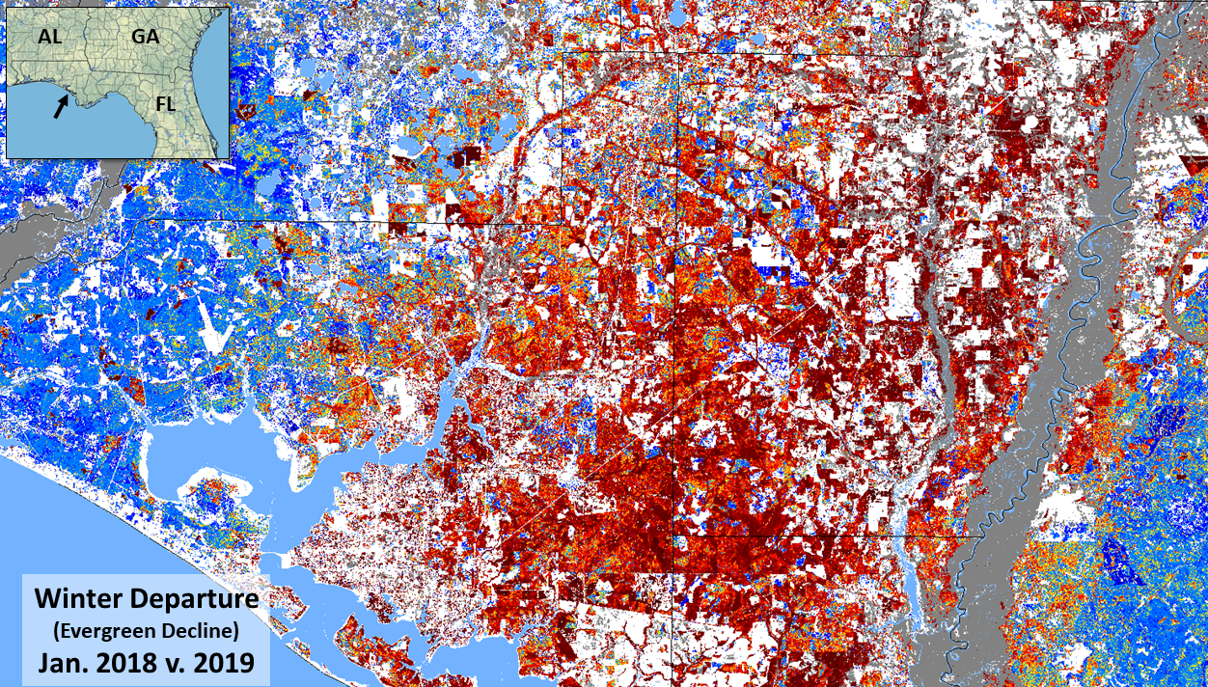

Slide 31
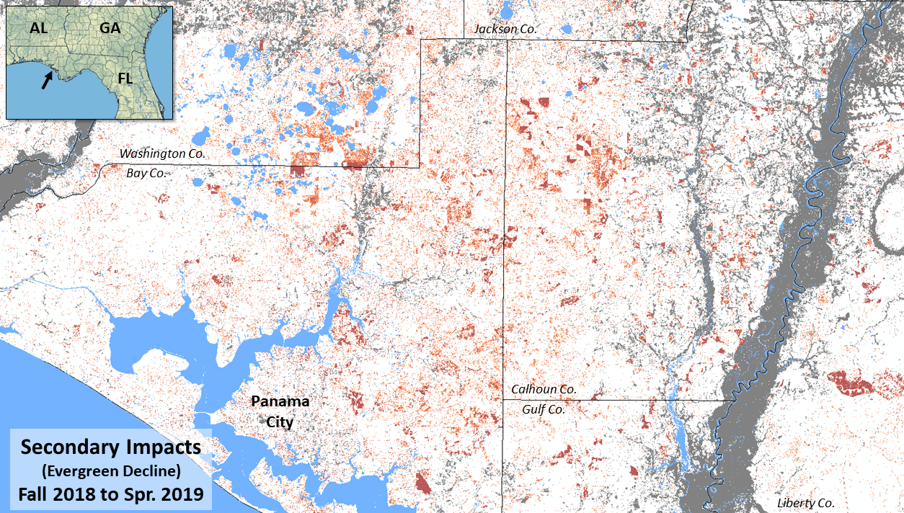

Slide 32
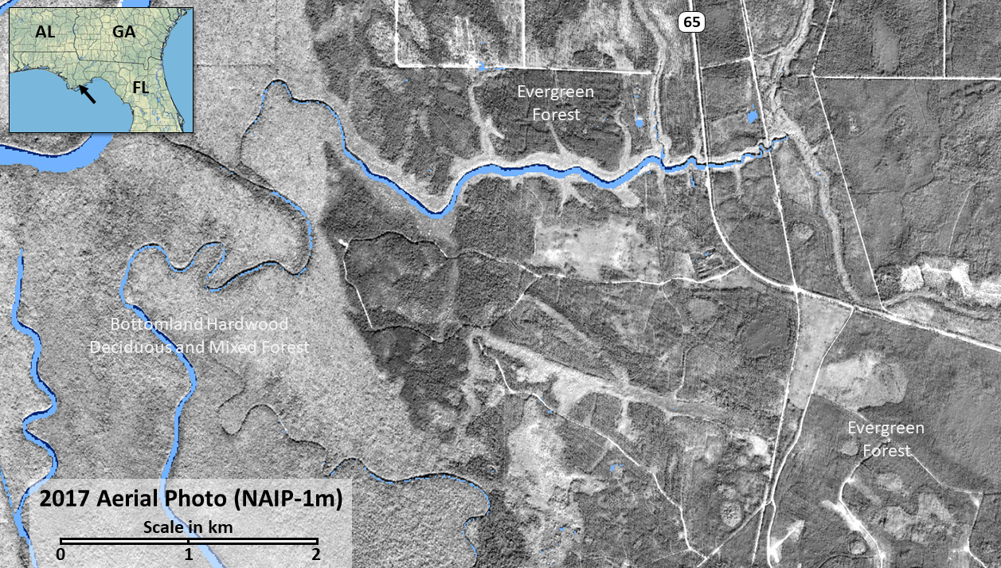

Slide 33
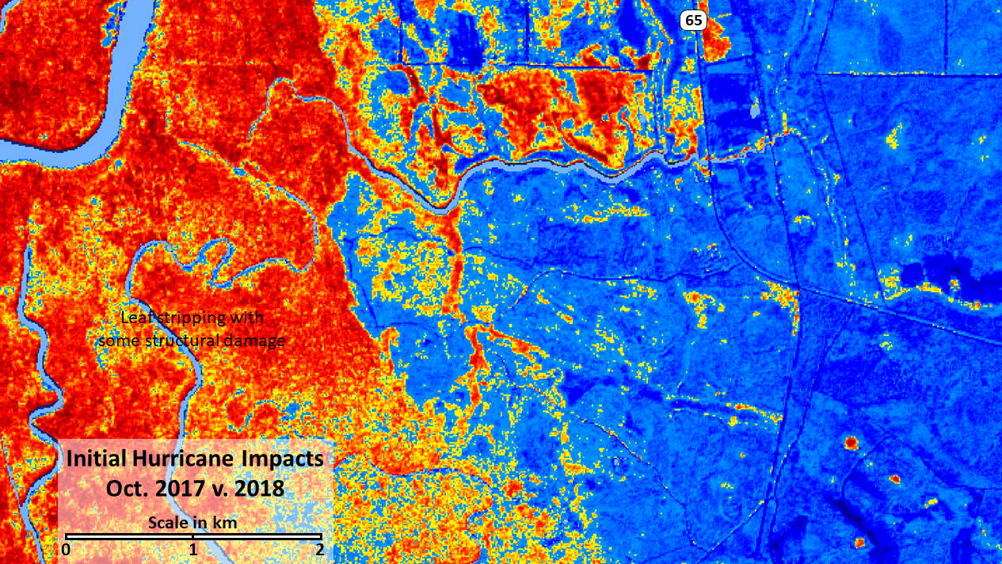

Slide 34
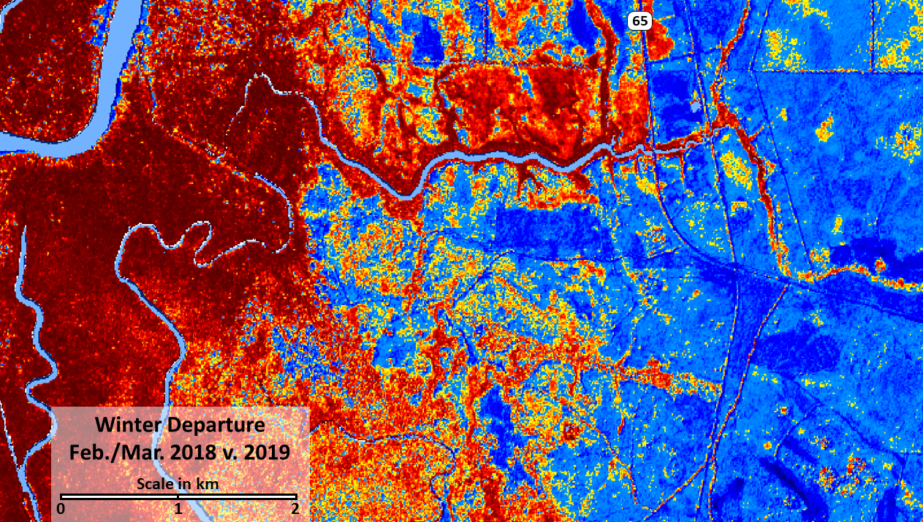

Slide 35
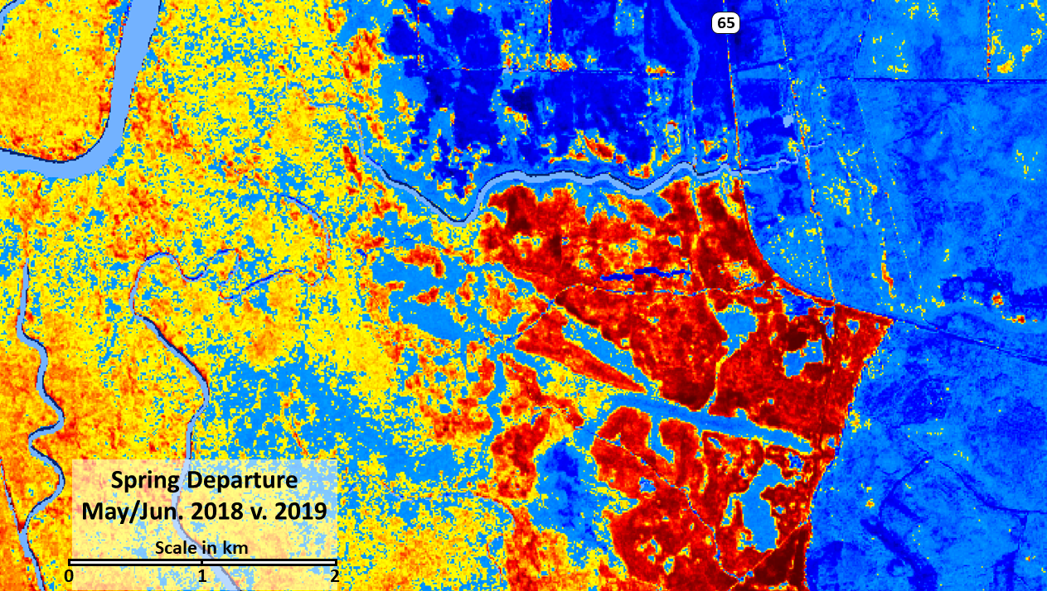

Slide 36
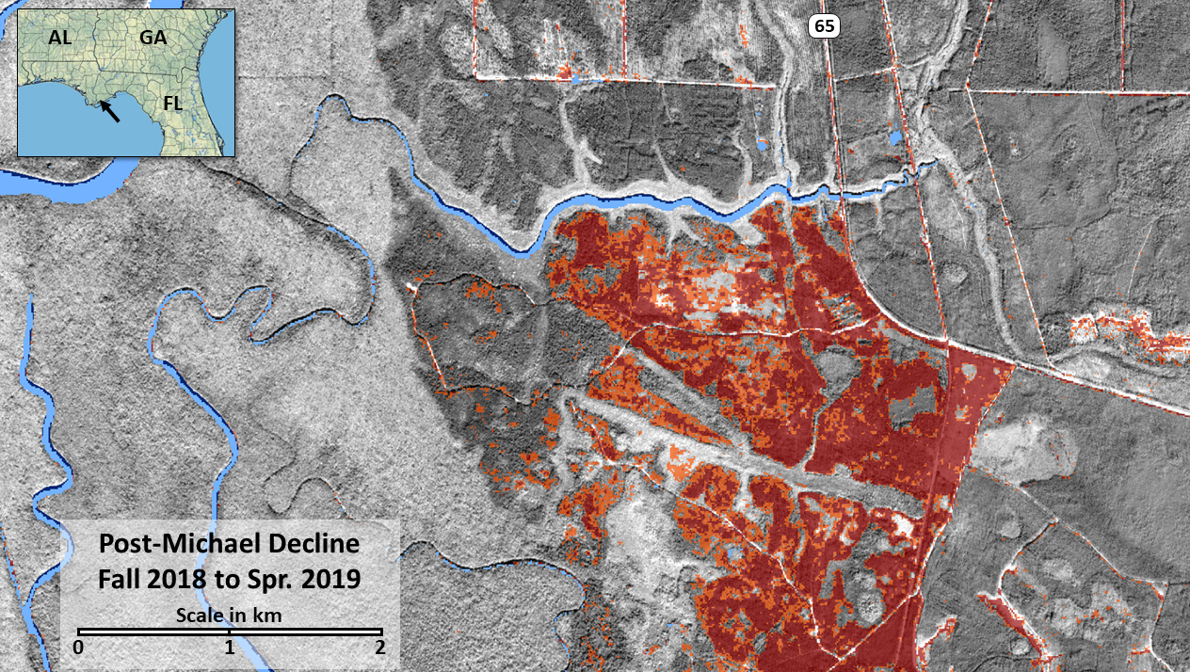

Slide 37
Remote sensing monitoring research related to the 2016 Southern Appalachian Fires
Steve Norman
USFS Southern Research Station Asheville, NC
In collaboration with
Matt Reilly, Humboldt State University Bill Christie, USFS SRS 4854, Asheville Bill Hargrove, USFS SRS 4854, Asheville
Rock Mountain Fire, July 2017; Credit: Kenny Frick USFS FHP

Slide 38
Chestnut Knob Fire, Nov. 2016
Sentinel 2 growing season 2016 vs. 2017
S. Norman
Scale in Km
W. Christie
0
1
2
3

Slide 39
Boteler Fire, Nov. 2016
Sentinel 2 growing season 2016 vs. 2017
S. Norman
W. Christie
Scale in Km
0
1
2
3

Slide 40
Tellico Fire, Nov. 2016
Sentinel 2 growing season 2016 vs. 2017
S. Norman
W. Christie
Scale in Km
0
1
2
3

Slide 41
Rough Ridge Fire, Nov. 2016
Sentinel 2 growing season 2016 vs. 2017
S. Norman
W. Christie
Scale in Km
0
1
2
3

Slide 42
Party Rock Fire, Nov. 2016
Sentinel 2 growing season 2016 vs. 2017
S. Norman
Scale in Km
W. Christie
0
1
2
3

Slide 43
Rock Mtn. Fire, Nov. 2016
Sentinel 2 growing season 2016 vs. 2017
NC GA
NC GA
S. Norman
W. Christie
Scale in Km
0
1
2
3

Slide 44
Camp Branch Fire, Nov. 2016
Sentinel 2 growing season 2016 vs. 2017
S. Norman
Scale in Km
W. Christie
0
1
2
3

Slide 45
Growing season impacts of the Chimney Tops 2 Fire
2016 vs. 2017
Seasonally-persistent windstorm
damage
Gatlinburg
Great Smoky Mountains National Park
rdNDVI
Seasonally- persistent clouds
Mt. Le Conte
TN
NC
Fire origin

Slide 46
Chimney Tops 2 Fire, Nov. 2016
Sentinel 2 growing season 2016 vs. 2017
S. Norman
W. Christie
Scale in Km
0
1
2
3

Slide 47
Chimney Tops 2 Fire, Nov. 2016
Sentinel 2 growing season 2016 vs. 2017
S. Norman
W. Christie
Scale in Km
0
1
2
3

Slide 48
Strength of the early May 2017 phenological reversal for the Great Smoky Mountain National Park region
Chimney Tops 2 Wildfire
TN
NC
REGIONAL
REVERSAL MAP
NDVI units
TN
NC
Clingmans Dome

Slide 49
High-Resolution Forest Disturbance Mapping
Bill Christie, Steve Norman and Bill Hargrove Eastern Forest Environmental Threat Assessment Center USDA Forest Service, Southern Research Station, Asheville, NC
ForWarn II adds Sentinel 10-meter ‘true-color’ to the Viewer
High-Resolution Disturbance Mapping Projects
From HiForM.org
Tornadoes - Beauregard-Smith Station, AL-GA
Hurricanes - Maria, Irma, Florence, Michael
Wildfire - s. Apps 2016, including the Gatlinburg fire
‘Cookbook’ PDF (a hi-res disturbance mapping workflow document)
Operational Use - Tornado forest disturbance mapping by the MsFC
Questions
2019 SGSF GIS Committee Summer Meeting
June 17 – 20, 2019 Franklin, TN
Notes:
Here’s where we’ll talk about news and improvements to ForWarn II since our last meeting (specifics follow on the next slide).

Slide 50
Creating 10m NDVI Change maps using Google Earth Engine
Select ‘book-end’ image dates
Modify and ‘Run’ the script
Review the output, download optional
Workflow Document - https://new.cloudvault.usda.gov/index.php/s/YZ6pa3w5iL72X4x
2019 SGSF GIS Committee Summer Meeting
June 17 – 20, 2019 Franklin, TN
Notes:
Here’s where we’ll talk about news and improvements to ForWarn II since our last meeting (specifics follow on the next slide).

Slide 51
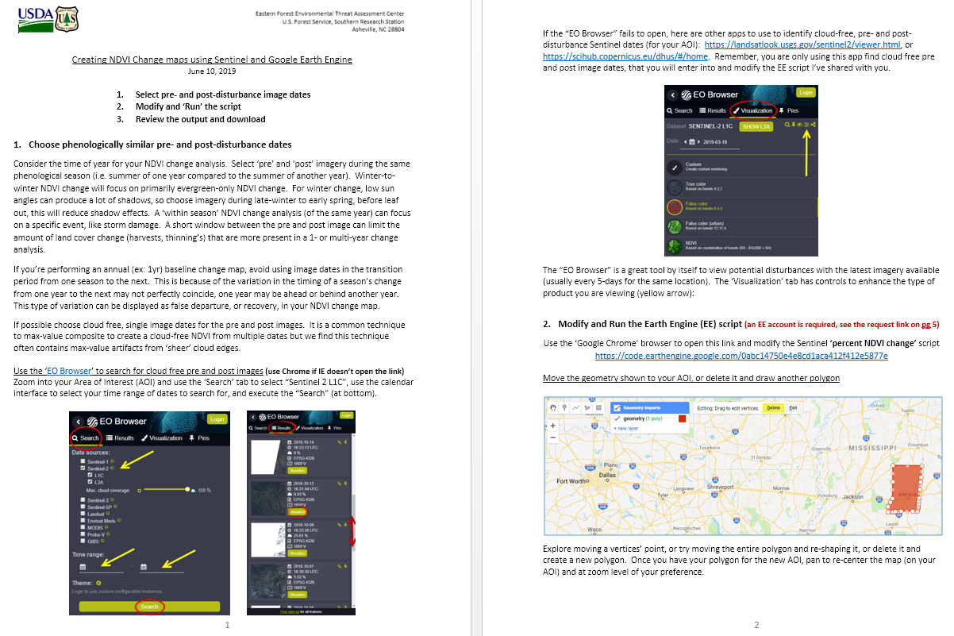

Slide 52
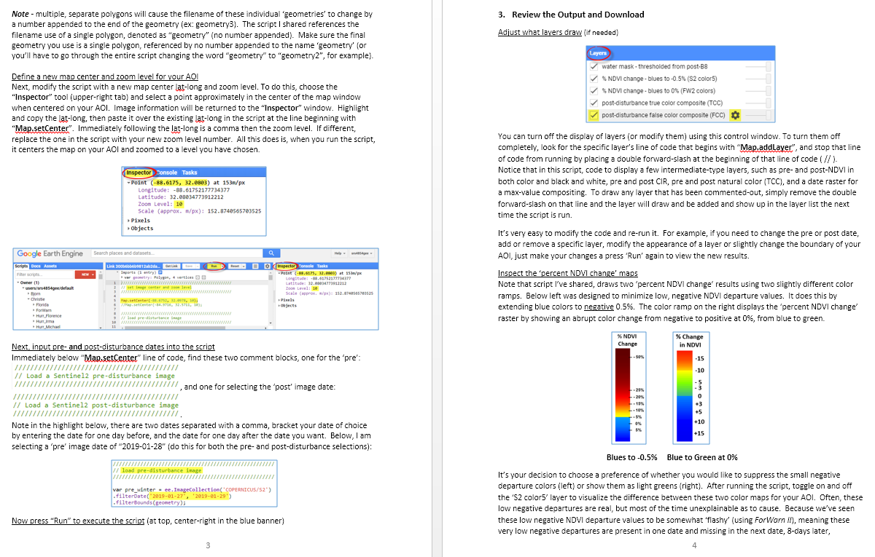

Slide 54
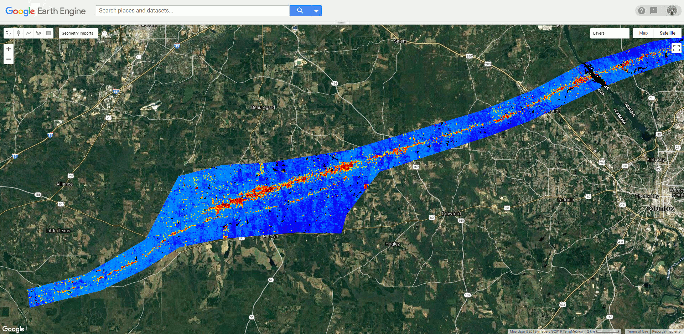

Slide 55
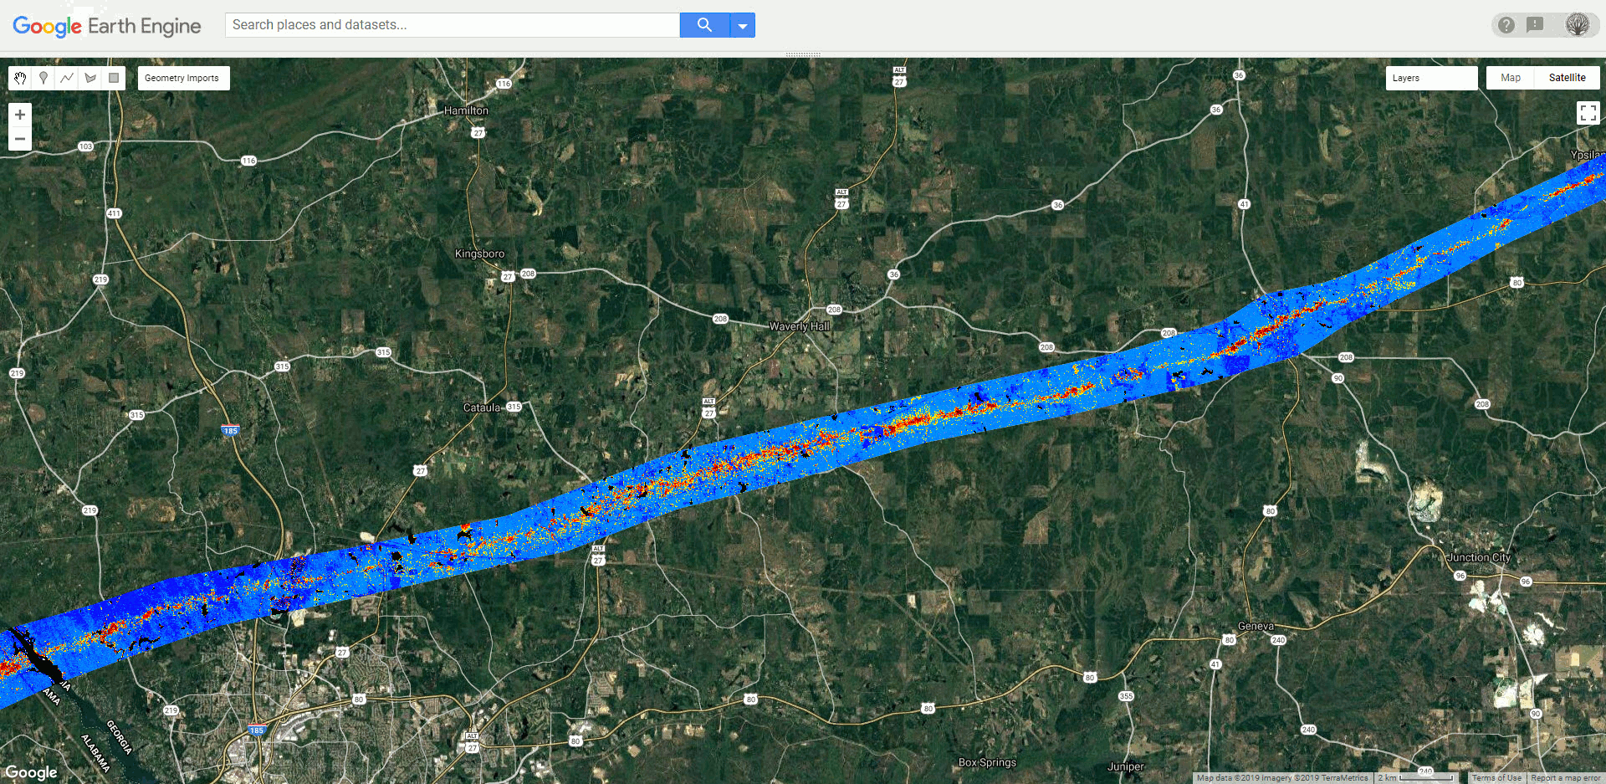

Slide 56
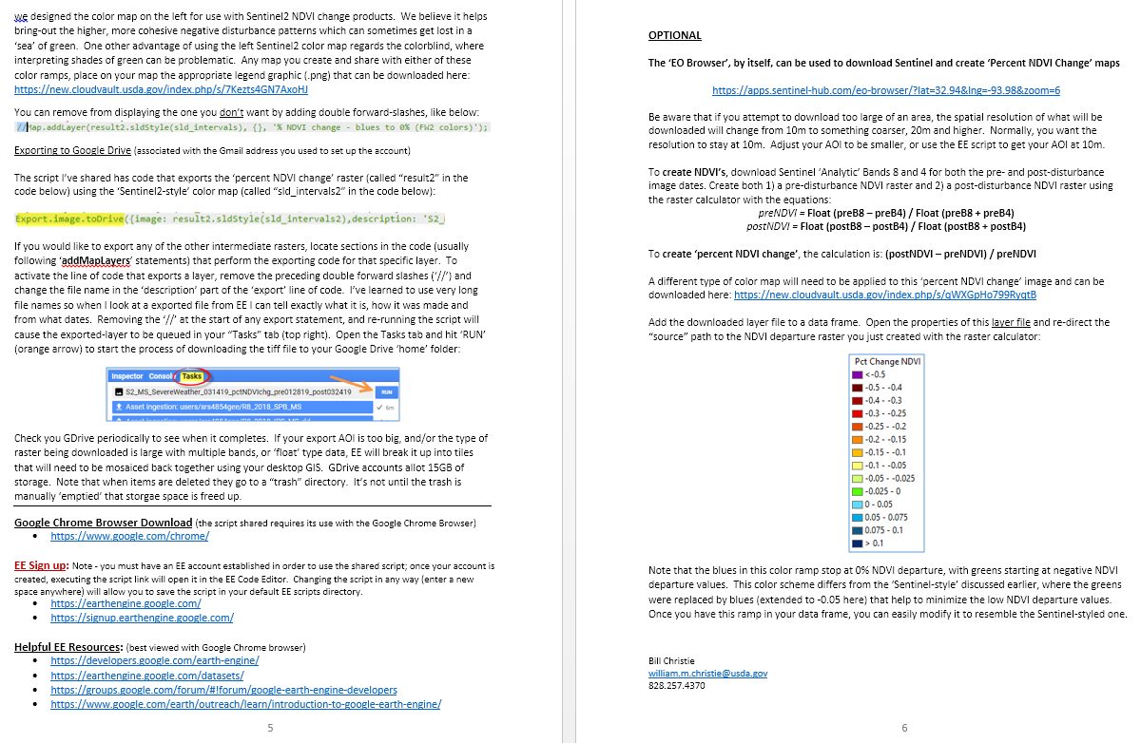

Slide 57
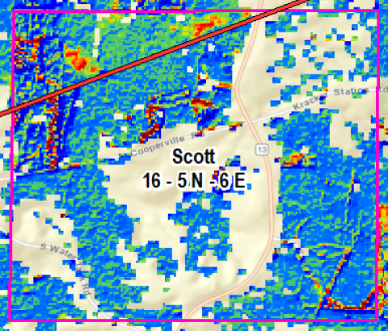
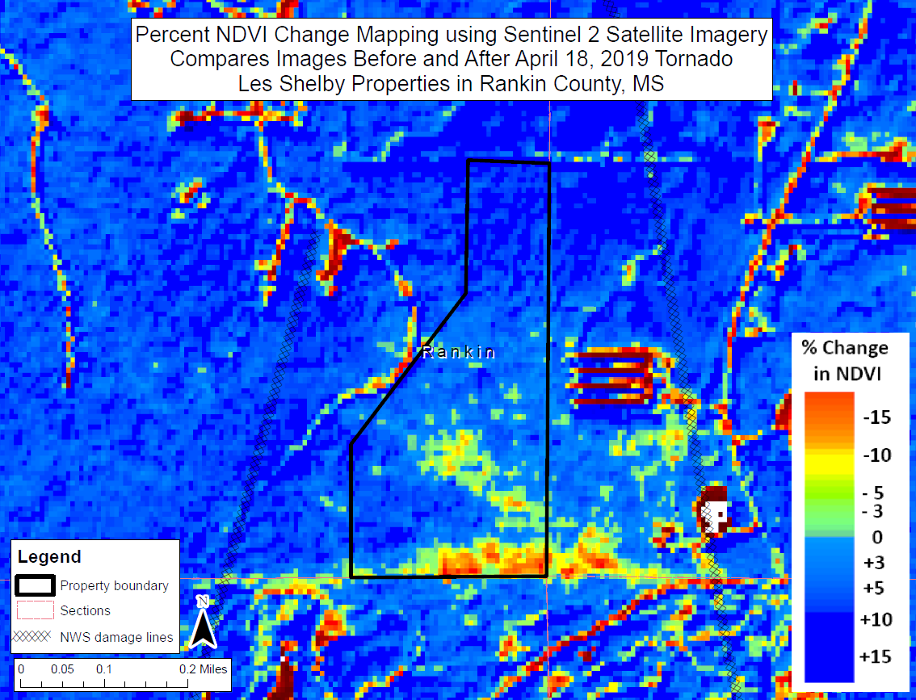
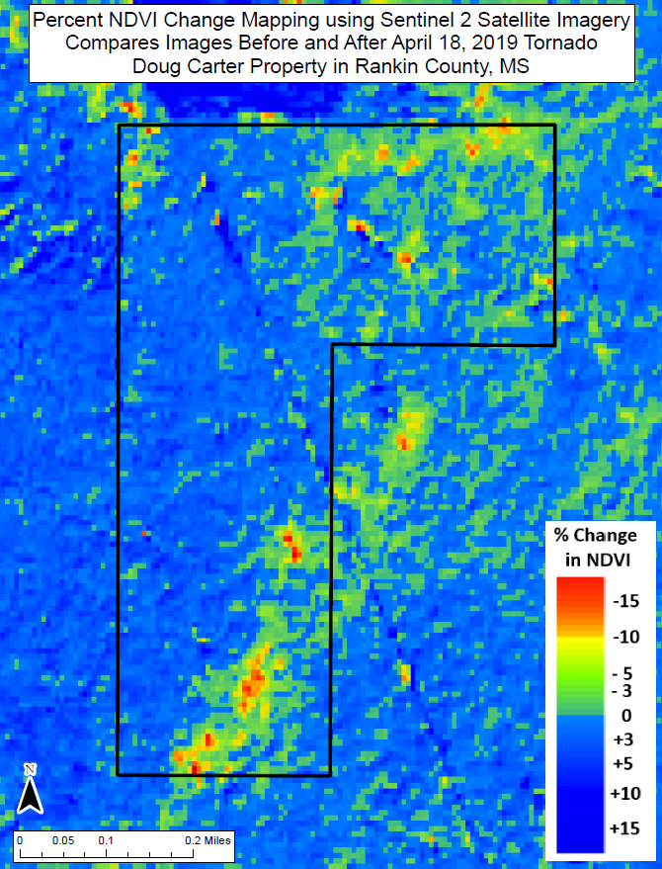
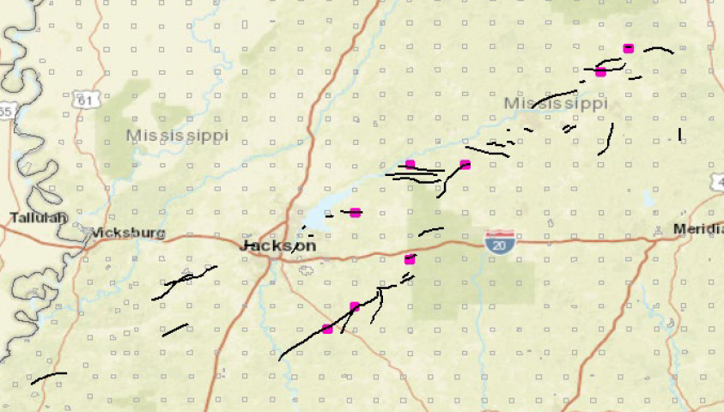
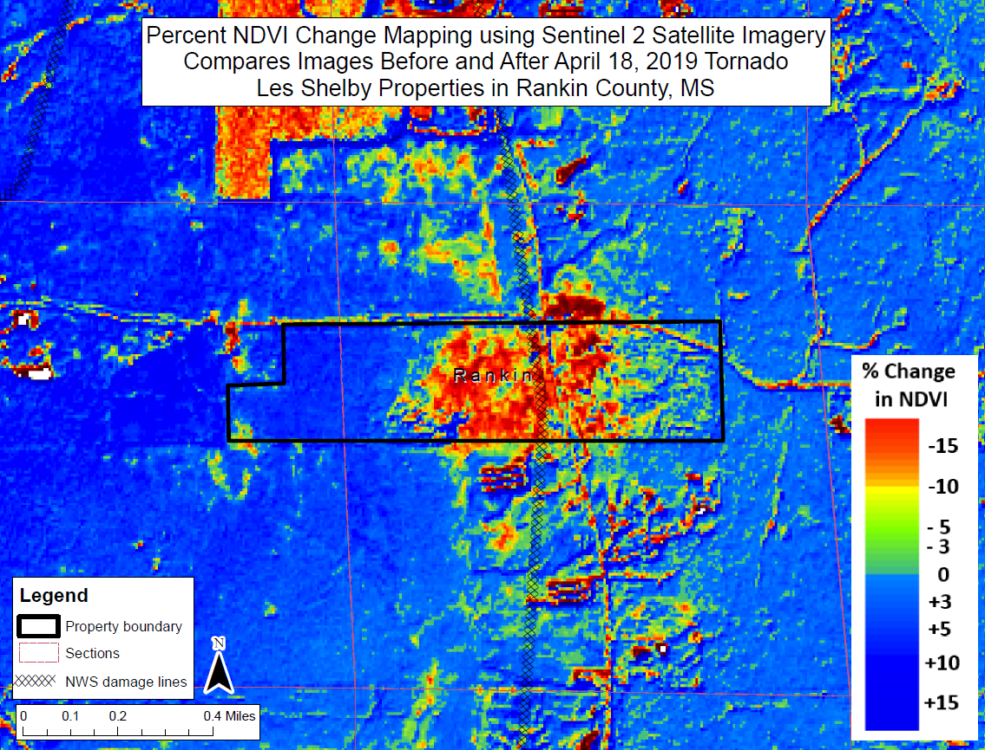
2019 Operational use by the MS Forestry Commission
Official Map Products
Severe Weather Event
April 18-19, 2019

Slide 58
High-Resolution Forest Disturbance Mapping
Bill Christie, Steve Norman and Bill Hargrove Eastern Forest Environmental Threat Assessment Center USDA Forest Service, Southern Research Station, Asheville, NC
ForWarn II adds Sentinel 10-meter ‘true-color’ to the Viewer
High-Resolution Disturbance Mapping Projects
From HiForM.org
Tornadoes - Beauregard-Smith Station, AL-GA
Hurricanes - Maria, Irma, Florence, Michael
Wildfire - s. Apps 2016, including the Gatlinburg fire
‘Cookbook’ PDF (a hi-res disturbance mapping workflow document)
Operational Use - Tornado forest disturbance mapping by the MFC
Questions
2019 SGSF GIS Committee Summer Meeting
June 17 – 20, 2019 Franklin, TN
Notes:
Here’s where we’ll talk about news and improvements to ForWarn II since our last meeting (specifics follow on the next slide).

Slide 59
High-Resolution Forest Disturbance Mapping
Bill Christie, Steve Norman and Bill Hargrove Eastern Forest Environmental Threat Assessment Center USDA Forest Service, Southern Research Station, Asheville, NC
Questions? (regarding the presentation, GEE, change analysis)
How can the Threat Center help you do your job?
View Sentinel 2 in the
Forest Change Assessment Viewer
https://forwarn.forestthreats.org/fcav2
Bill Christie
wchristie @ fs.fed.gov
william.m.christie @ usda.gov
office (828) 257- 4370
2019 SGSF GIS Committee Summer Meeting
June 17 – 20, 2019 Franklin, TN
Notes:
Here’s where we’ll talk about news and improvements to ForWarn II since our last meeting (specifics follow on the next slide).

