Slide 1
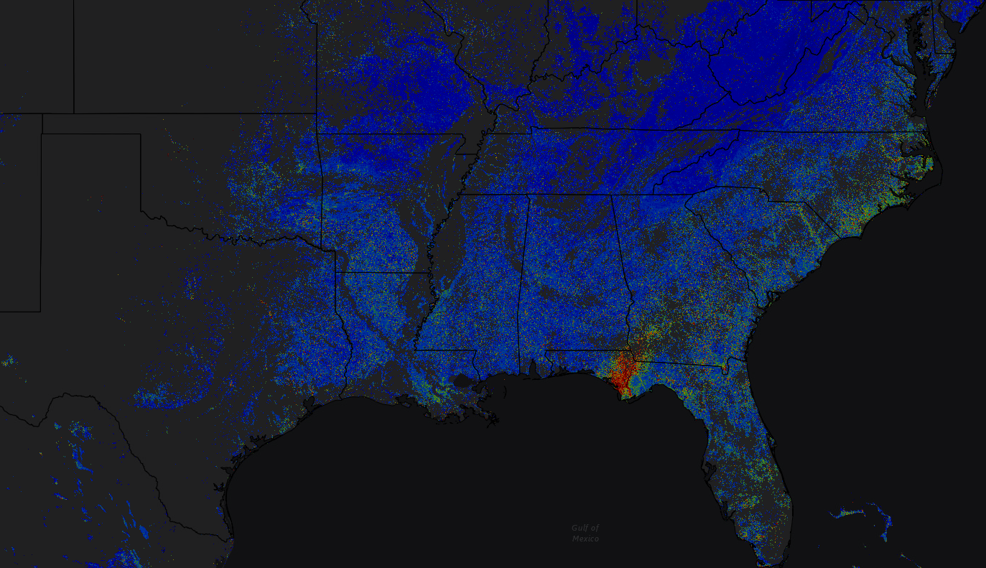
ForWarn II Update and Recent Disturbance Assessments
This PowerPoint file contains animations that require viewing in “Presentation” mode -
Watch the “Notes” section for notice of animated content
2019 SGSF GIS & Forest Health Committee Annual Meeting
January 7-11, 2019 Savannah, GA
Notes:
For those not previously aware, ForWarn II is a forest health web mapping application that utilizes MODIS satellite imagery to map the health and condition of forest, and all land-cover, every 8 days. Natural resource professionals can access the “Forest Change Assessment Viewer” web mapping application to view and monitor vegetation change (disturbance and recovery). Multiple ForWarn II products are produced every 8 days and provide meaningful insight as to potential forest disturbances due to severe weather, insects and disease, wildfire, silvicultural treatments, drought and other biotic and abiotic changes taking place on the landscape. The ‘Viewer’ contains a host of ancillary data layers that can be used to assist in vetting, or assigning cause, to potential forest disturbance presented in the forest change imagery.

Slide 2
ForWarn II Update and Recent Disturbance Assessments
Bill Christie, Steve Norman and Bill Hargrove Eastern Forest Environmental Threat Assessment Center USDA Forest Service, Southern Research Station, Asheville, NC
Introduction (for new folks only)
ForWarn II Update
Disturbance Assessments
Hurricane Florence, NC-SC
Hurricane Michael, FL-GA-AL
Questions?
2019 SGSF GIS & Forest Health Committee Annual Meeting
January 7-11, 2019 Savannah, GA
Notes:
For those not previously aware, ForWarn II is a forest health web mapping application that utilizes MODIS satellite imagery to map the health and condition of forest, and all land use and land-cover types, every 8 days. Natural resource professionals can access the “Forest Change Assessment Viewer” web mapping application to view and monitor vegetation change maps (disturbance and recovery). Multiple ForWarn II products are produced every 8 days and provide meaningful insight as to potential forest disturbances due to severe weather, insects and disease, wildfire, silvicultural treatments, drought and other biotic and abiotic changes taking place on the landscape. The ‘Viewer’ contains a host of ancillary data layers that can be used to assist in vetting, or assigning cause, to potential forest disturbance presented in the forest change imagery.

Slide 3
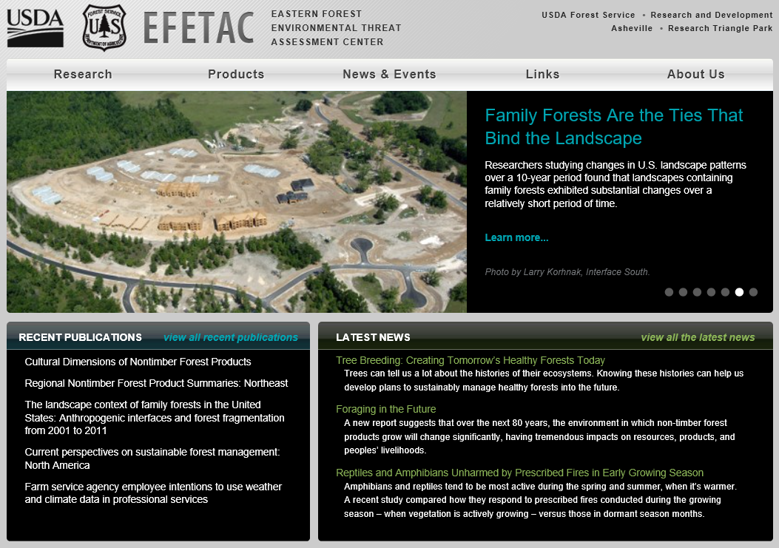
https://forestthreats.org
Notes:
For more information on this and other tools produced by our Forest Service Research Unit, visit https://forestthreats.org.

Slide 4
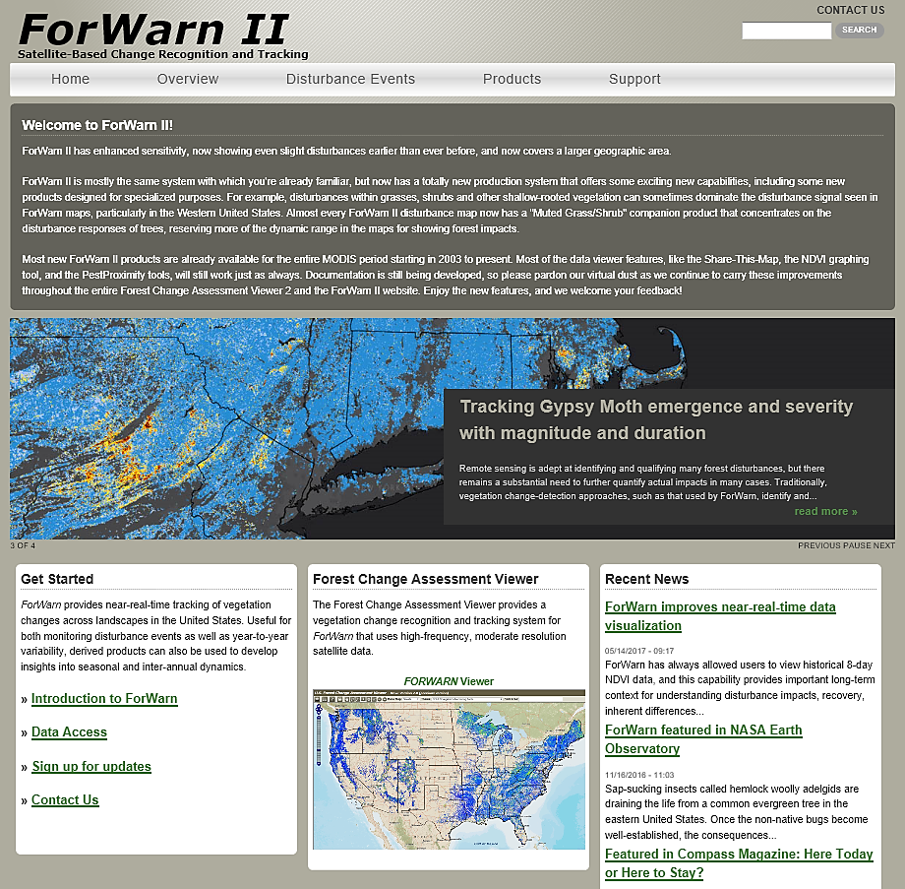
https://forwarn.forestthreats.org
Notes:
For more information on the ForWarn II forest health mapping application, visit https://forwarn.forestthreats.org.

Slide 5
ForWarn’s Context
Tier 1: Strategic – The ForWarn II system routinely monitors wide areas at coarse resolution, repeated frequently – it produces alerts or warnings that forest vegetation at particular locations may be affected by forest threats Tier 1 can be used to optimally direct the labor-intensive efforts of Tier 2, which are limited in coverage and frequency
Tier 2: Tactical – Airborne overflights and ground inspections of areas of potential interest are visited to determine if such warnings are confirmed and become alarms
The two tiers are complementary and support each other
ForWarn II
Insect and Disease Surveys
Notes:
ForWarn II is designed as a strategic tool used to view potential disturbance at landscape scale, and can be used to direct limited resources and attention to areas of concern. Once these areas have been identified, ForWarn II can compliment more tactical efforts from aerial detection surveys.

Slide 6
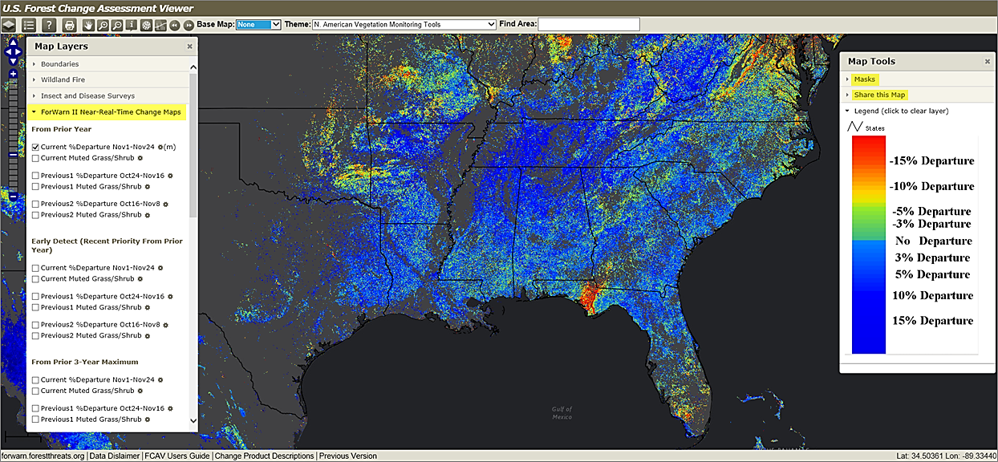
https://forwarn.forestthreats.org/fcav2
Notes:
The U.S. Forest Change Assessment Viewer is the delivery mechanism for ForWarn II’s forest change imagery. The application is open to all, no login or registration is required, and provides an intuitive interface with common mapping navigation icons and changeable base maps are located in the top banner. There exists a comprehensive “Map Layers” (table of contents) on the left and this is where ForWarn II’s forest change imagery, and other ancillary data layers, are located. On the right-side of the application window are “Map Tools” where one can apply NLCD-based masks to isolate and view vegetation-specific change information. Also available is a way to “Share this Map” with your colleagues to facilitate collaboration. Located in the bottom banner are links to a User’s Guide and a description of ForWarn II’s change products.

Slide 7
ForWarn II Update and Recent Disturbance Assessments
Bill Christie, Steve Norman and Bill Hargrove Eastern Forest Environmental Threat Assessment Center USDA Forest Service, Southern Research Station, Asheville, NC
Introduction (for new folks only)
ForWarn II Update
Disturbance Assessments
Hurricane Florence, NC-SC
Hurricane Michael, FL-GA-AL
Questions?
2019 SGSF GIS & Forest Health Committee Annual Meeting
January 7-11, 2019 Savannah, GA
Notes:
Here’s where we’ll talk about news and improvements to ForWarn II since our last meeting (specifics follow on the next slide).

Slide 8
ForWarn II Update
Relevant ForWarn II Improvements (reminder)
New ‘large’ extent
Legacy Products Retained
NEW PRODUCT – Square Root Product
New stuff in the Viewer (and AGOL)
Sentinel 2, 10m
NEW PRODUCT – Persistence, staged
NEW PRODUCT – Percent Seasonal Departure
NEW PRODUCT – Rank, Departure and Recovery, staged
ForWarn II products to ArcGIS Online
2019 SGSF GIS & Forest Health Committee Annual Meeting
January 7-11, 2019 Savannah, GA
Notes:
I’ll quickly revisit the most relevant changes regarding the name change to ForWarn II and talk about new content to the Forest Change Assessment Viewer since our last meeting.

Slide 9
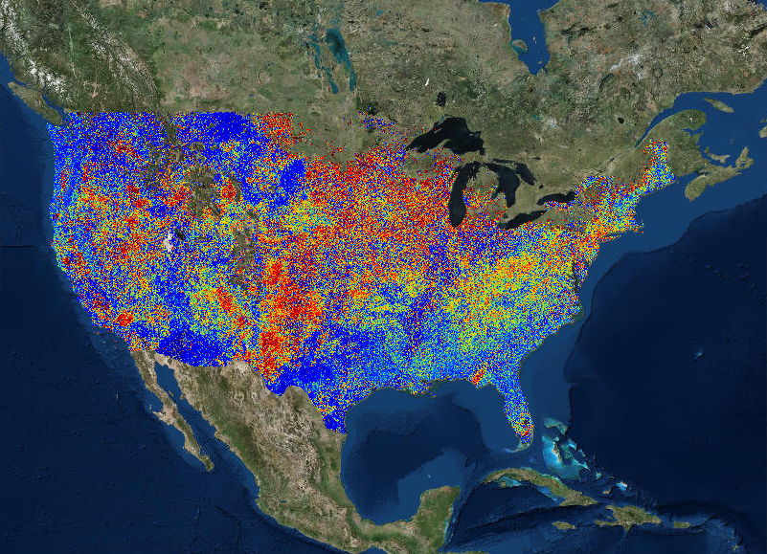
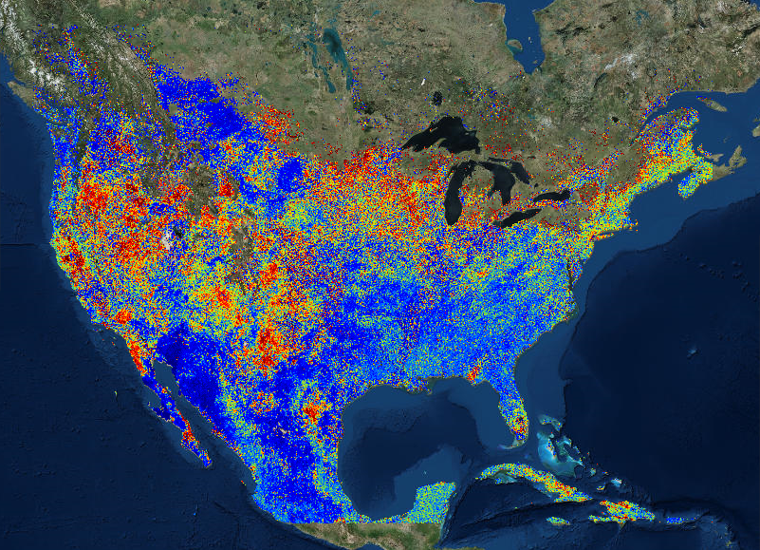
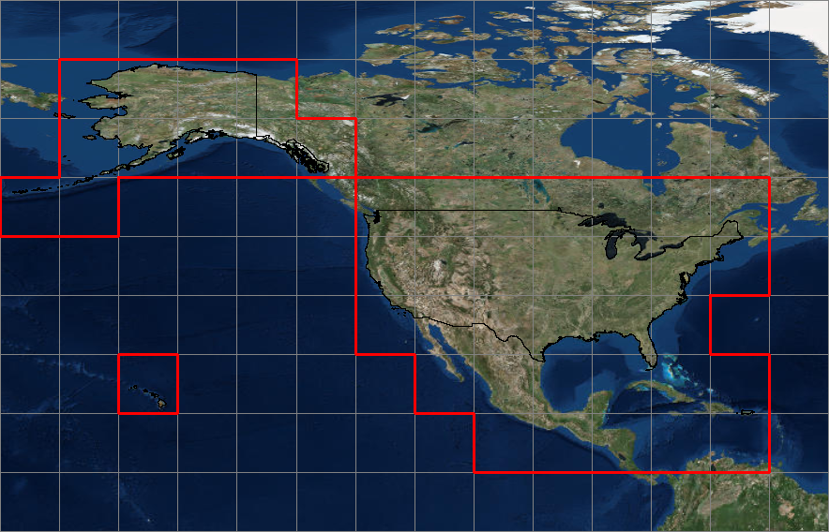
ForWarn II Update
Relevant ForWarn II Improvements
In-house production using a new data source with a larger extent
old extent, clipped to CONUS ( ForWarn I ) Leidos Legacy
existing, interim extent ( ForWarn II )
staged
Advantage – gain cross-boarder visibility for potential (insect and disease) disturbances
Notes:
What is different in “Forwarn II” - reminder 1 of 3: The most fundamental change from ForWarn to ForWarn II is that the Eastern Threat Center is now also producing forest change imagery, using a different data source than that our originating contracting partner Leidos, formally called NASA-Stennis. The graphic on the left shows the Leidos product clipped to CONUS extent which we’re now calling the ‘Legacy’ product. I’ll talk more later regarding the difference between Legacy ForWarn and the new ForWarn II products. The center graphic shows the current interim ForWarn II expanded CONUS extent, which extends beyond our borders. This extent allows us to view cross-border change information and observe encroaching forest disturbance. The graphic on the right shows a few select disturbance areas in 2018 (circled), and where we were given advanced warning as to real, encroaching forest disturbance. For example, an incoming Spruce Bud Worm insect disturbance to Maine from the maritime provinces of Canada and hurricane-related impacts in Puerto Rico and parts of Mexico to the south. This right-hand graphic also shows our end-game extent that will include more of boreal-Canada, including all of Alaska, Hawaii and Central America. The red outline depicts the tiles used in ForWarn II’s processing. Working with our partner at UNC-A’s NEMAC, we hope to have this new extent implemented sometime this year.

Slide 10
ForWarn II Update
Relevant ForWarn II Improvements
Legacy Products Retained
We’ve retained the original the ForWarn I version produced by our contractor Leidos, and calling it the “Legacy” product.
To compare the Legacy to the new ForWarn II, change the Theme to “ForWarn II Comparisons”
Notes:
What is different in “Forwarn II” - reminder 2 of 3: For the time being, we continue to produce and display the original Leidos ‘Legacy’ forest change products. To access and view the 8-day Legacy products, change the Theme drop-down to “ForWarn II Comparisons” and look at the appropriate file name in the appropriate tab of the Map Layers window.

Slide 11
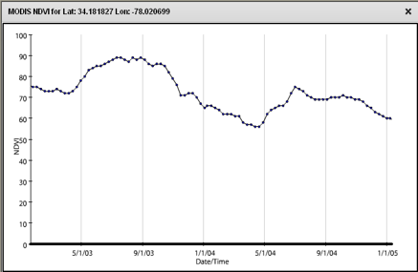
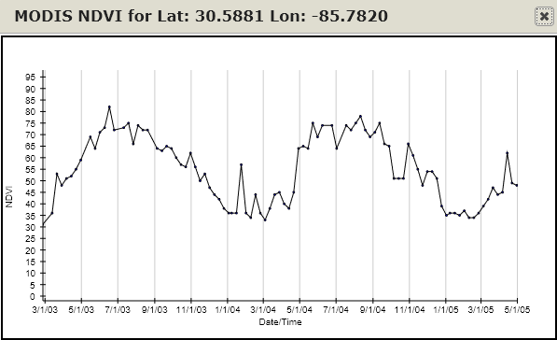
ForWarn II Update
Relevant ForWarn II Improvements
Legacy Products Retained
The difference between Legacy and ForWarn II is Legacy uses a smoothed, modeled baseline and ForWarn II does not
Use the ForWarn II products
Legacy
Smoothed via the “Savitzky–Golay” filter
ForWarn II
Notes:
The difference between ForWarn’s Legacy products and ForWarn II’s forest change imagery regards preprocessing. With Legacy, a smoothing algorithm is applied with creates a modeled trend line through the incoming data and that modeled data is used to create the NDVI change values. Conversely, there is no preprocessing, or modeling, of source data in ForWarn II. MODIS imagery is pulled from GIMMS/GLAM server as provided, and in an unadulterated form to calculate NDVI change that produces the forest change imagery. The following slide is an animation comparing the results from Legacy verses ForWarn II processing.

Slide 12
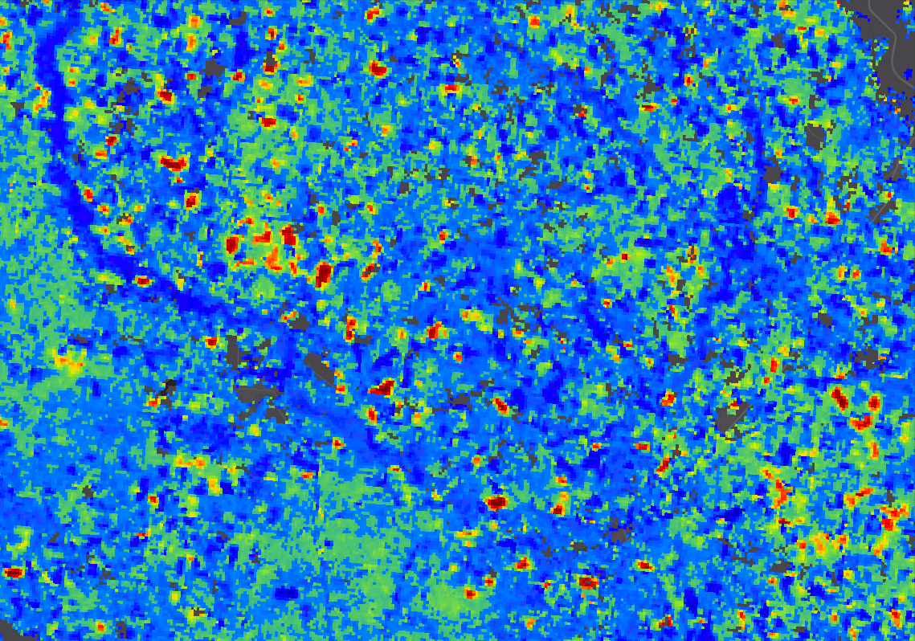
ForWarn II vs. ForWarn ‘Legacy’
Notes:
ANIMATED SLIDE, View in ‘Presentation’ Mode - The more smoothed appearing forest change image is from ForWarn II (where no preprocessing is applied). Notice how the ForWarn II change image is more coherent and has less ‘salt-and-pepper’ appearance than that of the Legacy change product. What is hard to explain is, why is it this way? One would expect smoothed (or modeled) data that is used for the baseline and smoothed (or modeled) data used for the current image would produce a more smoothed change image, when in fact, the opposite seems to be true.
Regarding the apparent spatial shift comparing Legacy to the ForWarn II product, we suspect that the shift is being introduced somewhere in the multiple software packages used by Leidos to process Legacy products. ForWarn II-derived forest change images are a result of using MODIS imagery in it’s source format, with no pre- or post-processing, both for baselines and current imagery used to calculate percent NDVI change. The methodology used to produce ForWarn II change imagery allows no opportunity for a spatial shift in x/y to be introduced.

Slide 13
ForWarn II Update
Relevant ForWarn II Improvements
Square Root Product (named “Muted Grass-Shrub” in the TOC)
Advantage (western-U.S. for grass and shrubland mix)
trees retain their relative sensitivity to even minor NDVI drops, while grasses, herbs and shrubs have more muted responses
Notes:
What is different in “Forwarn II” - reminder 3 of 3: We added another forest change product we called the ‘Square Root’ product. You will see this product labeled as “Muted Grass-Shrub” in the table of contents (in the default ‘Theme’). This product was created to reduce negative NDVI saturation in pixels with a large component of grass-shrub/brush land cover. Grasses and shrub/brush are relatively shallow-rooted and the first to show signs of high NDVI departure. Regarding the ForWarn II color table of ‘percent NDVI change’ and considering grass and shrub/brush land covers, when there is high negative departure, the ‘reds’ can quickly max-out and saturate in appearance in the forest change imagery. To mitigate this consequence, the square root product was created to adjust and compensate to lessen the high saturation of negative departure colors in these specific land cover types. This product is more useful in the central and western parts of the country where grass-shrub/brush cover types can dominate pixel composition resulting in high negative color saturation that can mask other disturbances in other land cover types.

Slide 14
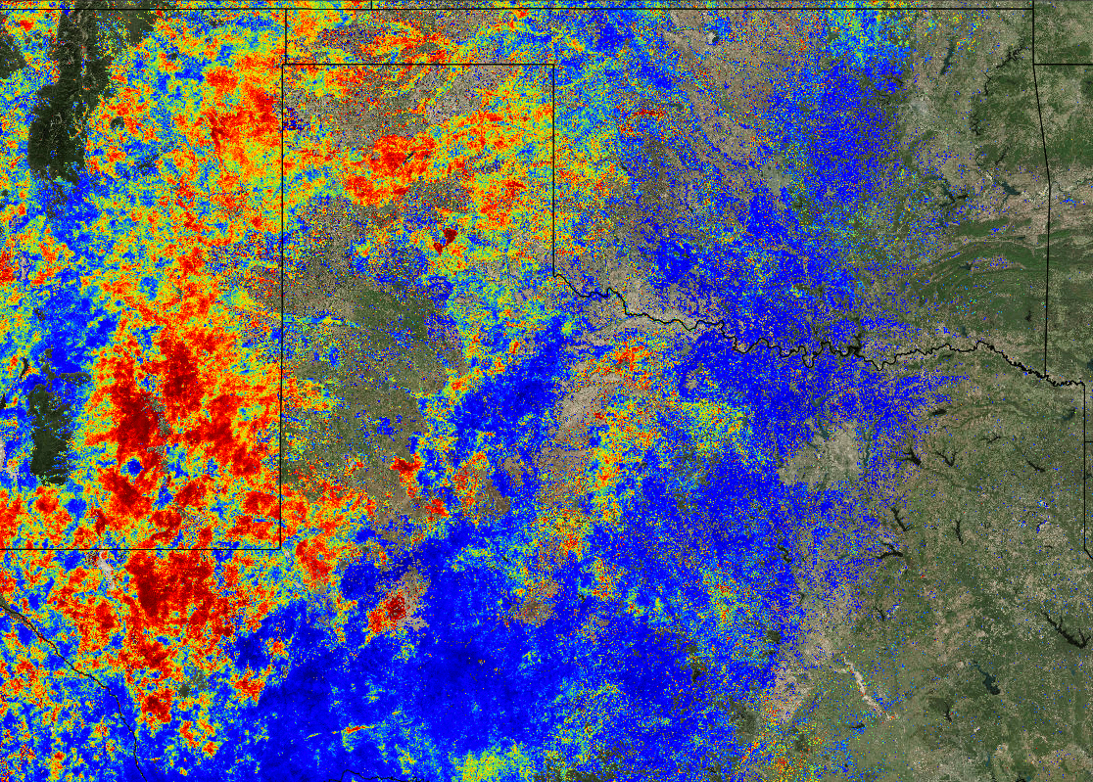
Comparison: 1yr-Max vs. 1yr-Max-SQRT (called “Muted Grass-Shrub” in the TOC)
Shrubland and Grass mask
Notes:
ANIMATED SLIDE, View in ‘Presentation’ Mode - Here’s an animated comparison of ForWarn II’s standard 1yr product verses the 1yr “Muted Shrub/Brush” product. Shown here is land covers masked to grass and shrub/brush classes only. Notice how the saturated red colors indicating high, negative ‘percent NDVI departure’ in the standard 1yr product are lessened with the square root product. In the eastern U.S., truly high NDVI departure in forest land cover types remain relatively unchanged when using the “Muted Grass-Shrub” to observe potential disturbances.

Slide 15
ForWarn II Update
Relevant ForWarn II Improvements
New ‘large’ extent
Legacy Products Retained
NEW PRODUCT – Square Root Product
New stuff in the Viewer (and AGOL)
Sentinel 2, 10m
NEW PRODUCT – Persistence, staged (Hargrove)
NEW PRODUCT – Percent Seasonal Departure
NEW PRODUCT – Rank, Departure and Recovery, staged
ForWarn II products to ArcGIS Online
2019 SGSF GIS & Forest Health Committee Annual Meeting
January 7-11, 2019 Savannah, GA
Notes:
I’ll talk about new content to the Forest Change Assessment Viewer since our last meeting, starting off with the biggest improvement – Sentinel 2 10m imagery has been added to the Viewer!.

Slide 16
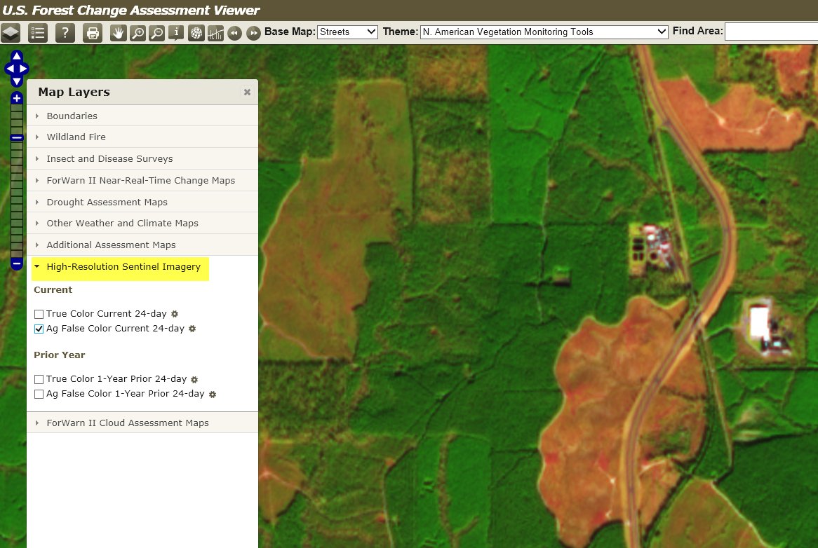
ForWarn II Update
New Stuff in the Viewer
Sentinel 2, 10m
Benefit
Quickly vet potential disturbances using 10m satellite imagery acquired from the same 24-day window as the ‘current’ forest change product.
A companion “Prior Year” image is also available for the same MODIS period a year back
(2) band combinations available – natural color and enhanced agriculture
Notes:
We’ve added the current periods (and previous years, same period) 10m Sentinel 2 imagery to the ‘Viewer’! Look in the Map Layers window for a tab named “High Resolution Sentinel Imagery”. The mosaic of the Sentinel imagery displayed is composed from the same dates of the current 24-day window of the current forest change product. When the next 8-day product is created, the dates of the Sentinel imagery sourced moves 8-days to match the new date range of the next 24-day window, it will always stay current with respect the current 24-day compositing window. There is also a companion Sentinel 2 composite for the matching ‘”Prior Year”. There are two flavors of band combinations: (1) Agricultural enhancement (Ag False Color), and (2) a “True Color”, I find the ag-enhanced version most helpful for forestry-related disturbance interpretations.

Slide 17
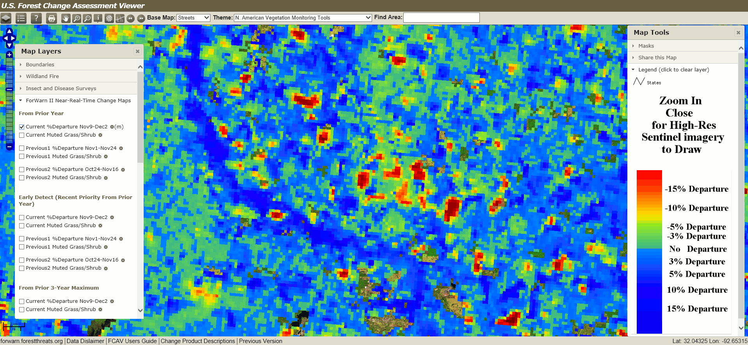
ForWarn II Update
New Stuff in the Viewer
Sentinel 2, 10m
LINK TO VIEWER
Notes:
ANIMATED SLIDE, View in ‘Presentation’ Mode - Here’s an animated blink-map showing a ForWarn II 1yr forest change image (in s. MS) and the corresponding 10m Sentinel 2 ag-enhanced satellite image. Notice how high departures areas present in the forest change image corresponds nicely to silvo-treatments in the Sentinel 2 imagery. This is an awesome way to vet potential disturbances presented in the ForWarn II’s ‘percent NDVI change’ imagery.
Notice the yellow arrow above on the left side of the slide. It is pointing to the mid-point of the zoom scale. In order for the Sentinel 2 imagery to display in the ‘Viewer’, one must be zoomed-in anywhere past the mid-point in the zoom-scale. This scale-dependency is imposed to keep from using bandwidth when trying to display Sentinel 2 imagery at continental, or world-wide extent(s).
The “LINK TO VIEWER” text (upper-right) is a hyperlink that will open the ‘Forest Change Assessment Viewer’ centered on the southeast, with the current periods Sentinel 2 ‘ag-enhanced’ satellite imagery already turned on, just zoom in past half-way (on the zoom scale on the left) to get the current ForWarn II periods’ 10m satellite imagery to appear for your area of interest). You must be in ‘Presentation’ mode for the hyperlink to be enabled.

Slide 18
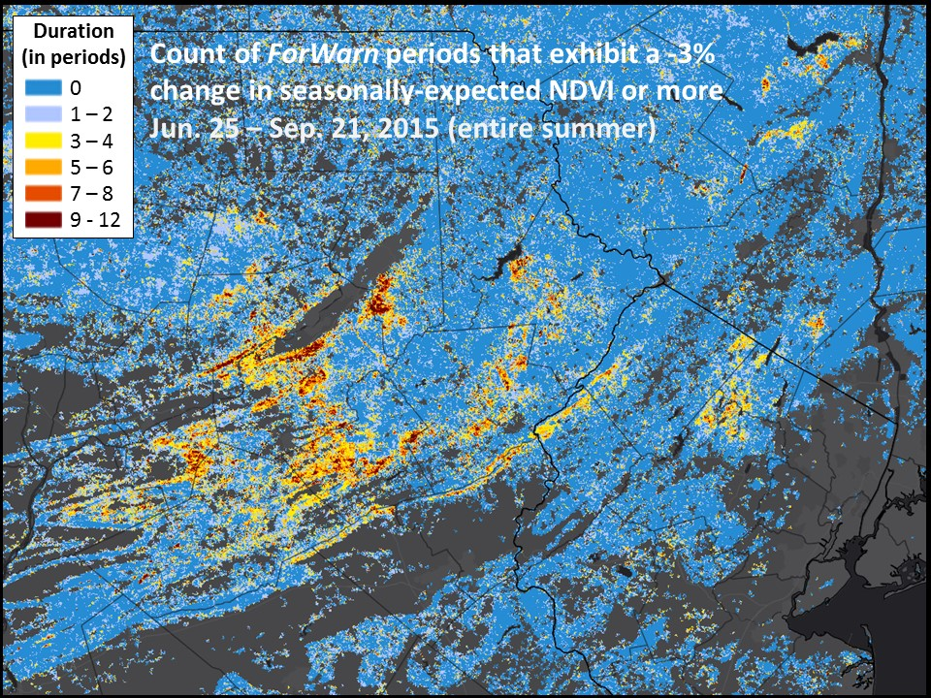
ForWarn II Update
New Stuff in the Viewer
An additional Duration-related product called ‘Persistence’
Similar to the 2016 “Duration” Product
Created for (4) different timeframes during the growing season (gs):
June 24 – Sep 21 (gs 12p)
May 8 – Jun 17 (western 6p)
Jun 24 Aug 4 (6p)
Aug 12 - Sep 21 (6p)
Benefit
Reduce disturbance complexity in the annual products and summarize persistent forest disturbance over a short period of time within the current year’s growing season
Notes:
We’ve added a new “Duration” product to the Viewer. The version we created back in 2016 were focused on looking at a few specific time frames throughout the growing season, and simply summed the number of times a pixel exceeded a threshold of -3% percent NDVI change. They did very well in capturing insect-related forest disturbances and helped summarize and separate ephemeral from longer-term disturbance events. What they did not do was continue to be produced at other times of the year.

Slide 19
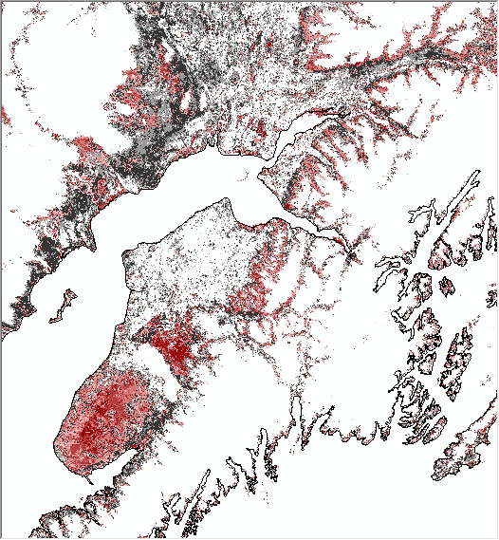
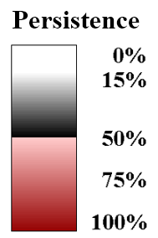
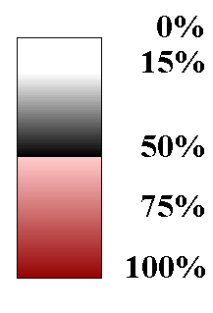
ForWarn II Update
New Stuff in the Viewer
NEW PRODUCT - ‘Persistence’
Created every 8-days looking back at the previous (7) MODIS periods
Benefit
Reduce disturbance complexity in the annual products and summarize persistent forest disturbance GTE -8.5% over the previous 7 periods
There will be a 1-, 3- and 5-year ‘Persistence’ product
Notes:
To distinguish the 2016 “Duration” products from this newly created one, we’re calling this 2018 product, “Persistence”. These new Persistence products are similar to 2016 version by the way of using a ‘percent NDVI change’ threshold and looking back over a specific time period. They differ by (1) using a higher percent NDVI departure threshold, (2) are created every 8 days, and (3) look back over the previous 7 ForWarn II product dates.

Slide 20
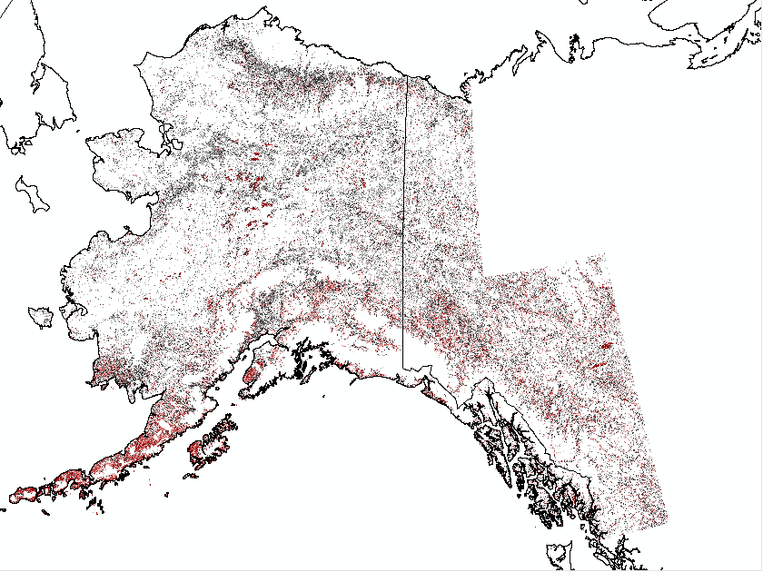
‘Persistence’ (Hargrove, 2018)
Persistence pertains to the prior 7 interval periods. There is a current year product, a 3 year product and a 5 year product. Duration counts the number of periods that each cell is above a particular damage threshold. For the current product, counts are 0 thru 7, but, for the 3 year product, counts could be 0 thru 21 (7 periods x 3 years) and for the 5 year product, counts could be 0 thru 35 (7 periods x 5 years). It would be confusing to have three different legends for the three duration maps, so we convert all maps to the “percent” of time periods that this cell location exceeded the damage threshold, so all three maps have exactly the same legend and color table appearance. There are two major color break gradients in the color table because we are interested in two kinds of places: 1) locations that are so disturbed for so long that they totally peg all durations, and 2) locations that are newly persistent, and are coming on fast in duration. OLD are red, NEW are black, the darker gradients in each is longer and on the 3- and 5-year products, it is the same 7 prior intervals in each of the earlier years, like everything else in ForWarn II.
1yr baseline, 07/04/2017
Notes:
These ‘Persistence’ maps are created using the 3yr and 5yr percent NDVI change products and use a value based on percentage of the 7-period timeframe departed over a -8.5% NDVI threshold. The two color breaks are a way to split the persistent departure information into two general categories depicting older verses newer departure values.

Slide 21
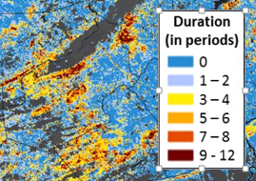
Duration(2016)
Persistence (2018)
(4) period counts during the growing season (gs)
-3% departure threshold
(3) 6-period counts during the gs
(1) 12-period counts during the entire gs
Must wait for period end to view
Every 8-days, all year long
-8.5% departure threshold
7-period count every 8-days, all year long
Data bins for ‘old’ verses ‘new’ disturbances
Available every 8-days
Notes:
Here’s a summary of the key differences between the 2016 Duration product and the newer, 2018 Persistence products soon to be added to the Forest Change Assessment Viewer.

Slide 22
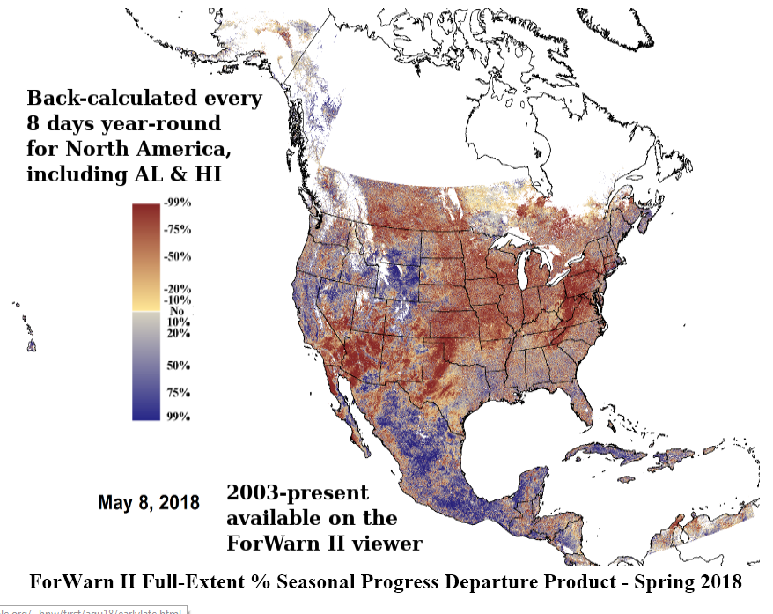
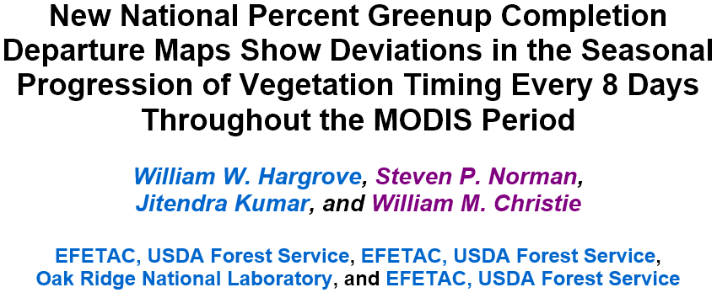
ForWarn II Updates
New Stuff in the Viewer
NEW PRODUCT - ‘Seasonal Progression Departure’
May be useful for correcting or adjusting the magnitude of detected disturbance damage from inter-annual phenological shifts in seasonal timing
Notes:
This new product, “Seasonal Progression Departure’, was recently presented to the 201 Fall American Geophysical Union (AGU) Meeting last December. Remember me talking about an early spring or late fall gets expressed, or shows up, in our forest change imagery? This product was created to help quantify the relative ‘earliness’ or ‘lateness’ in the phenological timing of seasons comparing the current to the previous year. Additionally, this product may be useful for correcting or adjusting the magnitude of detected disturbance damage from inter-annual phenological shifts in seasonal timing.

Slide 23
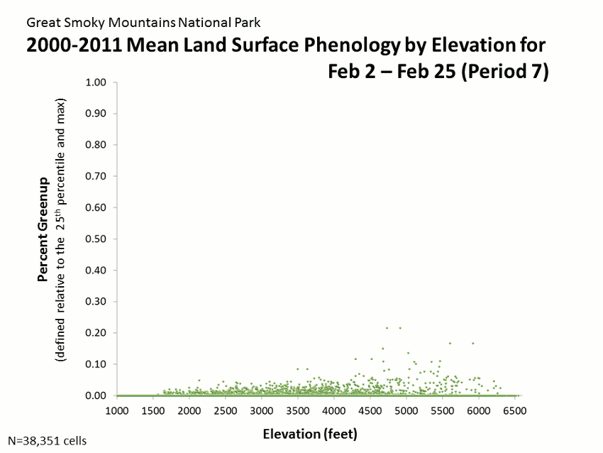
Notes:
ANIMATED SLIDE, View in ‘Presentation’ Mode - I put this into the presentation for two reasons: (1) because it’s a very cool animated graph by our colleague Dr. Steve Norman, and (2) because this clearly shows shifts in phenological timing (percent NDVI completion response) based on elevation. This is looking at all the MODIS pixels that comprise the GSMNP, over 38,000 pixels, for a 12-year period, in ForWarn II MODIS time steps (46 8-day periods/yr). Steve used the y-axis to map the mean NDVI completion percentage based on 2000-2011, and on the x-axis, he mapped the corresponding elevation value for those MODIS pixels occurring in the Park.
Just a few observations:
Notice the lag, or delay of green-up based on elevation, the high the elevation, the longer in the season it takes to complete
Notice the ‘stragglers’, these pixels are characterized by the evergreen component on north aspects at higher elevations
Observe the difference in the green-up verses brown-down pattern taking the mass of points as a whole (delayed green-up based on elevation, though in the fall, all fall down together
The vertical line at ~1500 – 1600’ is artifact from Fontana Lake
I show this just to state the obvious, that across the landscape there are differences in the timing of phenology based on many factors, and understanding the controlling factors helps one discern those dynamics when comparing one year to another.

Slide 24
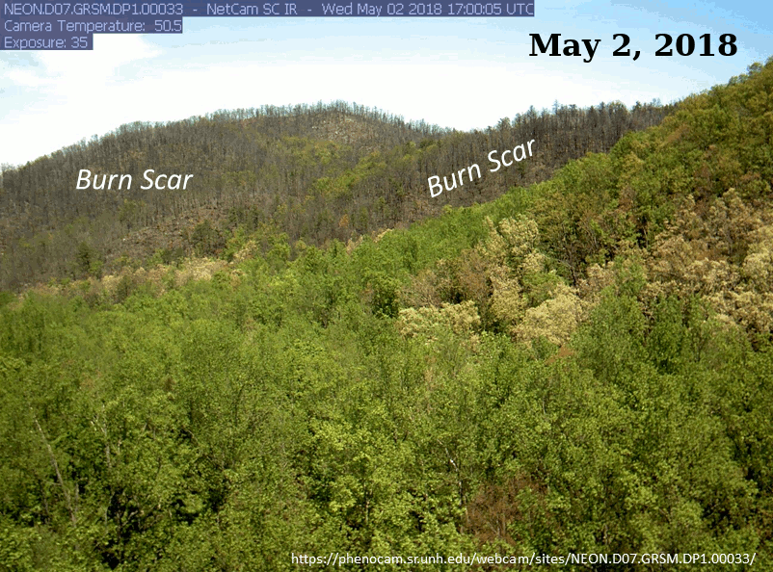
Notes:
ANIMATED SLIDE, View in ‘Presentation’ Mode - Here’s another look at the shifts in the timing of seasons from one year to the next, using ‘pheno-cams’ from inside the GSMNP.

Slide 25
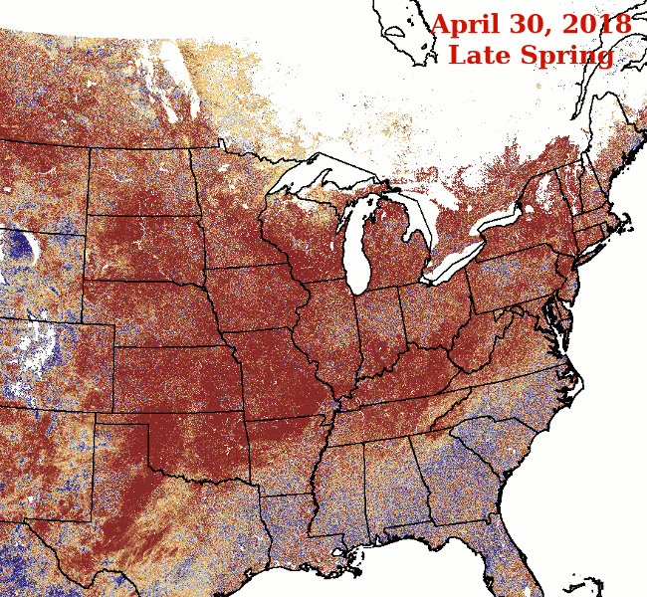
2012 vs. 2018
Spring was earlier than normal (blue) in 2012
Spring was later than normal (red) in 2018
% Seasonal Progression Departure clearly shows expected Seasonal Departures in each of these years
FORMULA
(median value this date all yrs - 10th percentile all yrs)
----------------------------------------------------------------------
(90th percentile all years - 10th percentile all years)
Notes:
ANIMATED SLIDE, View in ‘Presentation’ Mode - Here’s a look comparing the spring of last year to the same season multiple years ago using the new “Seasonal Progression Departure”.

Slide 26
Seasonal Progression Departure
for Oct 23, 2018
Late Fall in the
Mountains
Early Fall due to
Hurricane Florence
Win. Spr. Sum. Fall Win.
Late Fall in
fire areas
Colors in % Seasonal Progress Map "Flip" their meaning after Peak - Red is Late Spring, but Red is also Early Fall
Departure
Mixed status in
the Piedmont and
Coastal Plain
Early Fall due to
Hurricane Michael
October 2018 - Effect of Disturbances on % Seasonal Progression Departure - Hurricanes Florence and Michael, and Smoky Mountains Wildfires caused an Early Fall (red), even while Fall was generally Late (blue) in the surrounding Mountains and Piedmont - Disturbances cause Predictable Changes in % Seasonal Progression Departure
Notes:
Here’s a look at how disturbance manifest themselves in the “Seasonal Progression Departure” product, a perceived change in the timing of seasonal progression. Notice how the color map for seasonal progression flips between spring and fall.

Slide 27
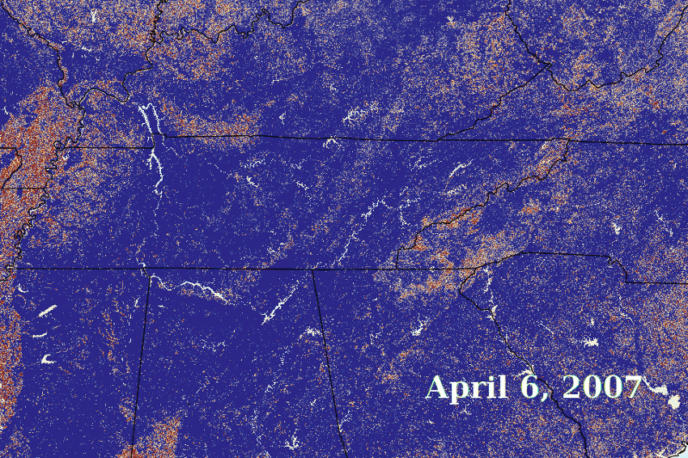
2007 Spring Late Hard Freeze in Mid-April - % Seasonal Progression Map Changes from Early (Blue), to Late (Red) Following this Hard Freeze - Clearly Shows the Extent of the Freeze-Affected Areas
Notes:
ANIMATED SLIDE, View in ‘Presentation’ Mode - Here’s a view of a 2007 late-spring hard-freeze using the new “Seasonal Progression Departure” product. This product clearly shows the extent of this frost/freeze event by mapping the departure of seasonal progression compared to the all-year baseline component in the .

Slide 28
ForWarn II Update
New Stuff in the Viewer
NEW PRODUCT - ‘Rank, Departure and Recovery’ (every 8-days)
Attempts to address ‘Questions of Management Concern’, such as…
“I’ve never seen it this bad before!”
“This is the worst it has ever been!”
“How many years has this damage, or recovery, been greater?”
Benefit
Instead of presenting the ‘magnitude’ of a disturbance (like the other ForWarn II products), this product looks at the entire MODIS time stack and measures time, how many years has it been worse or better, these are maps of ‘unusual-ness’
Notes:
This product attempts to address from what you’d expect to hear from forestry and land use managers.

Slide 29
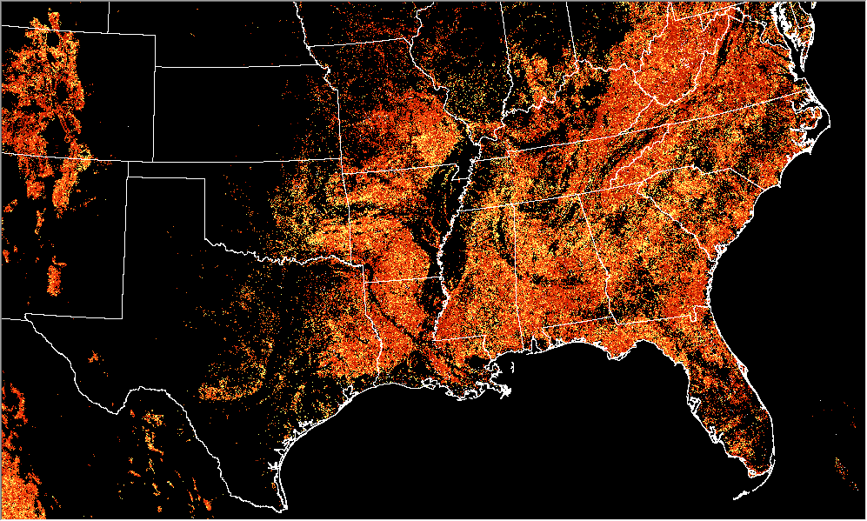
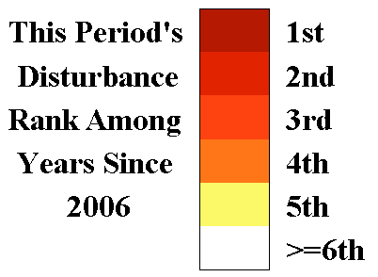
ForWarn II Update
New Stuff in the Viewer
NEW PRODUCT - ‘Rank, Departure’
DRAFT GRAPHIC
Notes:
While the Legend is correct, I need to confer further with Bill Hargrove, the creator of these (2) ‘Rank’ products that are staged to be placed in the Viewer.

Slide 30
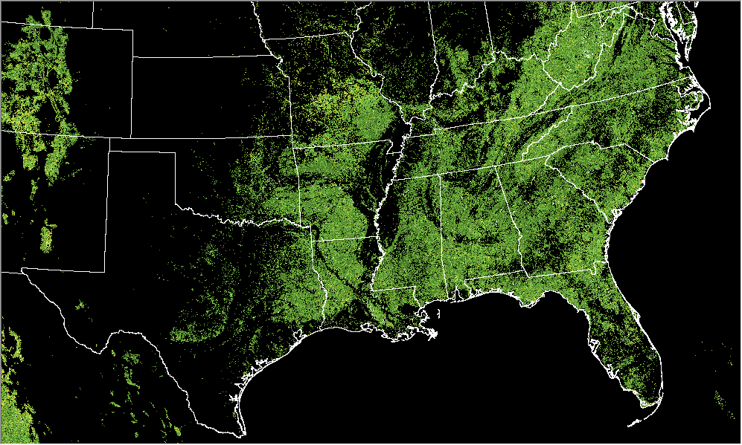
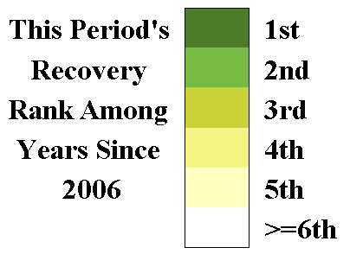
ForWarn II Update
New Stuff in the Viewer
NEW PRODUCT - ‘Rank, Recovery’
DRAFT GRAPHIC
Notes:
While the Legend is correct, I need to confer further with Bill Hargrove, the creator of these (2) ‘Rank’ products that are staged to be placed in the Viewer.

Slide 31
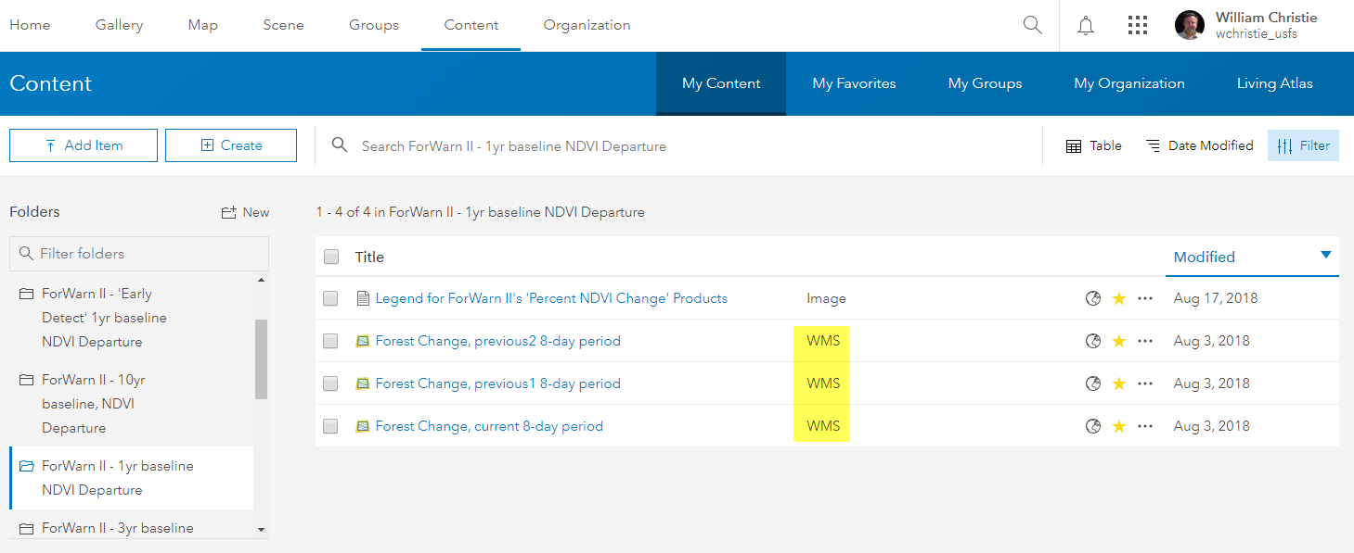
ForWarn II Update
New stuff (in AGOL)
ForWarn II Products to ArcGIS Online
Advantage – mash-up your own data with AGOL and ForWarn II layers
Notes:
You already know we have Web Map Services (WMS) for many of the ForWarn II forest change products that allows for their display on a desktop GIS, now, a set of our primary standard products are available in ArcGIS Online (AGOL). To locate and use them in AGOL, just search on “forwarn” and add your preference to your AGOL web map or AGOL map application. Make contact with me if you have any questions or would like to see other ForWarn II layers made available.

Slide 32
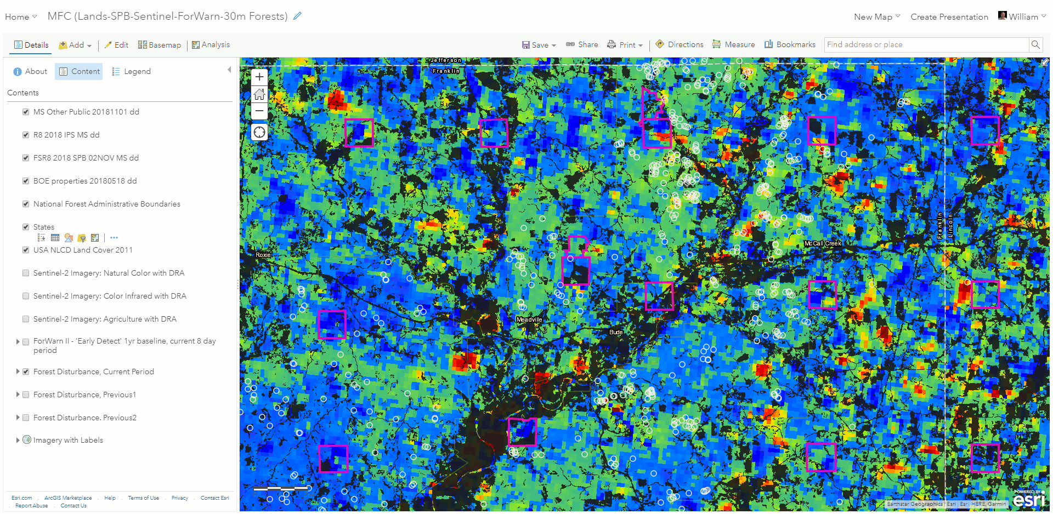
ForWarn II Update
New stuff (in AGOL)
ForWarn II Products to ArcGIS Online
Notes:
ANIMATED SLIDE, View in ‘Presentation’ Mode - Here’s an example of using AGOL and ForWarn II’s 1yr-baseline forest change product for the Mississippi Forestry Commission (MFC). Brian had asked me about the availability of the most up-to-date SPB and Ips points from the U.S. Forest Service. In an effort to get this information to Brian and his staff, I created and shared this AGOL Web Map with MFC so he could visualize the this information relation to their State lands for which they are responsible. Also in the mash-up are “dynamic” ForWarn II forest change products that update automatically every 8-day, along with current Sentinel 2 10m satellite imagery that can be used to vet known and potentially new insect outbreaks captured by ForWarn II’s forest change imagery masked using to the latest 30m NLCD-based forest classes (and not the 231m MODIS-based forest masks).

Slide 33
ForWarn II Update and Recent Disturbance Assessments
Bill Christie, Steve Norman and Bill Hargrove Eastern Forest Environmental Threat Assessment Center USDA Forest Service, Southern Research Station, Asheville, NC
Introduction (for new folks only)
ForWarn II Updates
Disturbance Assessments
Hurricane Florence, NC-SC
Hurricane Michael, FL-GA-AL
Questions?
2019 SGSF GIS & Forest Health Committee Annual Meeting
January 7-11, 2019 Savannah, GA

Slide 34
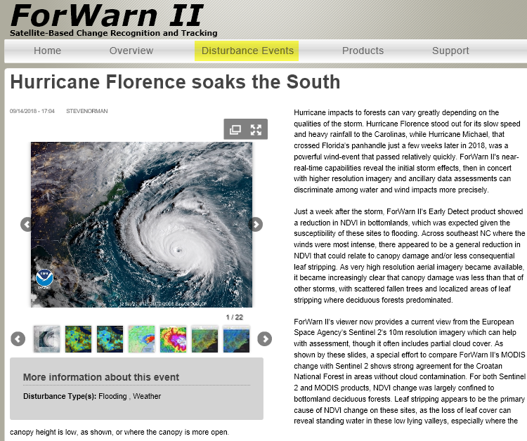
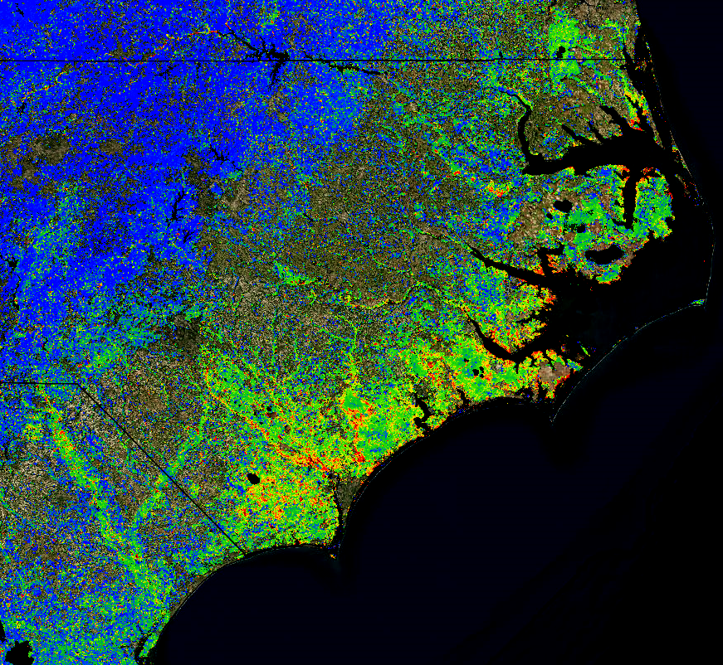
forwarn.forestthreats.org
10/31/2018, 1yr max
Notes:
First to look at is Hurricane Florence which came ashore in the Carolina in September, 2018. The right graphic is a small-scale screenshot of how the ForWarn II’s 1yr-baseline mapped NDVI departure after the event. What shows through in this change image are forest-only classes. What is obvious is the reduction in NDVI from this event compared to the previous years’ NDVI values proximal to the coast. It’s kind of hard to see at this scale but there are high NDVI departures in the bottomland hardwood forests (BLH) mainly due to flooded vegetation and or deciduous forest leaf stripping.

Slide 35
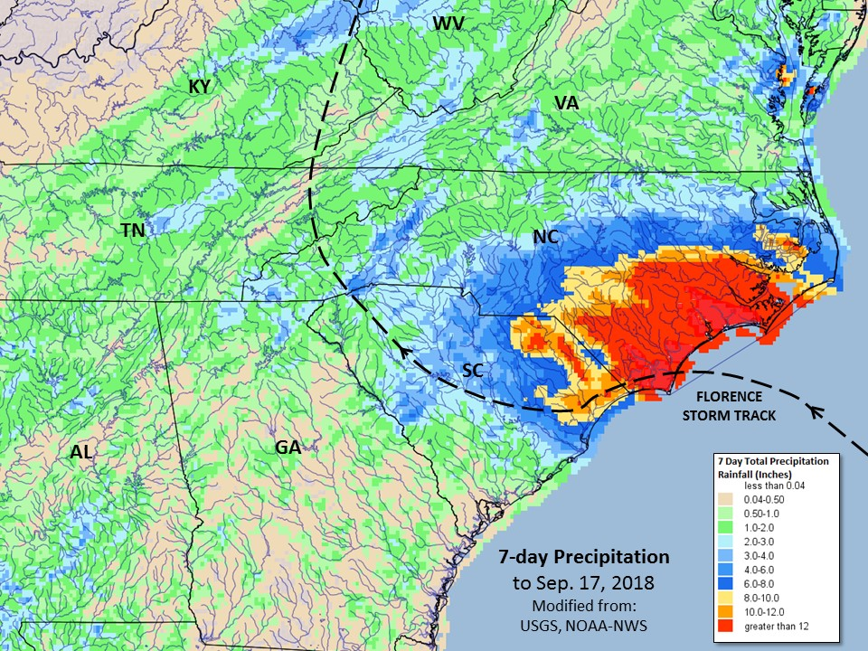
Notes:
What characterizes this hurricane from others is this one was primarily a flood event, much of the damage was caused by the high rainfall amount over the area for multiple consecutive days before it left the area. Wind speeds maxed-out ~85-90mph at landfall.

Slide 36
Notes:
Let’s look in more detail at how localized NDVI departure is presented in the ForWarn II change images and with Sentinel 2 10m imagery for the Croatan National Forest, in the general area circled in yellow.

Slide 37
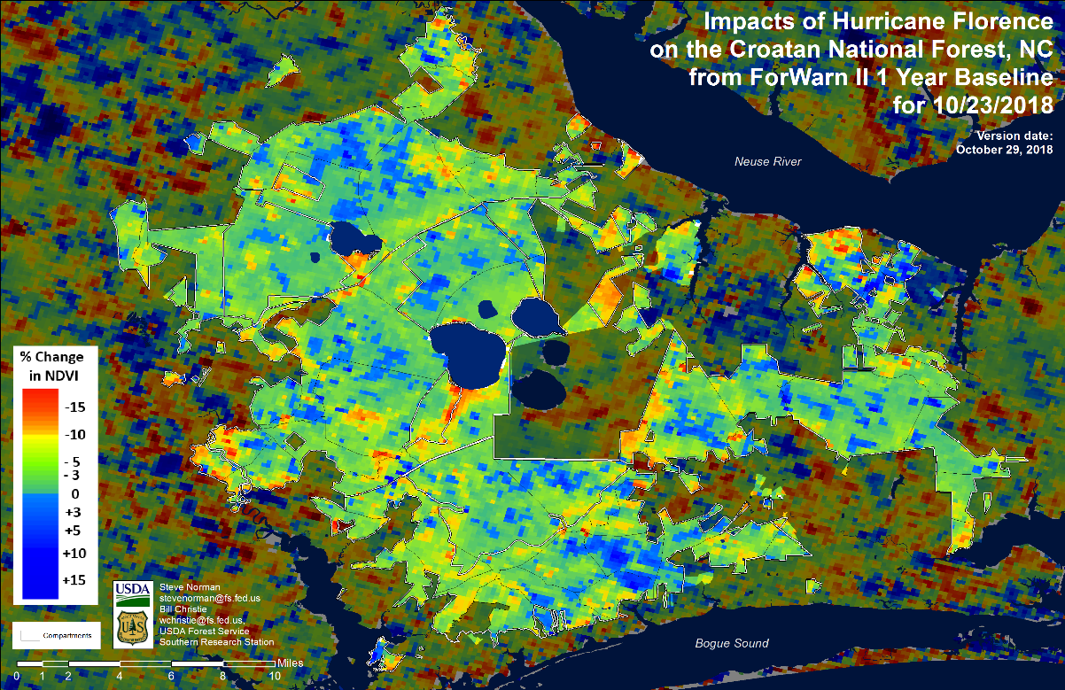
Notes:
Here’s the 231m spatial resolution ForWarn II 1yr-baseline percent NDVI change image for the Croatan National Forest. This image is approximately a month after the event and what is immediately obvious is the higher NDVI departure in the BLH forests occupying the lower riparian areas. We’ve learned this was more of a flood and lower-wind-speed event than what one would expect. Although there was tree breakage and blow-downs, we find those location to be on the forest edge and less so on interior forests. What we did learn is much of the departure evident in the forest change images came from deciduous leaf stripped and flooded vegetation in the lower elevation riparian areas.

Slide 38
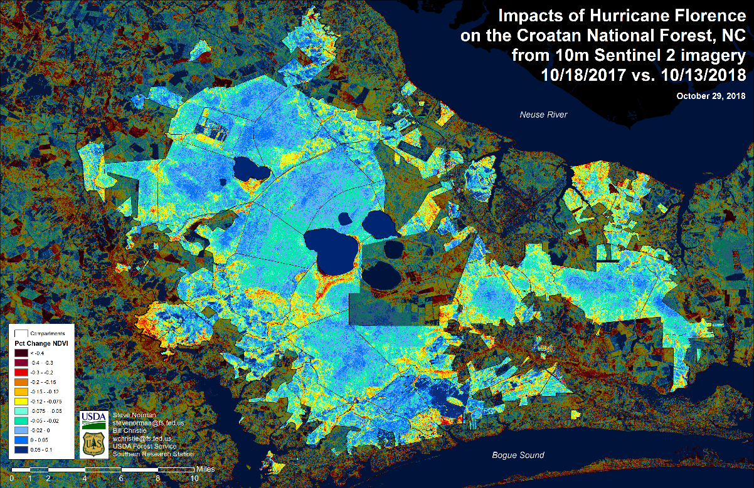
Notes:
Here we used pre-disturbance and post-disturbance imagery around the same dates as the previous ForWarn II map, but from Sentinel 2, at 10m spatial resolution imagery, and produced the same type of ‘percent NDVI change’ maps as the ForWarn II products. Notice there is high agreement and much higher quality departure information at 10m, something you’d expect from higher spectral and spatial resolutions.

Slide 39
Notes:
So jumping back to the MODIS derived ‘percent NDVI change’ image from ForWarn II, I’d like to show you an area of high disturbance to the east of the Croatan National Forest.

Slide 40
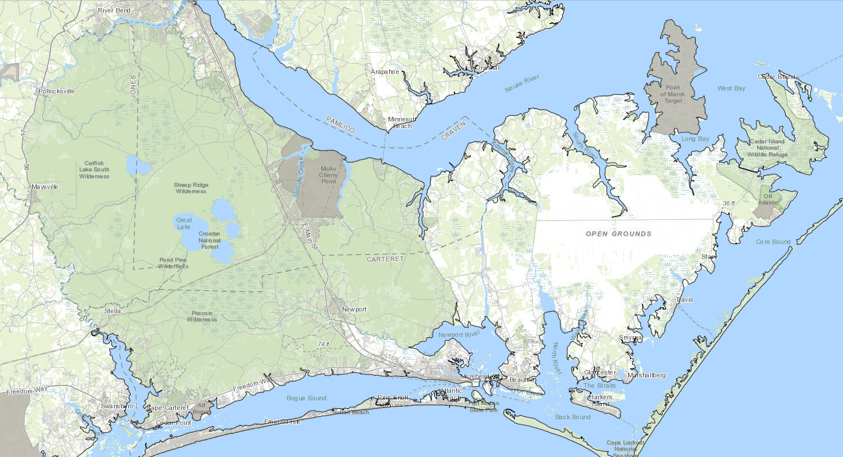
Notes:
Here’s the general location of the Croatan NF and located to the east to the south of the ‘open grounds’ label I’ll show the ForWarn II NDVI change image next.

Slide 41
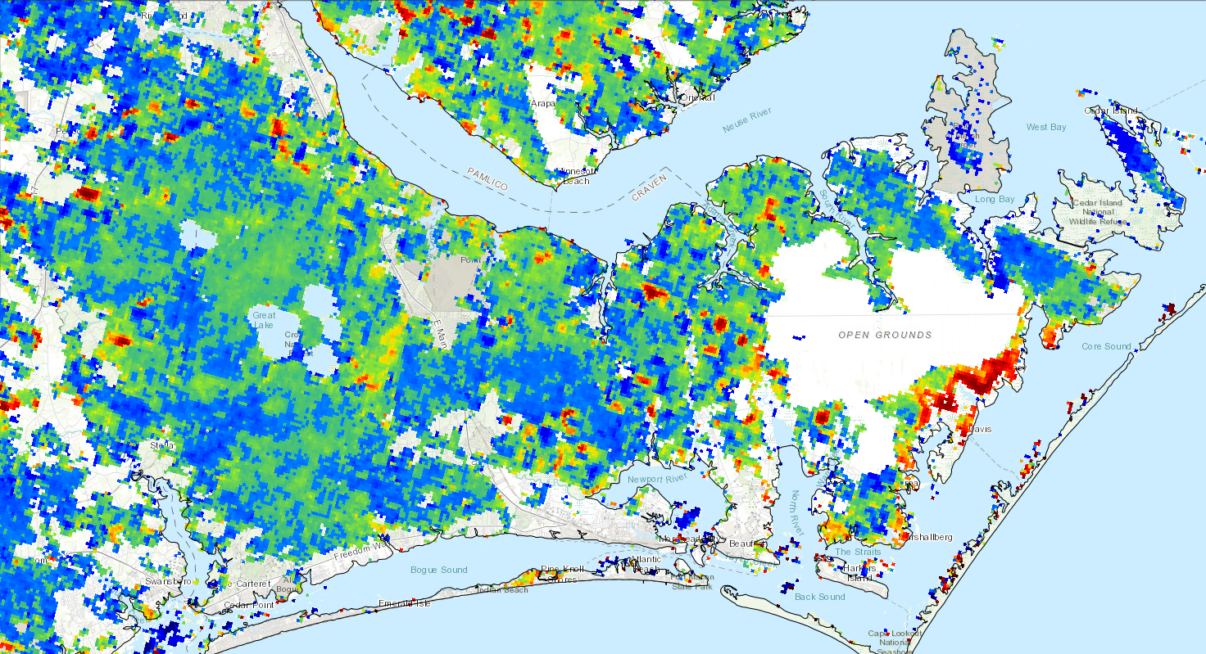
Notes:
Let’s zoom-in more and have a look at this area in more detail and try and ascribe cause to this apparent high NDVI departure site.

Slide 42
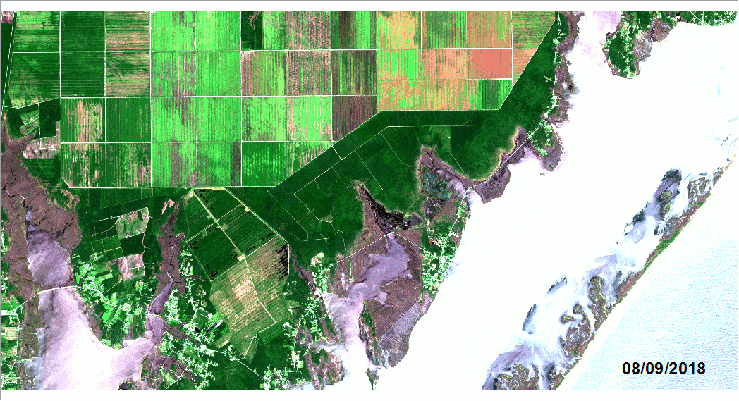
Notes:
ANIMATED SLIDE, View in ‘Presentation’ Mode - This animated gif presents three images: first are two Sentinel satellite images, a pre-disturbance date and a post-disturbance date. The third image in the group is the ForWarn II forest change image that clearly corresponds well to the disturbance areas seen with the Sentinel 2 imagery We believe this reduction in greenness is due to saltwater intrusion by both a high water table flooding and concentrated salt spray deposition. There also could exist a higher susceptibility to the vegetation in this area.

Slide 43
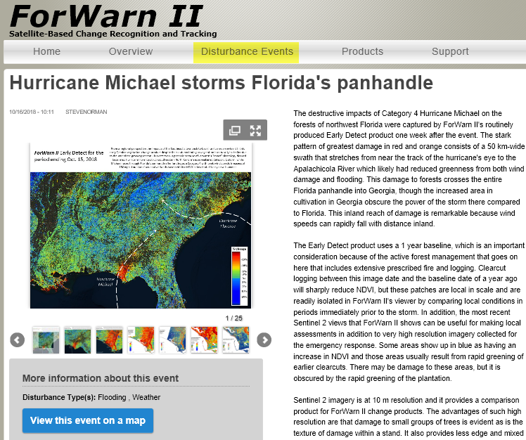
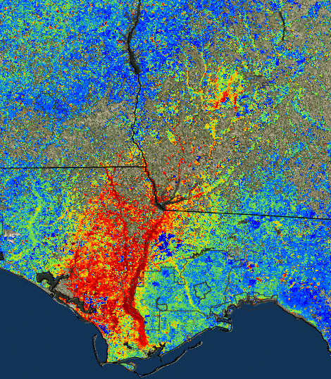
forwarn.forestthreats.org
10/31/2018, 1yr max
Notes:
Now let look at Hurricane Michael which was highly destructive like H. Florence, but in this case due to extremely high wind speeds. If you have a change, look these two events on the ForWarn II website to read in more detail about the character and severity of these two Hurricanes. There are more graphics available for these events that give great insight as to the scope and severity of thee events. On the right is a ForWarn II NDVI change image masked to show forested land cover only. The 30-mile Hurricane swath is clearly visible in the imagery and makes a striking image. On the next slide is a similar ‘percent NDVI change’ product, but this time using 10m Sentinel 2 satellite imagery.

Slide 44
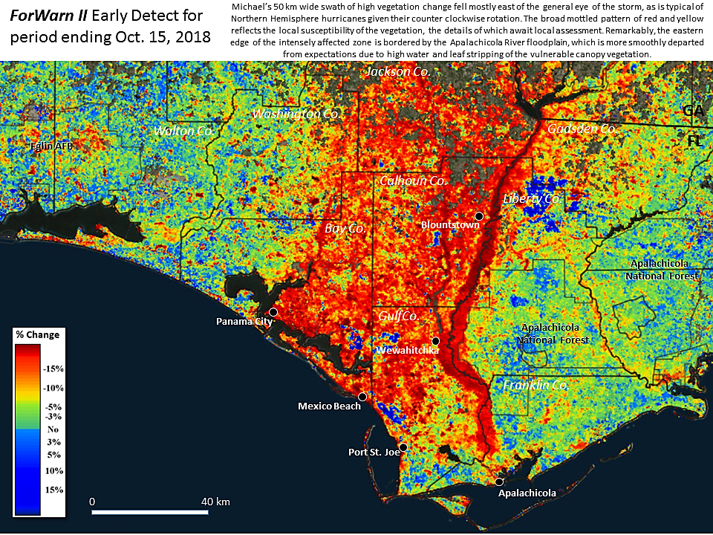

Slide 45
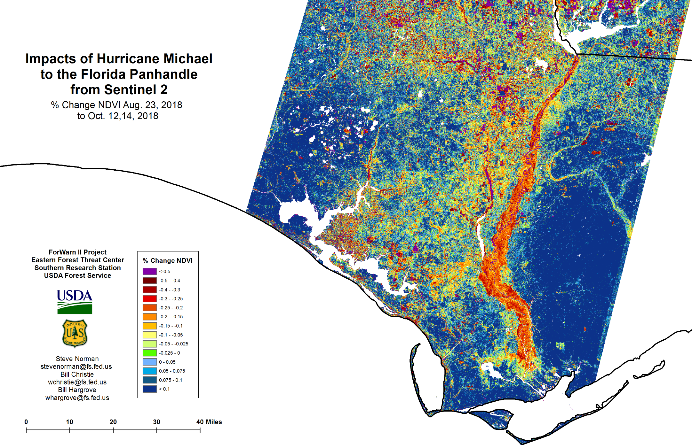
Notes:
This NDVI change image was created using a single seasonal approach to calculate change, as opposed the ForWarn II system which uses a 1yr-basline at it’s minimum temporal resolution (for the pre- and post-disturbance dates). Here we used an intra-annual, same season approach for the pre- and post-disturbance dates – one clear image available immediately before the event, and surprisingly, a clear image just a couple days immediately after making landfall. This is all well and good to come in and perform a NDVI change analysis so quickly after such an event, but caveats need to be explained when interpreting the resulting change map. Specifically, performing an analysis immediately following such an event can introduce ‘errors of commission’ and ‘errors of omission’ that I’ll discuss in the following slide.

Slide 46
Immediately following a disturbance event, be aware of these caveats when interpreting the magnitude and severity of disturbance using change in NDVI:
Commission errors regarding leaf-stripped deciduous forest cover (that can recover)
Commission errors associated with flooded/submerged green vegetation
Commission errors due to seasonal phenological timing (and harvesting)
Omission errors relating to ‘green zombies’
Be aware of the trade-offs between quickly performing an NDVI change assessment and waiting for the for the vegetation to brown-down.
Important take-home message
“Change in NDVI, even at 10m resolution, does not correlate 1:1 to the number of trees killed or the volume of surface fuel produced. Actual fuel conditions require observations on the ground. Satellite-based monitoring does, however, provide the extent and pattern of storm impacts and their likely causes. Damage to pine plantations is conveyed through use of our innovative 2018 pre-storm forest mask that we produced with help of the same cloud computing technologies that we use to process NDVI change products.”
Steve Norman, EFETAC Research Ecologist
Notes:
Commission errors are areas of disturbance that should not have been classified as disturbed. One can see these types of high severity, negative NDVI departure, in the in the bottomland hardwood deciduous forests of the Apalachicola and yellow Rivers in the panhandle. No doubt there are broken and blowdown forest in these bottomland hardwood areas, but much of the disturbance information is from leaf-stripped deciduous and low forest cover flooded vegetation. Another type of error introduced in performing NDVI change analyses immediately following a disturbance event come from ‘errors of omission’. Errors of omission are those classification of non-disturbance areas where there exist real vegetative disturbance. Example types of these omission errors include the mapping of NDVI change when there exist downed, still green vegetation. To the satellite sensor, NDVI greenness is still present with enough mass to create high NDVI values similar to those vales used in the baseline image for comparison. We began calling these types of omission errors ‘green zombies’, whereby the vegetation is dead, but they don’t know it. In the end, you will get a better NDVI change product is you wait a period to allow flood waters to recede, stripped deciduous vegetation to re-leaf, and the ‘green zombies’ to brown-down.
Also, be aware of the timing of normal phenological, or seasonal changes taking place in the landscape. In this case, fall ‘brown-down’ was approaching which limited the amount of imagery available to perform subsequent NDVI change analyses.

Slide 47
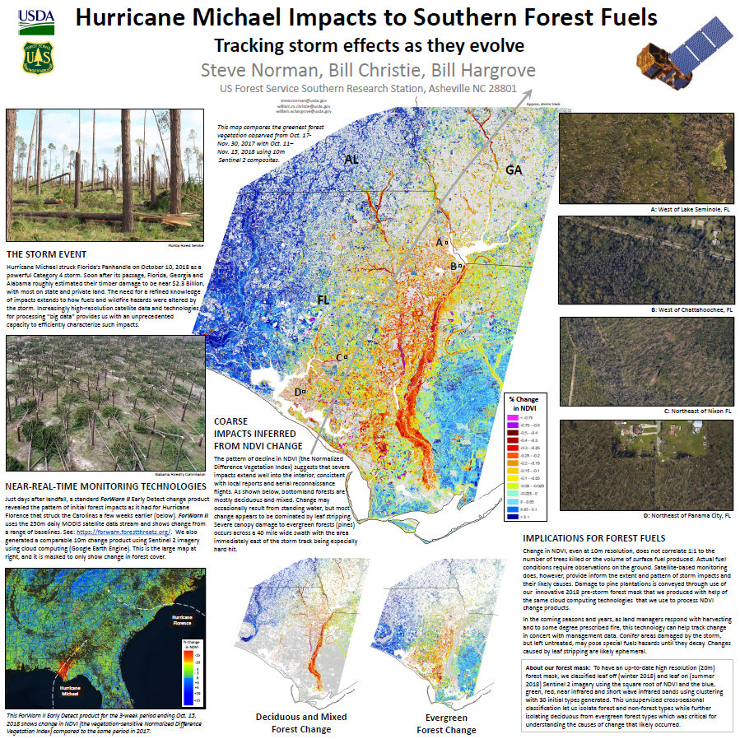
Notes:
Here’s a poster we created for Hurricane Michael using Sentinel 2 imagery in a 1yr-baseline timeframe NDVI Change analysis. Aside from the obvious advantages of mapping at 10m, what I’d like to highlight are the two maps at the bottom center that segment the disturbance map into distinct forest categories. You’re remember the ForWarn II’s ‘Forest Change Assessment Viewer’ offers the ability to mask the MODIS change information with NLCD-based masks at 231 meters. Utilizing this new Sentinel 2 we ended up creating our own forest-based land cover classification that allowed us to split the NDVI change image into 4 broad classes: (1) evergreen, (2) deciduous, (3) mixed forest, and (4) all ‘other’ land cover types and land uses. This gave us the ability to isolate and view evergreen-only vegetation to gain an understanding of the location, amount and severity to this economically important forest type in the region. I’ll zoom into the bottom center portion to show those two maps in more detail.

Slide 48
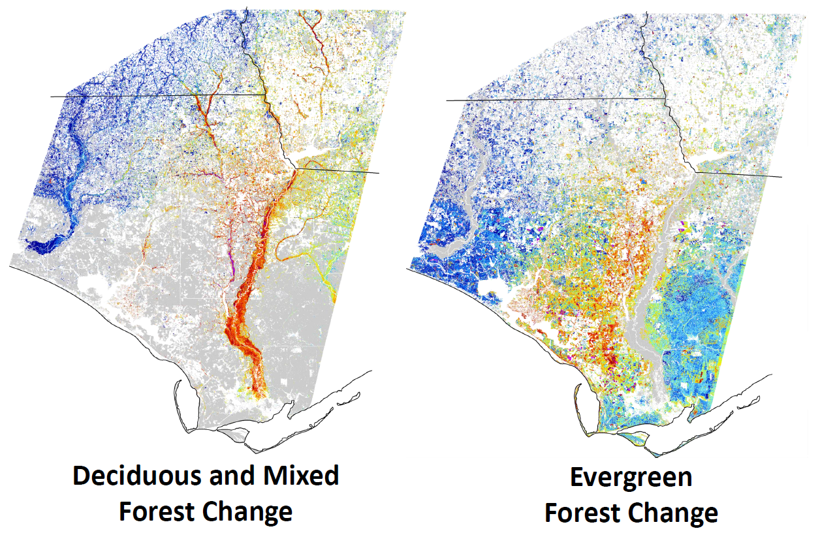
Classification
1 – evergreen
2 – mixed
3 – deciduous
4 – other
Creating a current forest mask – unsupervised classification via clustering, requesting 30-classes from (2) 20m cross-seasonal Sentinel band sets, and the square root of NDVI, then focal smoothed with a 4x4 window and a ‘nodata’ replacement.
Notes:
To produce really meaningful, and useful, disturbance information for State and Federal entities in the region, it’s necessary to filter the change image into it’s component land cover classes. Since we’re creating this at 10m spatial resolution, we needed a way to split-apart the change image into specific forest classes (i.e. evergreen, deciduous and mixed forest). So we used clustering to give to us an unsupervised classification where we manually assigned the forest classes of interest to segment the forest change image. It took a bit of testing and tweaking of the methods to stratify the change image into these four classes, but we believe we have a powerful product we can share as an end result.

Slide 49
ForWarn II Update and Recent Disturbance Assessments
Bill Christie, Steve Norman and Bill Hargrove Eastern Forest Environmental Threat Assessment Center USDA Forest Service, Southern Research Station, Asheville, NC
Introduction (for new folks only)
ForWarn II Update
Disturbance Assessments
Hurricane Florence, NC-SC
Hurricane Michael, FL-GA-AL
Questions?
2019 SGSF GIS & Forest Health Committee Annual Meeting
January 7-11, 2019 Savannah, GA
Notes:
That’s the end of the ForWarn II update and looking a both hurricanes, I’ll open it up for question regarding what you’ve seen today or on the ForWarn II forest disturbance web mapping application.

Slide 50
ForWarn II Update and Recent Disturbance Assessments
Bill Christie, Steve Norman and Bill Hargrove Eastern Forest Environmental Threat Assessment Center USDA Forest Service, Southern Research Station, Asheville, NC
Questions about what been presented?
How can we help you do your job?
ForWarn II Website
https://forwarn.forestthreats.org
Forest Change Assessment Viewer
https://forwarn.forestthreats.org/fcav2
Bill Christie
wchristie @ fs.fed.gov
office (828) 257- 4370
2019 SGSF GIS & Forest Health Committee Annual Meeting
January 7-11, 2019 Savannah, GA
Notes:
We’d like to hear your ideas about how can our research unit help your efforts, either at your State-level, or at the region-level. Here are the links to the ForWarn II website and ‘Forest Change Assessment Viewer’, and my contact information if you ever have any questions about what you’re seeing in the forest change images or how the Viewer works.

