Slide 1
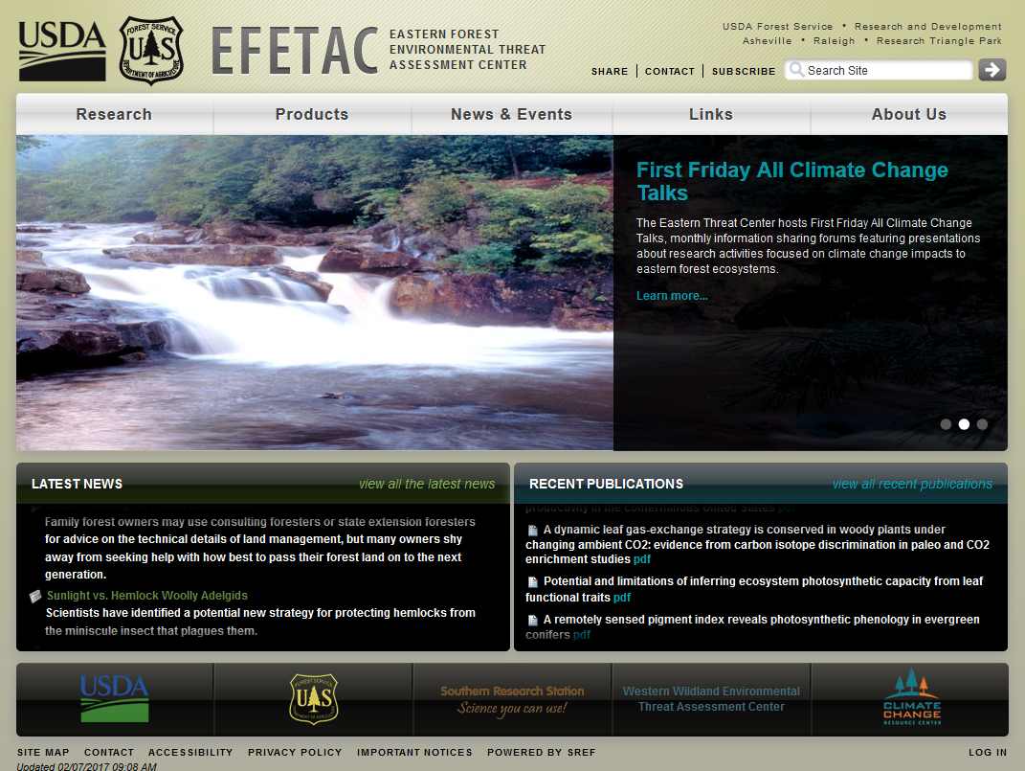
https://forestthreats.org

Slide 2
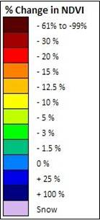
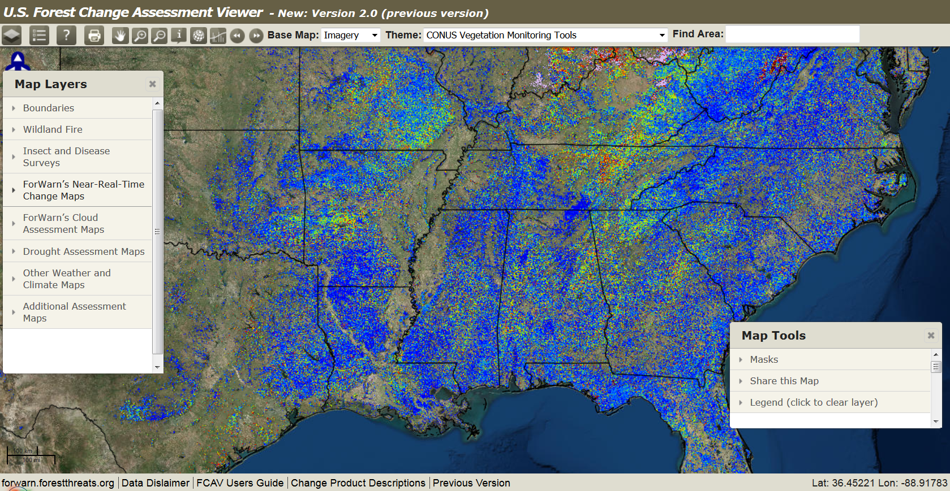
https://forestthreats.org/fcav2
ForWarn point of contact
Bill Christie, Eastern Forest Environmental Threat Assessment Center
wchristie@fs.fed.us 828.216.7443 cell

Slide 3
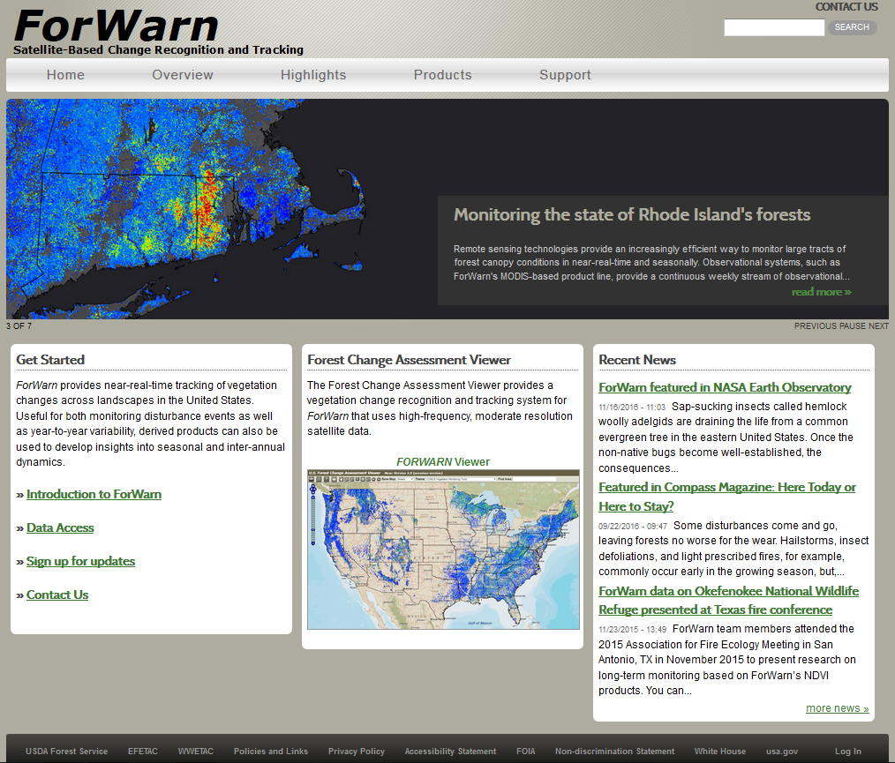
https://forestthreats.org

Slide 4
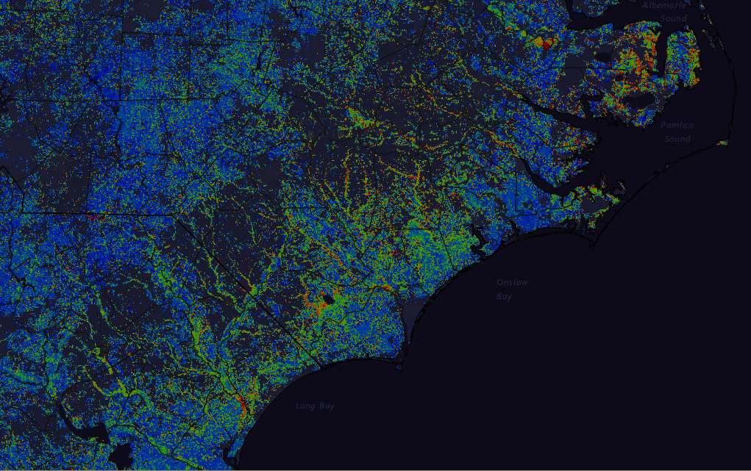
ForWarn & EFETAC Remote Sensing Projects Update Eastern Forest Environmental Threat Assessment Center USDA Forest Service, Southern Research Station forwarn.forestthreats.org
ForWarn: Select 2016 Forest Disturbances
LanDAT Application
Questions / Open Forum
2017 SGSF GIS Committee Annual Meeting
February 9-11, 2016 Raleigh, NC
Notes:
Self Intro (yrs wk’d, previous wk, primary respon – assist dev, maintain layers, perf outreach, query for new users brief intro, sources of info)

Slide 5
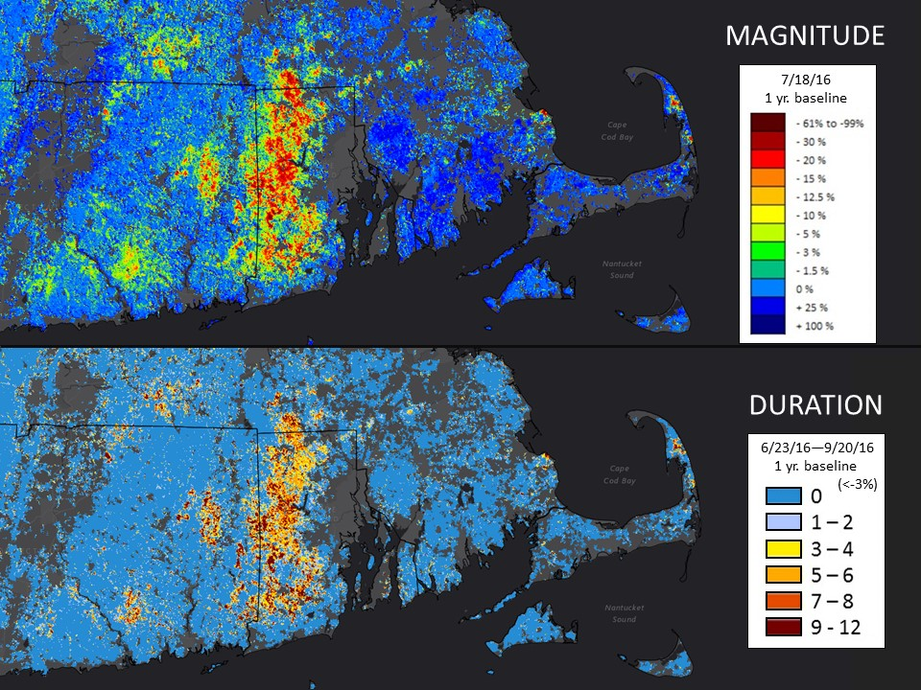
2016 Gypsy Moth defoliation in the state of Rhode Island
Single period observations can underestimate impacts because peak defoliations may not coincide.

Slide 6
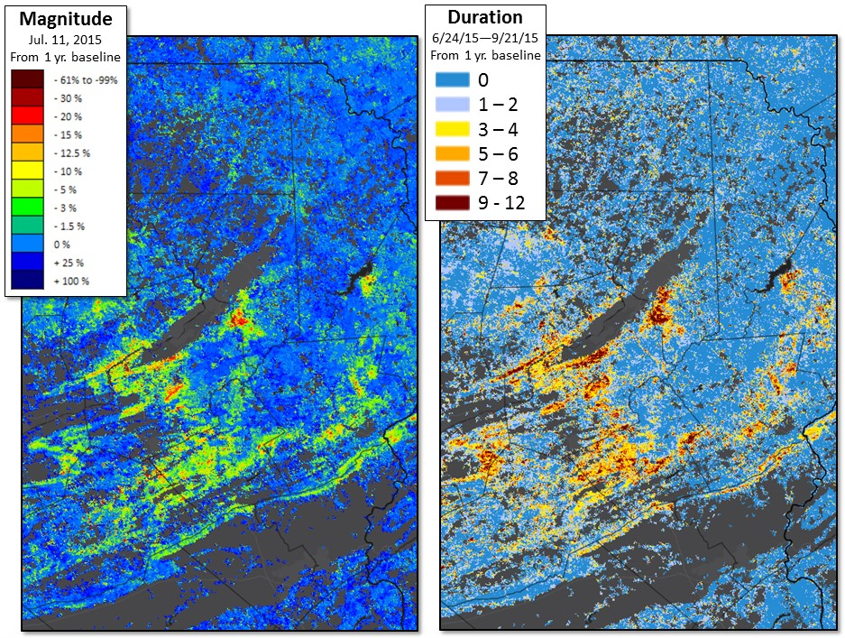
2016 Tracking Gypsy Moth emergence and severity with magnitude and duration (PA)
ForWarn's Seasonal Duration products help discriminate the ephemeral from persistent impacts

Slide 7
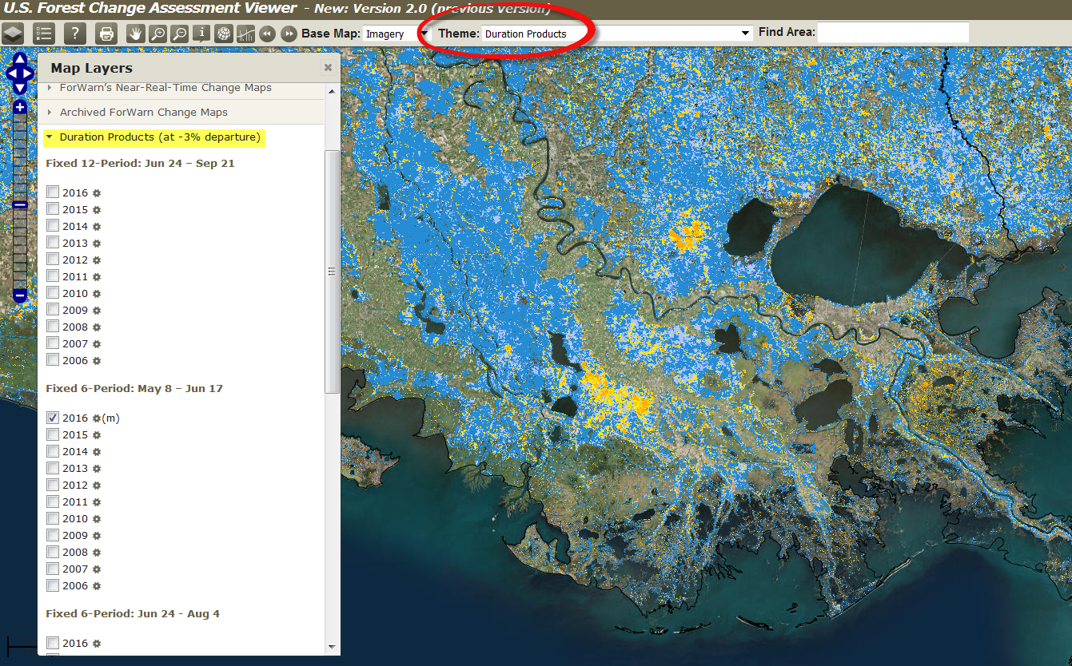
Accessing the Duration Products
6-period duration
May 8 – June 17 (for w. US)
June 24 – Aug 4
Aug 12 – Sept 21
12-period duration
June 24 – Sept 21
Use the ‘Theme’ dropdown to select, then open the “Duration” tab to choose from the 4-periods.
Created throughout the growing season when the period’s completion date is reached.

Slide 8
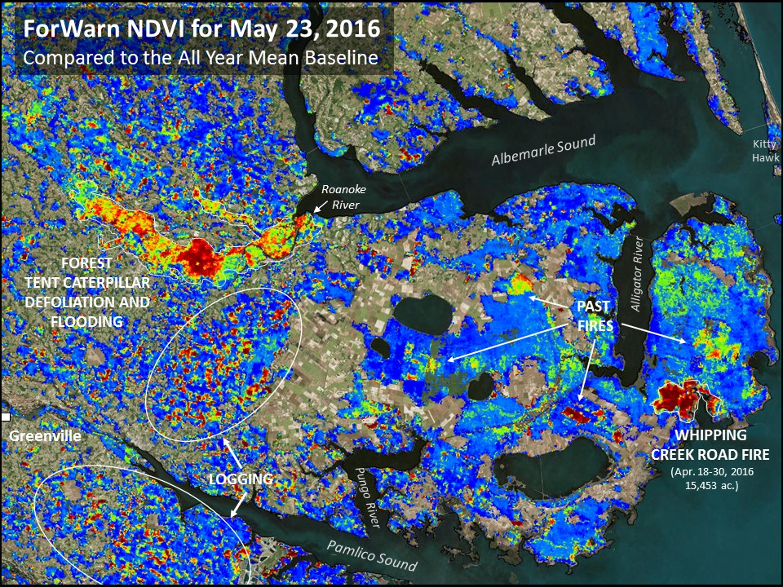
Defoliation in NC's Roanoke River Bottomland Forests

Slide 9
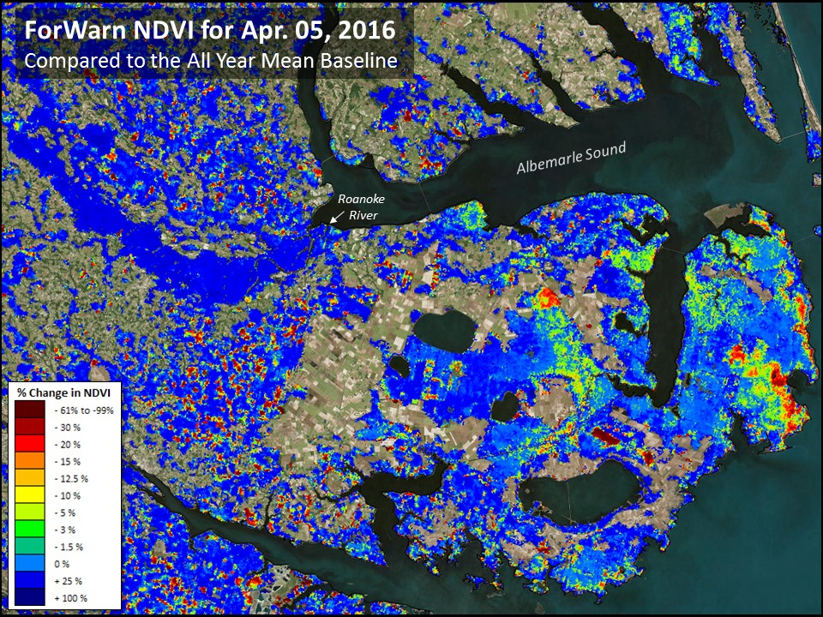
Defoliation in NC's Roanoke River Bottomland Forests

Slide 10
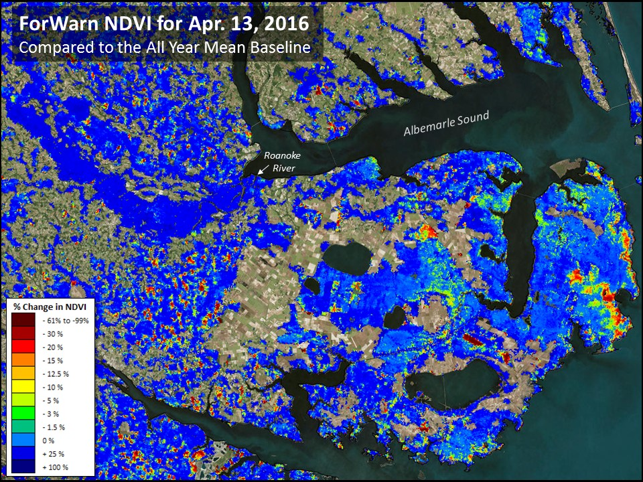
Defoliation in NC's Roanoke River Bottomland Forests

Slide 11
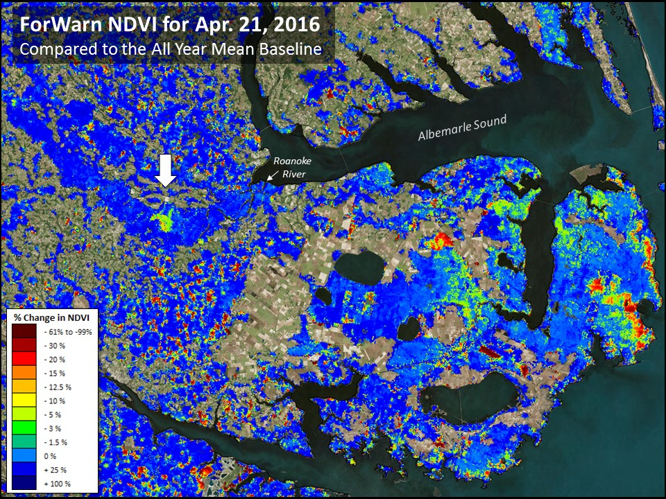
Defoliation in NC's Roanoke River Bottomland Forests

Slide 12
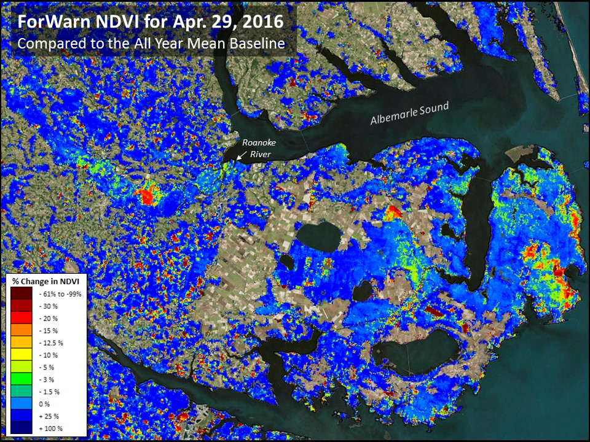
Defoliation in NC's Roanoke River Bottomland Forests

Slide 13
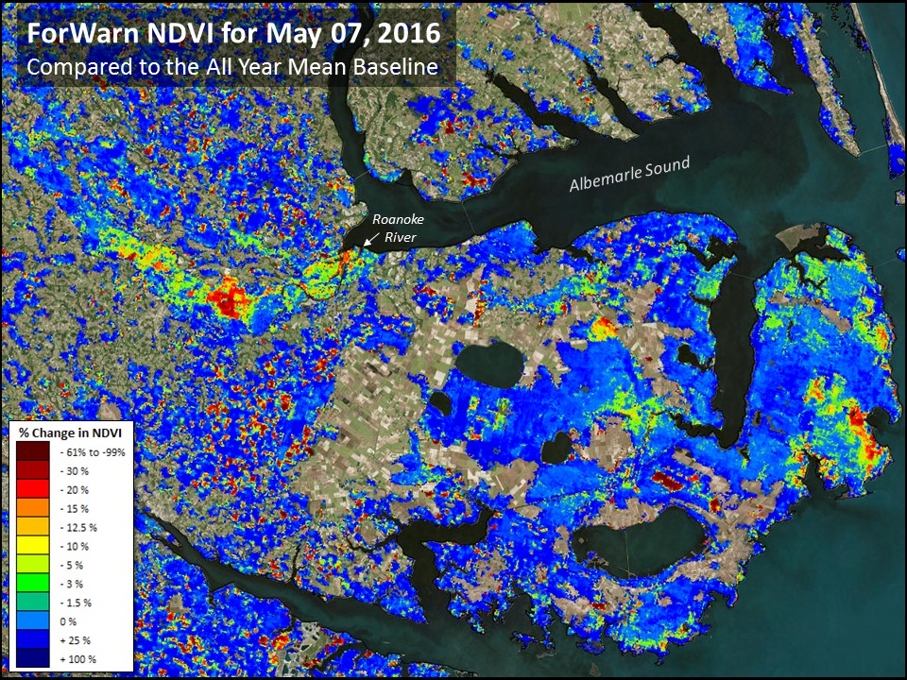
Defoliation in NC's Roanoke River Bottomland Forests

Slide 14
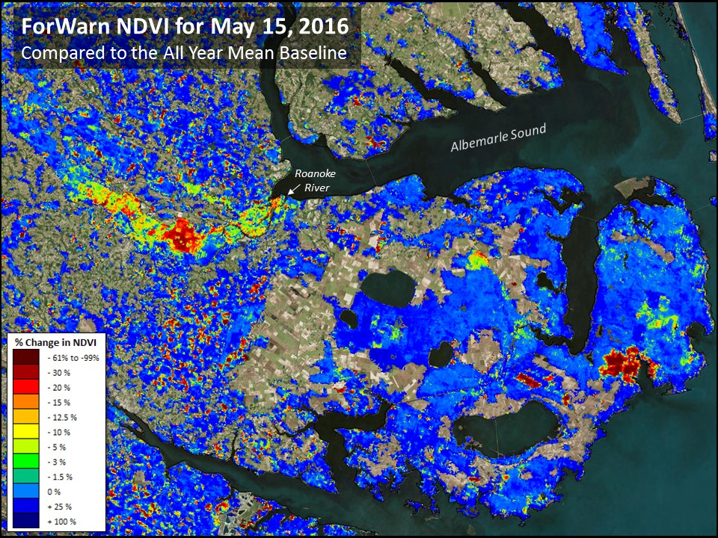
Defoliation in NC's Roanoke River Bottomland Forests

Slide 15
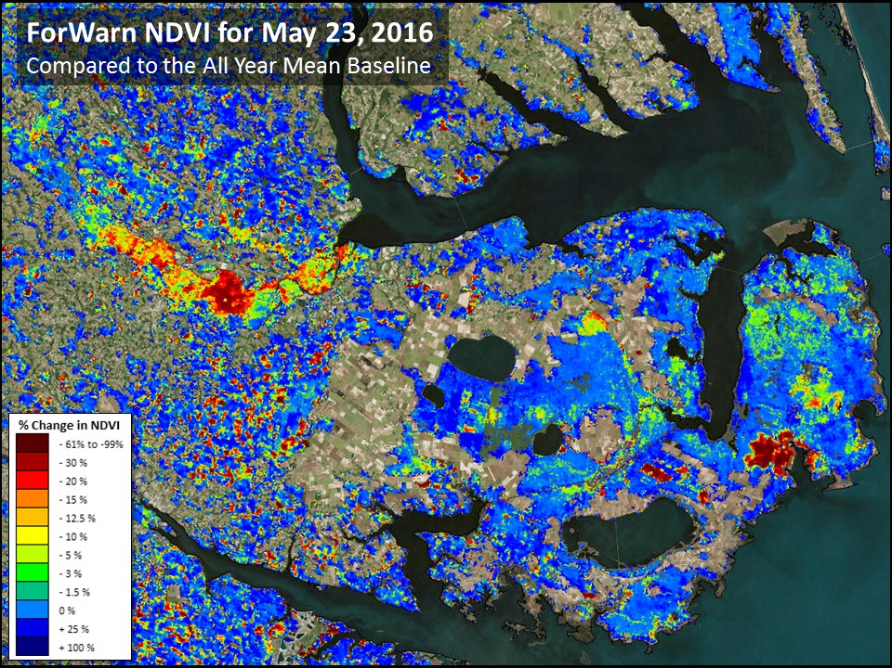
Defoliation in NC's Roanoke River Bottomland Forests

Slide 16
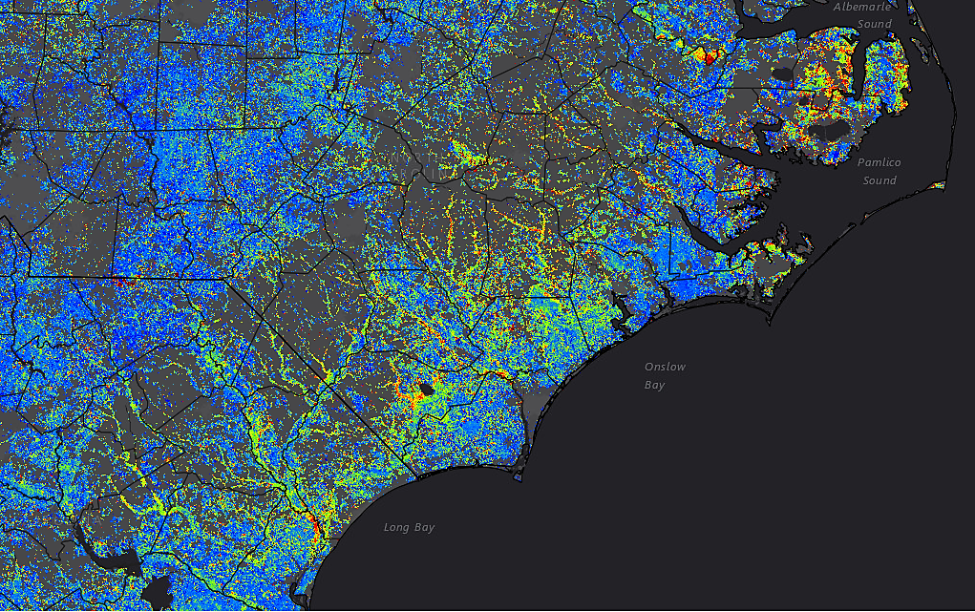
Hurricane Matthew - flooding effects in the bottomland hardwoods
‘Early Detect’ product - 10/14/2016 (forest mask applied)

Slide 17
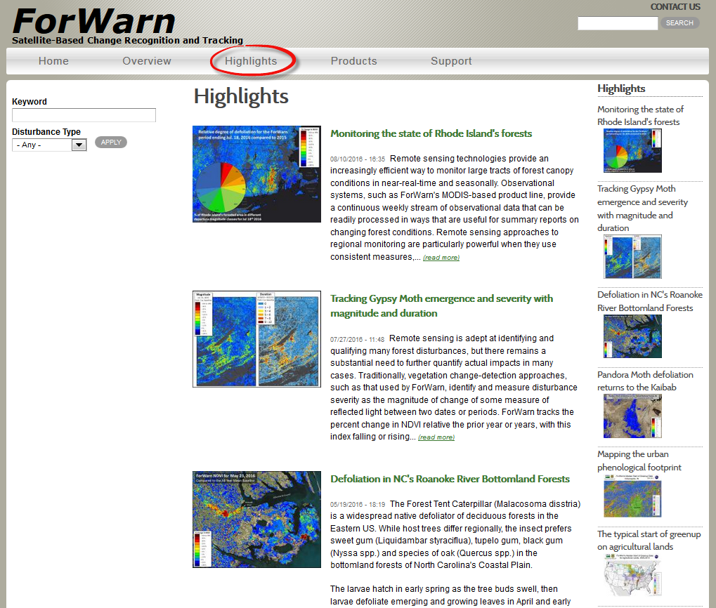

Slide 18
ForWarn & EFETAC Remote Sensing Projects Update Eastern Forest Environmental Threat Assessment Center USDA Forest Service, Southern Research Station forwarn.forestthreats.org
ForWarn: Select 2016 Forest Disturbances
LanDAT Application
Questions / Open Forum
2017 SGSF GIS Committee Annual Meeting
February 9-11, 2016 Raleigh, NC

Slide 19
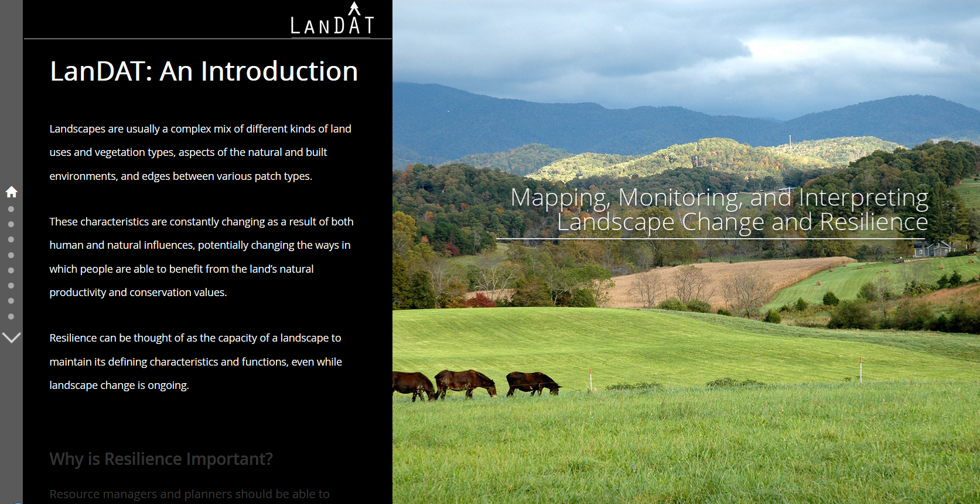
Landscape Dynamics Assessment Tools
Lars Pomara, Danny Lee, Bjorn-Gustav Brooks, and William Hargrove
FS Southern Research Station, Eastern Threat Center, Asheville, NC

Slide 20
Landscape Dynamics Assessment Tools

Slide 21
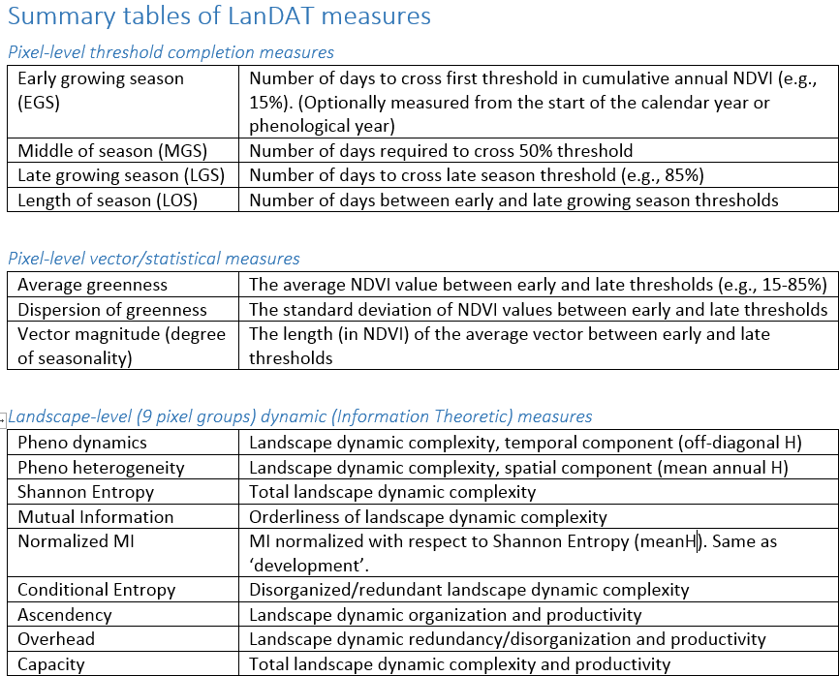
Landscape Dynamics Assessment Tools

Slide 22
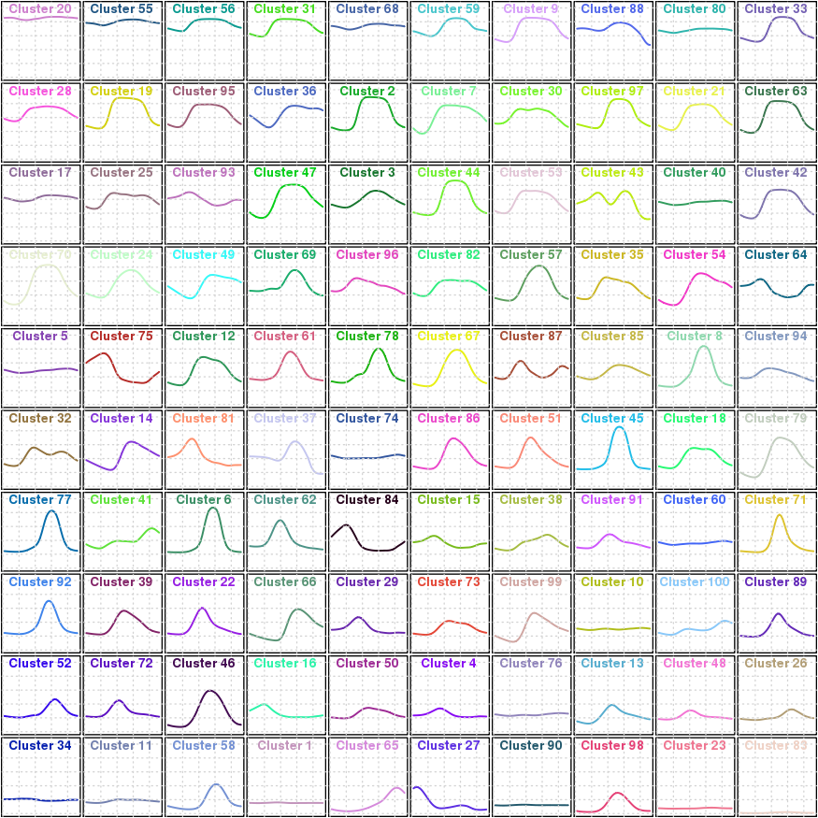
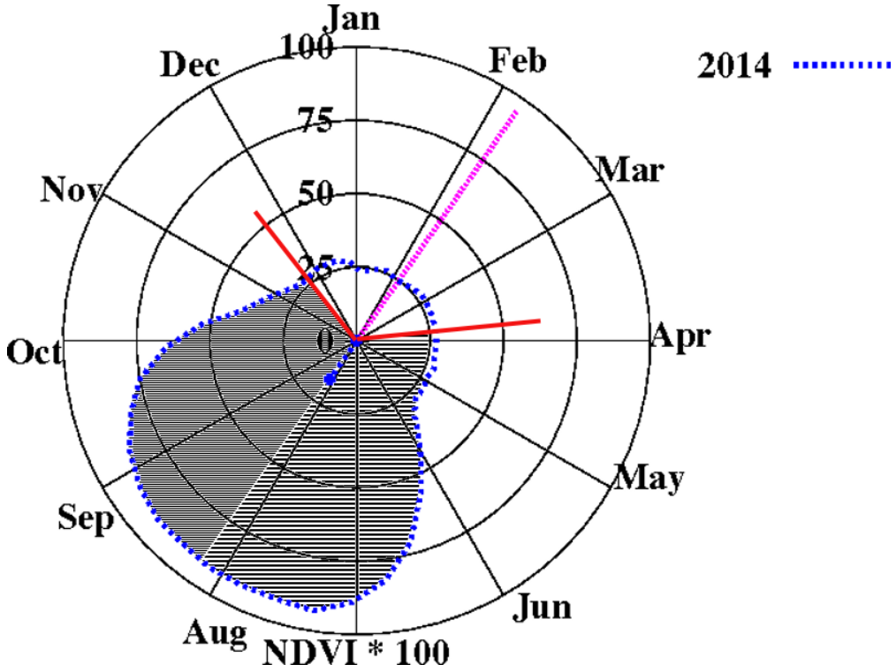
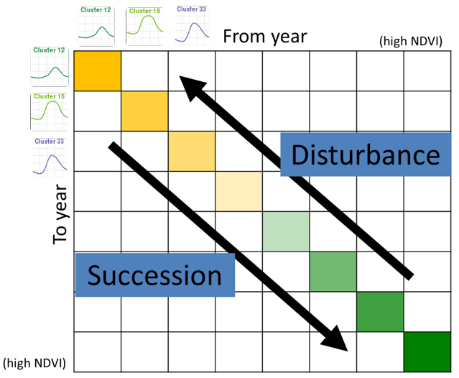
Measures used to derive landscape information metrics
Phenological Ecoregions (clustering of NDVI)
Phenological Completion Milestones (Polar Statistics from annual NDVI plots)
Transition Matrices (of phenoregion shifts)

Slide 23
Landscape Dynamics Assessment Tools
LanDAT is a system that uses the lens of land surface phenology to look at kinds and degrees of changes occurring across landscapes (Brooks, 2017).
LanDAT can be used to.....
Monitor and interpret landscape change
Incorporate landscape resilience and vulnerability into planning
Identify opportunities for restoration and other conservation actions
Spatially model for species and resources of concern
Understand the shifting landscape mosaic through a 'systems' lens
Understand drivers of landscape change in an integrative concept

Slide 24
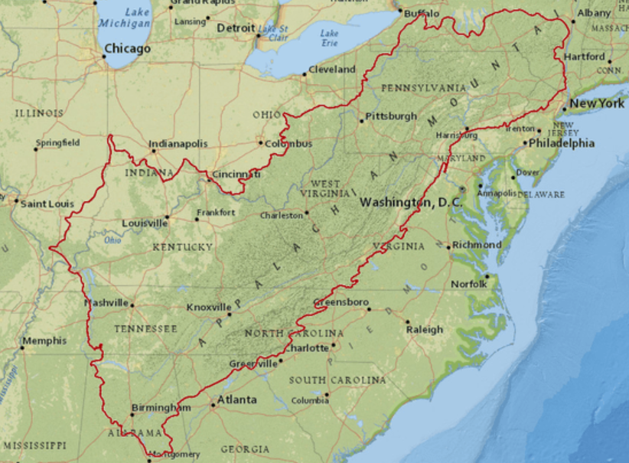
Rollout Timeline
LanDAT is still in the development stage, the ‘public’ rollout is expected mid-late 2017
Early summer 2017: (3) Workshops are planned within the App LCC region (north, central and south)
Lars Pomara, Research Ecologist from the Eastern Threat Center, and UNC-Asheville’s NEMAC will facilitate meetings

Slide 25
ForWarn & EFETAC Remote Sensing Projects Update Eastern Forest Environmental Threat Assessment Center USDA Forest Service, Southern Research Station forwarn.forestthreats.org
ForWarn: Select 2016 Forest Disturbances
LanDAT Application
Questions / Open Forum
ForWarn point of contact
Bill Christie, Eastern Forest Environmental Threat Assessment Center
wchristie@fs.fed.us 828.216.7443 cell

