Slide 1
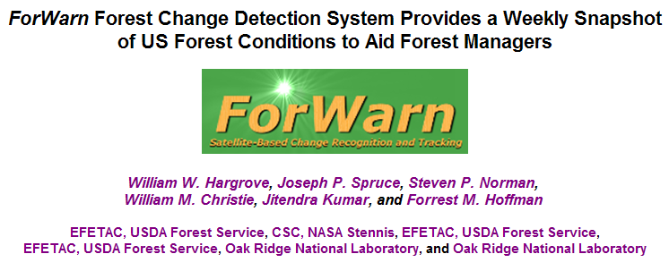



Slide 2

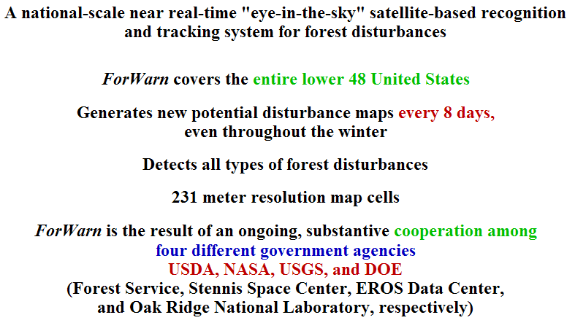

Slide 3
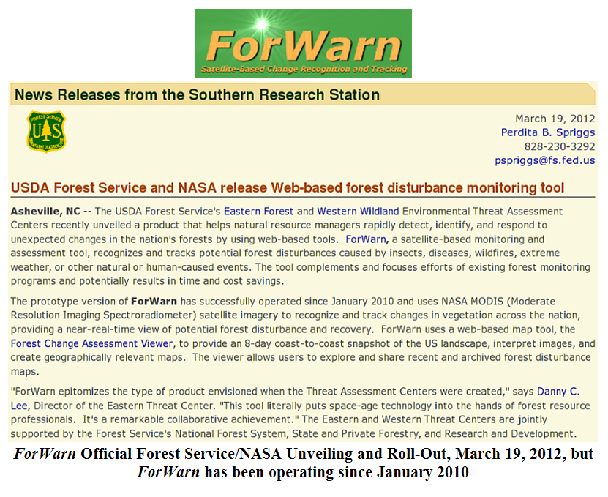

Slide 4


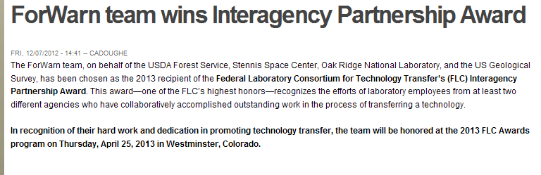

Slide 5
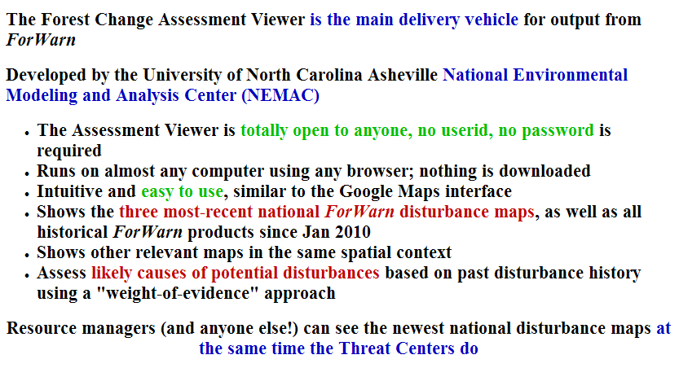

Slide 6
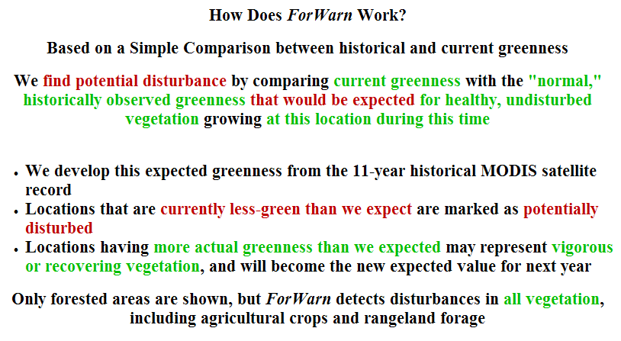

Slide 7
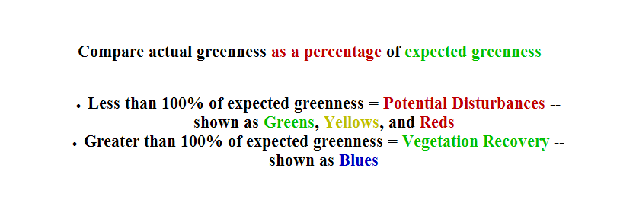
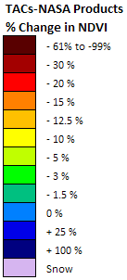

Slide 8
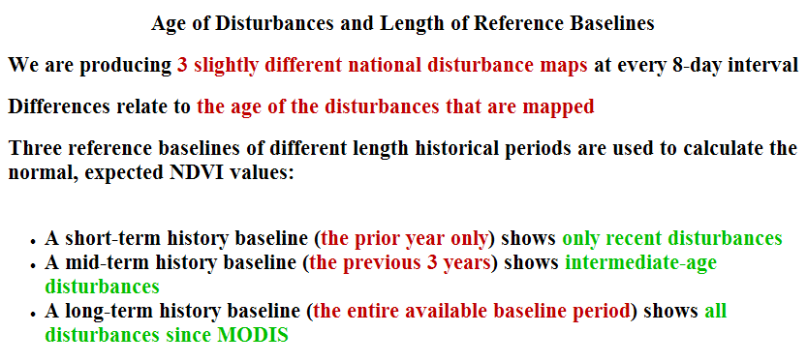

Slide 9
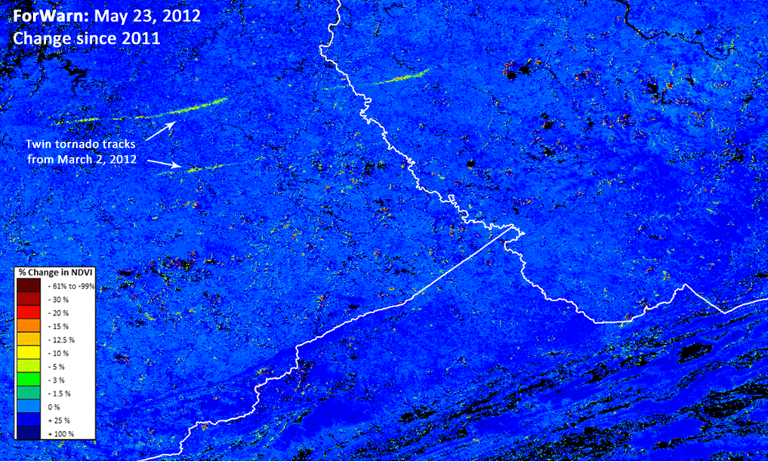

Slide 10
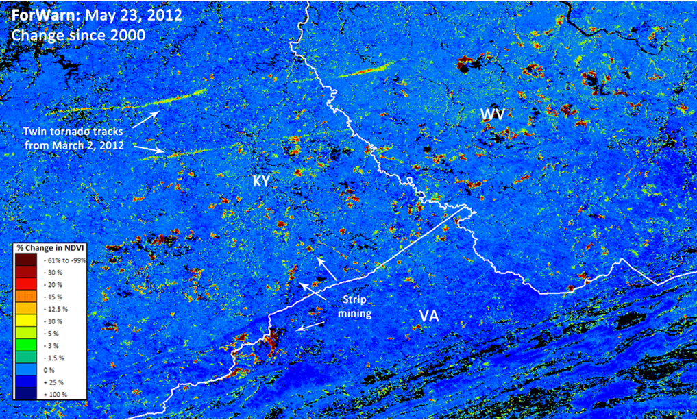

Slide 11
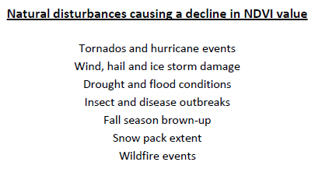
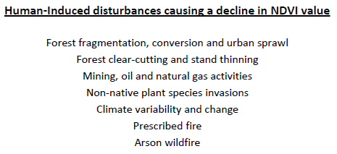
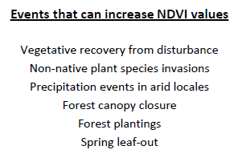
Examples of forest disturbance, or recovery, seen in the ForWarn forest change images
Forest disturbance events often display degrees of severity.
Variation in rates of recovery can relate to ecological, or vegetative resilience.

Slide 12
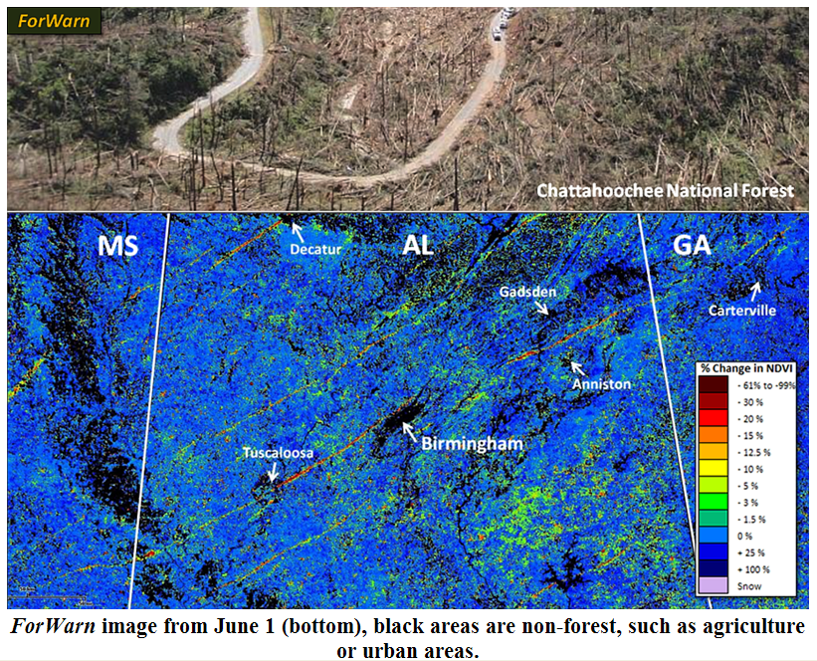

Slide 13
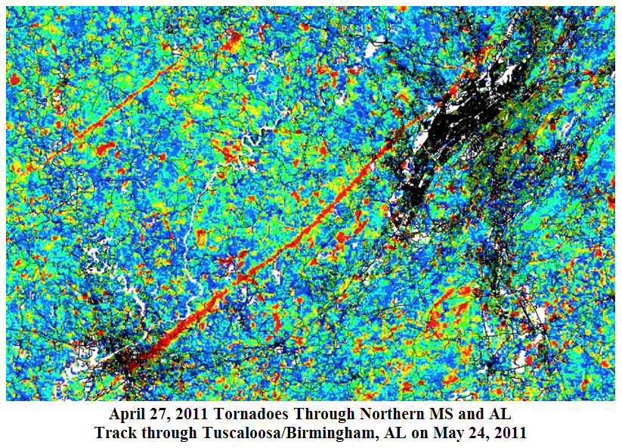

Slide 14
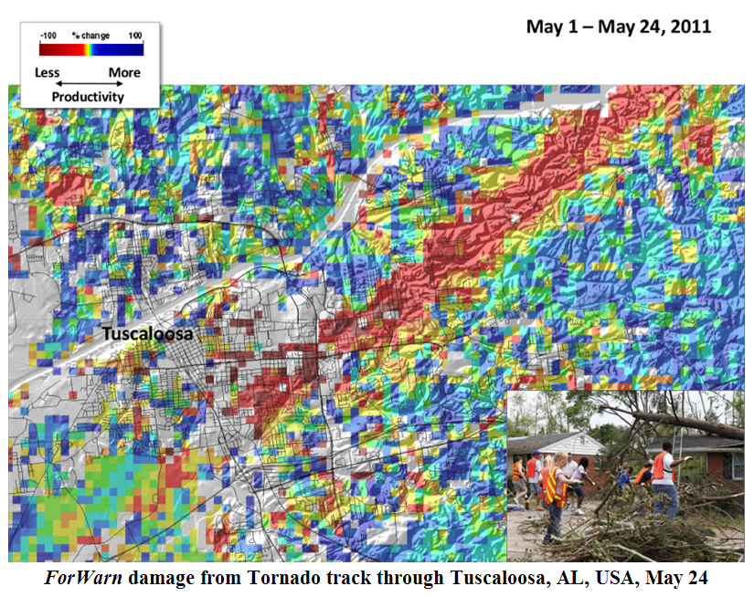

Slide 15
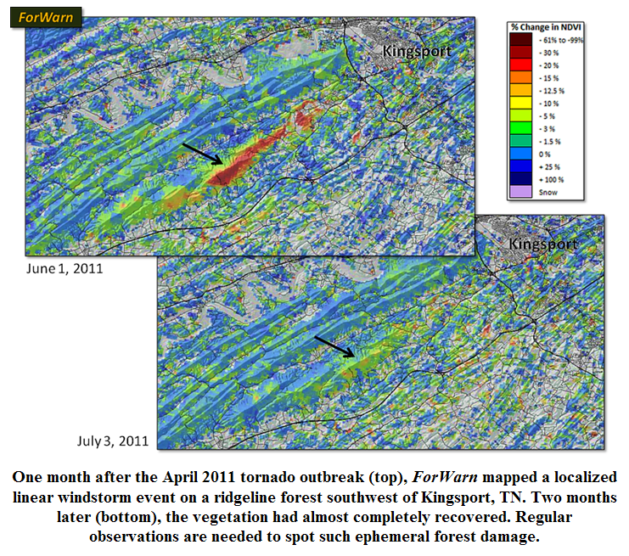

Slide 16
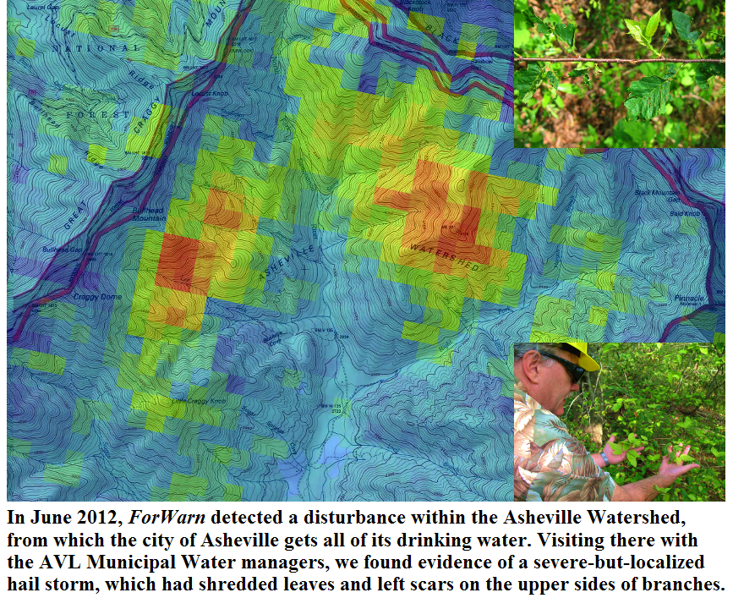

Slide 17
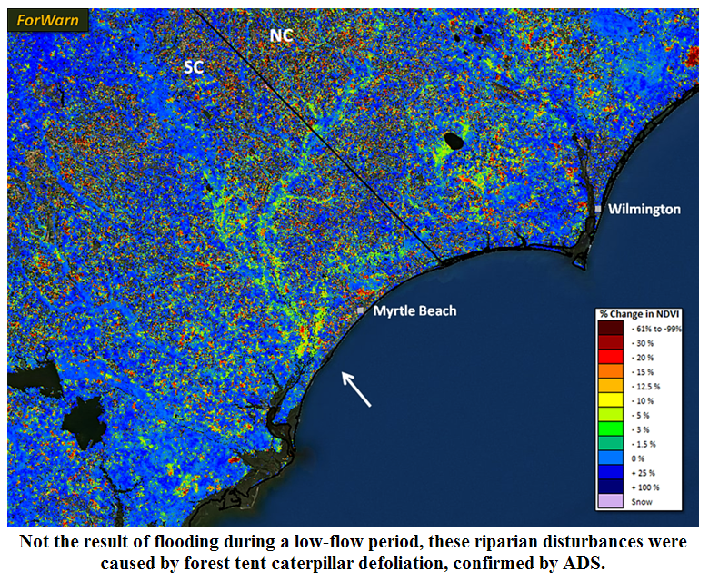

Slide 18
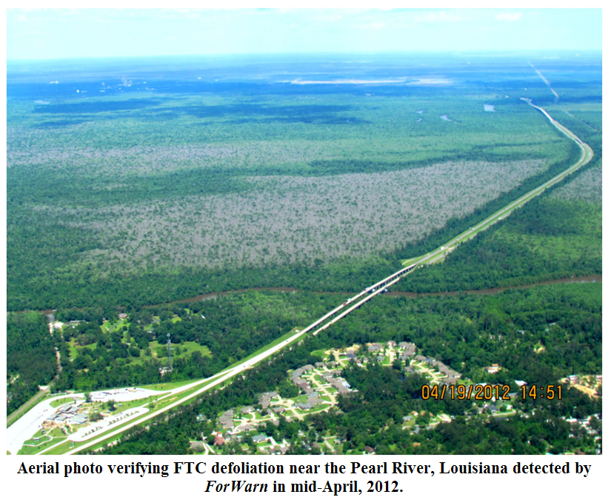


Slide 19
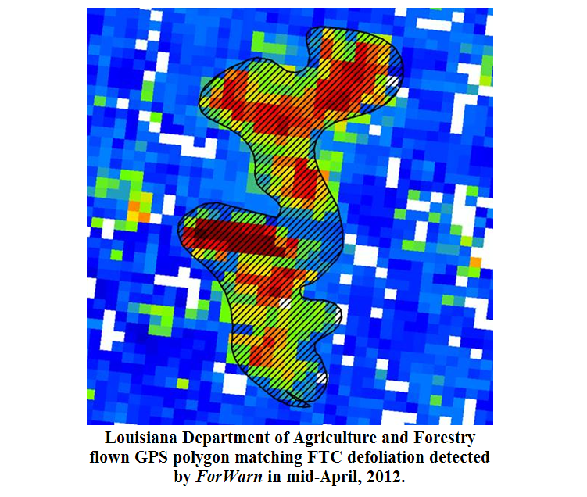

Slide 20
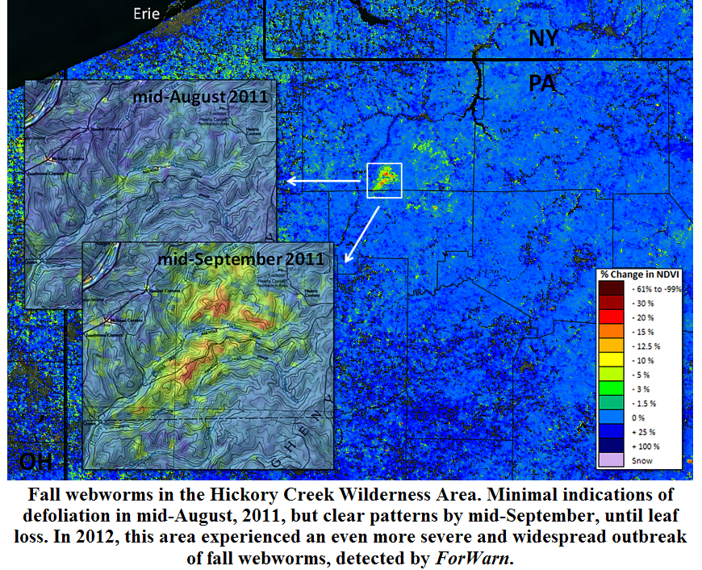

Slide 21
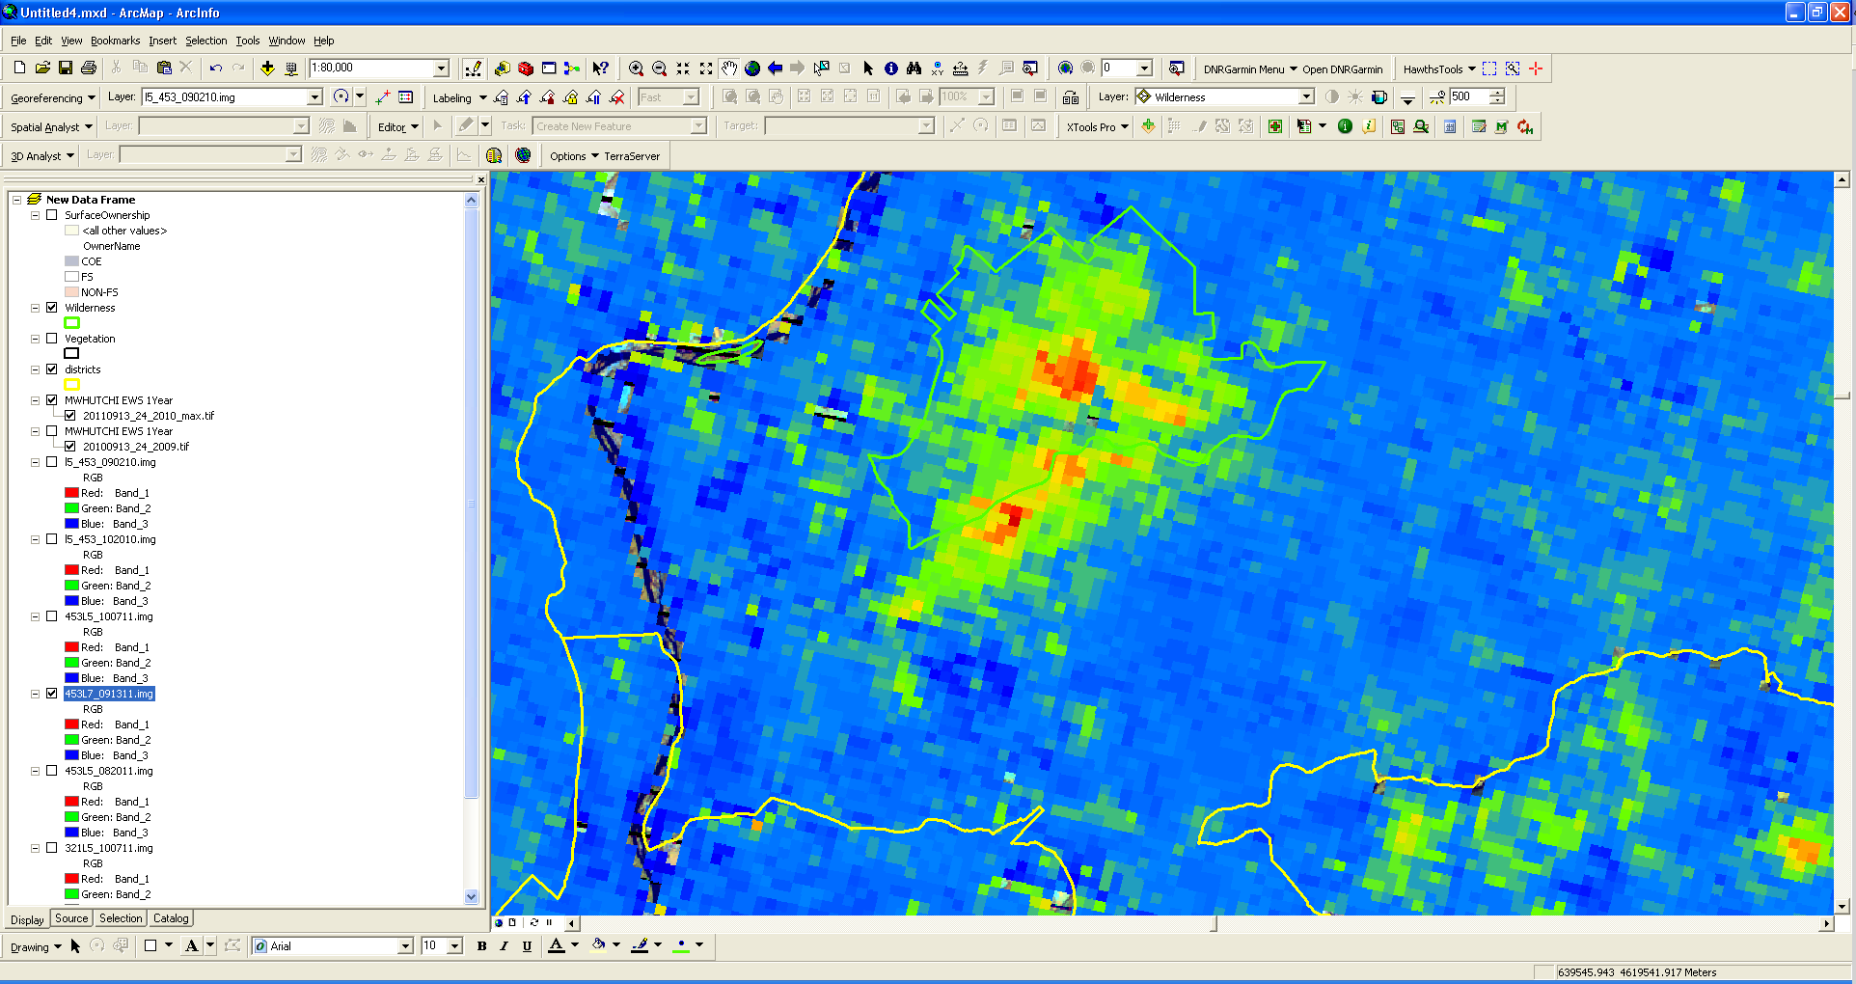
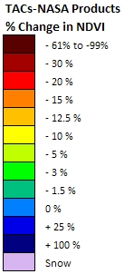


Area of vegetative
recovery from
forest disturbance
pre-2010
Allegheny National Forest
Hickory Creek Wilderness area
Forest Change Assessment Viewer (FCAV)
09/13/2011 1-yr baseline
http://ews.forestthreats.org

Slide 22
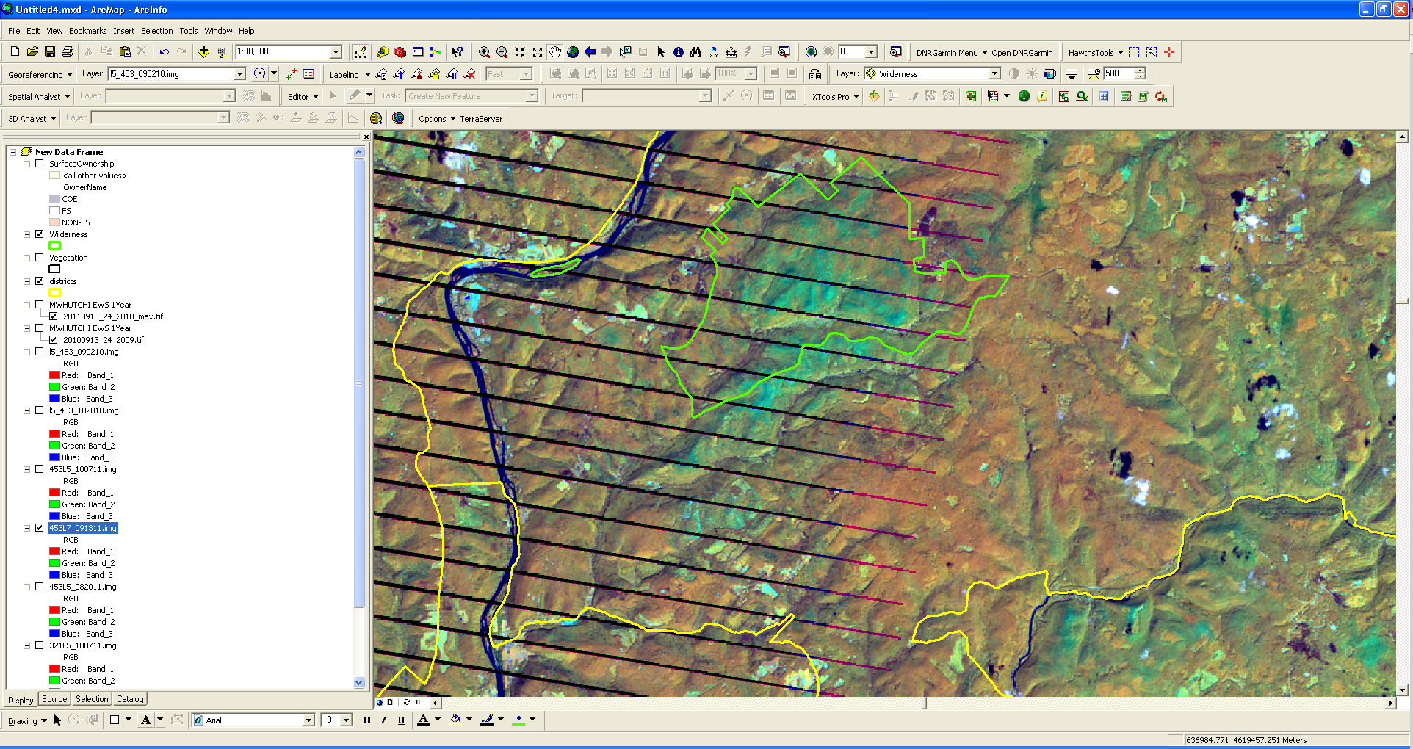
Allegheny National Forest
Hickory Creek Wilderness area
Landsat 7TM on 09/13/2011 , 453 RGB
http://ews.forestthreats.org

Slide 23
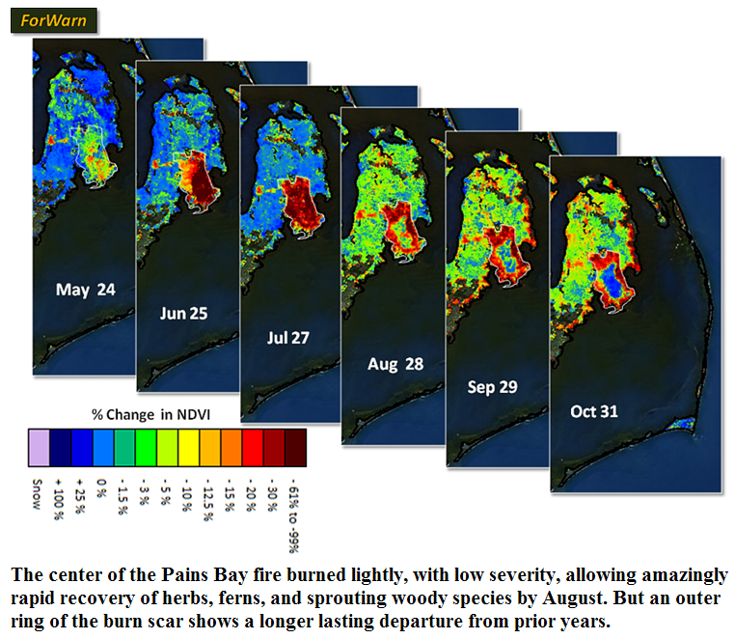
forwarn.forestthreats.org

Slide 24
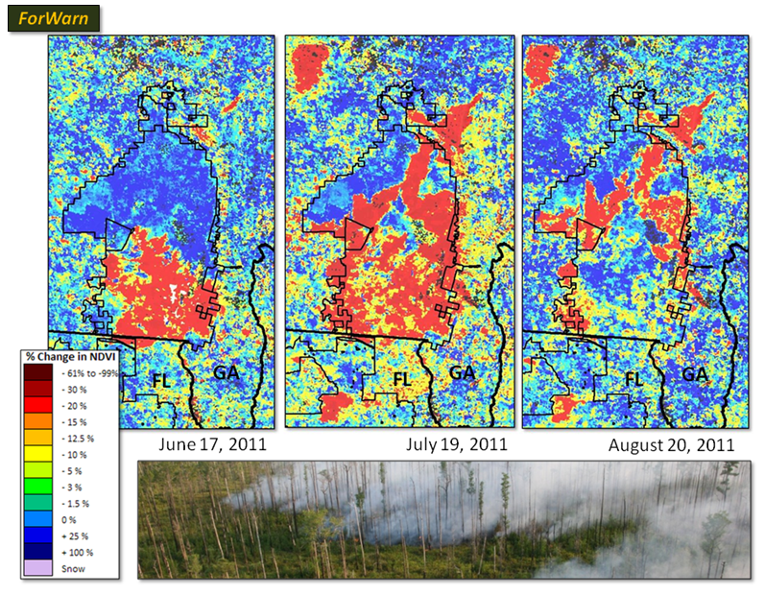

Slide 25
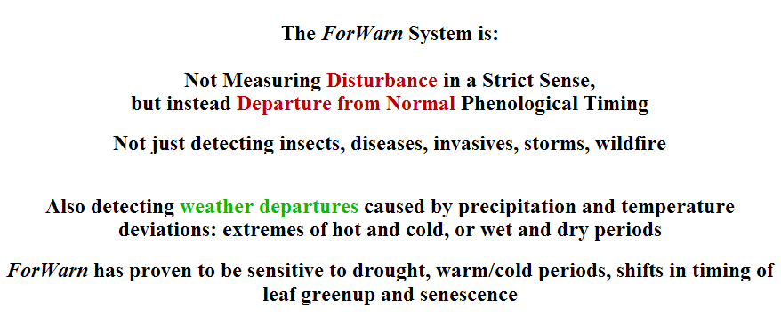

Slide 26
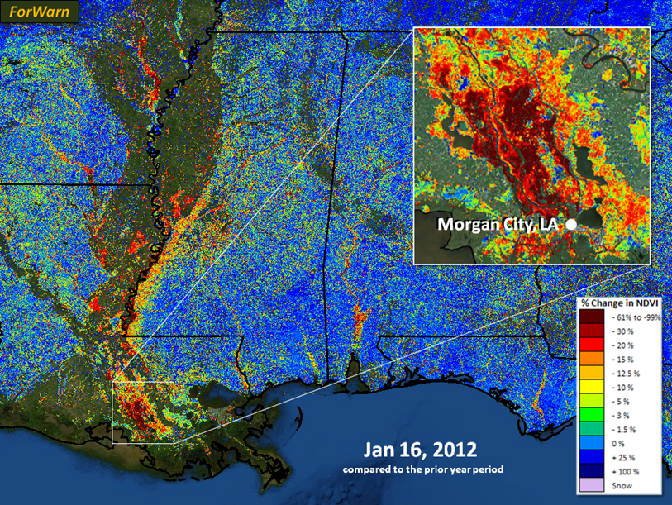
The Atchafalaya basin's forests thrive with seasonal flooding, yet high water is normally a spring phenomenon there. During the past month, unusually high water levels have inundated wetlands and forests along and near the Mississippi River basin. From space, floodwaters appear to decrease existing vegetation, as water masks low lying plant cover. According to the USGS, river discharge at Morgan City, Louisiana was 145,000 ft3/sec on January 16, 2012 compared to 84,000 ft3/sec the prior year. (See http://waterdata.usgs.gov.)

Slide 27
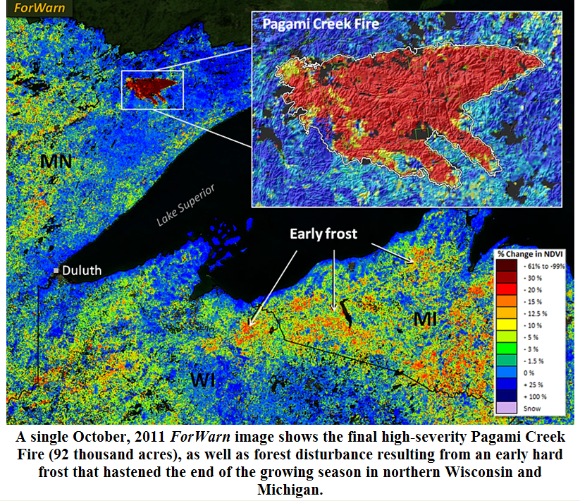

Slide 28
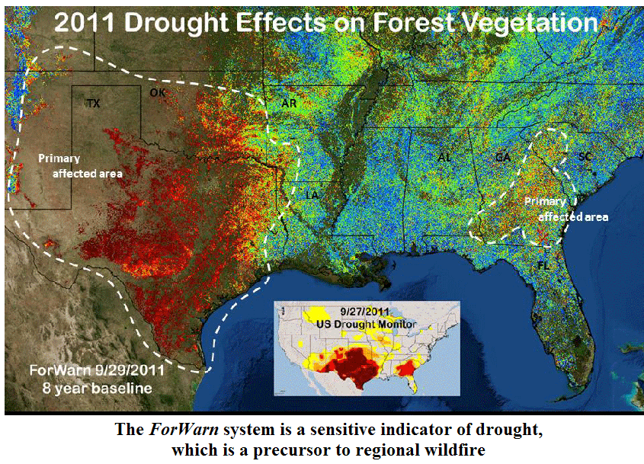

Slide 29
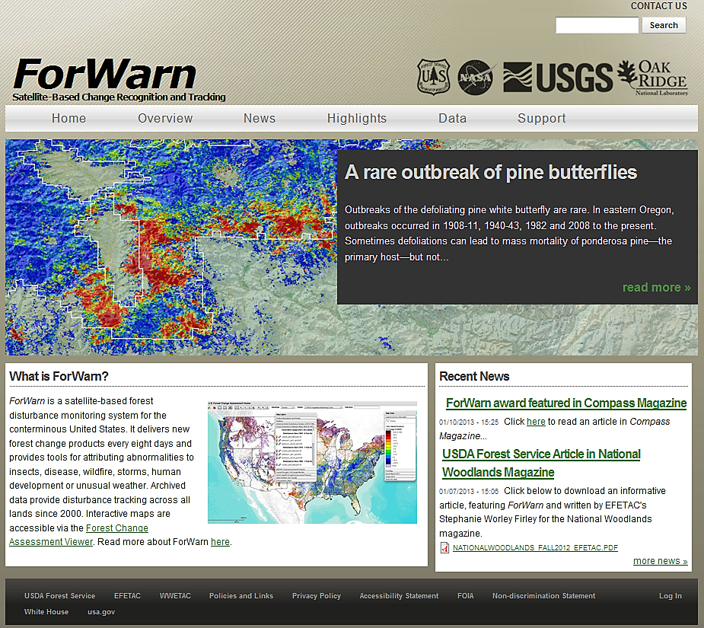
forwarn.forestthreats.org

Slide 30
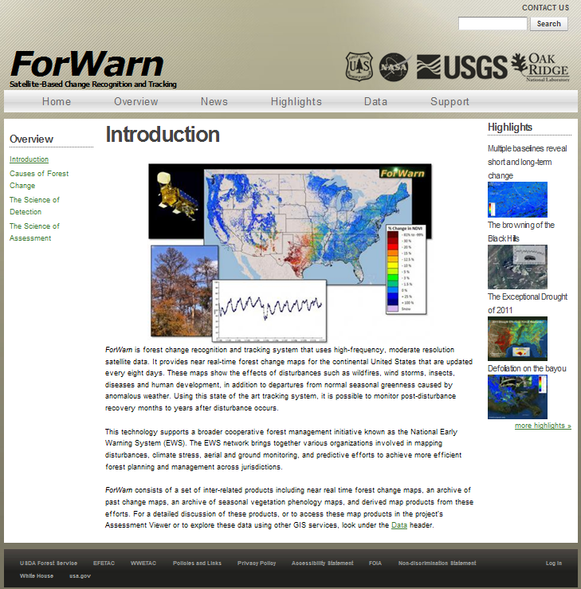

Slide 31
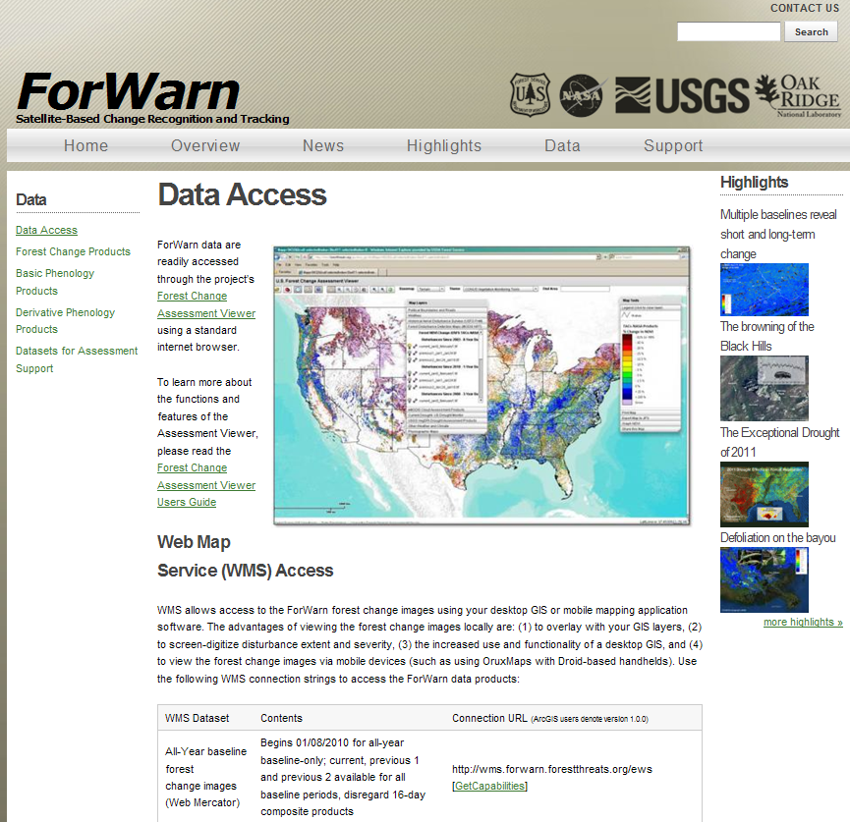

Slide 32
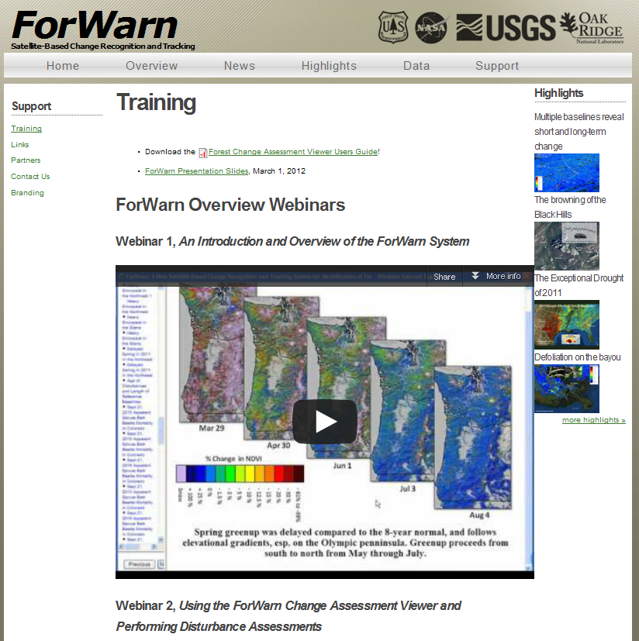

Slide 33
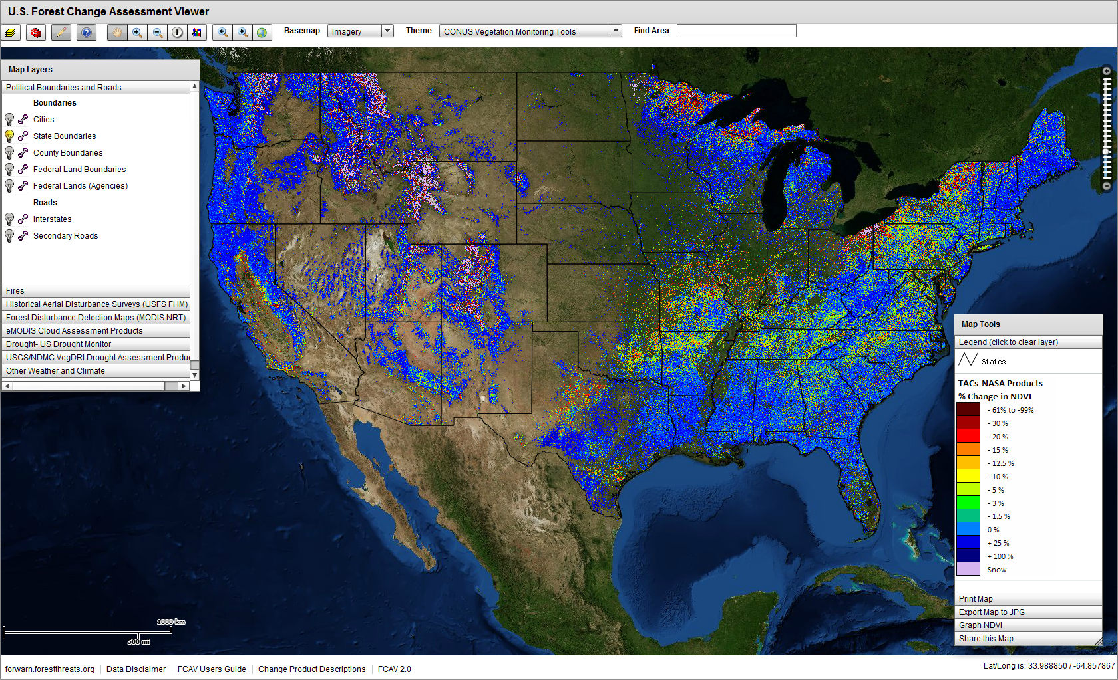

Slide 34
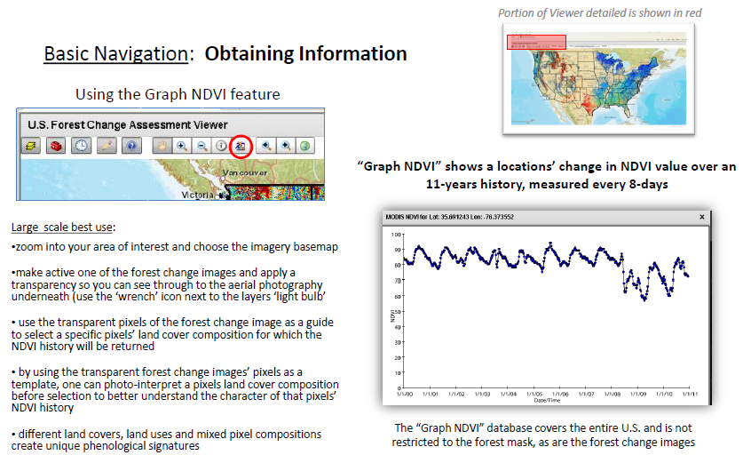

Slide 35
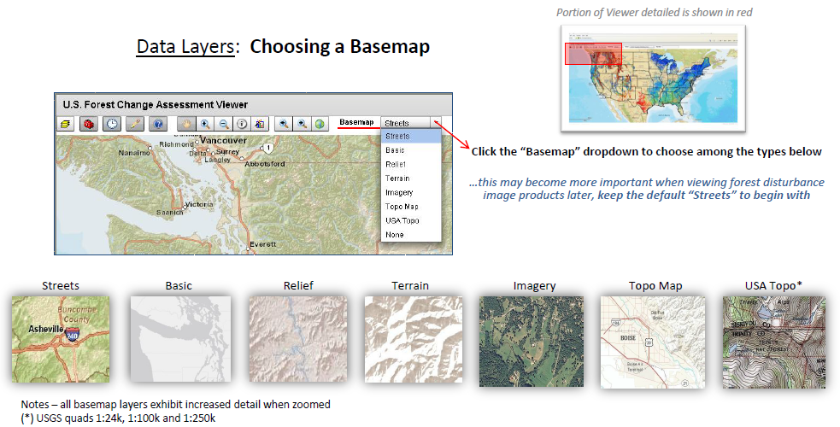

Slide 36
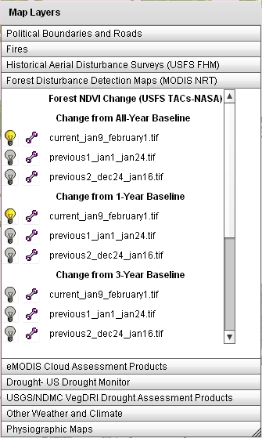
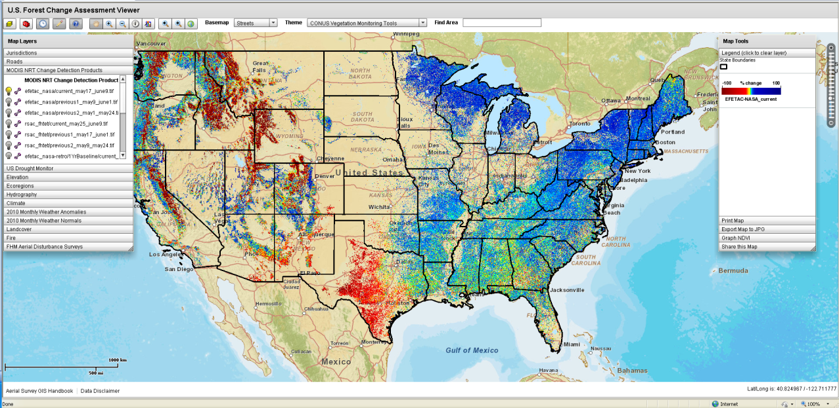
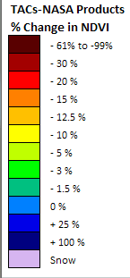
ForWarn Quick Start Guide
Open this URL in a web browser http://forwarn.forestthreats.org/fcav
In the Table of Contents window, click on the tab heading “Forest Disturbance Detection Maps” to expand and view the data layers (NRT – near real time)
By default, the most recent forest change image in the “All-Year” baseline will be displayed. This image is a result of comparing the most recent MODIS NDVI image to the maximum NDVI value over the entire MODIS NDVI history (12+ years), and shows all forest disturbances over the entire historical period.
Turn-off the most recent “All-Year” baseline image and turn-on the most recent in the “1-Year” baseline group. This allows one to view only forest disturbance, or recovery, that has occurred within just the past one year (for this specific time period).
Use the map controls to zoom and pan, or type the name of a county in the “Find Area” box in the top-right area of the FCAV viewer window
Use the ‘wrench’ icon to adjust the transparency of any layer to better view the basemap , or other layers
Table of Contents
window expanded

Slide 37
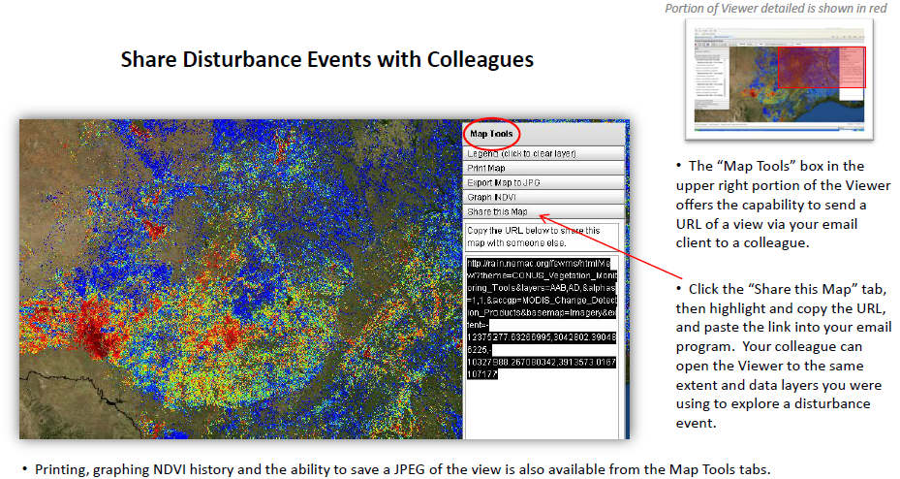
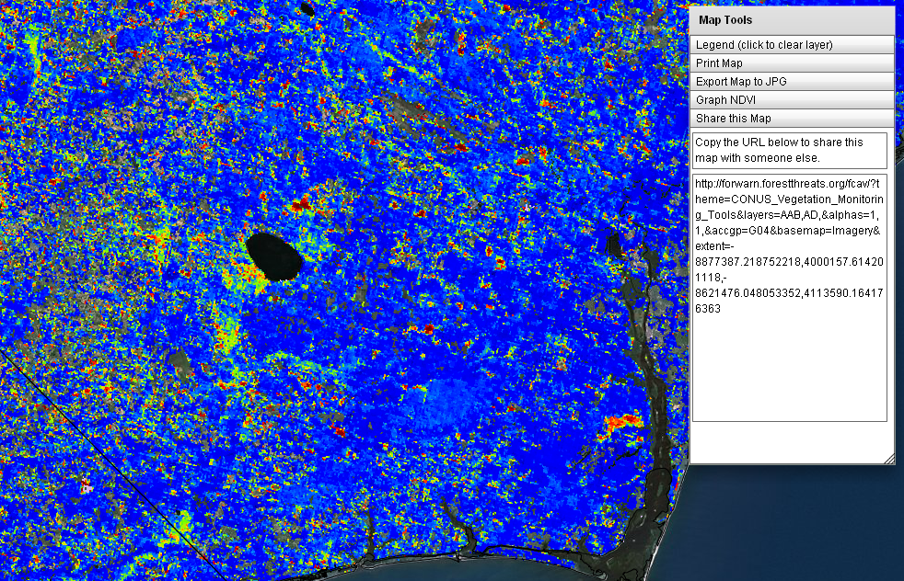

Slide 38
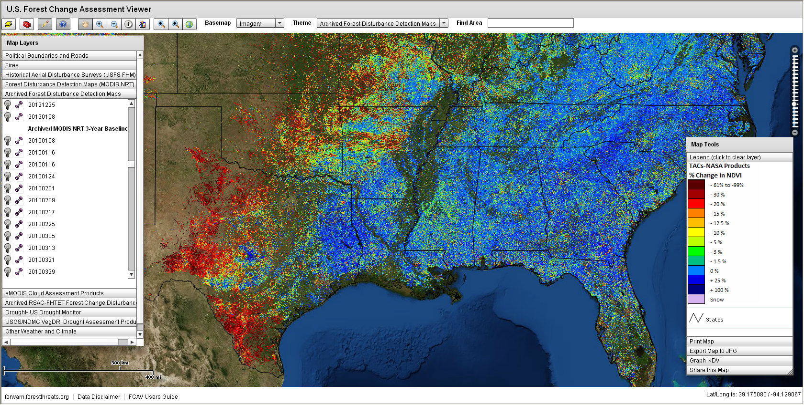

forwarn.forestthreats.org/fcav

Slide 39
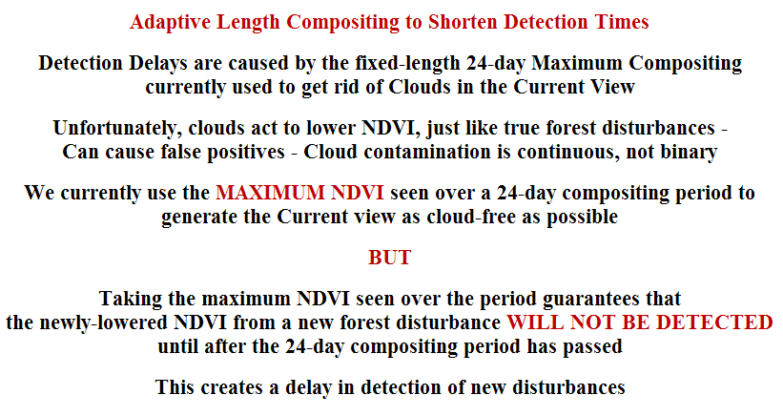
Application Limitation
- Detection delay due to compositing method -
Three additional change products now available:
(1) derived from an ‘Adaptive Length Compositing’ method, and
(2) called Seasonally Adjusted, which mitigates annual seasonal variations in the timing of spring and fall

Slide 40
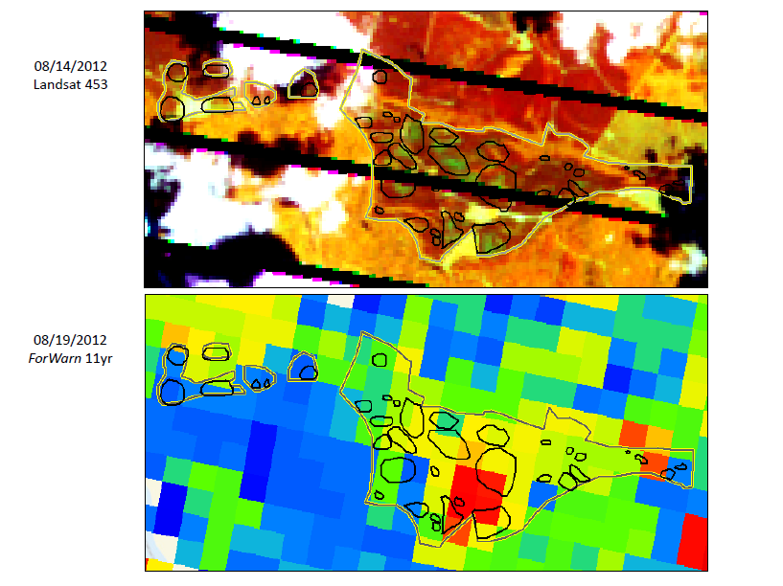

Application Limitation
- Spatial resolution -

Slide 41
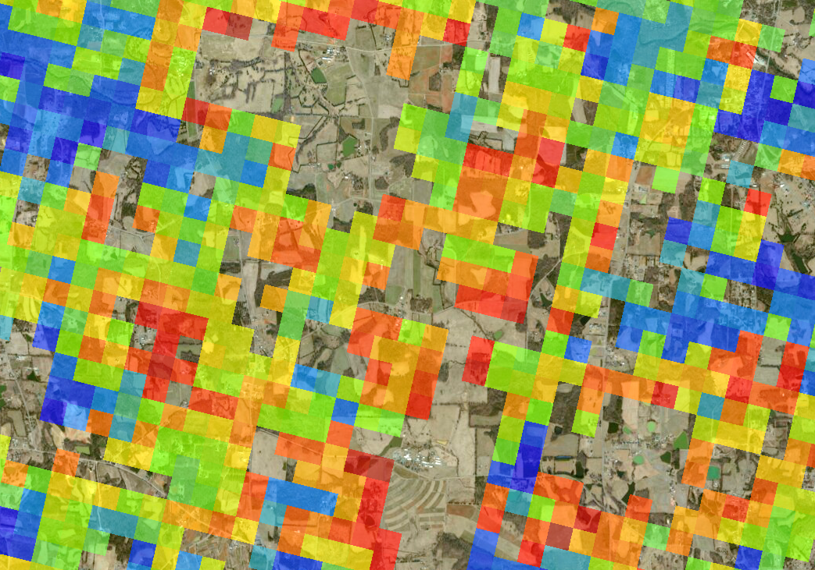
Application Limitation Awareness
- “Edge-of-the-mask” mixed pixels -
Drought Sensitivity at the ‘edge-of-the-mask’

Slide 42
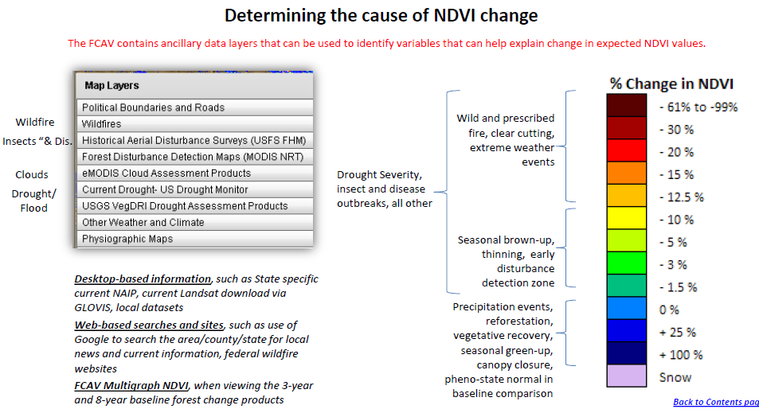
Forest Disturbance Assessment Layers

Slide 43
Forest Disturbance Assessment Process
Locate (understand geographic site and situation)
  Land cover / land use (recent aerials)
  Topographic position (in mountainous terrain elevation and aspect may
  be important, use topographic maps, hill shade)
Characterize (NDVI departure)
  Progression speed and duration (fast vs. slow, obs. successive images)
  Severity, or percent NDVI change (positive or negative, light-to-heavy)
  Spatial extent (large area or localized)
  Pattern and shape (spotty/scattered, bulls-eye, target-like, linearity)
  Edges (hard, well defined or trails-off, feathers out with less departure)
  Seasonality (in spring and fall, the regional variation in annual phenology
  can cause NDVI departure, positive or negative )
Assess (using data layers in the Forest Change Assessment Viewer)
  Use ancillary data layers in the ‘Viewer’ to vet disturbance or recovery
  Reference ‘Disturbance Protocol’ document

Slide 44
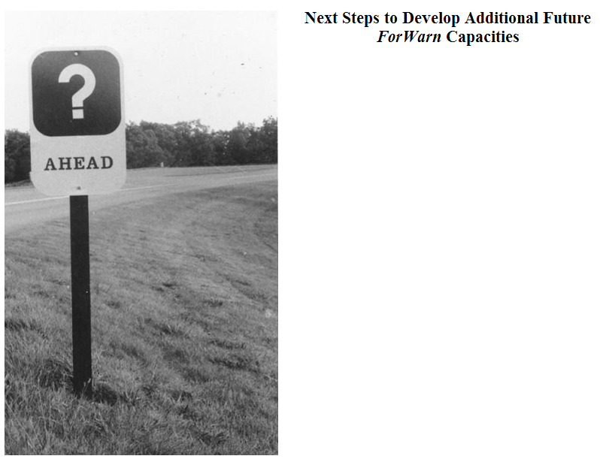
NLCD-based “Masks”
New Open-Source “FCAV Viewer”
Clip, Zip and Ship functionality
Download data by point/line/polygon
User-shapefile upload
Disturbance auto-detect
Disturbance auto-notify via any
social media format

Slide 45




Slide 46




