Slide 1
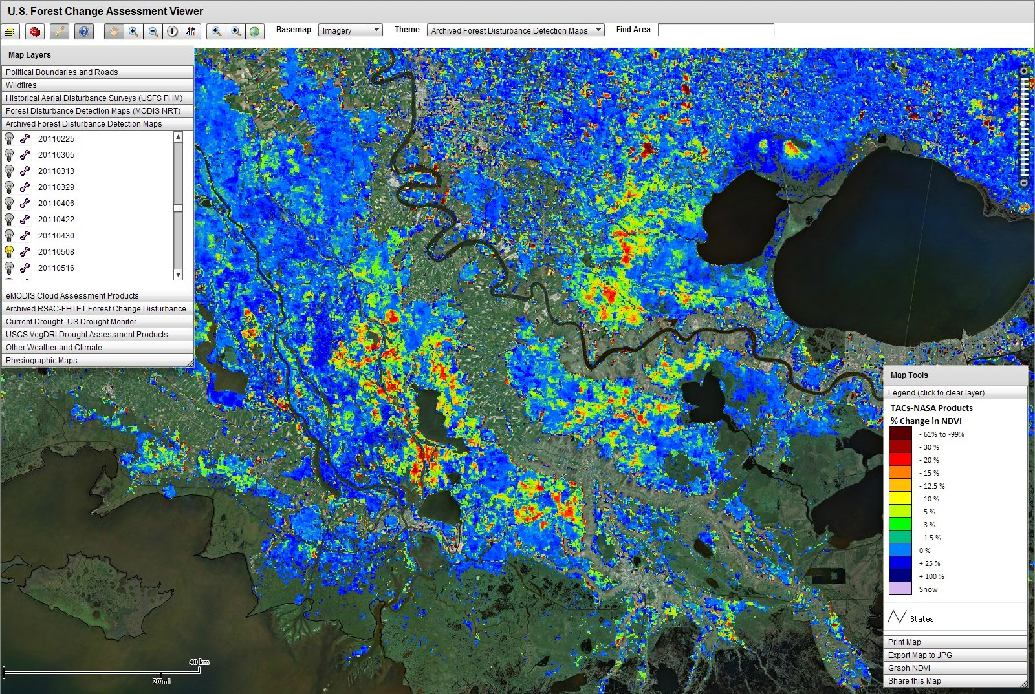
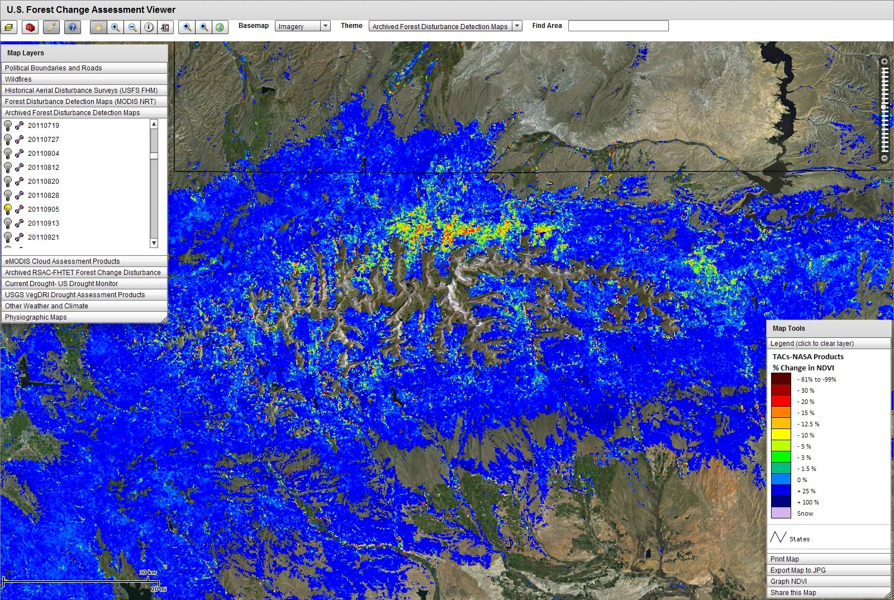
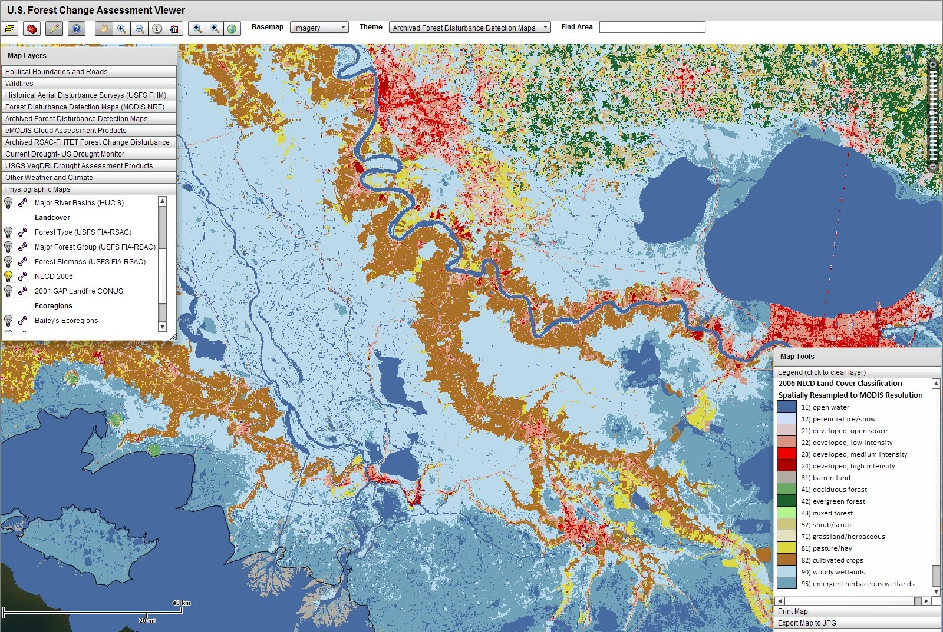
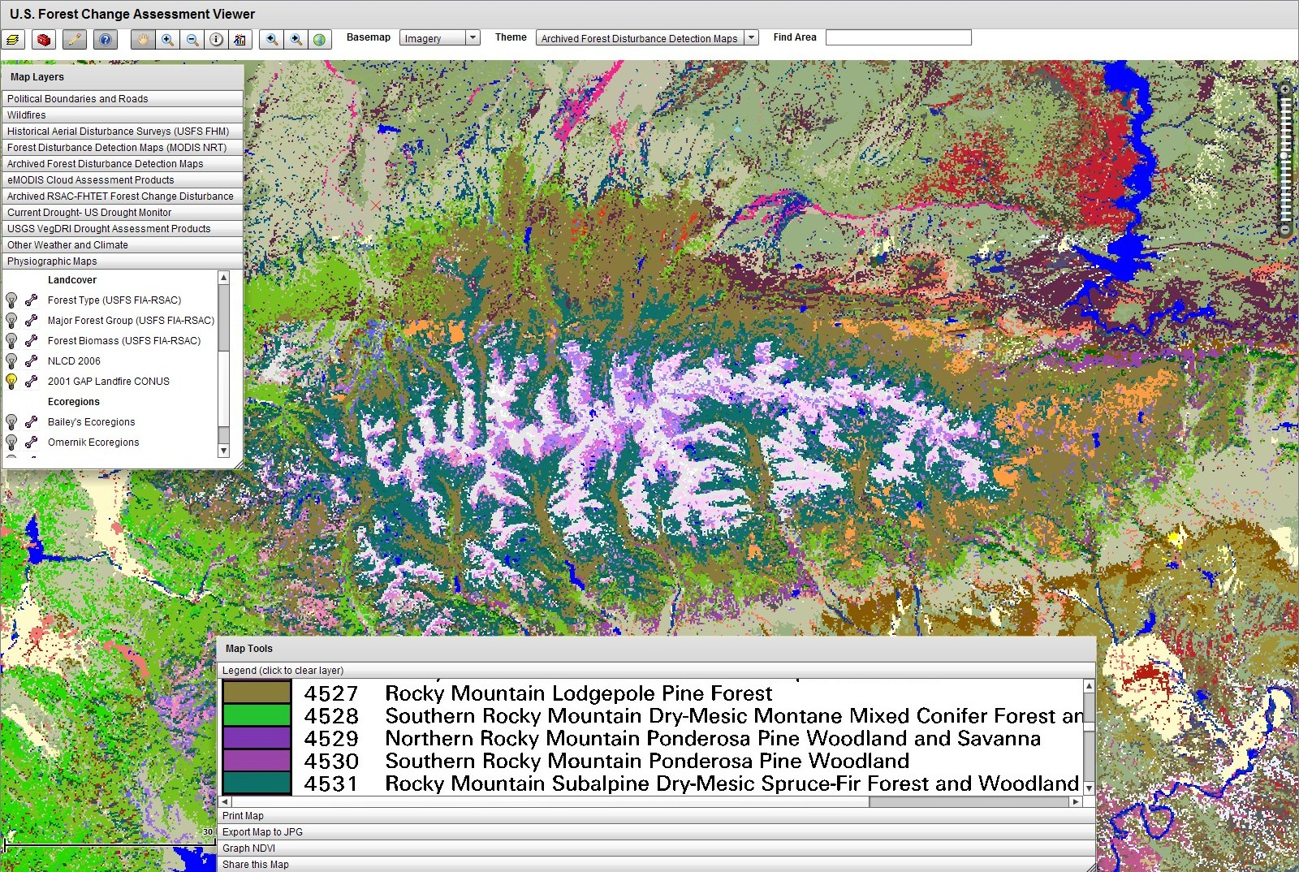
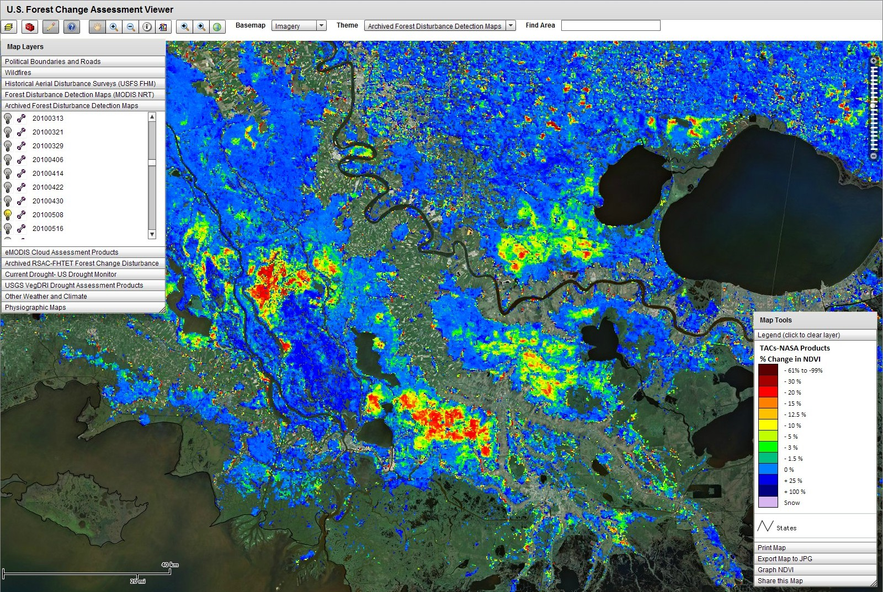
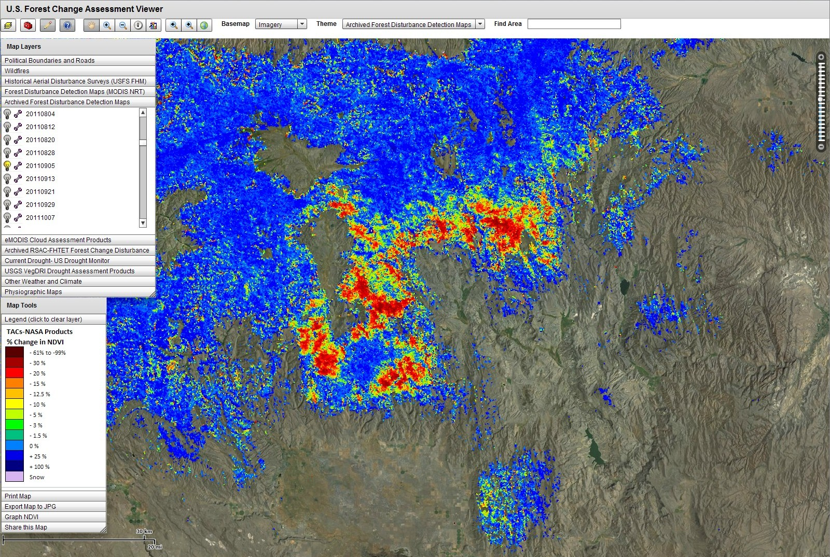
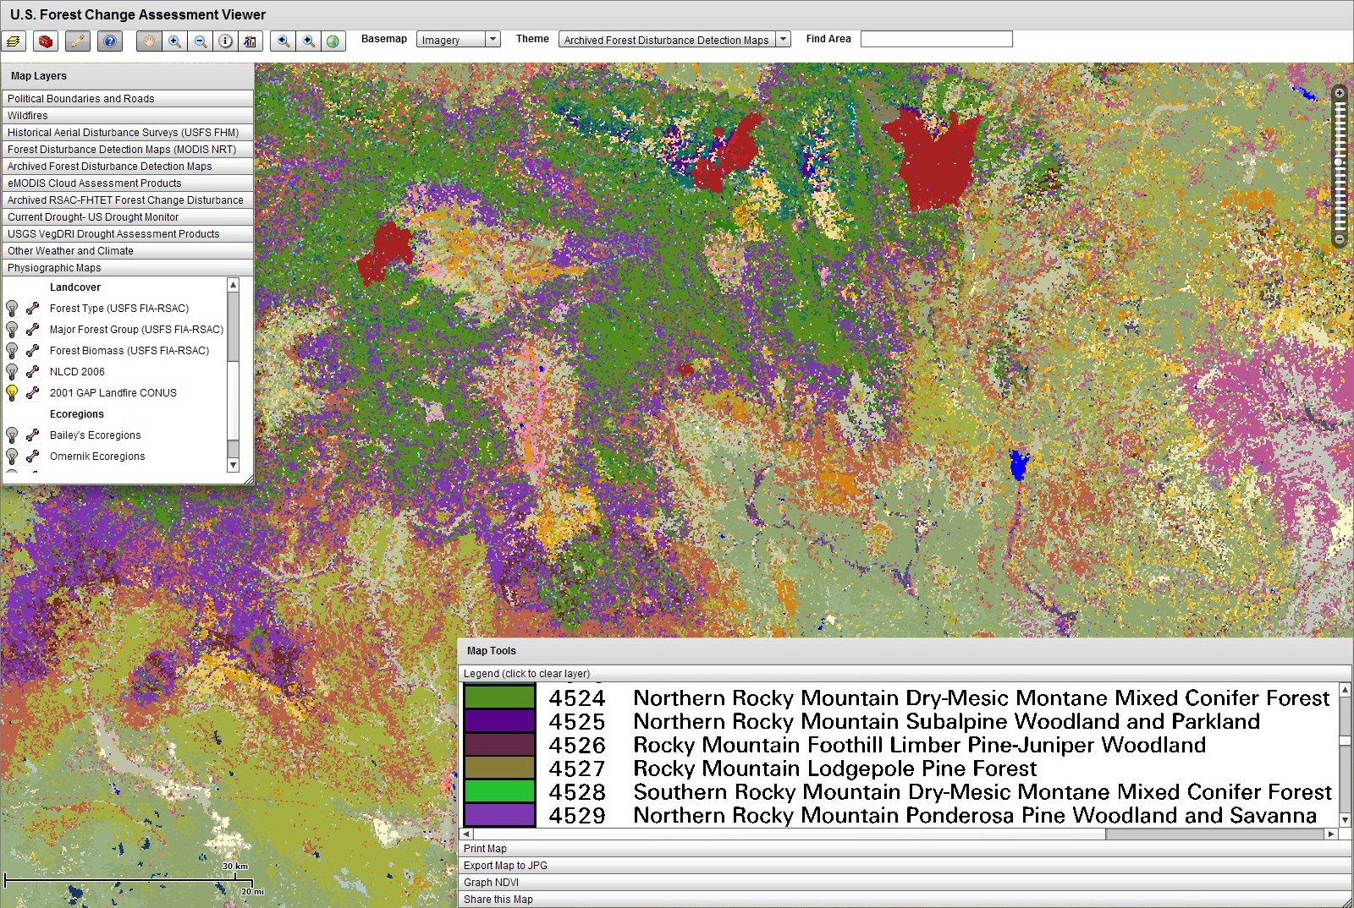
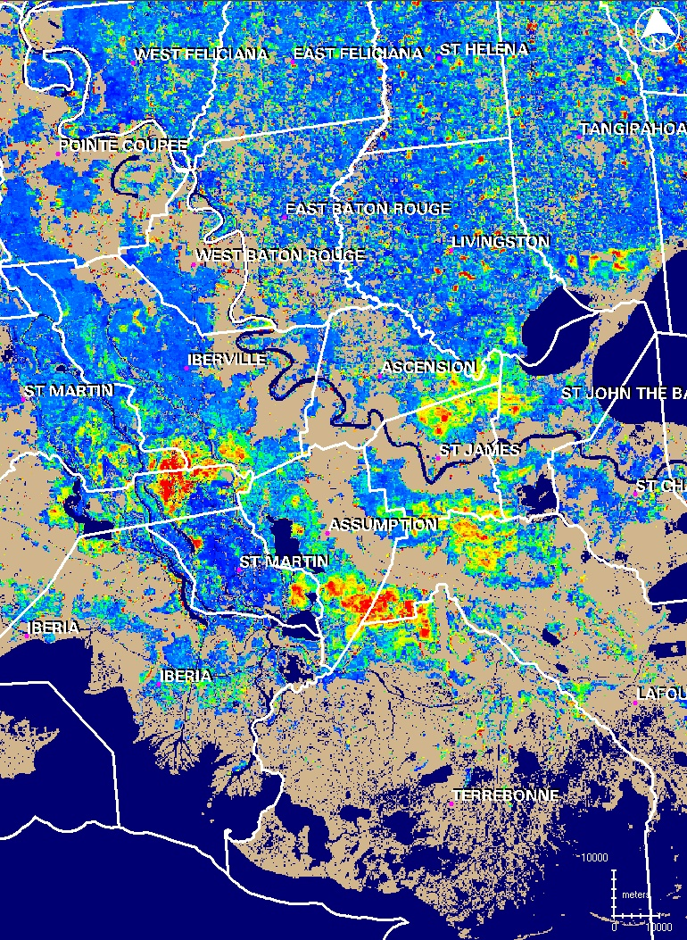
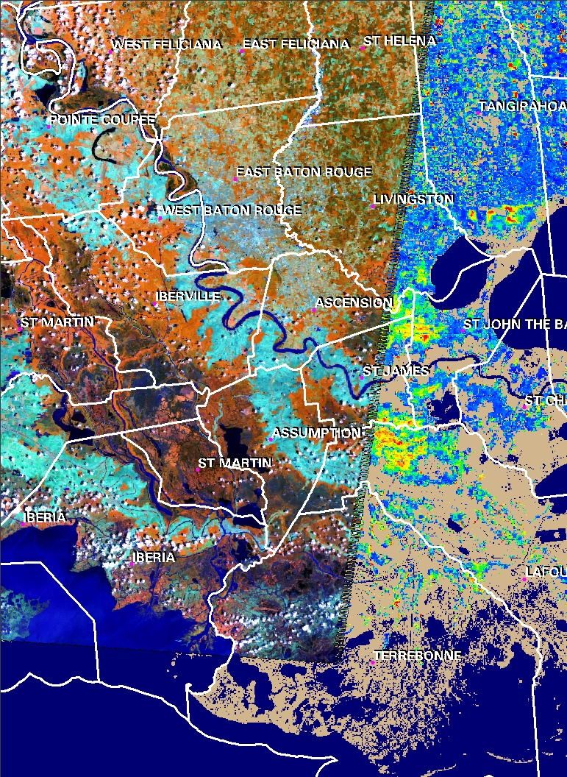
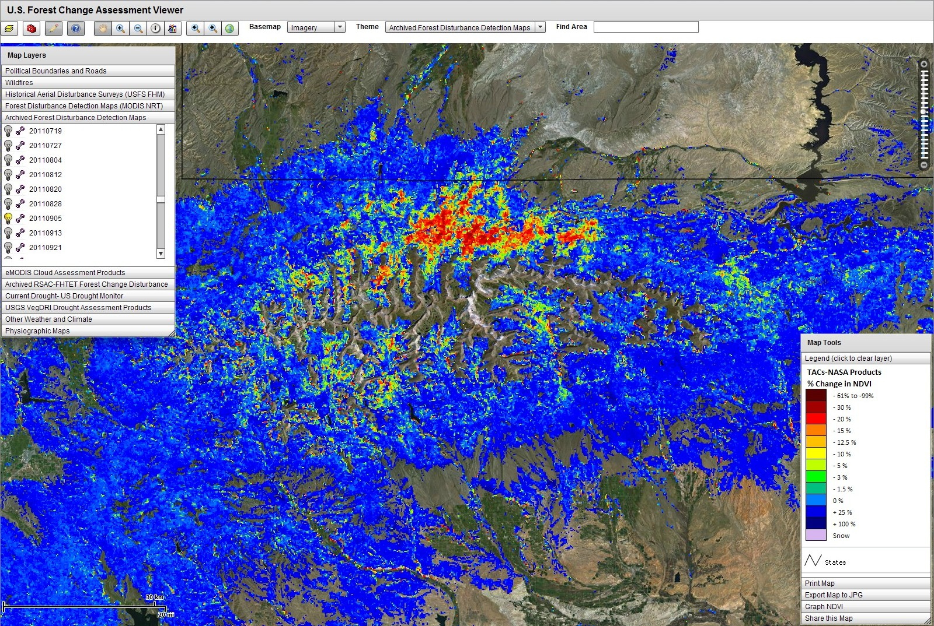
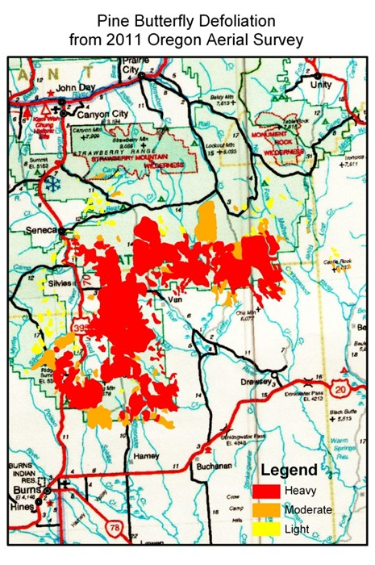
Example 2011 Forest Disturbance Detections Using MODIS Satellite Data Products
Resident to the US Forest Service ForWarn System
W.H. Hargrove¹; J. Spruce²; G. Gasser³; J. Smoot²; P. Kuper² 1. Eastern Forest Environmental Threat Assessment Center, USDA Forest Service, Asheville, NC, USA
2. Computer Science Corporation, Contractor to NASA Applied Science and Technology Project Office, Stennis Space Center, MS, USA
3. Lockheed Martin Civil Programs, Stennis Space Center, MS, USA
POC Email: hnw@geobabble.org
Introduction
Results and Discussion
This poster discusses near real time (NRT) 2011 MODIS forest disturbance detection products within the ForWarn system for forest change recognition and tracking. This system is being developed by the U.S. Forest Service (USFS) Eastern and Western Threat Centers with help from NASA, ORNL, and the USGS (Hargrove et al., 2009).
Forests occur on approximately 751 million acres of the United States, representing almost a third of the entire U.S. land base. Such forests can be negatively impacted or threatened by disturbances from biotic and abiotic factors, some of which are associated with climate change (e.g., drought, fire, insect attacks).
Current geospatial information on forest disturbances is a crucial component of ForWarn as part of a national forest threat EWS.
Temporally processed daily MODIS satellite data was used in the EWS to monitor 2011 forest disturbances at broad regional to CONUS scales.
The 2011 national forest disturbance detection products build upon previous work since 2006 , as discussed by Hargrove et al. (2009).
These products use USGS eMODIS expedited NDVI data for 2011 and pre 2011 MOD13 NDVI products for computing historical NDVI baselines.
MODIS-based NRT and other geospatial visualization products were posted each week on the EWS’s FCAV that depicted regionally evident 2011 forest disturbances (e.g., damage from insects, storms, and fire).
Computed forest change products from multiple baseline enabled many current, recent, and longer term disturbances to be assessed (Figures 1, 3-6, and 8).
More severe disturbance (e.g., mortality from fire and beetles) usually showed higher NDVI drops than ephemeral disturbance (e.g., caterpillar defoliation).
The 24 day compositing period and the fusion of MODIS Aqua and Terra data helped to mitigate cloud contamination effects, though product sometimes showed false NDVI drops apparently due to frequent bad weather.
The use of rainbow color tables on the % NDVI change products within the FCAV aided the visualization of regionally evident forest disturbances.
Effective NRT regional products were posted typically with low latencies of 1 -2 days after last collection date.
Conclusions and Future Work
Figure 1. ForWarn forest change product showing coastal Louisiana spring 2011 swamp forest defoliation (hot colors) for date ending 5/8/2011, incorporating a 2008-2010 baseline .
The results for 2011 included multiple examples in which MODIS NRT forest change products showed regionally evident forest disturbances
The on-line posting of refreshed NRT geospatial products into the FCAV enabled end-users with a means to view and track regionally evident forest disturbance.
The MODIS NRT % change in forest NDVI products enabled many extensive forest disturbances to be viewed and tracked during the 2011 growing season.
Forest change products based on 3 baselines was useful for assessing forest disturbance vintage and persistence, both for single and multiyear events.
Additional research is being done to assess whether MODIS phenology products such as these could be further applied to identify and quantify the areal extent of forest disturbance across CONUS.
Future work will include efforts to further automate forest disturbance detection and attribution. GIS techniques are being used to assess disturbance persistence and the year in which a given disturbance initially occurred.
These products also have potential for aiding climate change studies, such as research on forest mortality associated with prolonged drought.
Several other MODIS phenological products are being assessed for aiding forest disturbance monitoring needs of ForWarn, including cumulative NDVI products.
Figure 6. ForWarn forest change product for the Uinta Mountains showing fresh change in bark beetle damaged forests. This map is for date ending 9/5/2011, using a 2010 baseline.
Methods
Acquired and applied MODIS NDVI data to compute near real time “weekly” % change in forest NDVI products, based on 24 day temporal composite products that are refreshed every 8 days.
Historical MODIS NDVI products were derived from temporal processing and fusion of MODIS Aqua and Terra NDVI.
Current eMODIS NDVI data was used to compute current NDVI and MOD13 NDVI products were used to compute historical baselines.
Historical NDVI baseline products were computed for 2010, 2008-2010 and 2003-2010 time frames.
Computed forest % NDVI change products for each 24 day analysis window, comparing current year NDVI to that from each baseline.
Change products are posted in ForWarn, a near real time on forest threat EWS tool that includes the U.S. Forest Change Assessment Viewer (FCAV) – see http://forwarn.forestthreats.org/fcav (Figures 1-8).
Also supplied forest change products to USFS FHTET Forest Disturbance Mapper (FDM) tool to assist 2011 aerial disturbance detection surveys.
Assessed apparent disturbances compared to available reference data (Landsat, aerial, and ground-based geospatial data) and through communications with federal and state agency forest health specialists.
References
Figure 2. ForWarn circa 2006 land cover map from the National Land Cover Database for southeastern Louisiana. This product is resampled to the MODIS 231.66 meter cell size.
Hargrove, William W., Joseph P. Spruce, Gerald E. Gasser, and Forrest M. Hoffman (2009). Toward a national early warning system for forest disturbances using remotely sensed canopy phenology. Photogrammetric Engineering & Remote Sensing, 75:1150-1156.
Figure 7. ForWarn circa 2001 high specificity land cover map from the GAP/Landfire programs. This product shows forest types for disturbed areas in Figures 6 and 8.
Figure 3. ForWarn forest change product showing Louisiana spring 2010 swamp forest defoliation in hot colors for date ending 5/8/2010, incorporating 2007-2009 baseline.
Figure 4. ForWarn forest change product for Oregon’s Blue Mountains showing NDVI drops in area defoliated by pine butterflies. For date ending 9/5/2011, product uses a 2010 baseline.
Figure 5. ForWarn circa 2001 high specificity land cover map from the GAP/Landfire programs. This shows the forest types for disturbed areas in Figure 4.
Figure 8. ForWarn MODIS forest change product view of the Uinta Mountains, showing change versus a 2008-2010 baseline. This product is for date ending 9/5/2011.

