Slide 1
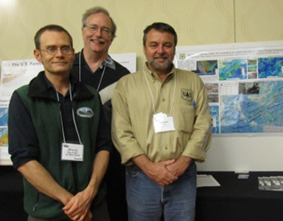
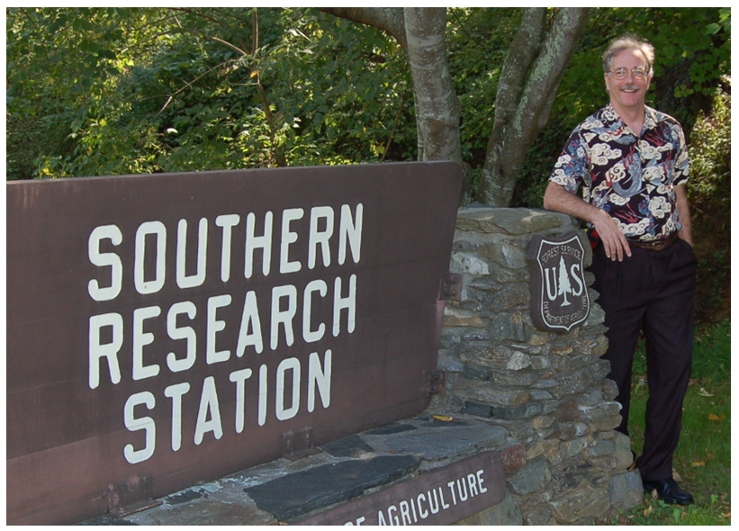

Slide 2
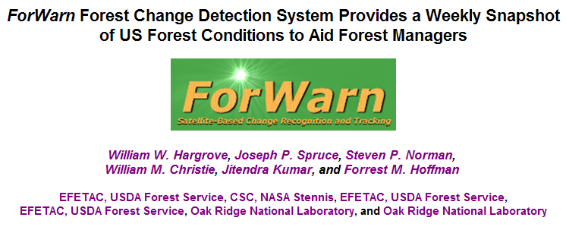

Slide 4
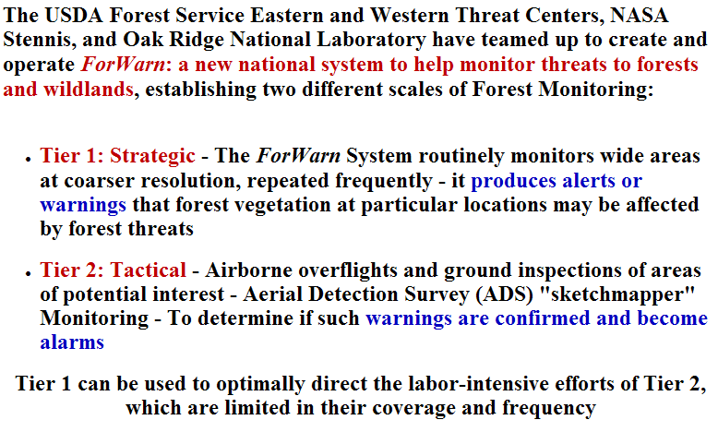

Slide 5
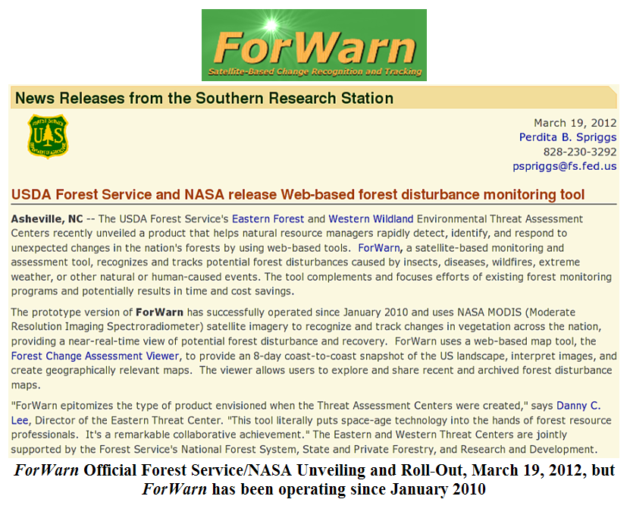

Slide 6
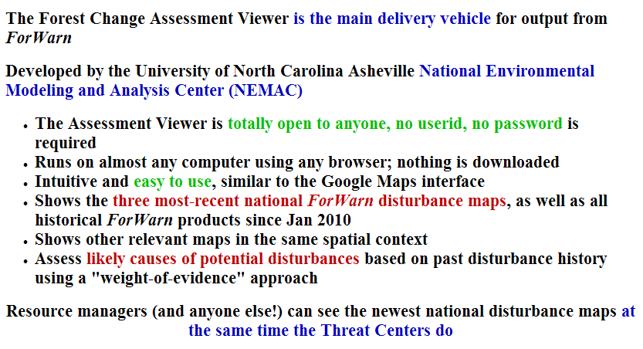

Slide 8
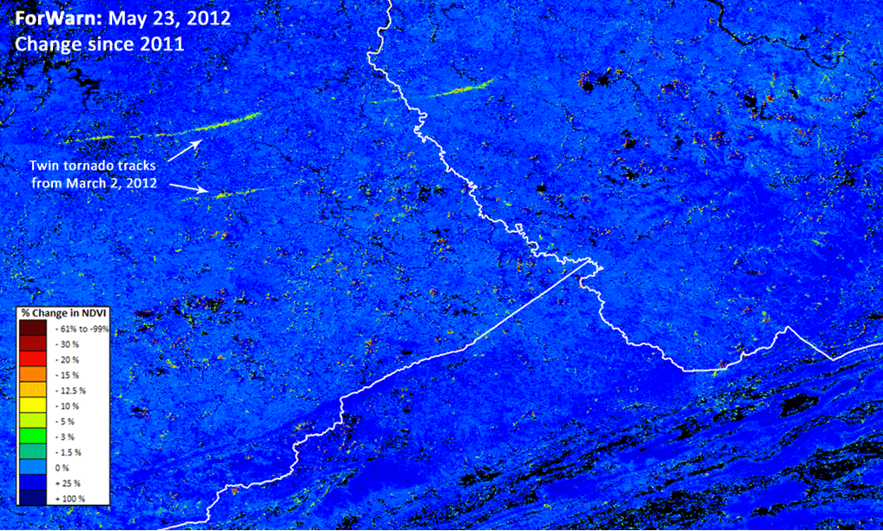

Slide 9
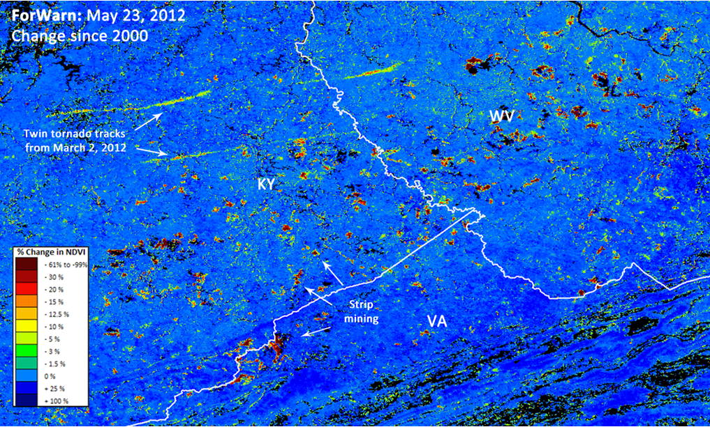

Slide 10
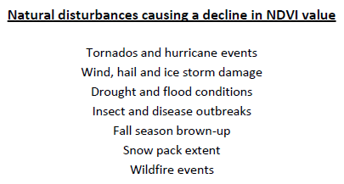
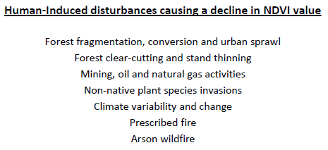
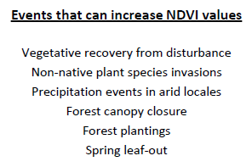
Examples of forest disturbance, or recovery, seen in the ForWarn forest change images
Forest disturbance events often display degrees of severity. Variation in rates of recovery can relate to ecological, or vegetative resilience.

Slide 11
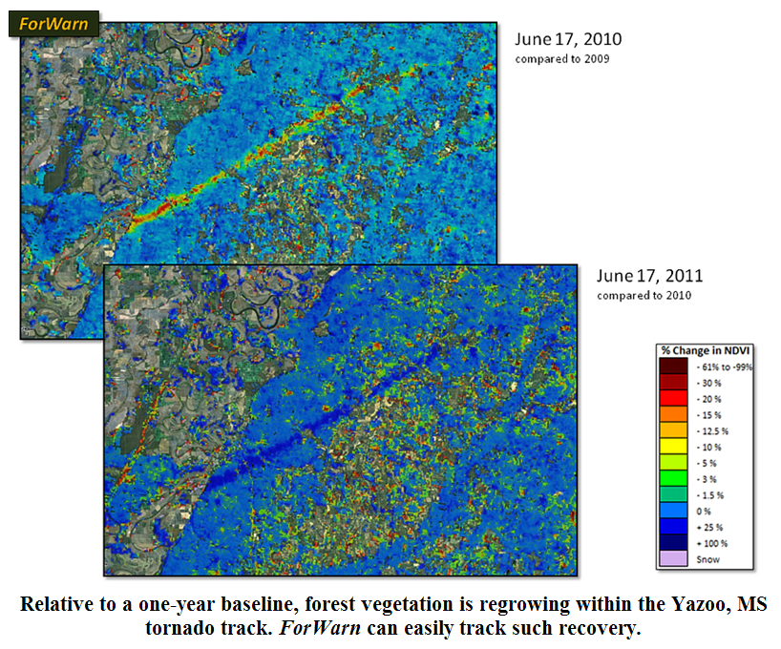

Slide 12
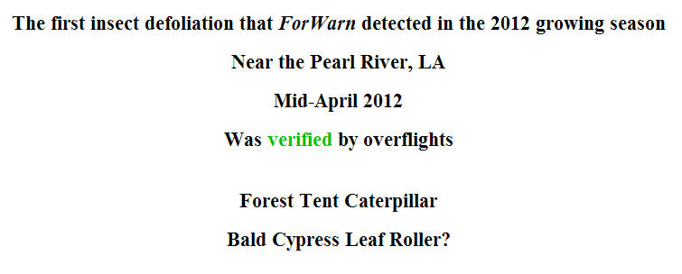

Slide 13
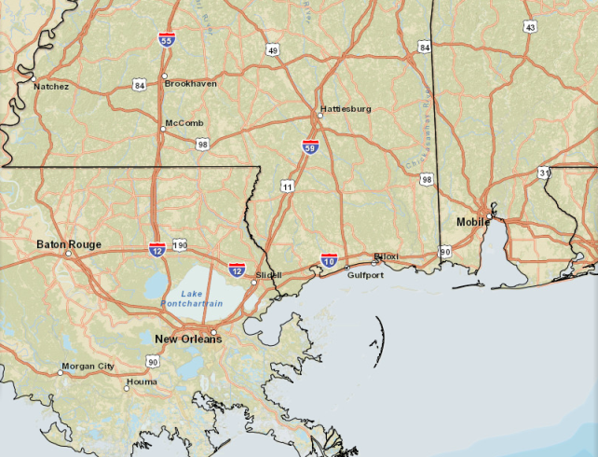
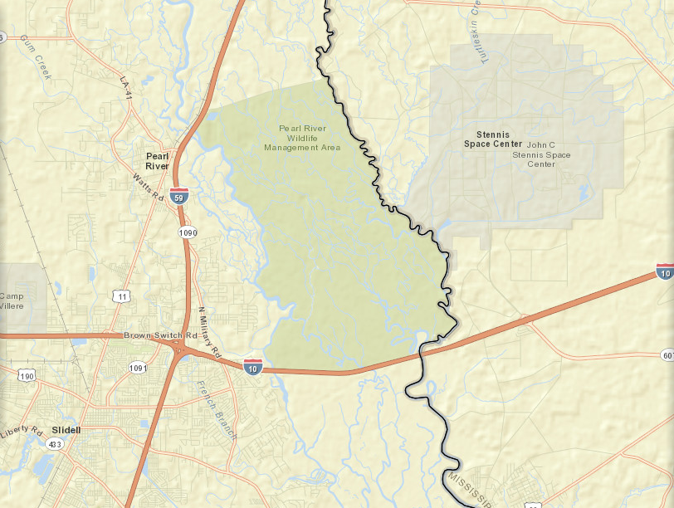

Slide 14
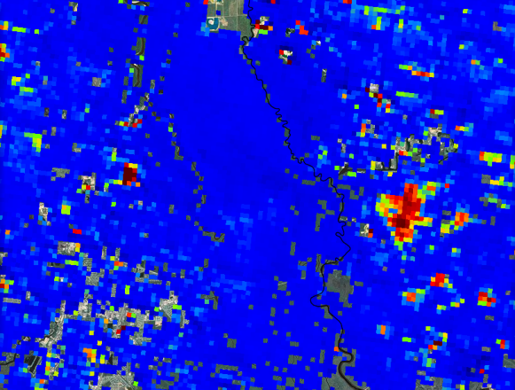
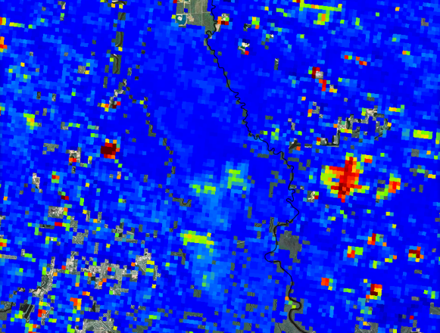
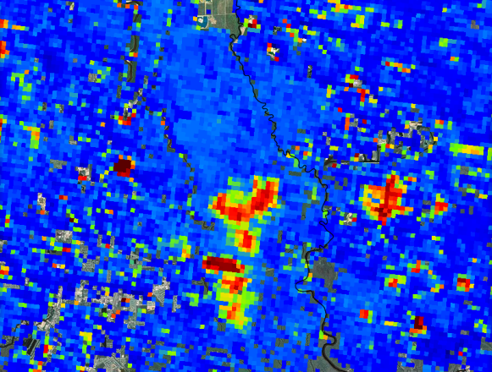
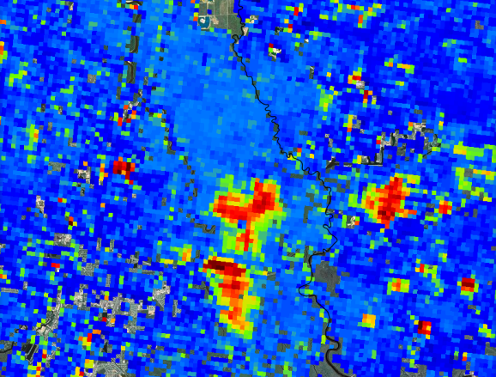
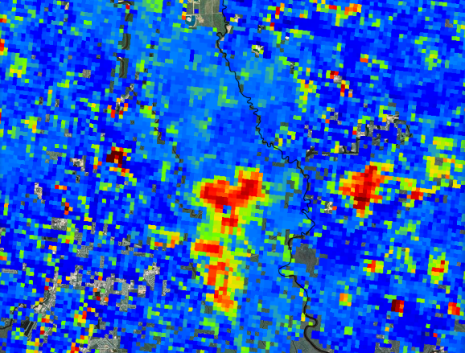
04/05/2012
04/13/2012
04/21/2012
04/29/2012
05/07/2012

Slide 15
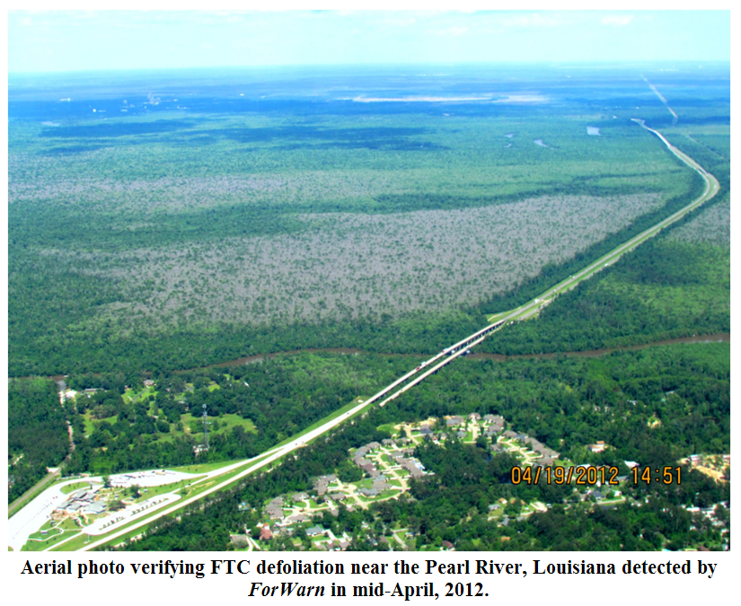

Slide 16
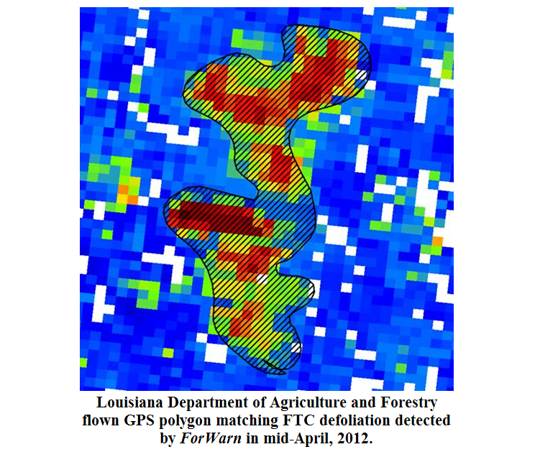

Slide 17
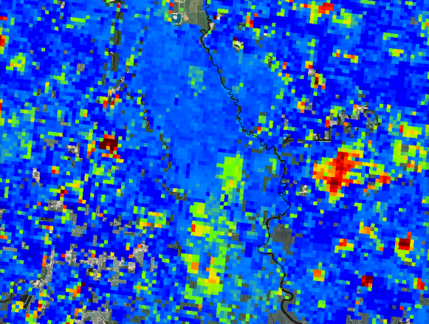
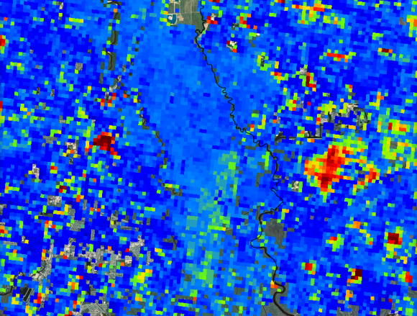
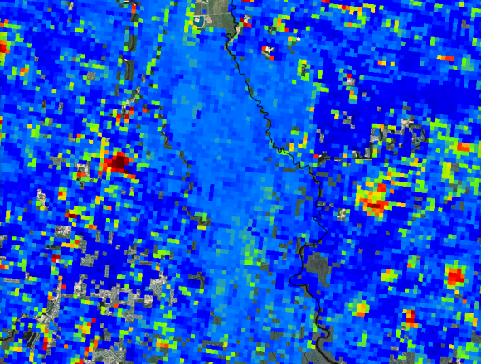
04/05/2012
04/13/2012
04/21/2012
04/29/2012
05/07/2012
05/15/2012
In ForWarn, this disturbance lasted approximately 4-weeks from inception to recovery. This was also witnessed in the Mobile Delta in Alabama. The consequence from this disturbance agent is a temporary loss of forest productivity.
05/23/2012
05/31/2012

Slide 18
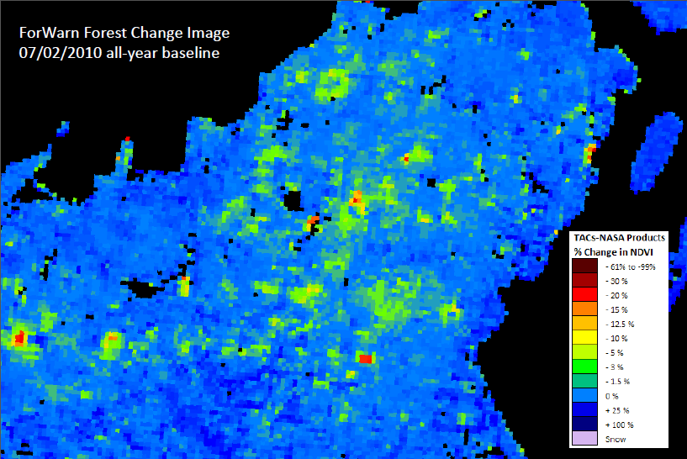

Slide 19
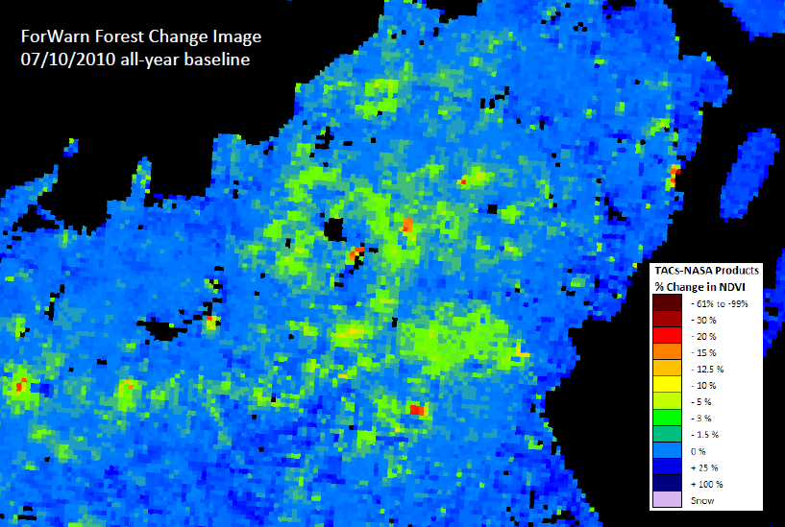

Slide 20
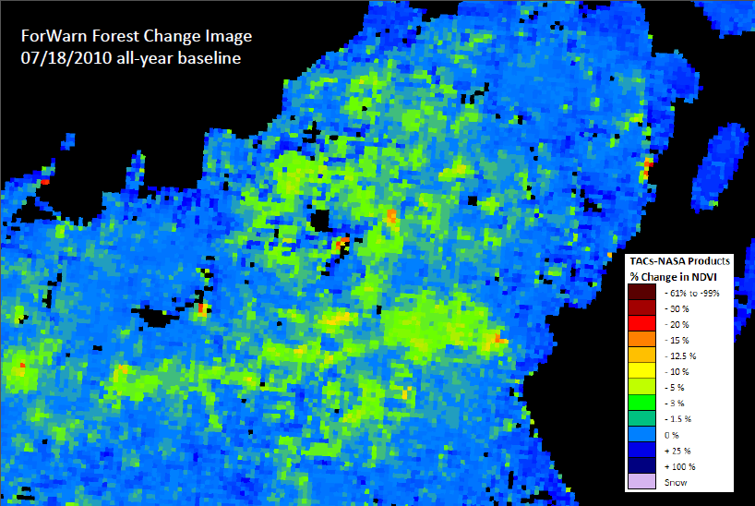

Slide 21
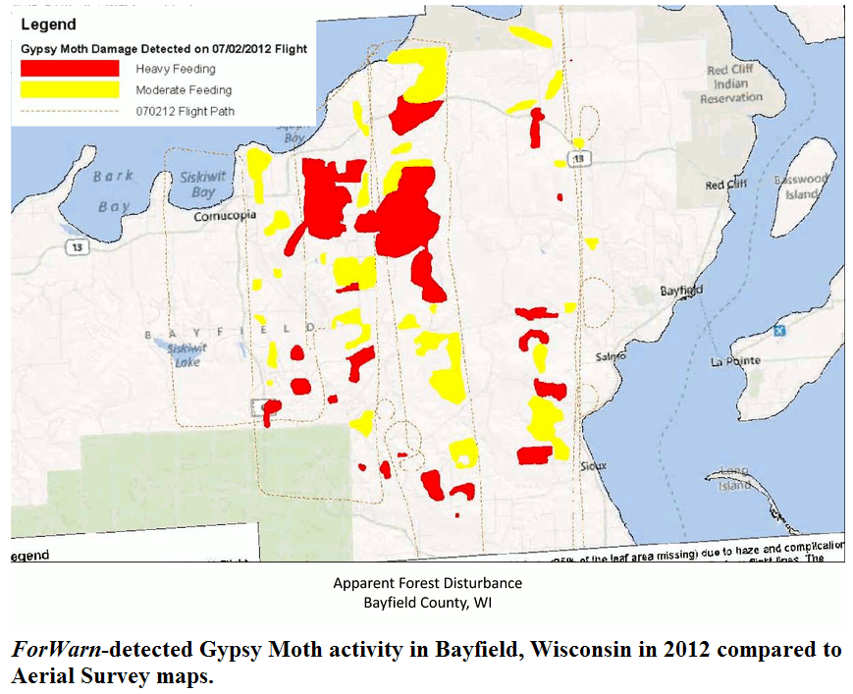

Slide 22
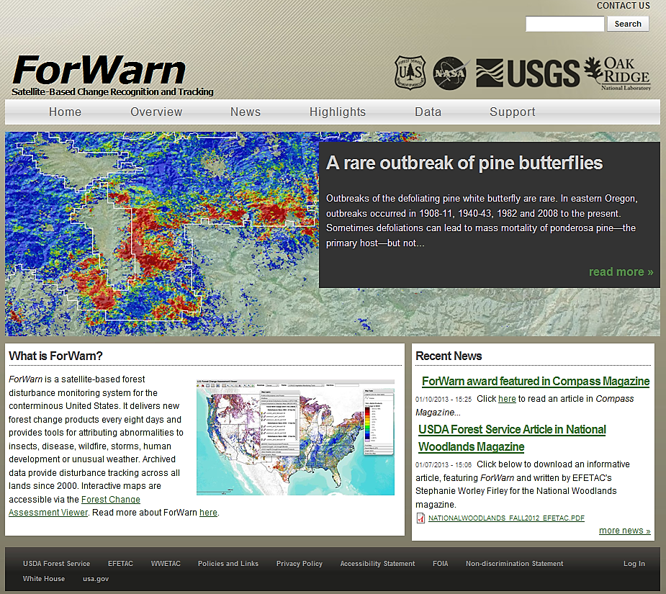
forwarn.forestthreats.org

Slide 23
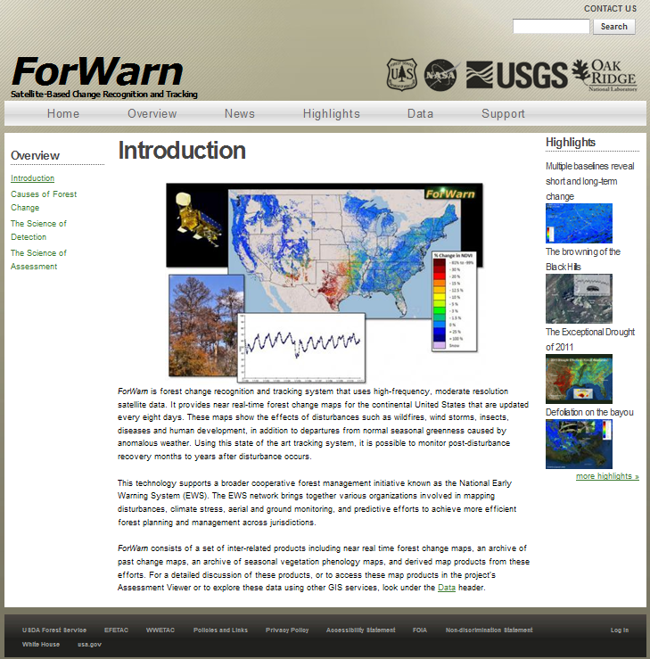

Slide 24
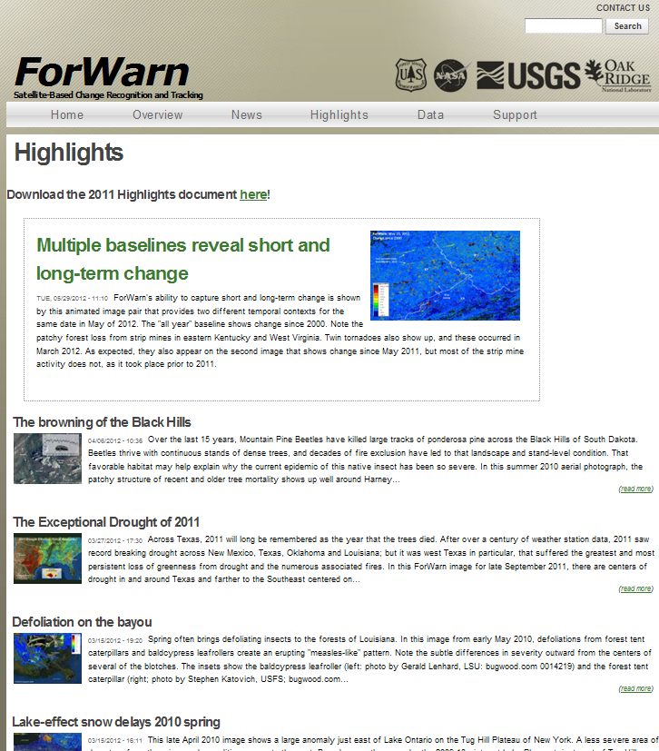

Slide 25
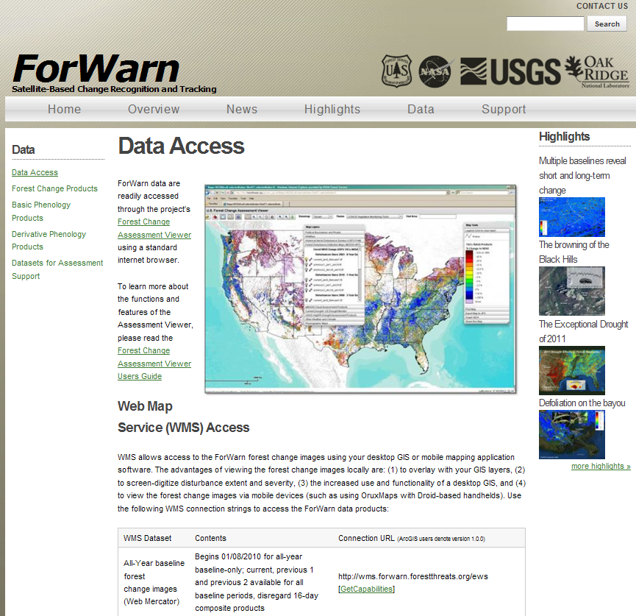

Slide 26
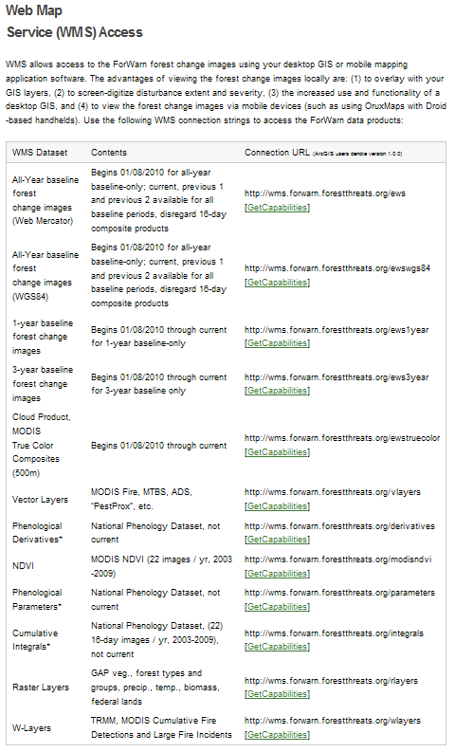
If you need a quick shapefile of a specific disturbance event, you can use the WMS on the desktop to screen-digitize the extent, and if present, depict zones of severity

Slide 27
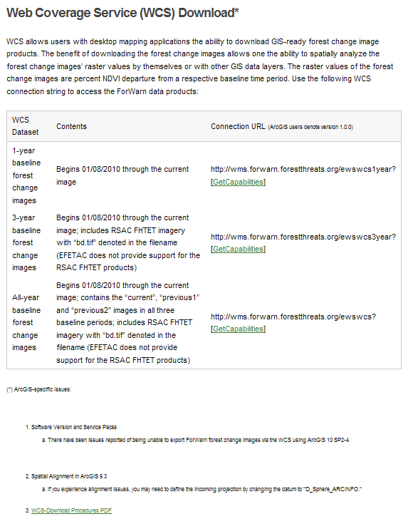

Slide 28
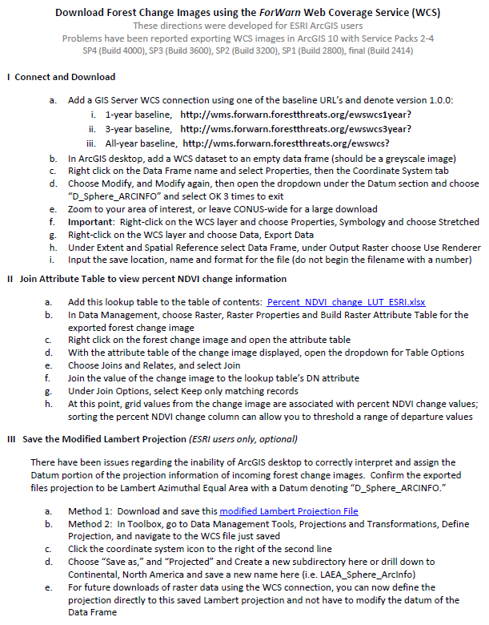

Slide 29
for
Android
devices
(independent
from the FS)

Slide 30
…we are a public service agency and glad to provide ForWarn products via FS FTP

Slide 31
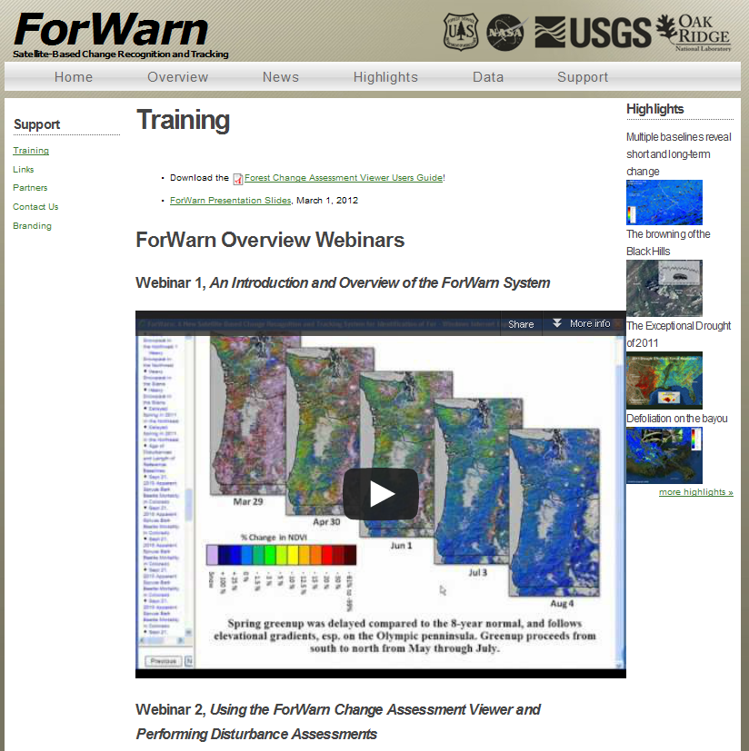

Slide 33
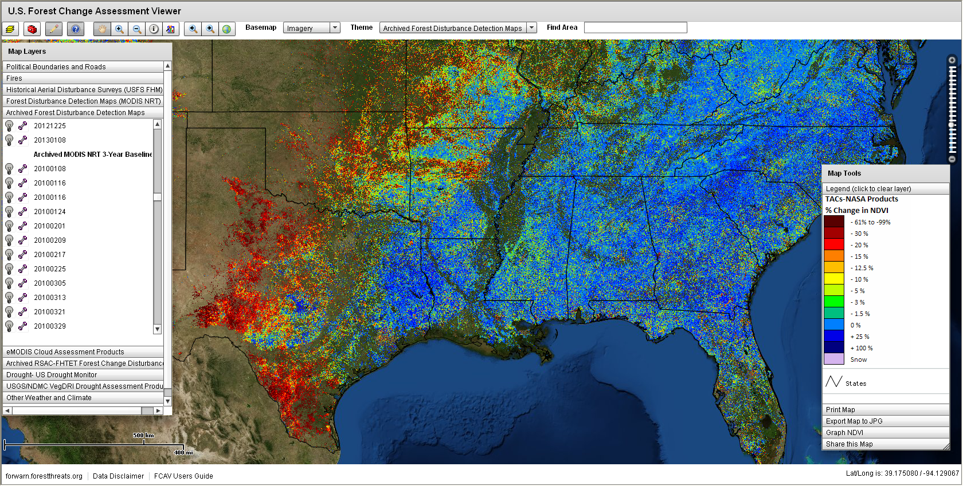
forwarn.forestthreats.org/fcav

Slide 36
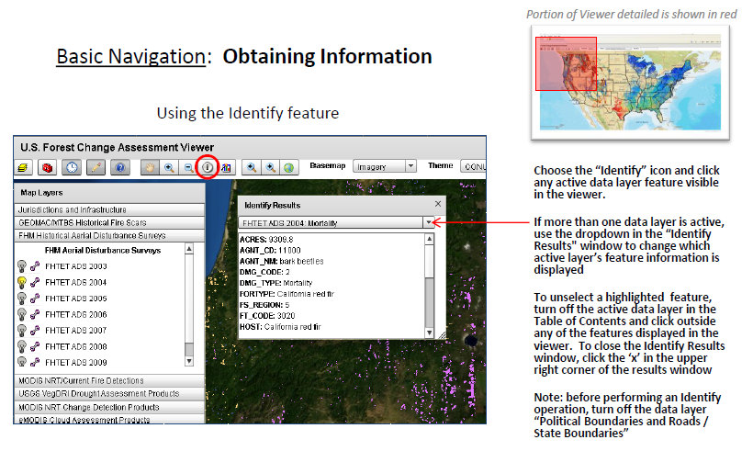

Slide 40
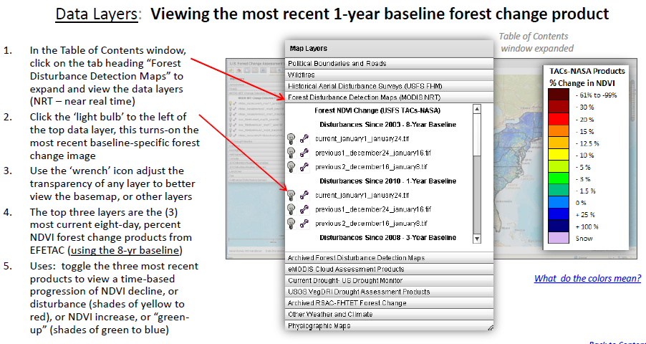

Slide 41
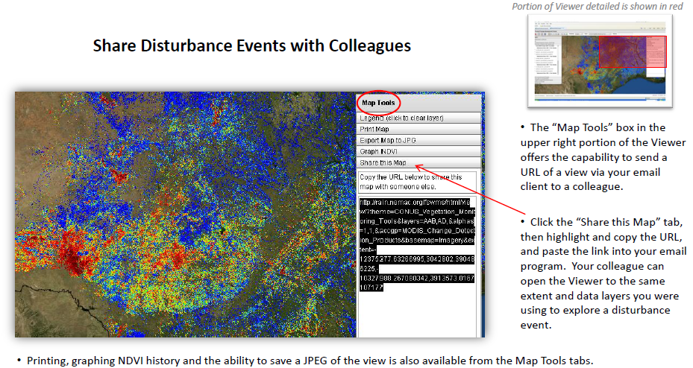
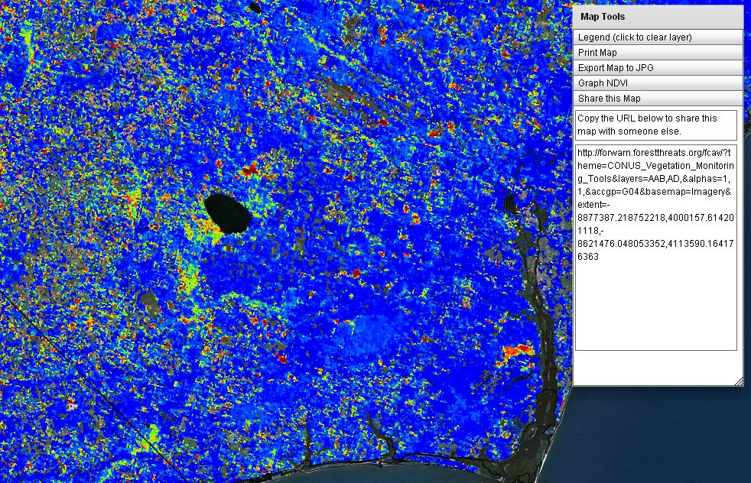

Slide 42
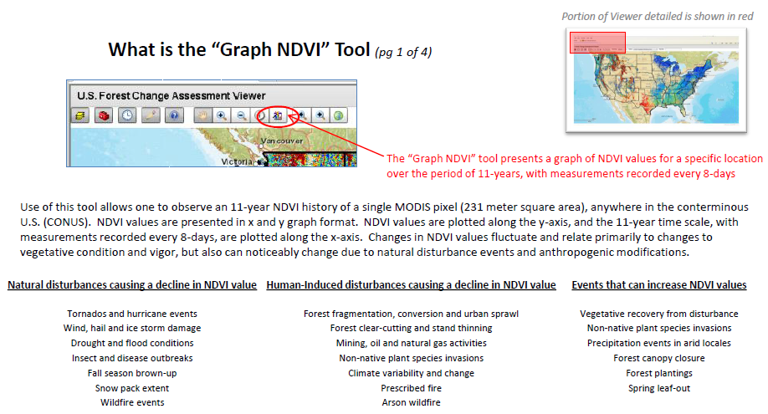
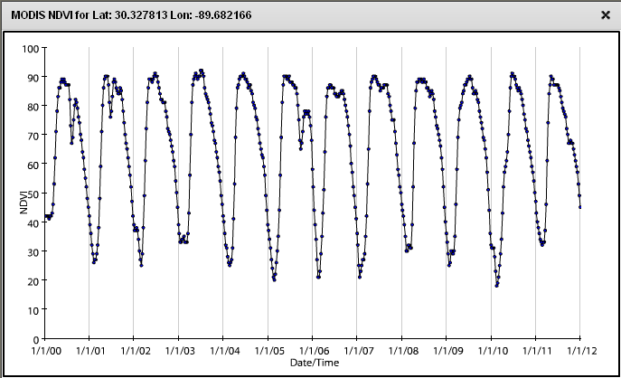

Slide 43
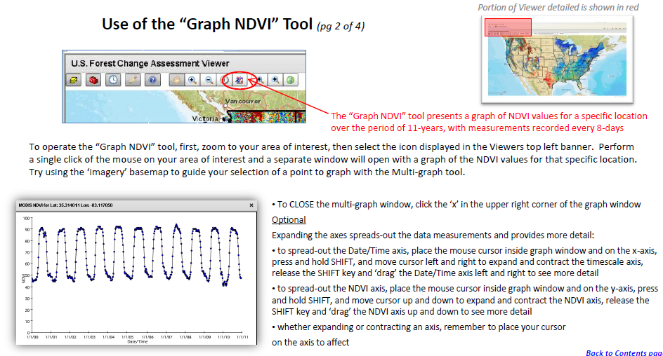
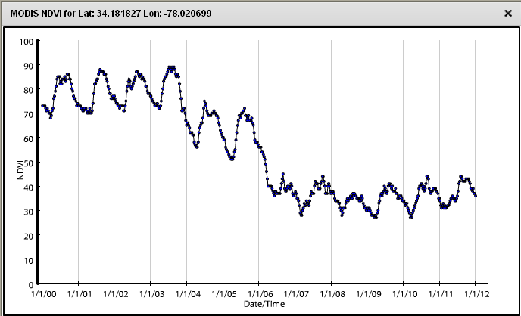
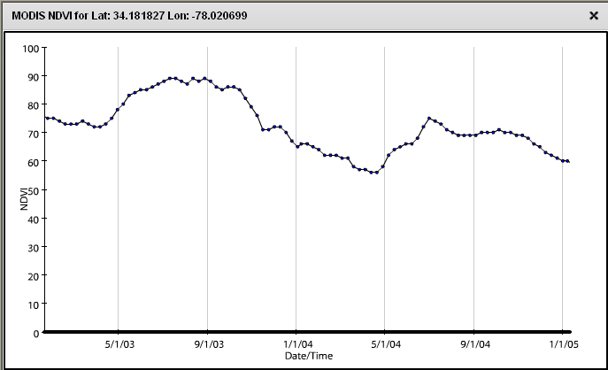

Slide 44
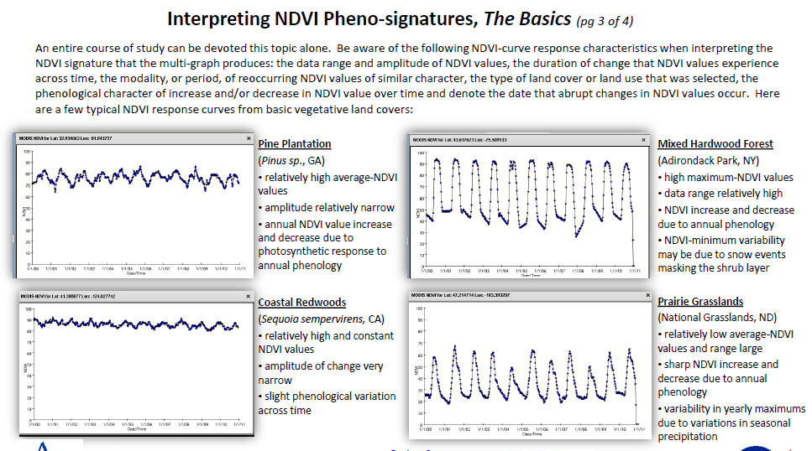

Slide 45
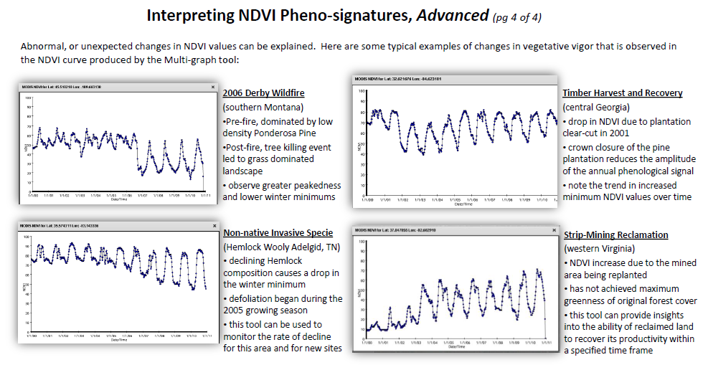

Slide 46
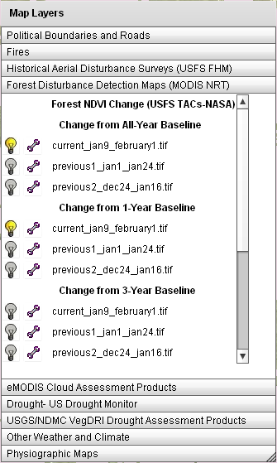
ForWarn Quick Start Guide
Open this URL in a web browser http://forwarn.forestthreats.org/fcav
In the Table of Contents window, click on the tab heading “Forest Disturbance Detection Maps” to expand and view the data layers (NRT – near real time)
By default, the most recent forest change image in the “All-Year” baseline will be displayed. This image is a result of comparing the most recent MODIS NDVI image to the maximum NDVI value over the entire MODIS NDVI history (12+ years), and shows all forest disturbances over the entire historical period.
Turn-off the most recent “All-Year” baseline image and turn-on the most recent in the “1-Year” baseline group. This allows one to view only forest disturbance, or recovery, that has occurred within just the past one year (for this specific time period).
Use the map controls to zoom and pan, or type the name of a county in the “Find Area” box in the top-right area of the FCAV viewer window
Use the ‘wrench’ icon to adjust the transparency of any layer to better view the basemap , or other layers
Table of Contents
window expanded

Slide 47
http://forwarn.forestthreats.org/data/data-access

Slide 49
ForWarn Forest Disturbance Assessment (locate, characterize and assess)
Location (geographic site and situation)
Land cover / land use (recent aerials)
Topographic position (in mountainous terrain elevation and aspect may be important, use topographic maps, hill shade)
Determine character of NDVI departure
Progression speed (fast vs. slow)
Severity, percent NDVI change (pos./neg., light-heavy)
Spatial extent (large area – localized)
Pattern and shape (spotty/scattered, bulls-eye, target-like, linearity)
Edges (hard/well defined or trails-off, feathers out with less departure)
Seasonality (spring, fall, winter: local and regional variation in annual phenology can causes NDVI departure, either positive or negative )

Slide 50
Forest Disturbance Assessment

Slide 56
Insects
Severe weather
Clouds
Roads development
Fire (prescribed or wild)
Natural Gas extraction pads
High elevation seasonal lag
Location
Land cover / land use
Topographic position
NDVI departure character Progression speed
Severity
Spatial extent
Pattern and shape
Edges
Seasonality
ForWarn Forest Change Image
08/03/2012 1yr

Slide 57
Insects
Severe weather
Clouds
Roads development
Fire (prescribed or wild)
Natural Gas extraction pads
High elevation seasonal lag
Location
Land cover / land use
Topographic position
NDVI departure character Progression speed
Severity
Spatial extent
Pattern and shape
Edges
Seasonality
ForWarn Cloud Product
MODIS TCC, 08/03/2012

Slide 58
Insects
Severe weather
Clouds
Roads development
Fire (prescribed or wild)
Natural Gas extraction pads
High elevation seasonal lag
These areas are predominately ‘green’ but suspected to be clouds. In the TCC, it is possible for true-cloud-artifacts be presented in shades of green
ForWarn Cloud Product
MODIS TCC, 08/03/2012

Slide 59
Insects
Severe weather
Clouds
Roads development
Fire (prescribed or wild)
Natural Gas extraction pads
High elevation seasonal lag
ForWarn Forest Change Image
08/03/2012 1yr

Slide 60
04/29/2012
05/07/2012
07/18/2012
wchristie@fs.fed.us
07/24/12

Slide 61
Insects
Severe weather
Clouds
Roads development
Fire (prescribed or wild)
Natural Gas extraction pads
High elevation seasonal lag
Location
Land cover / land use
Topographic position
NDVI departure character Progression speed
Severity
Spatial extent
Pattern and shape
Edges
Seasonality
ForWarn 07/18/2012 1yrbl
http://forwarn.forestthreats.org/fcav/?theme=CONUS_Vegetation_Monitoring_Tools&layers=AAB,AD,&alphas=1,1,&accgp=G04&basemap=Streets&extent=-9003225.077156924,4512328.821592092,-8759543.830983687,4603747.507421196
wchristie@fs.fed.us
07/24/12

Slide 62
Insects
Severe weather
Clouds
Roads development
Fire (prescribed or wild)
Natural Gas extraction pads
High elevation seasonal lag
Location
Land cover / land use
Topographic position
NDVI departure character Progression speed
Severity
Spatial extent
Pattern and shape
Edges
Seasonality
Landsat 453, 06/27/2012
wchristie@fs.fed.us
07/24/12

Slide 66
Insects
Severe weather
Clouds
Roads development
Fire (prescribed or wild)
Natural Gas extraction pads
High elevation seasonal lag
Location
Land cover / land use
Topographic position
NDVI departure character Progression speed
Severity
Spatial extent
Pattern and shape
Edges
Seasonality
Congratulations, you are all ‘ForWarn Disturbance Analysts’!

