Slide 1
Potential of pest and host phenological data in the attribution of regional forest disturbance detection maps according to causal agent
Presented to the 2014 US-IALE Meeting by:
Joseph Spruce, Computer Sciences Corporation (CSC)
William Hargrove, USDA Forest Service
Steven Norman, USDA Forest Service
William Christie, USDA Forest Service

Slide 2
Introduction
Since 2010, ForWarn disturbance monitoring system has provided new nationwide forest change maps every 8 days
ForWarn is being further developed to provide both forest disturbance detection and causal agent attribution
The disturbance detection component is functional with MODIS land surface phenology data mainly used for regional forest disturbance detection
Disturbance damage agent attribution is currently non-automated
In response, various geospatial phenology data is being explored along with geospatial techniques for potentially automating causal agent attribution of detected forest disturbances
Vegetation phenology data from MODIS NDVI
Phenological data on biotic disturbances
Phenological data on abiotic disturbances

Slide 3
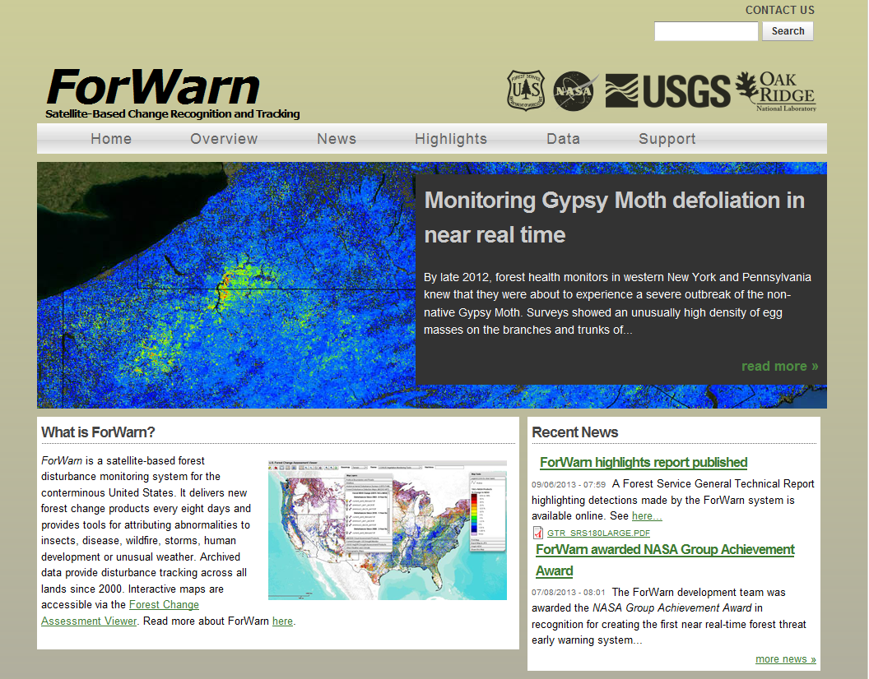
U.S. ForWarn System for Regional Forest Disturbance Monitoring
http://forwarn.forestthreats.org
NY
PA

Slide 4
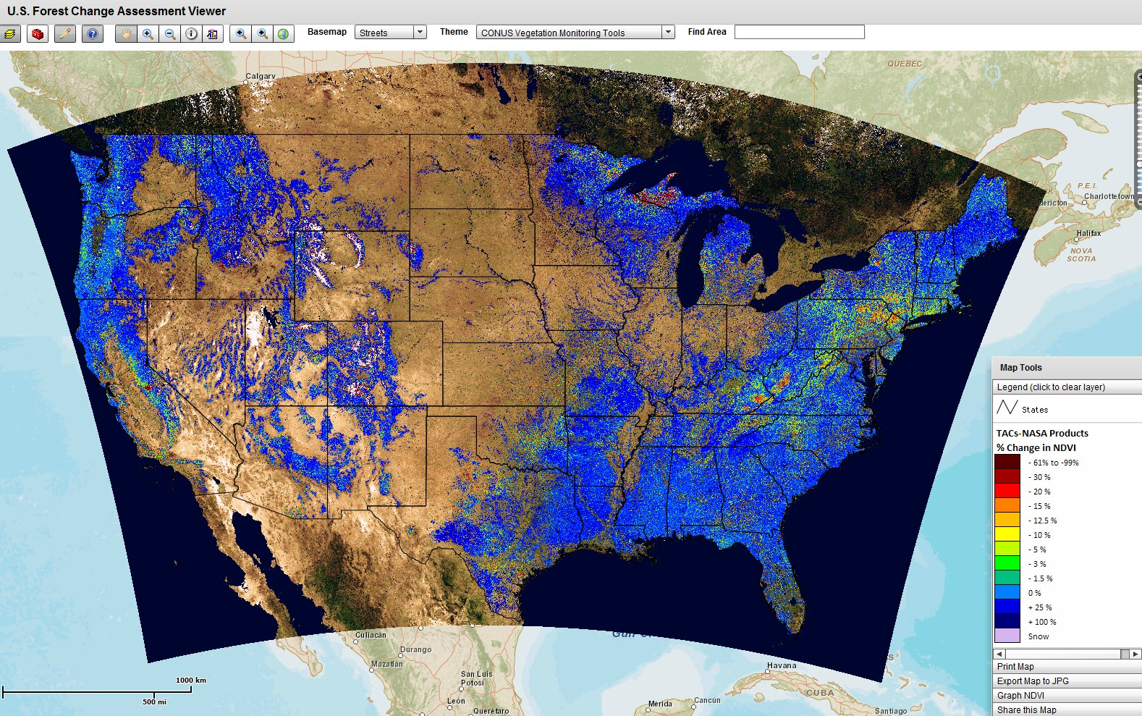
U.S Forest Change Assessment Viewer (FCAV) Resident to ForWarn
2013 Forest % NDVI Change versus Previous Year for October 24 - November 16
http://forwarn.forestthreats.org/fcav/

Slide 5
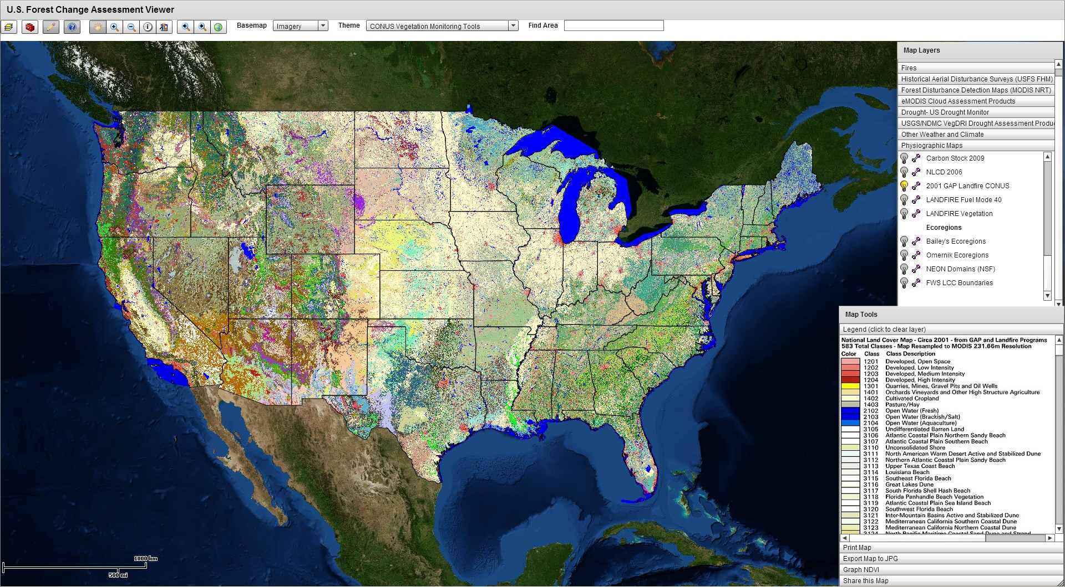
Example Land Cover Map in ForWarn Source: GAP/Landfire from 2001

Slide 6
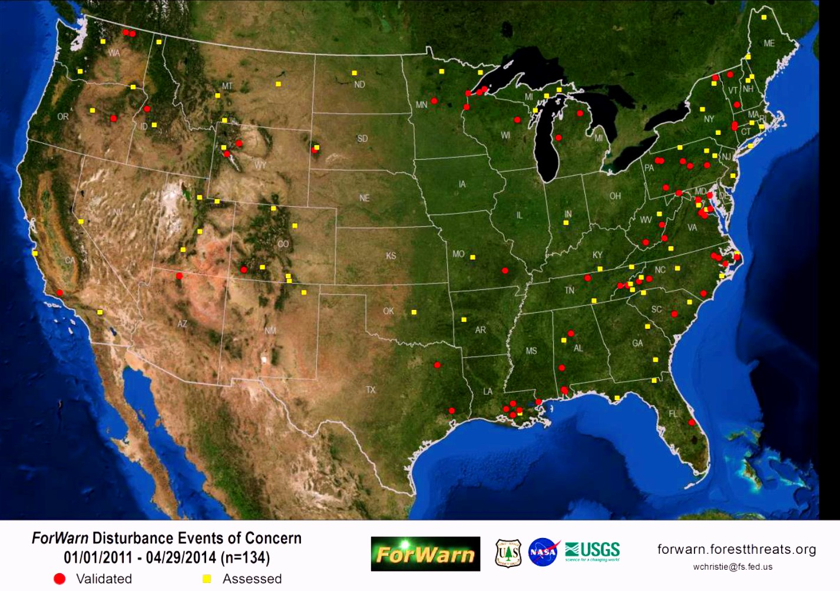
Dates of ForWarn Change Products Used in Confirmed Disturbances

Slide 7
Current Non-Automated Attribution Process for Detected Disturbance
ForWarn Forest Change Products
Analyst interpretation of change maps
- Reviews of 6 change products
Disturbance Detection
Analyst interpretation of change maps and ancillary data
- Landsat, aerial, and field data
- News accounts, fire, and land cover data
Assignment of Apparent Causal Agent
Internal communications discussing disturbance
Emails constructed for each alert notification
Alert Notification to Applicable Forest Health Specialists

Slide 8
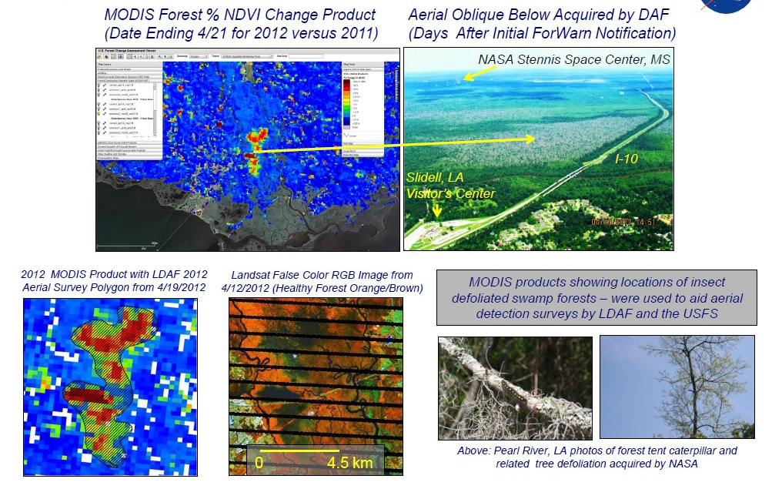
Example of ForWarn Detected Biotic Disturbance – Insect Defoliation
Forest Tent Caterpillar Defoliation in Coastal Louisiana

Slide 9
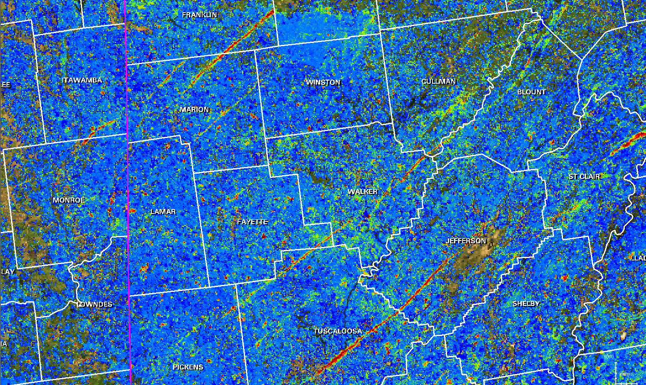
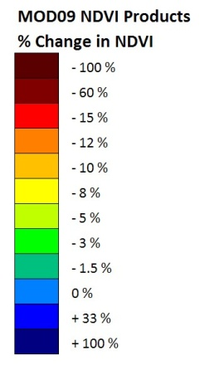
Example of ForWarn Detected Abiotic Disturbance - Tornadoes
Forest % NDVI Change for May 1-24, 2011 versus 2010 – Counties in White
Tornado Damage Tracks
Shown as Yellow to Red Linear Scars
Mississippi
Alabama

Slide 10
Series 1 – Biotic Disturbance Phenology Data
Monitoring Regional Forest Disturbances across the US with NRT MODIS NDVI Products included in the ForWarn EWS

Slide 11
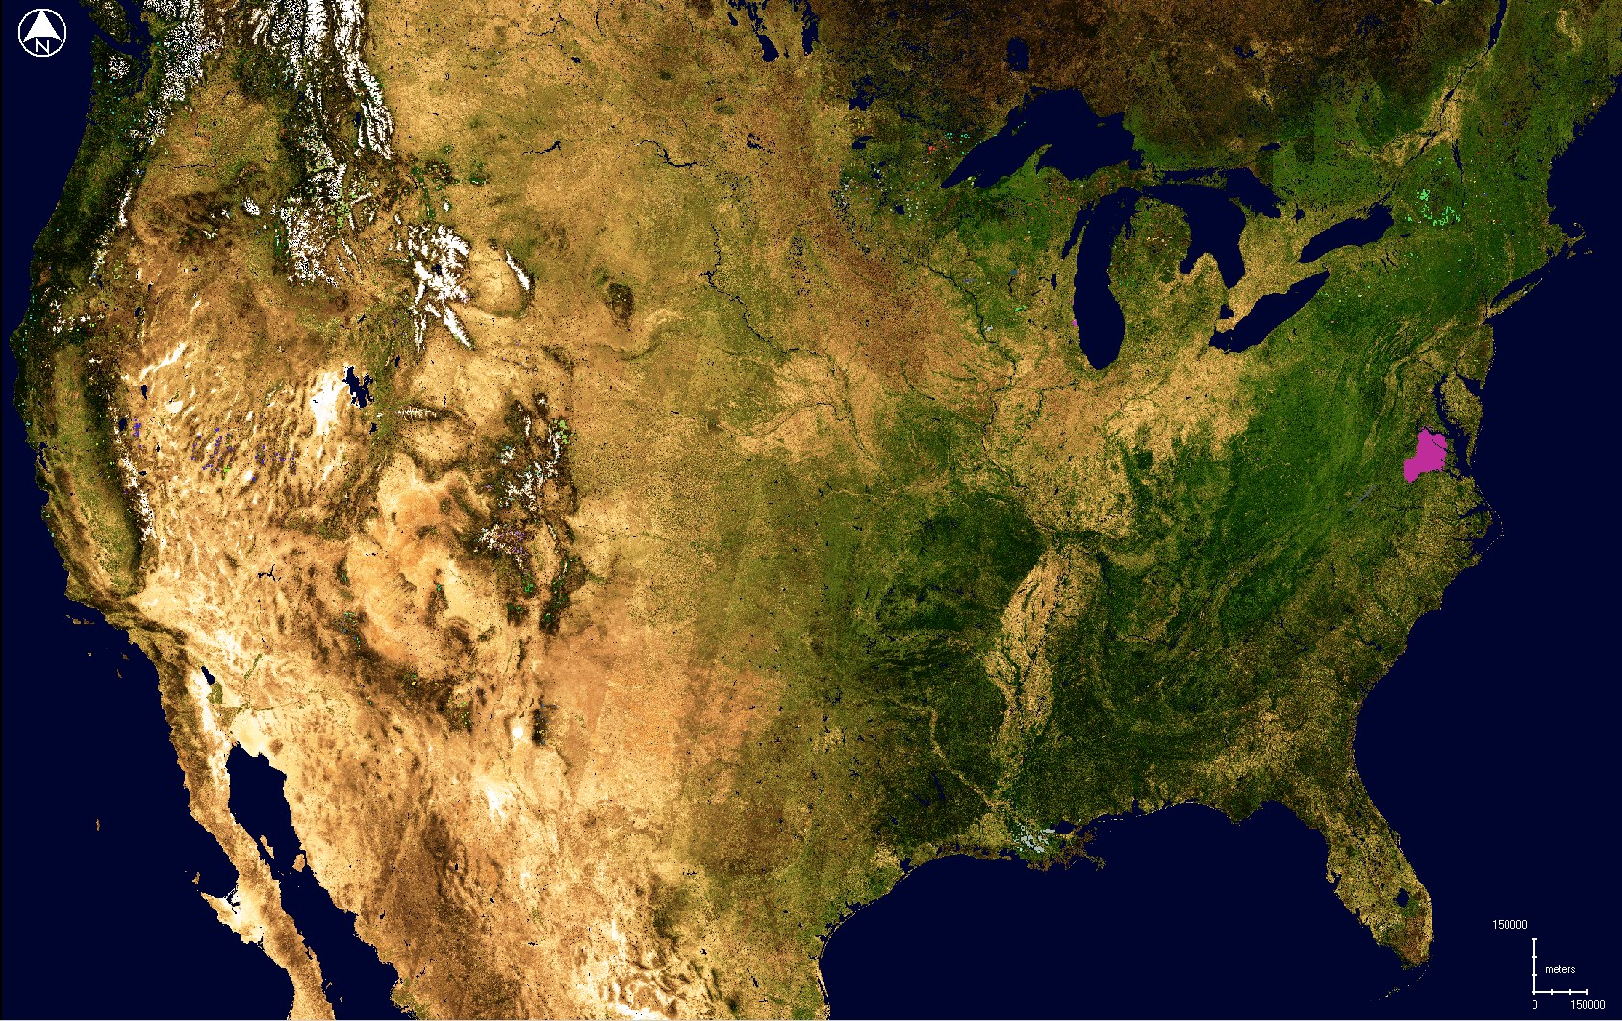
CONUS Aerial Detection Survey (ADS) Forest Damage Map for 2012
2012 ADS Polygons Overlain onto ForWarn MODIS True Color Image from 5/23/2012
Total ADS causal agent classes per year can exceed 100, though most are infrequent

Slide 12
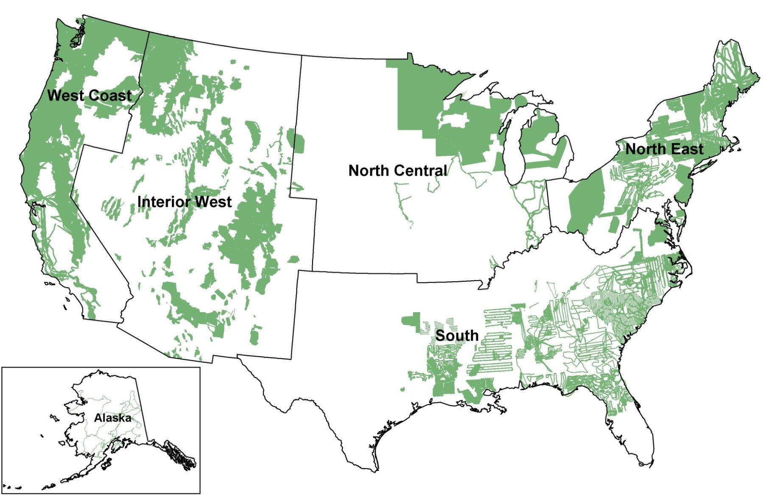
CONUS and Alaska ADS Effective Survey Areas for 2012
Source: USFS

Slide 13
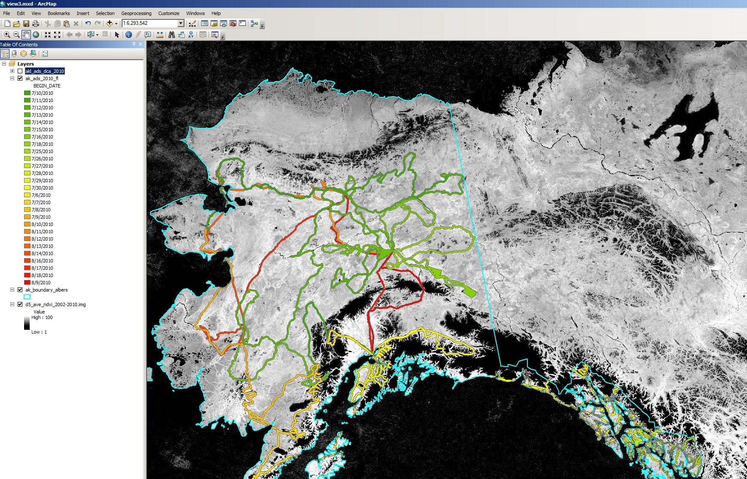
Alaska ADS Flight Lines for 2010
2010 ADS Flight Lines Overlain onto MODIS Mean NDVI for 7/29 of 2000-2012

Slide 14
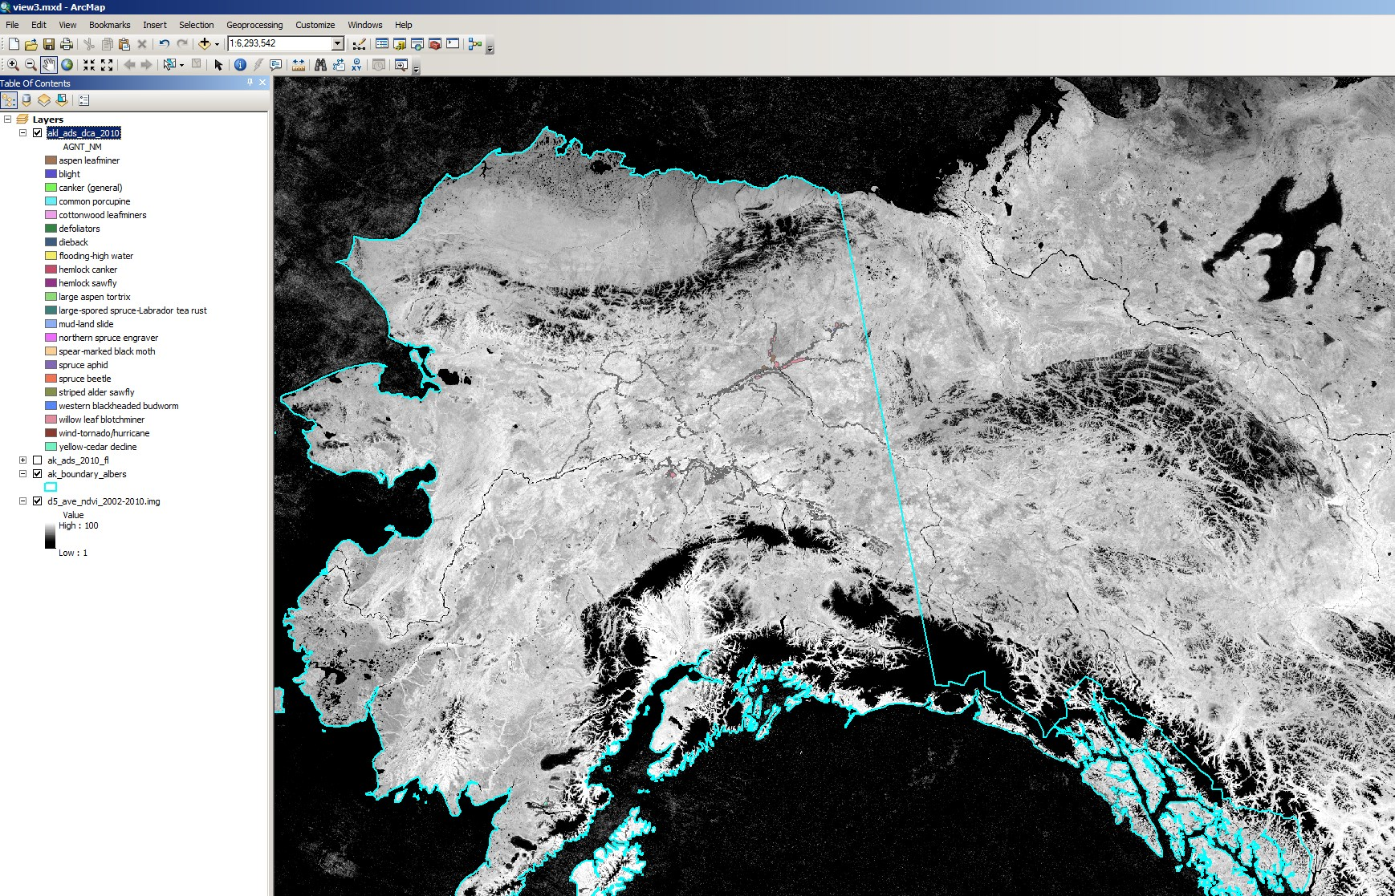
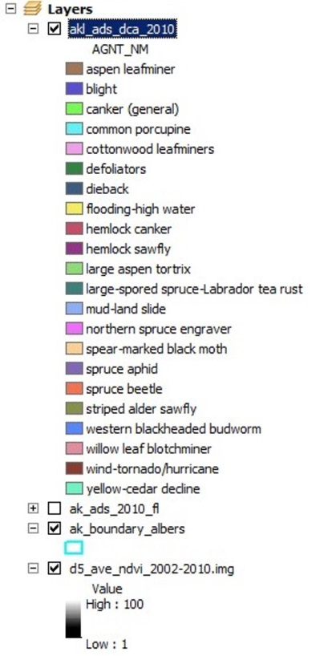
Alaska ADS Damage Agents for 2010
2010 ADS Damage Agents Overlain onto MODIS Mean NDVI for 7/29 of 2000-2012

Slide 15
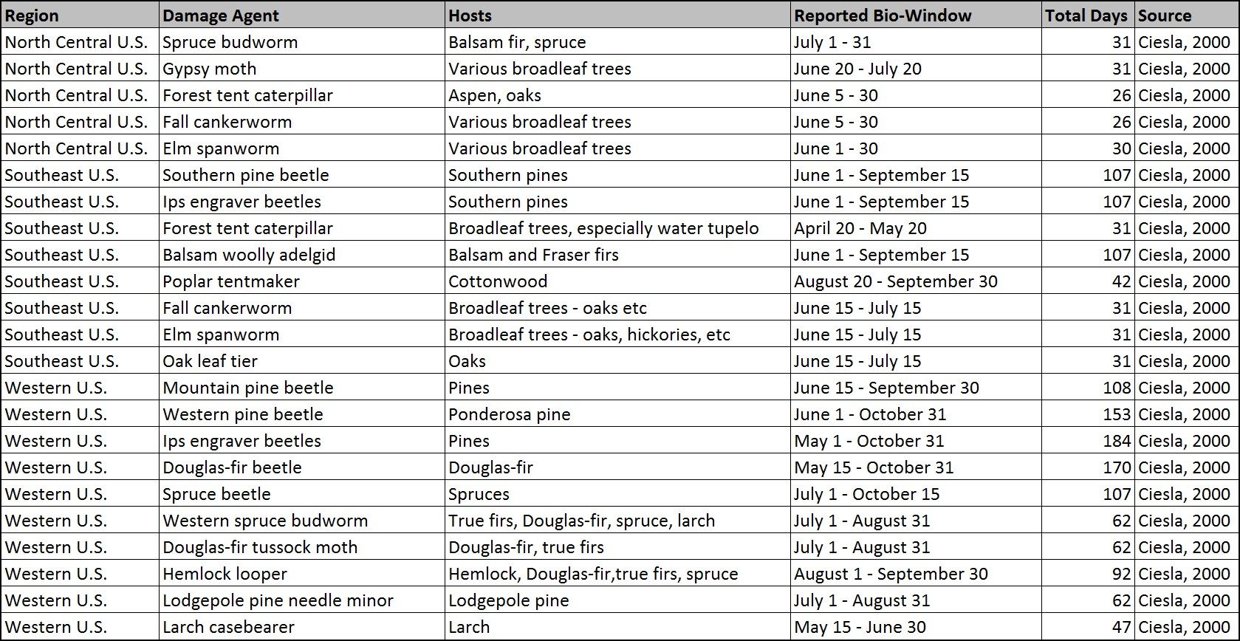
Example Guidelines for Scheduling ADS Flights for Main Damage Agents
Source: Ciesla (2000) Report “Remote Sensing in Forest Health Protection”

Slide 16
Series 2 – Abiotic Disturbance Phenology Data
Monitoring Regional Forest Disturbances across the US with NRT MODIS NDVI Products included in the ForWarn EWS

Slide 17
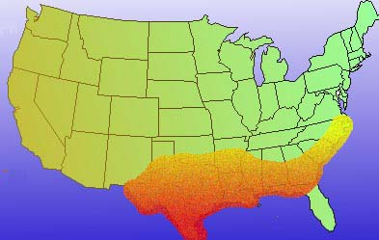
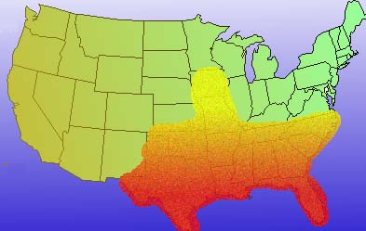
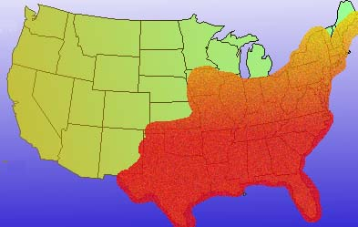
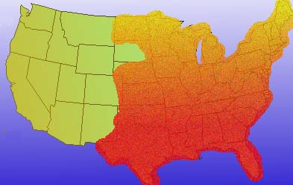
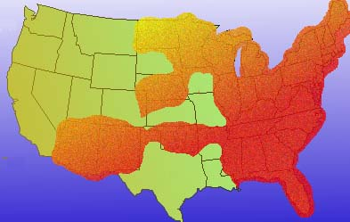
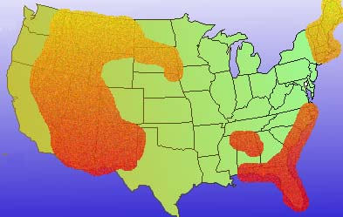
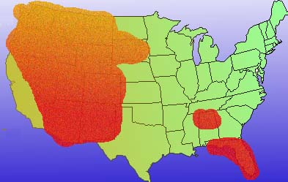
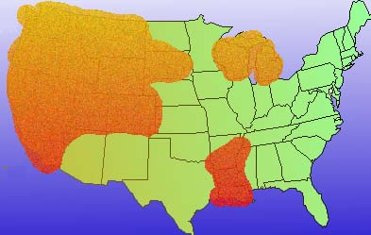
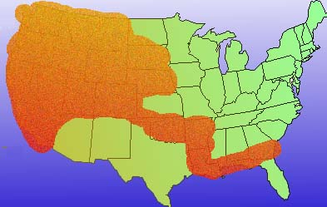
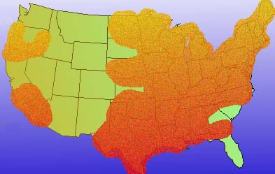
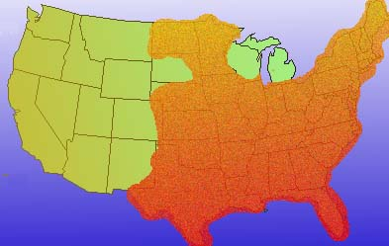
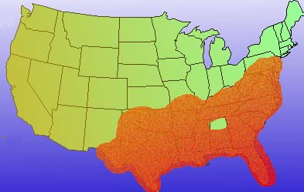
Fire Season Phenology Source: NOAA
January
February
March
April
May
June
July
August
September
October
November
December

Slide 18
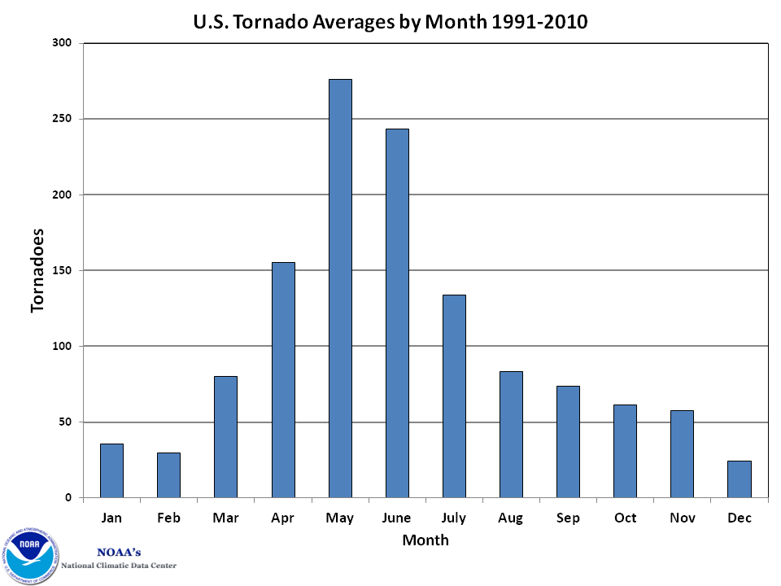
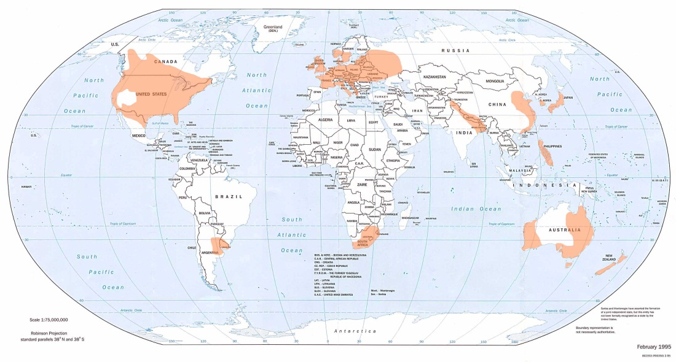
Tornado Season Phenology Source: NOAA NCDC
U.S. Tornado Averages by Month 1991-2010
Global Tornado Risk Map

Slide 19
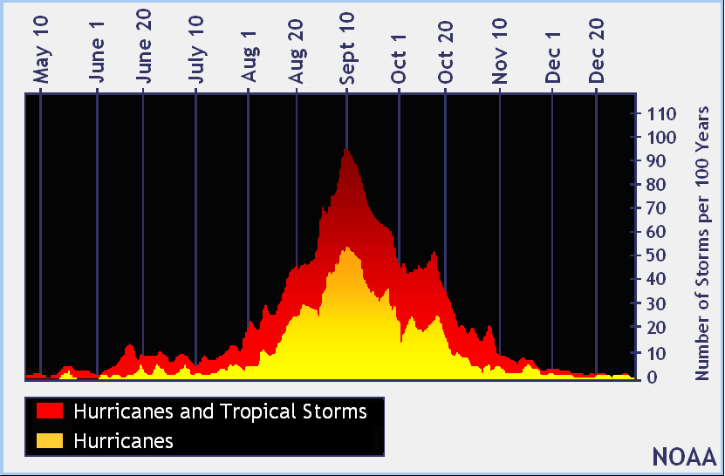
Hurricane Season Phenology Source: NOAA

Slide 20
Results - Discussion
Potential of Phenology Data for Causal Agent Attribution
When available ADS data appears to have sufficient phenological information to help in automated detection of biotic disturbances, but ADS only partially covers CONUS and highly incomplete for Alaska
Guidelines on when to fly ADS for region specific surveys of biotic pests is probably more useful, but care needs to be taken due to climatic variability, especially for spring and fall defoliators
Some phenology data for abiotic forest damage does exist at the national level, but availability for regions is TBD. Caution is needed in using these data, since anomalies can occur (e.g., Hurricane / Super Storm Sandy)
Causal agent attribution for the major pests may be enabled using GIS-based decision rules that compare change products to damage phenology, cover type, and elevation data
Geospatial processing techniques and historical disturbance data may help in attributing certain kinds of abiotic disturbances

Slide 21
Final Remarks – Next Steps
Construct and test geospatial model with decision rules for assigning preliminary causal agent of detected forest disturbances, based on change intensity, time of year, host, disturbance persistence, and patch characteristics
Use Erdas Imagine for geospatial model development with ArcGIS as a second option
Focus the initial effort on the historically predominant forest insect pests

Slide 22
Participation in this work by Computer Sciences Corporation, Inc., was supported by NASA at the John C. Stennis Space Center, Mississippi, under contract NNS10AA35C. Project funding was provided to NASA by the USDA Forest Service Eastern and Western Threat Assessment Centers.

