Slide 1
Potential for Expanding the Near Real Time ForWarn Regional Forest Monitoring System to Include Alaska
Presented to the 2014 US-IALE Meeting by:
Joseph Spruce, Computer Sciences Corporation (CSC)
William Hargrove, USDA Forest Service
Gerald Gasser, Lockheed Martin
James Smoot, CSC
Philip Kuper, CSC

Slide 2
Introduction
U.S. forests occupy ~1/3 of total land area (~304 million ha)
AK forests comprise ~52 million ha, including 1st and 2nd largest national forests in the nation (Tongass and Chugach NFs)
U.S. forests face many biotic and abiotic threats that cause regional forest damage – and also impact human life and property, bio-diversity and water supplies
Timely regional forest disturbance monitoring products are needed to aid forest health management work
Since 2010, the US Forest Service ForWarn Early Warning System has used daily MODIS data to provide regional forest monitoring products every 8 days
However…ForWarn currently only covers the lower 48 states with potential to include Alaska, Hawaii, etc.

Slide 3
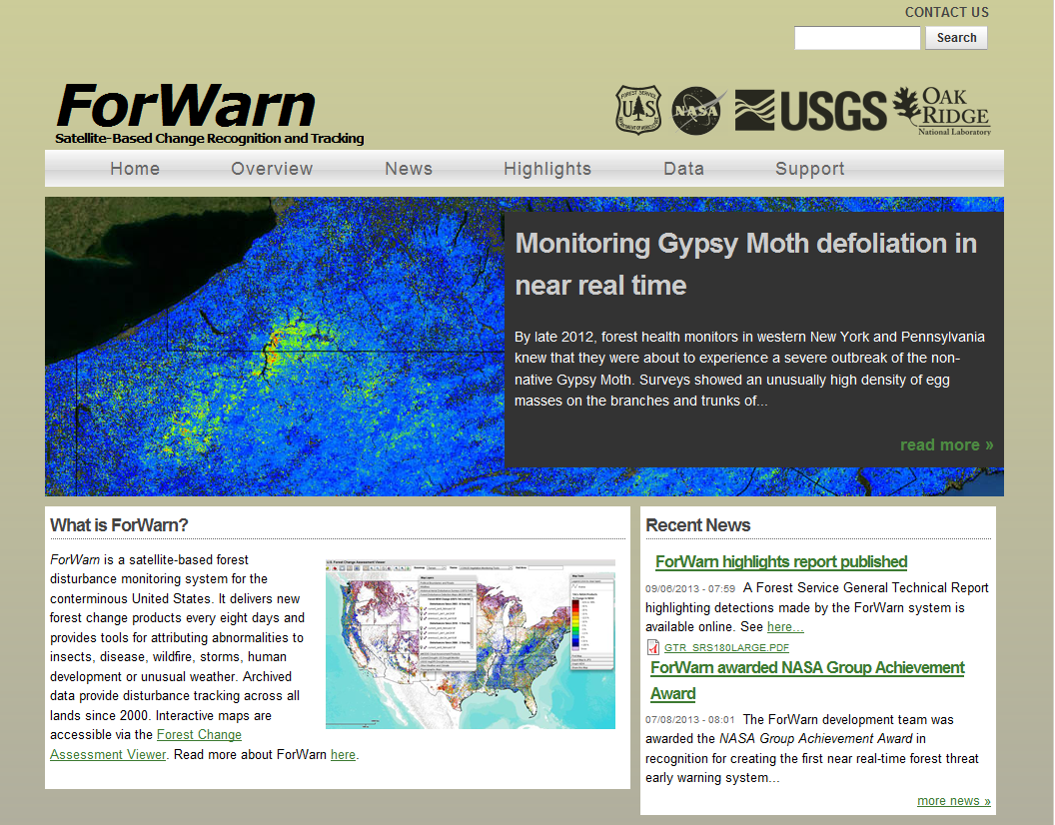
U.S. ForWarn System for Regional Forest Disturbance Monitoring
http://forwarn.forestthreats.org
NY
PA

Slide 4
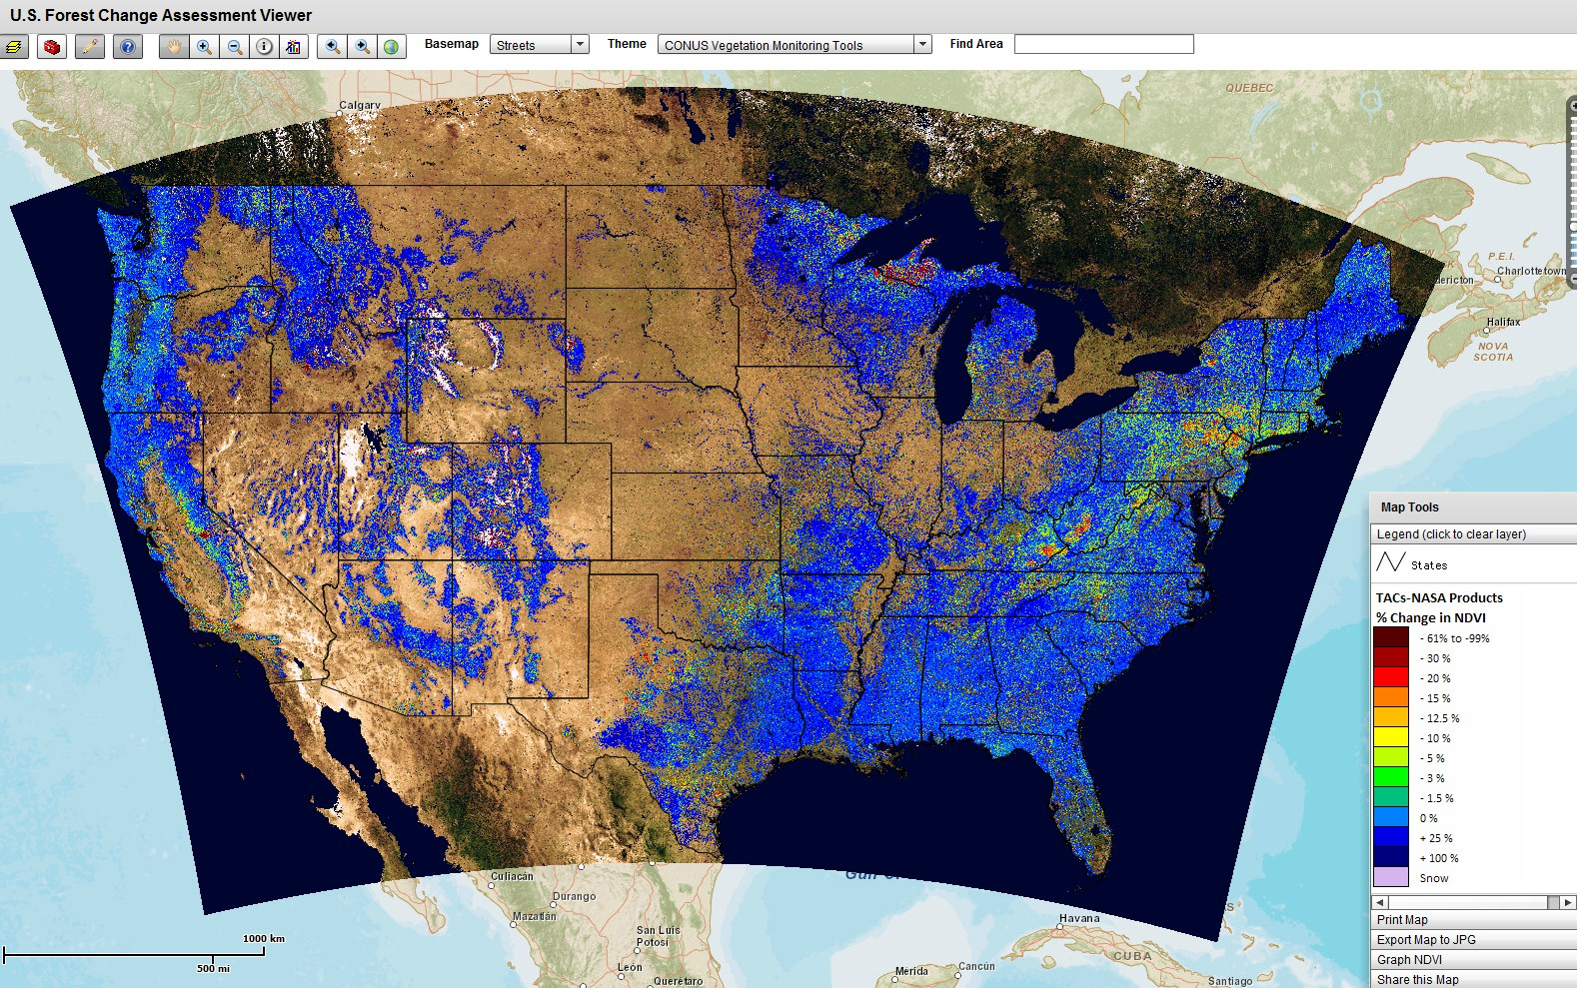
U.S Forest Change Assessment Viewer (FCAV) Resident to ForWarn
2013 Forest % NDVI Change versus Previous Year for October 24 - November 16
http://forwarn.forestthreats.org/fcav/

Slide 5
Process for Computing ForWarn’s MODIS NDVI Change Products
INPUT - Historical MOD13 16 Day Aqua & Terra NDVI Products
Process with Time Series Product Tool (TSPT)
- Noise Reduction, Fusion, Void Interpolation, Temporal Compositing
Process with Phenological Parameters Estimation Tool (PPET)
- Phenology Products, Temporal Compositing, Change Detection
Compute Cumulative Integral NDVIs
46 Products per Year
Compute 24 Day Historical NDVI Baselines
Compute 24 Day Current NDVIs
INPUT - Expedited eMODIS 7 Day Data
OUTPUT - Percent NDVI Change Products
Change vs. Previous Year
Change vs. 3 Previous Years
Change vs. All Previous Years
Change vs. Mean of All Previous Years
Change vs. Pheno-Region NDVI
Change vs. Previous Year (eMODIS Freshest NDVI)
NEW PRODUCTS
EVERY 8 DAYS
(1-2 Day Latencies)
eMODIS
Max NDVI
Notes:
I will explain verbally that the eMODIS Freshest NDVI is computed with the Adaptive Length Compositing (ALC) method

Slide 6
Goal and Objectives
Goal - develop ForWarn near real time Alaska forest monitoring capability
Objective 1 – Assess if eMODIS Terra historical data can be processed into effective NDVI forest change products
Objective 2 – Assess if 7-day eMODIS Terra historical data will suffice with its 3 day product latency
Objective 3 – Gauge potential benefit in adding MODIS Aqua data as inputs to deriving needed change products

Slide 7
Process Tested for Alaska MODIS NDVI Change Products
INPUT - Historical EMODIS 7 Day Terra Products
Preprocess with MATLAB into 21, 28, and 42 Day Composites
- Noise Reduce with Max NDVI Compositing and QA Data
Stack into Annual Baseline Stacks for 2002-2010
Select Compositing Interval
Compute 28 Day Historical NDVI Baselines
Compute 28 Day Current NDVIs
INPUT - Historical eMODIS 7 Day Data
OUTPUT - Percent NDVI Change Products
Change vs. Previous Year
Change vs. All Previous Years
Change vs. Mean of All Years
Change vs. All Previous Years – Median NDVI
NEW PRODUCTS
EVERY 8 DAYS
(3 Days Latency)
Max NDVI
Notes:
I will explain verbally that the eMODIS Freshest NDVI is computed with the Adaptive Length Compositing (ALC) method

Slide 8
Schedule for 28 Day Compositing Windows
Temporal Window # | Beginning Date | Ending Date
W1 | 6/4/2010 | 7/1/2010
W2 | 6/11/2010 | 7/8/2010
W3 | 6/18/2010 | 7/15/2010
W4 | 6/25/2010 | 7/22/2010
W5 | 7/2/2010 | 7/29/2010
W6 | 7/9/2010 | 8/5/2010
W7 | 7/16/2010 | 8/12/2010
W8 | 7/23/2010 | 8/19/2010
W9 | 7/30/2010 | 8/26/2010

Slide 9
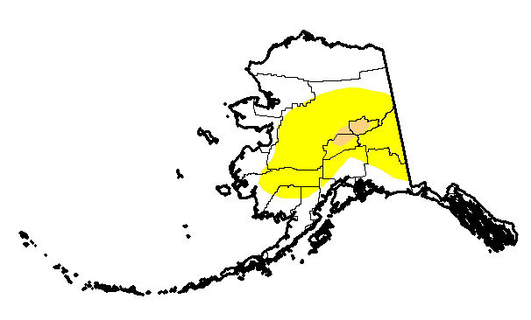
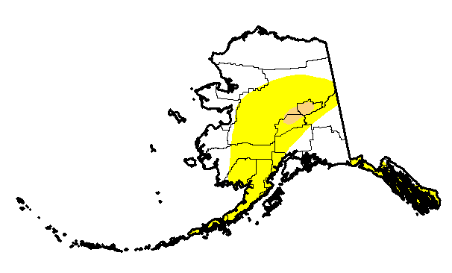
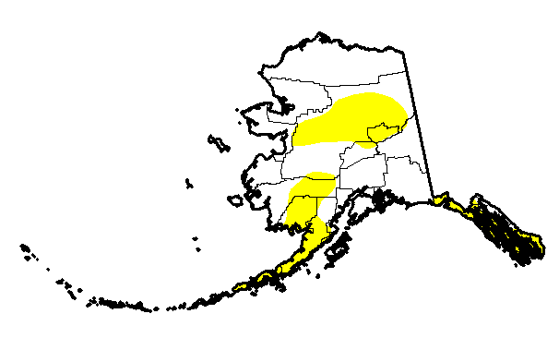
Alaska 2010 – Spring/Summer Drought
6-8-2010
6-15-2010
6-22-2010
6-29-2010
7-6-2010
7-13-2010
7-20-2010
7-27-2010

Slide 10
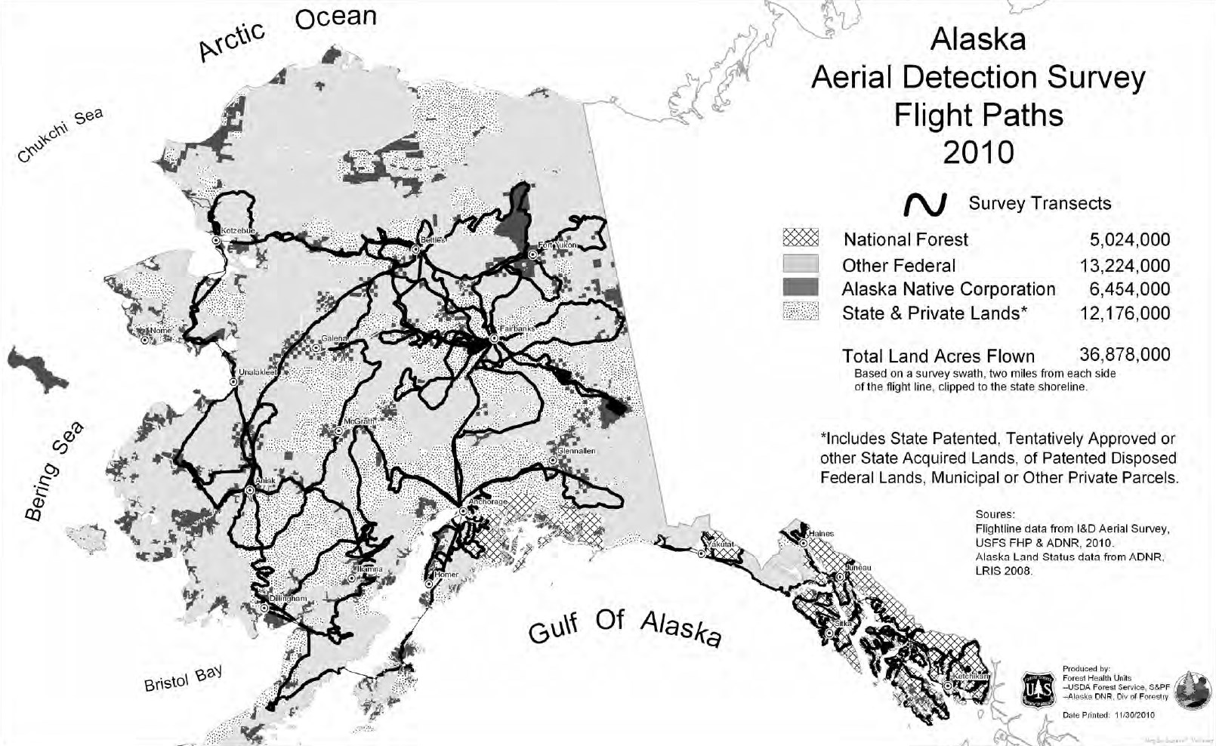
Flight Lines of Alaska 2010 Aerial Detection Survey (ADS)
2010 ADS Mapped ~ 29% of Total Alaskan Forest Lands

Slide 11
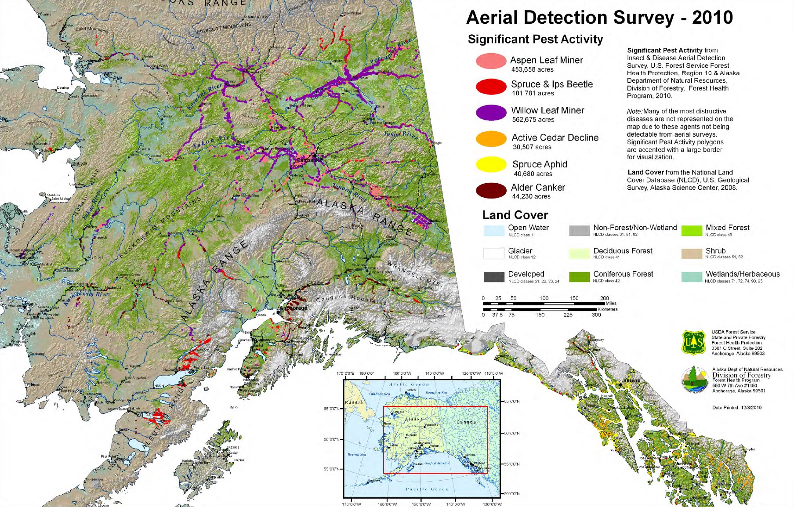
Results of Alaska 2010 Aerial Detection Survey (ADS)

Slide 12
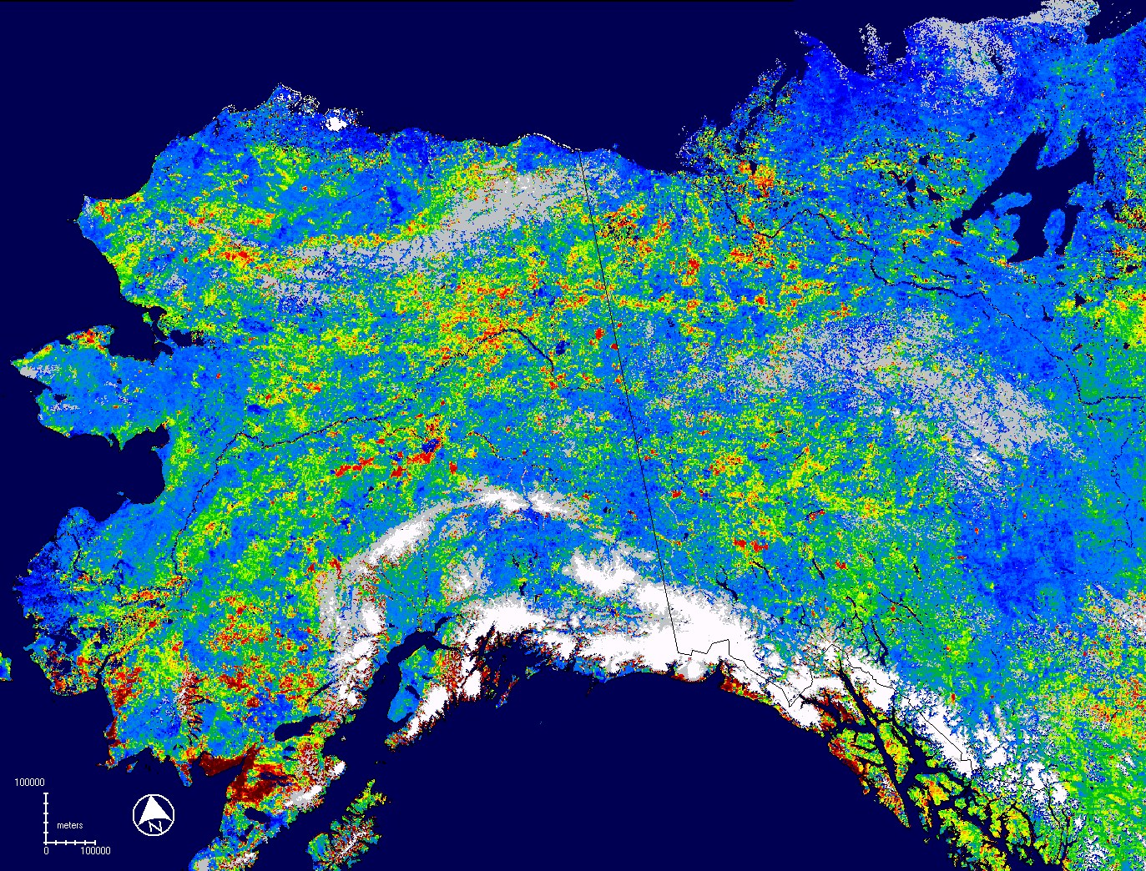
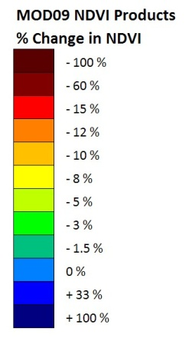
MODIS Percent NDVI Land Change (Previous Year Max NDVI Baseline)
Change for Date Ending 7/29/2010
Change vs. Previous Year
Frequent Minor NDVI Drops Maybe Due to Drier 2010
Gray Areas = Barren
White Areas = Snow

Slide 13
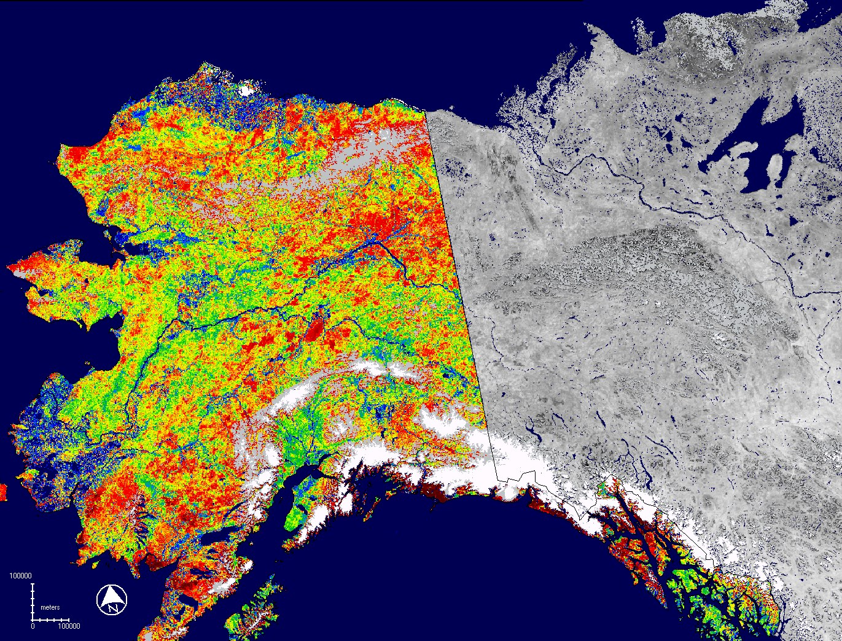
MODIS Percent NDVI Land Change (All Previous Years Max NDVI Baseline)
Change for Date Ending 7/29/2010
Most Areas Showing Reduced NDVI
Perhaps Due to Drought

Slide 14
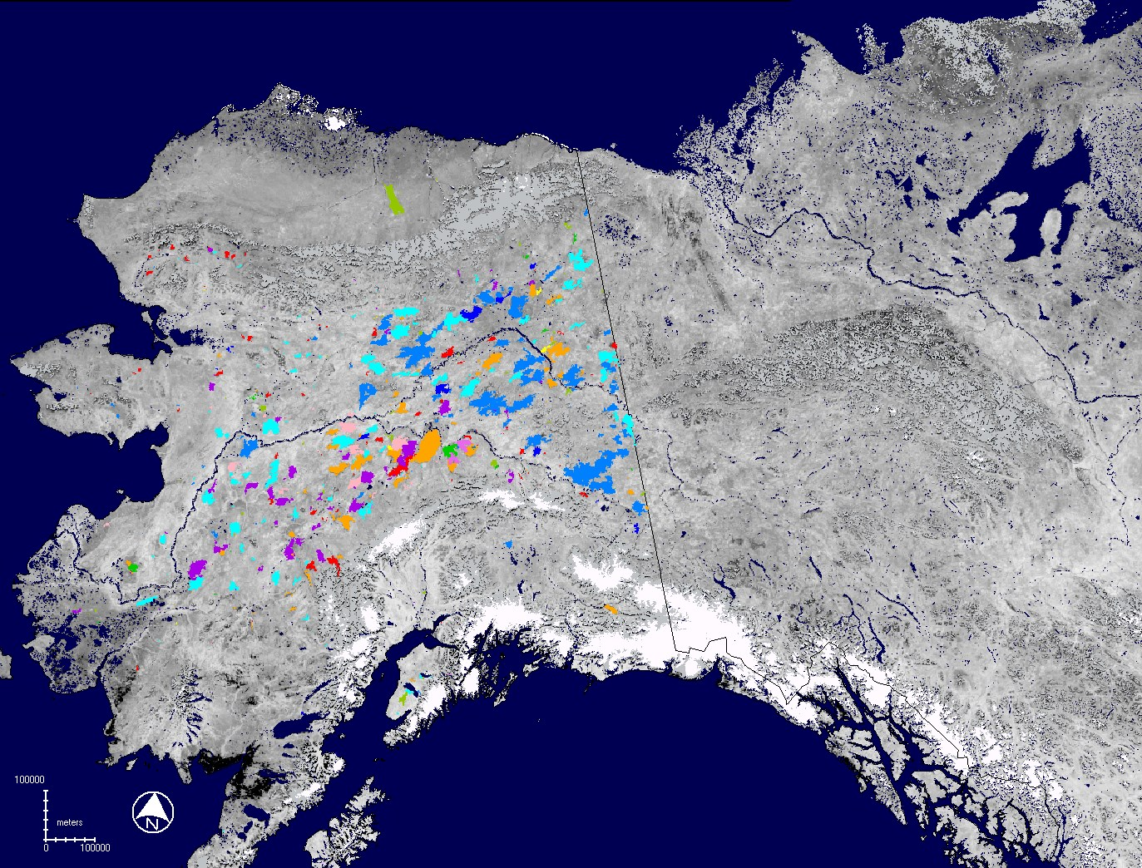
Historic Fires from 2000-2010 Overlain onto 28 Day NDVI
NDVI for Date Ending 7/29/2010
Many of these burn scars have highly reduced NDVI
compared to the All Previous Years NDVI Baseline

Slide 15
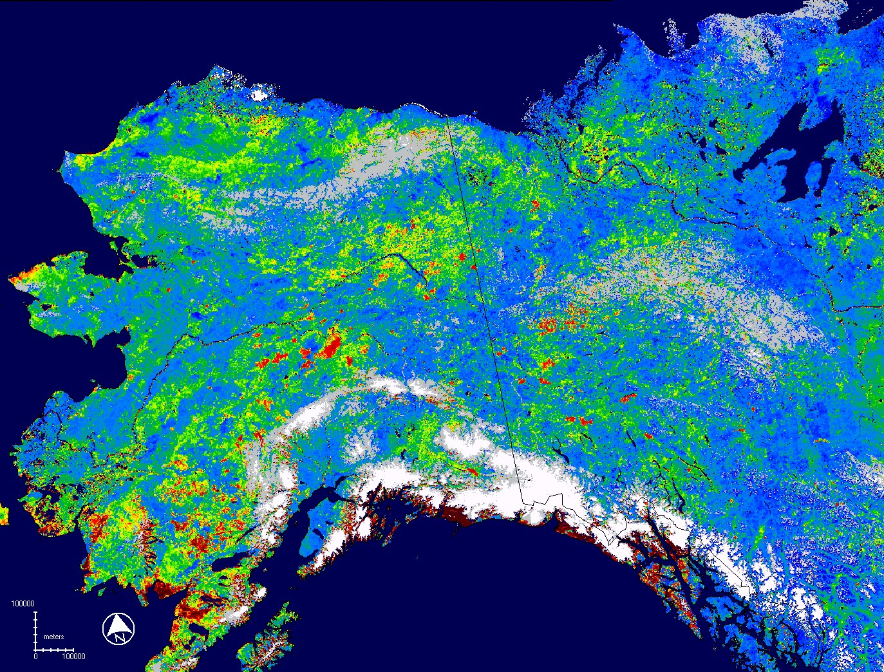
MODIS Percent NDVI Land Change (Mean of Max NDVI Baseline)
Change for Date Ending 7/29/2010
Change vs. Average Growing Condition
Some in Known Drought Impacted Areas
Some Dark Red Coastal
Areas Maybe Cloud Affected

Slide 16
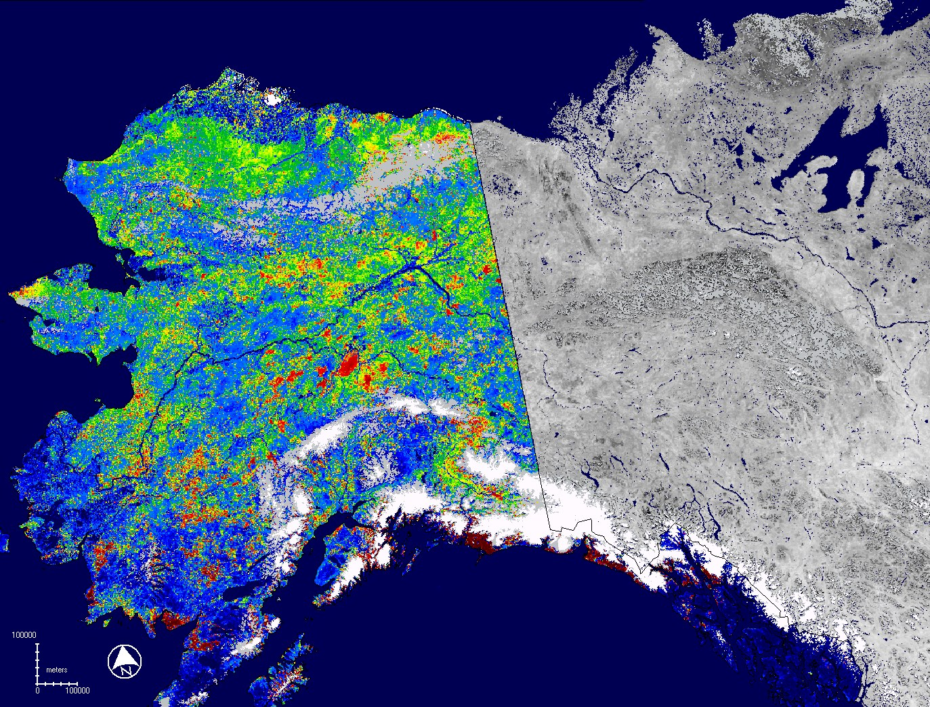
MODIS Percent NDVI Land Change (All Previous Years Median NDVI Baseline)
Change for Date Ending 7/29/2010
Some Data Drop Outs
In Coastal “Cloud” Zone

Slide 17
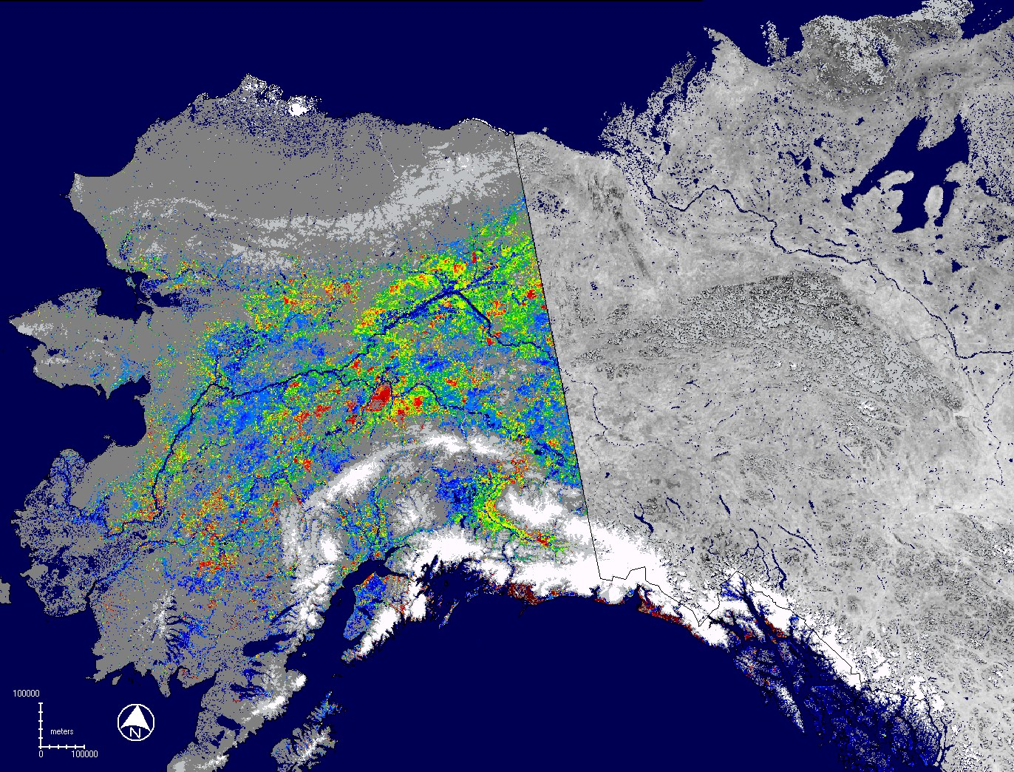
MODIS Percent NDVI Forest Change (Mean of Max NDVI Baseline)
Change for Date Ending 7/29/2010
Change vs. Average Growing Condition
Some in Known Drought Impacted Areas
Deep Dark Reds on Coast
Maybe Cloud Affected

Slide 18
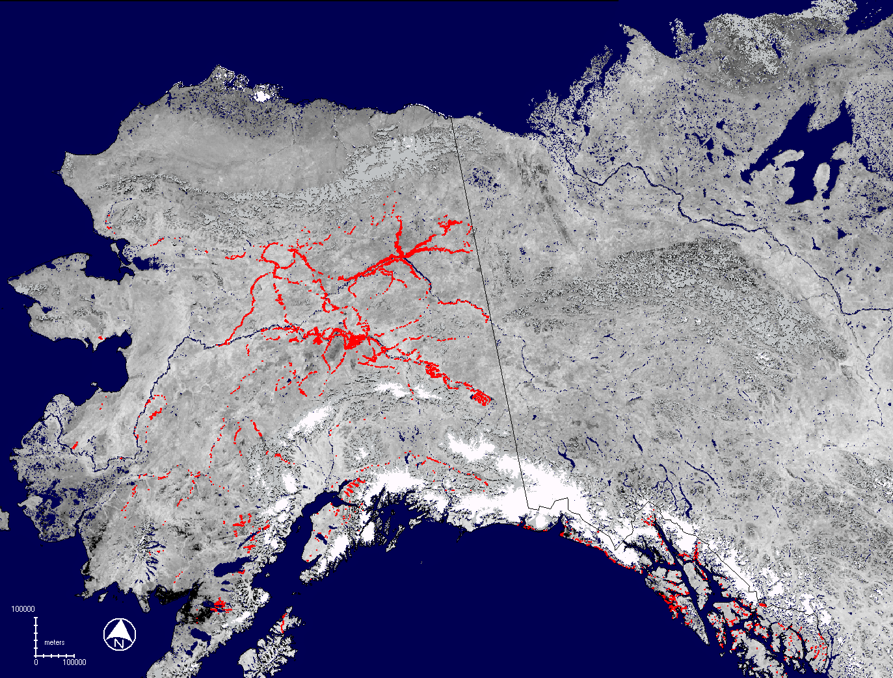
2010 ADS Forest Damage Polygons Overlain Onto 28 Day MODIS NDVI
ADS Polygons in Red - NDVI for Date Ending 7/29/2010
Red polygons frequently occur in areas with decreased NDVI on change product shown in previous slide
Less than 30% of total forest was surveyed via ADS

Slide 19
Comments on Initial Results
EMODIS Terra Products
The 28 day NDVI change products showed some utility for assessing regional disturbance – but more research is needed to confirm…
The results suggest variable growing conditions from year to year
The change products detected fire scars and showed reduced NDVI potentially related to the 2010 drought and insect impacts to forest
Given the drought year, change products using the mean of max NDVI baseline seemed to work best, but still are more noisy than the ForWarn CONUS products using MODIS Terra and Aqua data
ForWarn MODIS NDVI change products have been used to detect many regional forest disturbances across CONUS
The compositing window could possibly be narrowed to 21 days if MODIS Aqua data were also provided by eMODIS
The apparent 3 day latency of EMODIS historic Alaska products makes it possible for ForWarn expand into Alaska

Slide 20
Participation in this work by Computer Sciences Corporation, Inc., was supported by NASA at the John C. Stennis Space Center, Mississippi, under contract NNS10AA35C. Project funding was provided to NASA by the USDA Forest Service Eastern and Western Threat Assessment Centers.

