Slide 1
A National Satellite-Based Forest Disturbance Detection System in Near-Real-Time Eastern Forest Environmental Threat Assessment Center USDA Forest Service, Southern Research Station, Asheville, NC
ForWarn Team
William W. Hargrove, PI (USDA-FS)
Steven P. Norman (USDA-FS)
William M. Christie (USDA-FS)
Joseph P. Spruce (CSC, NASA Stennis)
Partners
USGS EROS Data Center, SD
CSC-NASA Stennis Space Center, MS
DOE Oak Ridge National Laboratory, TN
UNC-Asheville, NC: NEMAC

Slide 2
What is ForWarn and How does it Work?
The Forest Change Assessment Viewer
Disturbance Assessment and Vetting
The ForWarn Website: http://forwarn.forestthreats.org
What’s New and Future Enhancements
Points of Contact
Questions?

Slide 3
A national-scale near real-time satellite-based recognition and tracking system for all land cover disturbances
"Officially" rolled-out in 2012, but has actually been operating since January 2010
ForWarn covers the entire lower 48 United States
Generates new potential disturbance maps every 8 days, even throughout the winter
Detects most types of regional and local land cover disturbances
insects, diseases, wildfires, ice and frost damage, tornadoes, hurricanes, blowdowns, harvest, urbanization, seasonal timing and drought. and landslides
231 meter native resolution map cells (13-acre minimum mapping unit)
It is not necessary for an entire forested pixel to be disturbed for disturbance to be detected

Slide 4
In 2011, airborne observers from the Aerial Disturbance Survey (ADS) program covered about 70% of forests within the lower 48 United States once with visual observations from light aircraft
The ForWarn System covers essentially 100% of the forests within the lower 48 United States every 8 days
The two tiers are complementary:
ForWarn is coarse-scaled, automated and extensive, and has a very high repeat rate
Aerial surveys are finer-scaled, but require experienced observers, are labor-intensive and expensive, are a safety risk, are limited in extent and are completed once-a-year
The two different systems can support each other well
tactical
strategic

Slide 5
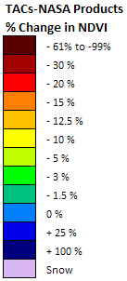
How Does ForWarn Work?
Based on a simple comparison between current greenness vs. historical greenness
We develop this historical greenness from the 16-year historical MODIS satellite record
The comparison is both spatially and temporally explicit – compares during the same 24-day period and for the same MODIS pixel
If the current NDVI value is less than 100% of the baseline used = Potential Disturbances
shown as Greens, Yellows, and Reds
If the current NDVI value is greater than 100% of baseline greenness = Vegetation Regrowth or Recovery
shown as Blues
Only shows a Disturbance if it affects the plants - and to the degree that it affects the plants
When first opening the ‘Forest Change Assessment Viewer’, only forested areas are shown by default, but ForWarn detects disturbances in all NLCD-based land use and land cover classes, including agricultural crops and rangeland forage (see the new “Masking” tool)

Slide 6
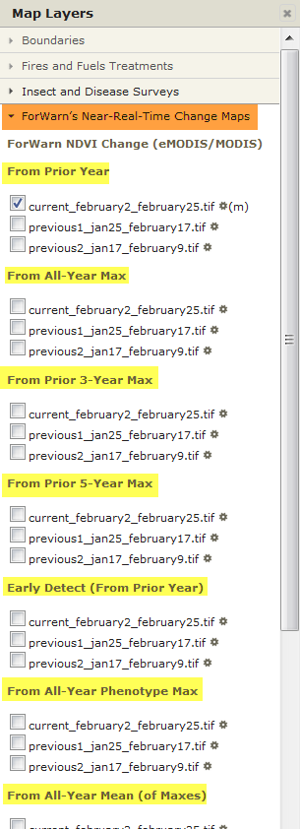
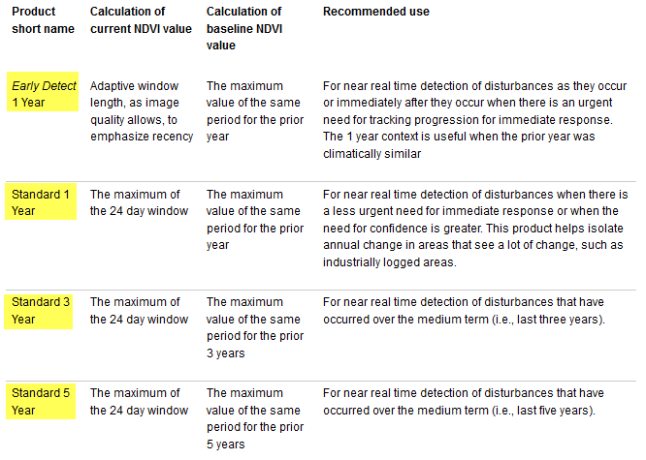
ForWarn produces seven types of disturbance maps every 8 days, each emphasizing the age of disturbances that are displayed
1
2
3
4

Slide 7
ForWarn produces seven types of disturbance maps every 8 days, each emphasizing the age of disturbances that are displayed
1
Most often used
2
3
4

Slide 8
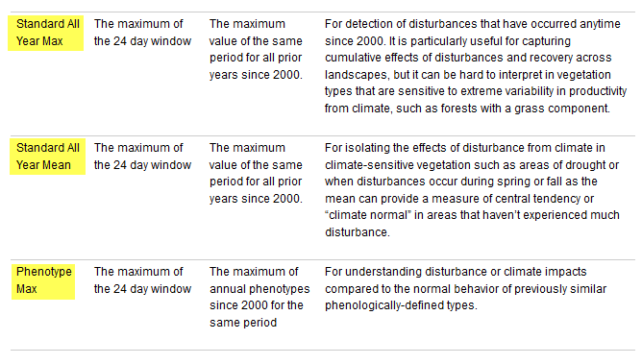
ForWarn produces seven types of disturbance maps every 8 days, each emphasizing the age of disturbances that are displayed
5
6
7
http://forwarn.forestthreats.org/products/near-real-time

Slide 9
ForWarn produces seven types of disturbance maps every 8 days, each emphasizing the age of disturbances that are displayed
5
These long-term baseline products also contain ‘fresh’ departures. The calculation method employed for these two, differ from the other change products and can offer additional discriminatory power when attempting to vet cause
6
7
http://forwarn.forestthreats.org/products/near-real-time

Slide 10
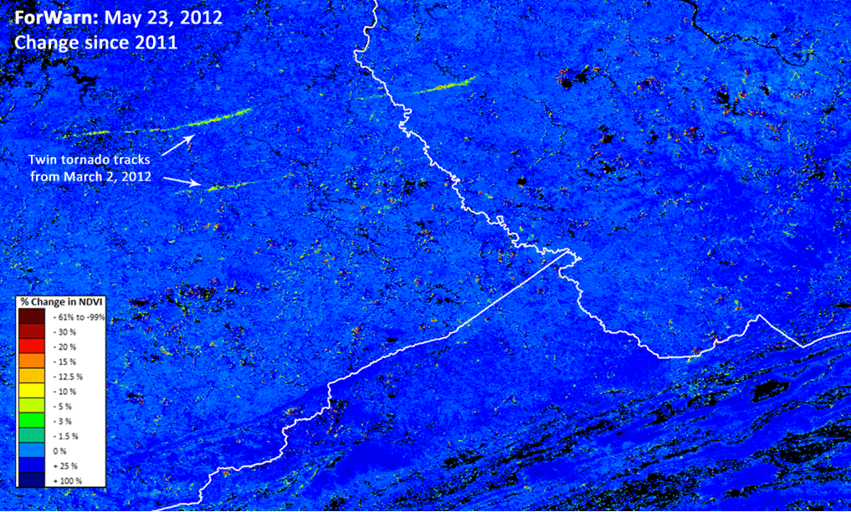
ForWarn 1 year baseline vs. All-year baseline

Slide 11
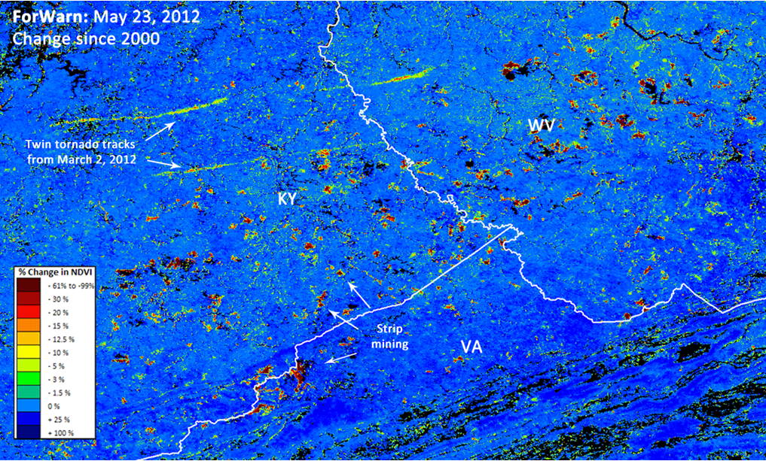
ForWarn 1 year baseline vs. All-year baseline

Slide 12
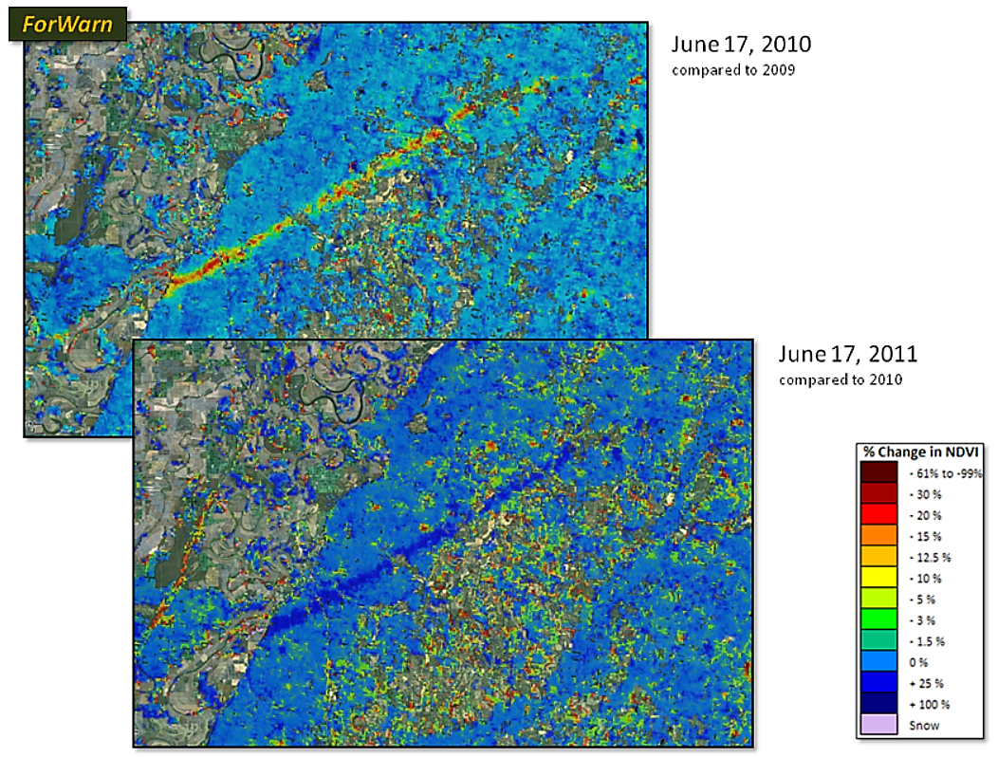
Positive NDVI Departure = Vegetative Recovery / Re-Growth
Relative to a 1-year baseline, forest vegetation is re-growing within the Yazoo, MS tornado track. ForWarn can easily track such recovery, and the rate of recovery is highly variable.

Slide 13
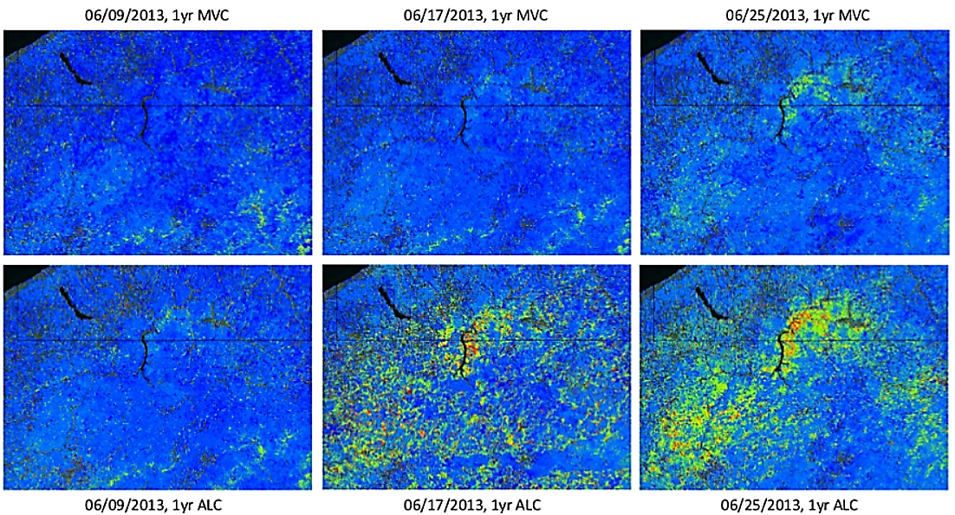
ForWarn 1yr Baseline ‘Standard’ Product vs. 1yr Baseline ‘Early Detect’ Product
The ‘Early Detect’ product dramatically reduces ForWarn detection speeds, allowing the detection of disturbances in as few as one 8-day period

Slide 14
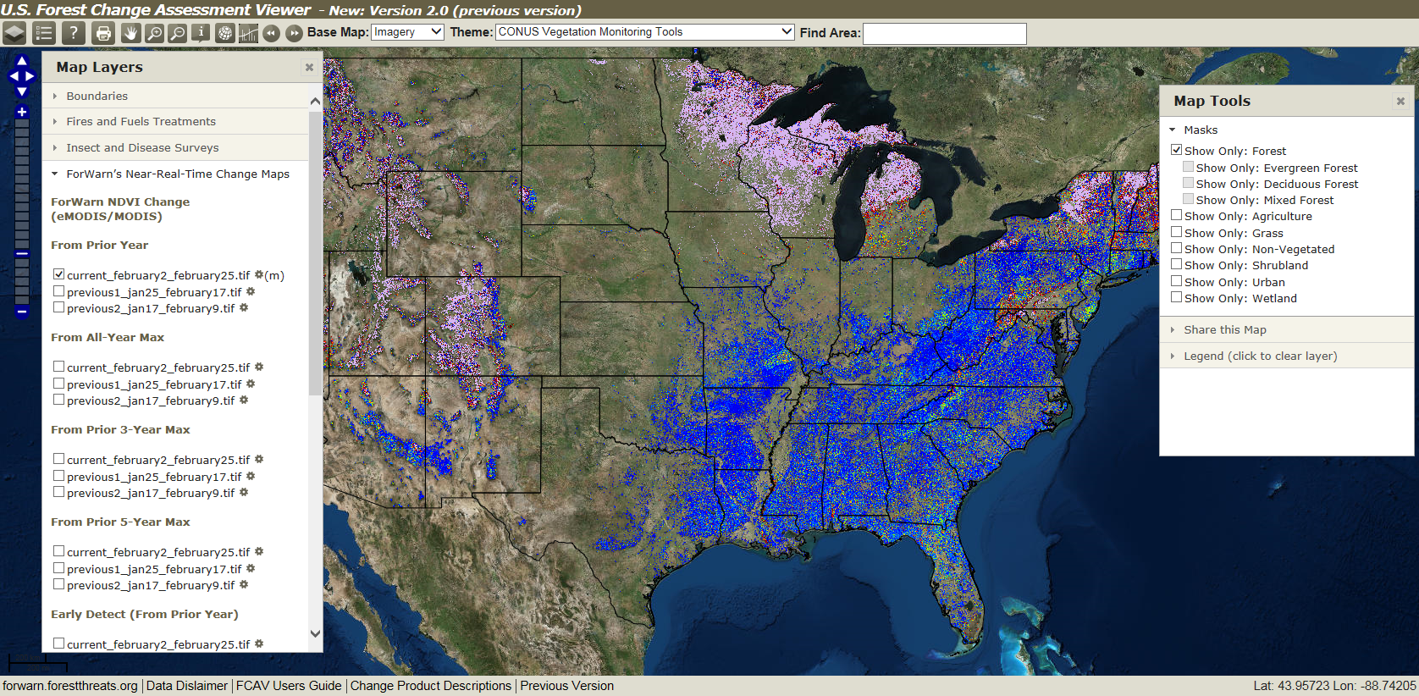
Forest Change Assessment Viewer (FCAV)

Slide 15
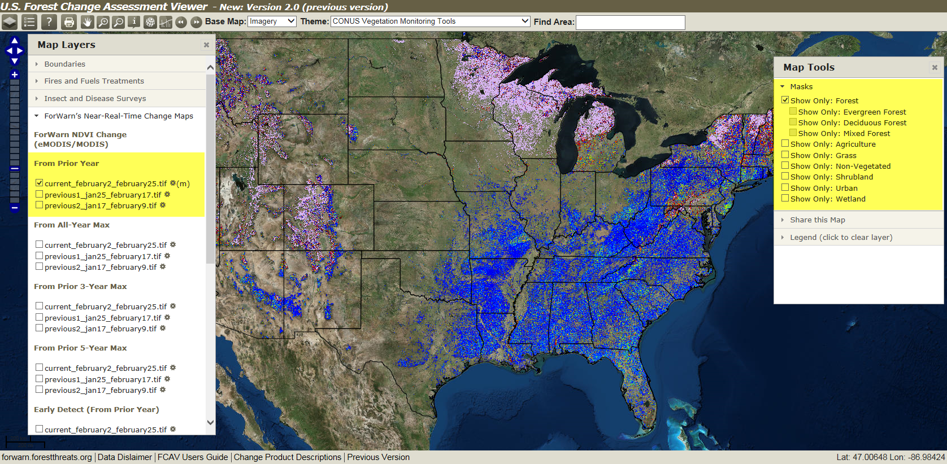
Forest Change Assessment Viewer (FCAV): Default View = Current 1yr BL with Forest Mask

Slide 16
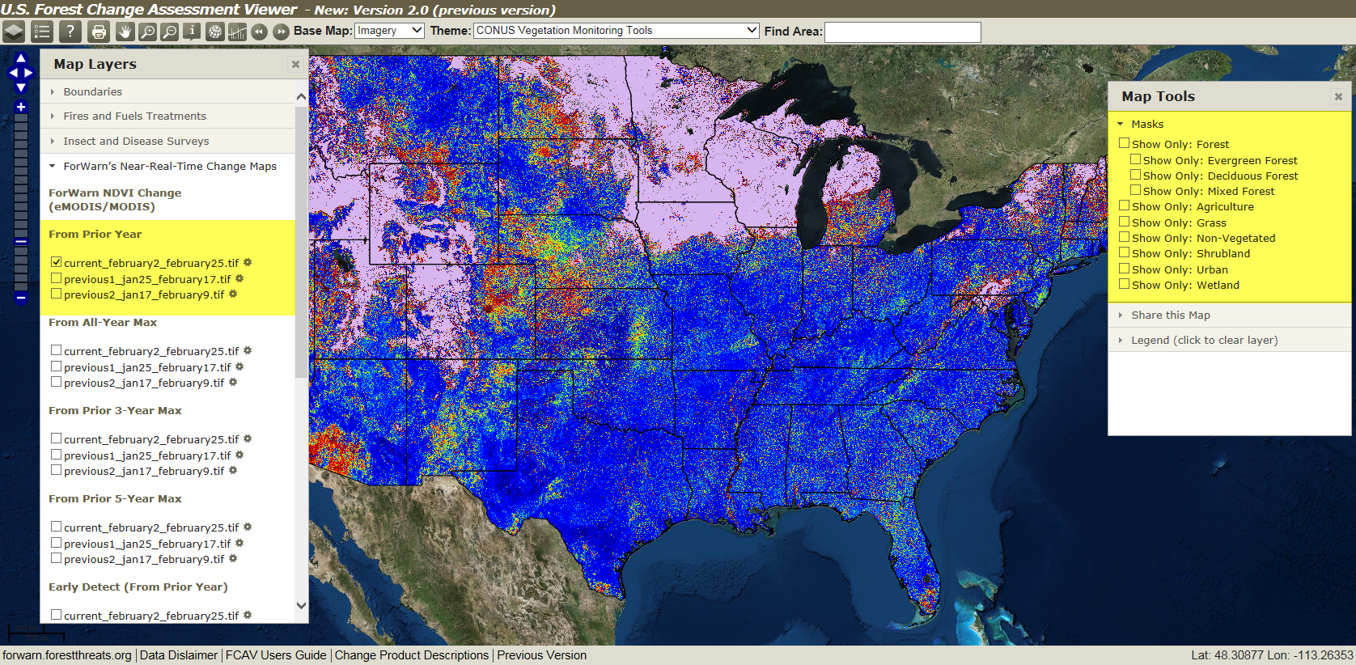
Forest Change Assessment Viewer (FCAV): Current 1yr BL, ‘All-Lands’ (no mask)
*
* Herbaceous wetlands only, woody wetlands were are placed in the Deciduous Forest class

Slide 17
FCAV Feature: Graph NDVI (110B NDVI observations)

Slide 18
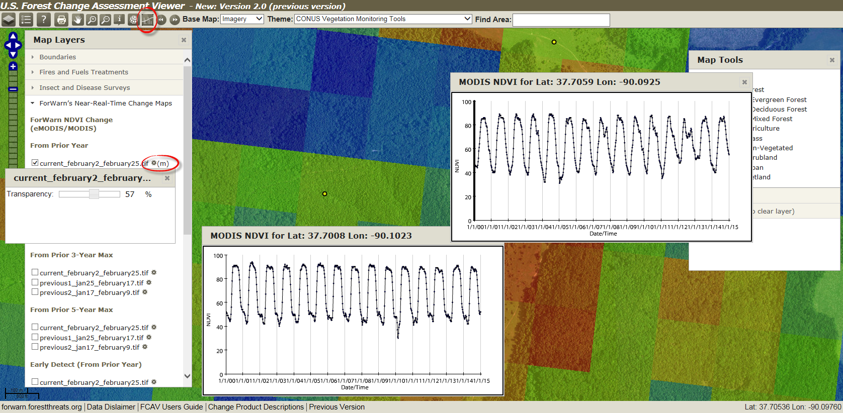
FCAV Feature: Graph NDVI (use zoomed with transparency to guide pixel selection)

Slide 19
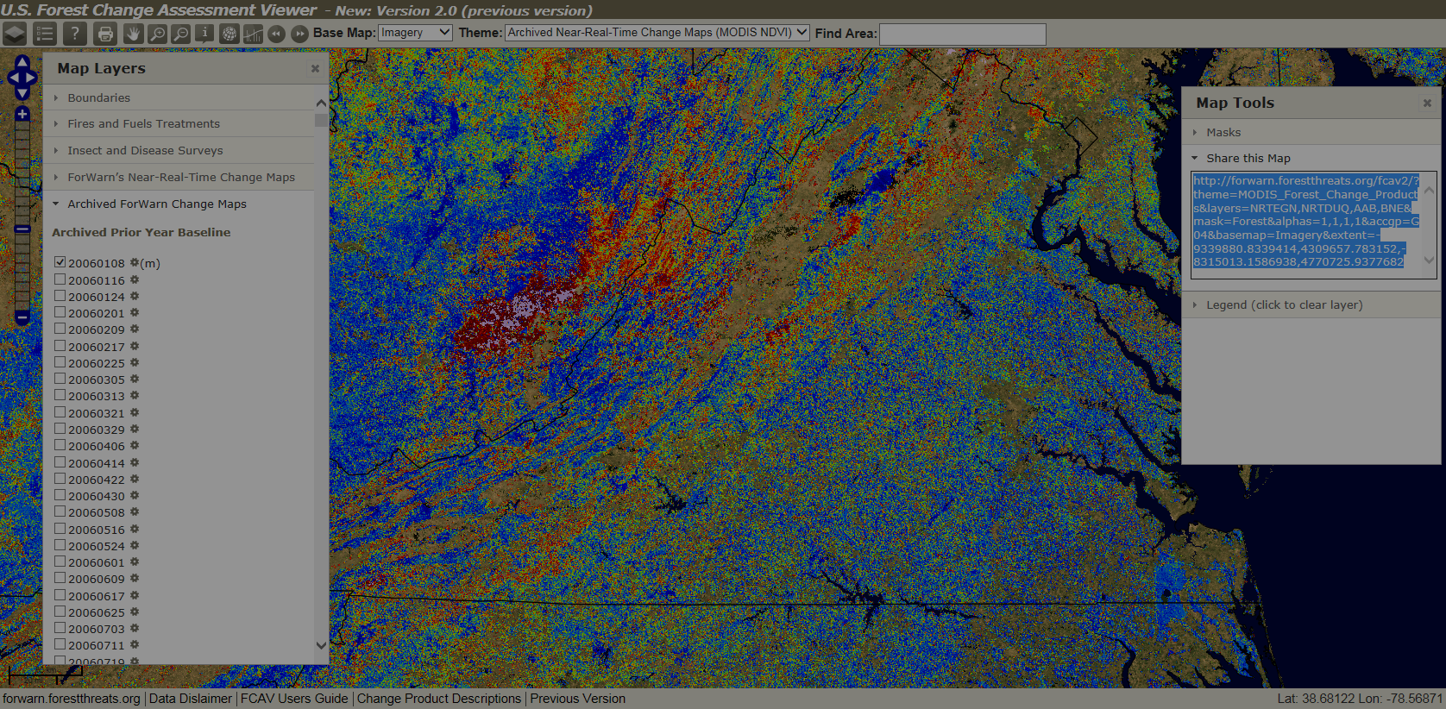
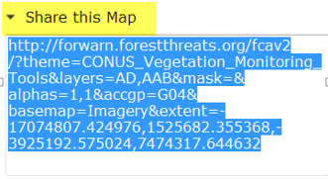
FCAV Feature: “Share this Map”(share your area of concern with your colleagues)
Share this Map
Users can cut, paste and send a URL that, when clicked on by others, launches the Assessment Viewer showing them exactly the same ForWarn disturbance map being viewed by the sender.
Same map composition and extent
Facilitates communication and consultation with the ForWarn Team and your colleagues

Slide 20
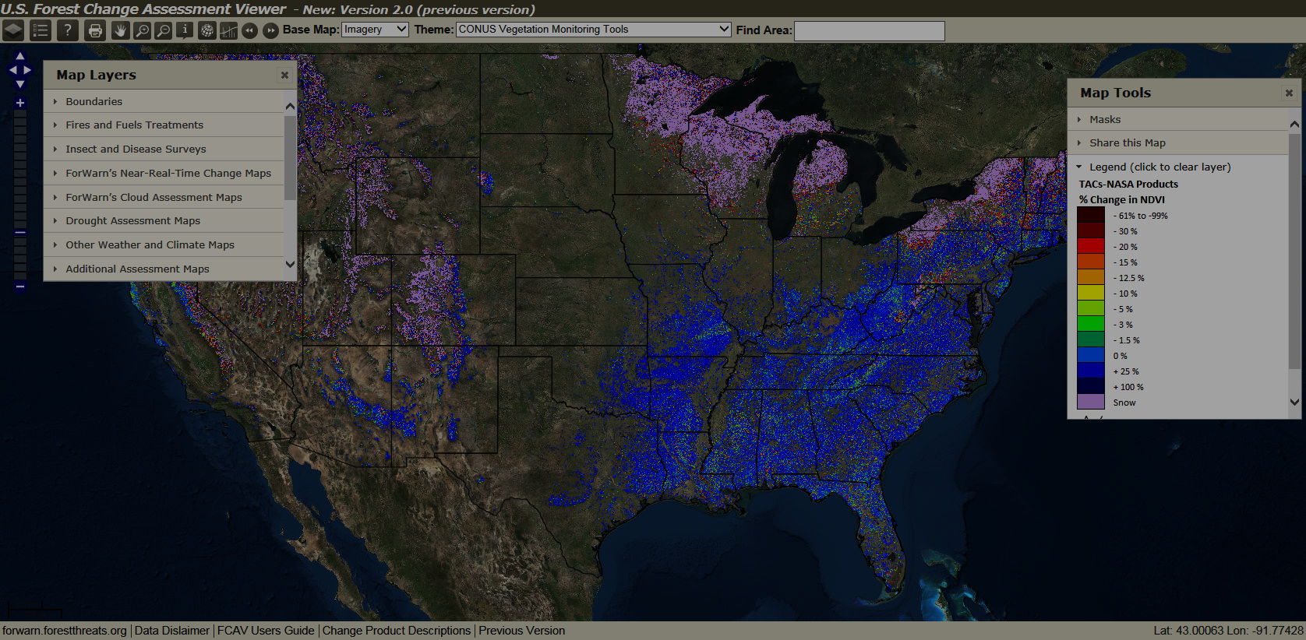
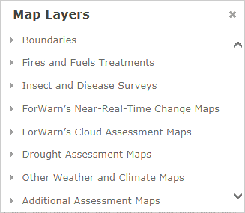
Forest Change Assessment Viewer (FCAV): Map Layers Window

Slide 21
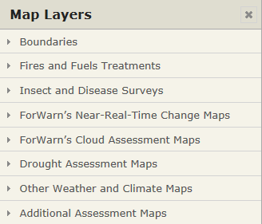
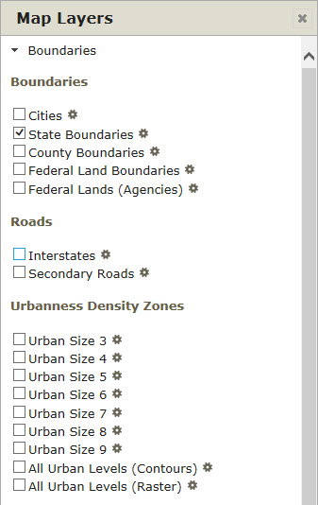
Forest Change Assessment Viewer (FCAV) Layers: Boundaries

Slide 22
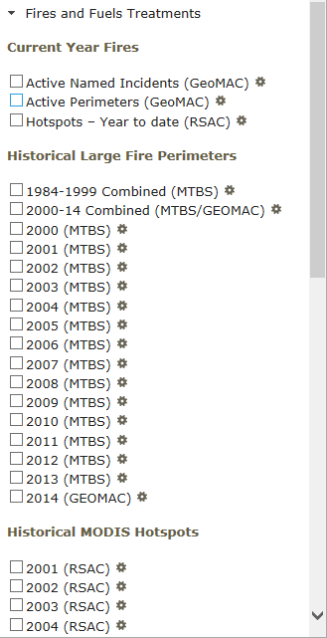
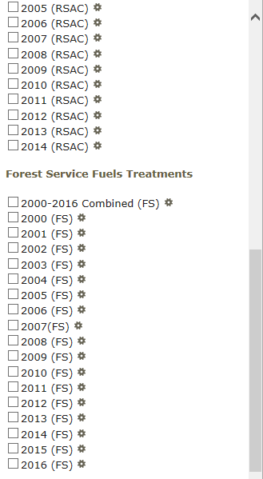
Forest Change Assessment Viewer (FCAV) Layers: Fire

Slide 23
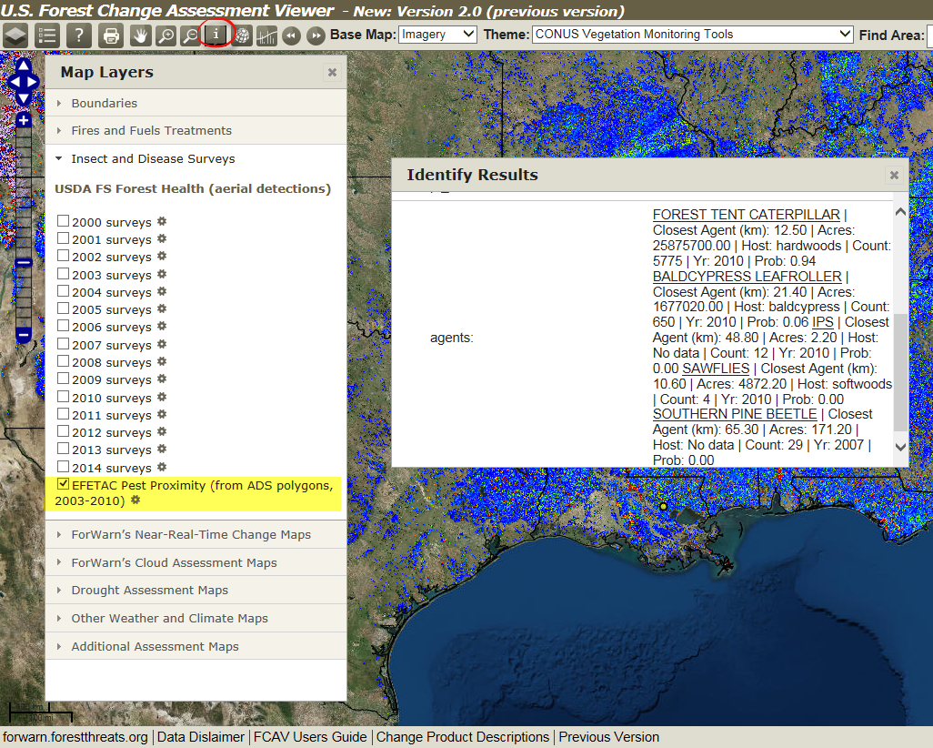
Forest Change Assessment Viewer (FCAV) Layers: ADS, PEST PROXIMITY
Pest Proximity Feature
Pest Proximity shows a list of all of the "Usual Suspects" -- all insects and diseases that have been found by the Aerial Disturbance Survey program -- near any point where the user clicks with the mouse
Shown in order of greatest likelihood, by area affected
‘Pest-Prox’ is designed to help you think of all of the likely possible causative disturbance agents

Slide 24
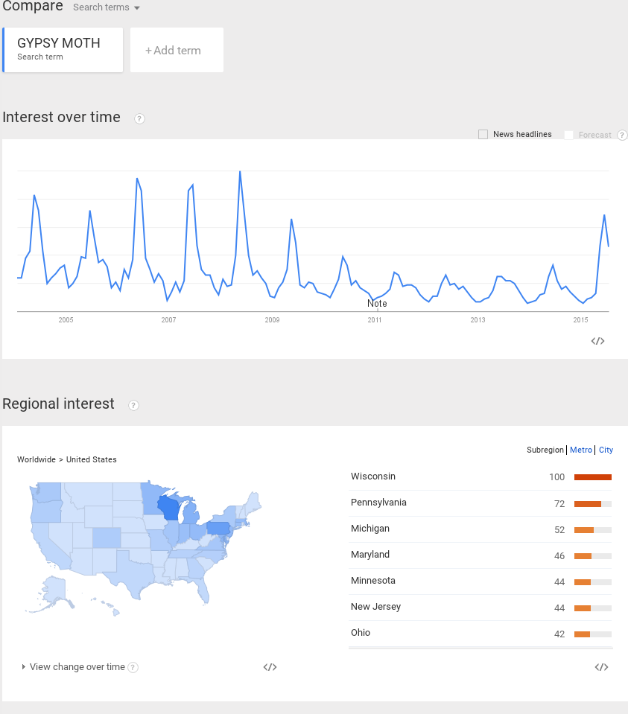
FCAV Layer PEST-PROX, Google Trends: Social ”Crowd-Sourcing”
Google Trends Pest-Prox Feature
Clicking on a Pest in Pest-Prox list does a Google Trends search, shows how frequently people have done a Google search on that Pest since 2004 – May, show:
historical seasonality of attack, and
relative magnitude / importance/interest of the attack this year, via indirect use of "Citizen Science.“
interesting feature, though all of you are the experts

Slide 25
FCAV Layers: Near-Real-Time Change Maps

Slide 26
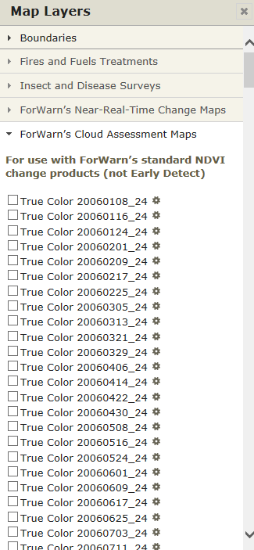
FCAV Layers: Cloud Assessment Maps (available from 01/08/06 through 09/29/15)

Slide 27
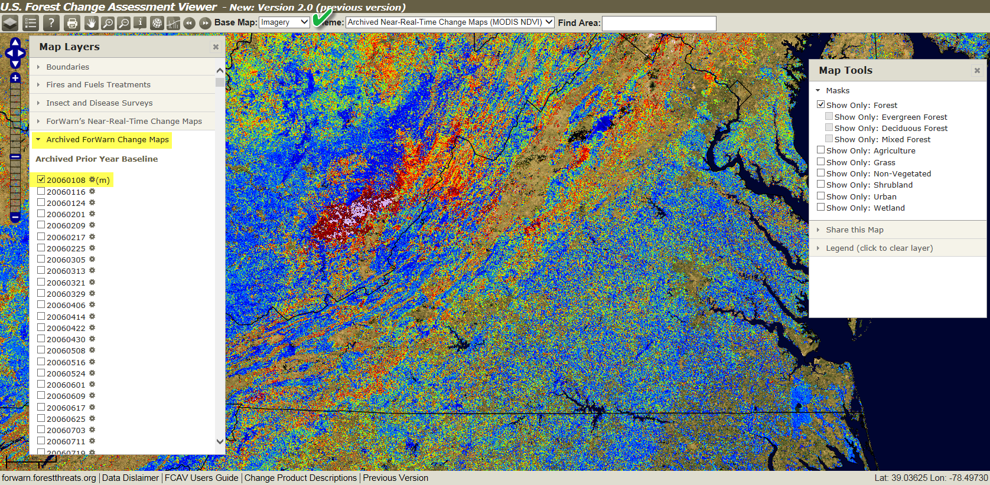
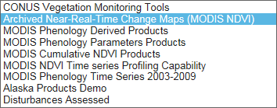
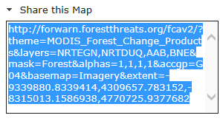
FCAV Layers: Cloud Assessment Maps (available from 01/08/06 through 09/29/15)

Slide 28
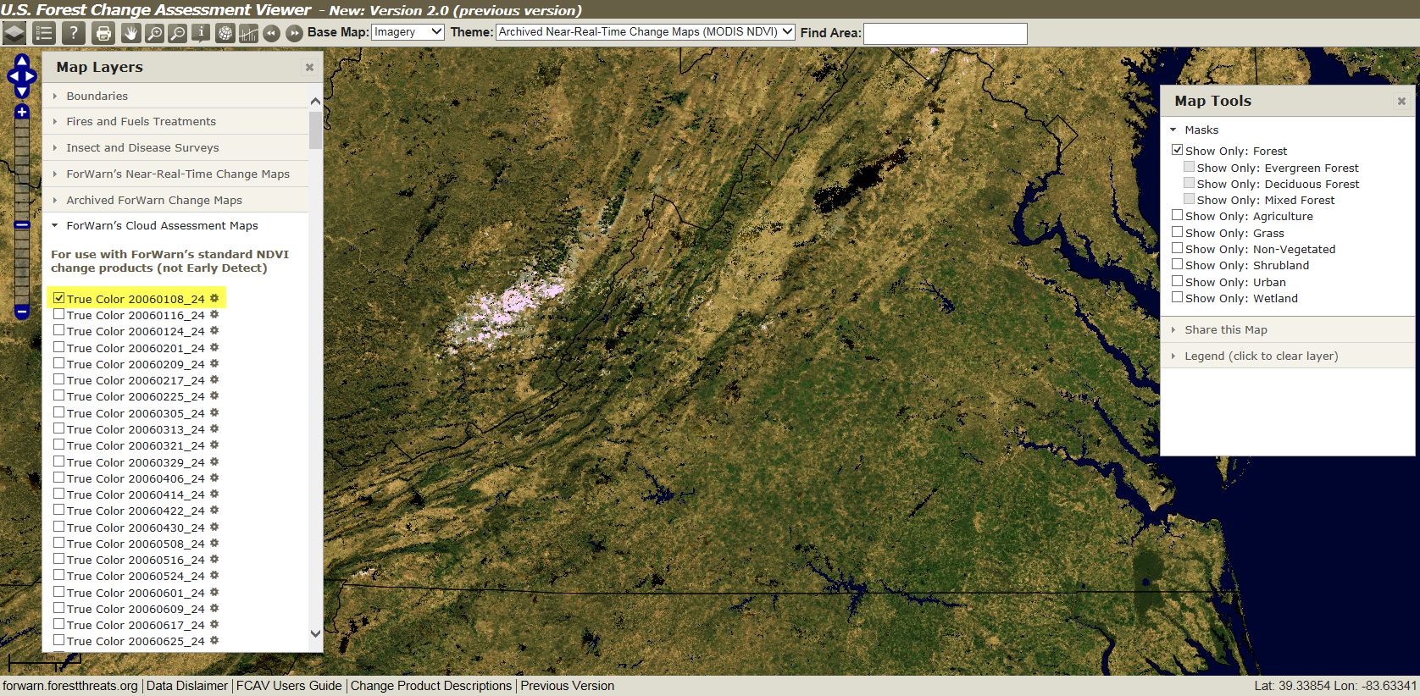
FCAV Layers: Cloud Assessment Maps (available from 01/08/06 through 09/29/15)

Slide 29
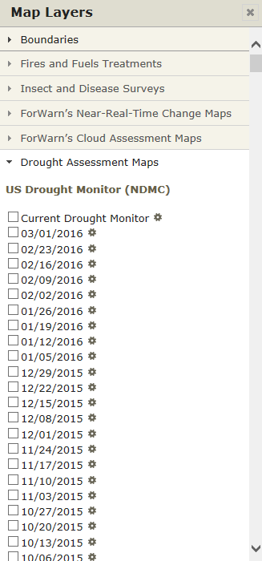
Forest Change Assessment Viewer (FCAV) Layers: Drought Monitor Maps

Slide 30
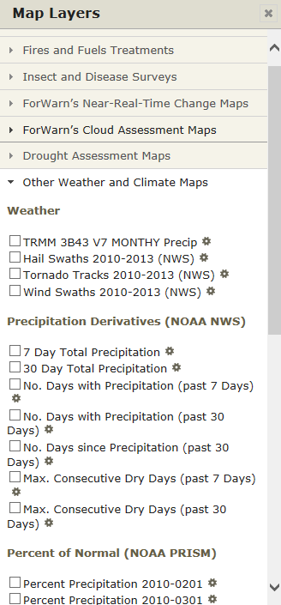
Forest Change Assessment Viewer (FCAV) Layers: Weather and Climate

Slide 31
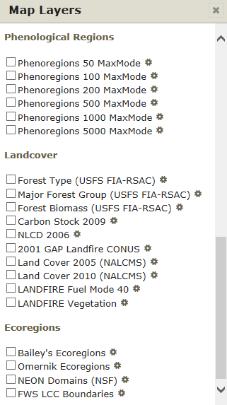
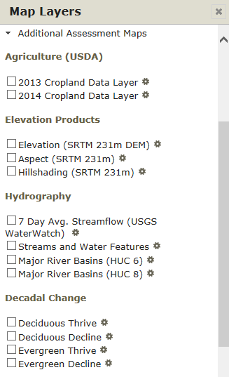
Forest Change Assessment Viewer (FCAV) Layers: Additional Assessment Maps

Slide 32
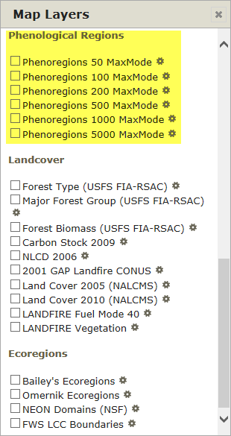
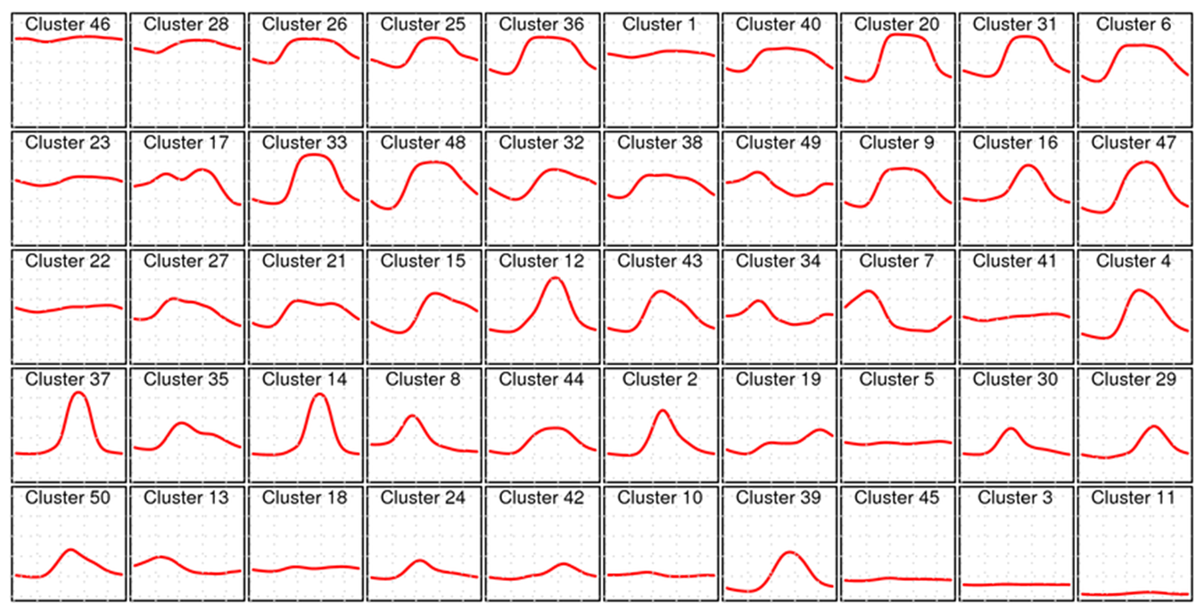
Forest Change Assessment Viewer (FCAV) Layers: Additional Assessment Maps
50 Distinct Phenological Classes

Slide 33
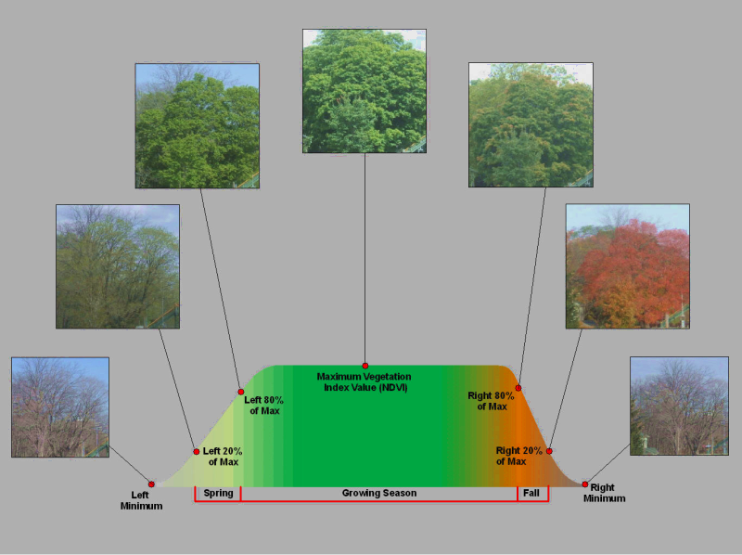
FCAV Layers: Additional Assessment Maps – Phenological Ecoregions
Annual Greenness Profile Through Time

Slide 34
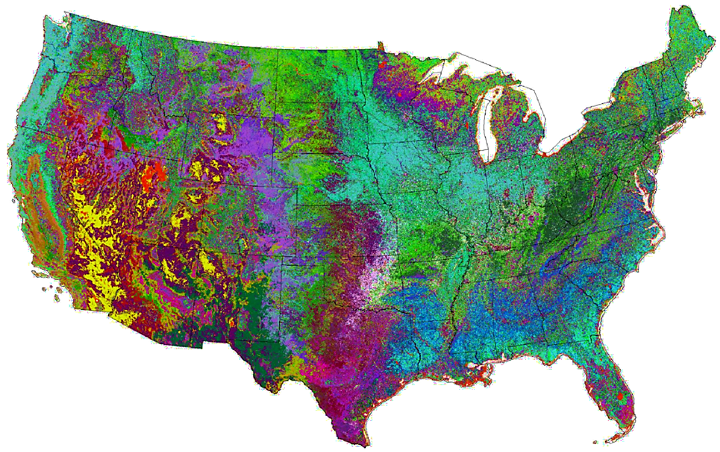
FCAV Layers: Additional Assessment Maps – Phenological Ecoregions
50 Distinct Phenological Classes
The 50 Most-Different National Phenological Ecoregions for 2010, Colored Randomly. This map is essentially a Dynamically Determined Vegetation Types Map.
Provisional Research Dataset

Slide 35
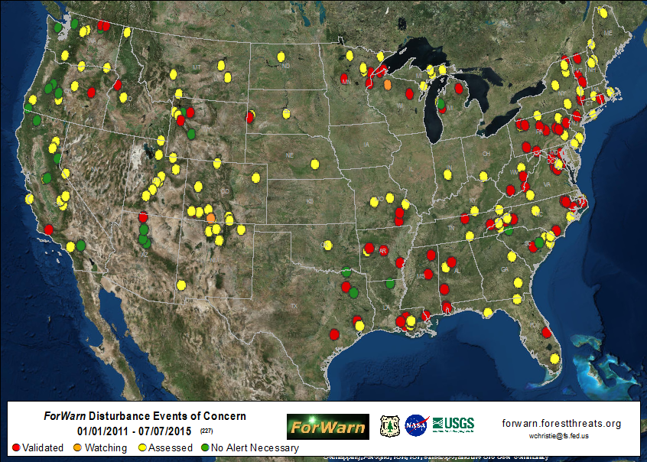
ForWarn: Disturbance Assessment and Vetting

Slide 36
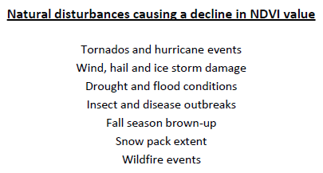
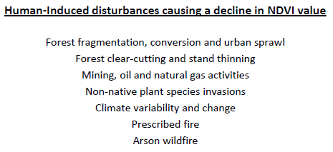
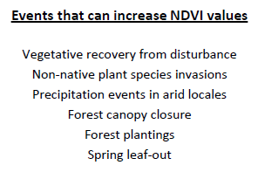
Examples of forest disturbance, or recovery, seen in the ForWarn forest change images

Slide 37
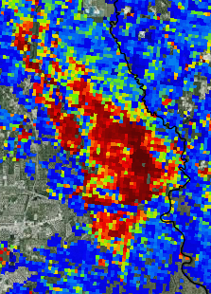
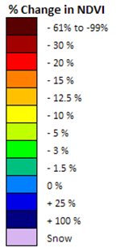
ForWarn Forest Disturbance Assessment (locate, characterize and assess)
Where is the Disturbance Located? (geographic site and situation)
Land cover / Land Use (image basemap, NLCD masks, FS/GAP veg maps)
Topographic position (elevation, slope and aspect, USGS topo's are available in Viewer under ‘Base maps’, wet/dry – USGS Stream Gauges, amount of mix?)
What is the character of the NDVI departure?
Progression speed (use the 3 most recent, fast vs. slow, on in 1/off in next = clouds)
Severity, percent NDVI change (pos./neg., low/high departure, climate affects?)
Spatial extent (large area or localized)
Pattern and shape (spotty/scattered, bulls-eye, target-like, linearity)
Edges (hard/well defined or bulls-eye – trails-off showing less departure)
Seasonality (spring, fall, snow: local and regional variation in annual phenology can causes NDVI departure (+/-); two new forest change products attempt to mitigate the effects in the variability of the start and stop of spring and fall from year to year)

Slide 38
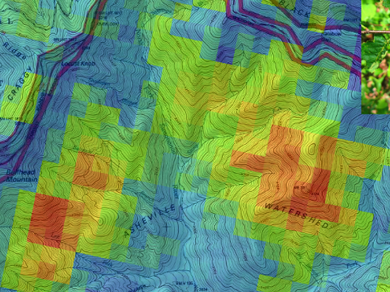
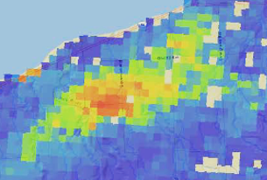
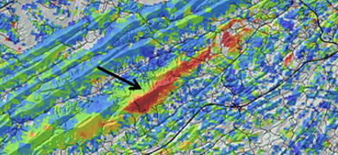
Examples of forest disturbance, or recovery, seen in the ForWarn forest change images

Slide 39
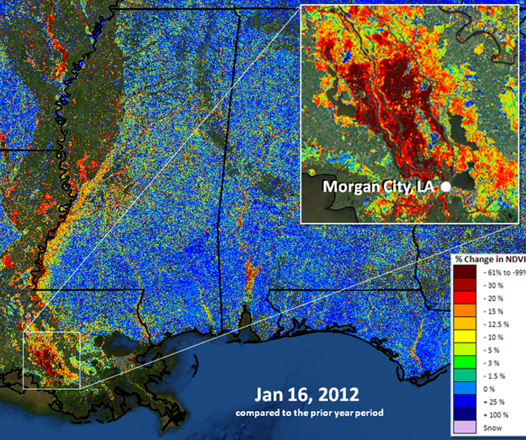
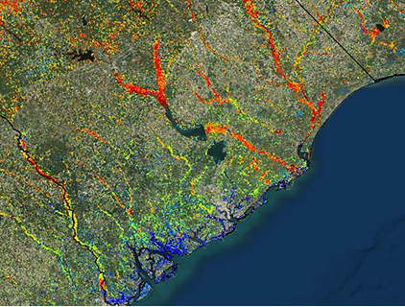
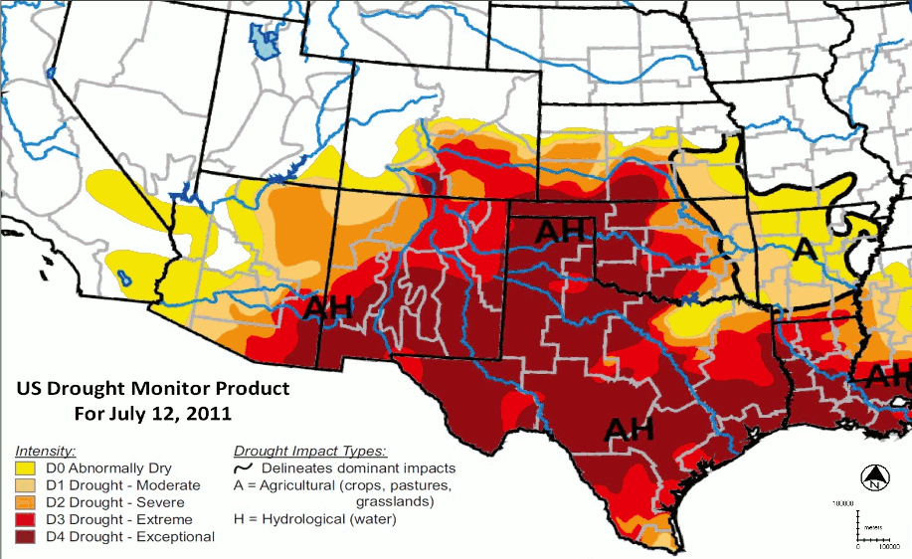
Examples of forest disturbance, or recovery, seen in the ForWarn forest change images

Slide 40
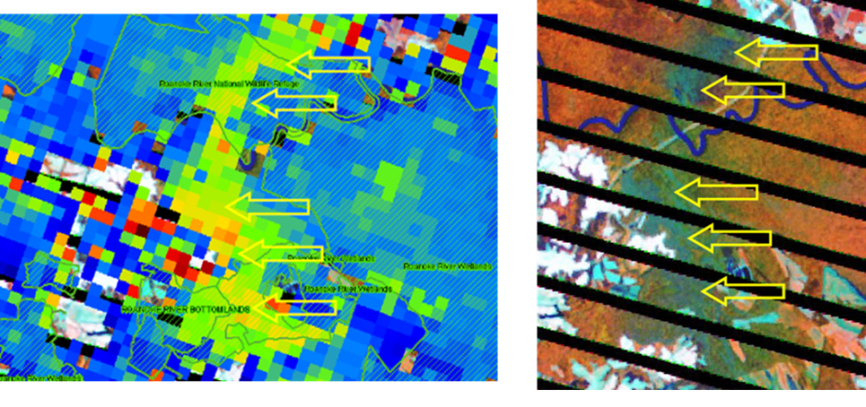
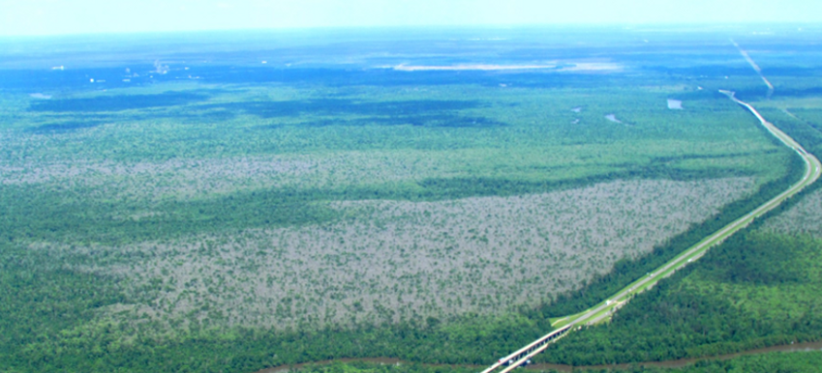
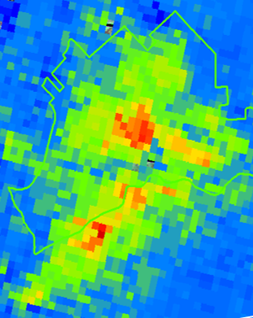
Examples of forest disturbance, or recovery, seen in the ForWarn forest change images

Slide 41
Examples of forest disturbance, or recovery, seen in the ForWarn forest change images
Monongahela National Forest, Pocahontas County, WV and
George Washington National Forest, Highland County, VA

Slide 42
Examples of forest disturbance, or recovery, seen in the ForWarn forest change images
ForWarn 07/27/2015, 1-year baseline

Slide 43
Examples of forest disturbance, or recovery, seen in the ForWarn forest change images
Landsat 7, 07/22/2015, 452rgb

Slide 44
Examples of forest disturbance, or recovery, seen in the ForWarn forest change images

Slide 45
Examples of forest disturbance, or recovery, seen in the ForWarn forest change images

Slide 46
Examples of forest disturbance, or recovery, seen in the ForWarn forest change images

Slide 47
Examples of forest disturbance, or recovery, seen in the ForWarn forest change images

Slide 48
Examples of forest disturbance, or recovery, seen in the ForWarn forest change images
Forest disturbance events often display degrees of severity. Variation in rates of recovery can relate to ecological, or vegetative resilience.

Slide 49
Examples of forest disturbance, or recovery, seen in the ForWarn forest change images

Slide 50
Examples of forest disturbance, or recovery, seen in the ForWarn forest change images

Slide 51
Examples of forest disturbance, or recovery, seen in the ForWarn forest change images

Slide 52
FCAV Feature: Graph NDVI (110B NDVI observations)

Slide 53
FCAV Feature: Graph NDVI (110B NDVI observations)

Slide 54
FCAV Feature: Graph NDVI (110B NDVI observations)

Slide 55
FCAV Feature: Graph NDVI (control the x and y axis)

Slide 56
ForWarn Website
forwarn.forestthreats.org

Slide 57
ForWarn Website: Highlights

Slide 58
ForWarn Website: Products
If you need a quick shapefile of a specific disturbance event, you can use the WMS on the desktop to screen-digitize the extent, and if present, depict zones of severity.

Slide 59
ForWarn WMS on Android Devices
(independent from the USFS)

Slide 60
ForWarn Website: Resources

Slide 61
ForWarn Website: User’s Guide

Slide 62
ForWarn Viewer: User’s Guide / Product Information

Slide 63
What is ForWarn and How does it Work?
The Forest Change Assessment Viewer
Disturbance Assessment and Vetting
The ForWarn Website: http://forwarn.forestthreats.org
What’s New and Future Enhancements
Points of Contact
Questions?

Slide 64
ForWarn FCAV: What’s New
New Land Cover Masks
MODIS Resolution 2010 Land Cover from NLCD
(from cec.org and landsat.usgs.gov)
*
(*) Hybridized – Woody wetland component of the Wetland class has been merged with the Deciduous Forest class
Benefit: Better overall representation and more accurate delineation of the “Mixed Forest” class

Slide 65
ForWarn FCAV: What’s New
‘Urbanness’ Data Layers
Population density Index modeled using LandScan and NLCD Impervious Surfaces
Benefit: Can be used to locate and monitor the WUI for wildfire potential, fuel treatment, harvests, controlled burns and smoke management. These data were produced in a uniform manner for CONUS.

Slide 66
ForWarn FCAV: What’s New
Federal Lands Boundary
Proclaimed vs. Administered

Slide 67
ForWarn FCAV: What’s New
Federal Land Boundaries’ Data Layer
Proclaimed vs. Administered
Holly Springs National Forest
Benefit: Proclaimed boundaries are misleading, view detailed parcel ownership when zoomed

Slide 68
ForWarn FCAV: What’s New
MODIS NDVI Data Distribution Site
Oak Ridge National Laboratory, Oak Ridge, TN
Benefit: Internet access to ForWarn’s NDVI-value data

Slide 69
ForWarn FCAV: What’s New
Intra-Annual ‘Persistence’ Product
In development, a value-added product to aid users
NDVI Polar Graph
Benefit: Reduce disturbance complexity in the annual products and summarize persistent forest disturbance over a short period of time

Slide 70
ForWarn FCAV: What’s New
Intra-Annual ‘Persistence’ Product
In development, a value-added product to aid users
NDVI Polar Graph
Benefit: Reduce disturbance complexity in the annual products and summarize persistent forest disturbance over a short period of time

Slide 71
ForWarn General Technical Report (USFS GTR)
Google ‘forwarn gtr’, first listing
(paper copies are also available)
http://www.srs.fs.fed.us/pubs/gtr/gtr_srs180.pdf

Slide 72
For More Information
ForWarn Website: http://forwarn.forestthreats.org
Forest Change Assessment Viewer: http://forwarn.forestthreats.org/fcav2
Bill Hargrove (PI), Research Ecologist: whargrove@fs.fed.us Steve Norman, Research Ecologist: stevenorman@fs.fed.us Bill Christie, Biological Scientist: wchristie@fs.fed.us
Many persons at many agencies have contributed to this work

Slide 73
What is ForWarn and How does it Work?
The Forest Change Assessment Viewer
Disturbance Assessment and Vetting
The ForWarn Website: http://forwarn.forestthreats.org
What’s New and Future Enhancements
Points of Contact
Questions?

Slide 74
Questions?
Bill Hargrove, PI
Research Ecologist
forwarn.forestthreats.org

