Slide 1
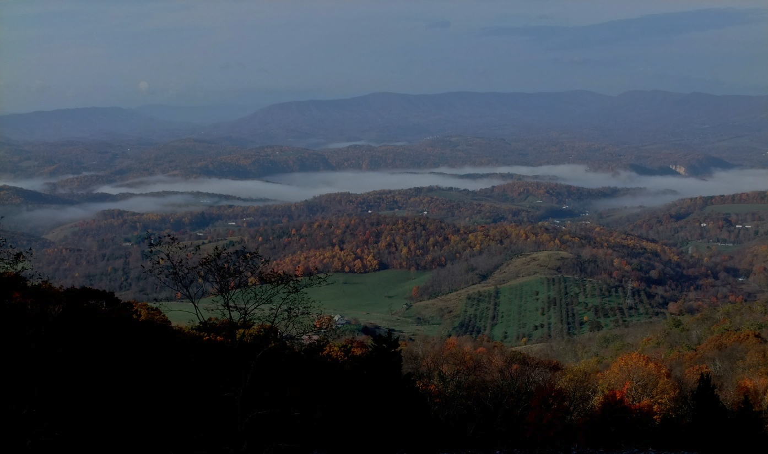
Landscape Dynamics Assessment:
Quantifying the shifting landscape mosaic
Lars Y. Pomara
Danny C. Lee
Bjørn-Gustaf Brooks
William Hargrove
Eastern Forest Environmental Threat Assessment Center
Southern Research Station, USDA Forest Service, Asheville, NC

Slide 2
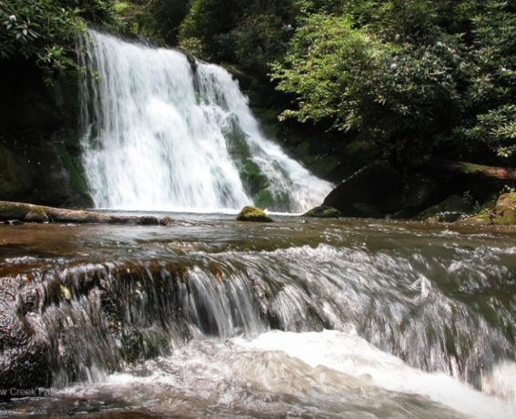
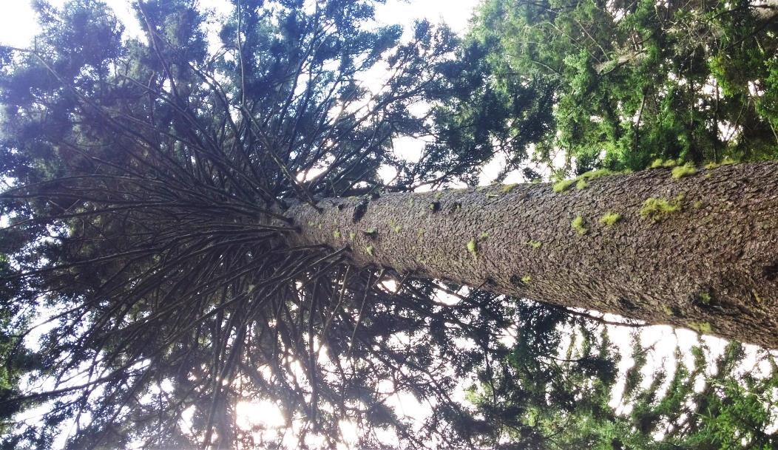
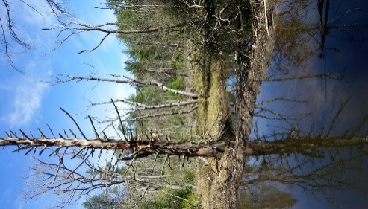
spatiotemporal landscape organization and dynamics through an information-theoretic, land surface phenology lens
Ralph Preston
Landscape resilience
Capacity to maintain defining characteristics, structure and functions
Disturbance & succession
Land use & climate change
Vulnerability to stressors
Eric Wood

Slide 3
Landscape resilience metric development
LanDAT
Landscape Dynamics Assessment Tool

Slide 4
LanDAT data source
MODIS Normalized Difference Vegetation Index (NDVI), 2000 – 2015
Annual phenology: timing of vegetation change
2000
2014
232 meters
232 meters
Appalachian forest pixel, southwestern WV
Rio Grande riparian pixel,
west Texas

Slide 5
Phenological description:
MODIS NDVI Within-year variability
Mean growing season NDVI (greenness)
Magnitude of mean vector NDVI (seasonality)
Midpoint of growing season (peak)
Beginning of growing season
Length of growing season
Growing season NDVI standard deviation

Slide 6
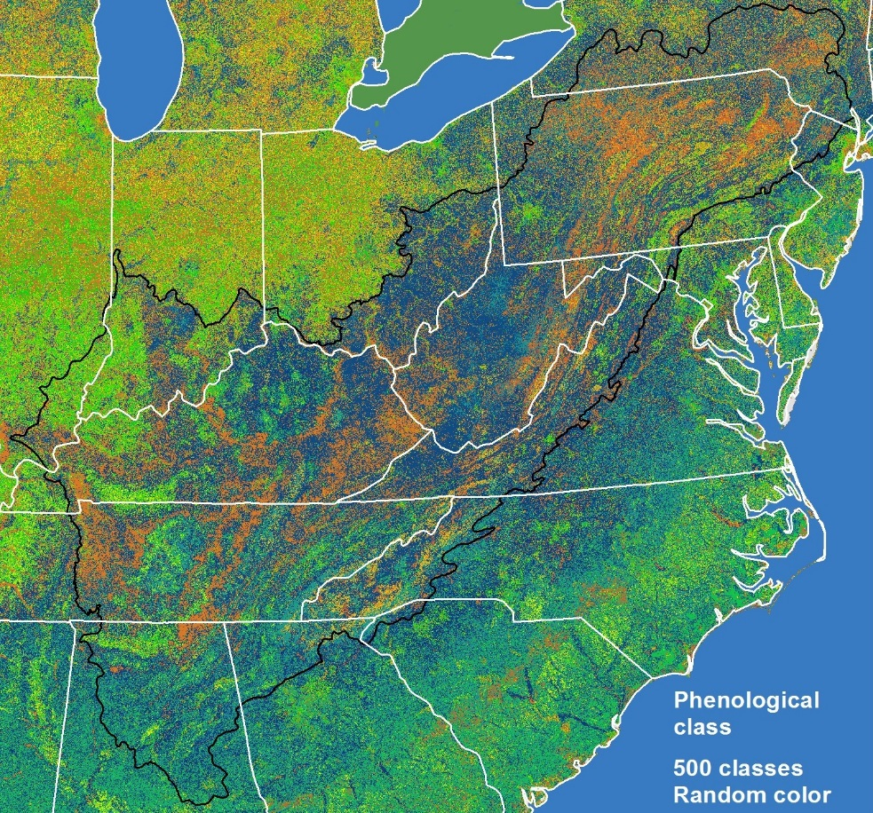
Annual phenological classification, 2000 – 2015
Cluster pixels, using 6 variables
Mean growing season NDVI
Magnitude of mean vector NDVI
Midpoint of growing season
Beginning of growing season
Length of growing season
Growing season NDVI standard deviation
Phenological class, 2014
2000
2014

Slide 7
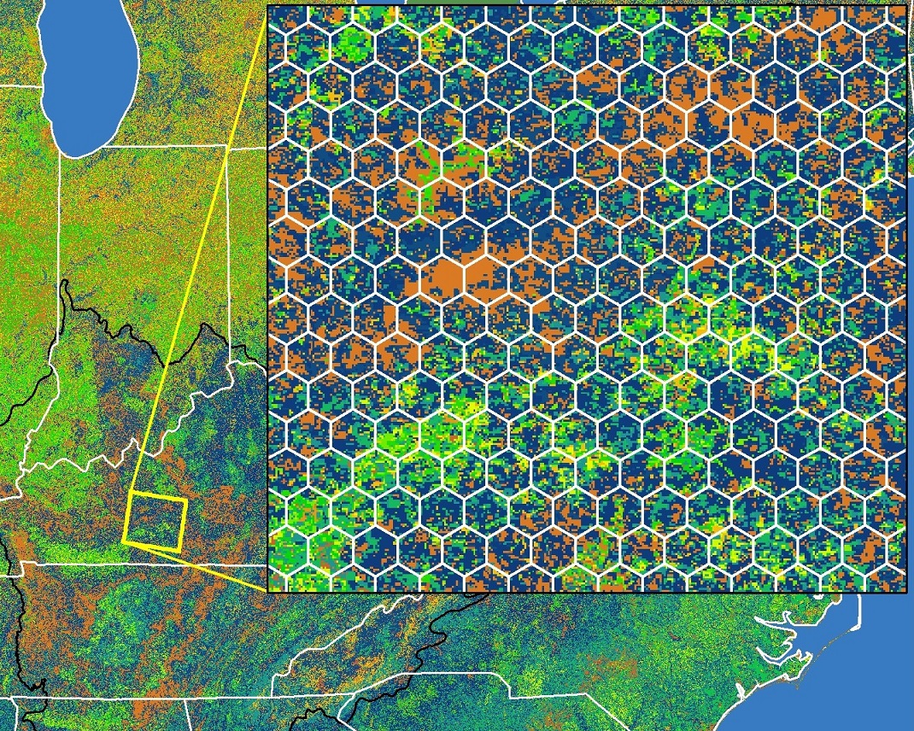
Information-theoretic measures of landscape dynamics
complexity and organization
2000 – 2015
Inter-annual phenoclass transitions
From class...
 |  |  |  |  | e | f | g | h | i | j | k
a
b
c
d
e
f
Disturbance
To class...
Succession
Phenological class in
2000, 2001, … 2015
Increasing NDVI
Landscape sizes: 81 pixels: ~ 435 ha
450 pixels: ~ 2400 ha

Slide 8
Information-theoretic measures of landscape dynamics
complexity and organization
2000 – 2015
Inter-annual phenoclass transitions
From class...
$P=$ Cell probability
 |  |  |  |  | e | f | g | h | i | j | k
a | .17 | .01 | .00 | .03 | .05 | .02 | .00 | …
b
c
d
e
f
$H=$ Shannon diversity
$$H=−\sum_{i}{\left(P_{i}∙ log2\left(P_{i}\right)\right)}$$
$MI=$ Mutual Information
$$MI=\sum_{i}{\sum_{j}{\left(P_{i,j}∙{log2\left(\frac{P_{i,j}}{P_{∙i}∙P_{∙j}}\right)}\right)}}$$
$Conditional Entropy=$ mean H $−$ MI
To class...
$Ascendency=$ MI $∙$ mean NDVI
$Overhead=$ CE $∙$ mean NDVI
Increasing NDVI
Ulanowicz, R. E. 1997. Ecology, the Ascendent Perspective. Columbia University Press, New York, NY.
Ulanowicz, R. E., et al. 2009. Quantifying sustainability: resilience, efficiency and the return of information theory. Ecological Complexity.

Slide 9
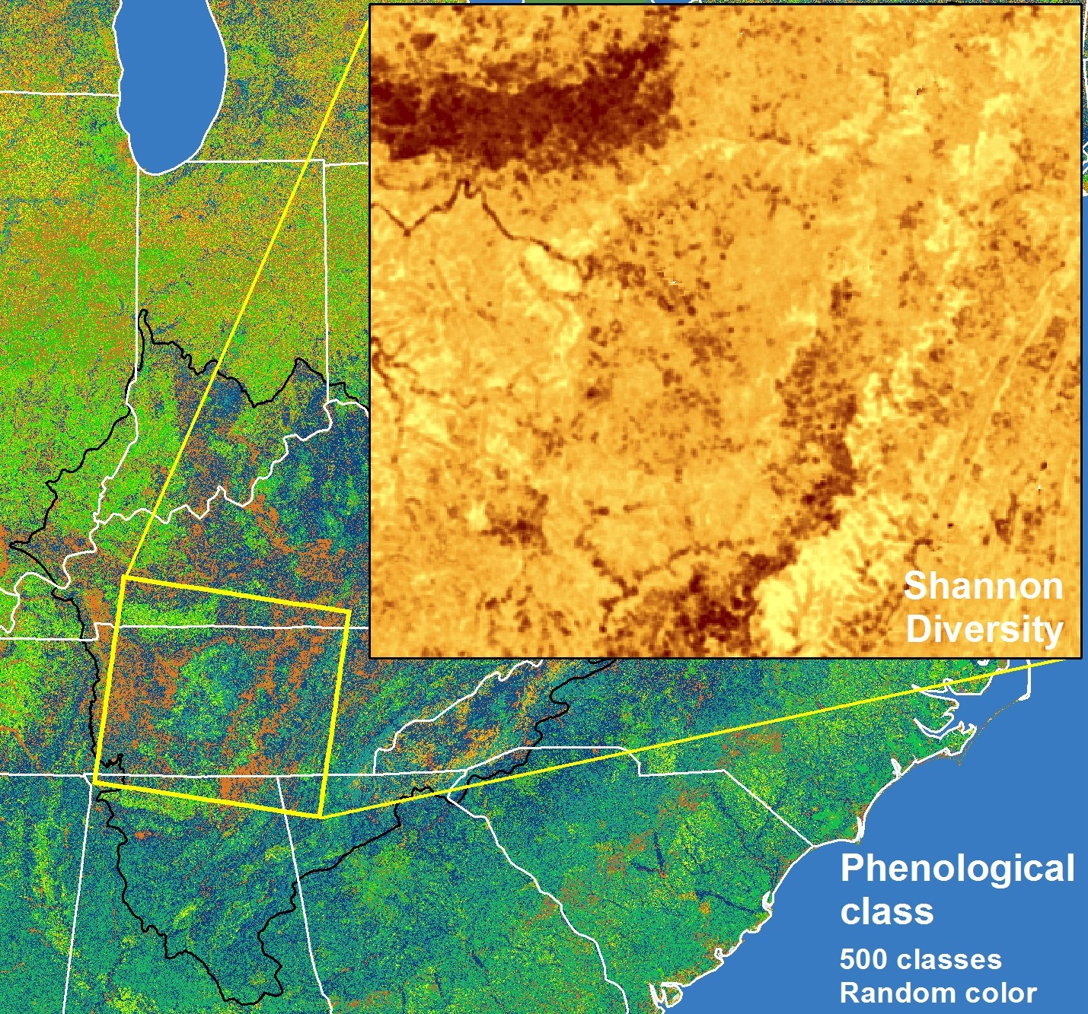
Example landscape metrics at national scale

Slide 10
Example landscape metric at regional scale
Landscape Ascendency shown in three subregions

Slide 11
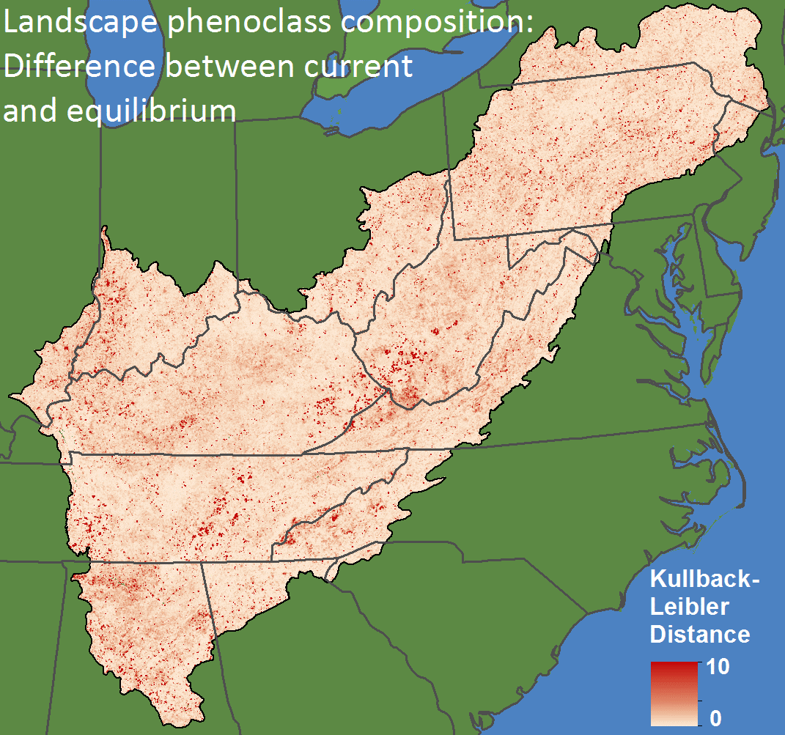
Expected shifts, given observed dynamics
Distance between current phenoclass distribution Q and projected equilibrium distribution P :
Kullback-Leibler divergence
$$D_{KL}P|Q=\sum_{i}{\left(P_{i}∙{log2\left(\frac{P_{i}}{Q_{i}}\right)}\right)}$$
Notes:
Bring in equilibrium vector analysis to demonstrate a key advantage of tying a resource to the IT metrics: now we can examine the direction, magnitude, and pace of landscape change, and map that to the resource. For example, what places with high carbon storage capacities are rapidly moving towards reduced carbon storage? Likely surface mining effect in WV/KY?

Slide 12
Drivers of change
Landscape capacity and use
USFS F2F
Ralph Preston
USFS FIA
Landscape resilience and vulnerability ??
We need to better understand the capacities of large landscapes to sustain ecosystem services, given environmental change.

Slide 13
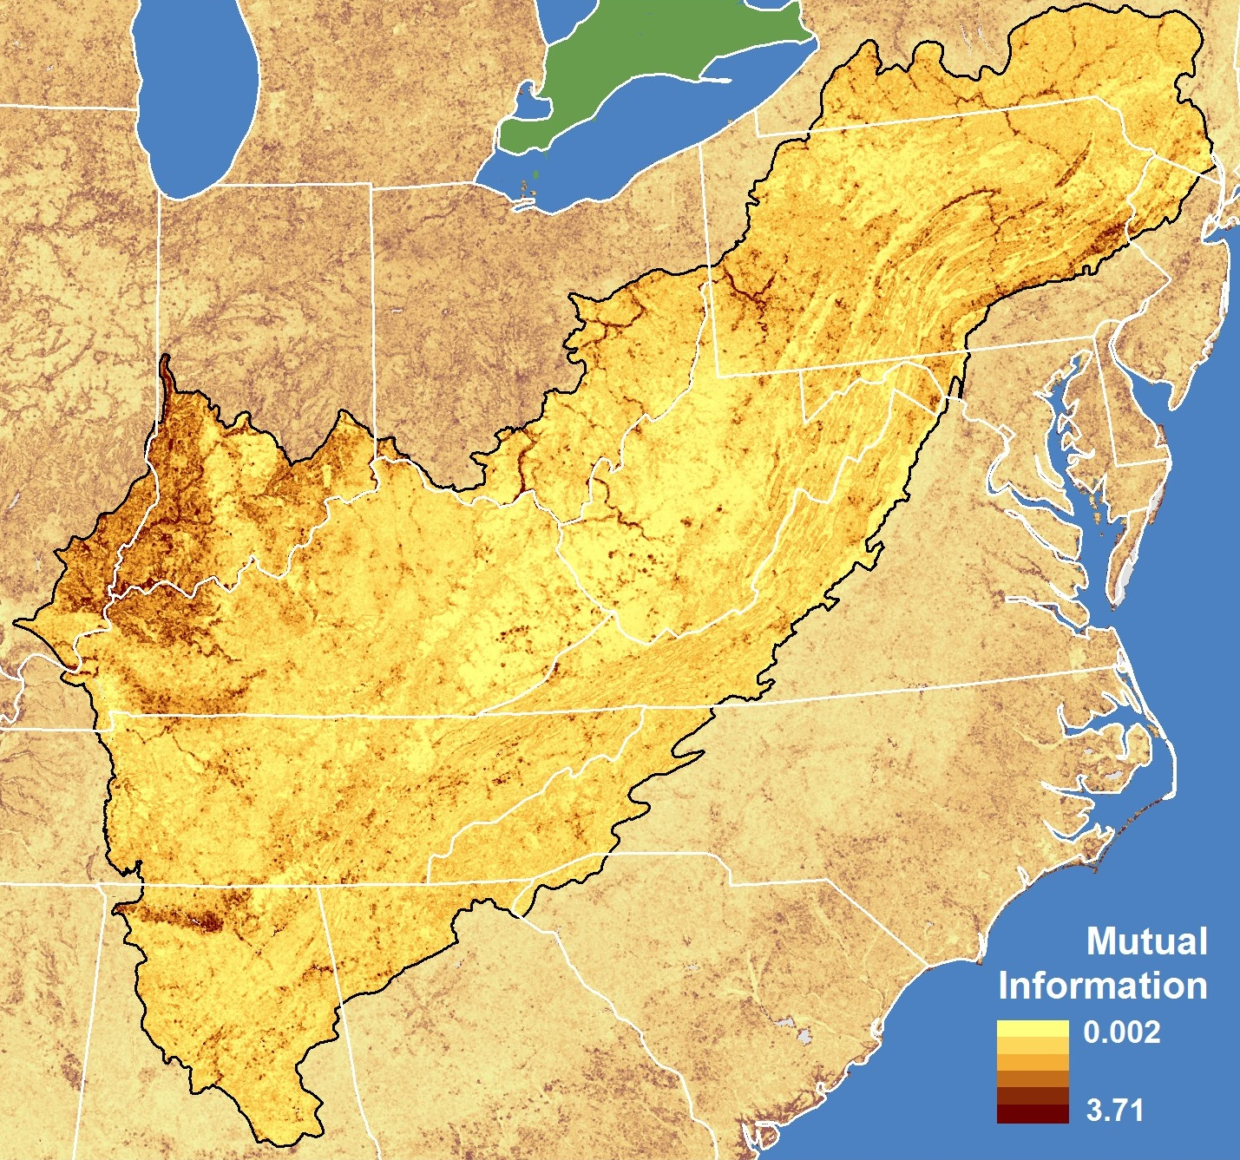
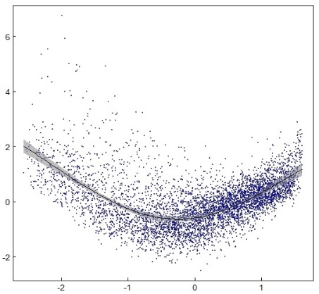
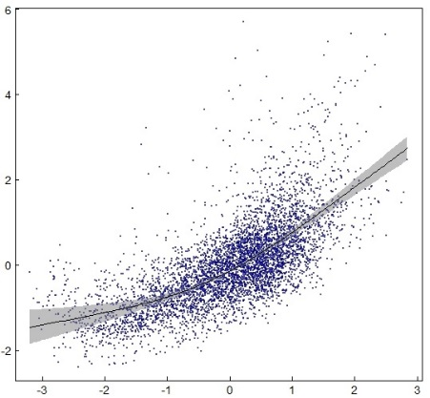
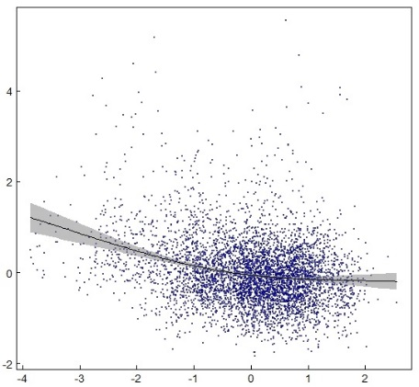
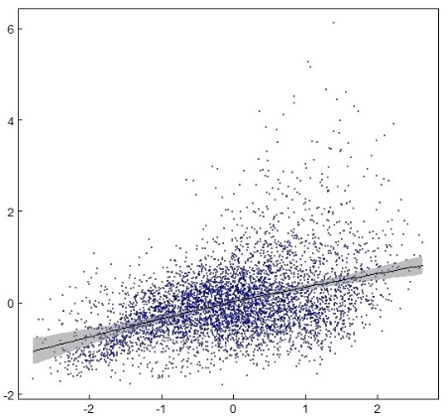
Landscape correlates of Mutual Information
Generalized Additive Models (GAM)
Spatial sample of 5000 cells
Predictors:
Forest density, spatial mean
Forest density, spatial variance
Drought Severity Index, variance among years
Spatial diversity (H) of land cover (NLCD)
Mutual Information
Partial residuals
Mean forest density
Forest density variation
s(parameter)
Inter-annual drought variability
Land cover diversity
Deviance explained: 49%
Parameter value
Notes:
Look at links between the IT variables and non-NDVI-based topo, climate, and LULC parameters

Slide 14
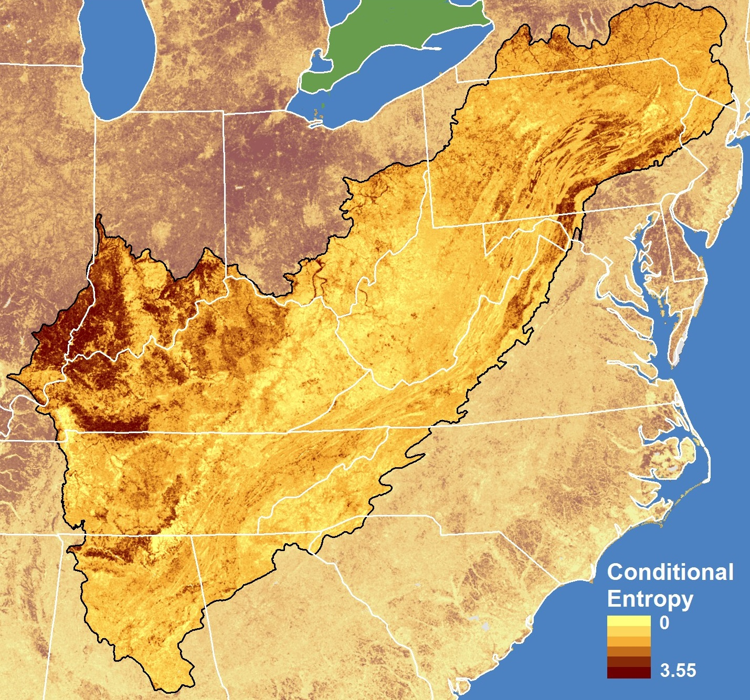
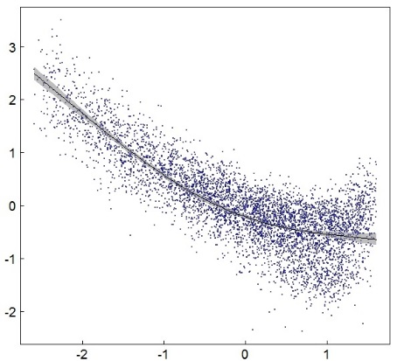
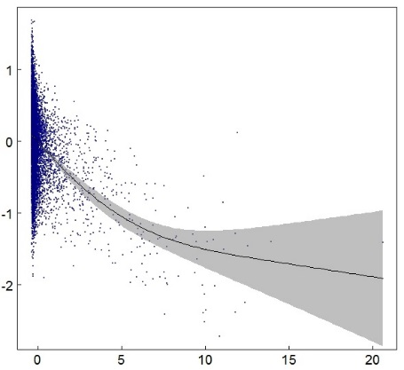
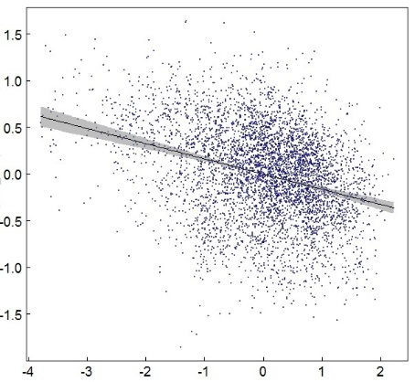
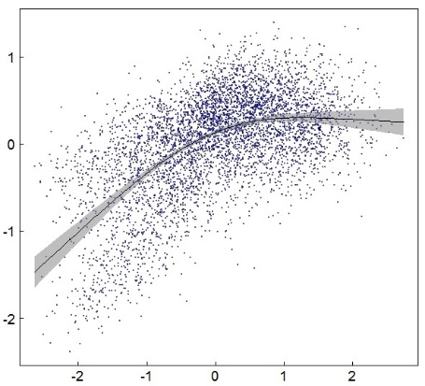
Landscape correlates of Conditional Entropy
Generalized Additive Models (GAM)
Spatial sample of 5000 cells
Predictors:
Forest density, spatial mean
Housing density, spatial mean
Drought Severity Index, variance among years
Spatial diversity (H) of land cover (NLCD)
Conditional Entropy
Partial residuals
Mean forest density
Mean housing density
s(parameter)
Inter-annual drought variability
Land cover diversity
Deviance explained: 78%
Parameter value
Notes:
Look at links between the IT variables and non-NDVI-based topo, climate, and LULC parameters

Slide 15
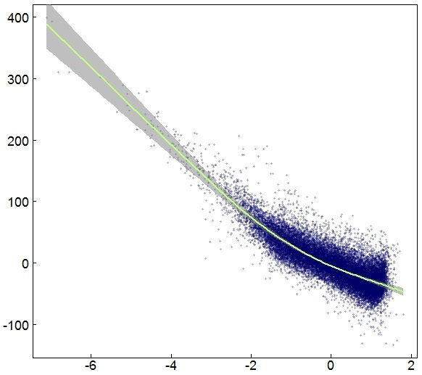
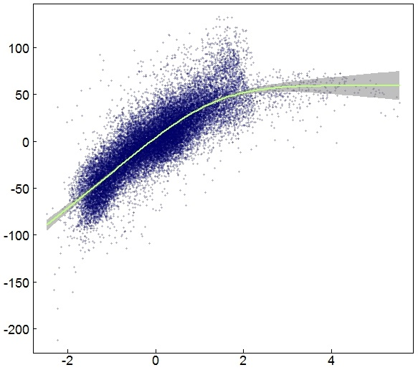
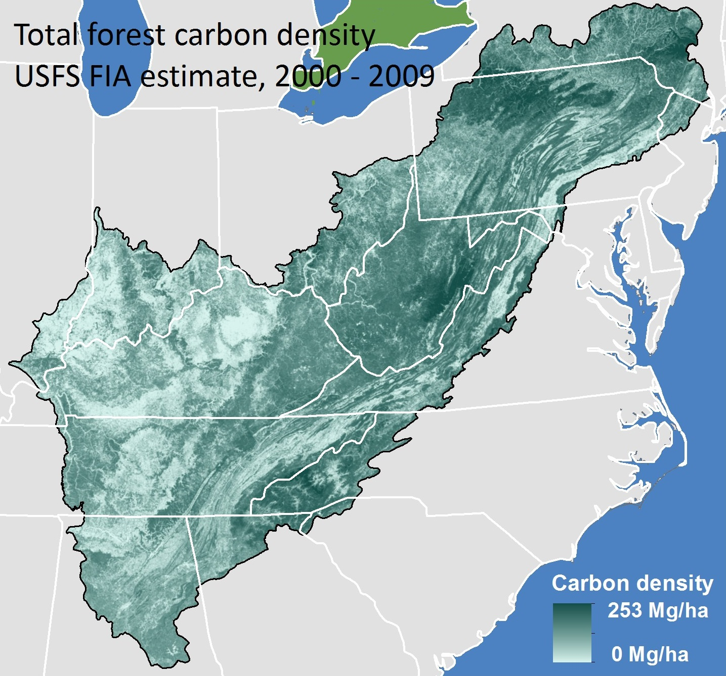
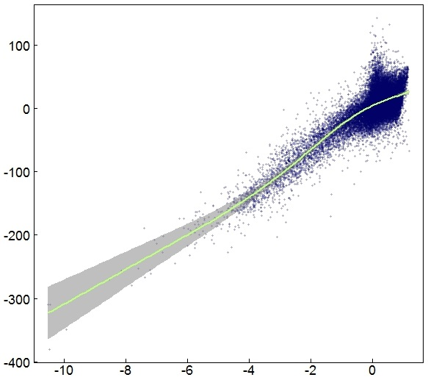
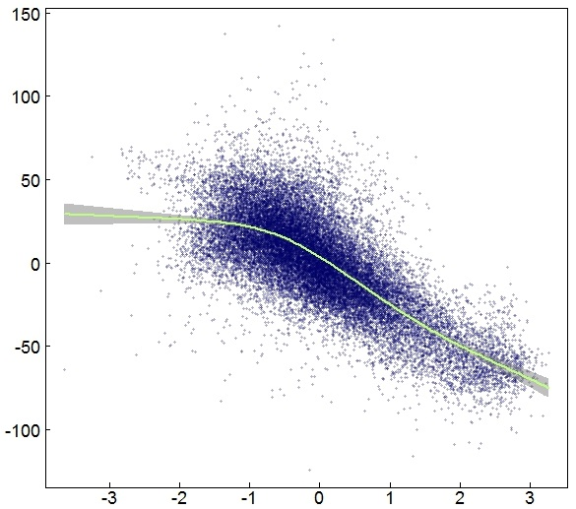
Landscape correlates of Forest Carbon Density
Generalized Additive Models (GAM)
Spatial sample of 25,000 cells
Deviance explained: 85%
Partial residuals
s(parameter)
Vector greenness (seasonality)
NDVI st dev (variability)
NDVI mean
Conditional Entropy
Parameter value
Notes:
Show links between IT measures and resources of interest

Slide 16
Expected shifts, given the observed dynamics
Compositional shift to higher/lower carbon storage capacity landscapes
(equilibrium minus current)
Drivers???
Notes:
Bring in equilibrium vector analysis to demonstrate a key advantage of tying a resource to the IT metrics: now we can examine the direction, magnitude, and pace of landscape change, and map that to the resource. For example, what places with high carbon storage capacities are rapidly moving towards reduced carbon storage? Likely surface mining effect in WV/KY?

Slide 17
Potential applications
Monitor and interpret landscape change
Spatial tools for planning with respect to resilience and vulnerability
Identify opportunities for restoration and other conservation actions
Spatial modeling for species and resources of concern
Understand the shifting landscape mosaic through a ‘systems’ lens
Understand mosaic drivers in an integrative context
Climate variability
Land use change
Ecological disturbance regimes

Slide 18
National Environmental Modeling and Analysis Center
University of North Carolina – Asheville
Appalachian Landscape Conservation Cooperative
Eastern Threat Center: Stephanie Worley-Firley, Sarah Workman, Steve Norman, Bill Christie, Kurt Riitters
Thank You!
Lars Y. Pomara
Danny C. Lee
Bjørn-Gustaf Brooks
William Hargrove
Eastern Forest Environmental
Threat Assessment Center
Southern Research Station
USDA Forest Service
Asheville, NC
lazarusypomara@fs.fed.us

