Slide 1
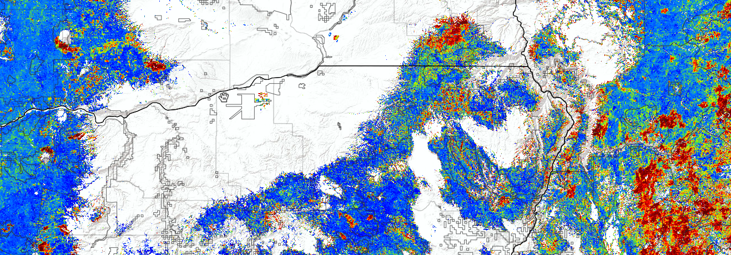
WA
ID
OR
Detecting and tracking forest change in the
Blue Mountains of Oregon and Washington using the
ForWarn system
Blue Mountains Forest Vegetation Workshop
April 3, 2014
Steve Norman - USDA Forest Service Eastern Threat Assessment Center
Bill Christie -
Bill Hargrove -
Joe Spruce - NASA-Stennis

Slide 2
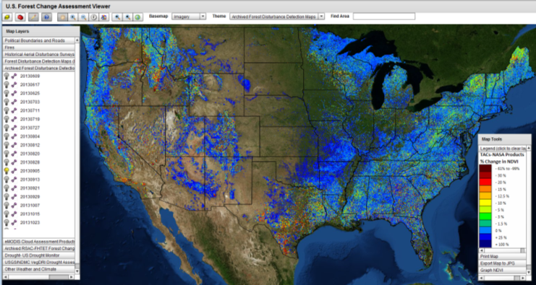
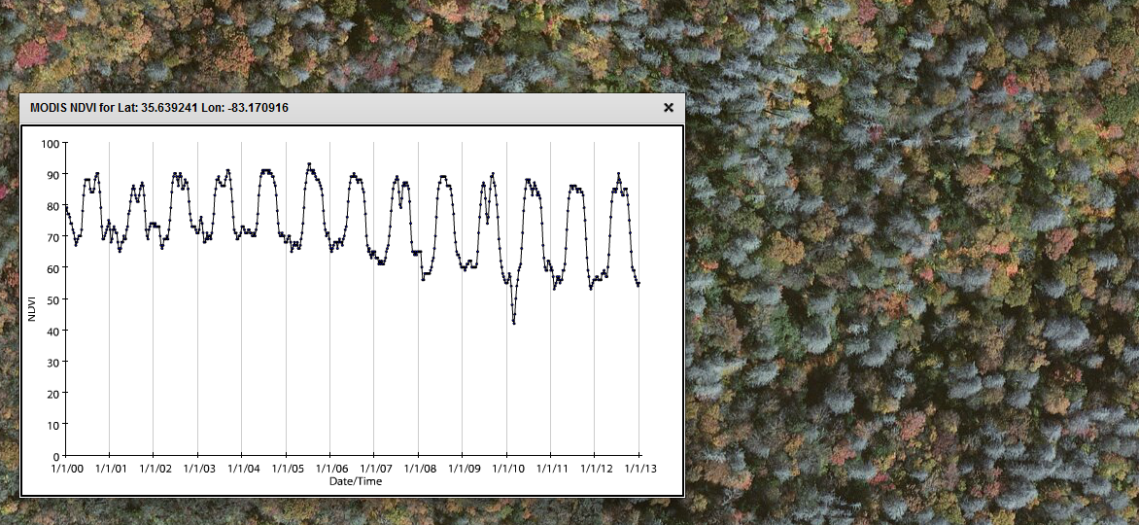
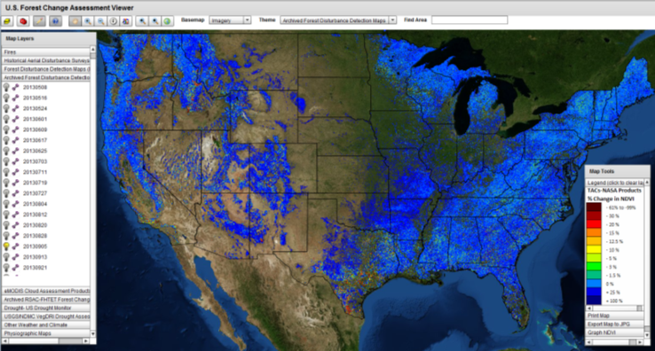
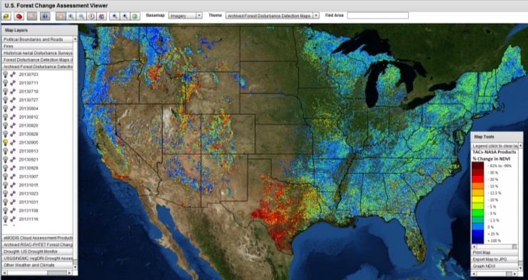
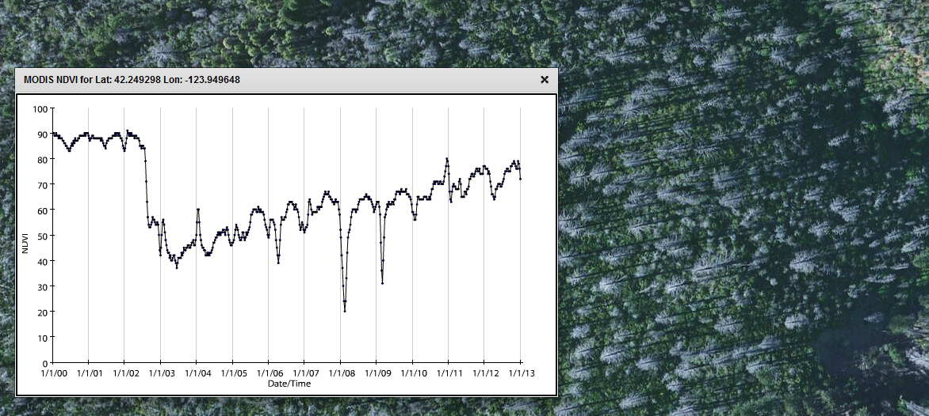
ForWarn
MODIS resolution NDVI @232m
NDVI data: 2000-present
Change maps: 2010-present
6 baselines for change context
8 day updates (46 periods/yr.)
Early Detect
1-year
Baseline
http://forwarn.forestthreats.org
Hemlock Woolly Adelgid mortality, NC
Standard
1-year
Baseline
All-year
Maximum
Baseline
Biscuit Fire, OR
All-year
Mean
Baseline

Slide 3
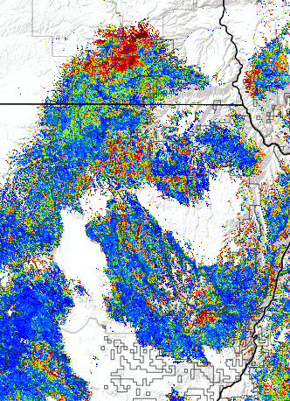
Five Applications of the ForWarn System
for Monitoring, Assessment and Prediction
Near-real-time disturbance detection.
Assessing seasonal climate impacts on vegetation productivity, such as fuels.
Tracking post-disturbance response over the long term.
Assessing cumulative effects from multiple disturbances or events across scales.
Monitoring vegetation status with respect to desired future conditions.

Slide 4
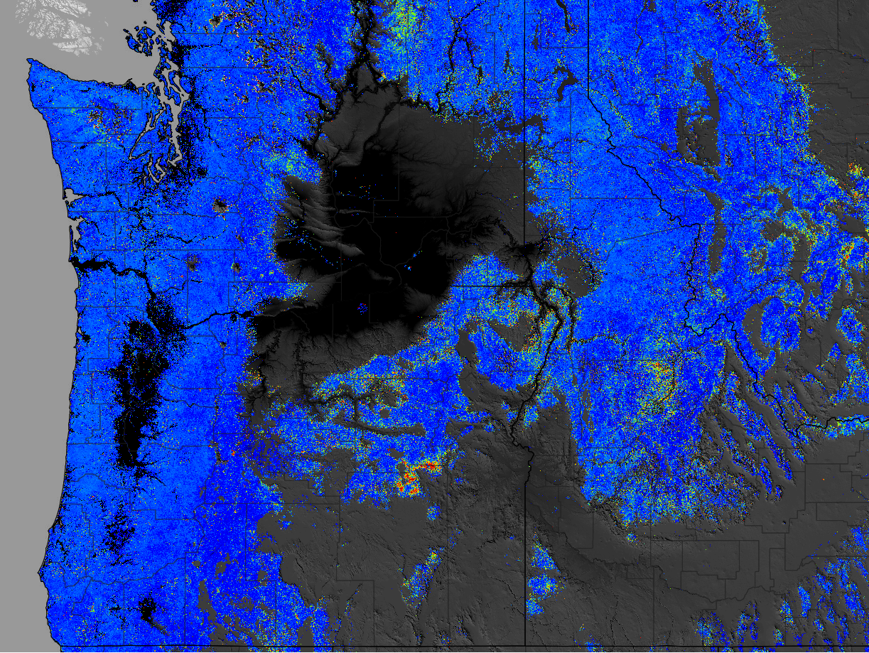
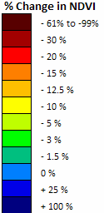
MT
WA
ID
OR
ForWarn
Change in NDVI for Sep. 05, 2011
Compared to 1-year baseline

Slide 5
MT
WA
ID
OR
Pine Butterfly
Neophasia menapia
ForWarn
Change in NDVI for Sep. 05, 2011
Compared to 1-year baseline

Slide 6
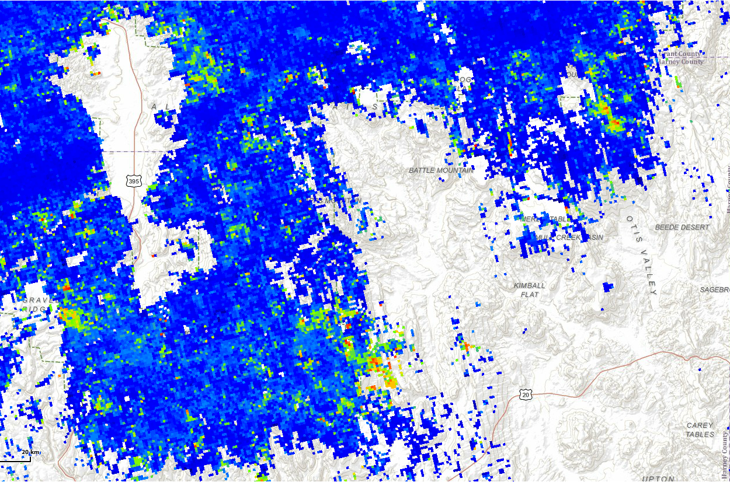
1. Near Real Time Disturbance Detection
Malheur National Forest Pine Butterfly Outbreak
ForWarn 1 year baseline Jul. 3, 2011

Slide 7
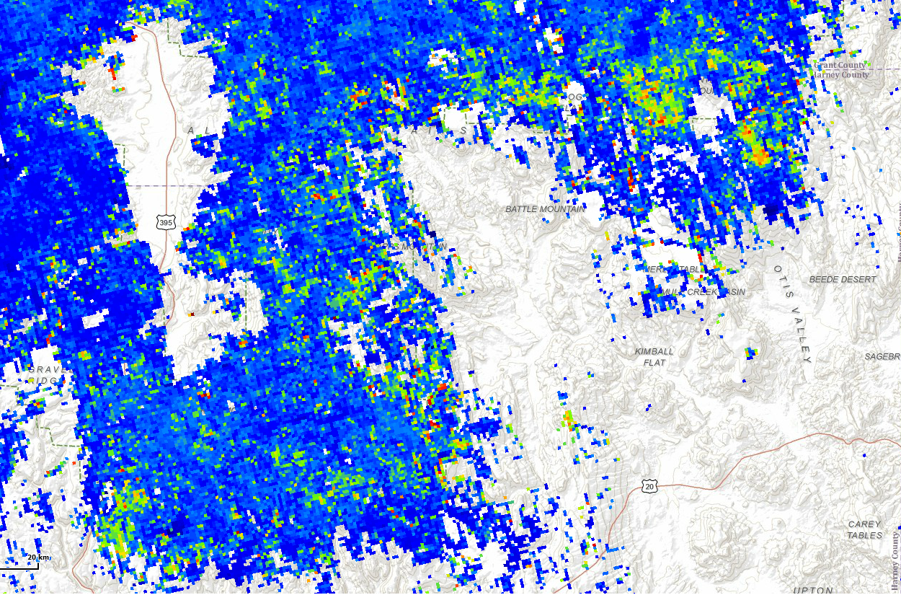
1. Near Real Time Disturbance Detection
Malheur National Forest Pine Butterfly Outbreak
ForWarn 1 year baseline Jul. 27, 2011

Slide 8
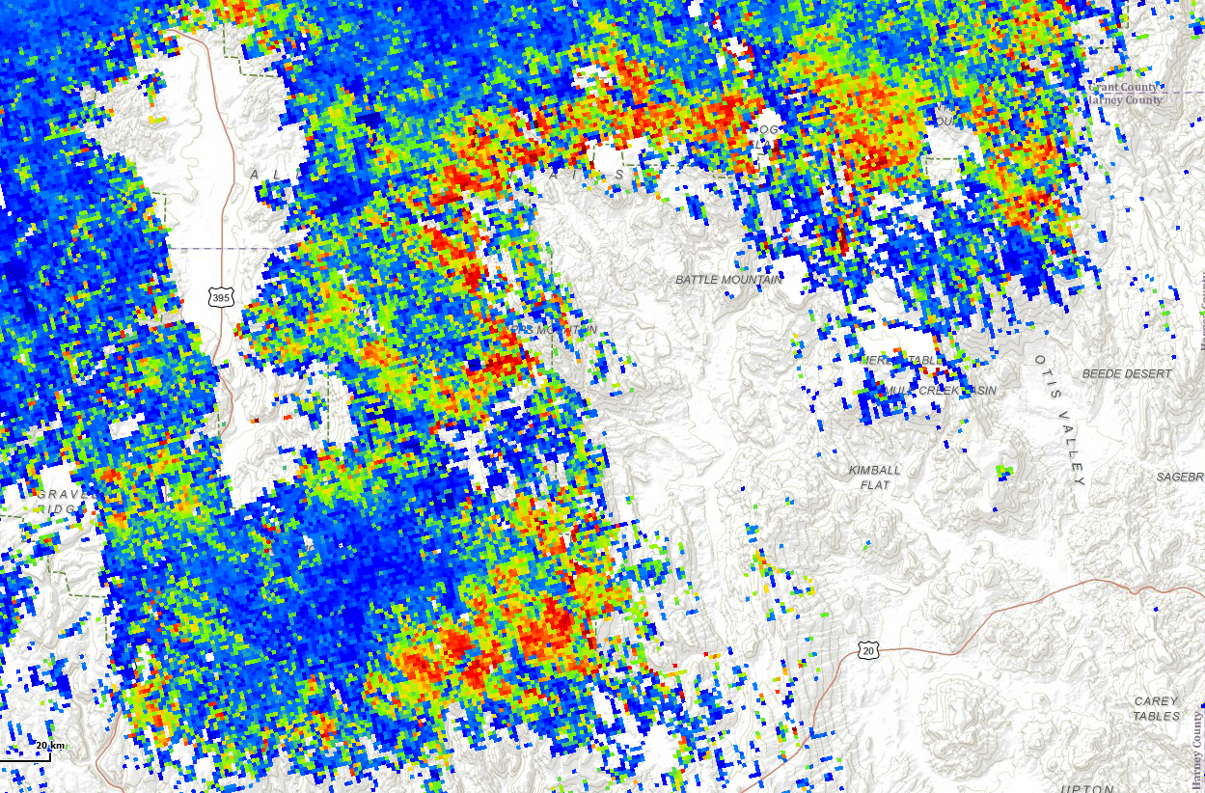
1. Near Real Time Disturbance Detection
Malheur National Forest Pine Butterfly Outbreak
ForWarn 1 year baseline Aug. 20, 2011

Slide 9
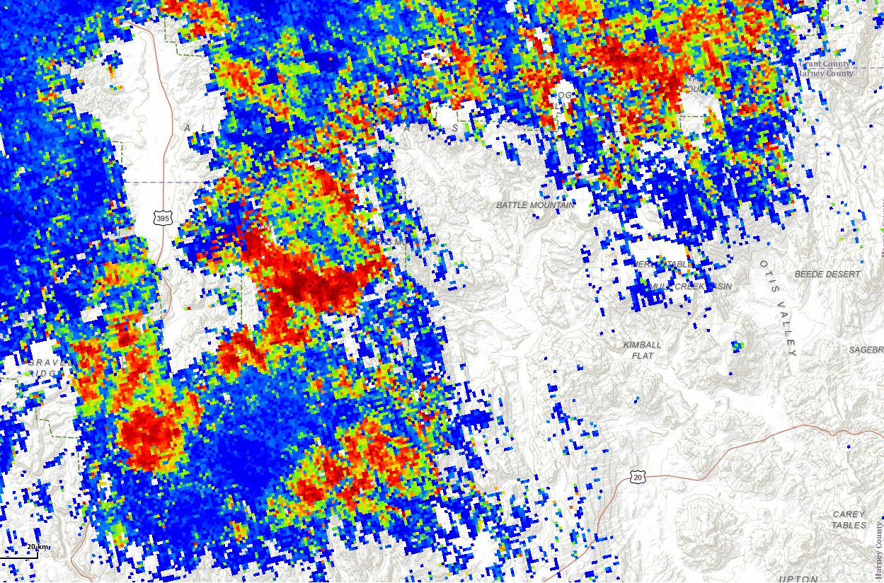
1. Near Real Time Disturbance Detection
Malheur National Forest Pine Butterfly Outbreak
ForWarn 1 year baseline Sep. 13, 2011

Slide 10
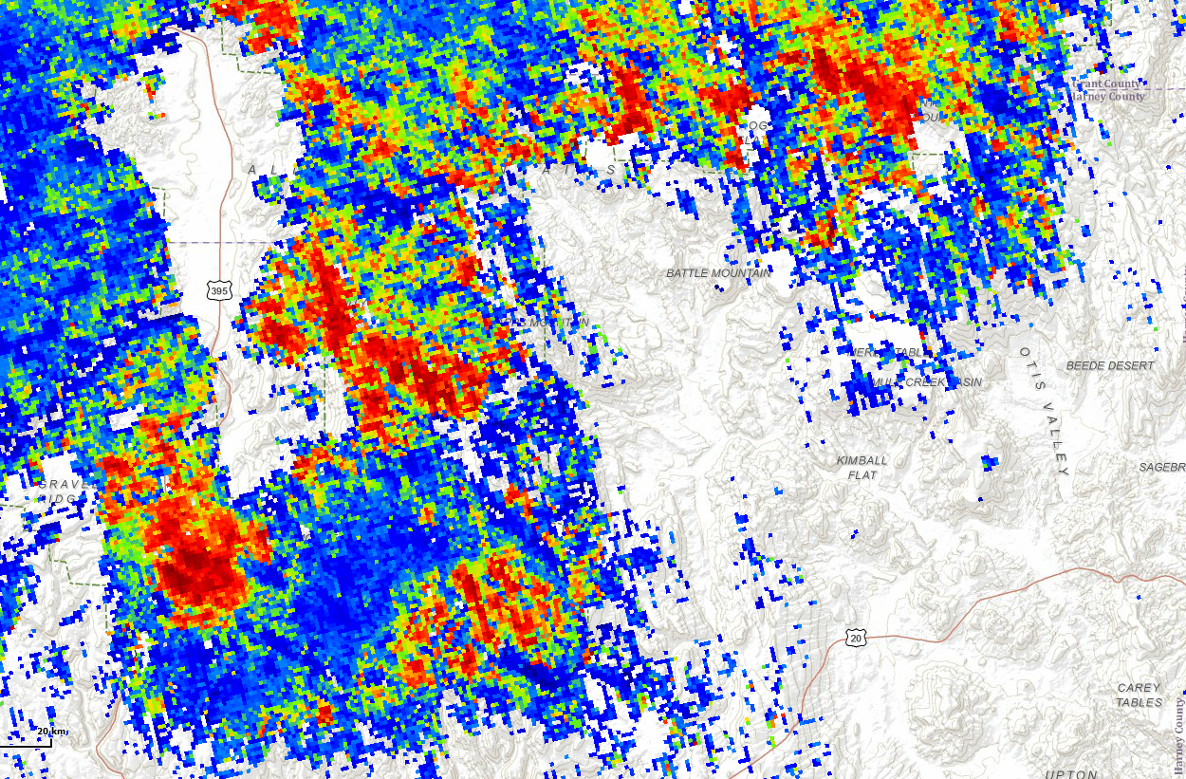
1. Near Real Time Disturbance Detection
Malheur National Forest Pine Butterfly Outbreak
ForWarn 1 year baseline Oct. 7, 2011

Slide 11
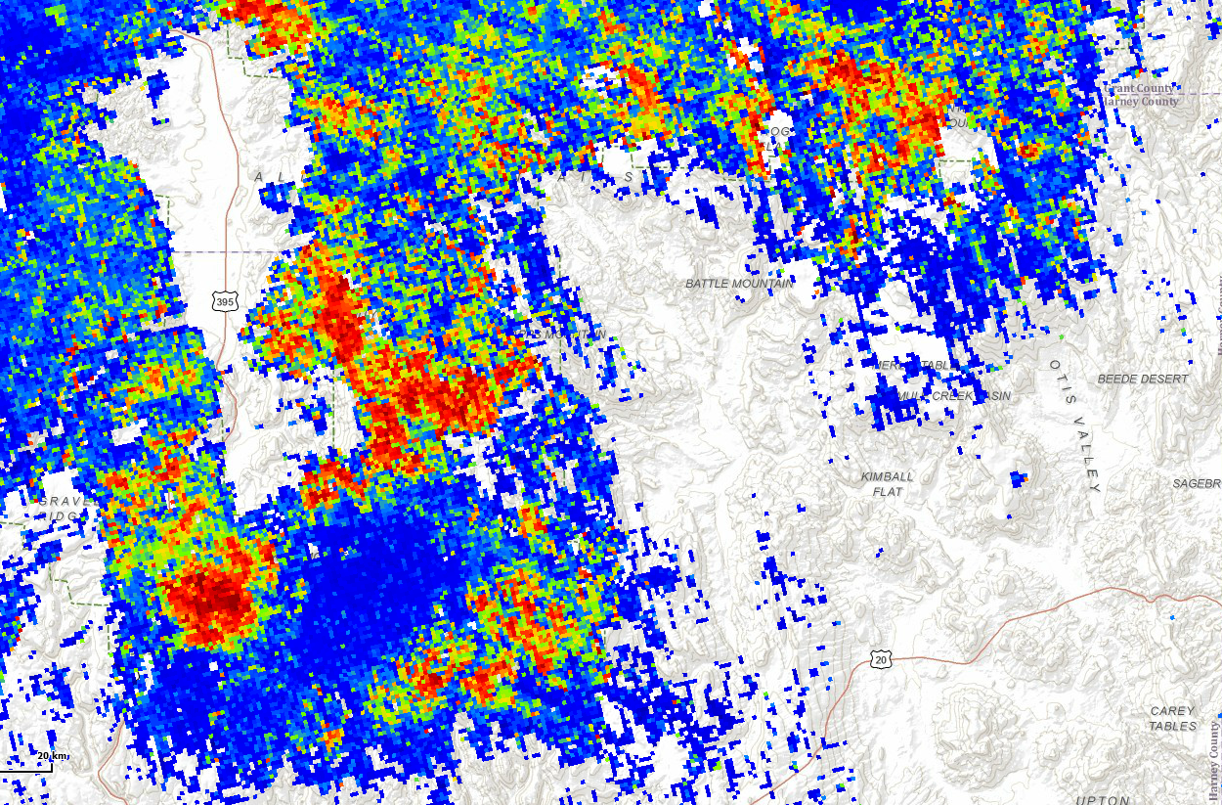
1. Near Real Time Disturbance Detection
Malheur National Forest Pine Butterfly Outbreak
ForWarn 1 year baseline Oct. 31, 2011

Slide 12
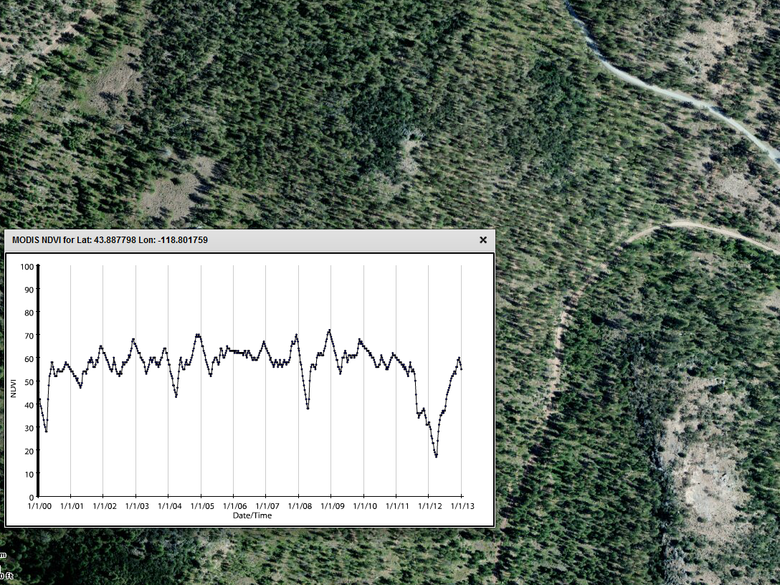
1. Near Real Time Disturbance Detection
Malheur National Forest Pine Butterfly Outbreak
2000-2012 NDVI time series

Slide 13
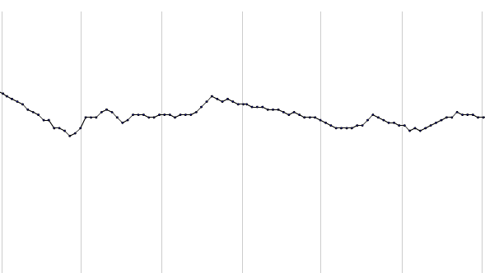
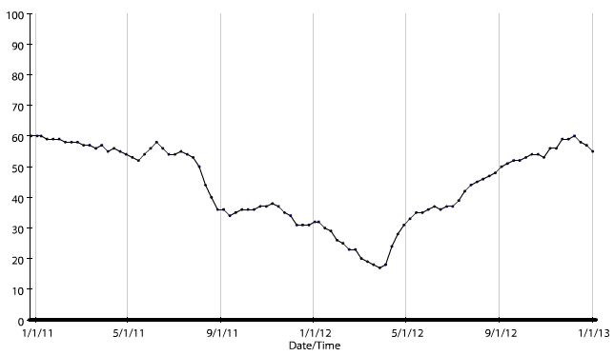
1. Near Real Time Disturbance Detection
Malheur National Forest Pine Butterfly Outbreak
2000-2012 NDVI time series
Jan. 2009 to Dec. 2010
(normal two-year period)
refoliation
Jan. 2011 to Dec. 2012
(defoliation impacts)
Period of defoliation
Jan
May
Sep
Jan
May
Sep
Jan
Expanded

Slide 14
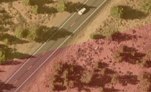
Five Applications of the ForWarn System
for Monitoring, Assessment and Prediction
Near-real-time disturbance detection.
Assessing seasonal climate impacts on vegetation productivity, such as fuels.
Tracking post-disturbance response over the long term.
Assessing cumulative effects from multiple disturbances or events across scales.
Monitoring vegetation status with respect to desired future conditions.

Slide 15
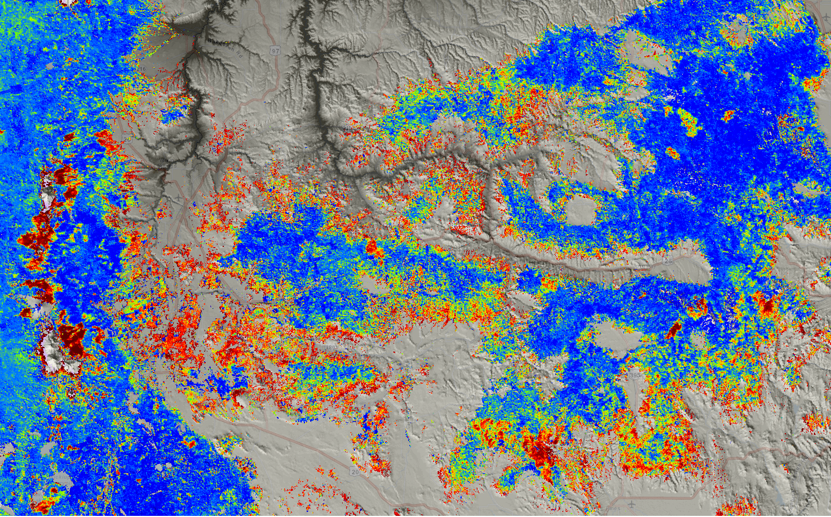
2. Assessing Seasonal Climate Impacts
Central Oregon Drought Sensitivity
ForWarn All-year baseline Jul. 3, 2013

Slide 16
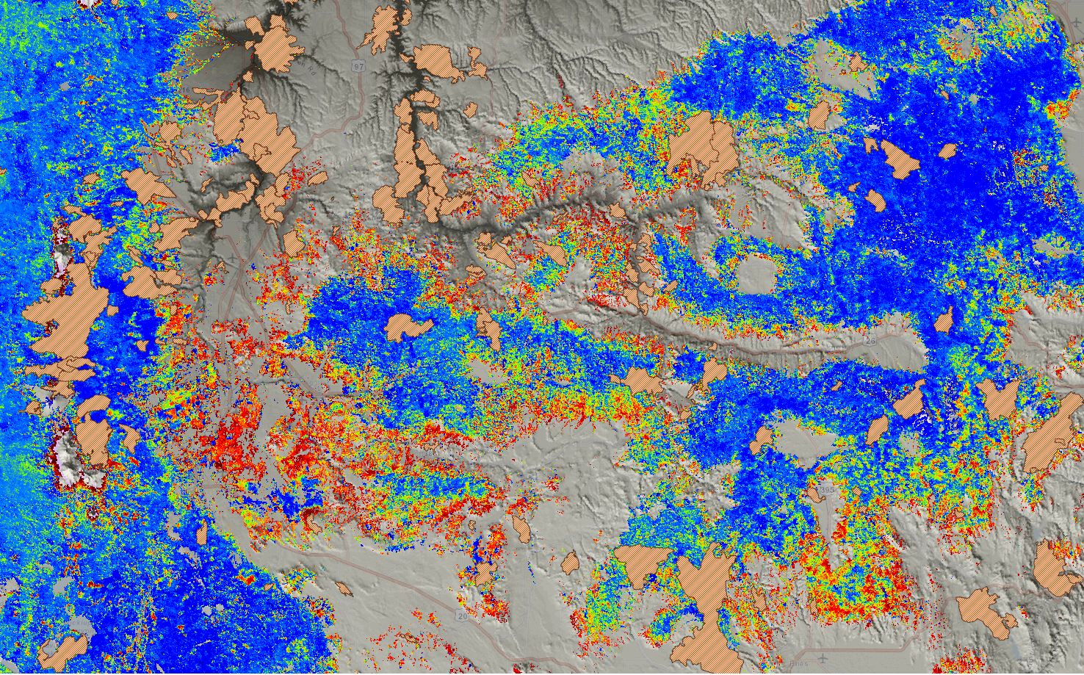
2. Assessing Seasonal Climate Impacts
Central Oregon Drought Sensitivity
ForWarn All-year baseline Jul. 3, 2013
Large Fires 2000-2013
Wildland fires

Slide 17
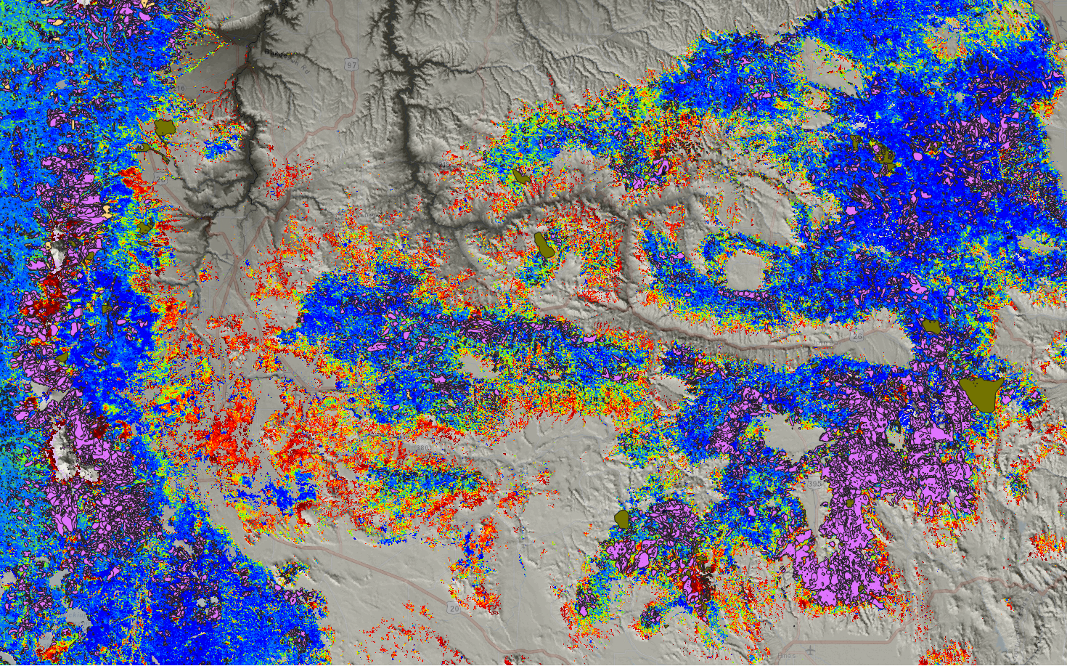
2. Assessing Seasonal Climate Impacts
Central Oregon Drought Sensitivity
ForWarn All-year baseline Jul. 3, 2013
Aerial surveys 2000-12
Biotic
Abiotic

Slide 18
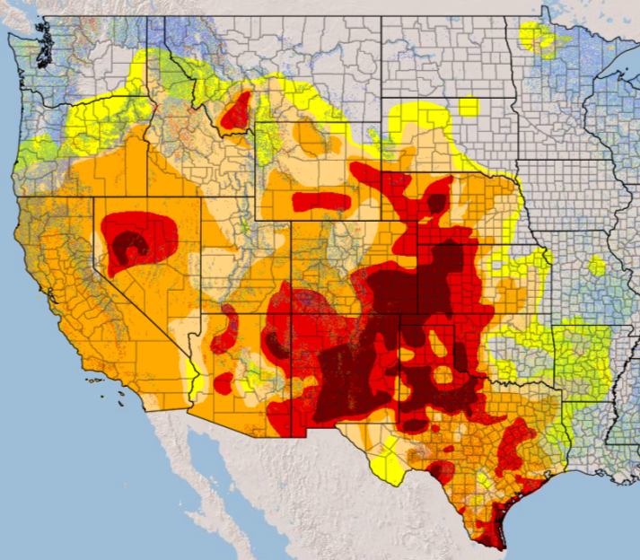
2. Assessing Seasonal Climate Impacts
Central Oregon Drought Sensitivity
ForWarn All-year baseline Jul. 3, 2013
US Drought Monitor
Jul. 9, 2013

Slide 19
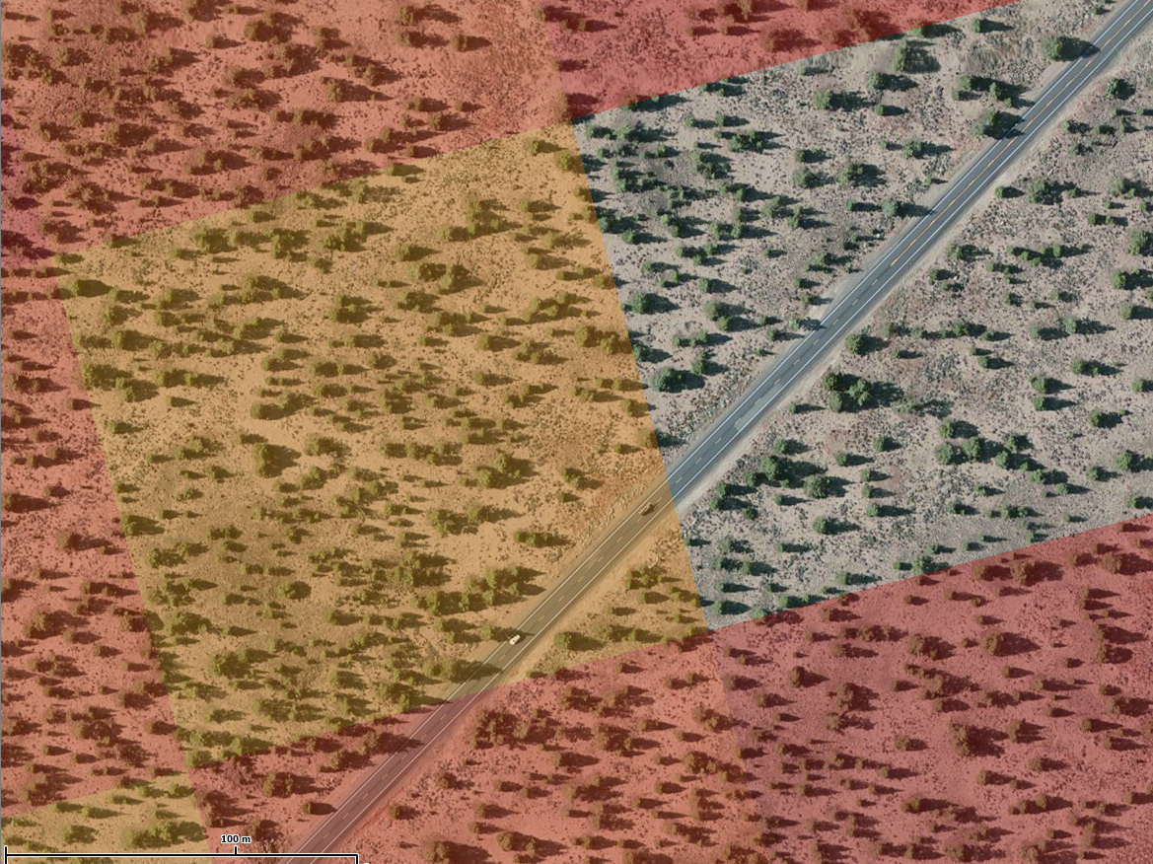
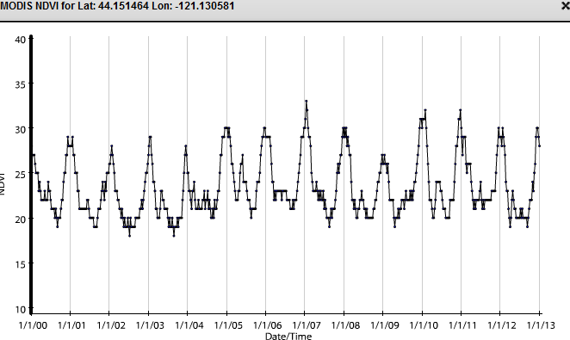
2. Assessing Seasonal Climate Impacts
Central Oregon Drought Sensitivity
ForWarn All-year baseline
US Drought Monitor
ForWarn NDVI
Crook Co. 15 km NE of Bend, OR
Powell Butte Highway

Slide 20
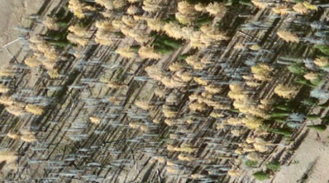
Five Applications of the ForWarn System
for Monitoring, Assessment and Prediction
Near-real-time disturbance detection.
Assessing seasonal climate impacts on vegetation productivity, such as fuels.
Tracking post-disturbance response over the long term.
Assessing cumulative effects from multiple disturbances or events across scales.
Monitoring vegetation status with respect to desired future conditions.

Slide 21
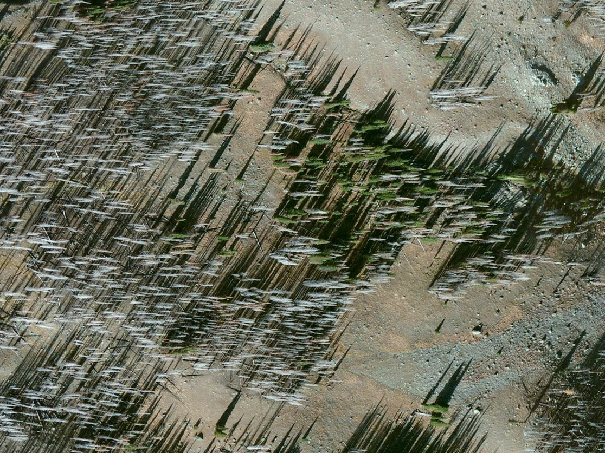
3. Tracking Post-Disturbance Response

Slide 22
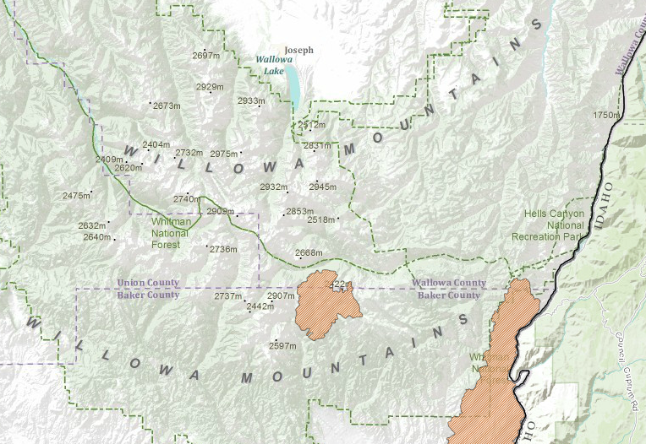
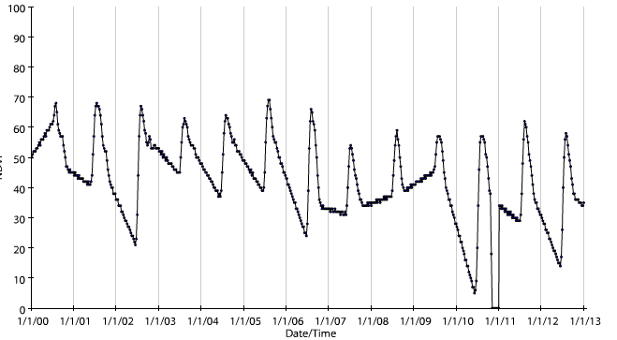
3. Tracking Post-Disturbance Response
Post-fire monitoring
2006 Fires
Twin Lakes Fire
(ignited Sep. 4, 2006)
Pre-fire
Post-fire
7000’ elev.
Variable snowpack

Slide 23
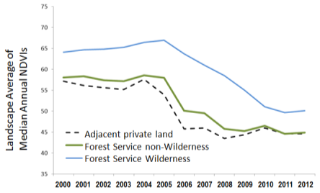
Five Applications of the ForWarn System
for Monitoring, Assessment and Prediction
Near-real-time disturbance detection.
Assessing seasonal climate impacts on vegetation productivity, such as fuels.
Tracking post-disturbance response over the long term.
Assessing cumulative effects from multiple disturbances or events across scales.
Monitoring vegetation status with respect to desired future conditions.

Slide 24
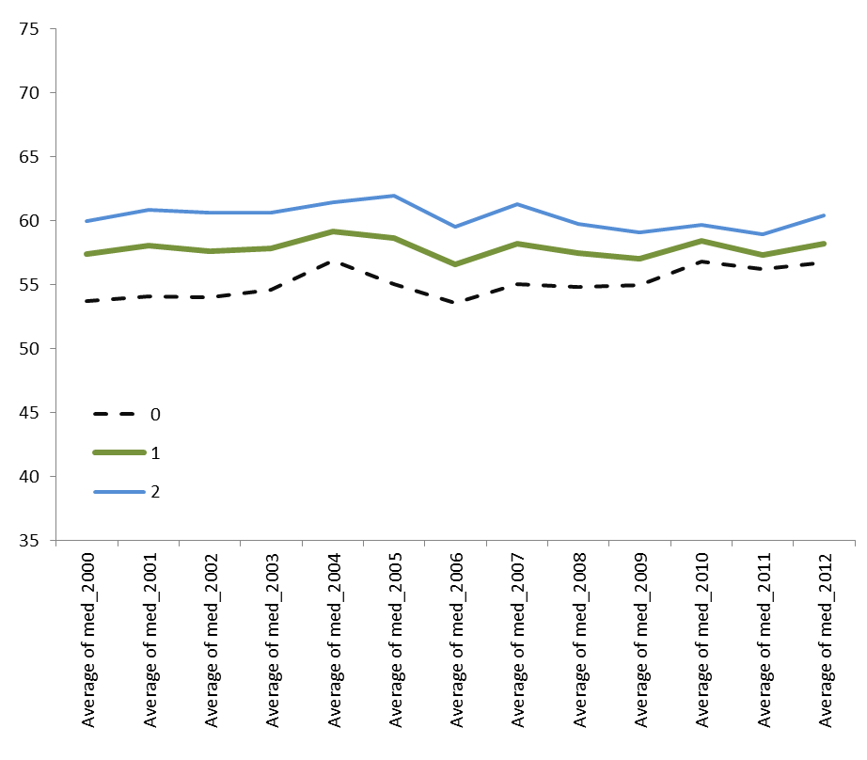
4. Assessing Cumulative Effects
Umatilla National Forest
Change in NDVI for all lands, 2000-2012
Landscape Average of
Median Annual NDVIs
Adjacent private land
Forest Service non-Wilderness
Forest Service Wilderness
2000 2001 2002 2003 2004 2005 2006 2007 2008 2009 2010 2011 2012
Adjacent private: 7,954 MODIS pixels
FS non-Wilderness: 82,980 MODIS pixels
FS Wilderness: 22,827 MODIS pixels

Slide 25
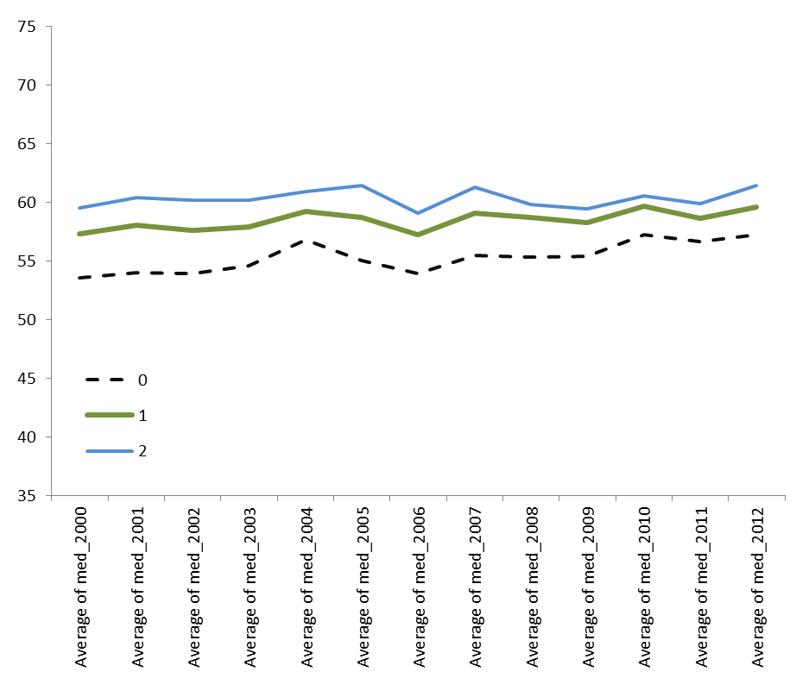
4. Assessing Cumulative Effects
Umatilla National Forest
Change in NDVI for all lands that did not burn between 2000 and 2012
Landscape Average of
Median Annual NDVIs
Adjacent private land
Forest Service non-Wilderness
Forest Service Wilderness
2000 2001 2002 2003 2004 2005 2006 2007 2008 2009 2010 2011 2012
Adjacent private: 7,625/7,954 (96%)
FS non-Wilderness: 75,065/82,980 (90%)
FS Wilderness: 20,706/22,827 (91%)

Slide 26
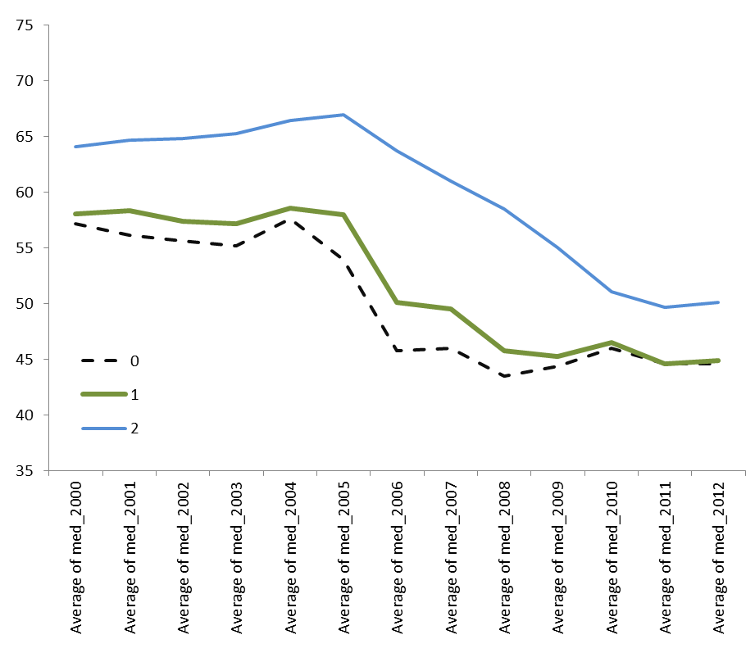
4. Assessing Cumulative Effects
Umatilla National Forest
Change in NDVI for all lands that burned at least once between 2000 and 2012
Landscape Average of
Median Annual NDVIs
Adjacent private land
Forest Service non-Wilderness
Forest Service Wilderness
2000 2001 2002 2003 2004 2005 2006 2007 2008 2009 2010 2011 2012
Adjacent private: 329/7,954 (04%)
FS non-Wilderness: 7,915/82,980 (10%)
FS Wilderness: 2,121/22,827 (09%)

Slide 27
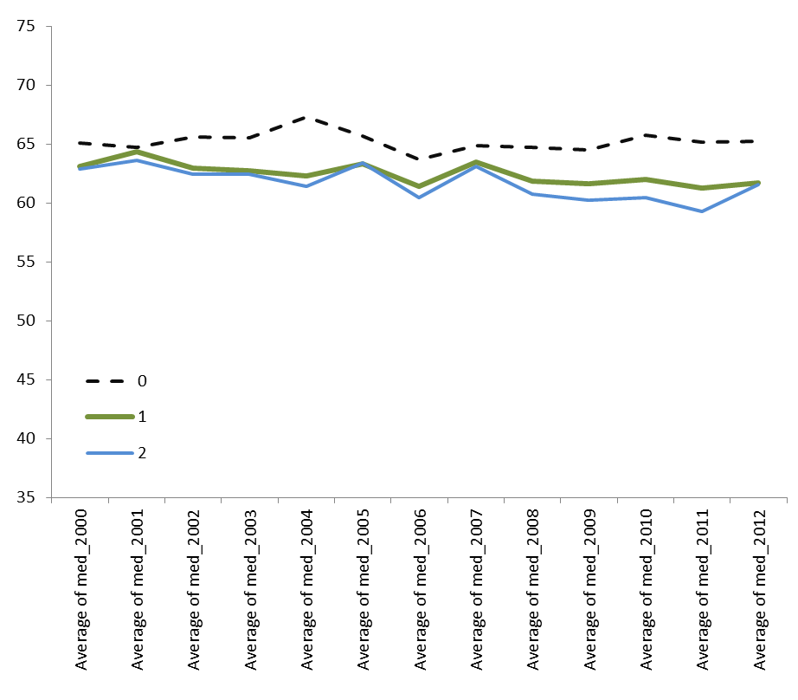
4. Assessing Cumulative Effects
Umatilla National Forest
Change in NDVI for all unburned lands with 2+ years of aerial insect/disease detections
Landscape Average of
Median Annual NDVIs
Adjacent private land
Forest Service non-Wilderness
Forest Service Wilderness
2000 2001 2002 2003 2004 2005 2006 2007 2008 2009 2010 2011 2012
Adjacent private: 243/7,954 (97%)
FS non-Wilderness: 7,066/82,980 (91%)
FS Wilderness: 4,553/22,827 (80%)

Slide 28
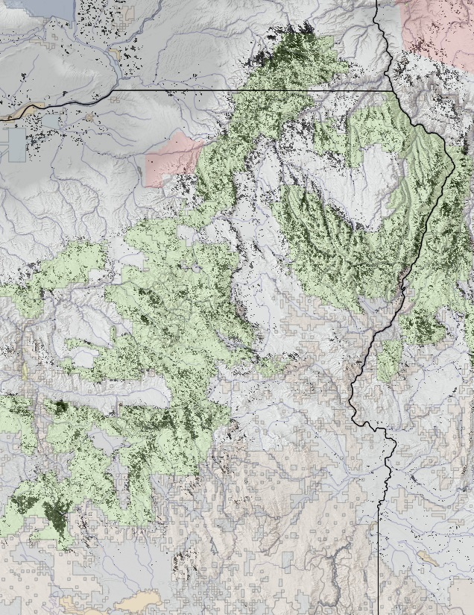
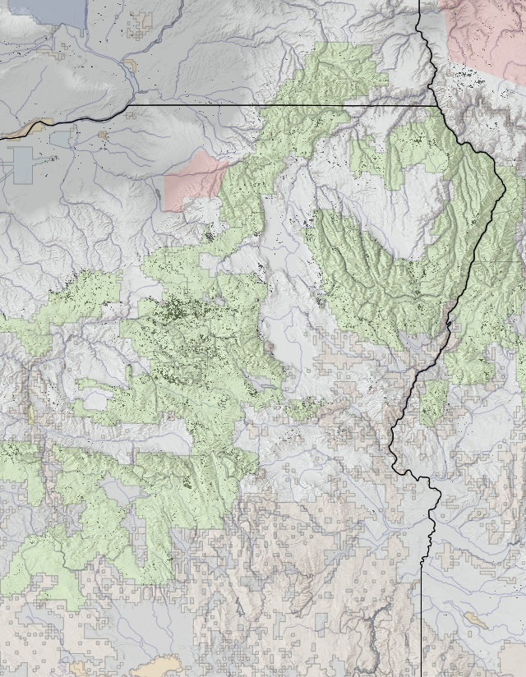
4. Assessing Cumulative Effects
NDVI-derived trends in the Blue Mountains
ForWarn’s Evergreen Decline (left) and Evergreen Thrive (Right), 2000-2011
WA
WA
OR
OR
ID
ID

Slide 29
Five Applications of the ForWarn System
for Monitoring, Assessment and Prediction
Near-real-time disturbance detection.
Assessing seasonal climate impacts on vegetation productivity, such as fuels.
Tracking post-disturbance response over the long term.
Assessing cumulative effects from multiple disturbances or events across scales.
Monitoring vegetation status with respect to desired future conditions.

Slide 30
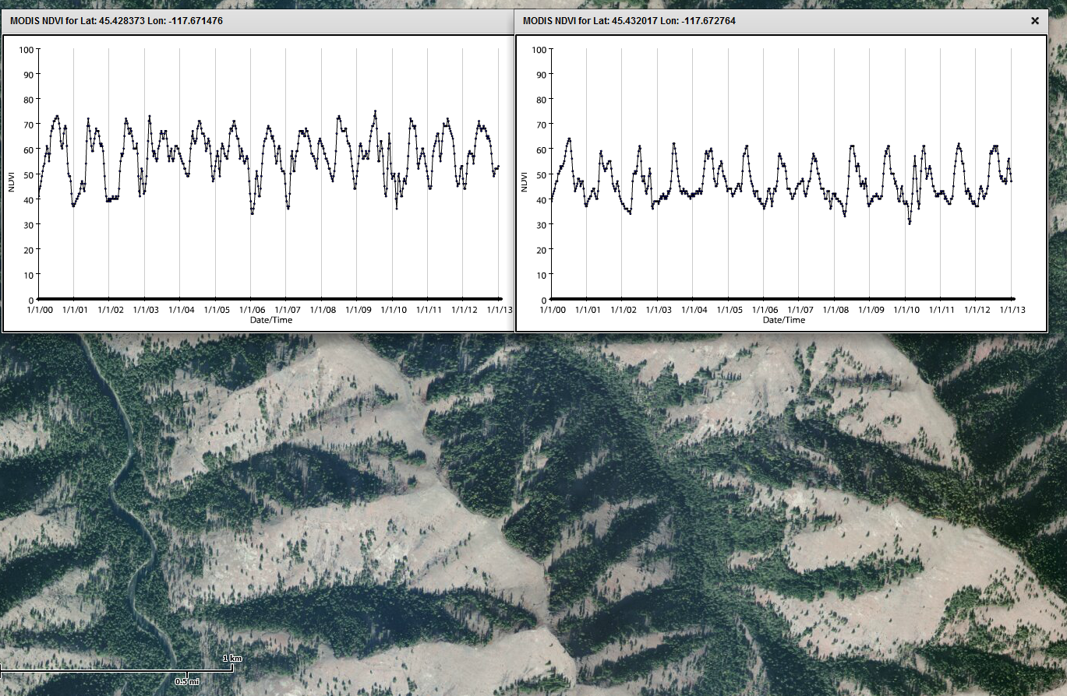
5. Monitoring for desired conditions
Vegetation types differ
Forest-dominated north aspect
Grass-dominated south aspect
Eagle Cap Wilderness
Wallow-Whitman National Forest
4,200’

Slide 31
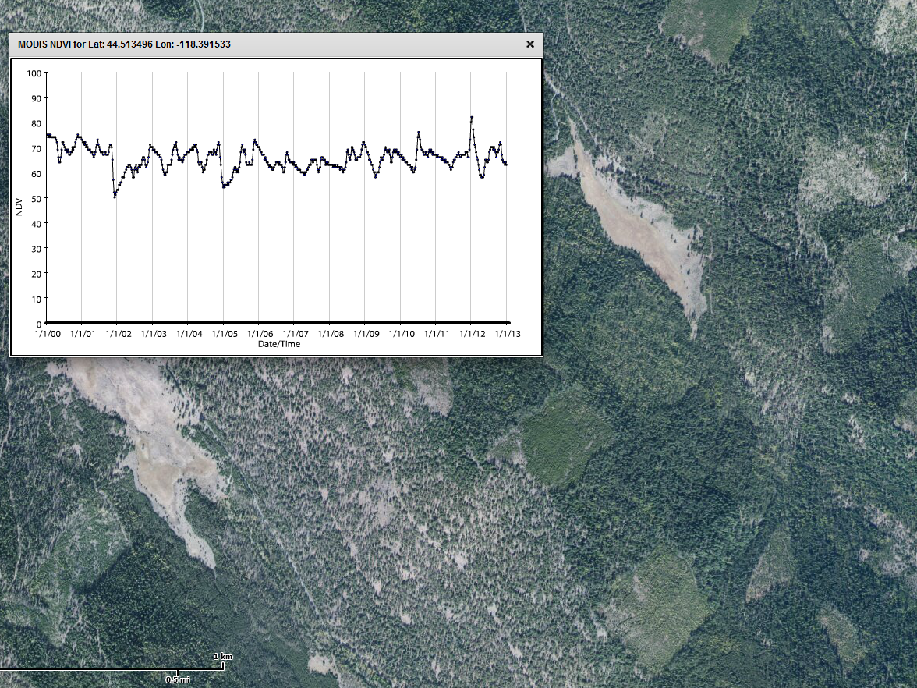
5. Monitoring for desired conditions
Restoration of forest structure
An opened evergreen forest
2001 Thinning Project
Squaw Creek, Malheur National Forest
5,200 ft.

Slide 32
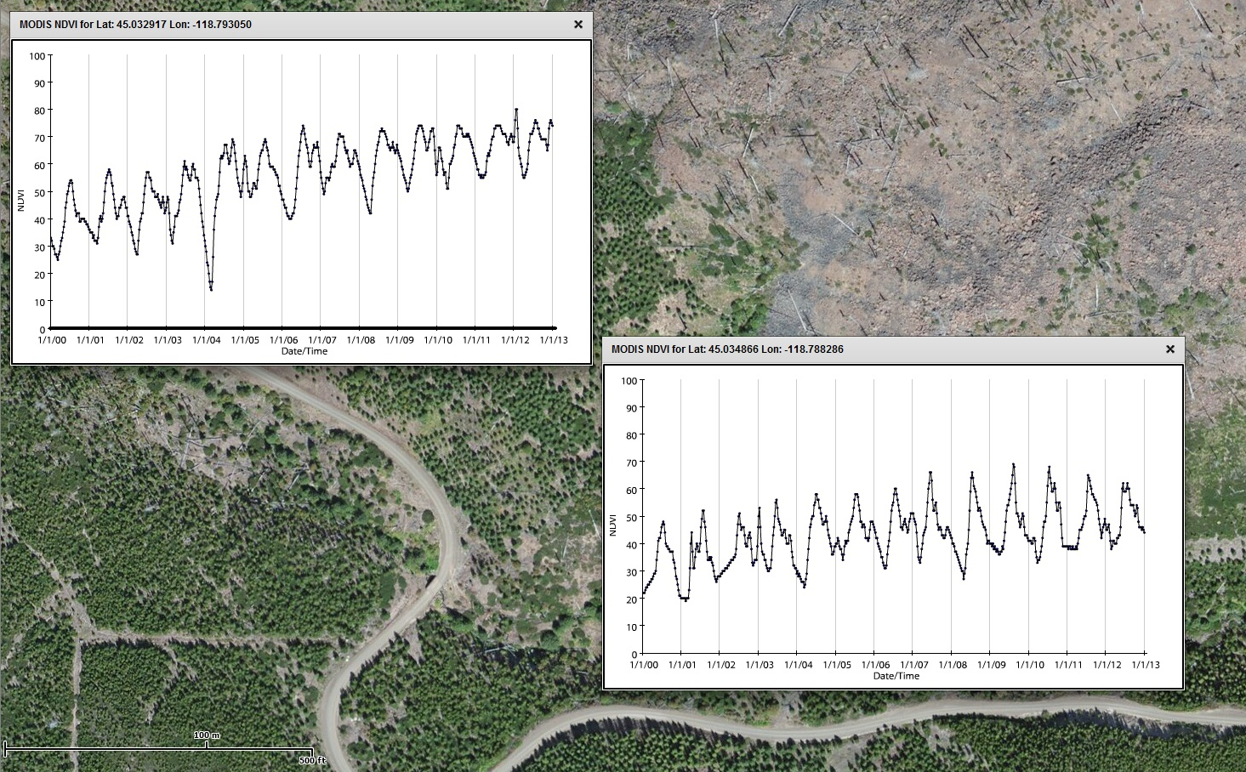
5. Monitoring for desired conditions
Post-fire succession
1996 Tower Fire
Texas Bar Creek
4,200 ft.
http://forwarn.forestthreats.org/fcav/?theme=MODIS_Forest_Change_Products&layers=AAB,AAD,BRH,AAI,DRTABM,&alphas=1,0.35,0.050000000000000044,0.35,0.55,&accgp=G05&basemap=Imagery&extent=-13224390.787353352,5626418.039684284,-13223245.426257484,5626966.236496591

Slide 33
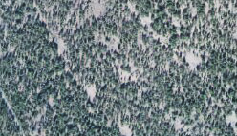
Five Applications of the ForWarn System
for Monitoring, Assessment and Prediction
Near-real-time disturbance detection.
Assessing seasonal climate impacts on vegetation productivity, such as fuels.
Tracking post-disturbance response over the long term.
Assessing cumulative effects from multiple disturbances or events across scales.
Monitoring vegetation status with respect to desired future conditions.

Slide 34
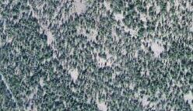
Thank You
stevenorman@fs.fed.us
http://forwarn.forestthreats.org
ForWarn@threatcenters.org

