Slide 1
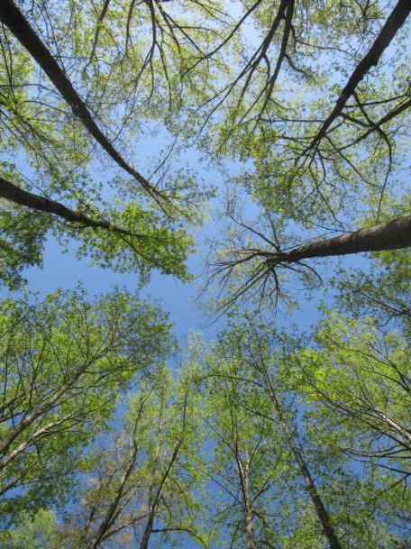
Understanding vegetation change for coarse-filter management
Steve Norman
William Hargrove
Appalachian State University
April 24, 2012
Acknowledgements:
Joseph Spruce, William Christie, Andrew Tait

Slide 2
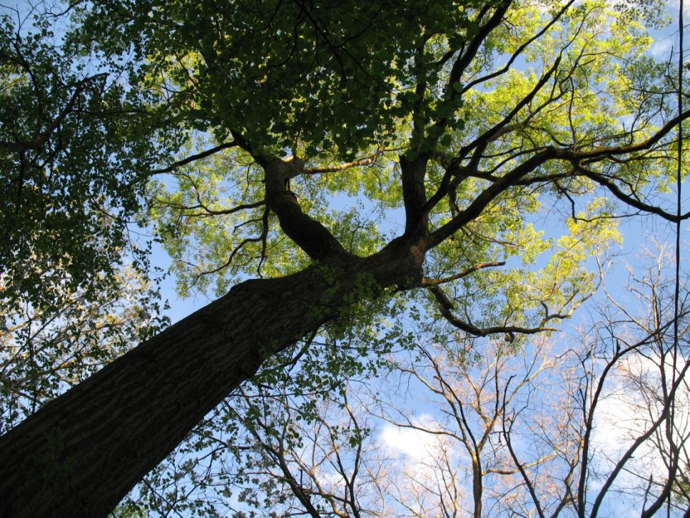
2012-04-16

Slide 3
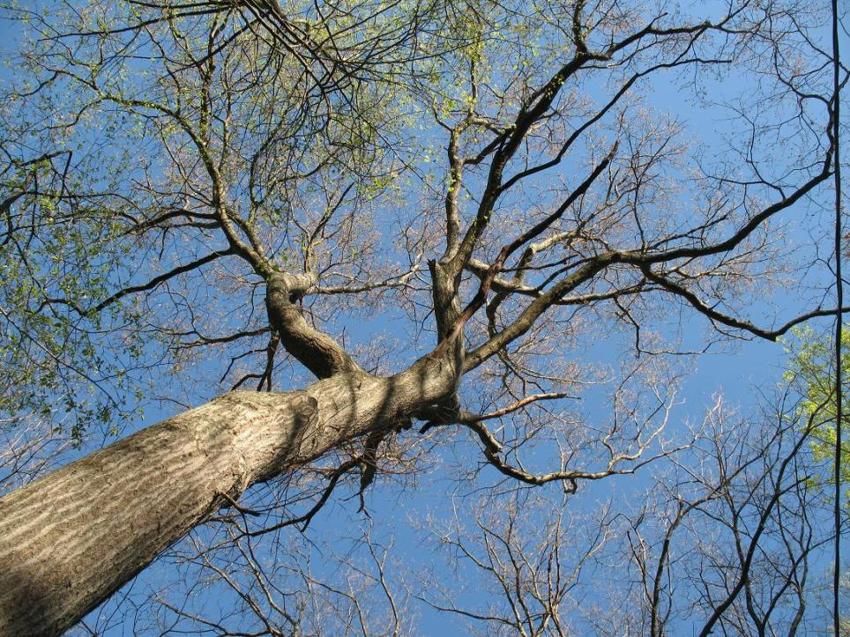
2009-04-17

Slide 4
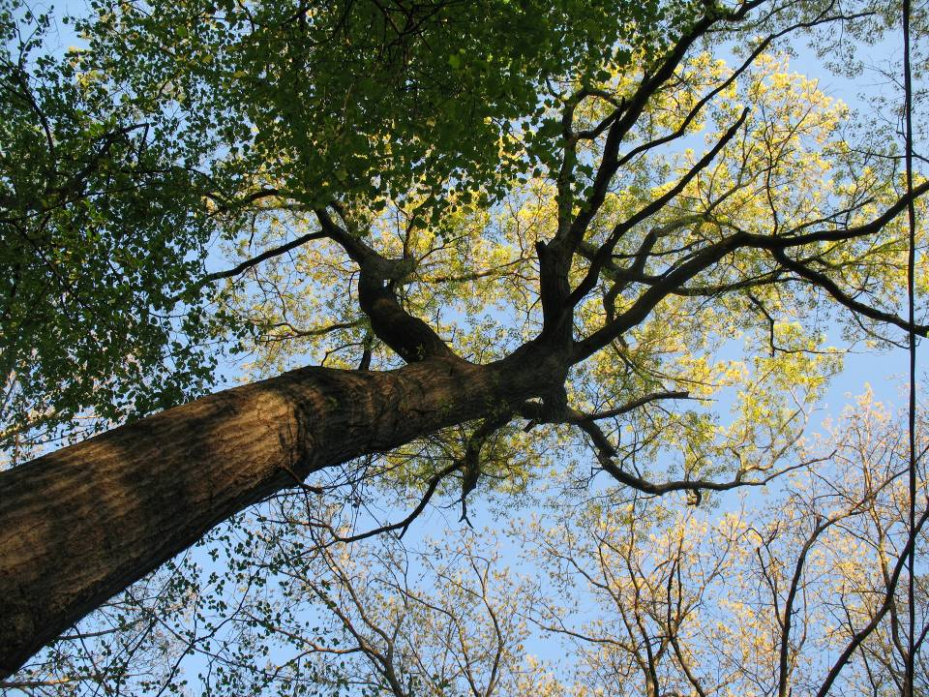
2009-04-27

Slide 5
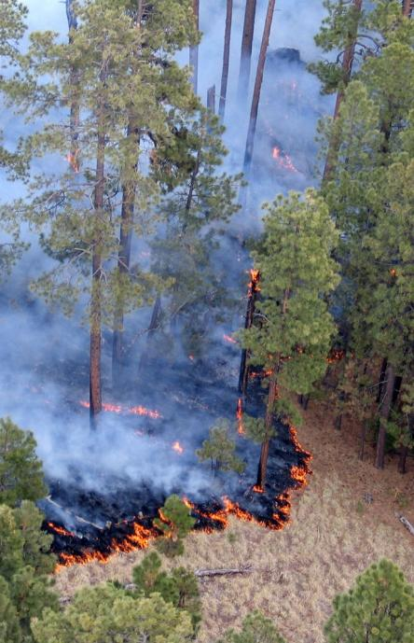
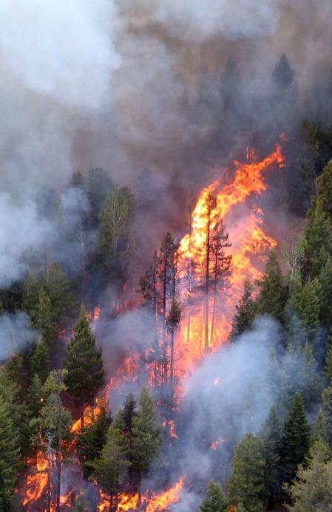

Slide 6
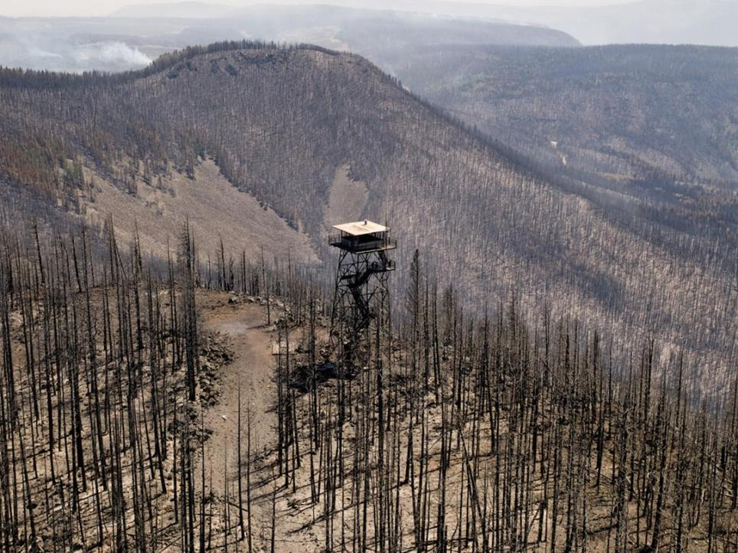

Slide 7
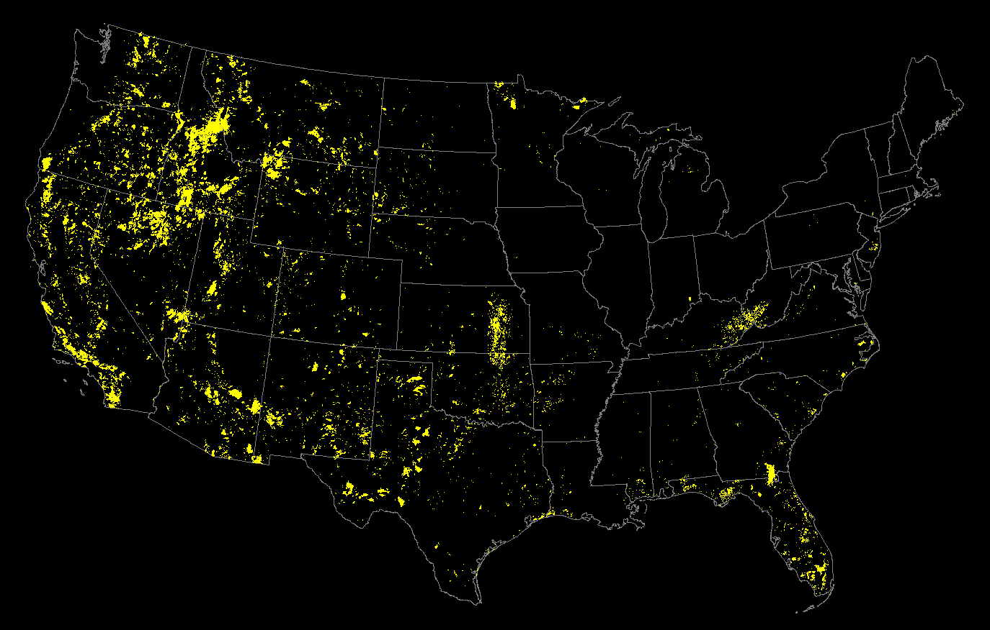
Large Fires in the US: 1984-2011
GeoMAC
MTBS

Slide 8
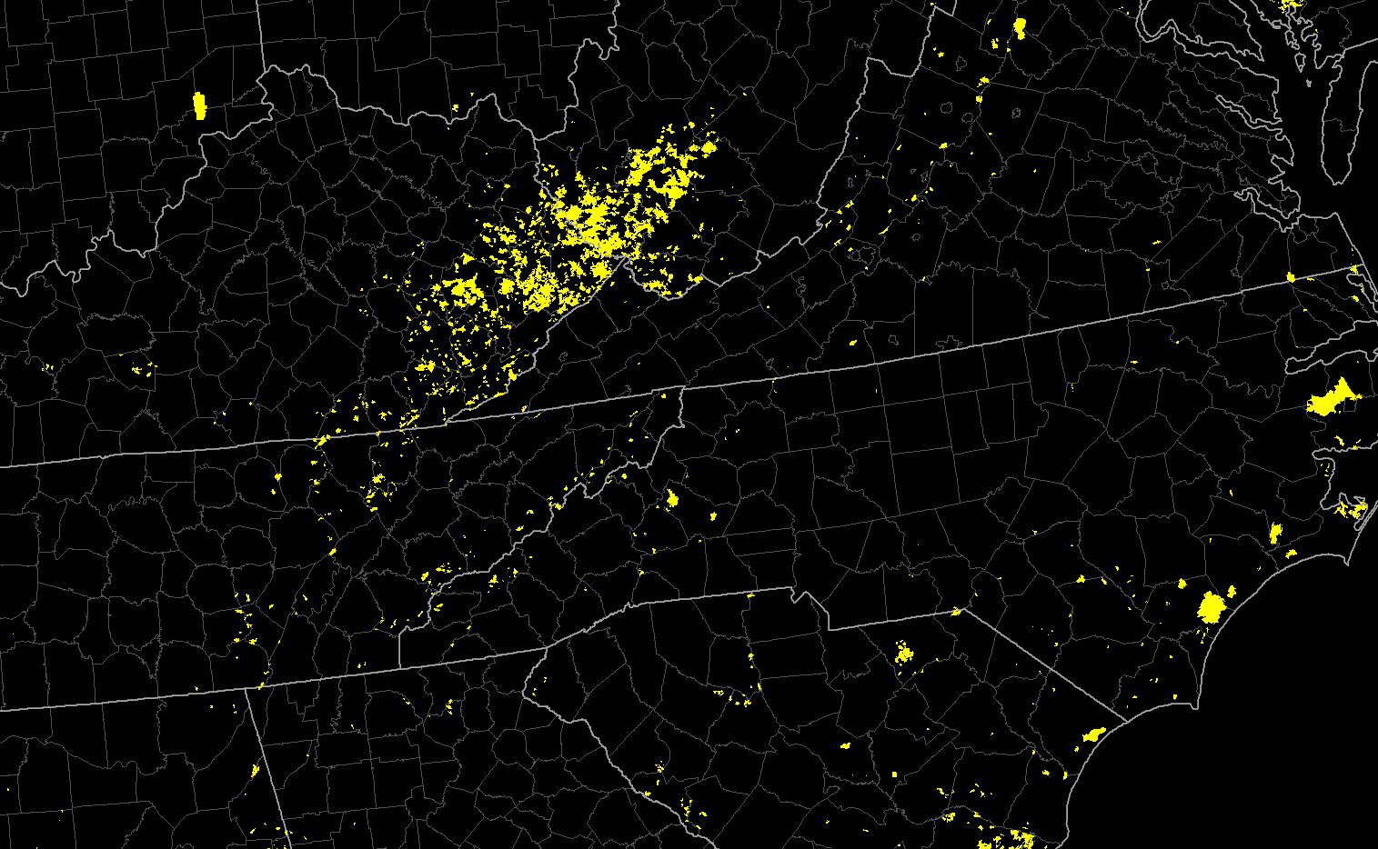
Large Fires in the US: 1984-2011
GeoMAC
MTBS

Slide 9
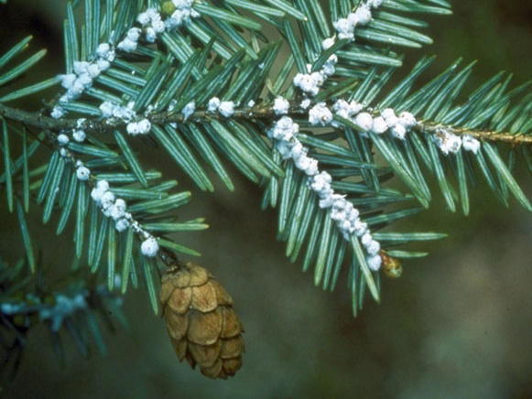
Invasive species can
lead to novel change

Slide 10
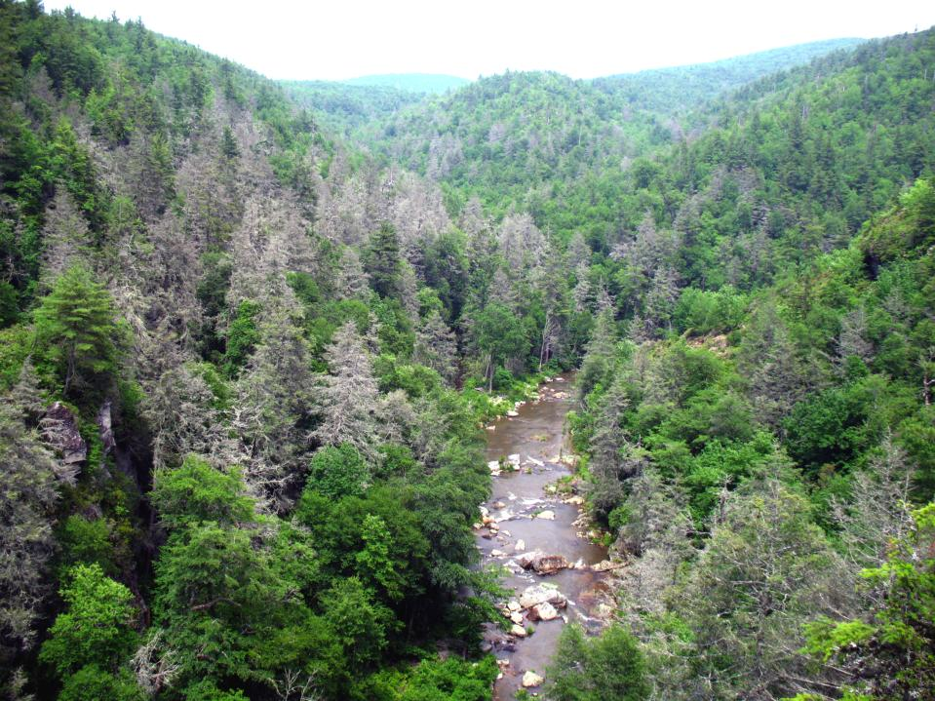

Slide 11
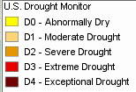
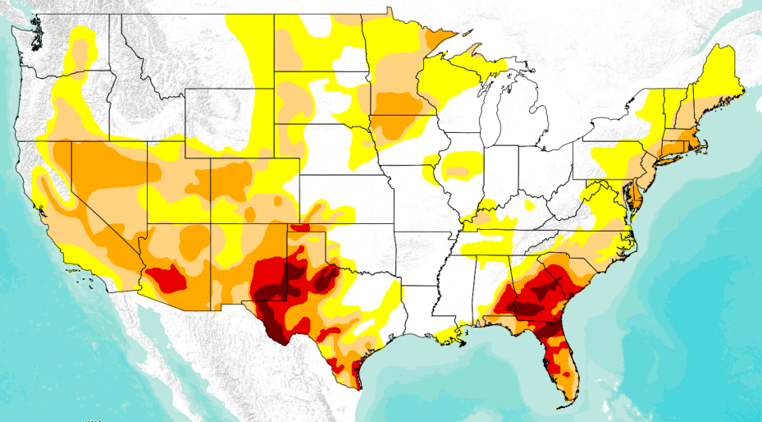
Current Drought: Mid April 2012

Slide 12
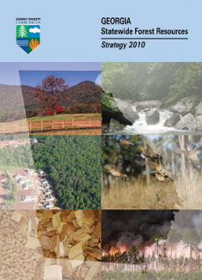
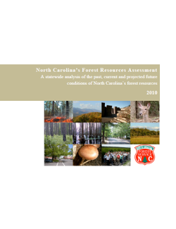
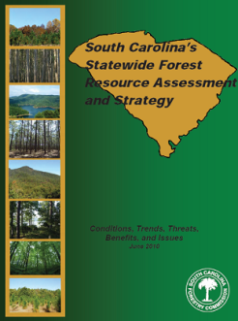
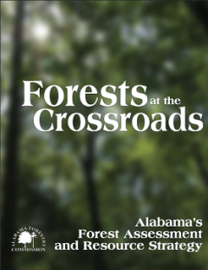
2010 STATE FOREST
ASSESSMENTS AND STRATEGIES

Slide 13
Critical Forest Management Needs
Knowing what’s happening (monitoring)
Understanding relevant science (assessment)
Planning ahead (predicting)
Implementing effort based on values at risk
and tradeoffs (prioritizing)

Slide 14
If you were a manager, which science would you prefer?
IMPRECISE
PRECISE
Inaccurate
Accurate
Accurate
Inaccurate

Slide 15
Highly precise,
but inaccurate
“The Future”
Semi-accurate,
but not precise
Frequency
Value
Coarse-filter science targets
accuracy over precision

Slide 16
What is Ecological Resilience?
The ability of species or communities to persist over time because of or despite disturbance (e.g., fire, wind, logging, insects, invasives, development, etc.) or climate variability and change, given the evolutionary attributes of species.

Slide 17
What is Ecological Resilience?
The ability of species or communities to persist over time because of or despite disturbance (e.g., fire, wind, logging, insects, invasives, development, etc.) or climate variability and change, given the evolutionary attributes of species.
High
Basins of attraction
form stable states
POTENTIAL ENERGY
Low
STATES

Slide 18
What is Ecological Resilience?
The ability of species or communities to persist over time because of or despite disturbance (e.g., fire, wind, logging, insects, invasives, development, etc.) or climate variability and change, given the evolutionary attributes of species.
High
Stress can temporarily lead
to unstable states
POTENTIAL ENERGY
Low
STATES

Slide 19
What is Ecological Resilience?
The ability of species or communities to persist over time because of or despite disturbance (e.g., fire, wind, logging, insects, invasives, development, etc.) or climate variability and change, given the evolutionary attributes of species.
High
Resilience is the dynamic between stress and stability
POTENTIAL ENERGY
Low
STATES

Slide 20
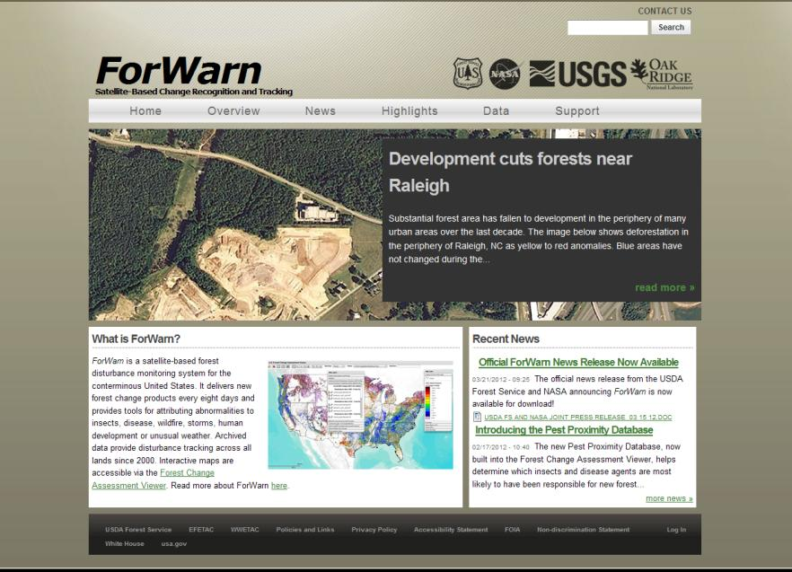
http://forwarn.forestthreats.org

Slide 21
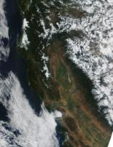
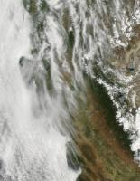
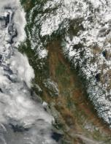
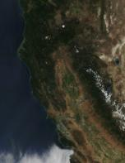
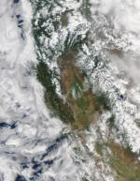
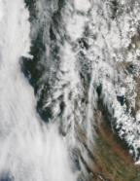
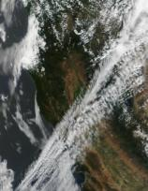
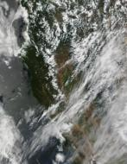
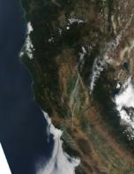
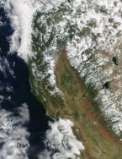
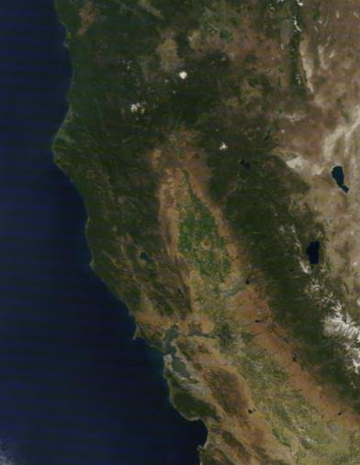
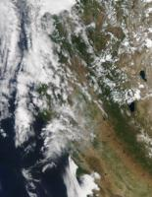
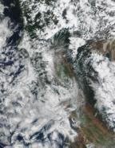
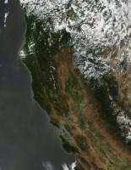
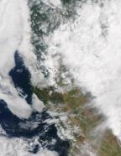
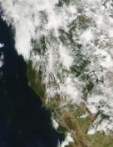
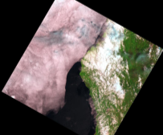
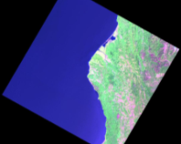
Frequency versus Resolution
L5: June 6, 2009
L5: June 22, 2009
June 22, 2009

Slide 22
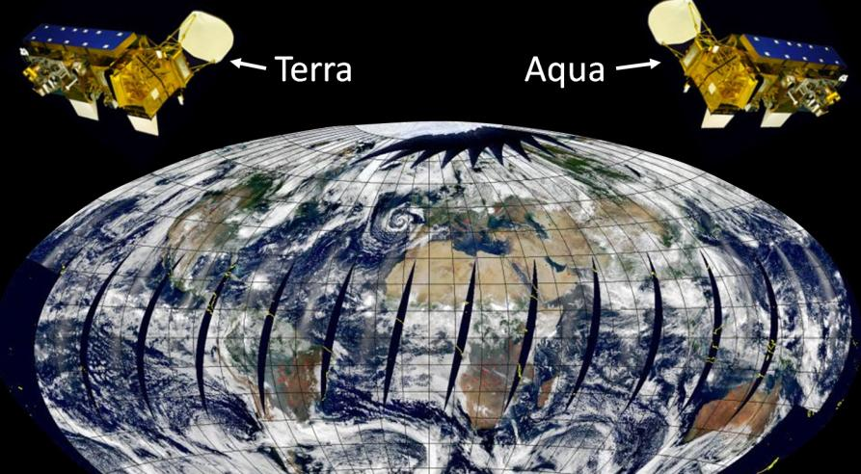
MODIS SENSOR:
Moderate resolution imaging spectro-radiometer
(36 spectral bands)

Slide 23
Normalized Difference Vegetation Index
Stressed
REFLECTACNE
Healthy
Modified from Kyllo 2003 (sugar beets)
NIR
MODIS wavelengths:
630 - 690 nm
780-900 nm
(Near Infrared) – (Red)
(Near Infrared) + (Red)
NDVI =

Slide 24
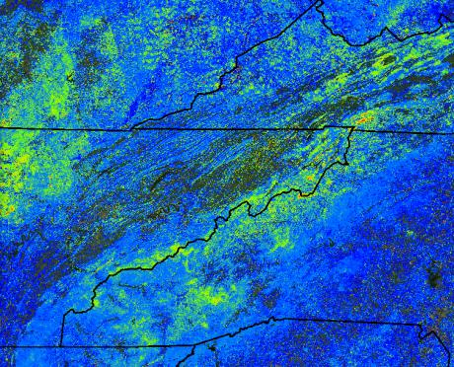
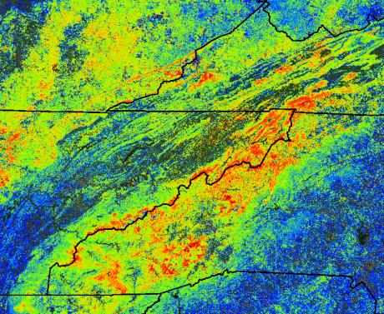
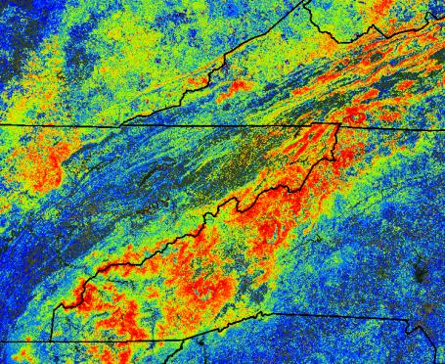
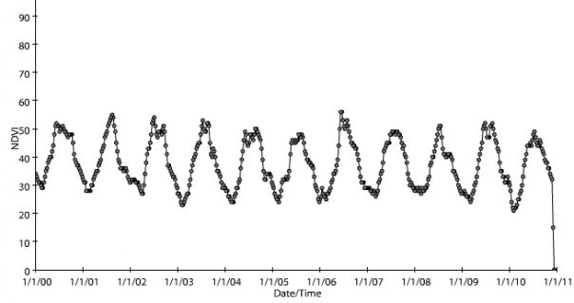
ForWarn
MODIS-based
Moderate resolution (~240m; 14ac)
2000 – present
Conterminous US
24-day window; 8-day steps
Normalized Difference Vegetation
Index (NDVI)
Maps of change in NDVI from multiple baselines (1, 3, all year)
An 11-year, 8 day NDVI time series for
Appalachian State University, Boone NC

Slide 25
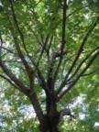
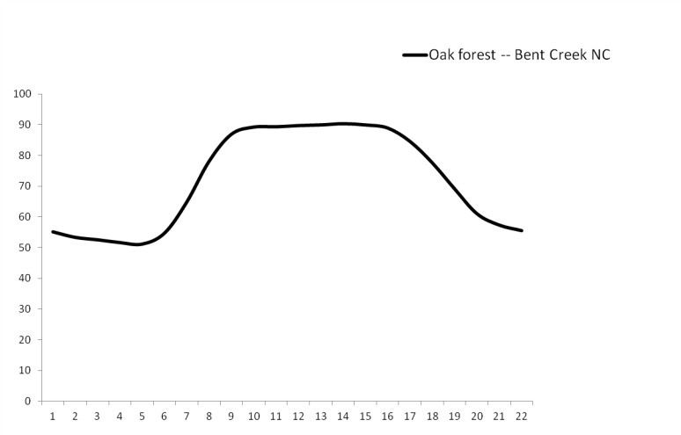
Land Surface Phenology of Eastern Deciduous Forest
1.0
Max.
Amplitude
Duration
Min.
0.5
(Normalized Difference Vegetation Index)
NDVI
0.0
Day of Year

Slide 26
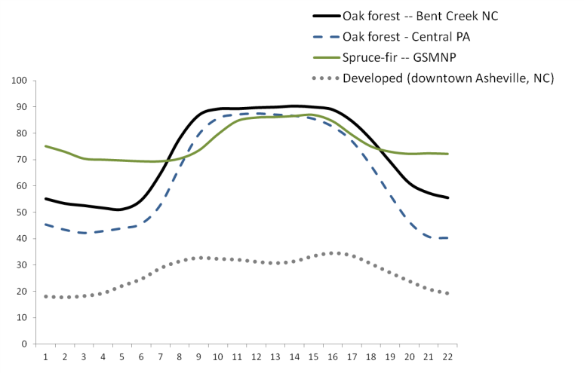
Land Surface Phenology of Four Vegetation Types
during 2008
1.0
0.5
(Normalized Difference Vegetation Index)
NDVI
0.0
Day of Year

Slide 27
Can we measure short-term severity?
Can we observe multi-year recovery?
Can we detect “stable state” transitions?
High
POTENTIAL ENERGY
Low
STATES

Slide 28
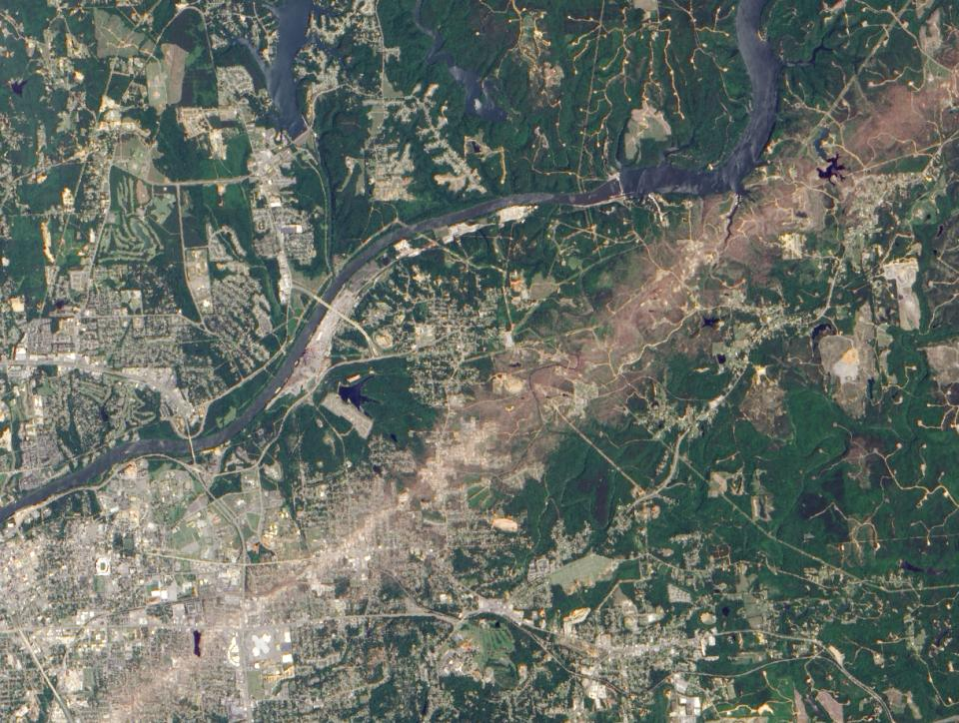
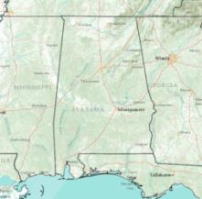
April 27, 2011 Tuscaloosa, Alabama Tornado
NASA: EO-1 – ALI
May 7, 2011

Slide 29
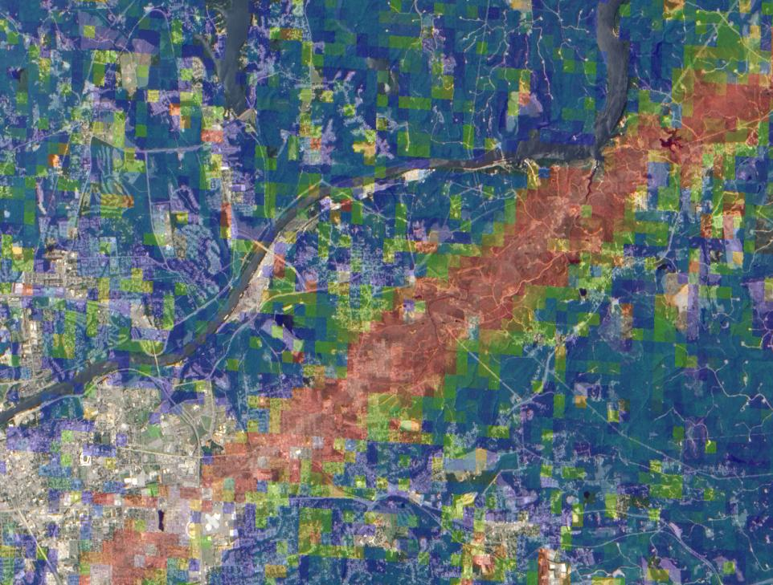
April 27, 2011 Tuscaloosa Alabama, Tornado
ForWarn Forest Change image (1 year baseline)
Jun 1, 2011

Slide 30
Within year disturbance-associated departures in NDVI
Theoretical response:
Low
Severity
NDVI
Minor reduction in NDVI
Within-season recovery
Baseline
Moderate
Severity
NDVI
Moderate reduction in NDVI
Growing season persistence
NDVI
High
Severity
Major reduction in NDVI
Growing season persistence

Slide 31
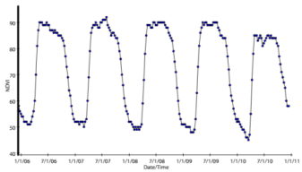
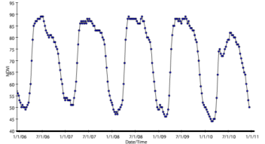
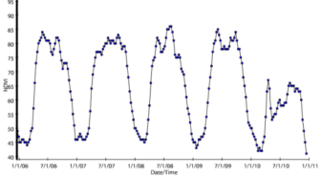
Within year disturbance-associated departures in NDVI
Predicted response:
Observed:
April 24, 2010 EF4 Tornado, Yazoo City, MS
Low
Severity
Low
Severity
NDVI
Baseline
Moderate
Severity
Moderate
Severity
NDVI
NDVI
High
Severity
High
Severity
2006 2007 2008 2009 2010

Slide 32
Leaf loss, then recovery in Tennessee
ForWarn
Kingsport
Kingsport
Full-fledged tornados are typically well documented, but the massive outbreak of April 2011 also had localized short-term effects that are easily overlooked. This image pair from a month after the storm (top) and two months later (bottom) shows how fast seemingly severe damage can recover, in this case a ridgeline forest southwest of Kingsport, Tennessee. While such ephemeral disturbances can reduce summertime productivity, it takes high frequency forest monitoring to know that these events have even occurred.
Kingsport
Kingsport
June 1, 2011
July 3, 2011

Slide 33
Kylbl, Kentucky (RAWS) Weather Station
Land Between The Lakes
The average minimum temperature from
Mar 20 to Apr 2 was 60ºF. (The minimum temp.
was above average for 15 days running).
Minimum Daily
Temperature (ºF)
freezing
21ºF on April 8th
http://www.raws.dri.edu/cgi-bin/rawMAIN.pl?ncKKYL

Slide 34
Atmospheric Drivers of the April 2007 Hard Frost
500 mb Geopotential Height (m)
Composite Mean
March 26, 2007
500 mb Geopotential Height (m)
Composite Mean
April 7, 2007
Source: NOAA/ESRL Physical Sciences Division. NCEP/NCAR Reanalysis

Slide 35
Land
Between
the Lakes
The number of dots (8-week data intervals) during greenup reflect the rate and duration of Spring. Note that 2007 had more than any year between 2000 and 2010.

Slide 36
Land
Between
the Lakes
Zoomed in, this extended 2007 spring is explained by an abrupt event in early April that arrested vegetational development for about 2 weeks.

Slide 37
Mountain
Pine Beetle
Black
Hills

Slide 38
Can we measure short-term severity?
Can we observe multi-year recovery?
Can we detect “stable state” transitions?
High
POTENTIAL ENERGY
Low
STATES

Slide 39
Northern Nevada

Slide 40
Texas Panhandle
March 2006
Amarillo Complex

Slide 41
Drought takes a toll on Texas trees
ForWarn
The forests of Texas continue to suffer through one of the most extreme droughts on record and a large number of trees have already died. The photo shows mortality in Memorial Park, Houston (Ron Billings, Texas Forest Service). By late August of 2011, the regional change in greenness from the prior year were extreme. Across the map, this decline was caused by the combined effects of drought and fire. By December of 2011, some recovery occurred as shown in blue, but this December condition is only with respect to conditions in December of 2010, which was also in drought. Note, the persisting anomaly near the western extent of the state's forests (above the word “Mexico”). Such transitional or “ecotonal” landscapes, where forest and grassland meet, are highly sensitive to climate extremes. See the Texas Forest Service website for more information on this event (http://txforestservice.tamu.edu).
Texas
Texas
Mexico
Mexico
August 28, 2011
December 26, 2011

Slide 42
6/2007
F3 Tornado
June 7, 2007
6/2007

Slide 43
Yazoo City, MS tornado recovery
ForWarn
June 17, 2010
compared to 2009
June 17, 2011
compared to 2010

Slide 44
2006
Western Nevada

Slide 45
1.0
July 2006
Superior National
Forest
Duluth
0.5
0.0
2000 2001 2002 2003 2004 2005 2006 2007 2008 2009 2010
Boundary Waters Wilderness, Minnesota
Photo credit: Steve Foss, 2011; Pagami Creek Complex

Slide 46
1.0
11/2000
4/2007
0.5
0.0
2000 2001 2002 2003 2004 2005 2006 2007 2008 2009 2010
Linville Gorge Fires
Pisgah National Forest, North Carolina

Slide 48
Can we measure short-term severity?
Can we observe multi-year recovery?
Can we detect “stable state” transitions?
High
POTENTIAL ENERGY
Low
STATES

Slide 49
Great Smoky Mountains National Park, NC
1.0
0.5
A typical deciduous signature
2000 2001 2002 2003 2004 2005 2006 2007 2008 2009 2010
1.0
0.5
A declining evergreen fraction
transitioning to a deciduous forest signature
2000 2001 2002 2003 2004 2005 2006 2007 2008 2009 2010

Slide 50
Great Dismal Swamp National Wildlife Refuge
“Hurricane Isabel inflicted considerable changes to the refuge landscape on September 18, 2003. Several thousand acres of Atlantic white cedar forests were destroyed, and countless trees were blown down through- out the refuge, creating a potentially volatile fire situation. Without restoration, significant Atlantic white cedar acreage will be lost. The potential for catastrophic fires due to the added fuels created by the hurricane will continue to pose a risk.”
Final Comprehensive Conservation Plan, July 2006
VA
NC
SC
http://library.fws.gov/CCPs/GDS/greatdismalswamp06.pdf

Slide 51
Hydrological alterations
Historical logging
Historical fires
2003 Hurricane Isabel
Atlantic white cedar restoration
2008 South One Fire
Atlantic white cedar restoration
2011 Lateral West Fire
Photo credit: USFWS, 2011

Slide 52
2011
Photo credit: Greg Sanders / USFWS

Slide 53
Great Dismal Swamp National Wildlife Refuge
FIRE
Moderate
multi-year
severity
Multi-year perspective
for two locations
0.9
0.3
0.9
High
multi-year
severity
0.3
2005 2006 2007 2008 2009 2010

Slide 54
Great Dismal Swamp National Wildlife Refuge, VA
2008
South One Fire
2011
Lateral West Fire
1.0
0.5
2003
Hurricane Isabel
0.0
2002 2003 2004 2005 2006 2007 2008 2009 2010
Location: 36.575399 -76.480208

Slide 55
Great Dismal Swamp National Wildlife Refuge, VA
2008
South One Fire
1.0
0.5
2003
Hurricane Isabel
0.0
Post 2011
Fire
Scenarios
2002 2003 2004 2005 2006 2007 2008 2009 2010
Location: 36.575399 -76.480208

Slide 56
http://articles.dailypress.com/2011-10-26/news/dp-nws-cp-dismal-swamp-20111026_1_invasive-plants-chris-lowie-refuge

Slide 57
1.0
August 2006
Derby Fire
Conifer signature
0.5
Grass signature
0.0
2000 2001 2002 2003 2004 2005 2006 2007 2008 2009 2010
Gallatin National Forest, Montana

Slide 58
Okefenokee National Wildlife Refuge, Georgia
Photo credit: Robert Carswell GFC 5/18/2011

Slide 59
Aerial view
Refuge boundary
GA
FL
GA
FL

Slide 60
1.0
2002
2007
2011
2007 Fire
0.5
0.0
2000 2001 2002 2003 2004 2005 2006 2007 2008 2009 2010
2007 and
2002 Fires
30.7172; -82.3843
2011 Incident Information
Ignition: April 28, 2011
Ignition source: Lightning
Extent: 310,000 acres
Veg types: Mixed forest, brush, grass, peat
2007 Fire

Slide 61
28 April Ignition
06-01

Slide 62
06-09

Slide 63
06-17

Slide 64
06-25

Slide 65
07-03

Slide 66
07-11

Slide 67
07-19

Slide 68
07-27

Slide 69
08-04

Slide 70
08-12

Slide 71
08-20

Slide 72
08-28

Slide 73
09-05

Slide 74
09-13

Slide 75
09-21

Slide 76
09-29

Slide 77
Monitoring Resilience
Can we measure short-term severity?
Yes*
Can we observe multi-year recovery?
Yes*
3. Can we detect “stable state” transitions?
Yes*
*Coarse filter aspects of ecological resilience can be
recognized and tracked with this technology.
For more information see go to http://forwarn.forestthreats.org

