Slide 1
Monitoring seasonal fire niches with
large phenological and fire datasets
Steven P. Norman
William W. Hargrove
200 WT Weaver Blvd, Asheville, NC 28804
USDA Forest Service Southern Research Station
Eastern Forest Environmental Threat Assessment Center

Slide 2
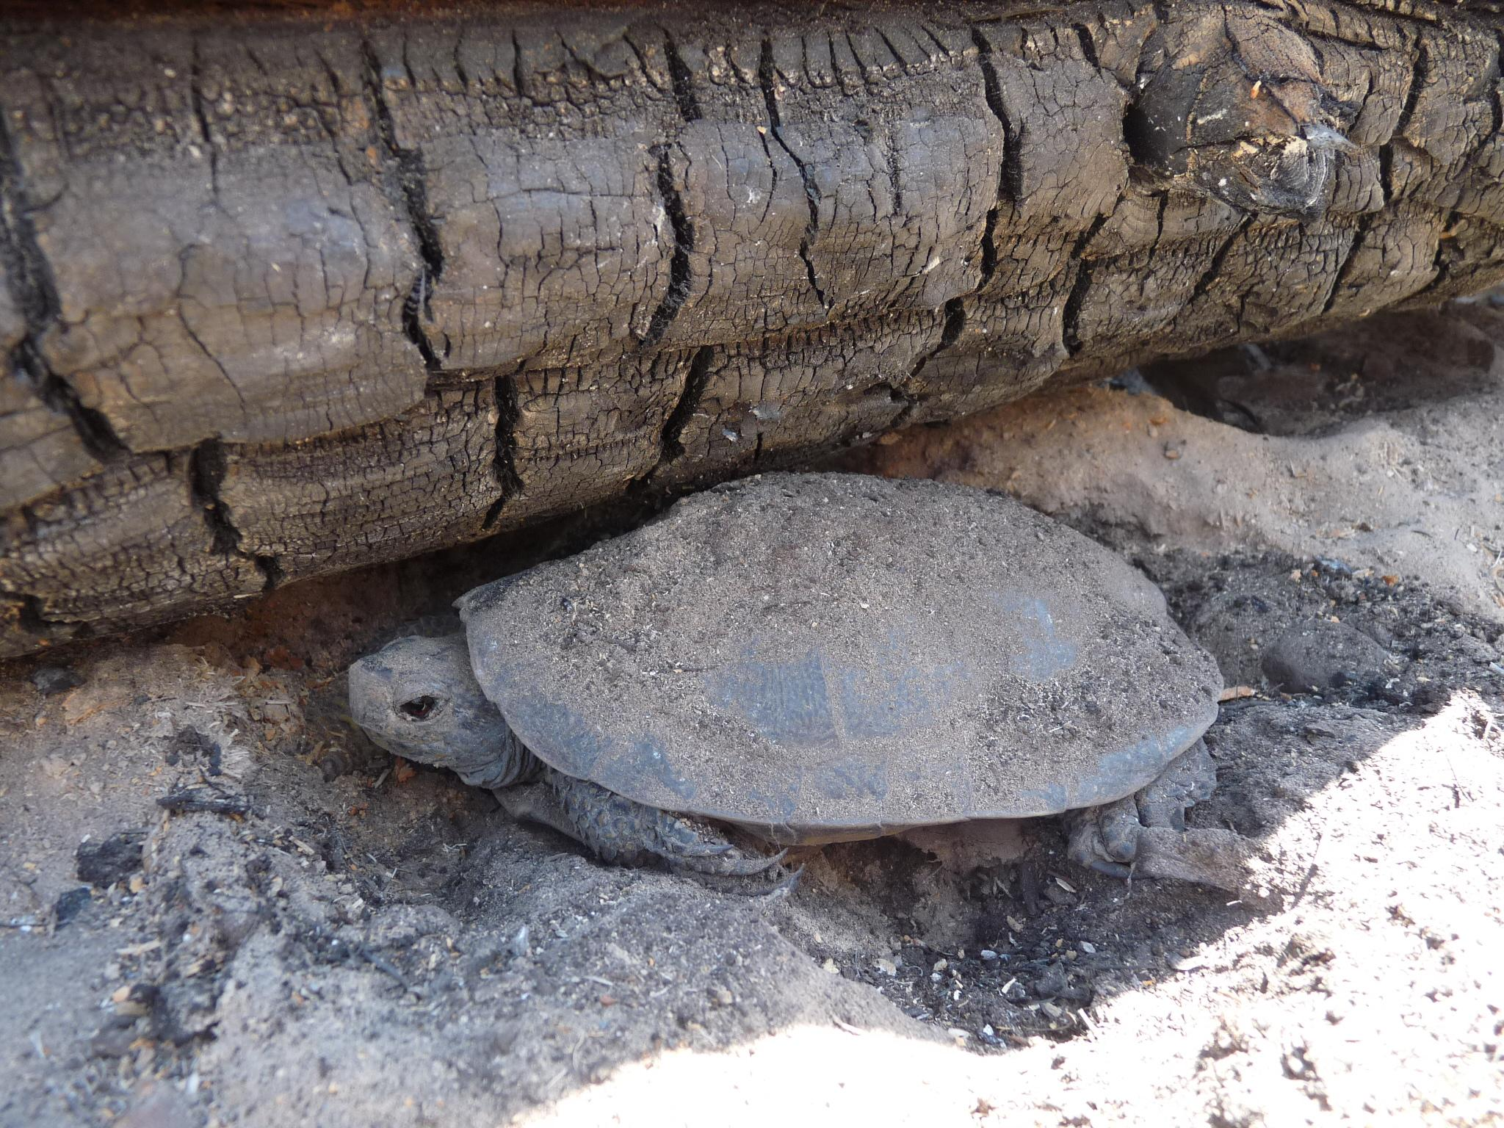
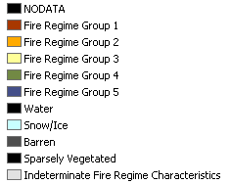
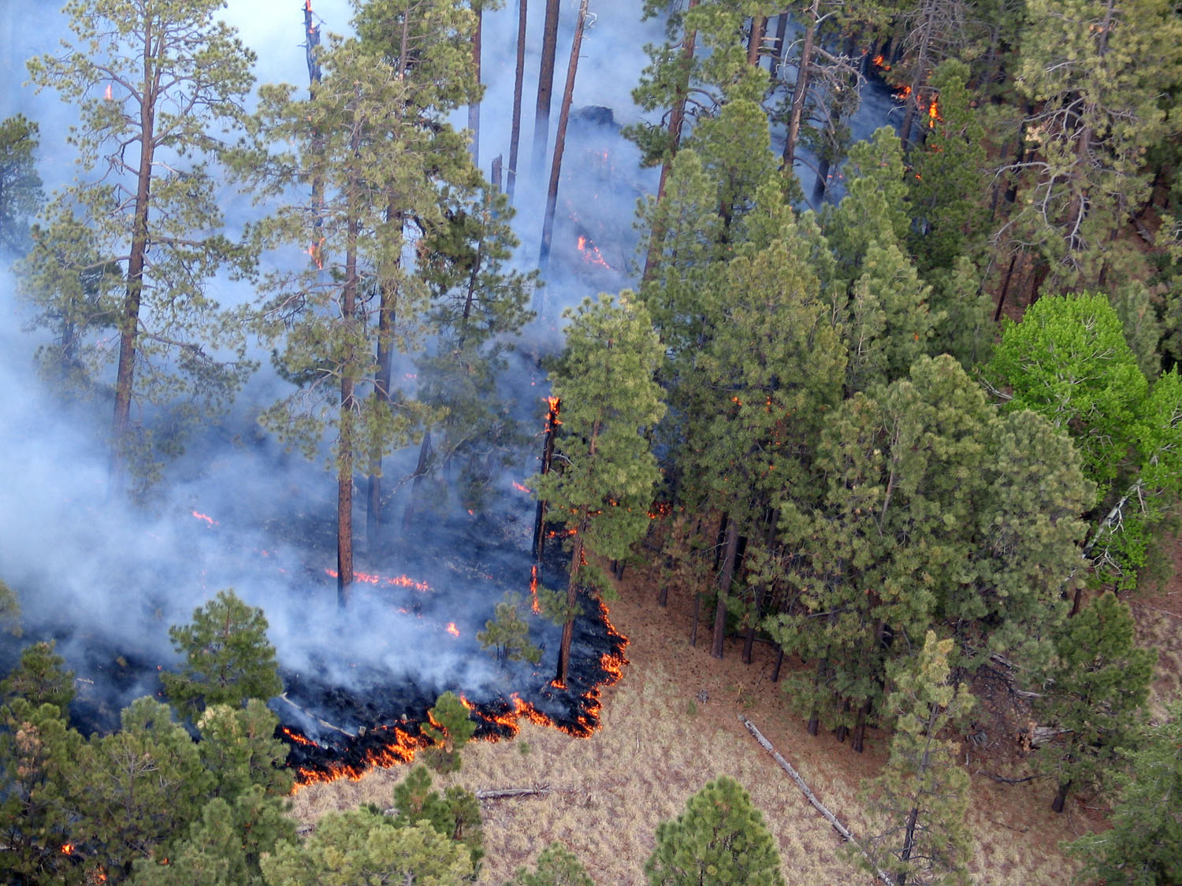
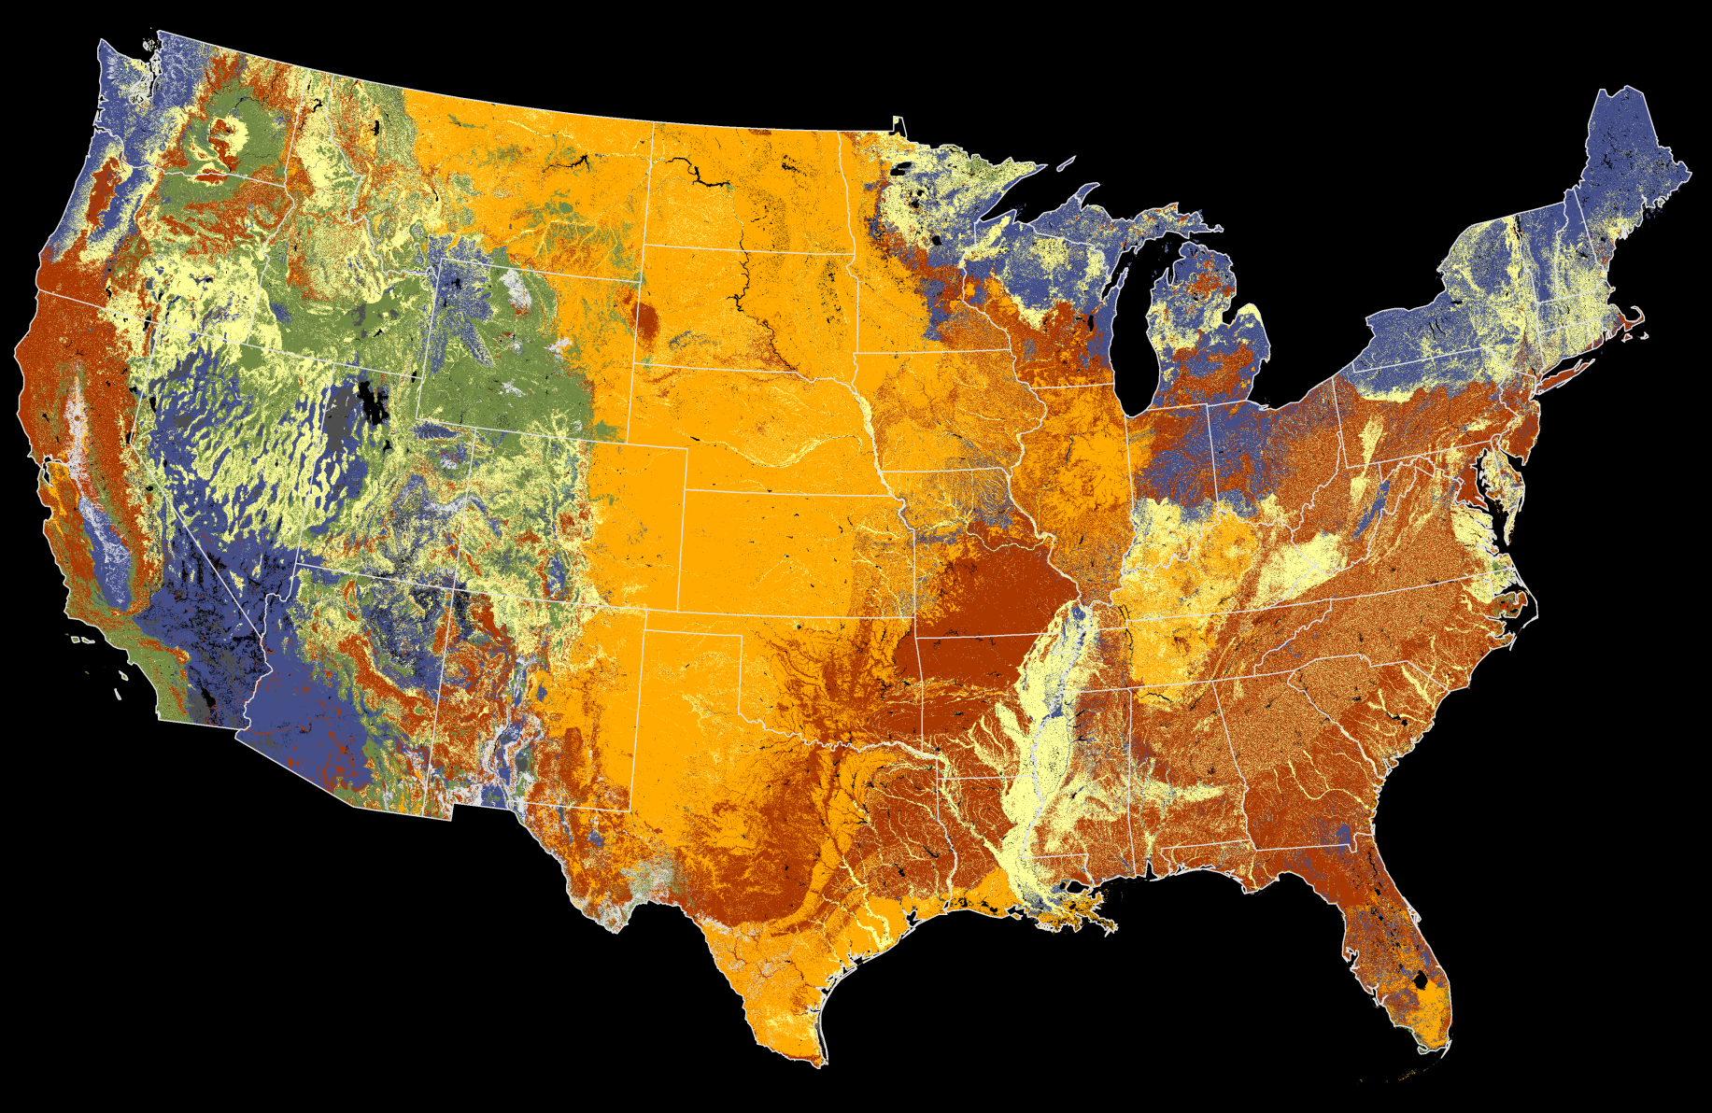
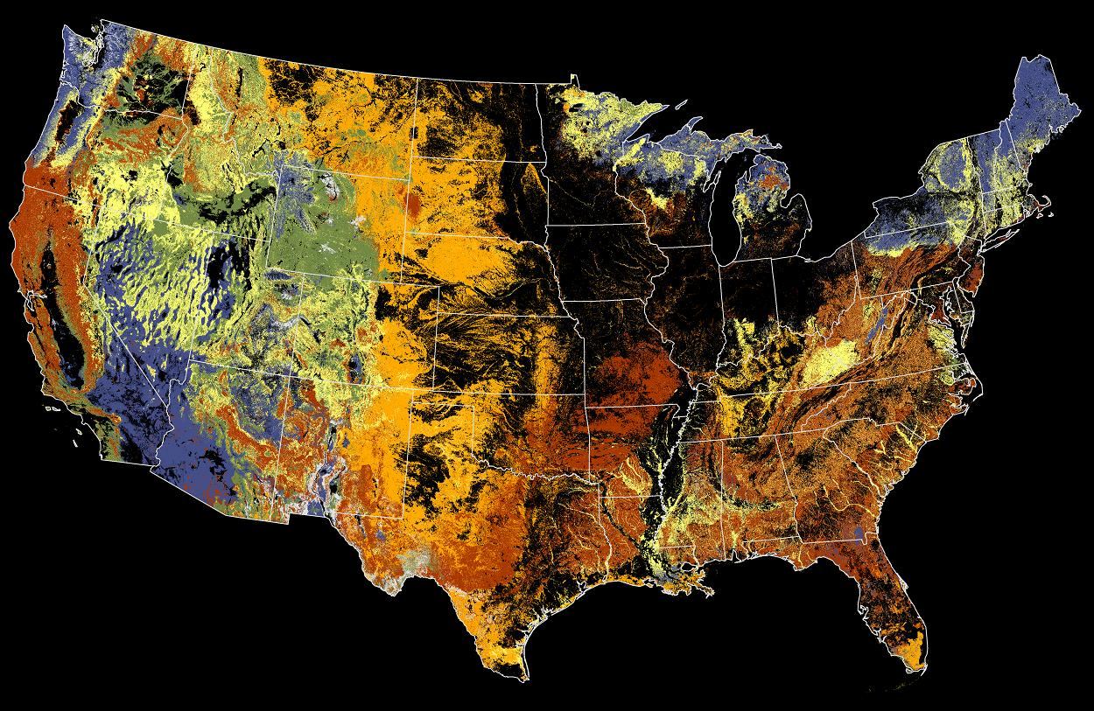
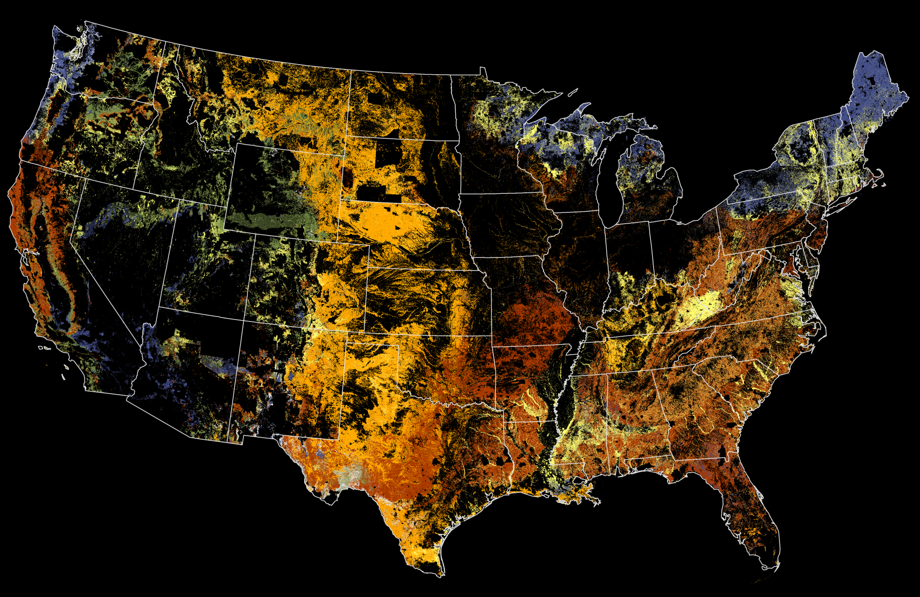
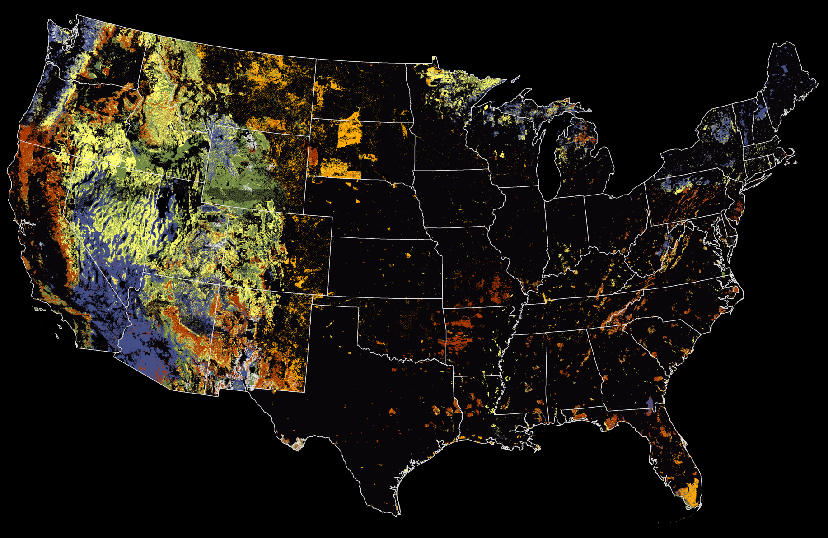
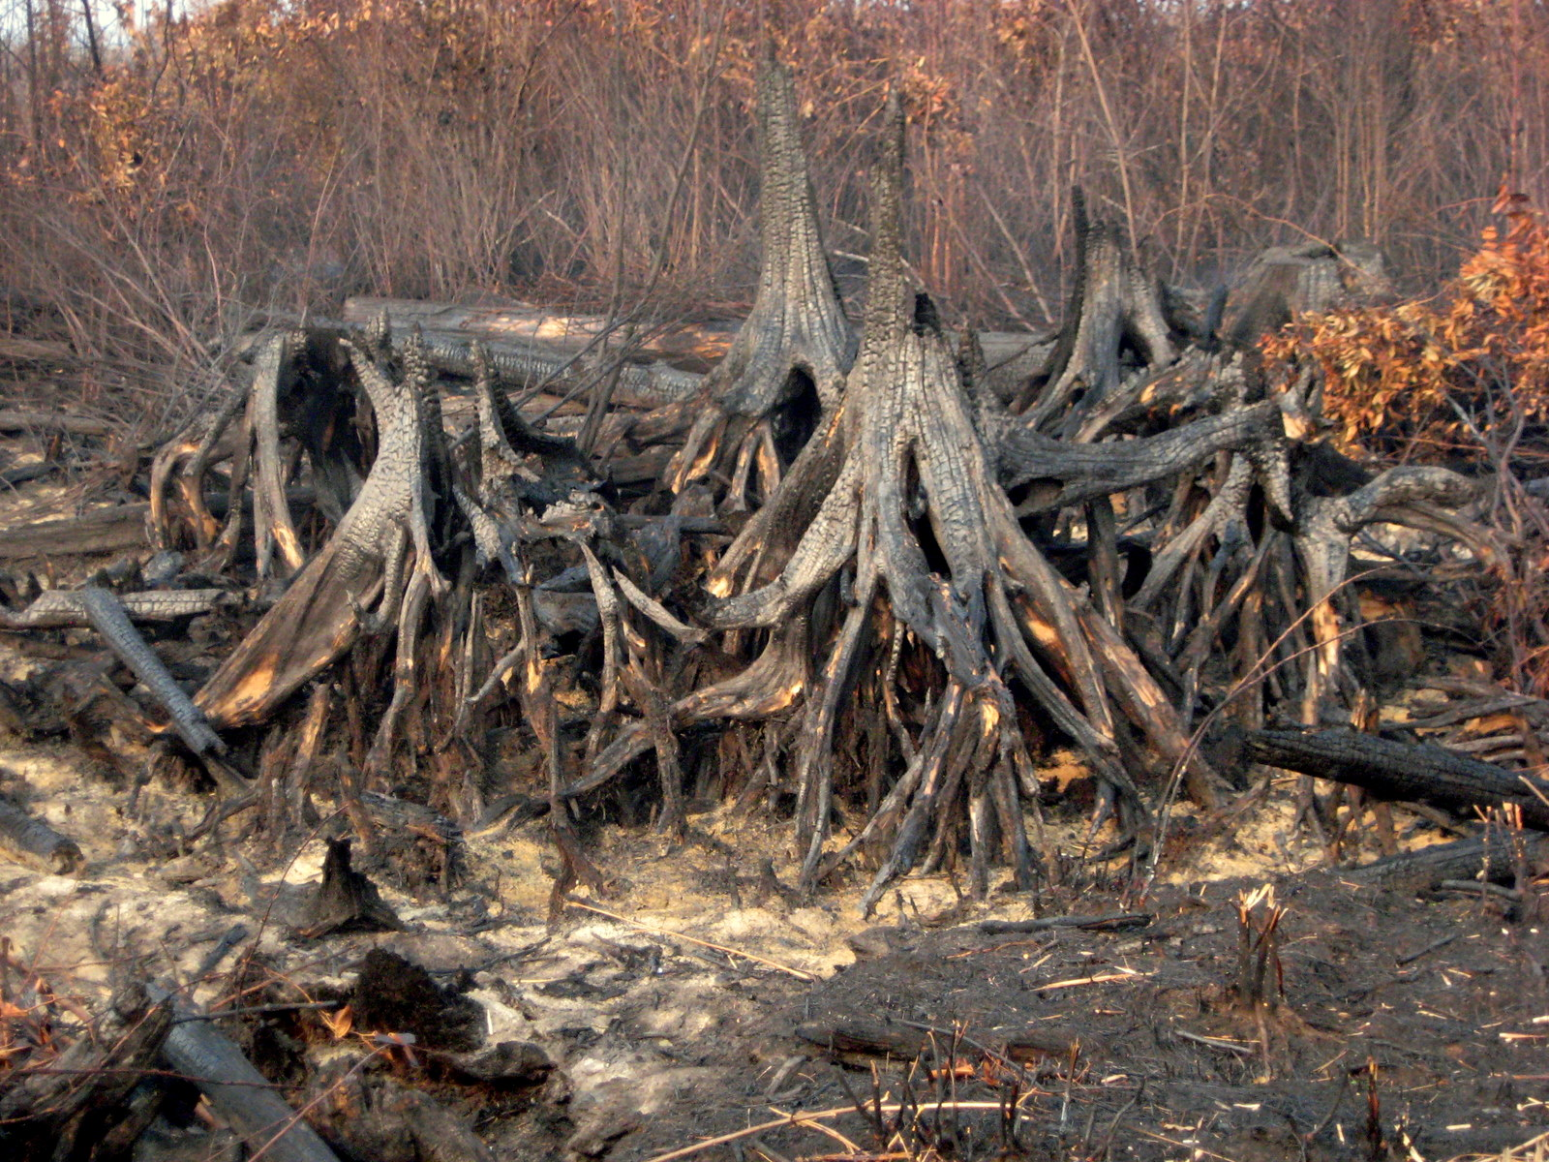
Rim_WesternPondTurtle_KibbiePonds_WestLakeEleanor_2013_09_17-19_00_11_178-CDT.jpg
Wallow_EasternAZIMT_pict-20110601-004357-2.jpg
Why do we care about fire seasonality?
Season of burn can affect species differently based on their phenology
Fire behavior often differs across seasons due to changing weather, fuels and canopy conditions
Fire season is an indicator of climate change and variability
DEFINITION: Fire season is the time when fire will and does burn.
CreditSteveBinghamFWS_VALateralWestStumps_6ftburndownbetween2008and2011.jpg

Slide 3
Components of fire regime seasonality
The seasonality of weather
The seasonality of fire ignition
The seasonality of the burnover
The seasonality of canopy conditions
The seasonality of fuels
The seasonality of species responses (effects)
Climate change affects
these in different, often
complex ways

Slide 4
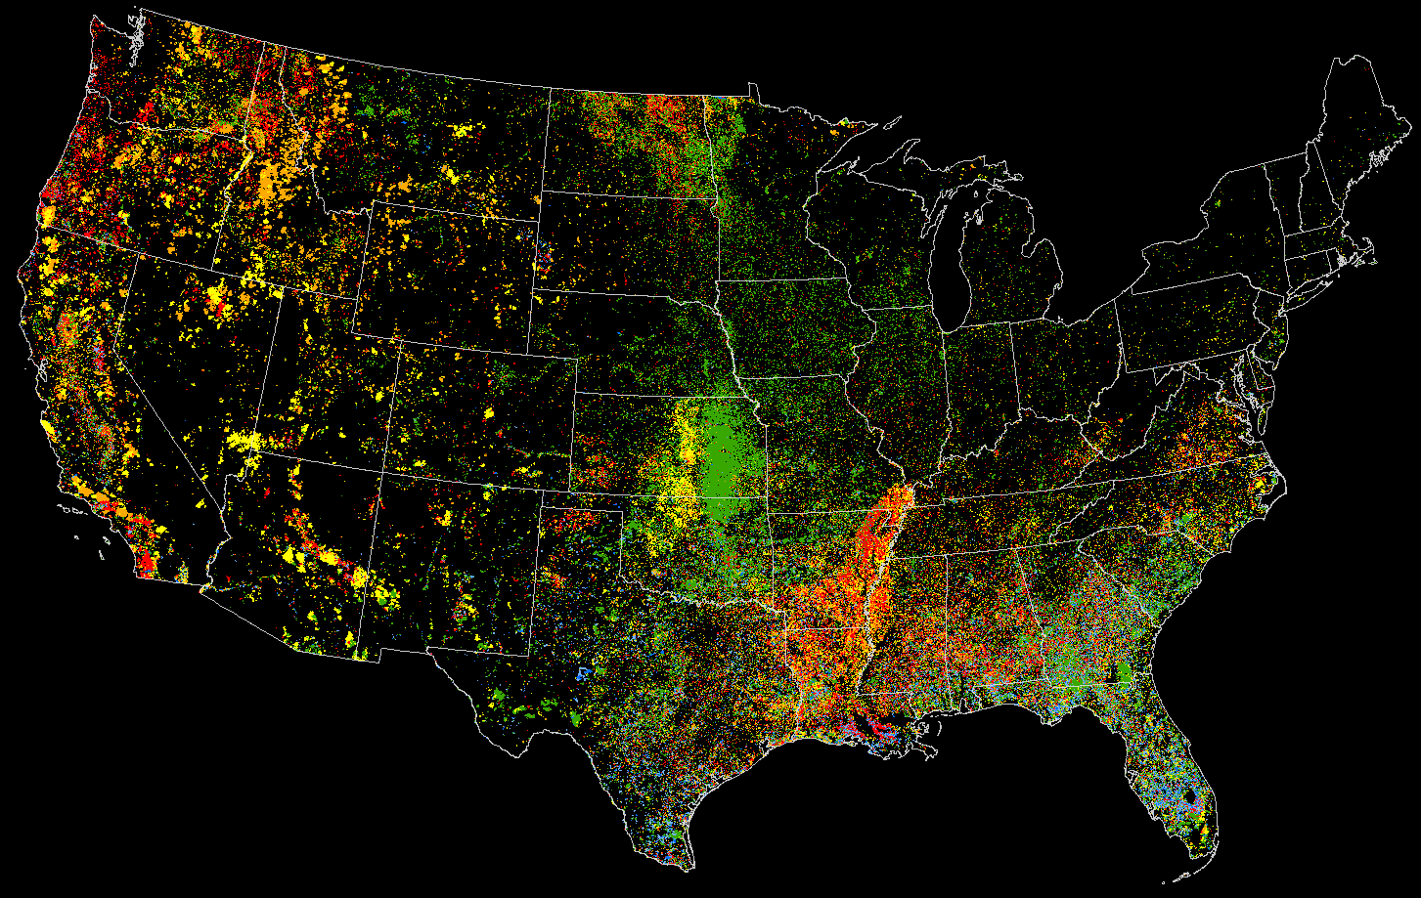
The Seasonality of Fire from individual MODIS Hotspots
2001-2011
Month
Dec, Jan, Feb
Mar, Apr, May
Jun, Jul
Aug, Sep
Oct, Nov
N=1,009,782
Steve Norman

Slide 5
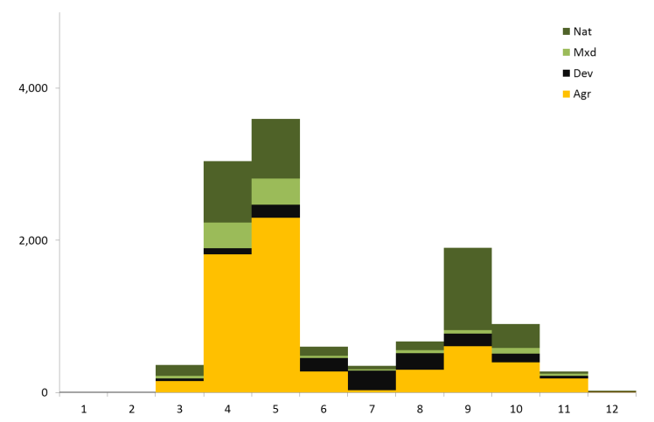
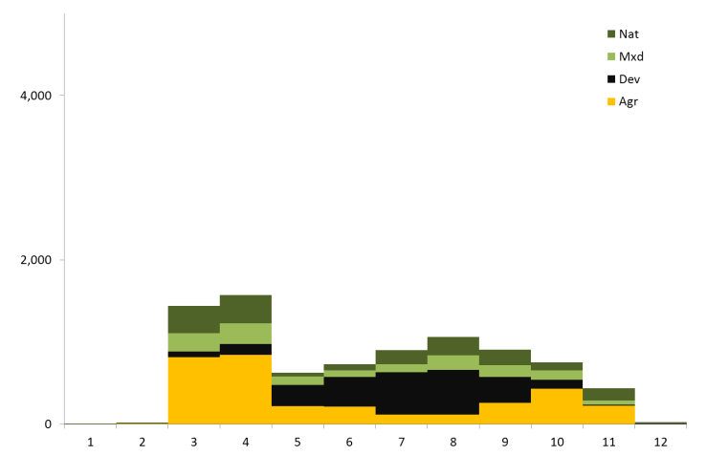
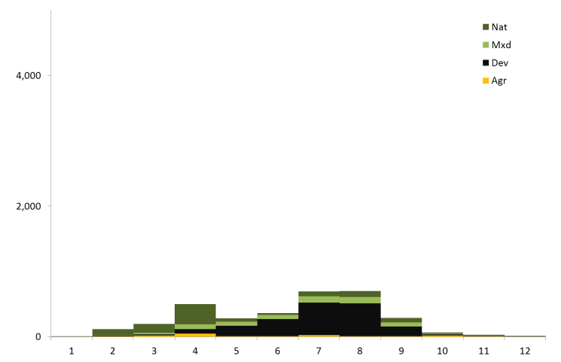
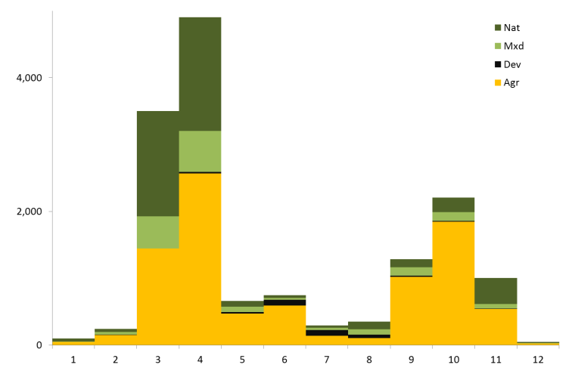
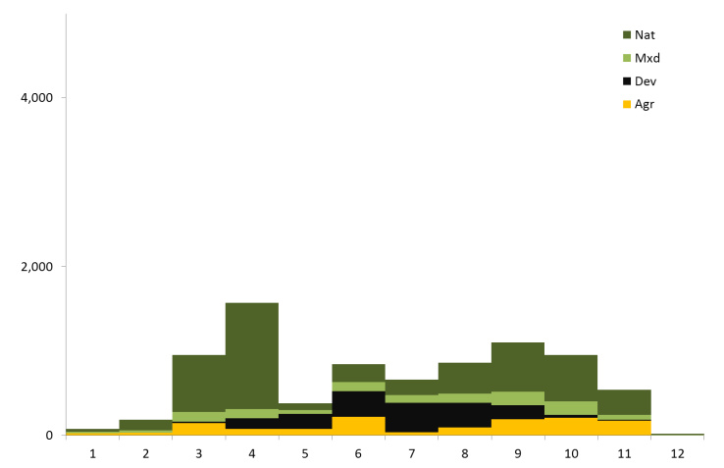
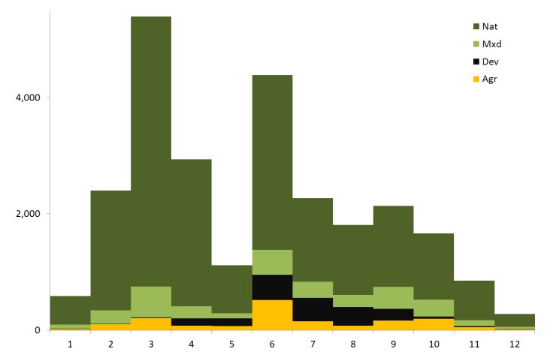
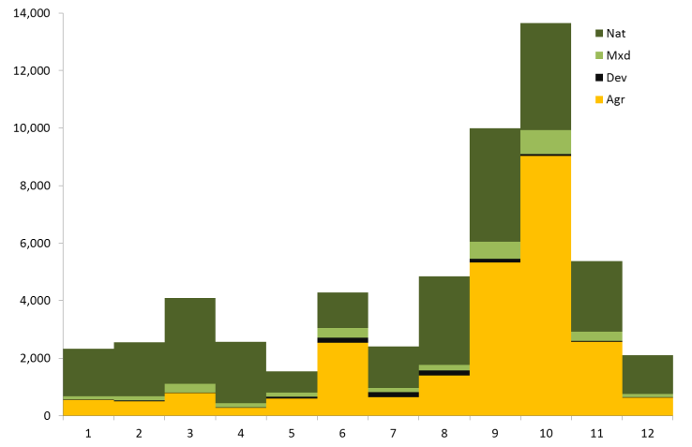
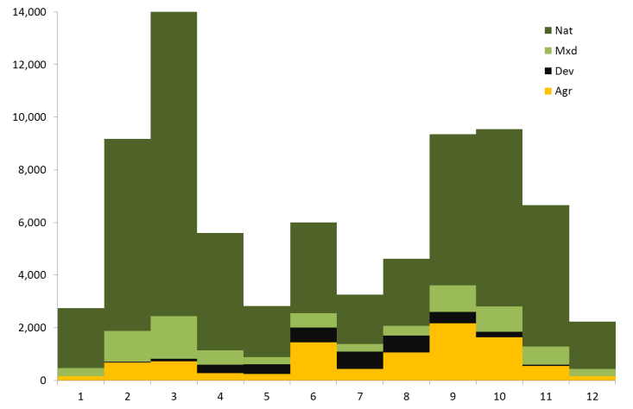
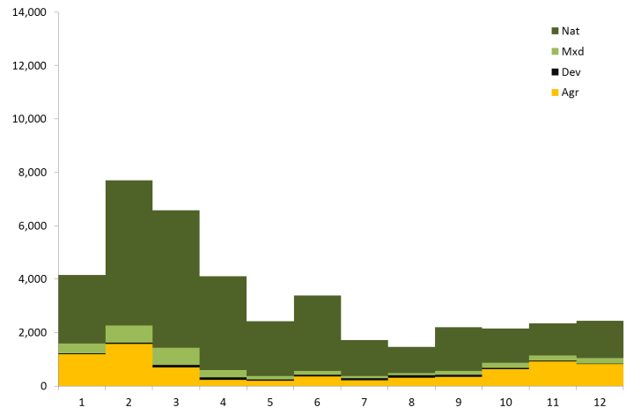
Monthly sources of fire by state group
MN,
WI,
MI
IL,
IN,
OH
ME, NH, VT, RI,
CT, MA, NY, PA,
NJ, DE, MD
IA,
MO
WV,
KY,
TN
VA,
NC,
SC
AR,
LA
MS,
AL,
GA
FL

Slide 6
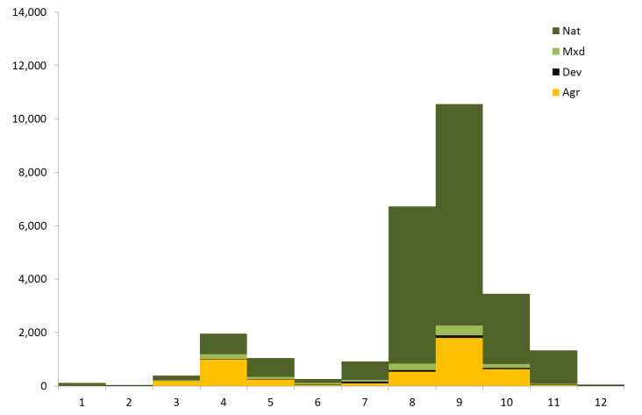
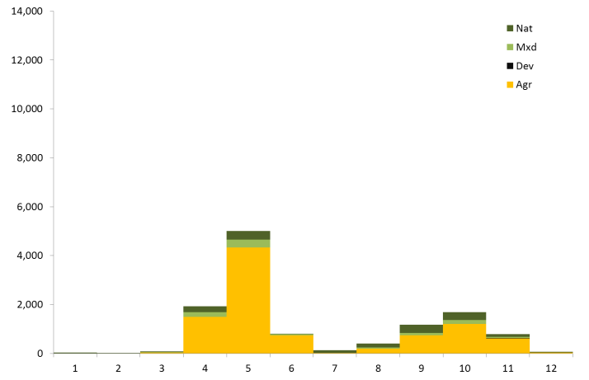
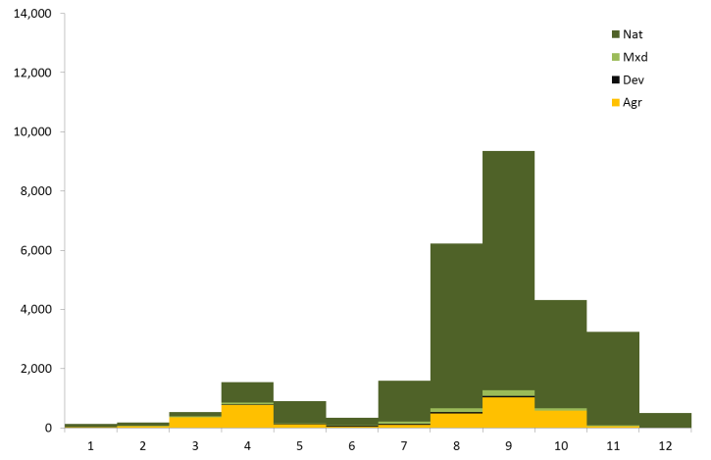
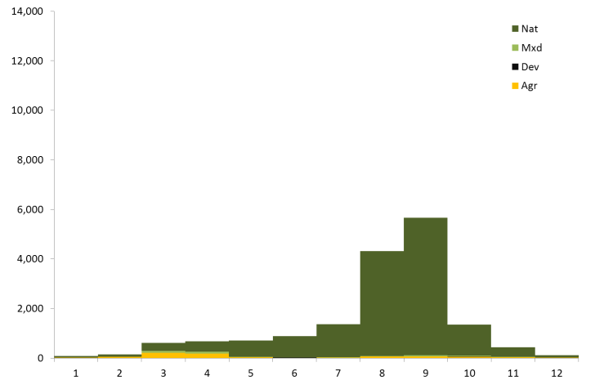
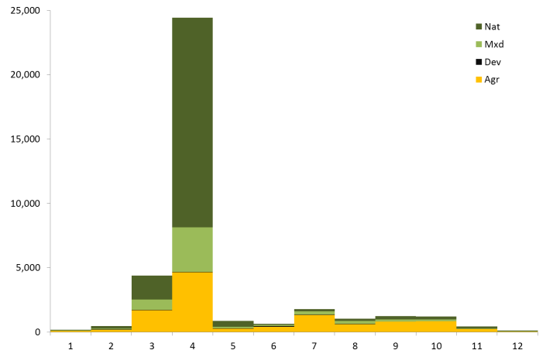
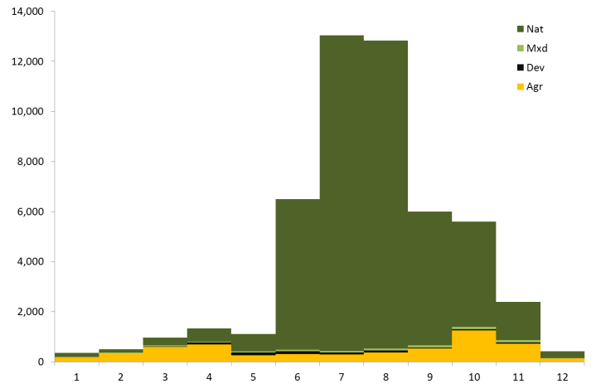
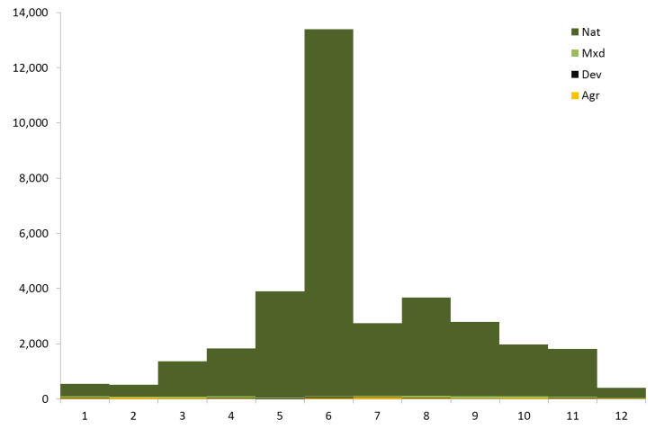
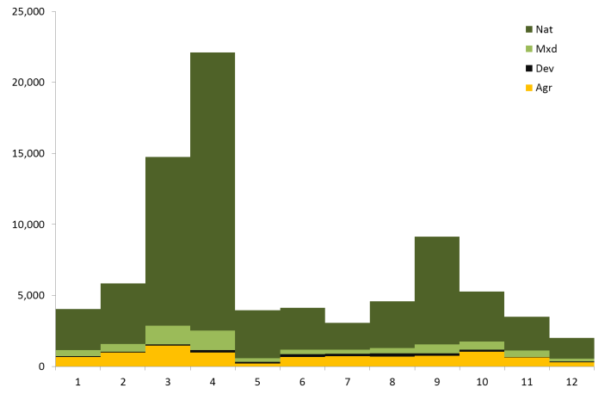
AK
Monthly sources of fire by state groups
ID,
MT
ND,
SD
OR,
WA
WY,
CO,
UT
NE,
KS
CA,
NV
AZ,
NM
OK,
TX

Slide 8
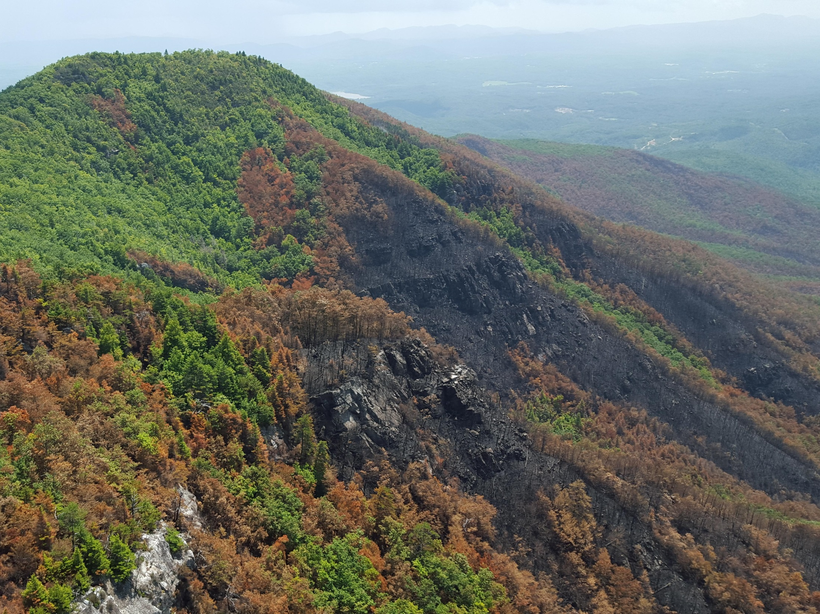

Slide 9
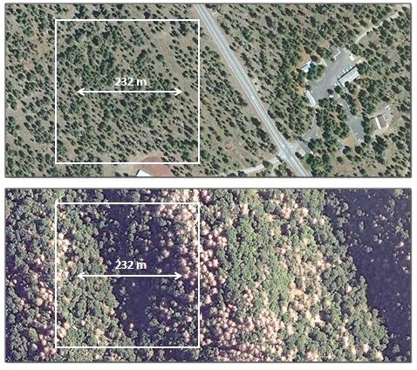
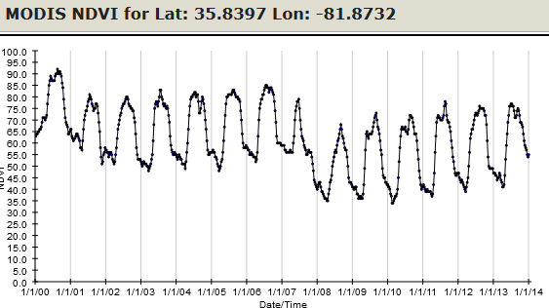
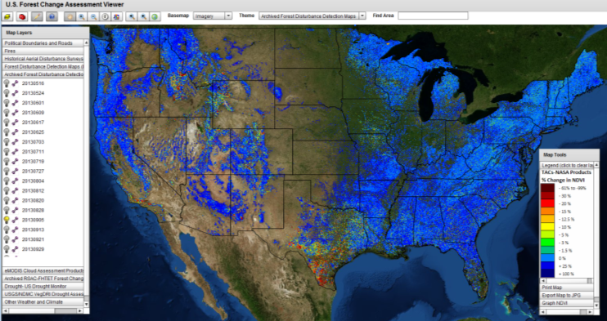
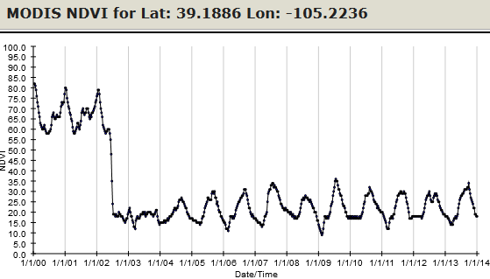
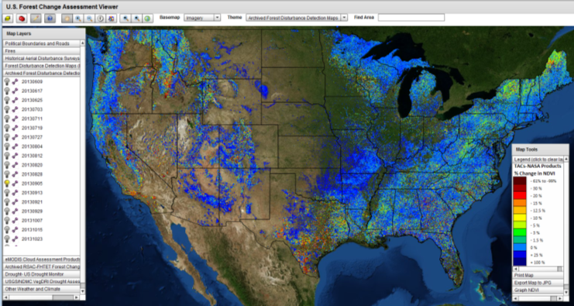
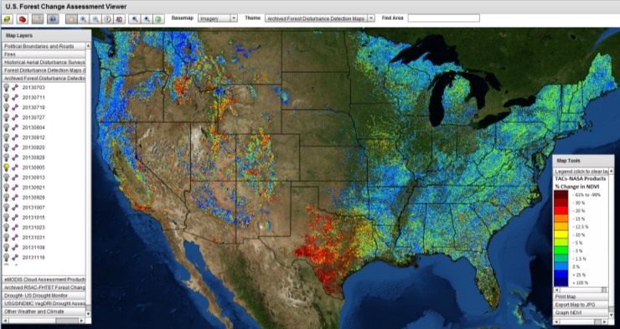
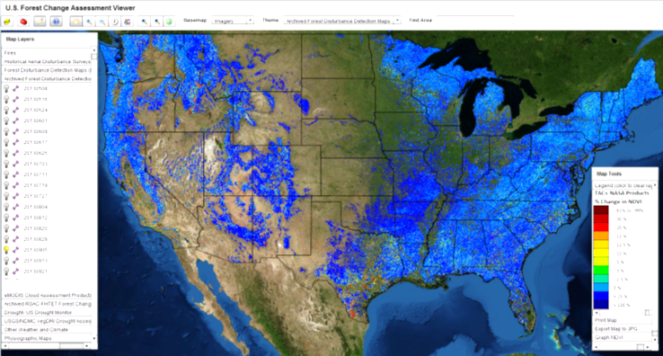
The ForWarn system
Online at http://forwarn.forestthreats.org
Measure is the Normalized Difference Vegetation Index (NDVI) from MODIS
232 meter resolution (5.4 ha/13 ac)
8-day frequency (46 periods/year from 2000)
Since 2010, 276 near-real-time change maps /year using 6 seasonally-adjusted baselines
Derived and long-term monitoring products
Baselines
1 Year Early Detect
1 Year Standard
3 Year Maximum
All Year Maximum
All Year Mean
All Year Max of Type

Slide 10
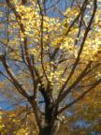
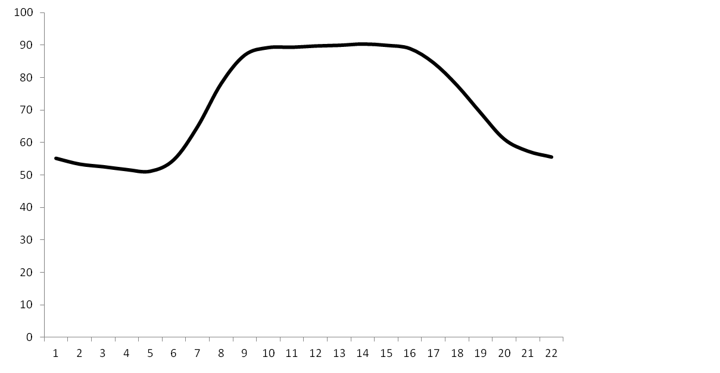
The ForWarn system
Seasonal change in NDVI reflects vegetational phenology
1.0
0.9
0.8
0.7
0.6
0.5
0.4
0.3
0.2
0.1
0.0
Summer
Spring
Fall
Winter
Winter
NDVI
Jan Feb Mar Apr May Jun Jul Aug Sep Oct Nov Dec

Slide 11
The ForWarn system
Baseline phenology compared to variation in Spring and Fall
Typical
Summer
1.0
0.9
0.8
0.7
0.6
0.5
0.4
0.3
0.2
0.1
0.0
Early
Spring
Late
Fall
Higher Lower
% change from baseline
Late
Spring
Early
Fall
NDVI
Jan Feb Mar Apr May Jun Jul Aug Sep Oct Nov Dec

Slide 12
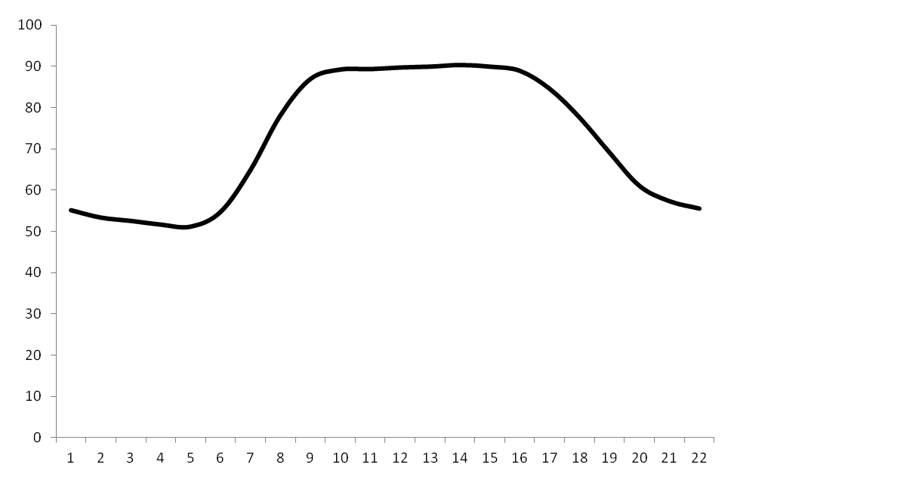
The ForWarn system
Baseline phenology compared to disturbance effects
Defoliating insects
Defoliating wind
Defoliating hail
Hard freeze
Thinning
Light fire
Severe blowdown
Severe fire
Heavy logging
Development
1.0
0.9
0.8
0.7
0.6
0.5
0.4
0.3
0.2
0.1
0.0
Higher Lower
Heavy
snowpack
BASELINE
“NORMAL”
% change from baseline
DEPARTURE
NDVI
Jan Feb Mar Apr May Jun Jul Aug Sep Oct Nov Dec

Slide 13
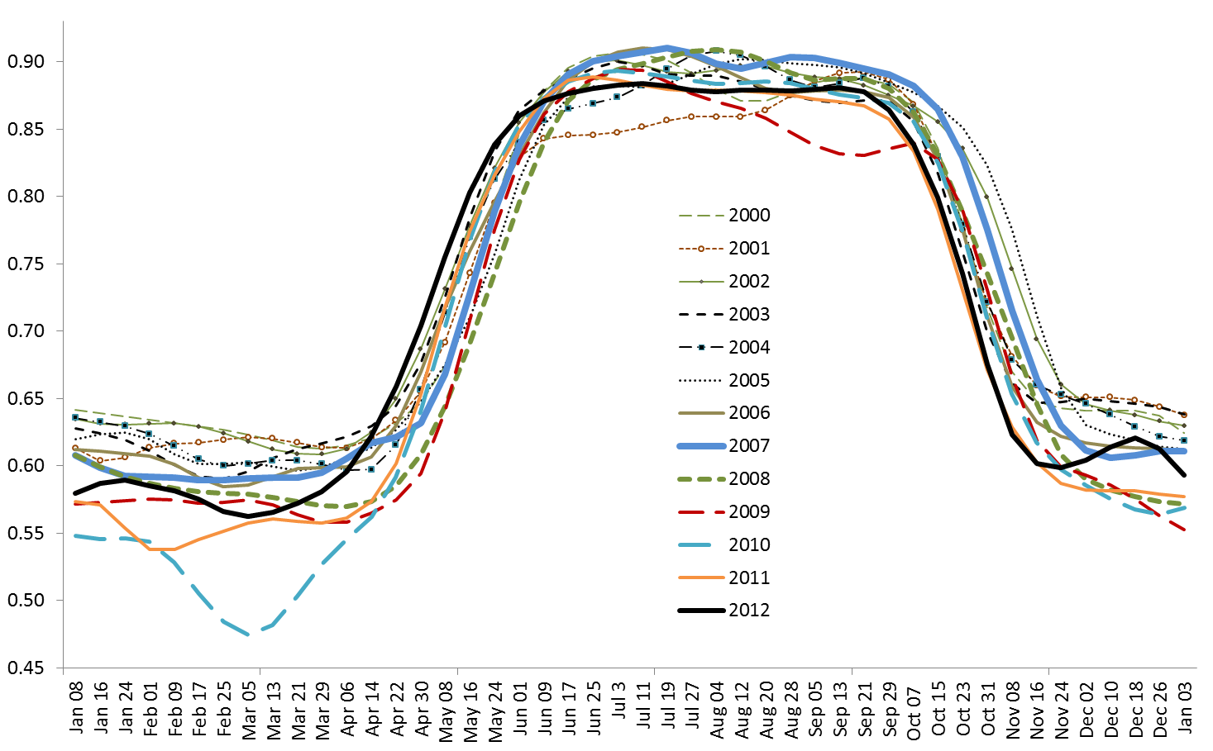
The ForWarn system
Capturing year-to-year variation in NDVI
Deciduous and Mixed Forest types across all elevations, Great Smoky Mountains National Park
3 weeks
3 weeks
Mean of 38,318 MODIS cells

Slide 14
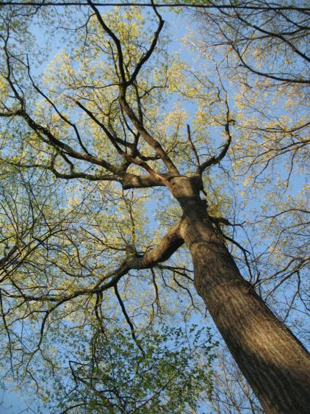
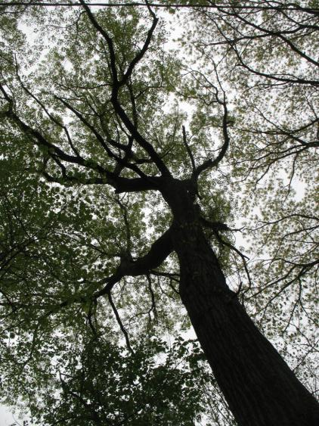
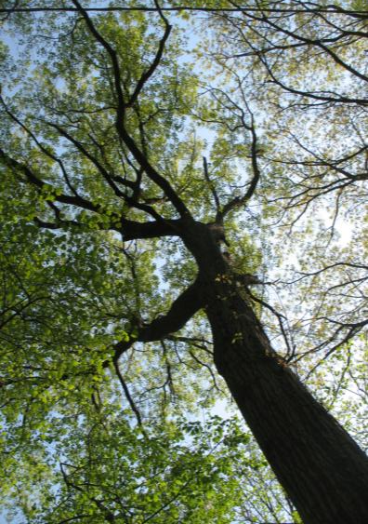
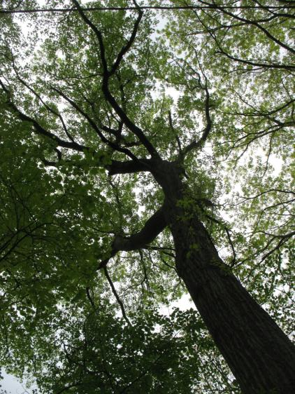
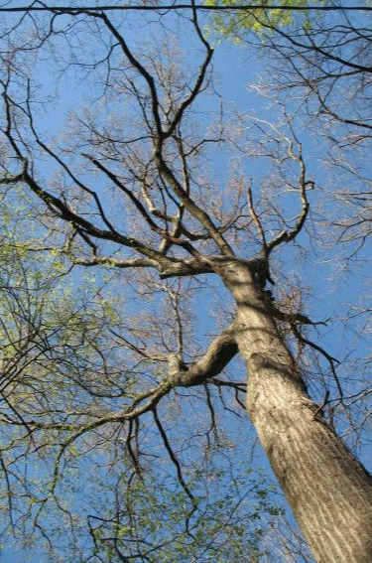
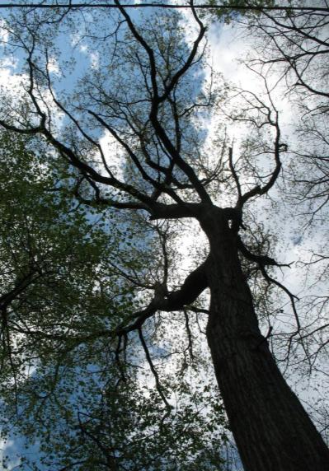
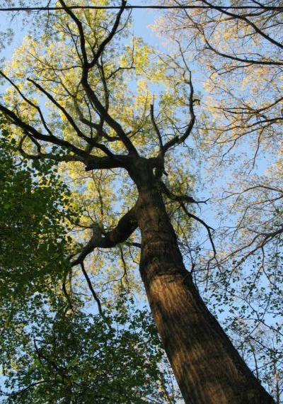
04-13
04-20
04-22
04-26
2010
Asheville
Scarlet Oak
2009
04-17
04-24
04-27

Slide 15
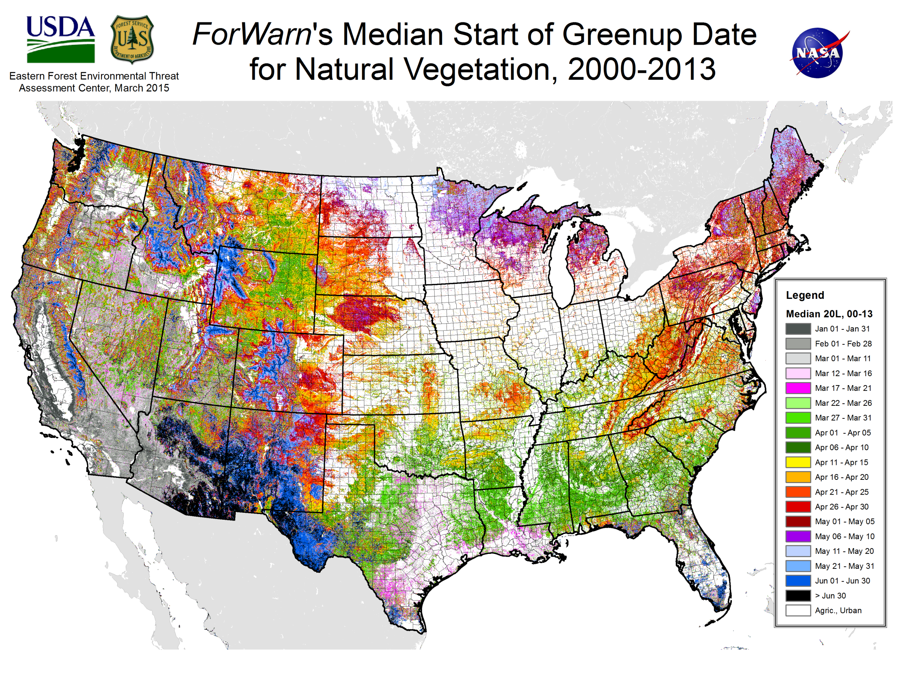

Slide 16
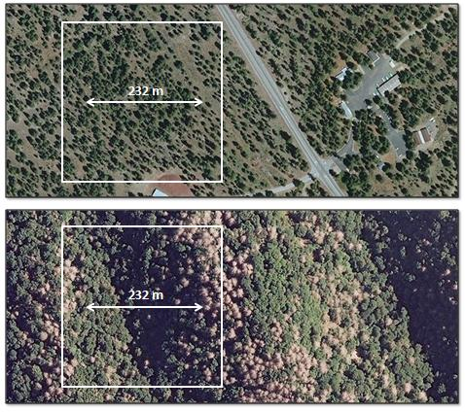
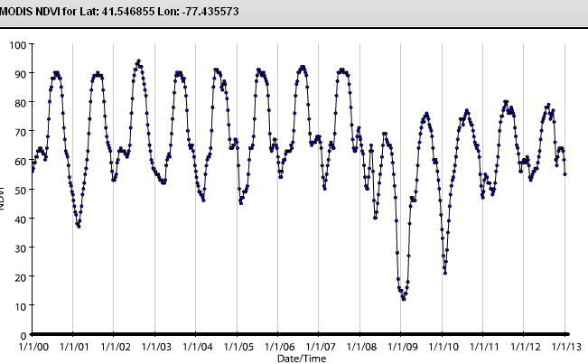
The ForWarn system
Baselines
1 year Early Detect
1 year value
3 year maximum
All year maximum
All year mean
All year type mean
Normalized Difference Vegetation Index (NDVI) from daily eMODIS and MODIS
232 meter resolution
46 periods per year (8-day intervals)
Max value of 24-day moving window
2000 to present historical database
Includes NDVI time series and change maps
Online: http://forwarn.forestthreats.org

Slide 17
04-13
04-20
04-22
04-26
2010
Asheville
Scarlet Oak
2009
04-17
04-24
04-27

Slide 18
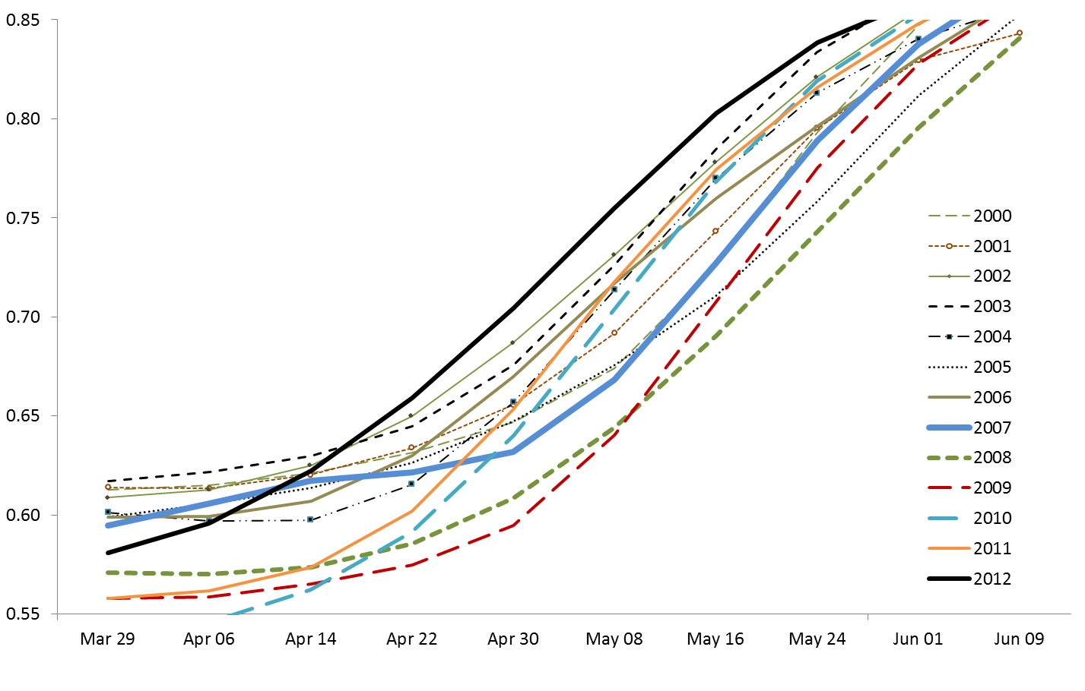
Monitoring within-season to inter-year variation in weather- and climate-sensitive vegetational phenology
Deciduous and Mixed Forest types across all elevations, Great Smoky Mountains National Park
RANKING
Apr 6
May 8
2nd 10th
3rd 8th
3rd 2nd
1st 3rd
8th 6th
5th 9th
7th 4th
5th 11th
10th 12th
12th 13th
13th 7th
11th 4th
8th 1st
Early spring
Early spring
with setback
Mean of 38,318 MODIS cells

Slide 20
Norman, SP, Hargrove, WW. Monitoring Seasonal Fire Niches with Large Phenological and Fire Datasets. Presentation for Association for Fire Ecology Meeting, November 2015, San Antonio, TX.
Fire regimes normally exhibit strong seasonality that is sensitive to climate, land surface phenology (LSP), ignitions and fuels. While considerable attention has been afforded to how fire regimes respond to climate, ignitions and fuels, the ties between LSP and fire are poorly understood even where the fire season is generally confined to a few months of the year. In the eastern US, the timing of phenological transitions is sensitive to variation in temperature and drought; ignition success and fire spread are often restricted by the higher moistures and lower wind speeds associated with the growing season; and fuels often change with senescence and leaf fall in deciduous forests and grasslands. In much of the West, LSP controls differ, but they are also present. Given that LSP is monitored by satellite, it provides an integrated measure linking top-down and local fire regime controls. Here we describe how historical fire occurrence has varied seasonally in concert with climate and MODIS-derived phenological gradients across the US since 2000. We describe the limits of LSP influence and how predicted changes in climate and the growing season may impact future fire seasonality.

Slide 21
Monitoring within-season to inter-year variation in weather- and climate-sensitive vegetational phenology
Deciduous and Mixed Forest types across all elevations, Great Smoky Mountains National Park
3 weeks
3 weeks
Mean of 38,318 MODIS cells

Slide 22
The effects of mesophication on fire seasonality

Slide 23
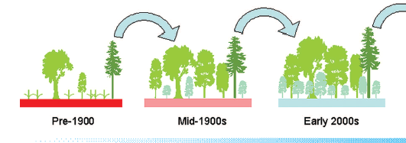
What is a resilient landscape?
Environmental aspects – Measuring resilience with vegetation composition and structure
Broad-scale mesophication
and decreased fire hazard in the East
Frequent low severity fire favored oaks and pines on dry and many mesophytic sites
Fire exclusion closed canopies and led to an
increase in shade-tolerant
mesophytic species
Decreased flammability
due to mesophytic fuels,
and humid microclimate
Pre-1900
Mid-1900s
2000s
SOURCE: modified from Nowacki, G.J., M.D. Abrams. 2008. The demise of fire and “mesophication” of forests in the eastern United States. Bioscience. 58(2):123-138.

Slide 24
What is a resilient landscape?
Environmental aspects – Measuring resilience with vegetation composition and structure
Broad-scale mesophication
and increased severe fire hazard in the inland West
Frequent low-severity fire
led to open ponderosa pine
dominated forests
Fire suppression allowed
seedlings of pine and more
mesophytic species to survive
Accumulated dead and live (ladder) fuels greatly increased severe fire hazard
Pre-1900
Mid-1900s
2000s

Slide 25
Broad-scale loss of resilience from densification or mesophication of Ponderosa Pine forests of the Interior West
A regime of frequent, generally low-severity fire keeps pine-dominated forests open and uneven aged.
Successful fire exclusion allows
more pine seedlings and meso-phytic species to survive. Even with logging, canopies begin to close.
Now unsuccessful, fire exclusion puts dense stands with heavy fuels at high risk of lethal burns
of large extent.
Pre-fire exclusion
Mid 1900s
2000

Slide 26
Broad-scale loss of resilience from mesophication and decreasing burnability of Eastern oak forests
Frequent low severity fire favors oaks and pines on dry sites with fewer mesophytic species on moderate sites.
Logging, chestnut loss and fire exclusion initiate a decline in xerophytic species on dry and moderate sites.
Xerophytic species decline further.
In a feedback, mesophytic species,
their fuels, and earlier canopy closure reduce burnability in the spring.
Pre-fire exclusion
Mid 1900s
2000s

Slide 27
What is a resilient landscape?
Environmental aspects — Measuring resilience (indirectly) with fire regime attributes
Historical Fire Regimes
Fire Regime Group
I
II
III
IV
V
Frequent, low severity
Frequent, high severity
Moderately frequent, low severity
Moderately frequent, high severity
Infrequent, high severity
Modified from LANDFIRE
Steve Norman, Bill Christie

Slide 28
What is a resilient landscape?
Environmental aspects — Measuring resilience (indirectly) with fire regime attributes
Historical Fire Regimes of Existing
Wildland Vegetation
Fire Regime Group
I
II
III
IV
V
Frequent, low severity
Frequent, high severity
Moderately frequent, low severity
Moderately frequent, high severity
Infrequent, high severity
Modified from LANDFIRE
Steve Norman, Bill Christie

Slide 29
What is a resilient landscape?
Environmental aspects — Measuring resilience (indirectly) with fire regime attributes
Historical Fire Regimes of Existing
Wildland Vegetation
On Public Lands
Fire Regime Group
I
II
III
IV
V
Frequent, low severity
Frequent, high severity
Moderately frequent, low severity
Moderately frequent, high severity
Infrequent, high severity
Modified from LANDFIRE
Steve Norman, Bill Christie

Slide 30
Land Surface Phenology-based vegetation types
Hardwood forest-dominated pixels
Sacramento Co. CA
Bottomland hardwood
Kanabec Co. MN
Oak-Maple
Hamilton Co. NY
Maple Beech Birch
Mills Co. IA
Oak
Johnson Co. AR
Oak
Centre Co. PA
Oak-Maple
Erath Co. TX
Oak
Transylvania Co. NC
Oak
Buncombe Co. NC
Beech-Maple

Slide 31
Land Surface Phenology-based vegetation types
Evergreen conifer forest-dominated pixels
Linn Co. OR (west Cascades)
Second growth Douglas Fir
SD (Black Hills)
Ponderosa Pine
Randolph Co. WV
Appalachian Spruce-Fir
Del Norte Co. CA
Old growth Redwood
Clear Creek Co. CO
Lodgepole Pine
Walton Co. FL (Eglin AFB)
Longleaf Pine
Trinity Co. CA
Old growth Mixed Conifer
Greenlee Co. AZ
Ponderosa Pine
Marion Co. FL (Ocala NF)
Mixed pine

Slide 32
Land Surface Phenology-based vegetation types
Grass-dominated pixels
Whitman Co. WA (Palouse)
Miner Co. SD (wheat)
McDonough Co. IL (corn)
Owyhee Co. ID (cheatgrass)
Cherry Co. NE (Sand Hills)
Butler Co. KS (Flint Hills)
Pima Co. AZ (invasives)
Andrews Co. TX (range)
Salem Co. NJ (coastal marsh)

Slide 33
Satellite-based monitoring of seasonal, successional and event fuels
for fire planning
Steve Norman
William Christie
Bjorn J Brooks
William Hargrove
USDA Forest Service, Southern Research Station, Eastern Threat Center, 200 WT Weaver Blvd, Asheville, NC 28804
Southern Blue Ridge Fire Learning Network Workshop
Morganton, NC
May 12-14, 2015

Slide 34
1. Monitoring seasonal fuels and fire conditions
ca. 1950s

Slide 35
1. Monitoring seasonal fuels and fire conditions
Wildfire ignitions in the Blue Ridge Region, 2000-2013
N=15,804 fires
Natural (Public)
Natural
Developed
Agricultural
Mixed
Ignitions 2000-13
Roanoke
Count of
Fires
Win
24.6%
Aut
19.5%
VA
.. .
Sum 7.3%
Spr
48.7%
NC
Knoxville
TN
Charlotte
Win
33.4%
Greenville
Aut
33.4%
SC
Spr
43.2%
Sum
10.4%
Area
Burned
Atlanta
GA
Sources: Short 2015 Fire Occurrence Database, v.3; Riitters 2006 Landscape Pattern Types

Slide 36
1. Monitoring seasonal fuels and fire conditions
Count of wildfire ignitions in the Blue Ridge Region, 2000-2013 compared to the mean ForWarn NDVI for deciduous forests of Great Smoky Mountains NP
NDVI
Ignitions
Mean NDVI
for GSMNP
Sources: Short 2015 Fire Occurrence Database, v.3; ForWarn NDVI data, 2000-2012

Slide 37
1. Monitoring seasonal fuels and fire conditions
Area burned by wildfire in the Blue Ridge Region, 2000-2013 compared to the mean ForWarn NDVI for deciduous forests of Great Smoky Mountains NP
NDVI
Area burned
Mean NDVI
for GSMNP
Sources: Short 2015 Fire Occurrence Database, v.3; ForWarn NDVI data, 2000-2012

Slide 38
1. Monitoring seasonal fuels and fire conditions
Offered explanations for the Blue Ridge’s “seasonal fire niches”
Seasonality of macro-climate
Regional temperature flux (heat)
Seasonal winds drive fire spread
Humidity and air masses
Seasonality of micro-climate
Overstory shading cools surface temperatures and raises humidity
Local transpiration increases RH.
Leafed canopy reduces surface wind
Seasonality of fuel availability
The timing of litter fall
The biology of species senescence
Decomposition
Seasonality of human behavior
Increased outdoor activity
Post-winter refuse burning
Land Surface Phenology

Slide 39
04-13
04-20
04-22
04-26
2010
Asheville
Scarlet Oak
2009
04-17
04-24
04-27

Slide 40
1. Monitoring seasonal fuels and fire conditions
ForWarn’s NDVI for Deciduous and Mixed Forests of the Great Smoky
Mountains National Park, 2000-2012
3 weeks
3 weeks
N=38,318 MODIS cells

Slide 41
1. Monitoring seasonal fuels and fire conditions
ForWarn’s NDVI for Deciduous and Mixed Forests of the Great Smoky
Mountains National Park, 2000-2012
RANKING
Apr 6
May 8
2nd 10th
3rd 8th
3rd 2nd
1st 3rd
8th 6th
5th 9th
7th 4th
5th 11th
10th 12th
12th 13th
13th 7th
11th 4th
8th 1st
Early spring
Early spring
with setback
N=38,318 MODIS cells

Slide 42
1. Monitoring seasonal fuels and fire conditions
ForWarn’s Land Surface Phenology seasonal parameters
Start of
Browndown

Slide 43
1. Monitoring seasonal fuels and fire conditions
ForWarn’s mean start of Spring greenup

Slide 44
1. Monitoring seasonal fuels and fire conditions
ForWarn’s mean Start of Fall browndown

Slide 45
2. Monitoring events that alter fuels
ca. 1930s

Slide 46
Summation
ForWarn’s NDVI data provides both near-real -time and retrospective monitoring insights into seasonal, event and successional fuel dynamics.
The data convey annualized fire effects that can be broken out seasonally to discern easily confounded evergreen and deciduous trends. These conditions can be coarsely associated with desired conditions across broad landscapes.
For more, contact:
stevenorman@fs.fed.us
USDA Forest Service
Eastern Threat Assessment
Center, Asheville, NC

Slide 47
Land Surface Phenology of Great Smoky Mountains National Park
Mean 2000-2011 Phenological Curves of the Deciduous
Forest Type By Elevation
NDVI *100
n=632
n=5,075
n=7,606
n=4,503
n=214

Slide 48
Land Surface Phenology of Great Smoky Mountains National Park
Mean 2000-2011 Phenological Curves of the Deciduous
Forest Type By Elevation
Summer productivity generally decreases with elevation
About 3 week difference in greenup in the Spring
Fall shows less elevational variation
Growing season length decreases with elevation
NDVI *100
n=632
n=5,075
n=7,606
n=4,503
n=214

Slide 49
04-13
04-20
04-22
04-26
2010
Asheville
Scarlet Oak
2009
04-17
04-24
04-27

Slide 50
04-13
04-20
04-22
04-26
2010
Asheville
Scarlet Oak
2009
04-17
04-24
04-27

Slide 51
Land Surface Phenology of Great Smoky Mountains National Park
Yearly Variation in Phenology of the Deciduous Forest Type
Across All Elevations
Greater inter-year variability in Fall
n=18,030 MODIS cells

Slide 52
Land Surface Phenology of Great Smoky Mountains National Park
Mean Greenup of Deciduous Forest Type Across All Elevations
NDVI *100
n=18,030 MODIS cells

Slide 53
Land Surface Phenology of Great Smoky Mountains National Park
Heating Degree Days for Western NC and Eastern TN
(Average of NCDC Climate Division TN 1 and NC 1)
Heating Degree Days
Warm Cold
March April May

Slide 54
Land Surface Phenology of Great Smoky Mountains National Park
Heating Degree Days for Western NC and Eastern TN
(Average of NCDC Climate Division TN 1 and NC 1)
Heating Degree Days
Warm Cold
2012
March April May

Slide 55
Land Surface Phenology of Great Smoky Mountains National Park
Mean NDVI Reduction of Deciduous Forest Type During Fall
Across All Elevations
NDVI *100
n=18,030 MODIS cells

Slide 56
Land Surface Phenology of Great Smoky Mountains National Park
Cooling Degree Days for Western NC and Eastern TN
(Average of NCDC Climate Division TN 1 and NC 1)
Cooling Degree Days
Cold Warm
August September October

