Slide 1
The Land Surface Phenology of
Great Smoky Mountains National Park
The Land Surface Phenology of
Great Smoky Mountains National Park
A Preliminary Satellite and Climatic Analysis
Steve Norman
Bill Hargrove
Bill Christie
And many others
30 January 2013 EFETAC-National Park Service Meeting; Forest Service SRS Headquarters Asheville NC

Slide 2
Land Surface Phenology of Great Smoky Mountains National Park
Methodology
Land Surface Phenology
ForWarn dataset, 2000-2011 (8-day)
Vegetational Filtering
National Land Cover Dataset, 2006 at 30m
Rescaled to near-MODIS resolution (231.6m) by counting the number of 30m cover types within a moving 240m² window (eight 30m cells = 240m) separately for every cover type
Then reclassified for purity of veg type so that:
Deciduous Forest at 240m had all 64 cells as Deciduous (DEC n=18,030)
Evergreen Forest at 240m had all 64 cells as Evergreen (EVE n=15,575)
Mixed Forest at 240m included all other pure forest (MXD n=336)
If at least one 30m cell of the 64 was non-forest, it was classified as non-forest (grass, developed, water, barren, etc.) (n=3,409)
Climate Data
NCDC Monthly Climate Divisional data
Selected station data

Slide 3
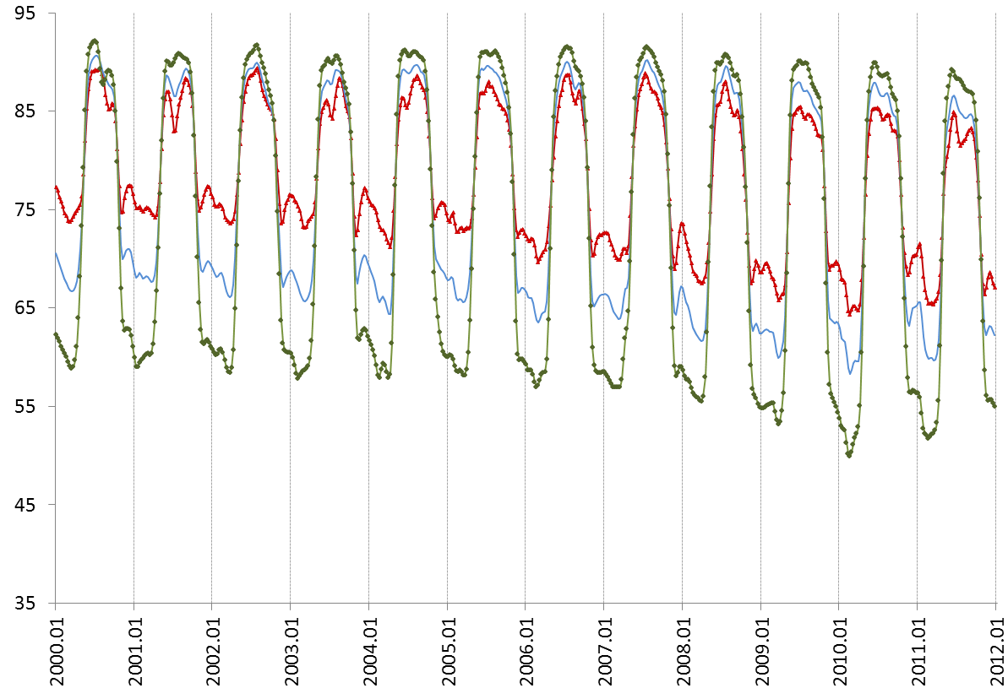
Land Surface Phenology of Great Smoky Mountains National Park
A 12-Year NDVI Time Series for Three Forest Types at
<2,000 ft. Elevation within the Park
NDVI *100
Deciduous (n=632)
Mixed (n=3,044)
Evergreen (n=49)

Slide 4
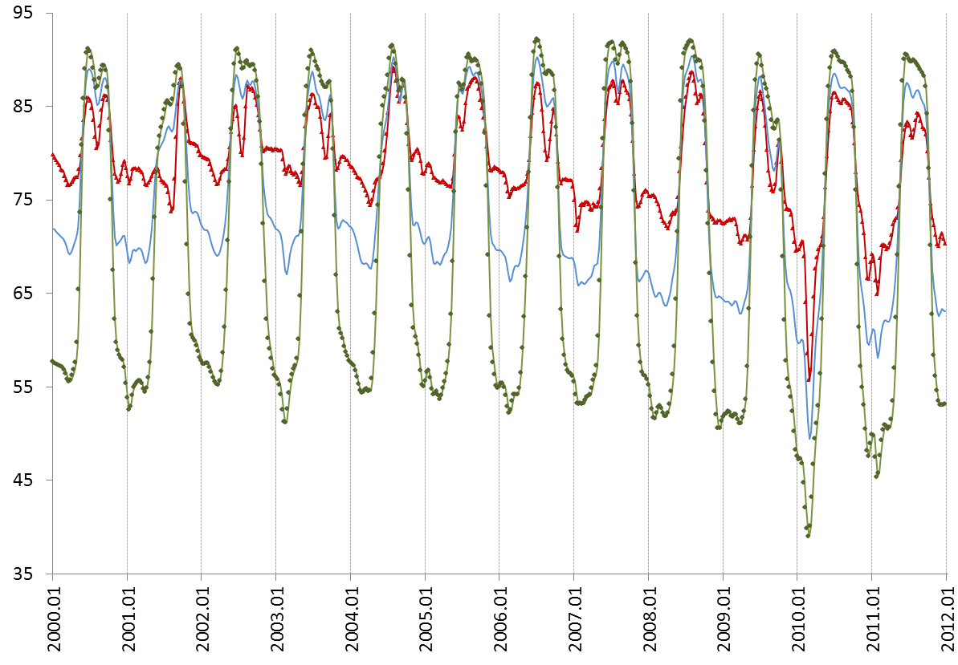
Land Surface Phenology of Great Smoky Mountains National Park
A 12-Year NDVI Time Series for Three Forest Types at
4,000-4,999 ft. Elevation within the Park
NDVI *100
Deciduous (n=4,503)
Mixed (n=4,193)
Evergreen (n=42)

Slide 5
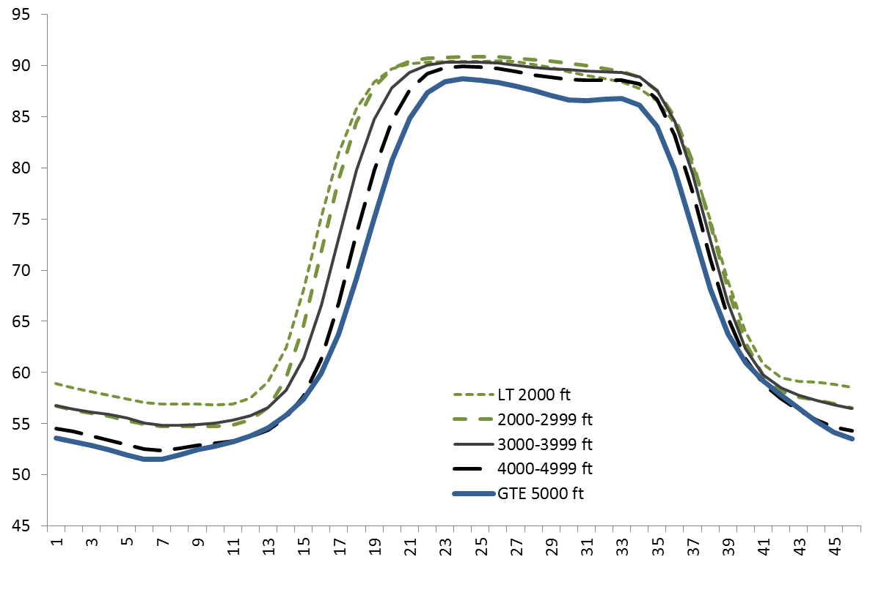
Land Surface Phenology of Great Smoky Mountains National Park
Mean 2000-2011 Phenological Curves of the Deciduous
Forest Type By Elevation
NDVI *100
n=632
n=5,075
n=7,606
n=4,503
n=214

Slide 6
Land Surface Phenology of Great Smoky Mountains National Park
Mean 2000-2011 Phenological Curves of the Deciduous
Forest Type By Elevation
Summer productivity generally decreases with elevation
About 3 week difference in greenup in the Spring
Fall shows less elevational variation
Growing season length decreases with elevation
NDVI *100
n=632
n=5,075
n=7,606
n=4,503
n=214

Slide 7
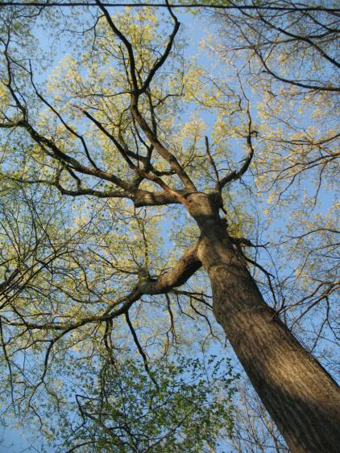
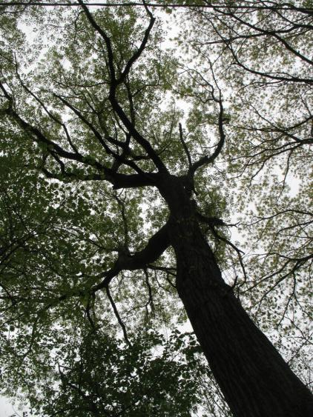
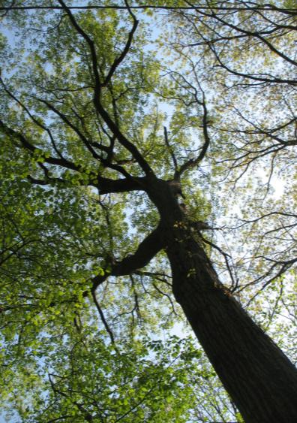
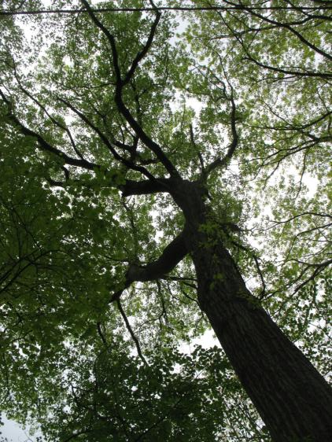
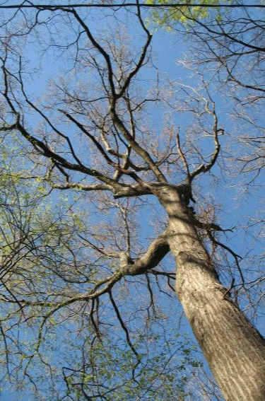
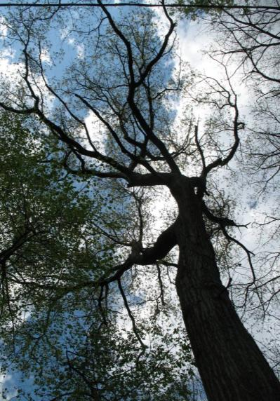
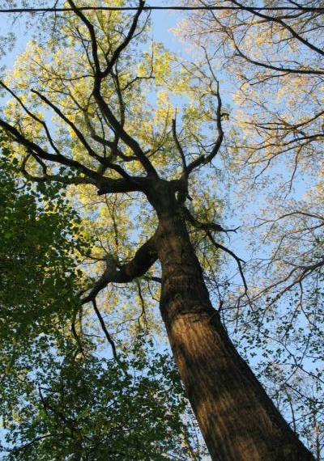
04-13
04-20
04-22
04-26
2010
Asheville
Scarlet Oak
2009
04-17
04-24
04-27

Slide 8
04-13
04-20
04-22
04-26
2010
Asheville
Scarlet Oak
2009
04-17
04-24
04-27

Slide 9
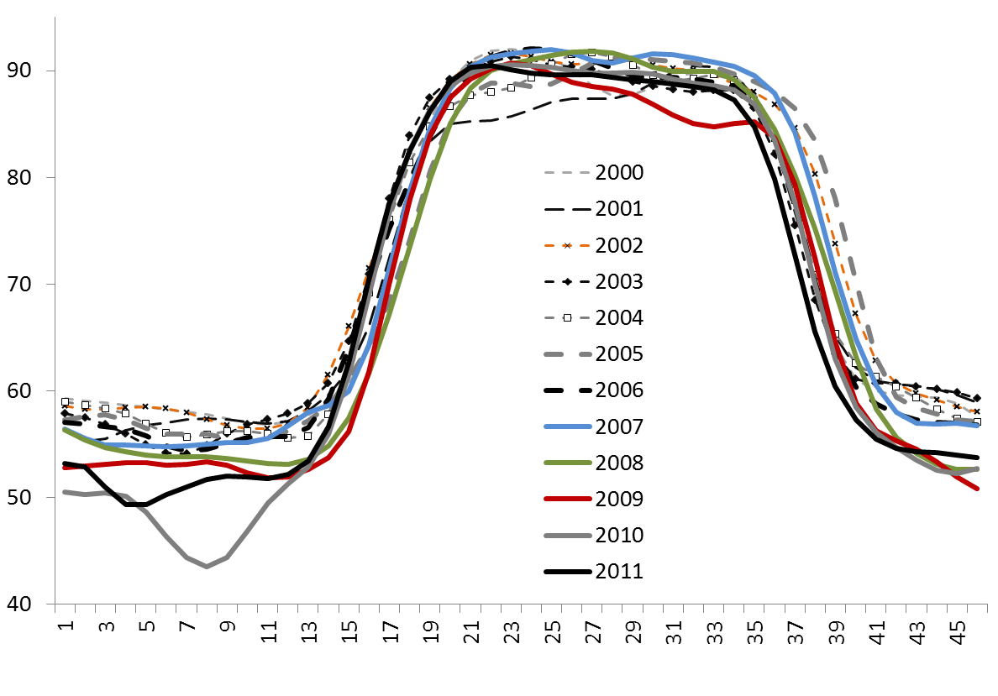
Land Surface Phenology of Great Smoky Mountains National Park
Yearly Variation in Phenology of the Deciduous Forest Type
Across All Elevations
Greater inter-year variability in Fall
n=18,030 MODIS cells

Slide 10
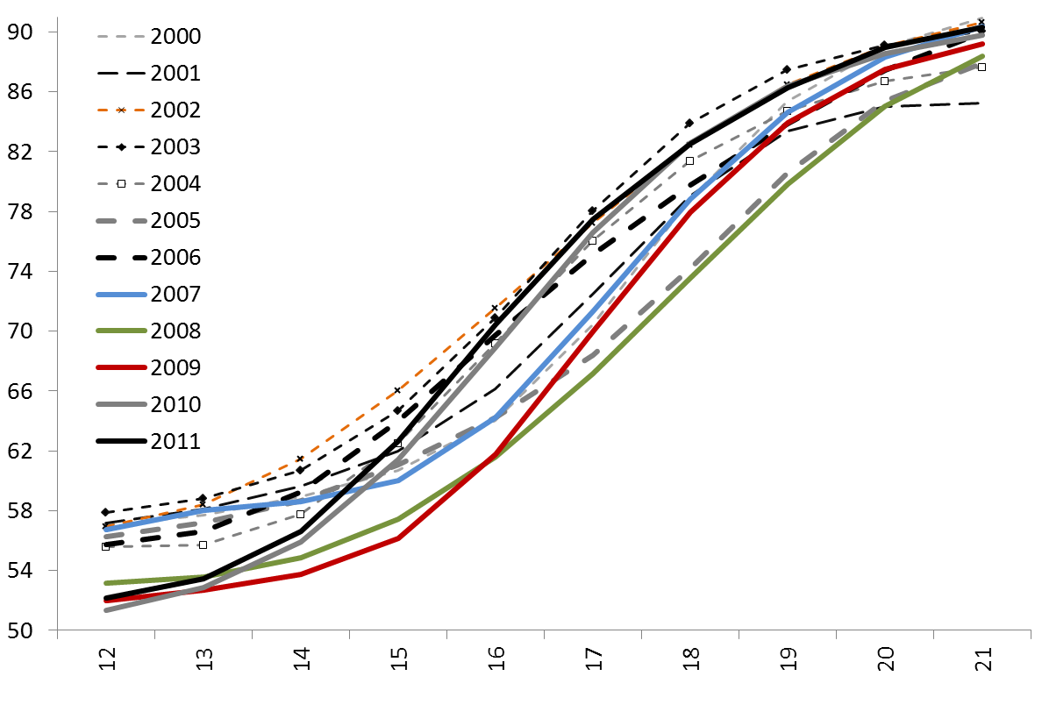
Land Surface Phenology of Great Smoky Mountains National Park
Mean Greenup of Deciduous Forest Type Across All Elevations
NDVI *100
n=18,030 MODIS cells

Slide 11
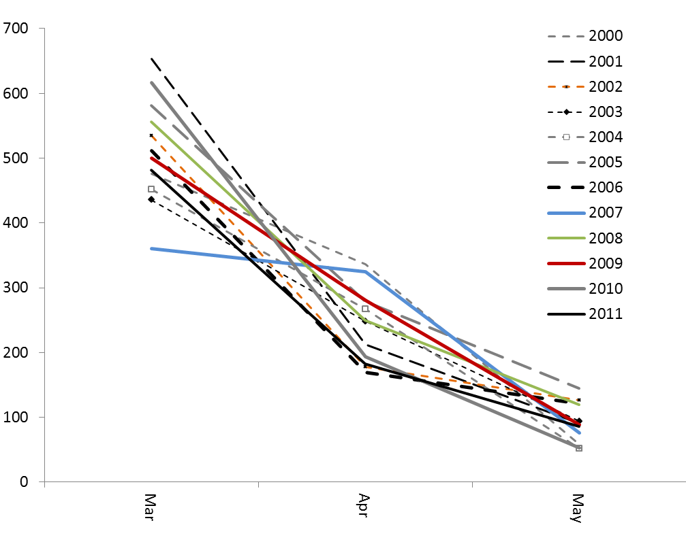
Land Surface Phenology of Great Smoky Mountains National Park
Heating Degree Days for Western NC and Eastern TN
(Average of NCDC Climate Division TN 1 and NC 1)
Heating Degree Days
Warm Cold
March April May

Slide 12
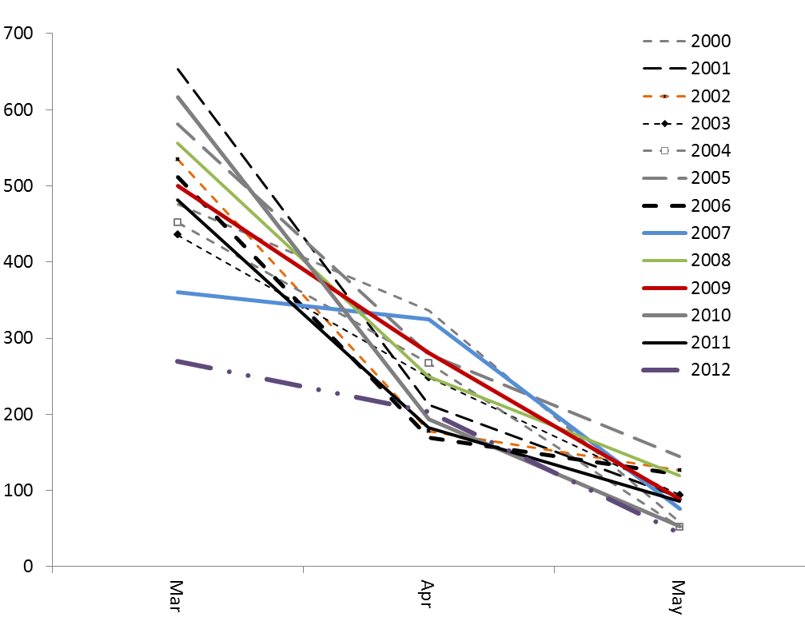
Land Surface Phenology of Great Smoky Mountains National Park
Heating Degree Days for Western NC and Eastern TN
(Average of NCDC Climate Division TN 1 and NC 1)
Heating Degree Days
Warm Cold
2012
March April May

Slide 13
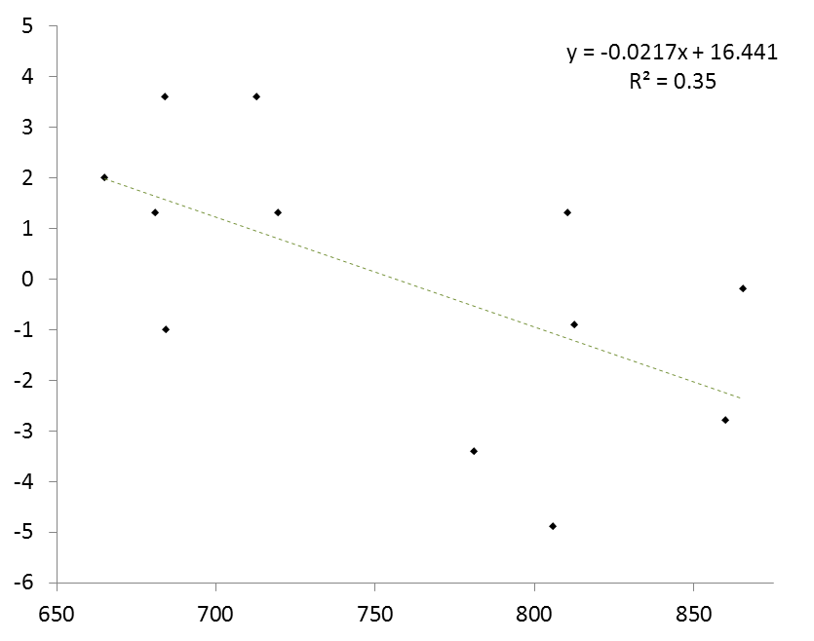
Land Surface Phenology of Great Smoky Mountains National Park
Comparison of Heating Degree Days and Spring Greenup Departure for the Deciduous Forest Type, 2000-2011
2003
2002
2011
2004
2010
2006
Departure from 2000-2011 Mean NDVI
For Spring (ForWarn Periods 14-19)
2001
2007
2000
2009
2005
2008
2012 had only 474 HDD
Cumulative Heating Degree Days, March and April

Slide 14
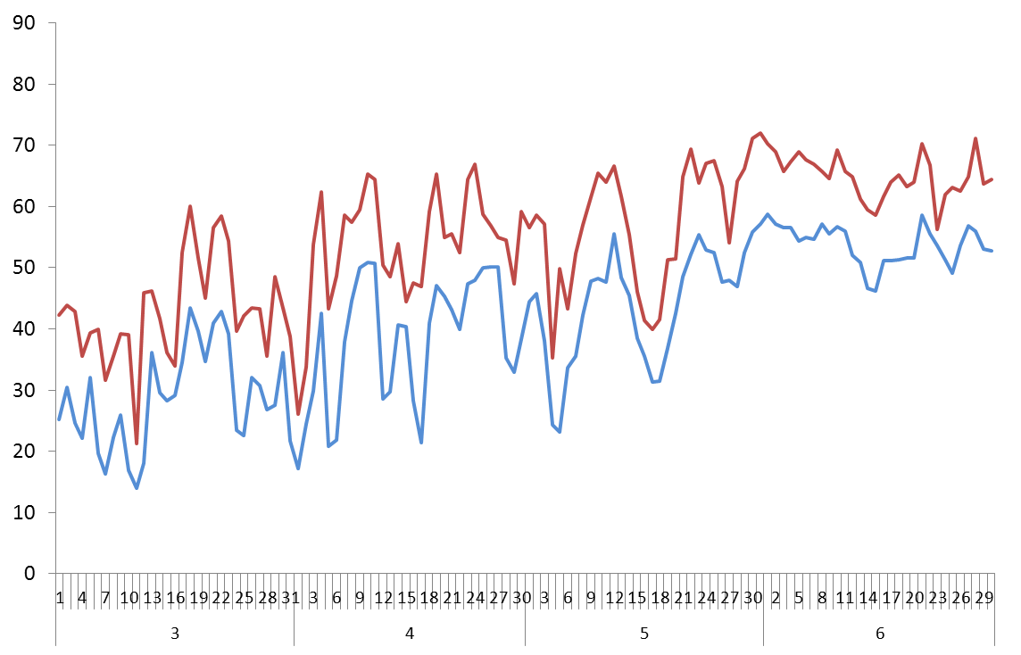
Land Surface Phenology of Great Smoky Mountains National Park
Daily Temperatures during early 2011 on Mount Mitchell (MITC 6,200 ft.)
Daily maximum 2011
Daily minimum 2011
Temperature (F)
Freezing
March April May June

Slide 15
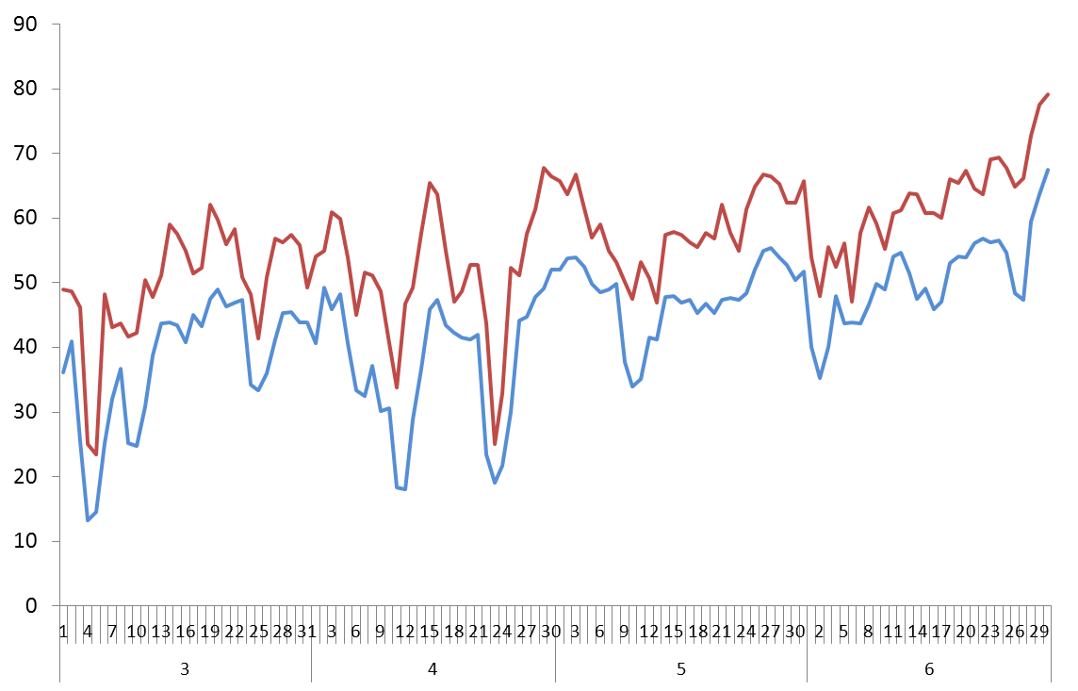
Land Surface Phenology of Great Smoky Mountains National Park
Daily Temperatures during early 2012 on Mount Mitchell (MITC 6,200 ft.)
Daily maximum 2012
Daily minimum 2012
Temperature (F)
Freezing
25ºF max
19ºF min
April 23
18ºF min
April 12
March April May June

Slide 16
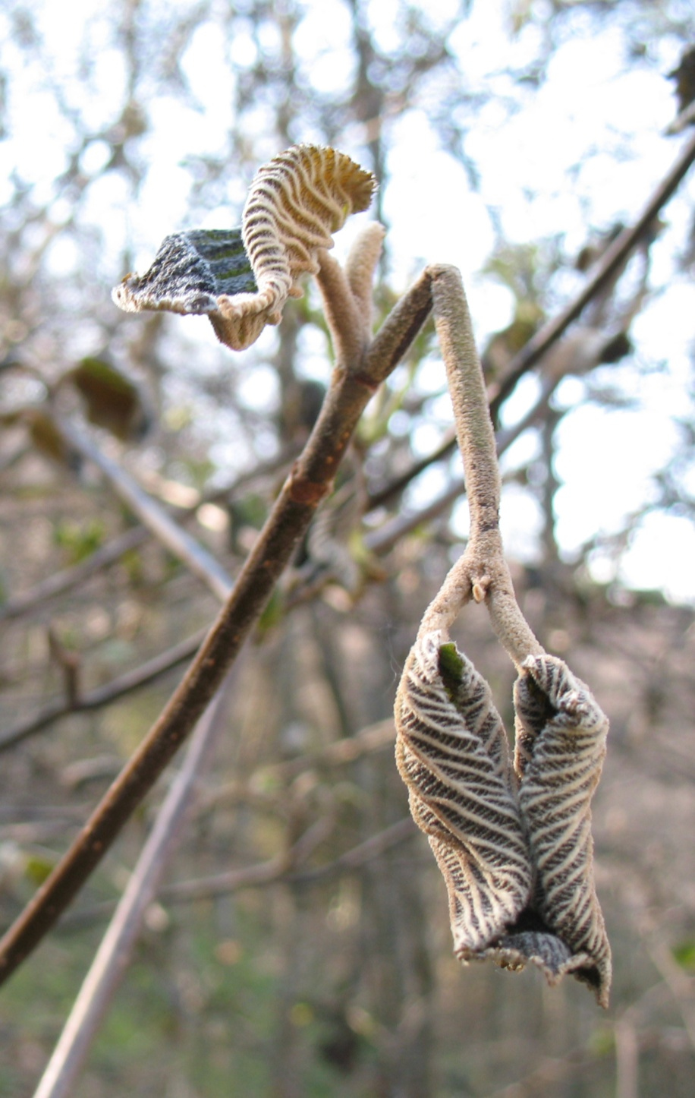
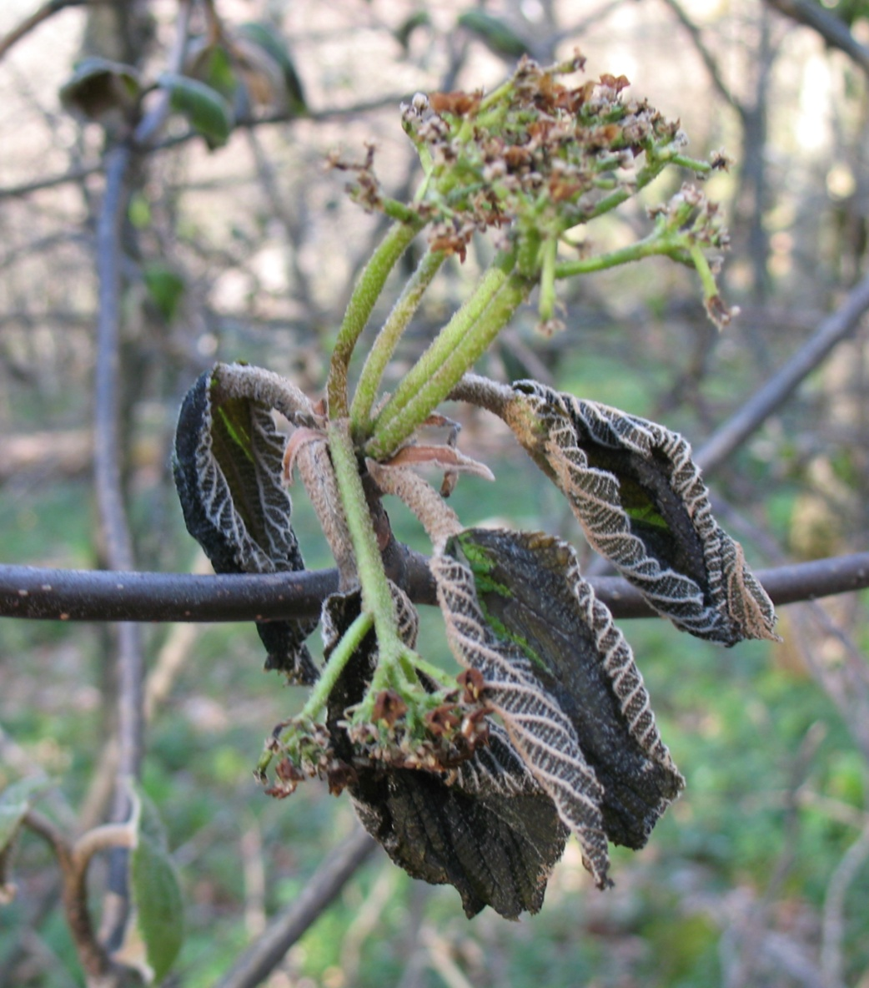
Selected effects of an anomalously warm March and April Frost along the Snowball Trail (4,950ft.), Pisgah N.F.
(photos taken 4/27/2012 by SPN)
Hobblebush viburnum

Slide 17
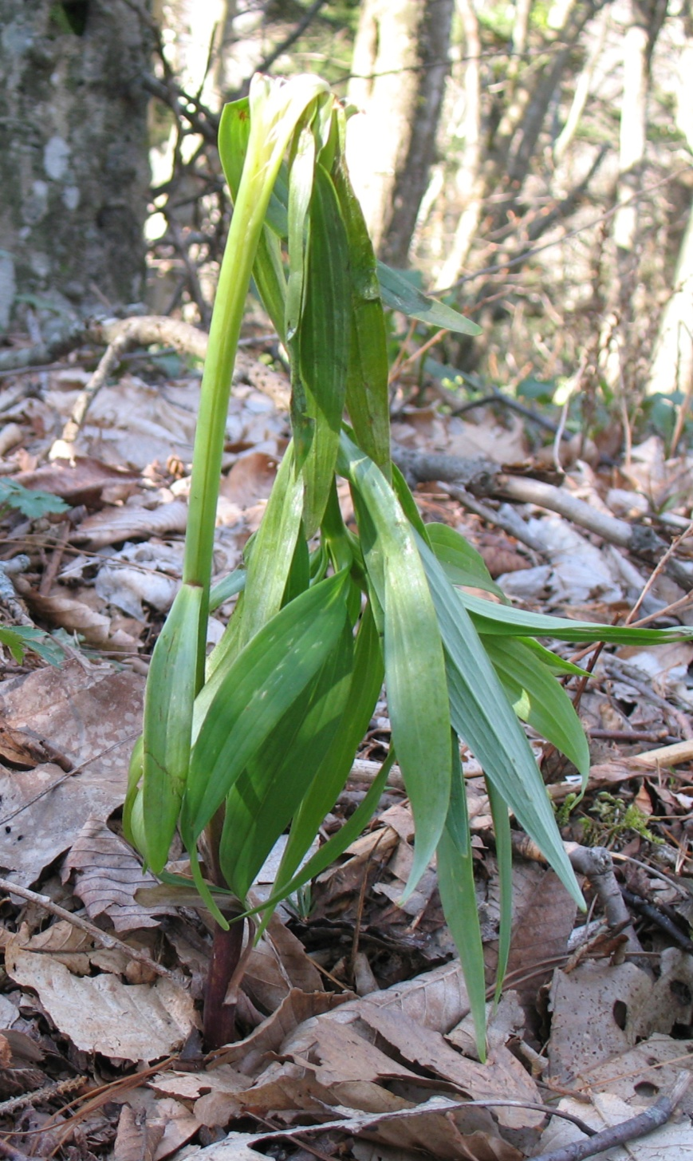
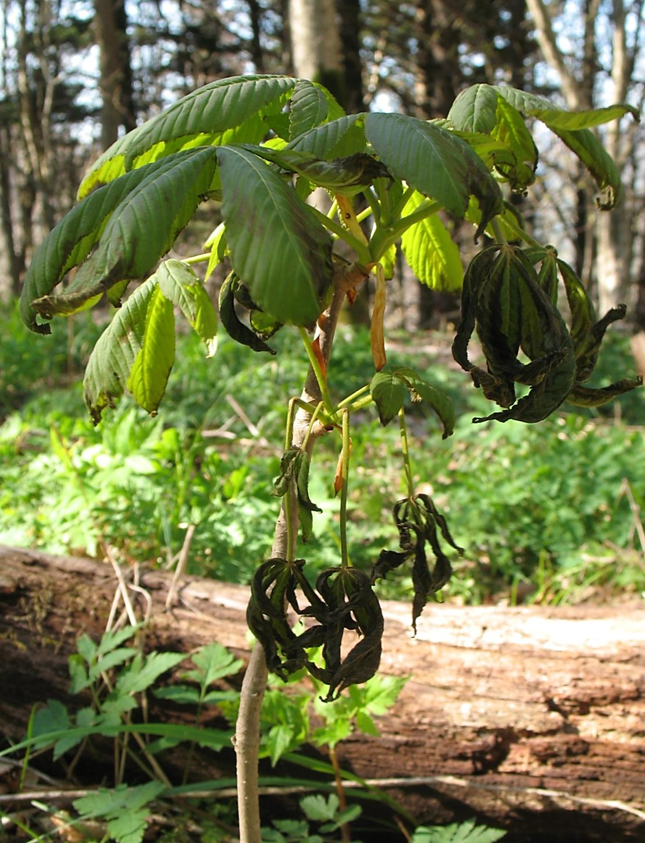
Yellow Buckeye
Turk’s Cap Lily

Slide 18
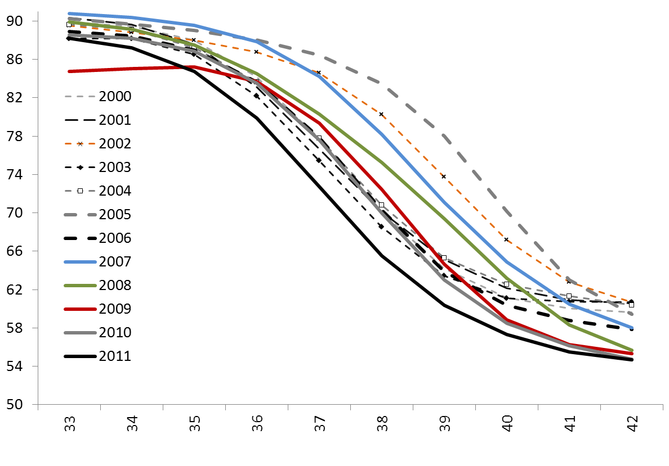
Land Surface Phenology of Great Smoky Mountains National Park
Mean NDVI Reduction of Deciduous Forest Type During Fall
Across All Elevations
NDVI *100
n=18,030 MODIS cells

Slide 19
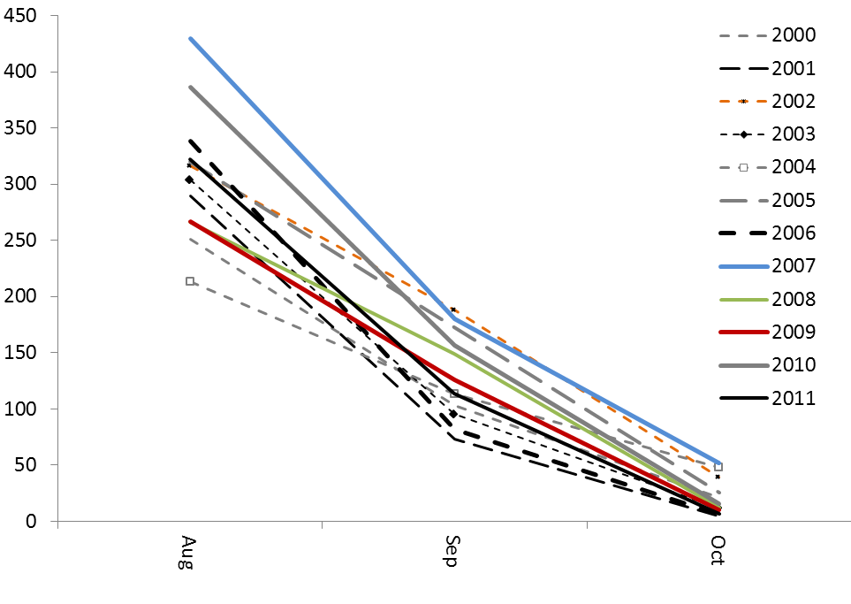
Land Surface Phenology of Great Smoky Mountains National Park
Cooling Degree Days for Western NC and Eastern TN
(Average of NCDC Climate Division TN 1 and NC 1)
Cooling Degree Days
Cold Warm
August September October

Slide 20
Land Surface Phenology of Great Smoky Mountains National Park
Cooling Degree Days for Western NC and Eastern TN
(Average of NCDC Climate Division TN 1 and NC 1)
2012
Cooling Degree Days
Cold Warm
August September October

Slide 21
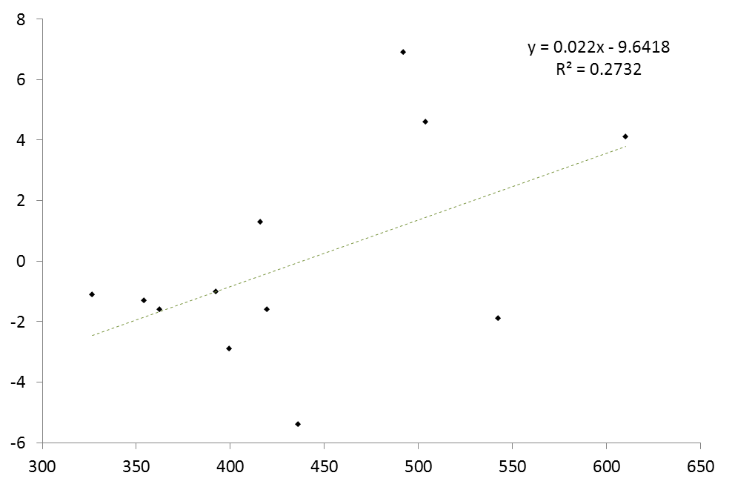
Land Surface Phenology of Great Smoky Mountains National Park
Comparison of Cooling Degree Days and Fall Decline Departure for the Deciduous Forest Type, 2000-2011
2005
2002
2007
Departure from 2000-2011 Mean NDVI
For Fall (ForWarn Periods 35-39)
2008
2000
2004
2009
2001
2006
2010
2003
2011
2012 had
355 HDD
Cumulative Cooling Degree Days, September and October

Slide 22
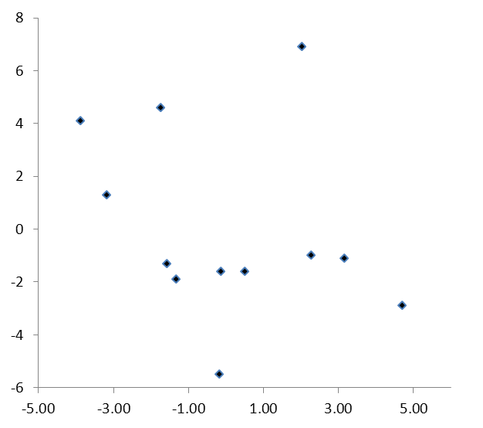
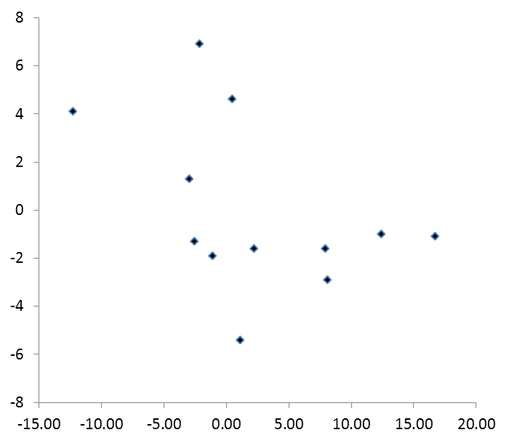
Land Surface Phenology of Great Smoky Mountains National Park
Comparison of Drought Indices and Fall Decline Departure for the Deciduous Forest Type, 2000-2011
Palmer Modified Drought Index
(PMDI)
Palmer Z Index (ZNDX)
(Monthly Moisture Anomaly Index)
Hypothetical
relationship
Hypothetical
relationship
Fall NDVI departure
PMDI August-September
ZNDX August-September
Climate Divisions TN 1 and NC 1 were averaged

Slide 23
Land Surface Phenology of Great Smoky Mountains National Park
Comparison of Drought Indices and Fall Decline Departure for the Deciduous Forest Type, 2000-2011
Palmer Modified Drought Index
(PMDI)
Palmer Z Index (ZNDX)
(Monthly Moisture Anomaly Index)
2005
2007
2006
Fall NDVI departure
2004
2003
2011
PMDI August-September
ZNDX August-September
Climate Divisions TN 1 and NC 1 were averaged

Slide 24
Land Surface Phenology of Great Smoky Mountains National Park
Timing of Spring and Fall for Deciduous Forests Compared to
the 12-Year Mean
YEAR | Spring (Mean of Periods 14-19) | Fall (Mean of Periods 35-39)
2000 | -0.9 Late | -1.3 Early
2001 | -0.2 Late | -1.6 Early
2002 | 3.6 Early | 4.6 Late
2003 | 3.6 Early | -2.9 Early
2004 | 1.3 Early | -1.1 Early
2005 | -2.8 Late | 6.9 Late
2006 | 1.3 Early | -1.6 Early
2007 | -1.0 Late | 4.1 Late
2008 | -4.9 Late | 1.3 Early
2009 | -3.4 Late | -1.0 Early
2010 | 1.3 Early | -1.9 Early
2011 | 2.0 Early | -5.4 Early
 | Fall Early | Fall Late
Spring Early | 5 | 1 | 6
Spring Late | 4 | 2 | 6
 | 9 | 3 | 12

