Slide 1
Eastern Threat Center Special Emphasis Areas
United States Department of Agriculture
Issues, Research, and Impacts
Forest Monitoring
Forest Service
Eastern Forest Environmental Threat Assessment Center

Slide 2
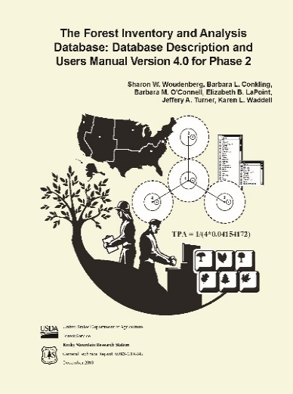
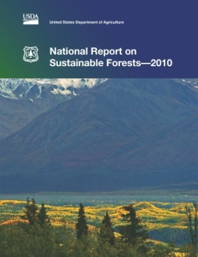
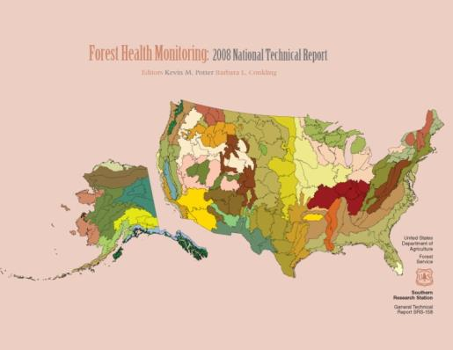
EFETAC Supports FHP and FIA National Monitoring Programs
EFETAC focus on national client needs:
Develop & improve monitoring and assessment techniques (FHTET, FHM & FIA)
Implement new techniques in USFS National assessments (FHM, FIA, RPA, others)
Produce National Status & Trends Report (FHM)
Additional roles played by EFETAC:
FHM Management Team
FIA Documentation Teams (Field Guide, FIADB Manual)
RPA (4)
FIA (2)
~20 years
Sustainability (2)
FHM (15)
Notes:
2
EFETAC has a long history of supporting forest monitoring, going back to the 1990’s when part of EFETAC was the headquarters of the Forest Health Monitoring Program.
EFETAC’s roles in forest monitoring have expanded since those days, but there remains a core commitment to support Forest Service operational forest monitoring, particularly FIA and FHM, as well as a commitment to research to support technical teams such as the Forest Health Technology Enterprise Team.
Today, the EFETAC is asked to partner with the national monitoring efforts in three specific ways.
First, EFETAC develops and improves techniques that are in use by ongoing monitoring programs.
Second, EFETAC participates in national reports prepared by its partners.
Third, EFETAC is responsible for compiling, editing, and producing the annual National Status and Trends report for FHM.
In addition, EFETAC serves on the FHM national management team, and continues to participate in the documentation of monitoring protocols through membership on the FIA field guide and database teams.

Slide 3
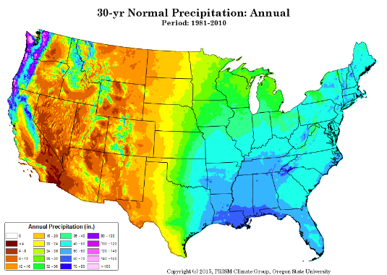
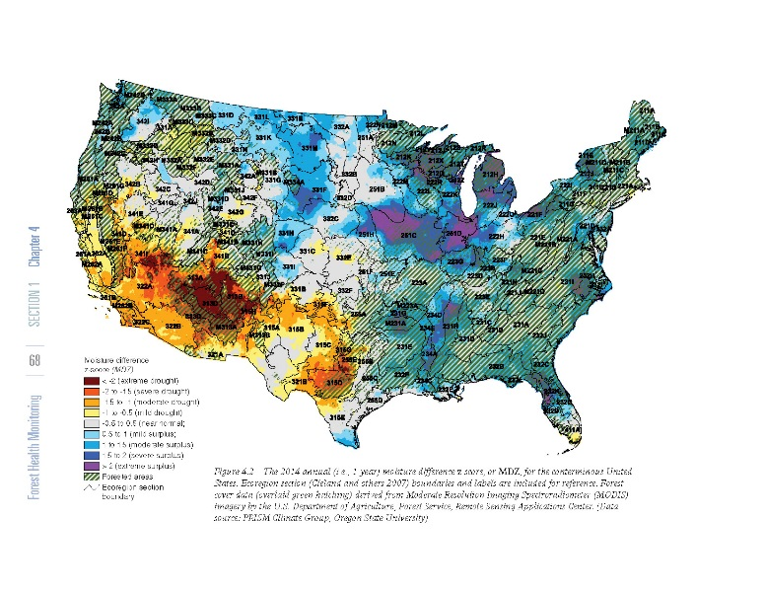
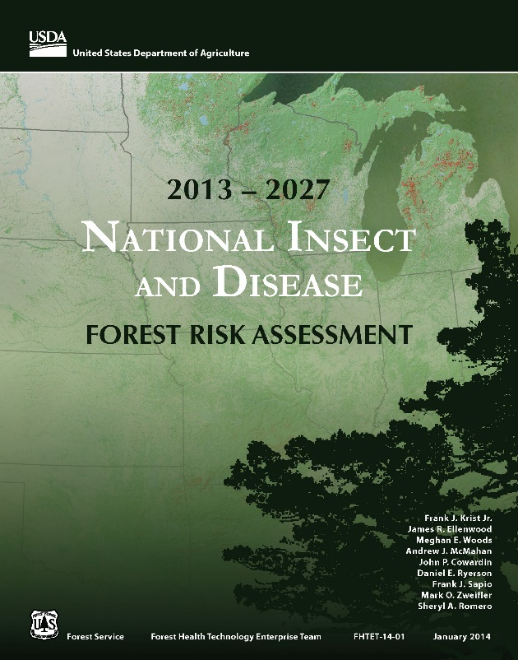
Research Extends Forest Monitoring
by Improving Interpretation of Existing Data
PRISM (weather/climate)
EFETAC Research
An improved method for standardized mapping of drought conditions
The risk models in the FHTET Forest Risk Assessment use EFETAC drought mapping methods
Notes:
One example of how EFETAC research contributes directly to FHTET goals is the National Risk Assessment. Many of the risk models that were used by FHTET to develop the risk assessment required information about drought conditions. While programs such as PRISM collect and summarize data, that data was not tailored to the needs of forest risk assessment models. EFETAC helped by developing a method to standardize drought information and map drought conditions and projections for the United States.

Slide 4
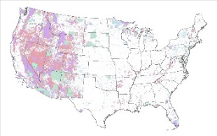
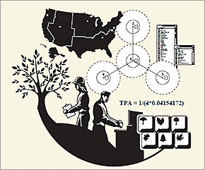
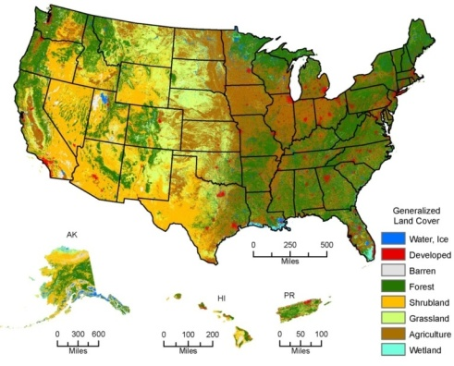
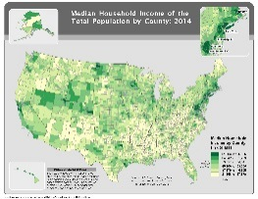
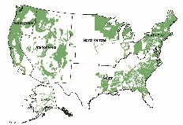
Integration Extends Forest Monitoring
by Adding Value to Existing Data
Protected
area
What are the USFS roles (NFS & SPF) in conserving or restoring unfragmented forest habitat?
Forest
inventory
Land cover
FS lands have the lowest rate of fragmentation, but most of the unfragmented forest is privately-owned
Census
What are the socio-economic impacts of forest pests? (EGM & MPB)
Insect &
disease survey
East: middle class
West: upper middle class
Notes:
Even if a lot of funding is devoted to collecting forest monitoring data, it always makes sense to use freely-available data from other sources to add value to the forest monitoring data.
The first example illustrates how forest inventory data is integrated with maps of land cover and protected areas, in this case to evaluate the status and trends of forest fragmentation on forestlands with different owners. This analysis, which appears in the 2015 RPA report, showed that while Forest Service lands have relatively low rates of forest fragmentation, most the unfragmented forest area is in private, non-industrial ownership. This information, when combined with similar information about the types and locations of forests which are fragmented, can help inform USFS policies and investments designed to conserve or restore forest conditions.
(Frank Koch has either already talked about this next example, or he will subsequently talk about it).
The second example illustrates integrating census data and data from insect and disease surveys to evaluate the socio-economic impacts of forest pests such as Eastern Gypsy Moth and Mountain Pine Beetle. In this example, impacts appear to be more of a middle-class problem in the east, and an upper middle-class problem in the west. These preliminary results could help the Forest Service develop ways to address issues of environmental equity in a socio-economic context.

Slide 5
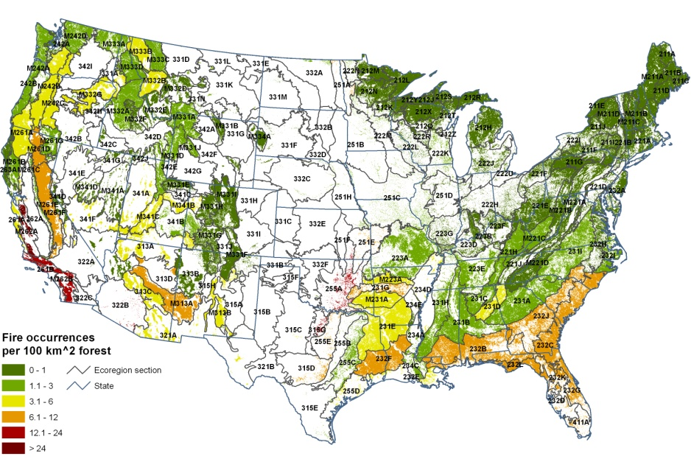
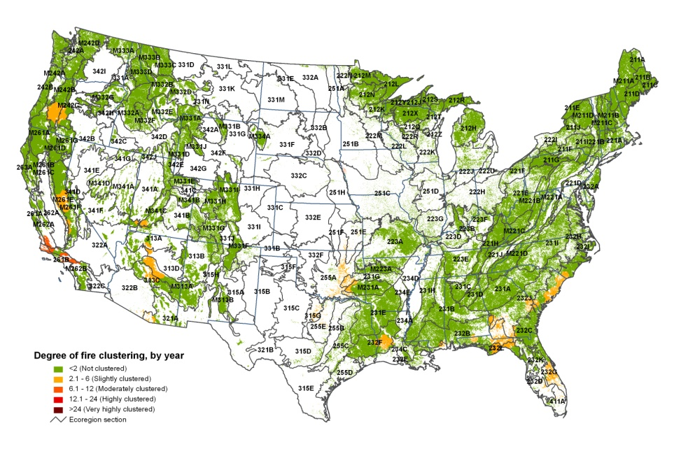
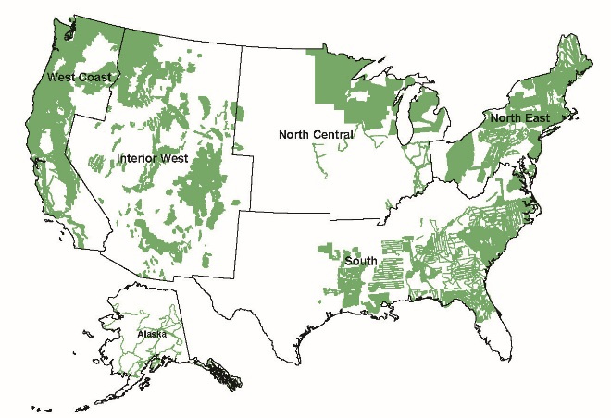
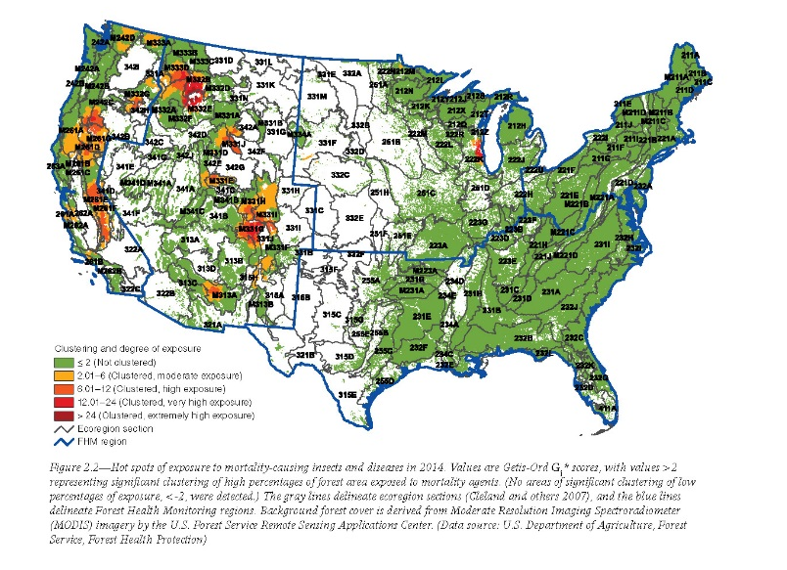
Synthesis Adds Value to Forest Monitoring Data
Fire occurrence
Geographic clusters of fire occurrence
“Hotspot”
Analyses
Hotspots in space and time
Insect & disease survey
Geographic clusters of bark beetles
Notes:
There is one additional example of how EFETAC can add value to forest monitoring data. Fire occurrence is obviously monitored very closely all the time, and there are annual insect and disease surveys. These national datasets are most often reported as tables or maps of the area of forest that is affected. In this example, EFETAC adds value by conducing space-time hotspot analysis so that forest managers can visualize the specific locations where fire or pests appear in unusually large clusters. In both cases, there was no need to conduct research to figure out how to find the clusters. The role of EFETAC was to collate the source data, perform well-known methods, and produce the assessment. EFETAC conducts these particular analyses every year as part of the FHM national status and trends report.

Slide 6
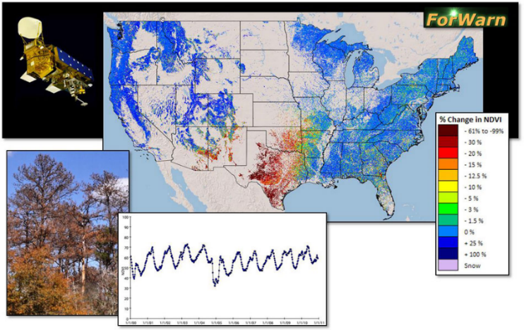
A national-scale near real-time "eye-in-the-sky" satellite-based recognition and tracking system for forest disturbances
ForWarn covers the entire lower 48 United States. Generates new potential vegetation disturbance maps every 8 days, even throughout the winter
Detects most types of forest disturbances, including:
insects, diseases, wildfires, ice and frost damage, tornadoes, hurricanes, blowdowns, harvest, urbanization and landslides - monitors all terrestrial vegetation
Began in January 2010, but retrospective ForWarn products have been created back through 2006 - Custom-generated products
Funded by both EFETAC and WWETAC, ForWarn is the result of an ongoing, substantive cooperation among USDA, NASA, USGS, and DOE
ForWarn resolution
232 meter map cells (about 13 acres)

Slide 7
ForWarn and ADS
In 2011, airborne observers from the FHM Aerial Disturbance Survey (ADS) program cover about 70% of forests within the lower 48 United States once with visual observations from light aircraft
The ForWarn System covers nearly 100% of forests within the lower 48 United States every 8 days
The two systems are complementary --
ForWarn is coarse-scaled but automated, extensive and repeated frequently
Aerial Surveys are finer-scaled but require experienced observers, are labor-intensive and expensive, are a safety risk, limited in extent and usually conducted once a year
The two systems can support each other well

Slide 8
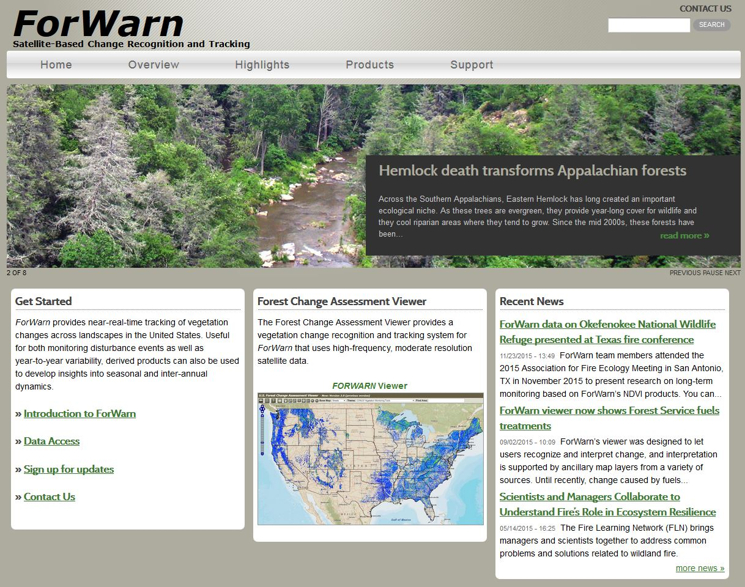
Two main parts of ForWarn, the Website/production system and the Viewer/delivery system
Website includes
Overview of forest assessment & monitoring
Highlights of notable disturbances
Training & support materials
Data access methods & tips

Slide 9
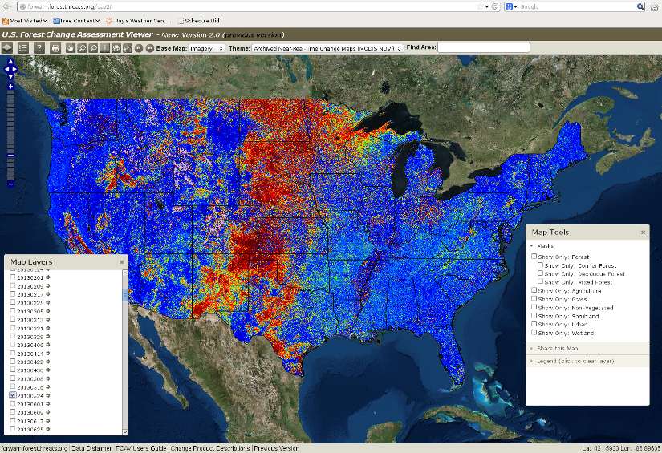
The Forest Change Assessment Viewer is the main delivery vehicle for ForWarn products - Implemented by our Partners at the National Environmental Modeling and Analysis Center (NEMAC) – http://forwarn.forestthreats.org/fcav2
Open to anyone, runs on any computer
Shows the most recent ForWarn disturbance maps and all historical products
Shows many other relevant maps, including Forest Disturbance Monitor (FDM) maps
Can be pulled into a Desktop GIS system
Resource managers (and anyone else!) can see the newest national disturbance maps at the same time the Threat Centers do, using the same tools that we use

Slide 10
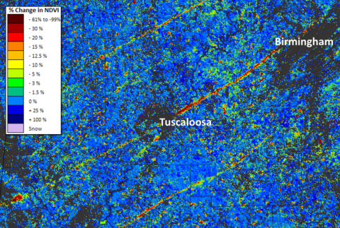
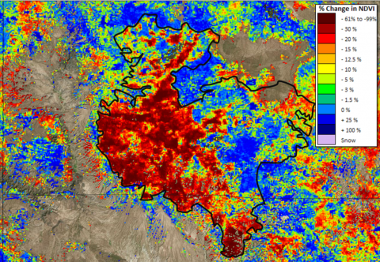
How Does it Work?
Compares current versus normal or expected “healthy” greenness, based on the 15-year historical MODIS satellite record
Locations that are currently less-green than expected are marked as potentially disturbed
Locations having more actual greenness than we expected may represent vigorous or recovering vegetation
The expected normal value is both spatially customized for every map cell and temporally customized appropriately for vegetation growing at this time and location
Tornado
Wildfire

Slide 11
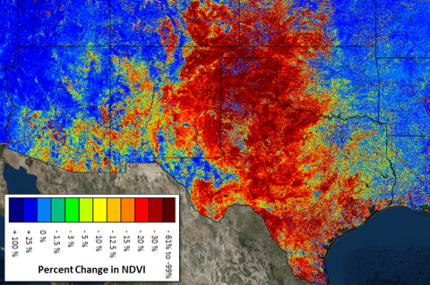
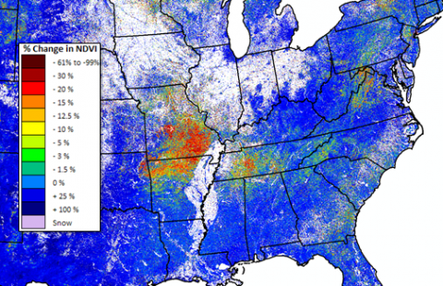
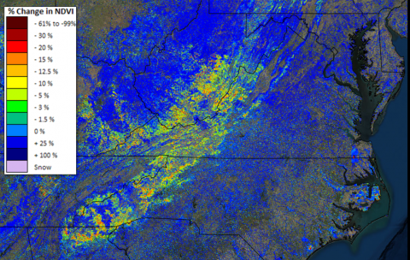
Difference Products – Show both areas of vegetation disturbance and recovery
Less than 100% of expected greenness = Potential Disturbances -- mapped as Greens, Yellows, and Reds
Greater than 100% of expected greenness = Vegetation Regrowth or Recovery -- mapped as Blues
Sees disturbances directly through the behavior of the vegetation itself
Only shows a Disturbance if it affects the plants - and to the degree that it affects the plants
Shows weather and climate departures as well as “classical” forest disturbances: Heat, Cold, Drought, Flooding
Drought
Hard Freeze
Late Spring

Slide 12
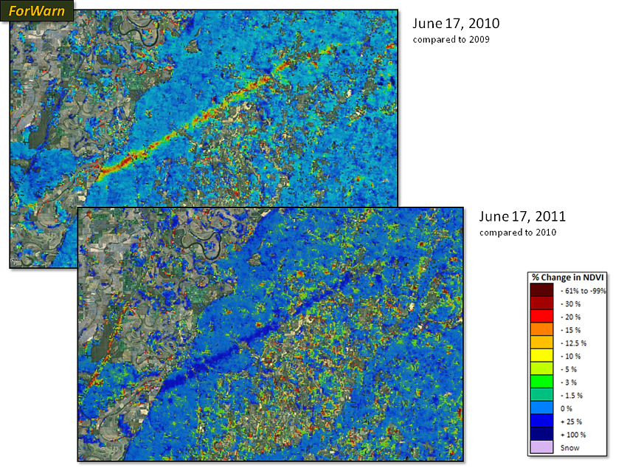
ForWarn Forest Change Products
“Normal” over what period? We provide a spectrum of products so that ForWarn users can select the definition of normal that is most appropriate for their purposes
Relative to a one-year baseline, vegetation is regrowing within the Yazoo, MS tornado track. ForWarn can easily track such recovery, and the rate of recovery is highly variable

Slide 13
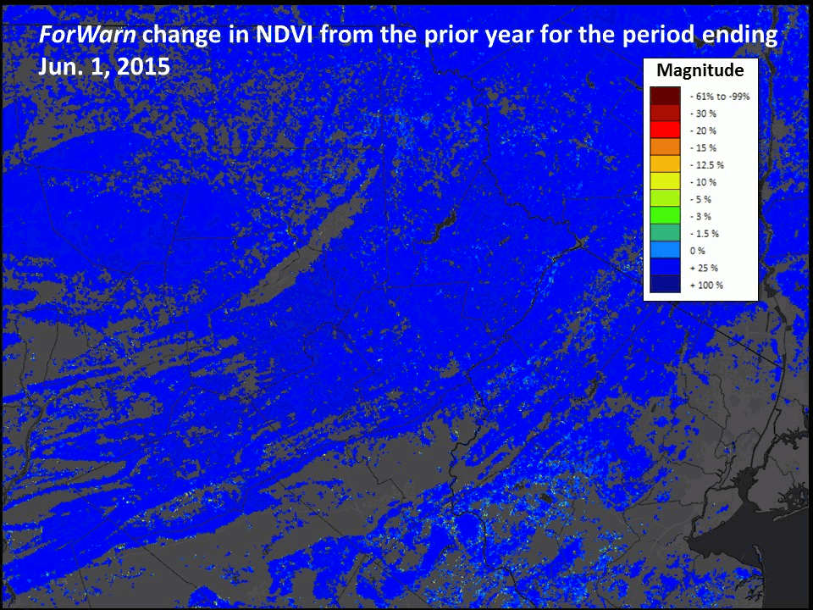
Hundreds of such ForWarn monitoring examples over 7 years from which to choose

Slide 14
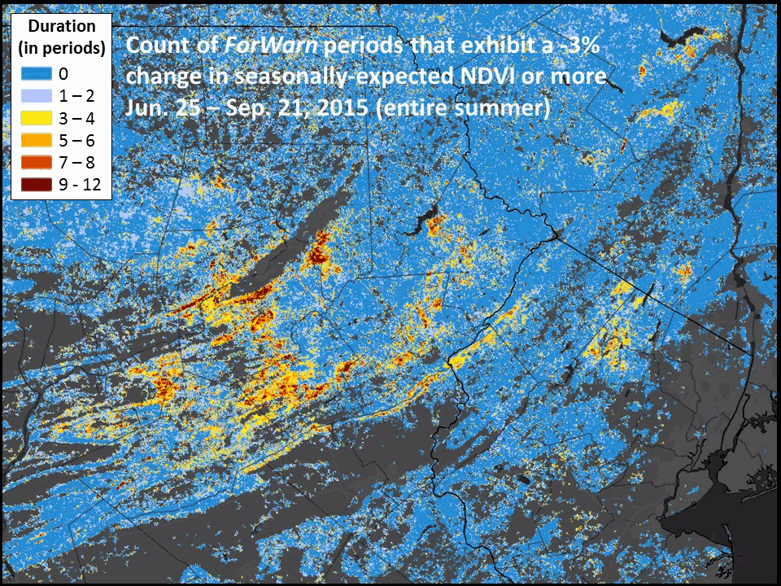
There is No Truth, but both omission and commission differences can be seen

Slide 15
ForWarn Alerts
When new ForWarn disturbances are seen, the ForWarn Team issues email alerts to notify managers at that location – providing a disturbance “smoke alarm”
Alerts contain a Share-This-Map URL, when clicked, launches the Assessment Viewer showing them this disturbance – Facilitates communication with the ForWarn Team. Alerts also contain a best-guess attribution as to the cause of the disturbance
To whom? Federal, State, and/or County points-of-contact – All Lands, not just Federal
Selective, to entomologists for suspected insect disturbances, to plant pathologists for plant diseases
Relevant FHM Regional Program Manager is always included
What happens? No response is necessary, but we ask for confirmation of the disturbance and the causal agent

Slide 16
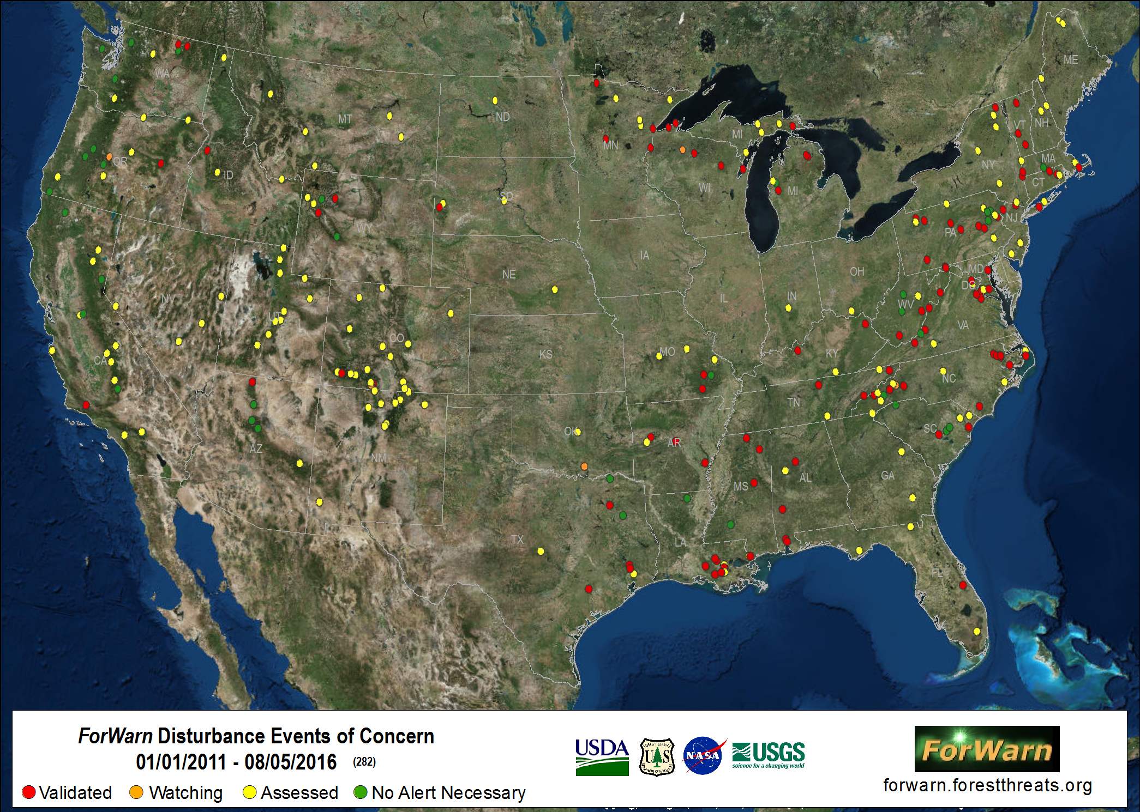
Alert recipients often are impressed, and start watching the ForWarn Viewer themselves -
Often become committed ForWarn users themselves - ForWarn establishes a working, two-way partnership with ever-growing numbers of forest managers across the United States, looking over their shoulders as they monitor their own forests

Slide 17
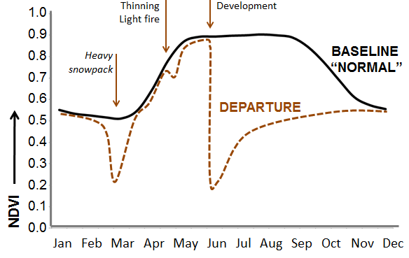
ForWarn Future Directions
Automated Disturbance Recognition - We currently use direct visual inspection to find disturbed locations
Automated Attribution of Causal Agents - Bayesian Statistics
Automated Issuance of Alerts
Not just Disturbance Magnitude, but also Disturbance Duration
Magnitude x Duration = Vegetation Health Impact
Developing New Disturbance Duration and “Area Under the Greenness Curve”
Products to directly show Vegetation Health Impacts and Status

Slide 18
ForWarn: What We Have Learned
Several Surprises during ForWarn’s 7-year history:
ForWarn works well for its Near-Real-Time raison d’etre
BUT also very useful for other, non-NRT purposes:
Disturbance Recovery and Speed of Recovery
Recovery Times – from Ephemeral to Never
simple leaf-stripping by wind or hail to the Hayman Wildfire
Re-Balances the Over-Emphasis on Initial Development of Disturbances
Likelihood of Occurrence x Duration of Impact = Management Concern
Data About Both Terms is Necessary for Risk-Based Management
Value for Long-Term Monitoring: Invasions, Succession, Land Use Conversion, Management Implications, Resilience, Landscape Analysis

