Slide 1
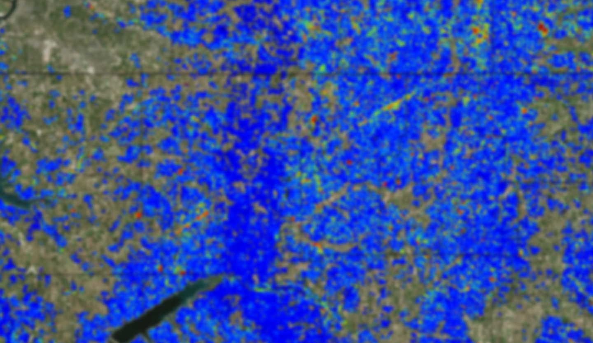
ForWarn Update – February, 2016 USDA Forest Service, Southern Research Station forwarn.forestthreats.org
‘Early Detect’ Highlight
Ancillary Data Layers
New Masks
‘Persistence Product’
2016 SGSF GIS Committee Annual Meeting
February 9-11, 2016 Columbia, SC

Slide 2
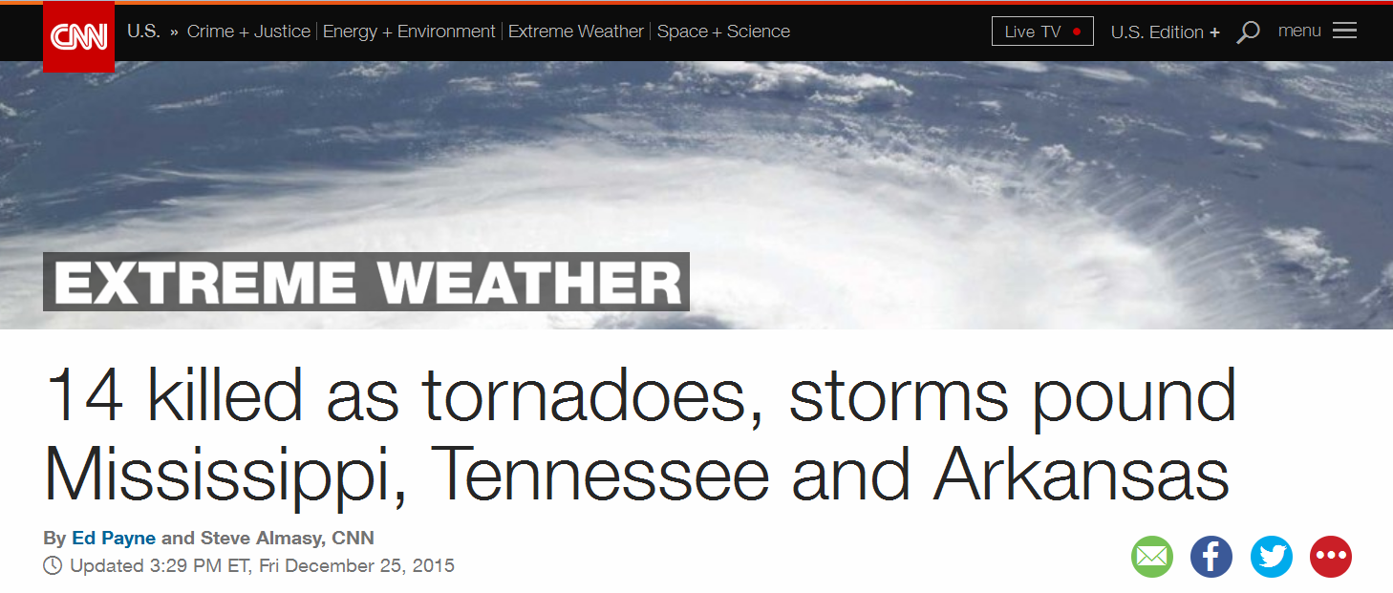
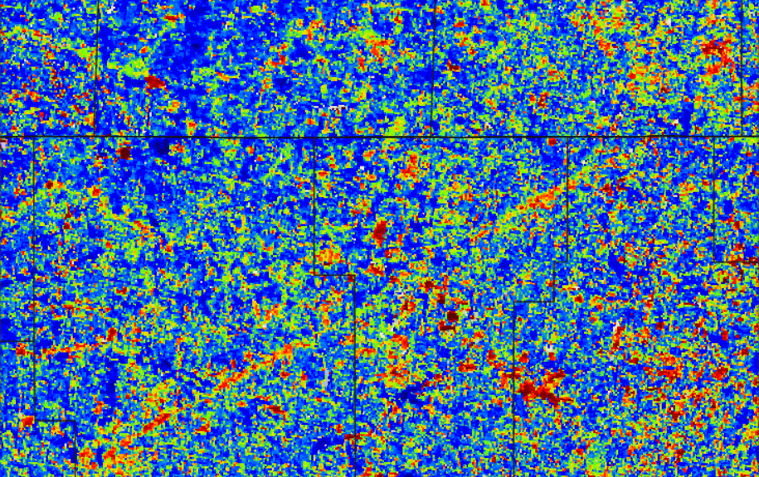
2015 Christmas Eve Tornado, northern MS
“Early Detect” Product date ending January 8, 2016

Slide 3
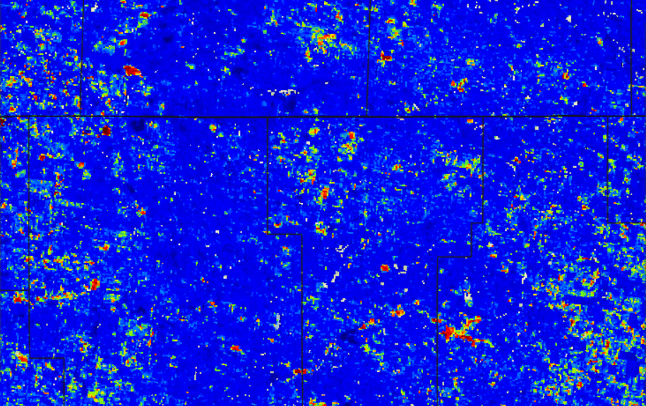
2015 Christmas Eve Tornado, MS
“1yr Baseline” Product date ending January 8, 2016

Slide 4
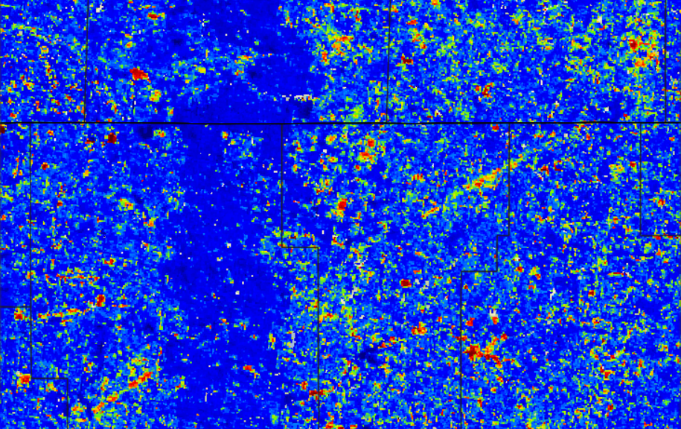
2015 Christmas Eve Tornado, MS
“1yr Baseline” Product date ending January 16, 2016

Slide 5
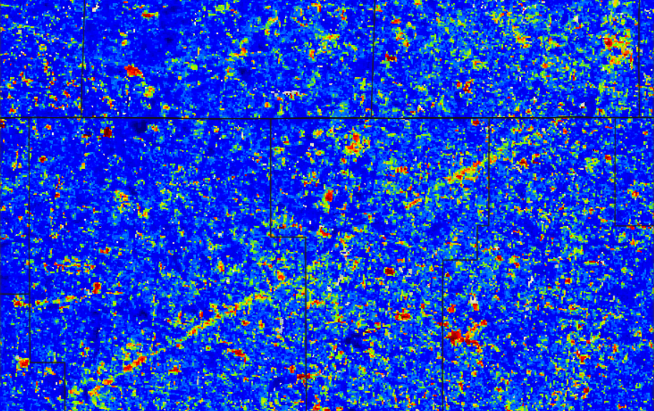
2015 Christmas Eve Tornado, MS
“1yr Baseline” Product date ending January 24, 2016
Benefit: The ‘Early Detect’ product can display forest disturbance is as few as (1) 8-day image period, instead of three image periods (24-days) as with the standard 1-year baseline forest change product.

Slide 6
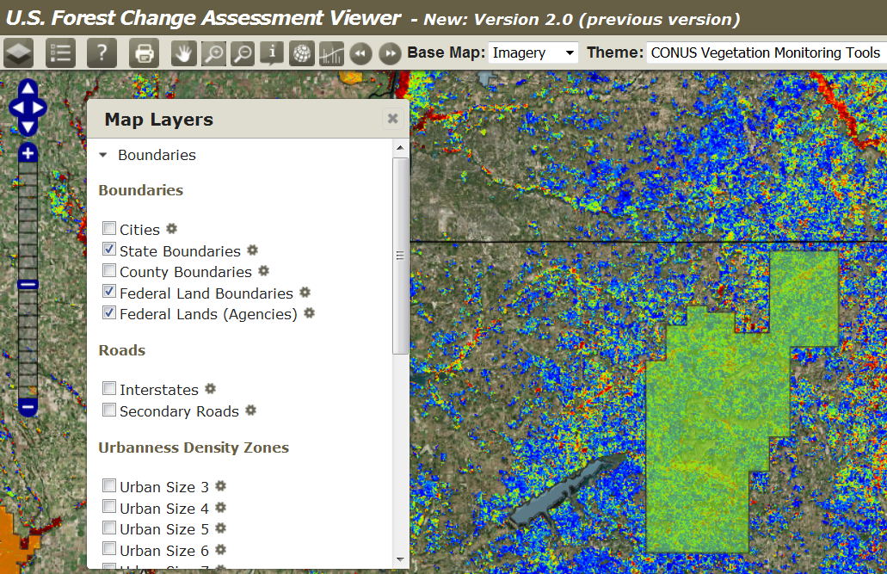
‘Federal Land Boundaries’ Data Layer
Scale dependent, Proclaimed vs. Administered
Holly Springs National Forest
Notes:
Reason, websites, major difference, hybrid deciduous and wetland classes

Slide 7
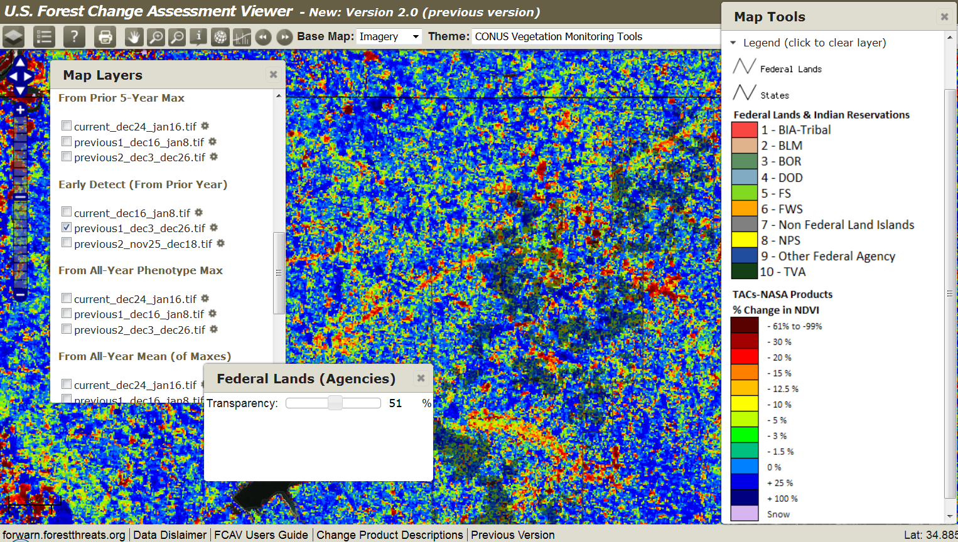
‘Federal Lands’ Data Layer
Scale dependent, Proclaimed vs. Administered
Holly Springs National Forest
Benefit: Proclaimed boundaries are misleading, view detailed parcel ownership when zoomed

Slide 8
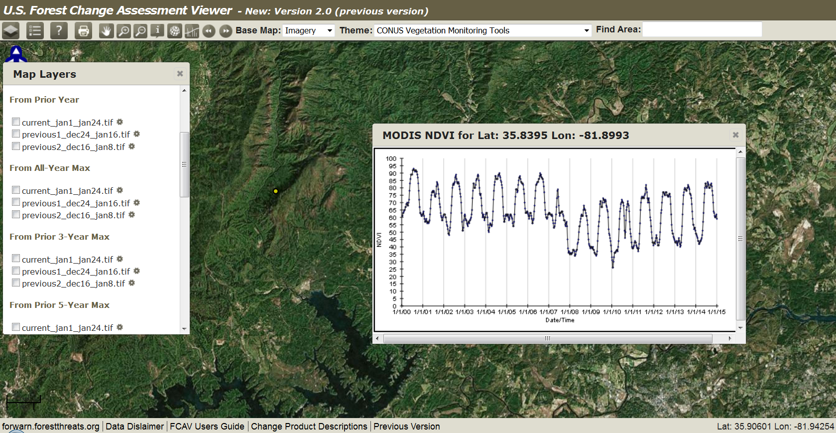
2014 NDVI Values have been added to ‘Graph NDVI’
2000-2014 NDVI values for every MODIS pixel (103B)

Slide 9
2014 NDVI Values have been added to ‘Graph NDVI’
2000-2014 NDVI values for every MODIS pixel (103B)
Benefit: An additional year of NDVI values are now available to view historical disturbance and predict recovery. (46 periods/year) x (15 years of MODIS history) x (150M CONUS pixels) = 103.5B observations, and counting…

Slide 10
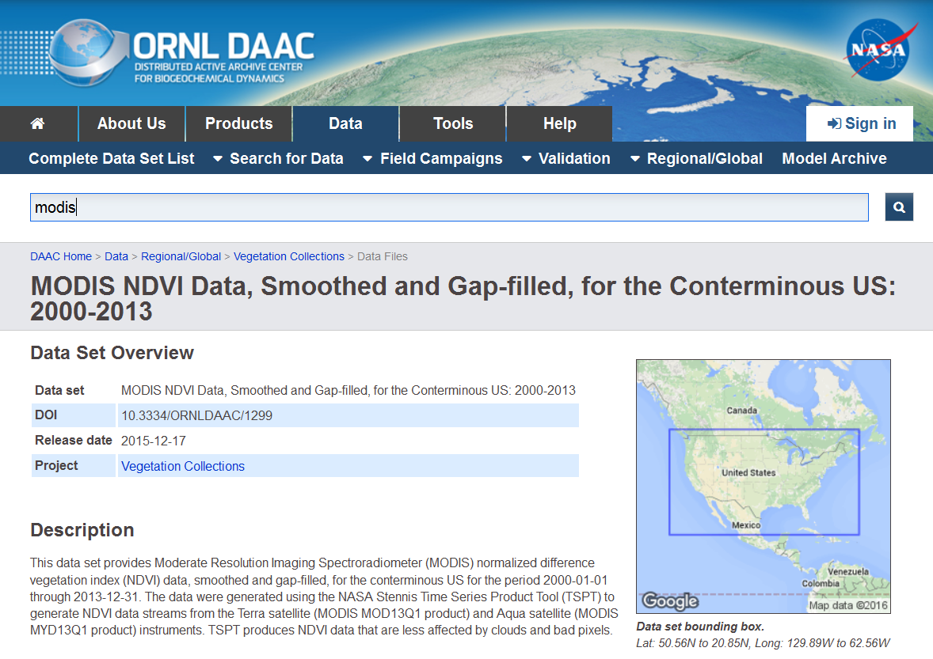
MODIS NDVI Distribution Site
Oak Ridge National Laboratory, Oak Ridge, TN
Benefit: Internet access to ForWarn’s NDVI-value data

Slide 11
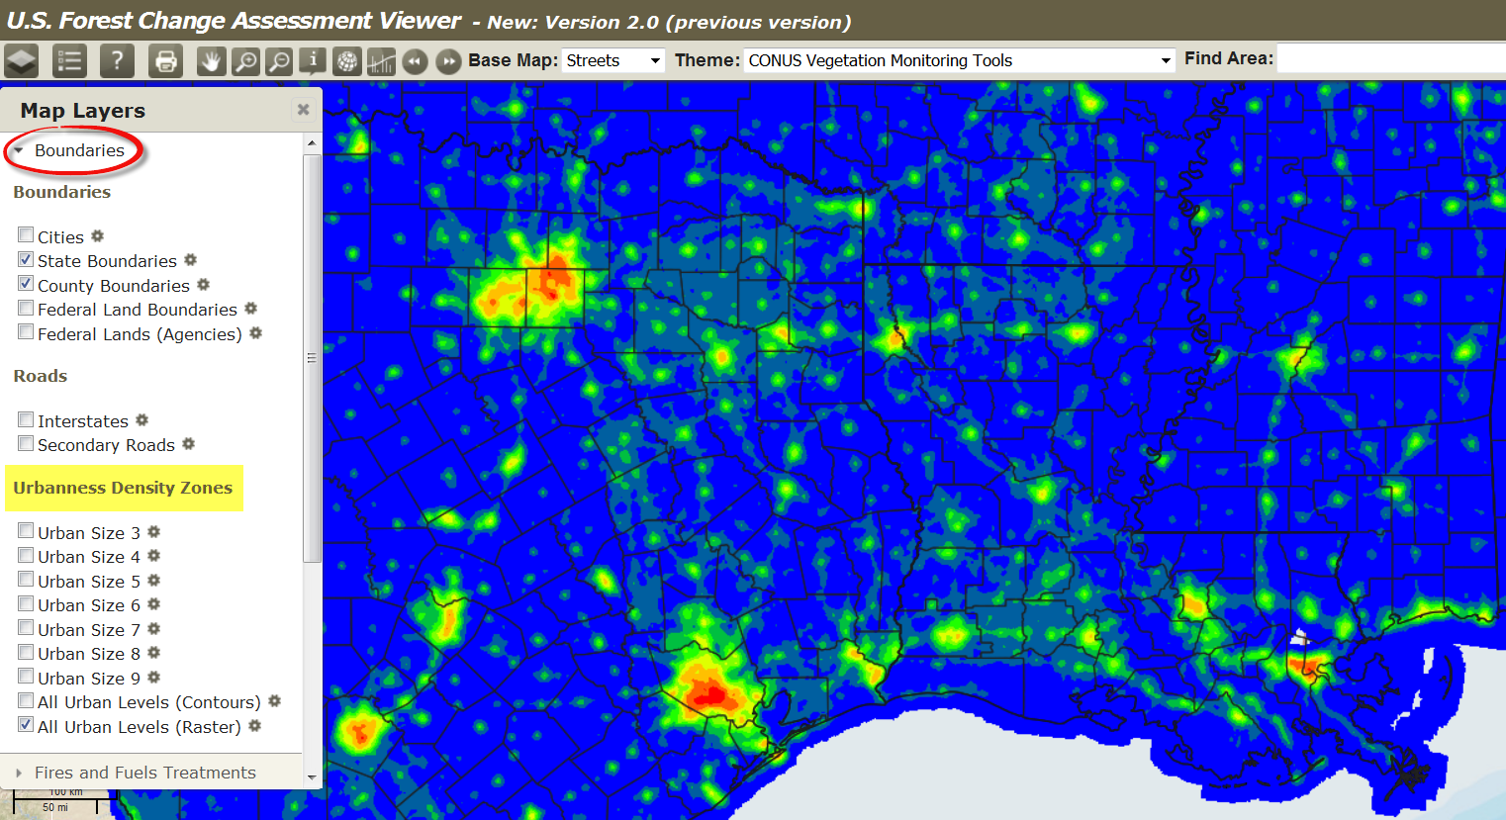
‘Urbanness’ Data Layers
Population density Index modeled using LandScan and USGS Impervious Surfaces
http://web.ornl.gov/sci/landscan/
Benefit: Can be used to locate and monitor the WUI for wildfire potential, fuel treatment, harvests, controlled burns and smoke management. These data were produced in a uniform manner for CONUS.

Slide 12
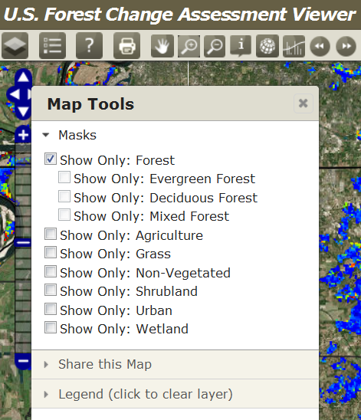
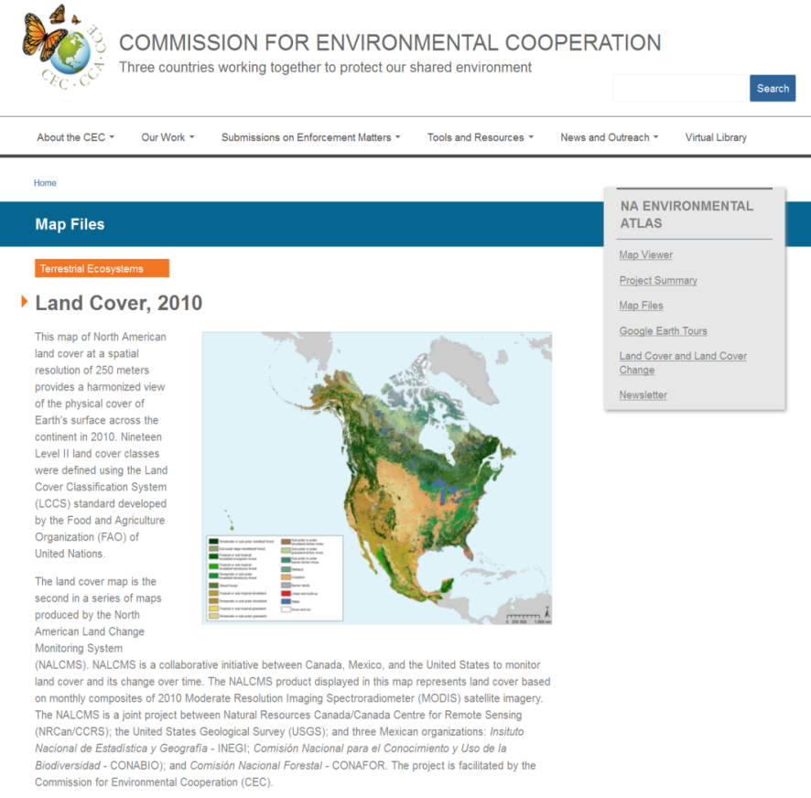
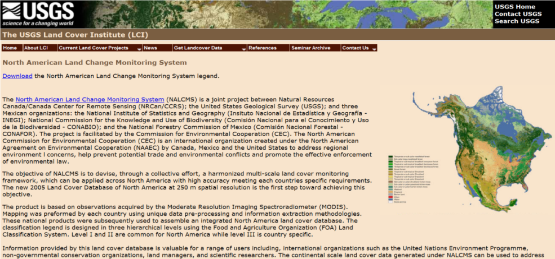
New Land Cover Masks
MODIS Resolution 2010 Land Cover from NLCD
(from cec.org and landsat.usgs.gov)
*
(*) Hybridized – Woody wetland component of the Wetland class has been merged with the Deciduous Forest class
Benefit: Better overall representation and more accurate delineation of the “Mixed Forest” class

Slide 13
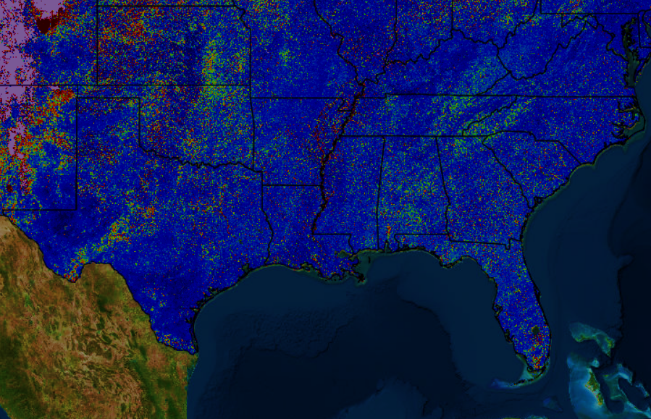
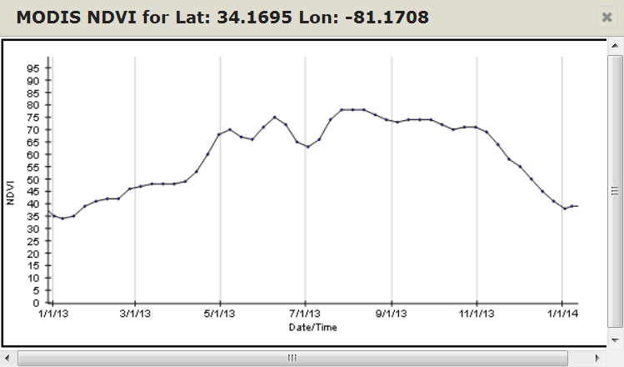
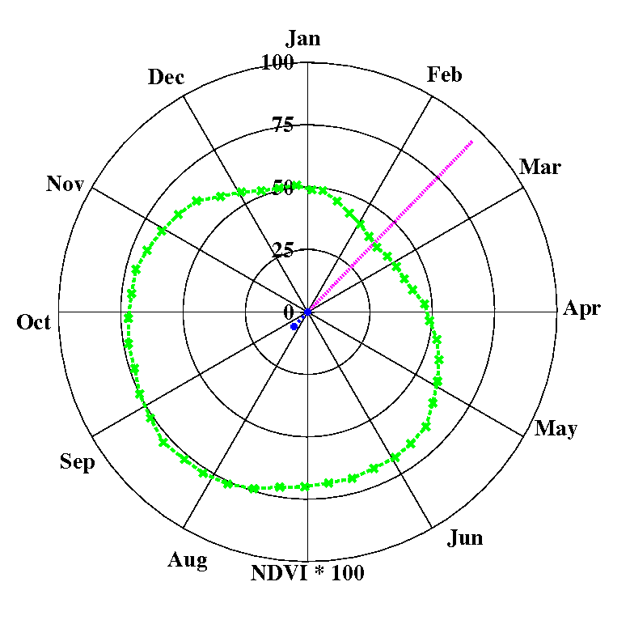
NEW ‘Persistence’ Product being tested
Purpose
Provide an intra-annual value-added forest change product to end-users
Considerations / Methods Testing
Timing (when in the calendar year to begin counting?)
Use a-priori, human-derived selection of the beginning of growing season, works in the east US, not the western US
Use of ‘polar diagrams’ and ‘polar statistics’ to choose when to begin counting persistence
Beginning of the growing season?
Spring, Summer, Fall period products?
Produced all year long, rolling every 8-days?
How many consecutive periods to count
Testing 6-8
What to display
Limiting the ‘count above the threshold’ to display
Benefit: Reduce disturbance complexity in the annual products and summarize persistent forest disturbance over a short period of time

Slide 14
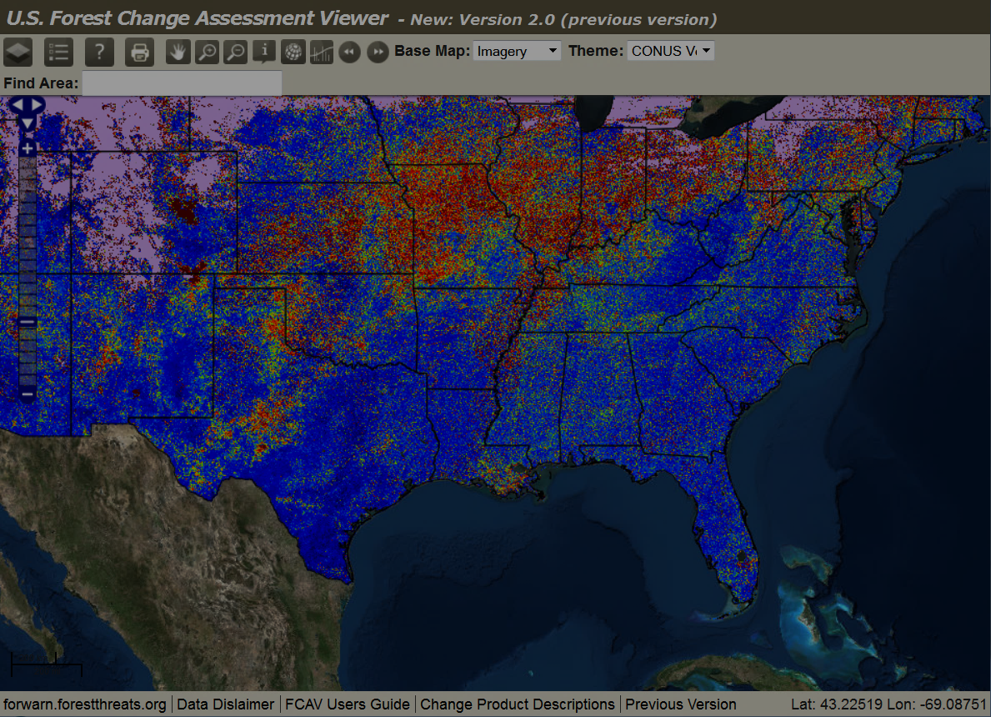
ForWarn: going forward (from 2015)
Develop more advanced ‘near-real-time’ and ‘long-term’ change products
Persistence, “how many 8-day periods” has a level certain of disturbance existed
Phenological State-Change via Transition Matrices (Mass Primary Productivity Modeling/Prediction, Lee & Brooks)
Create standardized longer-term products for users reporting:
State Assessments – how can EFETAC help you in your annual reporting?
National Forest Plans
Continue machine-assisted disturbance recognition research and the auto-reporting to team members (requires the persistence product)
Develop subscription services via social networks for notification (Landsat Facts?)
Perform user surveys to direct the creation of new, future products
NEW - talk continues on designing a lightweight, user friendly, ‘landowner-version’ of the Forest Change Assessment Viewer (mobile device oriented)

Slide 15
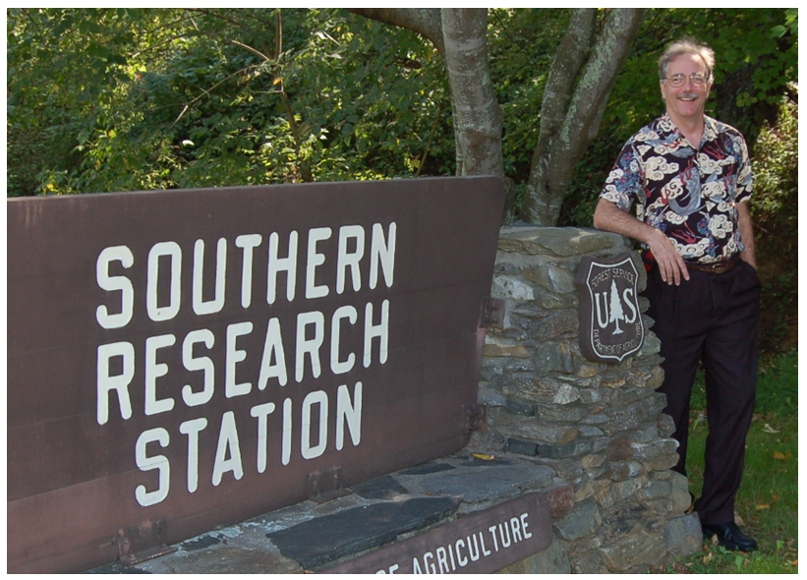
Questions?
forwarn.forestthreats.org
Bill Hargrove
Research Ecologist
Bill Christie, Eastern Forest Environmental Threat Assessment Center
wchristie@fs.fed.us 828.532.0437 office 828.216.7443 cell

